Slide 1

Thera bank
THERA BANK
DIGITALLY YOURS
Personal Loan Marketing campaign

Slide 2



Objective
Explore customer data.
Mining strategies for higher conversion ratio of liability to asset customers.
Prediction of potential personal loan customers.

Slide 3
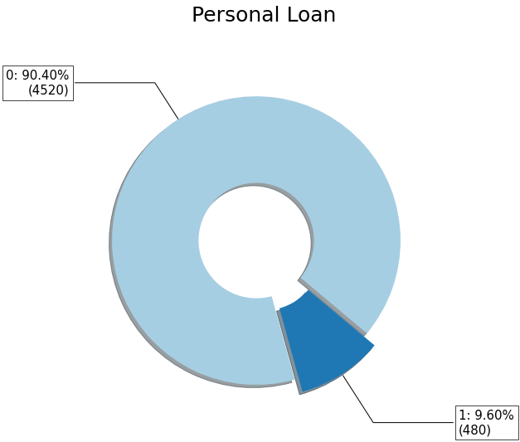
Customer information
The data from about 5000 bank customers include
Demographic data
Age, experience, income, family size, education etc.
Relationship data
Mortgage, securities account, Online accessibility to the account, deposit account, credit card etc.
Response to the last personal loan campaign
Only 480 of 5000 accepted the personal loan.

Slide 4
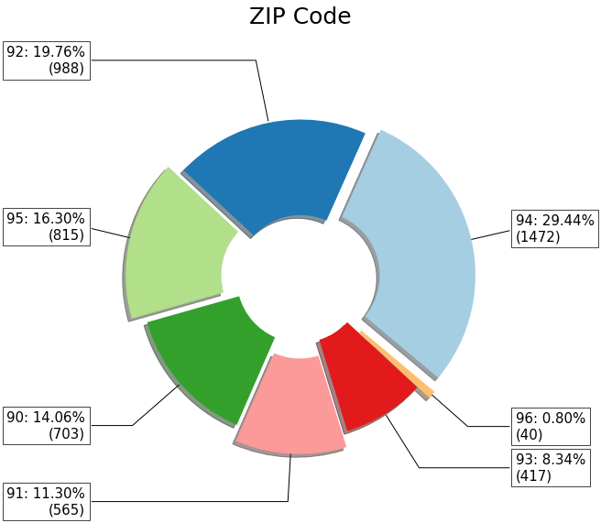
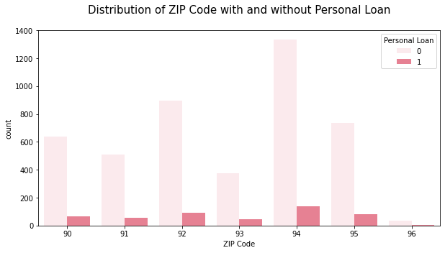
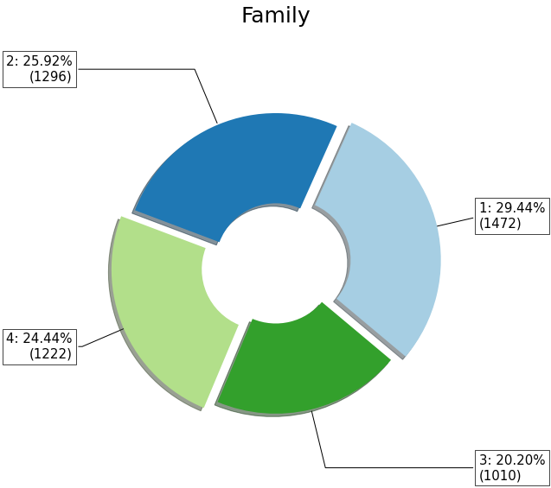
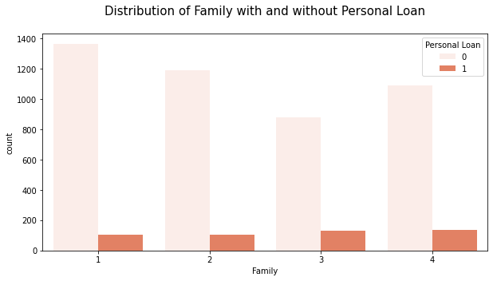
Data Speaks
Almost 50% of the customers are from ZIP Code prefix 94 and 92 and who have opted for the personal loan.
Almost 55% of the customers are either singles Singles or couples are 44% of personal loan customers.

Slide 5
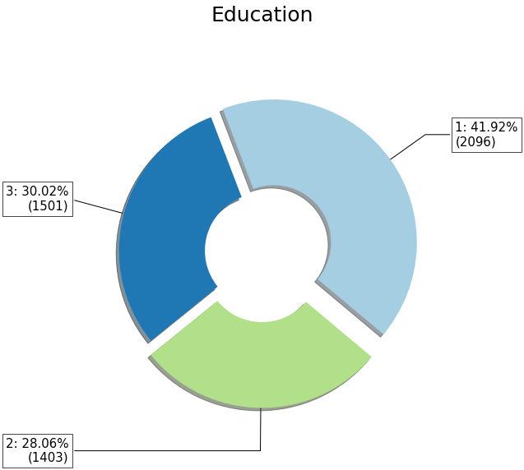
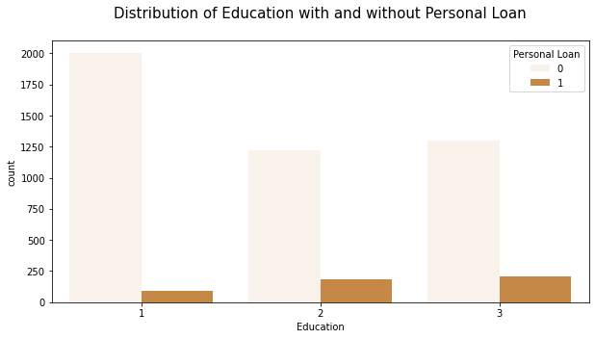
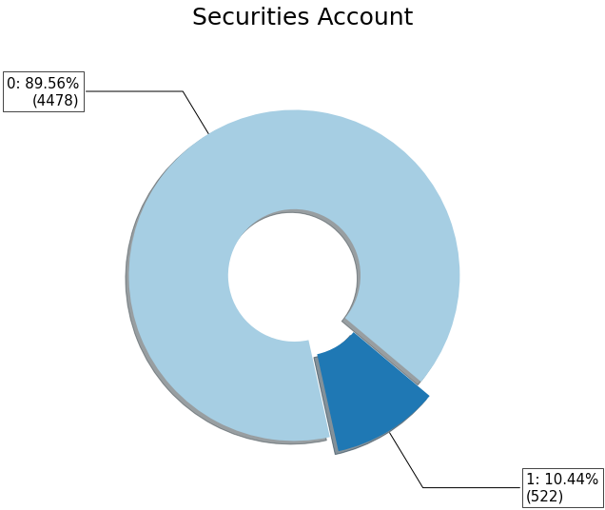
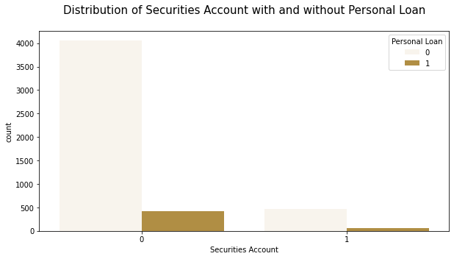
Data Speaks
Almost 58% of the customers have higher education i.e graduates and professionals.
These constitute 81% of the personal loan customers.
Only 10.4% of the customers have Securities account and these customers contribute to 12.5% of the personal loan.

Slide 6
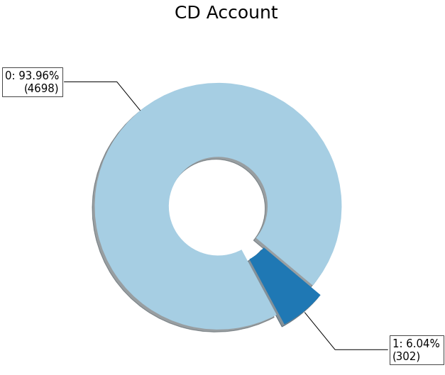
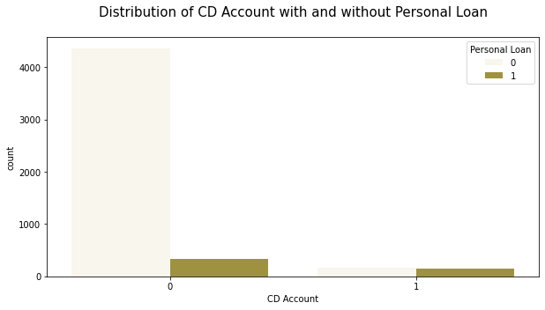
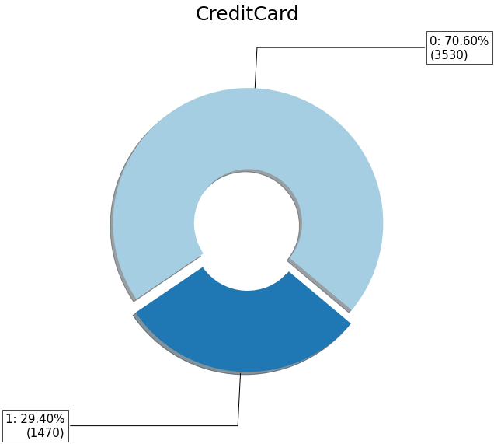
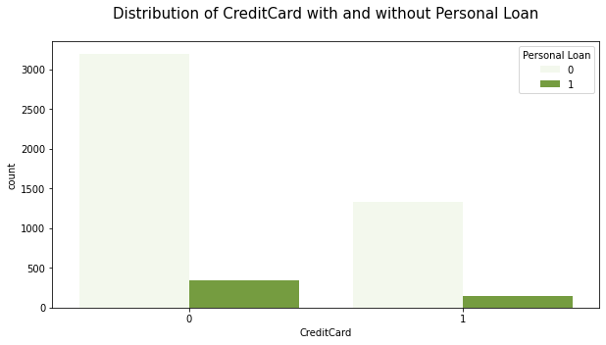
Data Speaks
Almost 6% of the customers have Certificate of Deposit account and these customers contribute to 29% of the personal loan.
Almost 29% of the customers have crdit card account and these customers contribute to 29% of the personal loan.

Slide 7
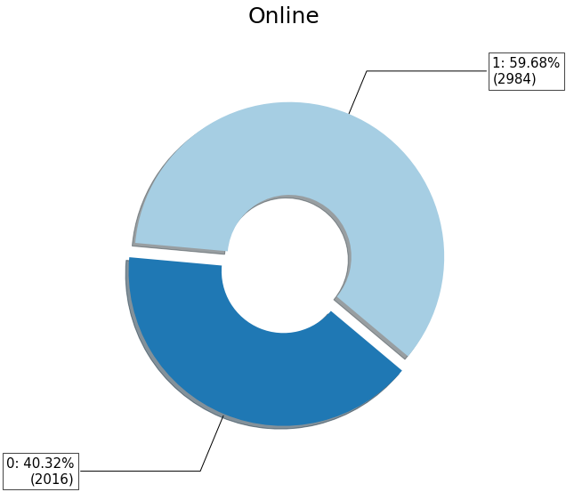
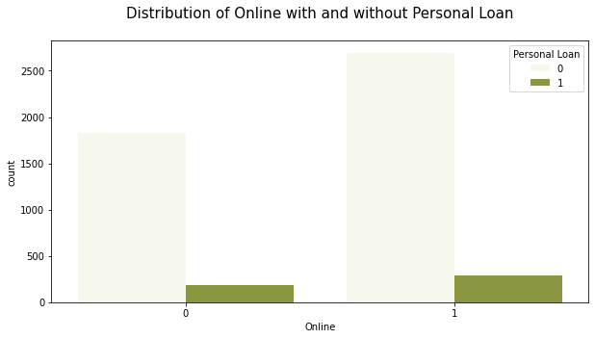
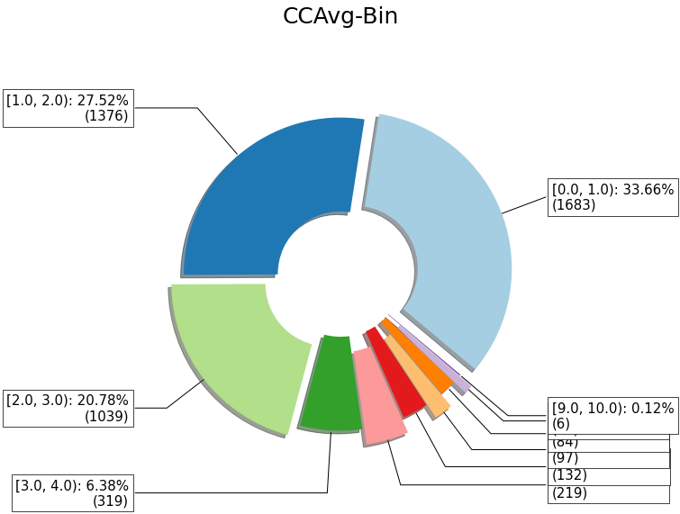
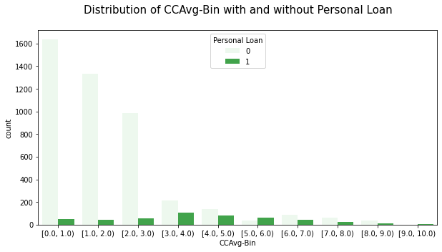
Data Speaks
Almost 60% of the customers have online access to their bank account and these customers contribute to 50% of the personal loan customers.
By large, people with 3-4 credit cards have opted for the personal loan and they are alsmost 6.4% of the overall dataset.

Slide 8
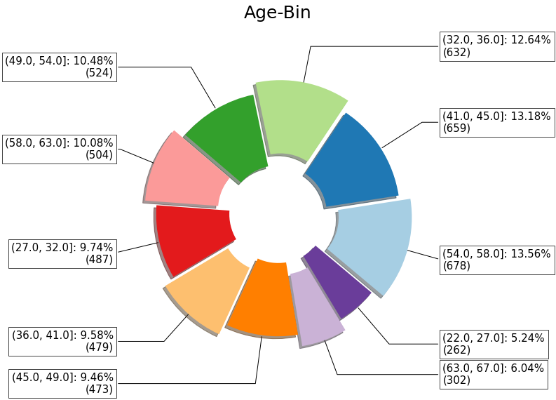
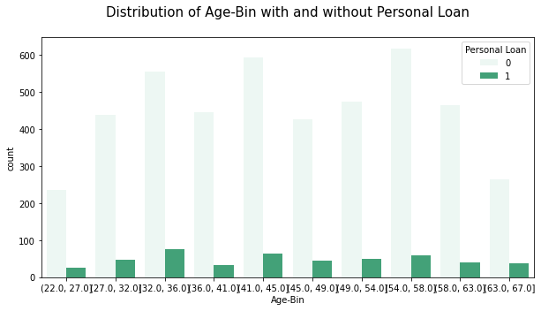
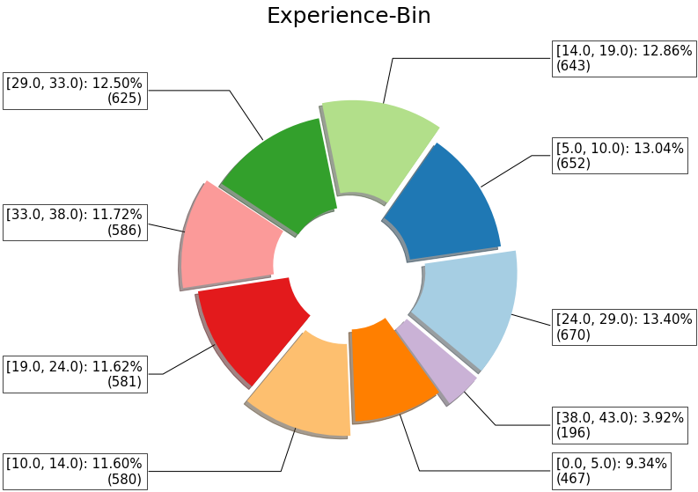
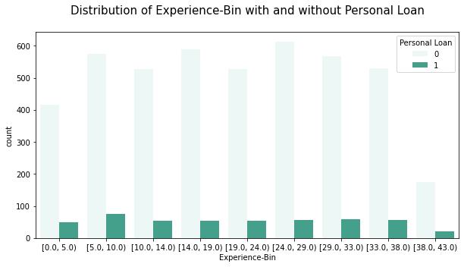
Data Speaks
By large, people in the age group of 32-36 years have opted for the personal loan and this age group is almost 13% of the total data set.
By large, people with an experience of 5-10 years have opted for the personal loan and they are 13% of the total dataset.

Slide 9
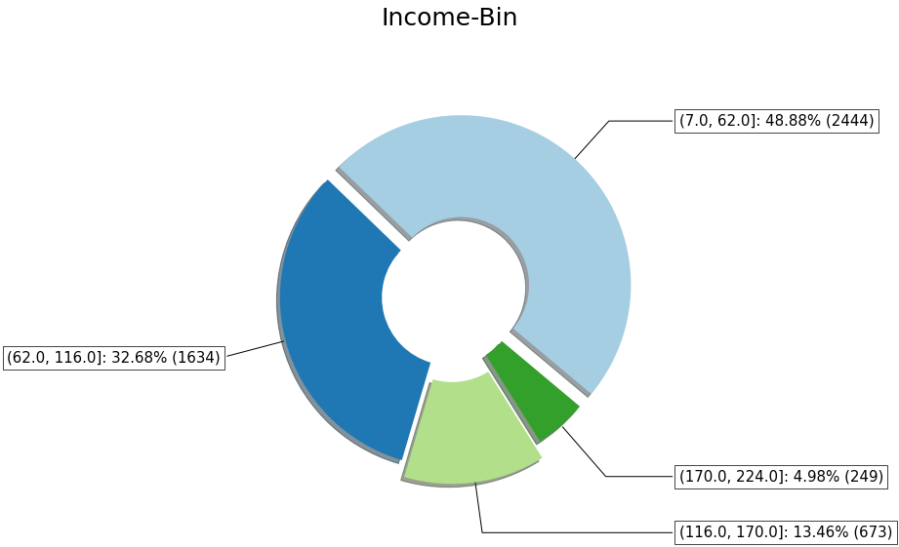
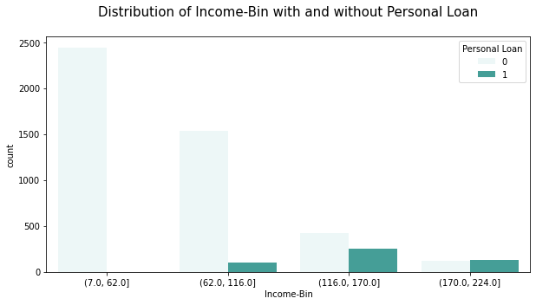
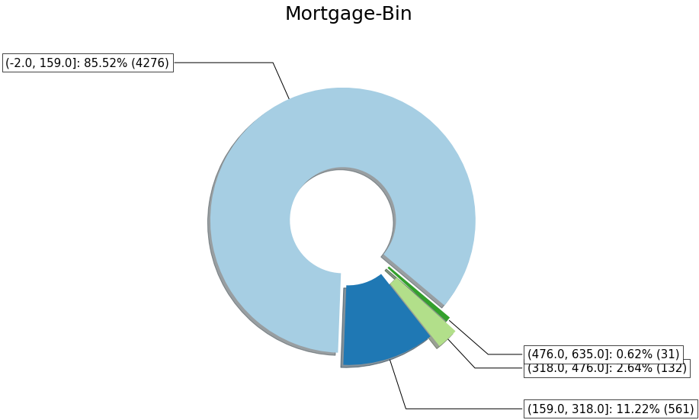
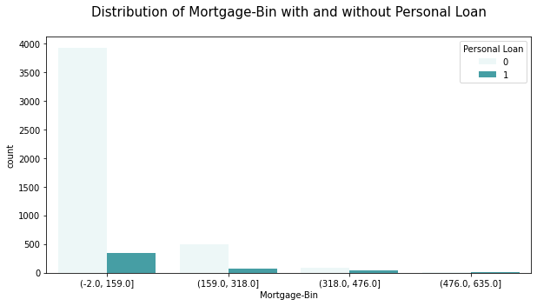
Data Speaks
By large, people with an income between 116-170K USD have opted for the personal loan and this age group is almost 13% of the total data set.
By large, people with a mortgage of upto 159KUSD have opted for the personal loan and they are 85% of the total dataset.

Slide 10

train your Model !!!
Trained the data on 6 classification machine learning algorithms,
Ridge,
Support Vector Machine -Linear,
Support Vector Machine-RBF,
K-Nearest Neighbor
Naïve Bayes
Logistic Regression
Performance metric : Focus on getting higher Recall [True Positives/(True Positives + False Negatives)]. Need to predict +ve with higher probability than –ve.
Support Vector Machine-RBF is a better classifier when compared to others.

Slide 11
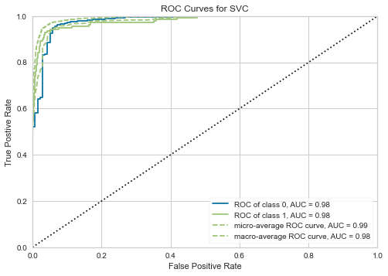
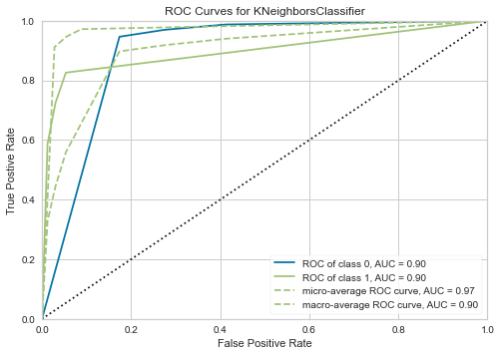
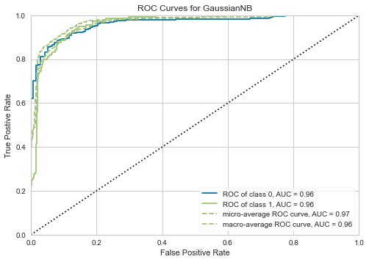
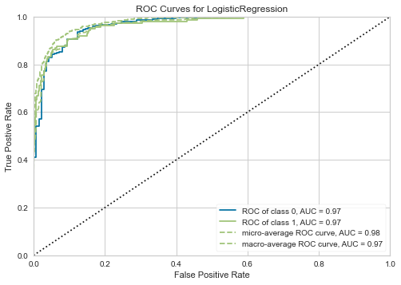
How confident are we in predicting potential customers?
This means that the SVM-RBF will predict a +ve with higher probability of 98% than the -ve. Which exactly is required in this case.
98%

Slide 12
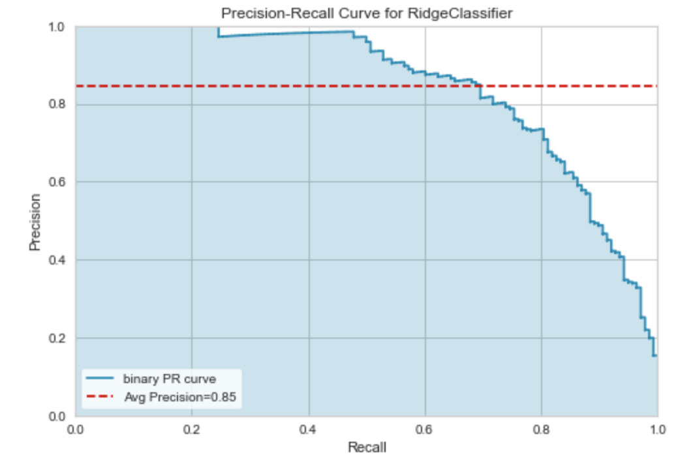
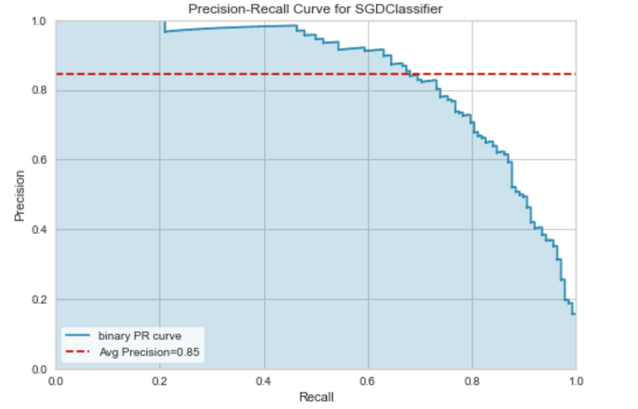
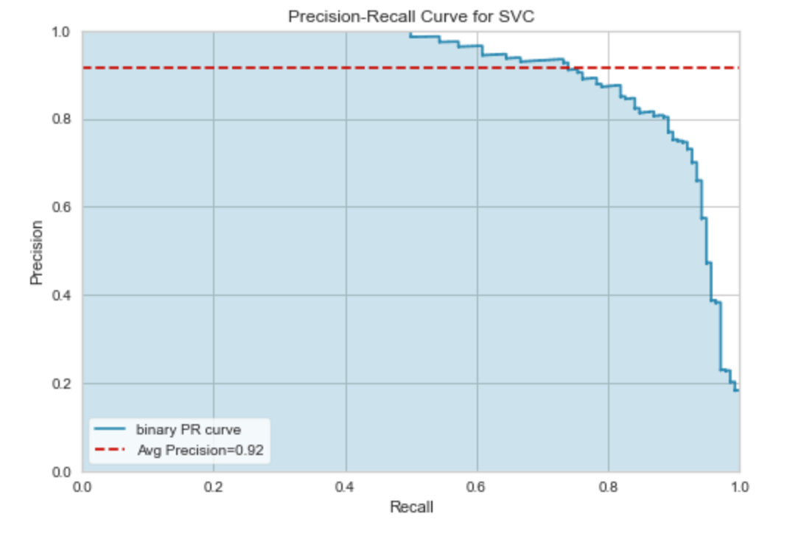
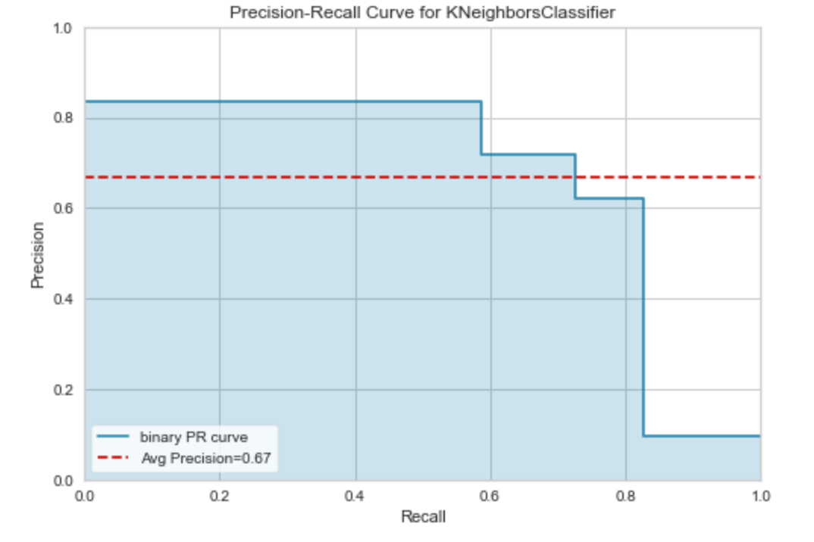
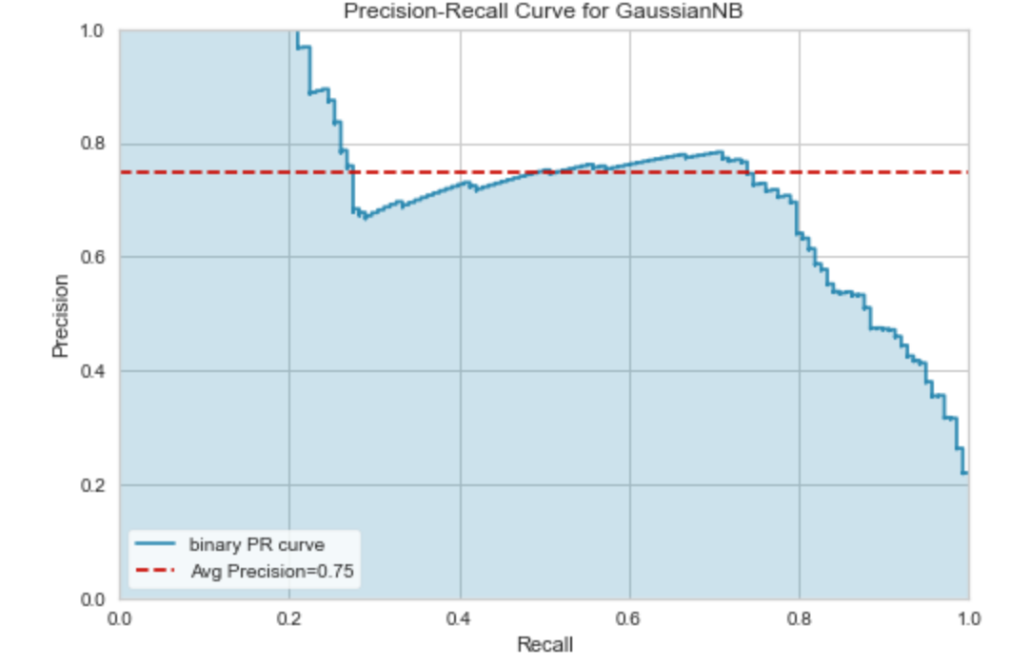
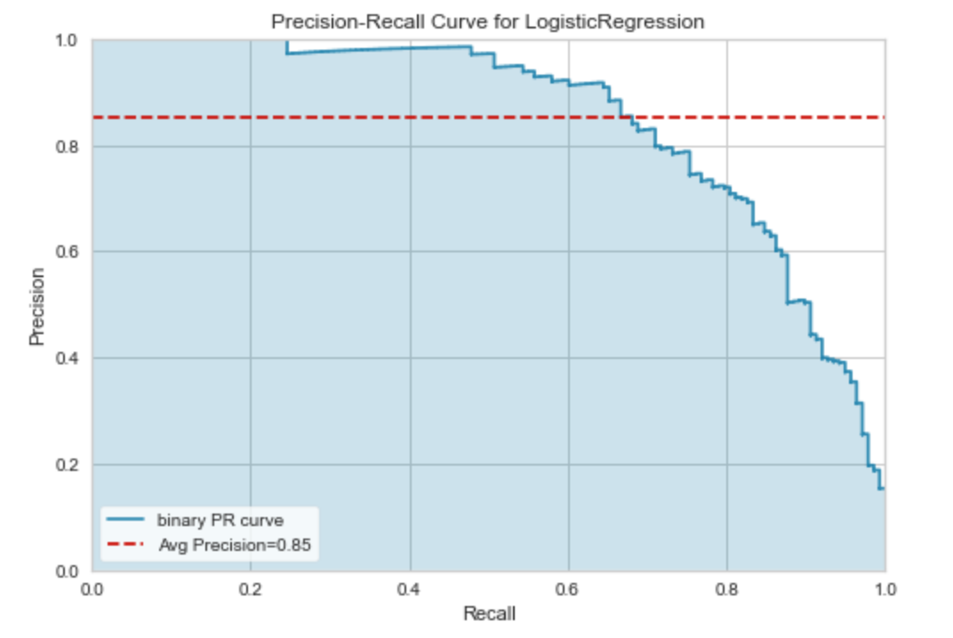
How Precise are we in predicting a potential customer?
This means that the SVM-RBF is 92% positive in identifying a potential loan customer.
92%

Slide 13
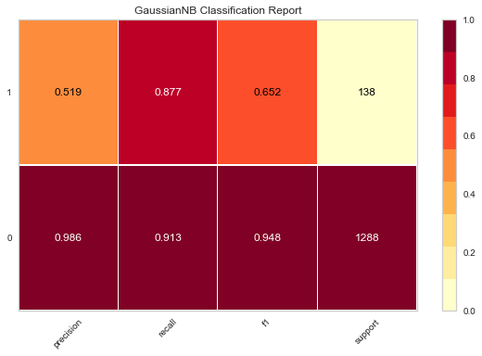
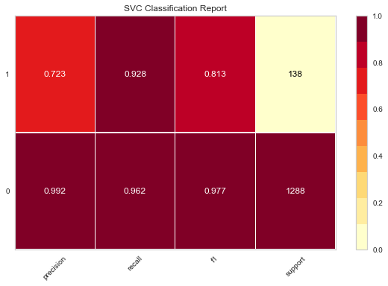
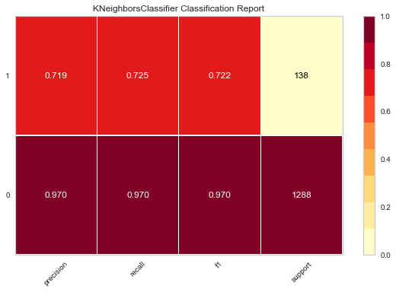

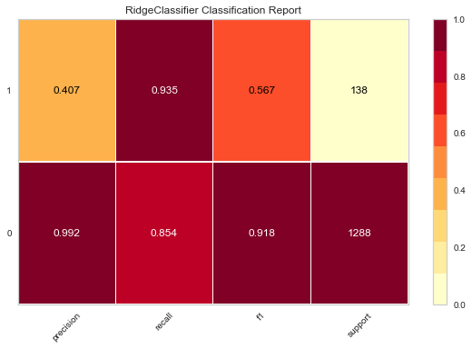
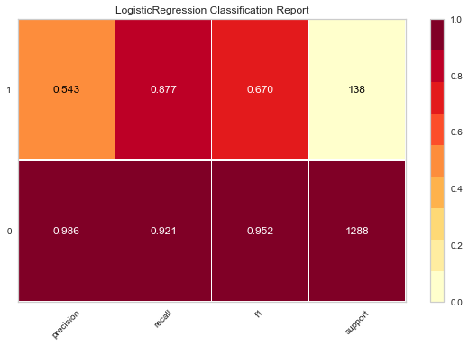
How good is this in separating a potential customer from others ?
Has the highest recall value for predicting a +ve
+ve : 93% & -ve: 96%

Slide 14
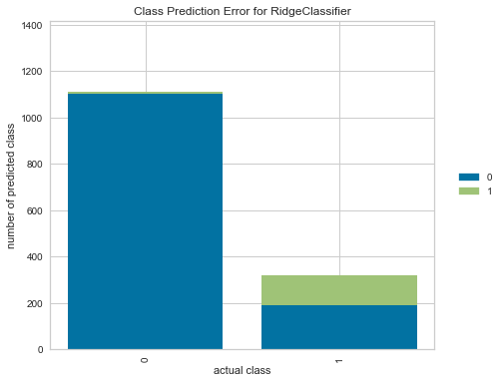
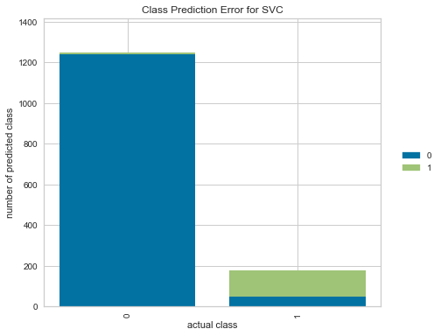
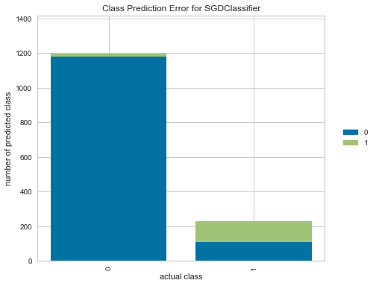
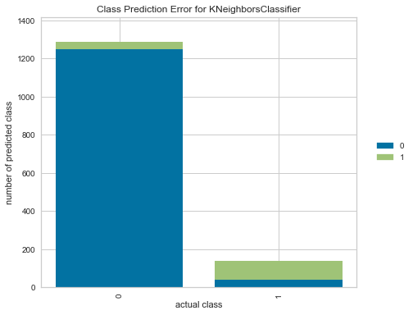

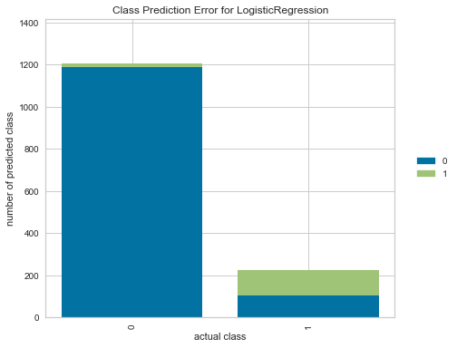
And cost of misclassification?
Has the least error for both +ve and –ve class.
LOW

Slide 15
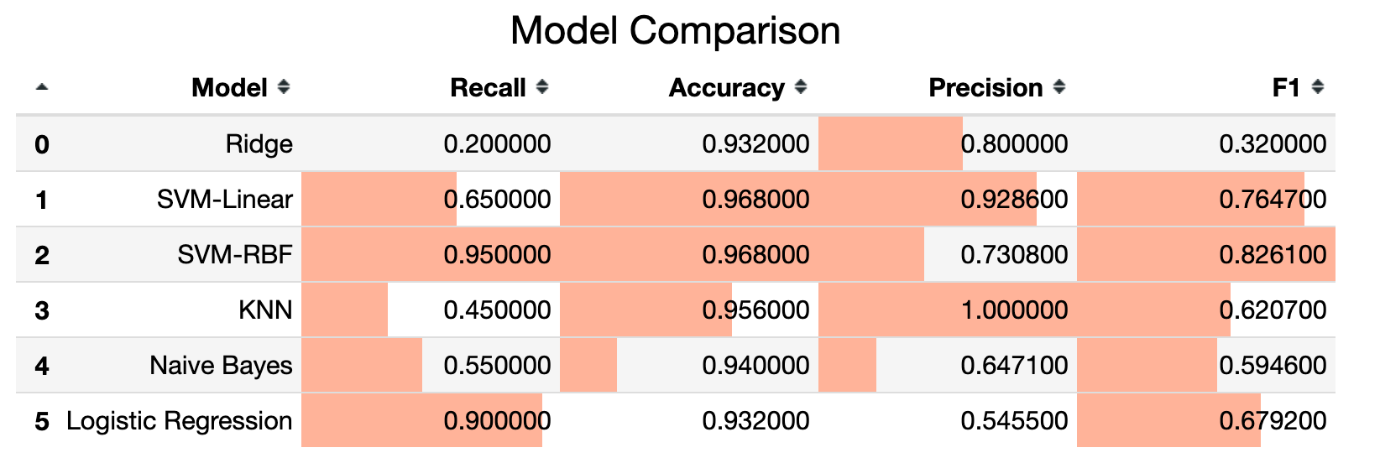

WHY SVM is better than other algorithms ?
The SVM-RBF classifier has the highest average precision of 92%.
SVM-RBF has the highest AUC of 98%.
SVM-RBF not only has the highest Recall but also has highest Accuracy as well.
SVM
RBF

Slide 16
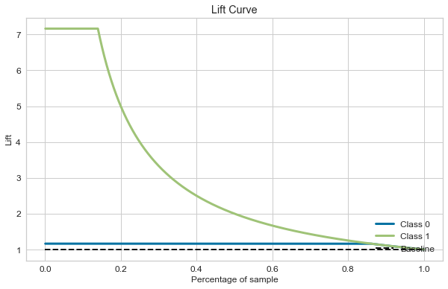

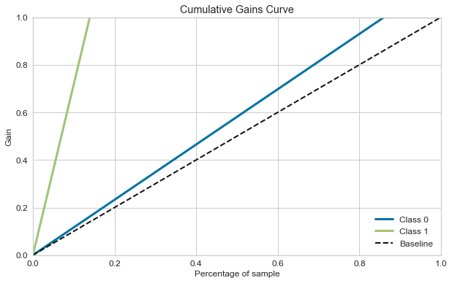
What value does the marketing campaign get from this analysis ?
5-7 times more +ve response from 20% of the total customers.
100% +ve response from 20% of the total customers.

Slide 17
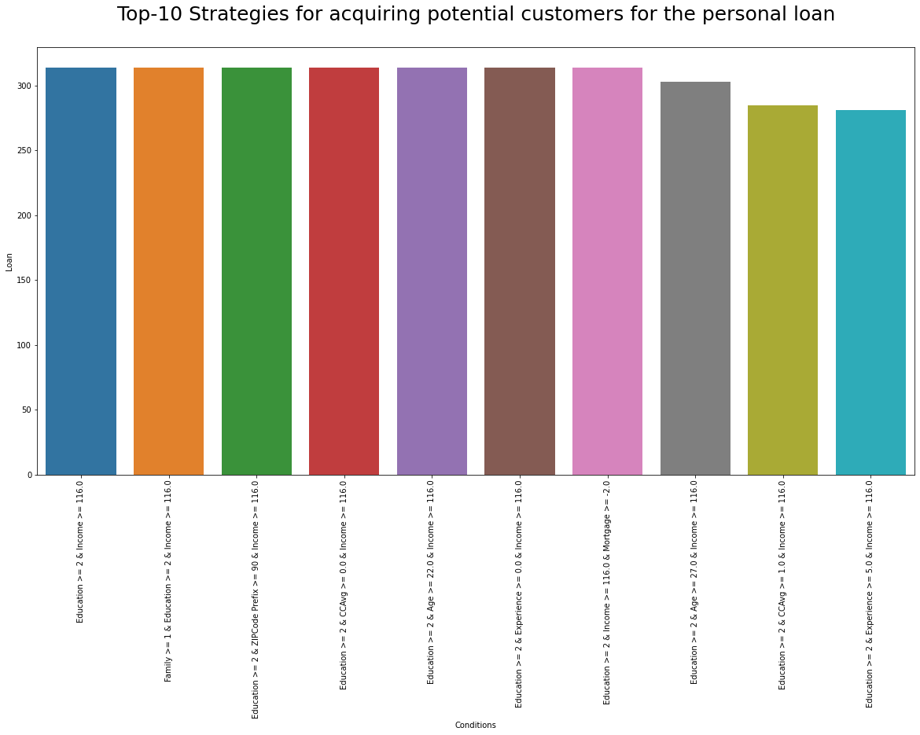

What kind of customers should we sell it too?
Target Customers with 100% conversion ratio per last year’s data:
Single
Graduate
Based out of ZIP code prefix 90
27 years of age
Work experience of 0-5 years
With atleast 1 credit card
No mortgage
Income of 116K USD per annum or above
N | Strategy | Customers
1 | Education >= 2 & Income >= 116.0 | 314
2 | Family >= 1 & Education >= 2 & Income >= 116.0 | 314
3 | Education >= 2 & ZIPCode Prefix >= 90 & Income >= 116.0 | 314
4 | Education >= 2 & CCAvg >= 0.0 & Income >= 116.0 | 314
5 | Education >= 2 & Age >= 22.0 & Income >= 116.0 | 314
6 | Education >= 2 & Experience >= 0.0 & Income >= 116.0 | 314
7 | Education >= 2 & Income >= 116.0 & Mortgage >= -2.0 | 314
8 | Education >= 2 & Age >= 27.0 & Income >= 116.0 | 303
9 | Education >= 2 & CCAvg >= 1.0 & Income >= 116.0 | 285
10 | Education >= 2 & Experience >= 5.0 & Income >= 116.0 | 281

Slide 18
Thank You

