Slide 1
Adaptive Multi-Channel Transmission Power Control for Industrial Wireless Instrumentation by Deepak H.K 2nd sem S.E Mrs CHAMPA H.N

Slide 2
ABSTRACT
The adoption of wireless technology for industrial
wireless instrumentation requires high-quality communication performance.
The use of transmission power control (TPC) can help
address industrial issues concerning energy consumption, interference,
TPC algorithm designed forindustrial applications based on theoretical and empirical studies.

Slide 3
TPC- Transmission Power Control
Energy savings by reducing transmission power to the minimum required;
prolonging battery life for fast sampling applications
adaptation to continuing improvements in devices, particularly in terms of receiver sensitivity
spectrum efficiency, topology control, and interference suppression to ensure co-existence

Slide 4
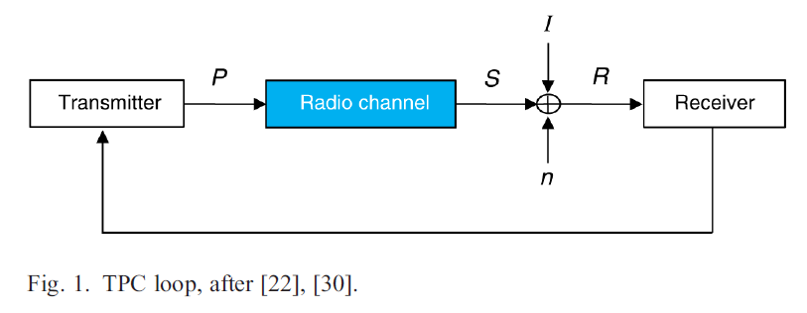

Slide 5



Slide 6
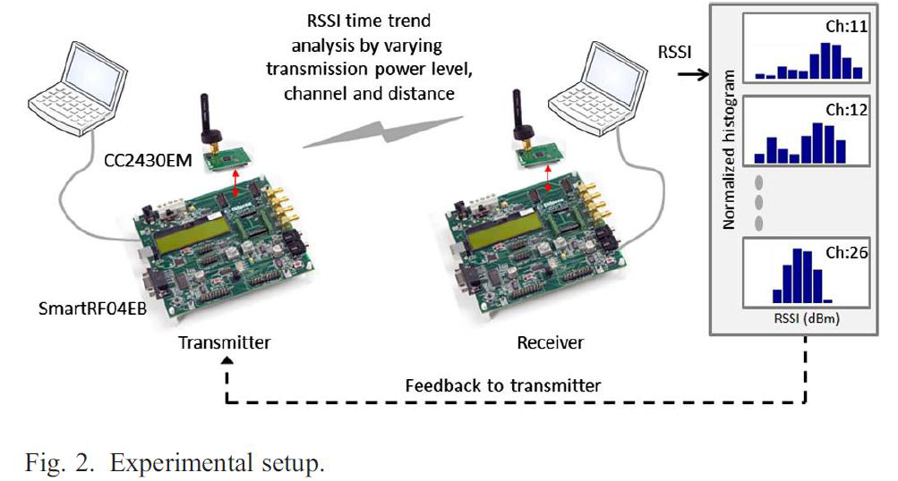

Slide 7
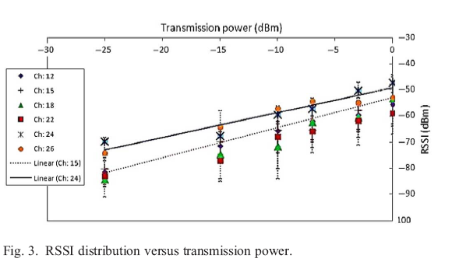
Results and Performance Analysis

Slide 9
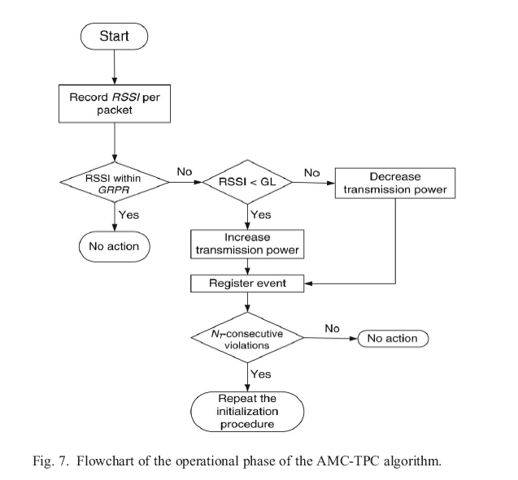

Slide 10
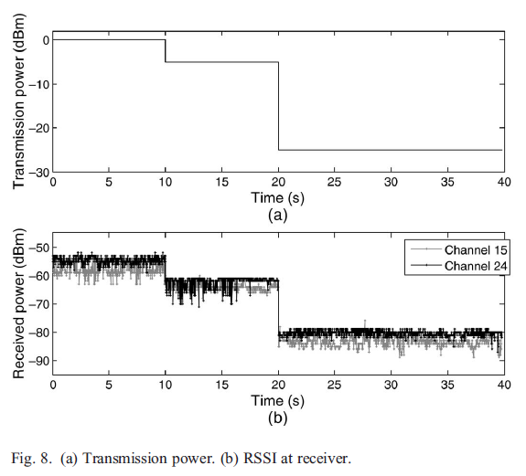

Slide 11
Advantages of AMC-TPC
Interference Suppression
Adaptation
Multi-Channels
Time slotted

Slide 14
CONCLUSION
It is based on RSSI and PRR for link estimation.
A linear approximation Assumed between the transmission power and RSSI.
The algorithm comprises two phases. The initialization phase is responsible for setting the limits of operation for the RSSI values which satisfy the SINR criteria and the fade margin.
During the operational phase, the algorithm considers whether the RSSI for the received packets falls within a GRPR.

Slide 15
REFERENCES
[1] Industrial Communication Networks—Wireless Communication Network
and Communication Profiles—WirelessHART, IEC Standard 62591:2010,
2010.
[2] Wireless Systems for Industrial Automation: Process Control and Related
Applications, ANSI/ISA Standard 100.11a-2011, 2011.
[3] Industrial Communication Networks—Fieldbus Specifications—WIA-PA
Communication Network and Communication Profile, IEC/PAS Standard
62601:2009, 2009.
[4] V. C. Gungor and G. P. Hancke, “Industrial wireless sensor networks:
Challenges, design principles, and technical approaches,” IEEE Trans. Ind.
Electron., vol. 56, no. 10, pp. 4258–4265, Oct. 2009.
[Mobile Wireless Netw.,

