Slide 1


||Jai Sri Gurudev || BGSKH Education Trust (R.) – A unit of Sri AdichunchanagiriShikshanaTrust(R.) BGS College of Engineering and Technology (BGSCET) Mahalakshmipuram , West of Chord Road, Bengaluru-560086
Mini Project(BCG586)
Presentation on
TITLE : RSA Encryption and Decryption
Team Members Guide Name
Kiran kumar N A (1MP22CG026) Dr. Chandrakala H.S
Santhosh S M (1MP22CG048) Associate professor
Tharun K L (1MP22CG057)
Jagadish kumar N (1MP23CG401)
Project Coordinator HOD
Mrs. Sanjitha S Dr. Madhu Patil

Slide 2
Contents
Introduction
Objectives
Literature Survey/Research Gap
System Requirement
Proposed Methodology
Flow Diagram
Results
Future Scope

Slide 3
Introduction
Encryption : encryption is the process of converting a plain text , readable data into a coded format to protect it from unauthorized access.
encryption making the data secure by hiding its original meaning.
Decryption : decryption is the process of converting encrypted data back into its original data.
Decryption requires a specific key, often a private key, to unlock the binary data and reveal the original information.

Slide 4
Objectives
Data privacy
Protection Against Data
Access Control
Secure Data Transmission
Confidentiality and Privacy
Ensuring system reliability
Authentication

Slide 5
Literature Survey/Research Gap
Existing research on encryption and decryption shows significant advances in algorithm efficiency and security.
DES( Data encryption Standard) algorithm is used in 1970s, with a 56-bit key length .
AES( Advanced encryption standard) is used to develop a symmetric key algorithm with key sizes of 128, 192, or 256 bits.
Emerging technologies, like quantum computing, present challenges in ensuring privacy.
Blowfish is a symmetric key algorithm developed in the 1990s, know for it’s speed and effectiveness in application like password hashing.

Slide 6
System Requirement
Software Requirement:
Implementation of strong encryption/decryption algorithms (eg : RSA).
We use a software language in frontend like html, java script and css , And we use python and related libraries to backend.
Hardware Requirement:
High-speed network infrastructure for secure data transmission.
Suitable RAM to support encryption operations, especially for large data sets.

Slide 7
Proposed Methodology
Algorithm Selection: Choose appropriate encryption algorithms based on RSA (Rivest-Shamir-Adleman).
Key Management: Implement a secure key management system to generate and store encryption keys safely.
Data Encryption: Apply the chosen encryption algorithm to convert plaintext into ciphertext.
Data Decryption: The process of converting encrypted data back into its original, readable form.

Slide 8
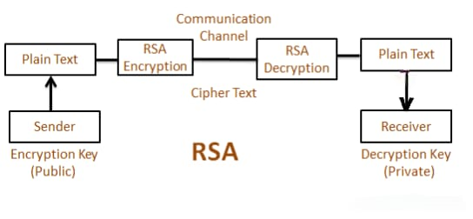
Flow Diagram :

Slide 9
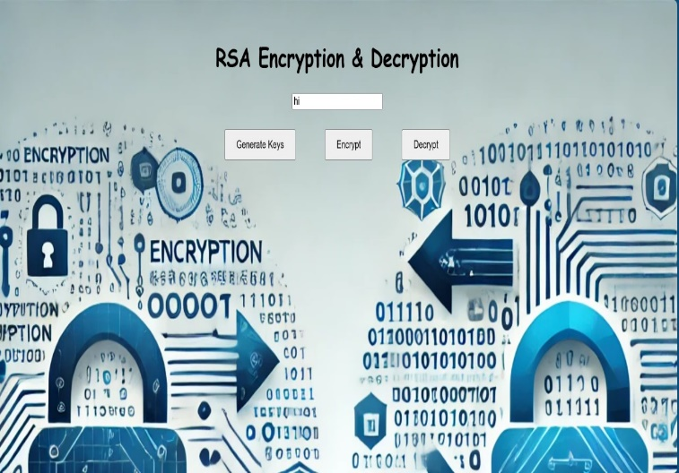
Results and Discussion
Encryption and decryption algorithms balance security and performance ,RSA ensuring secure key exchange.
Key length affects both security and efficiency.
Challenges include key management, scalability, and valuenerabilities, while future advancements focus on quantum-resistant encryption techniques.

Slide 10
Future Scope
Quantum-Resistant Algorithms
Scalability for IoT and Big Data
AI-Driven Security
Homomorphic Encryption

Slide 11
THANK YOU

