Slide 1


Slide 2

Agenda
What is Google Summer of Code ?
What are the goals of the program ?
How does GSoC work ?
Google Summer of Code timeline
Student stipends
Participating projects
GSoC statistics

Slide 3
What is GSoC ?
The Google Summer of Code
is a program
designed to encourage college student participation in open source development

Slide 4
GSoC goals
Inspire young developers to begin participating in open source development
Provide students in Computer Science and related fields the opportunity
to do work related to their academic pursuits during the summer
Give students more exposure to real-world software development scenarios
(e.g., distributed development, software licensing questions, mailing-list etiquette, etc.)
Get more open source code created and released for the benefit of all
Help open source projects identify and bring in new developers and committers

Slide 5
How does it work ?
Program Genesis
  “Flip bits not burgers” during summer holidays
  Exposure to real-world software development
Students submit project proposals to the organizations, organizations rank the submissions (students paired with mentor from open source community)
  Execute to milestones laid out in accepted program application
  Google allocates a given number of slots to each organization, the students work all summer on their project in close mentored collaboration with that organization
  Program stipend allows students to concentrate on OSS development full-time

Slide 6
GSoC 2008 timeline
March 3-12: Google will accept applications from open source projects.
March 13-17: Google program administrators review organization applications.
March 17: List of accepted mentoring organizations published on code.google.com/soc/
March 24-31: Student applications acceptance period.
Interim Period: Would-be student participants discuss application ideas with mentoring organizations.

Slide 7
GSoC 2008 timeline
March 24: Student application period opens.
April 14: accepted student proposals announced at code.google.com/soc/
May 26: Students begin coding for their GSoC projects.
July 14: Mid-term evaluations deadline.
September 1: Final evaluation deadline.
September 3: Students can begin submitting required code samples to Google.

Slide 8
Student stipends
Google will provide a stipend of 5000 USD per accepted student developer, of which 4500 USD goes to the student and 500 USD goes to the mentoring organization.
Accepted students in good standing with their mentoring organization will receive a 500 USD stipend shortly after coding begins on May 26, 2008.
Students who receive passing mid-term evaluations will receive a 2000 USD stipend shortly after the mid-term evaluation deadline, July 14, 2008.
Students who receive passing final evaluations and who have submitted their final program evaluations will receive a 2000 USD stipend and mentoring organizations will receive 500 USD shortly after the final evaluation deadline, September 1, 2008.

Slide 9
Wide range of participating projects
Operating Systems
OS Enhancements
Hardware Management
Mobile, Portable, Handheld & Calculators
Databases
Programming Languages, Libraries & Compilers
Code Design, Development & Management
Open Source Development
Internet & Networks
Video, TV & Photography

Slide 10
Wide range of participating projects
Web Technologies
Content Management
Office Applications & Text Editors
Simulations, Modeling & Neural Network
Analytical Sciences
Biology & Health Care
Graphics, 3D Rendering, CAD & Animation
Game Development
Mail, Phone & Instant Messaging
Library Science & Publishing
Multimedia, Audio & Music

Slide 11
Why should I participate ?
The program has been exceptionally successful both for Google and for the participating organizations/projects
Can attract advanced degree research efforts, talented students
Students are eager and work exceptionally hard on their projects (in fact, they usually propose their own project topics)
Successful collaboration model for remotely interacting as part of an open source project with community resources in place

Slide 12
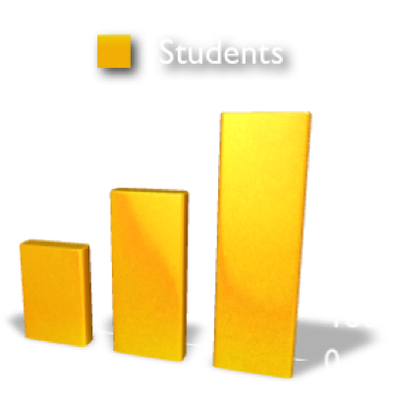
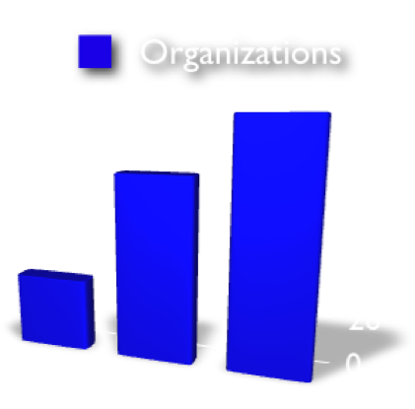
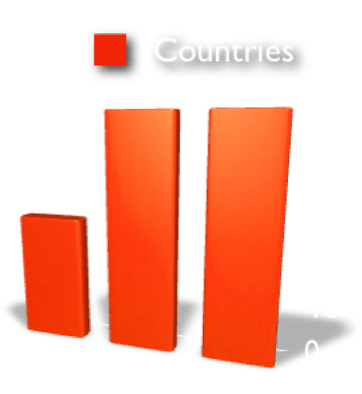
GSoC statistics
2005
2006
2007
400 students
40 organizations
49 countries
80% final success rate
630 students
100 organizations
90 countries
82% final success rate
900 students
130 organizations
90 countries
80% final success rate

Slide 13
Useful links
Google Summer of Code web page
http://code.google.com/soc/2008/
Google Summer of Code FAQ
http://code.google.com/soc/2008/faqs.html
Google Summer of Code program discussion group
http://groups.google.com/group/google-summer-of-code-discuss
Chat with us at IRC Freenode #gsoc channel

Slide 14
Any questions ?

Slide 15
Thank you for your attention
For more information visit
code.google.com/soc/
and apply
We are looking forward for your participation !

