Slide 1
Hacking with the Language
An Introduction to Natural Language Computing
Santhosh Thottingal

Slide 2
Agenda
What is language computing and its importance
L10N and I18N
Applications for language
Challenges
Contributing

Slide 3
Why?
English- De facto language?
English covers 5-15% of word population
Preserving our data in our own language
Not only preserving , processing too!
Technology for all- removing the language barriers
Effective communication.

Slide 4
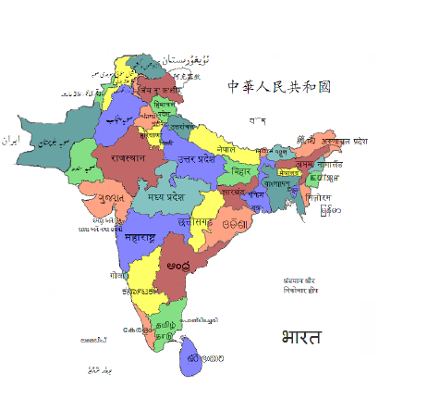
Languages

Slide 5
Digital Representation-Unicode
അയ്യപ്പന്റമ്മ നെയ്യപ്പം ചുട്ടു =\u0d05\u0d2f\u0d4d\u0d2f\u0d2a\u0d4d\u0d2a\u0d28\u0d4d\u0d31\u0d2e\u0d4d\u0d2e \u0d28\u0d46\u0d2f\u0d4d\u0d2f\u0d2a\u0d4d\u0d2a\u0d02 \u0d1a\u0d41\u0d1f\u0d4d\u0d1f\u0d41

Slide 6
Rendering
ക + േ = കേ
ഭ + ൂ = ഭൂ
ദ + ് + യാ = ദ്യാ
ഗ് + ദ് +ധ് +രോ = ഗ്ദ്ധ്രോ
क + ि = कि
Rendering Engines:
Pango,
Qt,
Harfbuzz,
Uniscribe(MS)

Slide 7
Fonts
“ I can’t go to a restaurant and order food because I keep looking at the fonts on the menu.”- Donald Knuth
തപ്പോ തപ്പോ തപ്പാണി - Anjali
തപ്പുകുടുക്കയിലെന്തുണ്ട്‌ ? - Dyuthi
നാഴിയുരി ചോറുണ്ട്‌ ! - Meera
അമ്മാമന്‍ വന്നേ വിളമ്പാവൂ ! - Rachana
അമ്മാമി തന്നേ ഉണ്ണാവൂ ! - Suruma

Slide 8
Internationalization
C Example
AtkObject *obj;
obj = gtk_widget_get_accessible (save_button);
atk_object_set_name (obj, _("Save"));
atk_object_set_description (obj, _("Saves all the settings and dismisses the dialog."));
But it is English...?!

Slide 9
Localization
সংরক্ষণ
સંગ્રહો
സംരക്ഷിക്കുക
சேமி
_(Save) =
ସଞ୍ଚଯ
सहेजें
ਸੰਭਾਲੋ
దాచు
....

Slide 10
Free software and Language Computing
Transparency
Developed and maintained by people from their language
Language is no ones property

Slide 11
Applications
Input Methods
Spellcheckers
Text to speech system
Speech recognition
Grammer checkers
Optical character readers
Dictionaries
Automated Translation
Data mining
Natural Language Processing

Slide 12
What you can do?
1. Participate in Localization projects.
A stepping stone to foss development
familiarization of community based s/w development
Good understanding of FOSS applications and environments
Bringing the benefit of IT to commons
2. Develop Internationalized Applications- Not a feature, but requirement
3. Develop applications for the language – Don't expect that foreigners will do for us to consume!

Slide 13

How?
Be a member of any language computing community. For eg: SMC for Malayalam
Learn to type in your mother tongue!
Participate in localization projects
There are many projects waiting for developers- speech recognition, OCR, NLP related projects, calendars..
Internationalize existing applications
Google Summer of code 2009 is coming...!

Slide 14
Q&A
Santhosh Thottingal (http://santhoshtr.liveournal.com
"എന്റെ കമ്പ്യൂട്ടറിനു എന്റെ ഭാഷ"
സ്വതന്ത്ര മലയാളം കമ്പ്യൂട്ടിങ്ങ് http://smc.org.in

