Slide 1

FilmFlickz
Application built using
flutter
Movie @ ease
Synsara’20

Slide 2

Filmflickz is the fastest and easiest way to find and discover movies and its trailers. It enables to find detailed information about any movie along with its ratings and a short description about the movie.

Slide 3
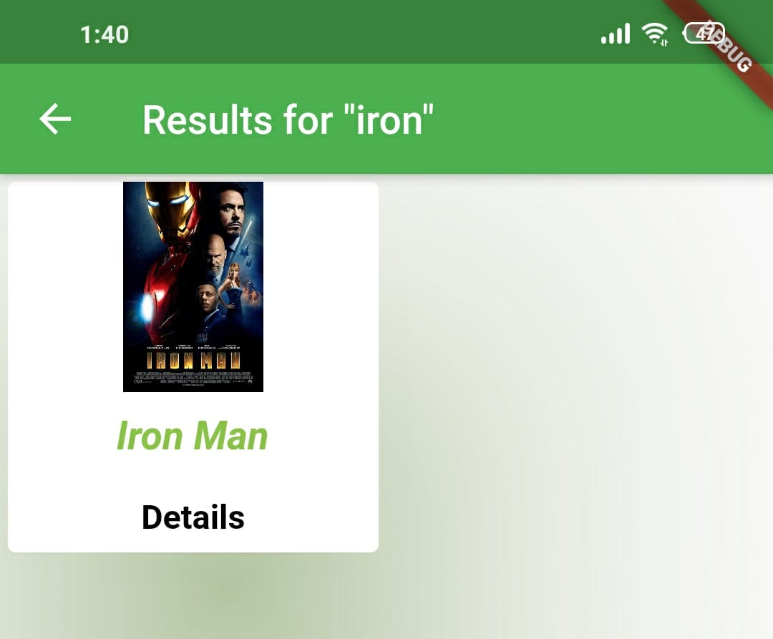
Search by movie name
The search widget in our app
helps users to find the movies
they like.

Slide 4

Movies are listed under 3 predefined categories
Best of all time
(classical movies)
Best of 2019
(blockbusters of 2019)
Best of 2020
(hits of 2020)

Slide 5

Easy to find the details about the movie you like and their trailers
By just tapping
“Watch Trailer “ user will be spontaneously redirected to the trailer

Slide 6
Hack Elite
Santhosh K
Deepthi Sherley J
Nivedha B
Dinesh Rohit K B
A project by Computer Science and Engineering students

