Slide 1
TAILORED TRAVEL DESTINATION DISCOVERY
COLLEGE
JNN INSTITUTE OF ENGINEERING
Presented by
1.G.HITHISHI
2.A.SANTHOSH
3.G.SRIDHAR
4.S.VENKATESH

Slide 2
PROJECT OUTLINE
ABSTRACT
INTRODUCTION
AIM AND SCOPE
EXISITING
PROPOSED
ARCHITECTURE DIAGRAM
MODULES
CONCLUSION
REFERENCE
LIMITATIONS
CONCLUSION

Slide 3
ABSTRACT
This project presents an analysis of a travel dataset aimed at uncovering insights into traveler behavior, preferences, and trends. The dataset includes information such as travel duration, traveler demographics, destination details, and travel expenses. Through exploratory data analysis (EDA), we examine various aspects of travel patterns, including preferred destinations, transportation modes, accommodation types, and seasonal trends. The report highlights key findings and implications for the travel industry.
This project aims to personalize travel recommendations by leveraging user preferences and interests. The model will utilize unsupervised clustering techniques to identify unique user groups based on demographic, budget and taste preferences. Once these clusters are identified, the model will use relevant information from multiple sources to recommend tailored and interesting travel destinations to users.
The model will consider factors such as location, weather, accommodation availability, cuisine, attractions, and activities, among others. To enhance the model's recommendation accuracy, we will include social media data, user reviews, and ratings, and other forms of user-generated content. We will use techniques such as natural language processing to extract insights from this data.

Slide 4
INTRODUCTION
Travel is a fundamental aspect of human experience, driven by a myriad of factors including personal preferences, cultural influences, and economic considerations. Understanding travel patterns and preferences is crucial for stakeholders in the travel industry to tailor their services and offerings to meet the diverse needs of travelers. In this project, we have handpicked a selection of travel destinations that will offer you a unique perspective and unforgettable experiences. We have compiled a list of destinations that cater to different travel styles, be it adventure, culture, history, or relaxation.
We understand that everyone has different needs and preferences when it comes to travel, which is why we have taken great care to curate a selection of destinations that appeal to a wide variety of people. So whether you're looking for a romantic getaway, a family-friendly vacation, or a solo adventure, we've got something for everyone in our collection.
Our detailed guides will give you an in-depth look at each destination, including the best places to stay, must-visit attractions, and local delicacies to try. We will help you plan your trip by providing insights and tips that will help you make the most of your time in each destination.
Through this project, we aim to inspire you to explore the world, learn about new cultures, and create memories that will last a lifetime. So sit back, relax, and let us take you on a journey through some of the most stunning and captivating travel destinations in the world. In this report, we analyze a travel dataset to gain insights into traveler demographics, destination popularity, preferred transportation modes, accommodation preferences, and seasonal travel trends.

Slide 5
AIM AND SCOPE
The aim of our tailored travel destination project is to inspire and assist travelers in planning their next adventure by providing a comprehensive guide to our handpicked selection of destinations.
We want to offer a unique and diverse range of destinations that cater to a variety of travel styles and preferences, ensuring that there is something for everyone.
Our scope includes providing detailed information about each destination, including attractions, activities, accommodations, cuisine, and local customs. We want to provide a comprehensive guide that will help travelers plan their trip and make the most of their time in each destination.
We will also provide insights and tips on how to make the most of your trip, such as budget-friendly options and sustainable travel practices. We believe that travel should not only be enjoyable but also responsible and respectful to the local communities and environment.
Overall, the goal of our project is to inspire people to explore the world, learn about new cultures, and create unforgettable memories through travel experiences. We hope our tailored travel destination project will help make that dream a reality.

Slide 6
EXISTING
The existing travel dataset analysis provides valuable insights into traveler behavior and preferences. However, it can be enhanced by incorporating additional features such as travel duration, trip purpose, and traveler feedback. Furthermore, sentiment analysis of traveler reviews could provide deeper insights into destination satisfaction and service quality.

Slide 7
PROPOSED
Future iterations of the analysis could include predictive modeling to forecast travel trends and demand for specific destinations. Additionally, integrating external datasets such as economic indicators and weather data could enhance the analysis by identifying factors influencing travel decisions. Furthermore, real-time data integration from travel booking platforms could enable dynamic analysis and personalized recommendations for travelers.

Slide 8
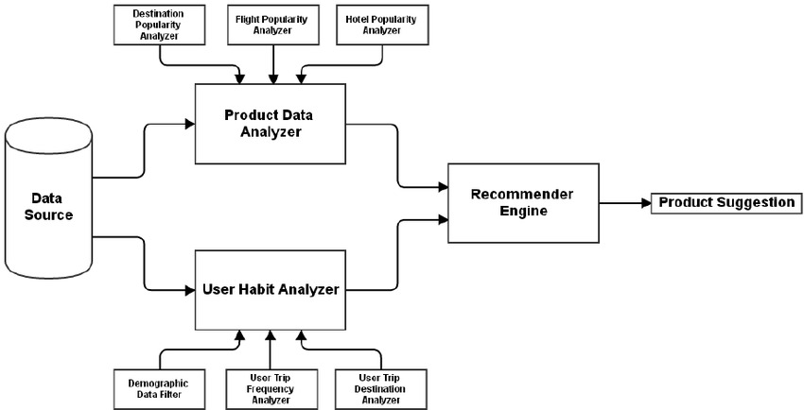
ARCHITECTURE DIAGRAM

Slide 9
MODULES
Data Preparation and Cleaning:
The dataset is loaded and inspected for missing values, which are subsequently removed. Numeric columns are converted to appropriate data types, and special characters in cost columns are removed.
Feature Engineering:
New features such as day of the week, month, and destination details are extracted from the date and destination columns.

Slide 10
MODULES
Exploratory Data Analysis (EDA):
Various visualizations are created to analyze traveler demographics, popular destinations, preferred months for travel, and costliest countries in terms of accommodation.
Insights Extraction:
Key insights are derived from the analysis, including traveler demographics, popular destinations, preferred transportation and accommodation types, and top places to visit.

Slide 11
CONCLUSION
In conclusion, the analysis of the travel details dataset offers valuable insights into traveler behavior and preferences. By leveraging data analytics techniques, businesses in the travel and tourism sector can tailor their offerings to meet customer needs, enhance customer experiences, and stay competitive in the dynamic travel market. Continuous monitoring of travel trends and consumer preferences is essential for adapting to evolving market dynamics and maintaining a competitive edge.

Slide 12
REFERENCE
[1] H. Huang, ‘”The spatial distribution, influencing factors, and development path of inbound tourism in China-An empirical analysis of market segments based on travel motivation”, Sustainability (Switzerland), 12(6), 2020. doi: 10.3390/su12062508.
[2] P. Fakfare, “A scale development and validation on domestic tourists’ motivation: the case of second-tier tourism destinations”, Asia Pacific Journal of Tourism Research, 25(5), 2020, pp. 489–504. doi: 10.1080/10941665.2020.1745855.
[3] H. Zhanga, H. Song, L. Wen, and C. Liu, “Forecasting tourism recovery amid COVID-19”, Annals of Tourism Research, 87, 2021, p. 103149. doi: 10.1016/j.annals.2021.103149.
[4] M. Carvache-Franco, “Segmentation and motivations in eco-tourism: The case of a coastal national park”, Ocean and Coastal Management, 178, 2019. doi: 10.1016/j.ocecoaman.2019.05.014.
[5] M. Kim, “The effects of motivation, deterrents, trust, and risk on tourism crowdfunding behavior”, Asia Pacific Journal of Tourism Research, 25(3), 2020, pp. 244–260. doi: 10.1080/10941665.2019.1687533.
[6] I. Choi, “A recommender system based on personal constraints for smart tourism city *”, Asia Pacific Journal of Tourism Research, 2019. doi: 10.1080/10941665.2019.1592765.
[7] I. Egger, “Digital free tourism – An exploratory study of tourist motivations”, Tourism Management, 79, 2020. doi: 10.1016/j.tourman.2020.104098.

