Slide 1

Micro-Credit Defaulter Model
Submitted By: Naroj Santhosh Kumar

Slide 2
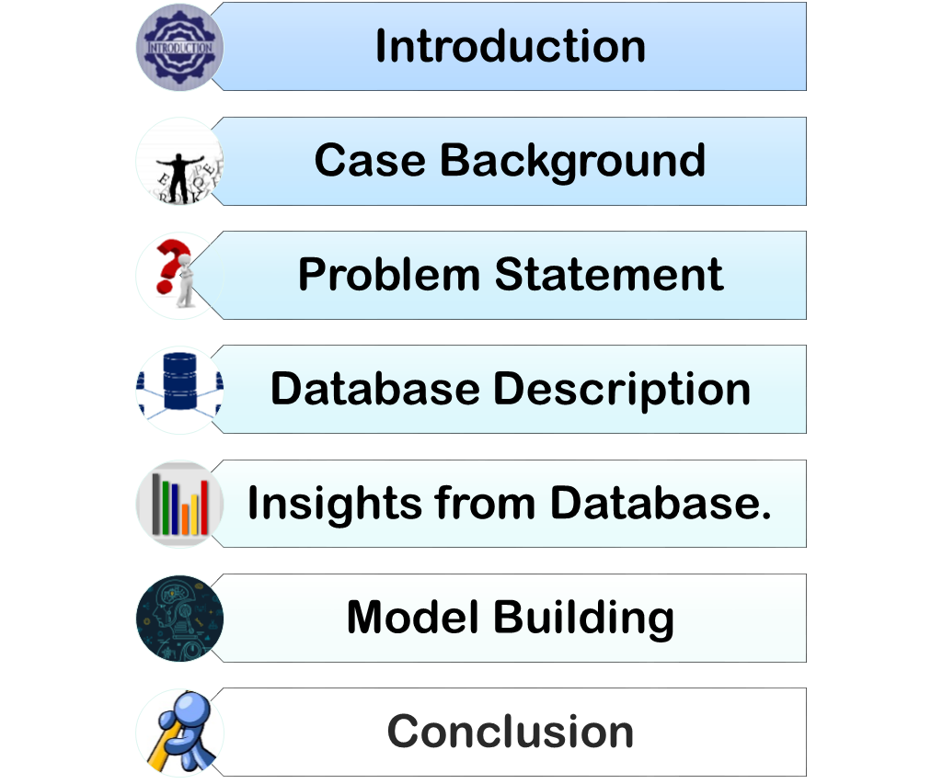

CONTENTS

Slide 3
INTRODUCTION
A Microfinance Institution (MFI) is an organization that offers financial services to low income populations in remote areas.
The Microfinance services (MFS) provided by MFI are Group Loans, Agricultural Loans, Individual Business Loans and so on.
MFI collaborates with Telecom company to provide micro-credit on mobile balances to be paid back in 5 days.
The Consumer is believed to be defaulter if he deviates from the path of paying back the loaned amount within the time duration of 5 days.
Copyright 2008 PresentationFx.com | Redistribution Prohibited | This text section may be deleted for presentation.

Slide 4
CASE BACKGROUND
Before advancement of Data Science, loan lending companies used to risk a high rate of defaulting.
Many a times a perfect candidate would display erratic financial and repayment behavior after being approved for loan.
Machine Learning can help lenders predict potential defaulters before approving their candidature using their past data.
The candidates’ income, past debt and repayment behavior can be important metrics for the same.

Slide 5
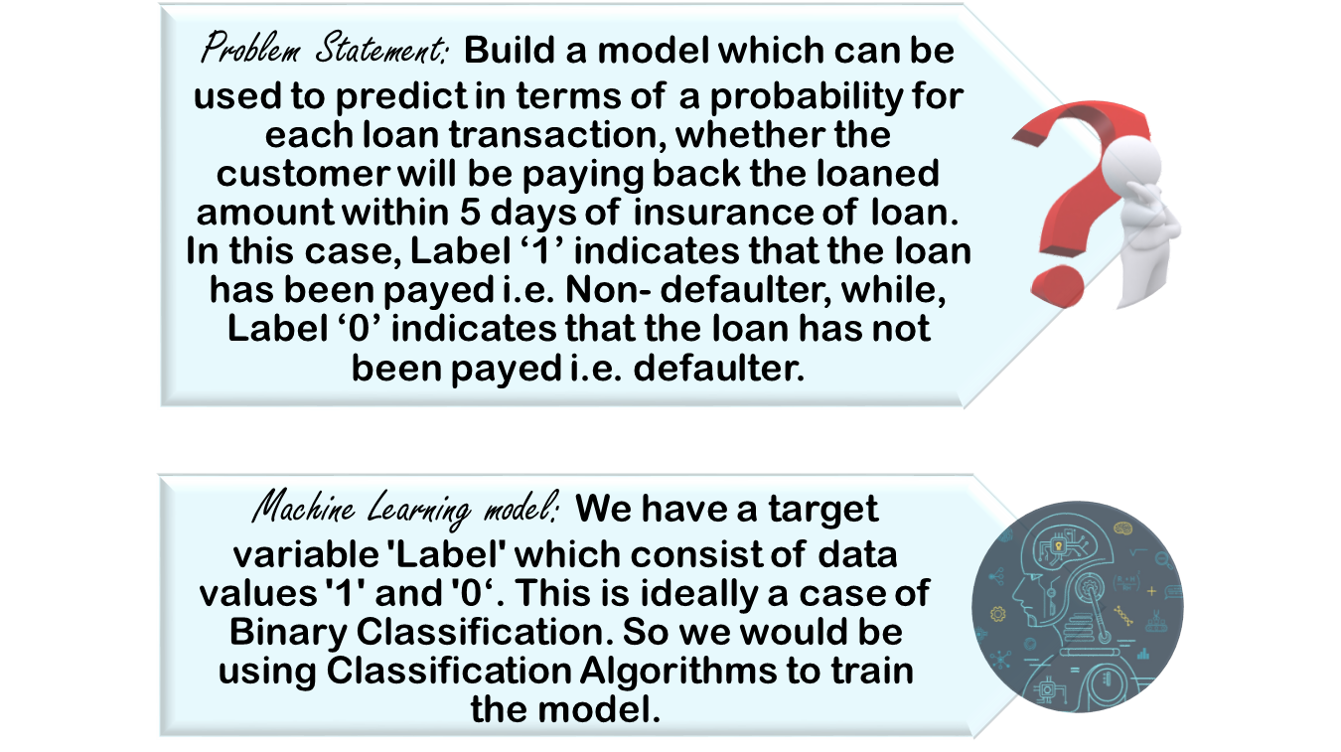
PROBLEM STATEMENT & MODEL

Slide 6
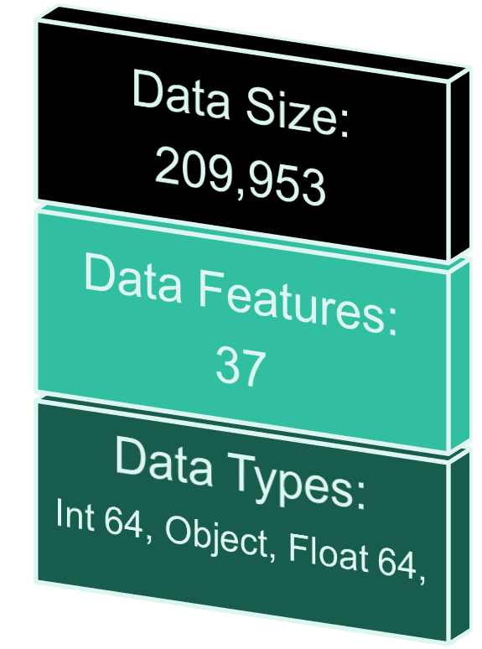
DATABASE DESCRIPTION
Major Data Features
Label-Target Variable.
Avg. daily amount spent .
Avg. main account balance.
Avg. amount of recharge.
Frequency of main account recharge.
Total amount of main acc. recharge.
Median of amount recharges done.
Maximum amount of loans taken.
Median of loan amount taken
Total amount of Loans taken.
Number of loans taken.
Average payback time.
All features recorded for 30 days and 90 days.

Slide 7
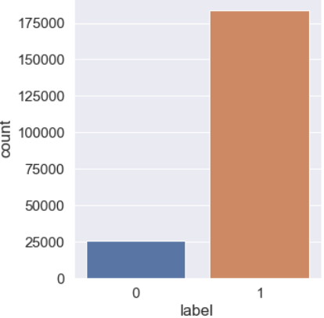
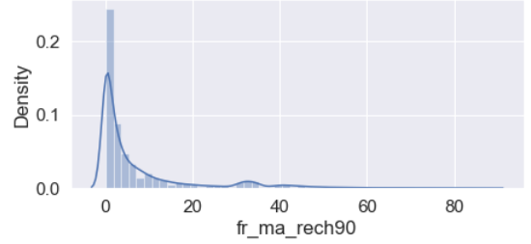
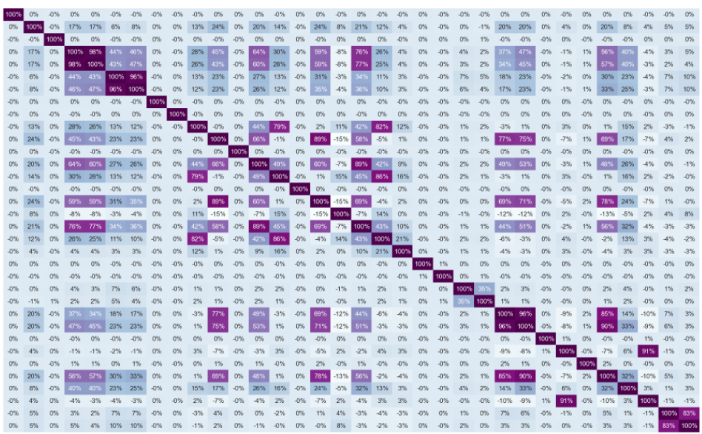
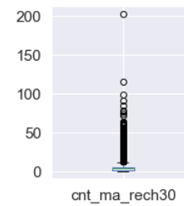
INSIGHTS FROM DATA
Dataset was imbalanced for the target feature(87.5% for Non-defaulters and 12.5% for Defaulters).
Data distribution was analyzed and irrelevant columns were deleted.
Data Visualization: On visualizing data, there were two important insights was gathered.
a. Imbalance of data
b. Distribution was not normal.
Data Normalization: Since the data was not normal, all the features except the target variable was normalized.
Sampling: As data sampling may cause data lose, oversampling of minority class using SMOTE was performed.

Slide 8
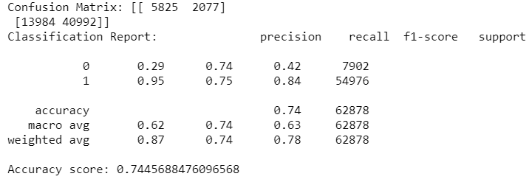
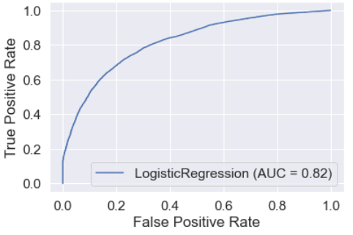
MODEL BUILDING
Build Models Since it was a supervised classification problem, 3 models were built to evaluate performance of each of them. Metrics like precision, recall and ROC-AUC curve were used.
1. LOGISTIC REGRESSION

Slide 9
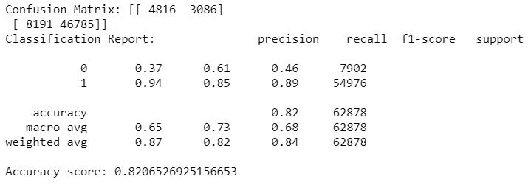
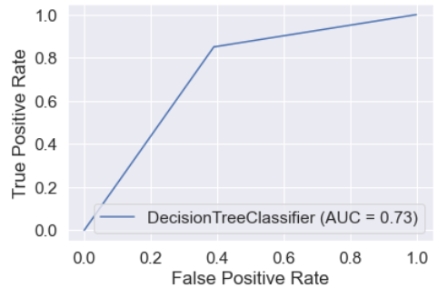
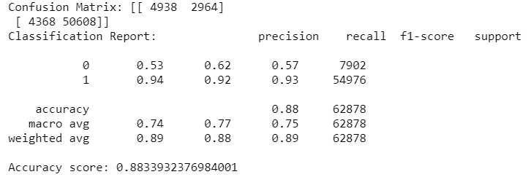
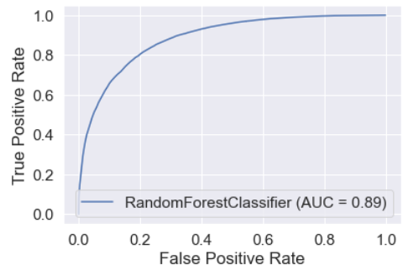
2.DecisionTree Classifier
3. RandomForest Classifier

Slide 10
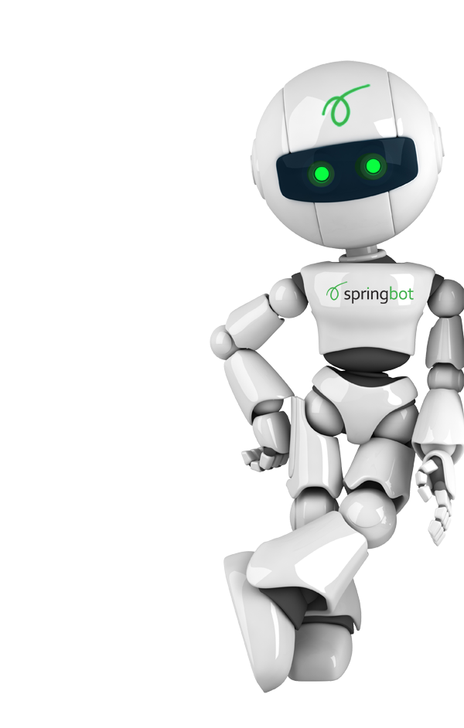
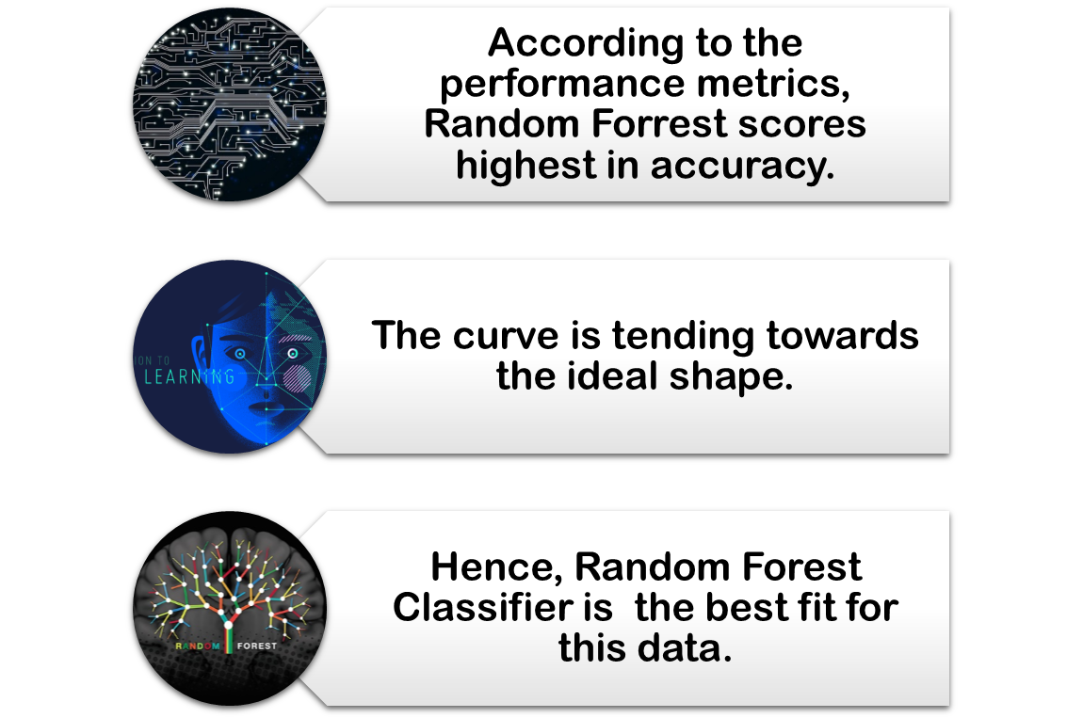
CONCLUSION

