Slide 1

DEEP NEURAL NETWORK
MODULE # 5 : DEEP FEED-FORWARD NEURAL NETWORKS
DNN Team
BITS Pilani WILP

Slide 2
The instructor is gratefully acknowledging the authors who made their course materials freely available online.
This deck is prepared by Seetha Parameswaran.
Deep Learning

Slide 3









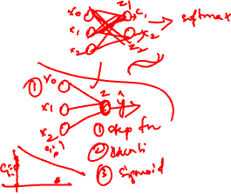
Table of Contents
Motivation: The XOR Problem
Non-Linearity in Neural Networks
The Four Components of DFNN
Training DFNN
Making Predictions
Impact of Depth and Width
DFNN Architecture
Design Implementation Tips
Summary
1
2
3
4
5
6
7
8
9
Deep Learning

Slide 4
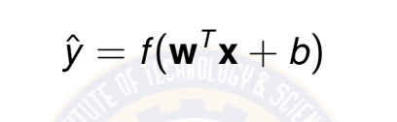
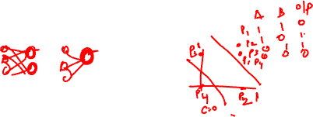
Linear Models Have Limitations
Recall: Linear models uses a single neuron with activation function f (·)
(1)
Problem: Many real-world relationships are non-linear
Image recognition (pixel intensities → object classes) Natural language understanding (words → sentiment) Medical diagnosis (symptoms → disease probability) Game playing (board state → optimal move)
Linear models cannot solve non-linearly separable problems!
Deep Learning

Slide 5

The XOR Problem
XOR (Exclusive OR): A classic non-linearly separable problem
Visual Representation:
Truth Table:
x₂
x₁ | x₂ | y (XOR)
0 | 0 | 0
0 | 1 | 1
1 | 0 | 1
1 | 1 | 0
1
0
No linear separator!
x₁
0
1
Challenge: No single straight line can separate the two classes!
Deep Learning

Slide 6

Why Single Neuron Fails on XOR
Single neuron model:
y^{ˆ} = σ(w₁x₁ + w₂x₂ + b)
(2)
where σ is any activation function.
Decision boundary: w₁x₁ + w₂x₂ + b = 0 (a line/hyperplane)
x₂
 | Fails
Fails
x₁
Conclusion: We need models that can learn non-linear decision boundaries!
Deep Learning

Slide 7

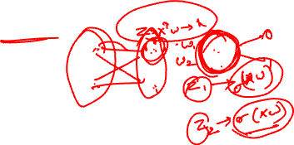
Solution: Multi-Layer Perceptron (MLP)
Key Idea: Stack multiple layers of neurons with non-linear activations
Input Layer ^{Hidden Layer} Output Layer
x₁
h₁
x₂
h₂
Non-linear activation functions enable non-linear boundaries
Deep Learning

Slide 8



MLP Solves XOR
Architecture: 2 inputs → 2 hidden units → 1 output
How it works:
Hidden layer creates new feature representations Each hidden unit learns a linear separator Output layer combines these separators
Non-linear activation enables complex boundaries
x₂
Hidden layer
!
x₁
h₁
Input Space
Hidden Space
Deep Learning

Slide 9


Table of Contents
Motivation: The XOR Problem
Non-Linearity in Neural Networks
The Four Components of DFNN
Training DFNN
Making Predictions
Impact of Depth and Width
DFNN Architecture Design Implementation Tips
Summary
1
2
3
4
5
6
7
8
9
Deep Learning

Slide 10
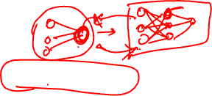
What is Non-Linearity?
Definition
A function f is non-linear if it does not satisfy the linearity property:
f (ax₁ + bx₂) ≠ a f (x₁) + b f (x₂)
(3)
for all scalars a, b and inputs x₁, x₂.
Why non-linearity matters:
Without non-linearity, deep networks collapse to single-layer models Non-linear activations enable learning complex patterns
Deep Learning

Slide 11
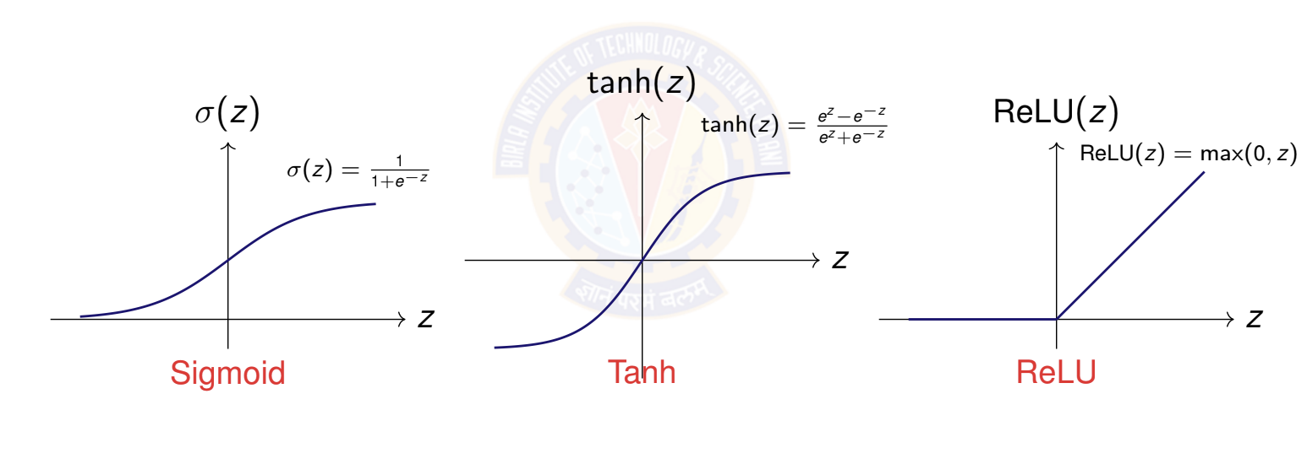
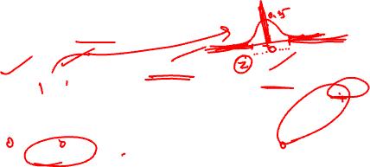
Common Activation Functions
Activation functions introduce non-linearity
Deep Learning

Slide 12
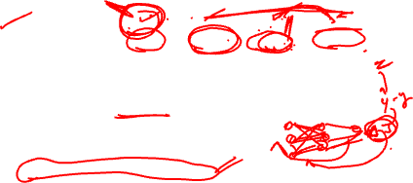
Activation Function Properties
Property | Sigmoid | Tanh | ReLU | Leaky ReLU
Range | (0, 1) | (−1, 1) | [0, ∞) | (−∞, ∞)
Zero-centered | x | ✓ | x | ✓
Differentiable | ✓ | ✓ | x at 0 | x at 0
Vanishing gradient | High | Moderate | No | No
Computational cost | High | High | Low | Low
Typical use | Output layer | Hidden layer | Hidden layer | Hidden layer
Modern preference: ReLU and variants for hidden layers Fast computation (simple thresholding)
No vanishing gradient for positive values Sparse activation (biological plausibility)
Deep Learning

Slide 13
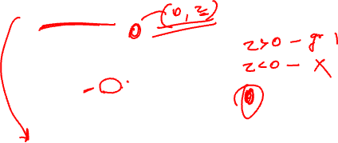
Why ReLU Works Well?
ReLU: f (z) = max(0, z)
Advantages:
1
Computational efficiency
⁾ Simple comparison and multiplication
⁾ Much faster than sigmoid/tanh (no exponentials)
Avoids vanishing gradients
⁾ Gradient is 1 for z > 0, flows unchanged through network
⁾ Enables training of very deep networks
Sparse activation
⁾ Many neurons output exactly 0
⁾ More efficient representations
⁾ Closer to biological neurons
2
3
Caveat: ”Dying ReLU” problem when neurons always output 0
Solution: Use Leaky ReLU, PReLU, or ELU variants
Deep Learning

Slide 14

Table of Contents
Motivation: The XOR Problem
Non-Linearity in Neural Networks
The Four Components of DFNN
Training DFNN
Making Predictions
Impact of Depth and Width
DFNN Architecture Design
Implementation Tips
Summary
1
2
3
4
5
6
7
8
9
Deep Learning

Slide 15
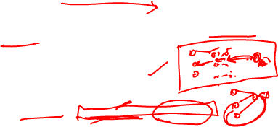
Deep Feed-Forward Neural Network (DFNN)
Definition
A DFNN is a neural network with one or more hidden layers between input and output layers, where information flows forward through non-linear transformations.
Complete system requires four components:
Data: Input features and target outputs
Model: Multi-layer architecture with non-linear activations Objective Function: Loss function to minimize
Learning Algorithm: Backpropagation with gradient descent
1
2
3
4
This is the same framework as linear models, but with added depth and non-linearity!
Deep Learning

Slide 16
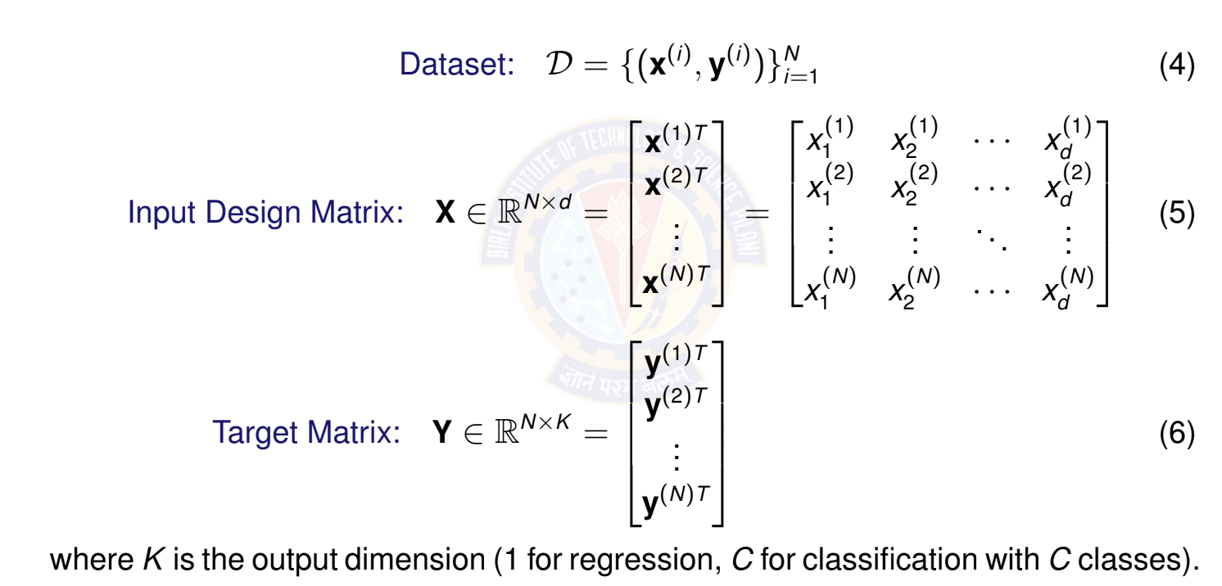

Data Representation
Deep Learning

Slide 17
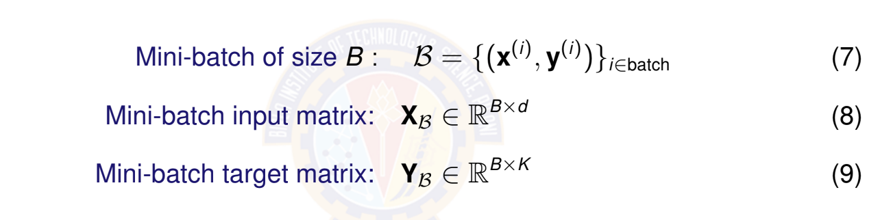
Mini-Batch Representation
For computational efficiency, we process data in mini-batches
Common batch sizes: B ∈ {32, 64, 128, 256}
Balances computational efficiency with gradient stability Enables parallelization on GPUs
Deep Learning

Slide 18
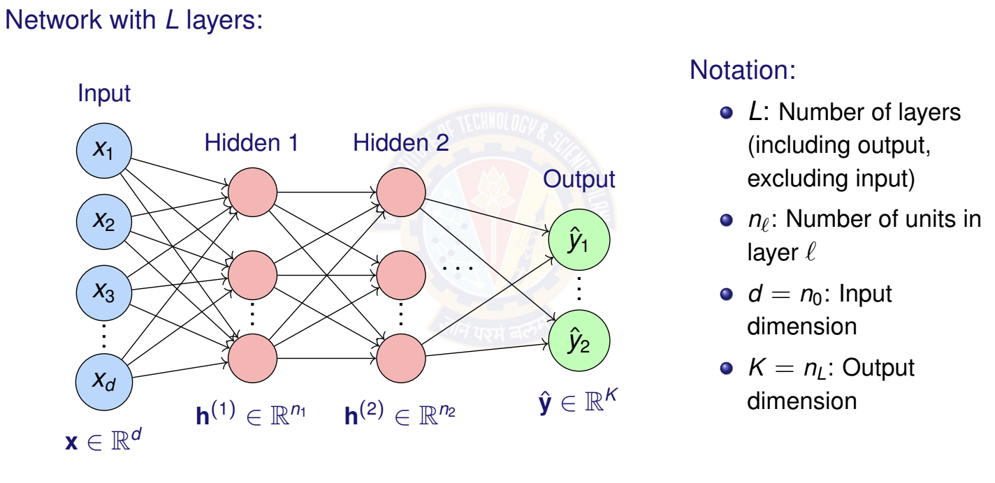
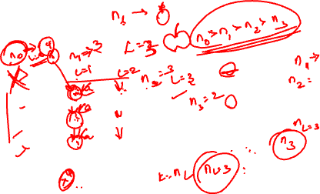
DFNN Architecture
Deep Learning

Slide 19
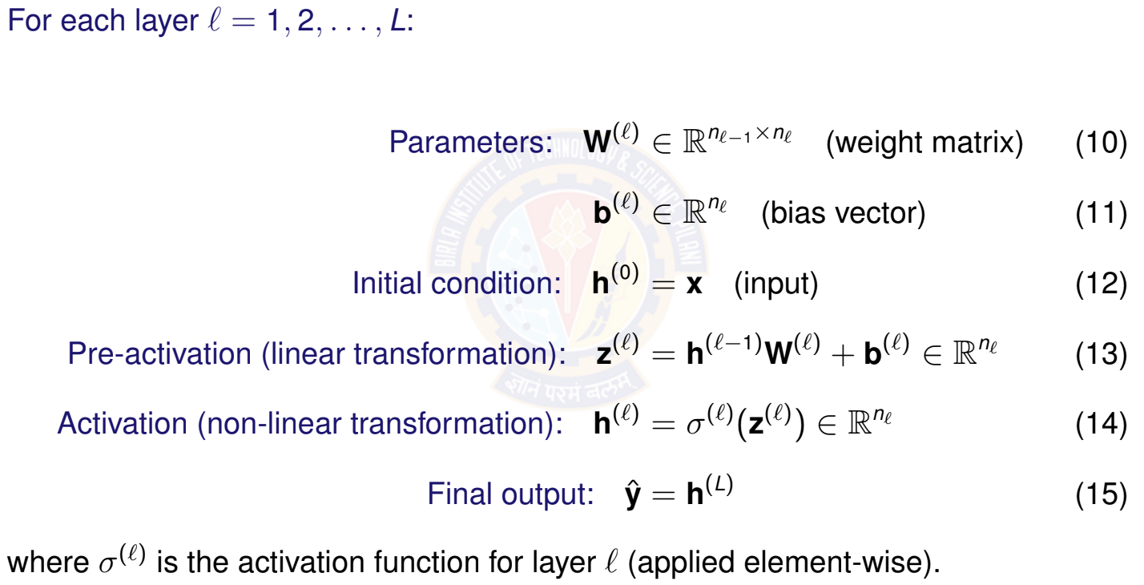
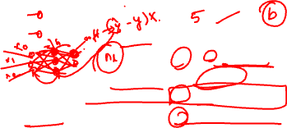
Layer-wise Computation
Deep Learning

Slide 20
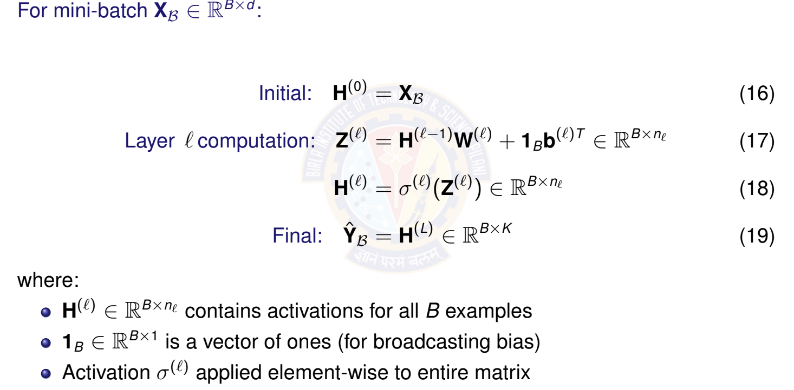
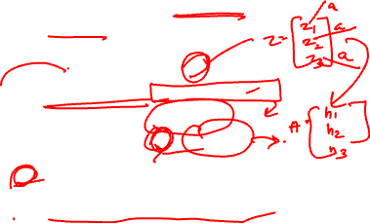
Vectorized Computation for Mini-Batch
Deep Learning

Slide 21
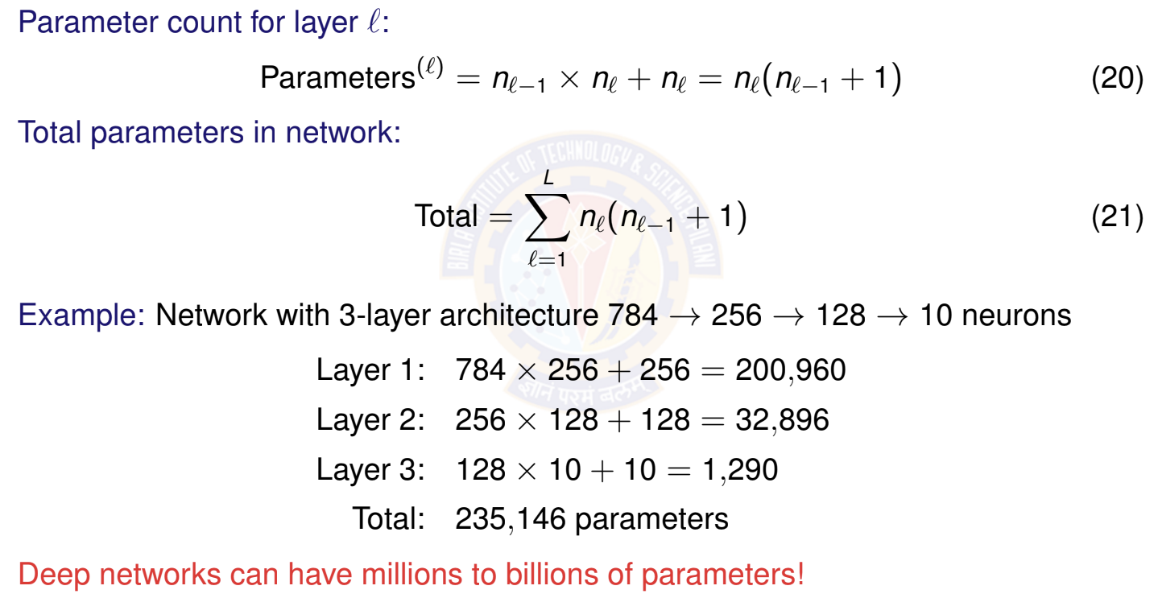
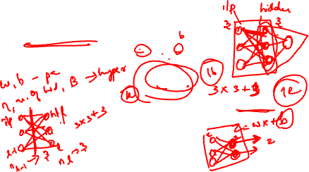
Total Parameters in Network
Deep Learning
21 / 67

Slide 22
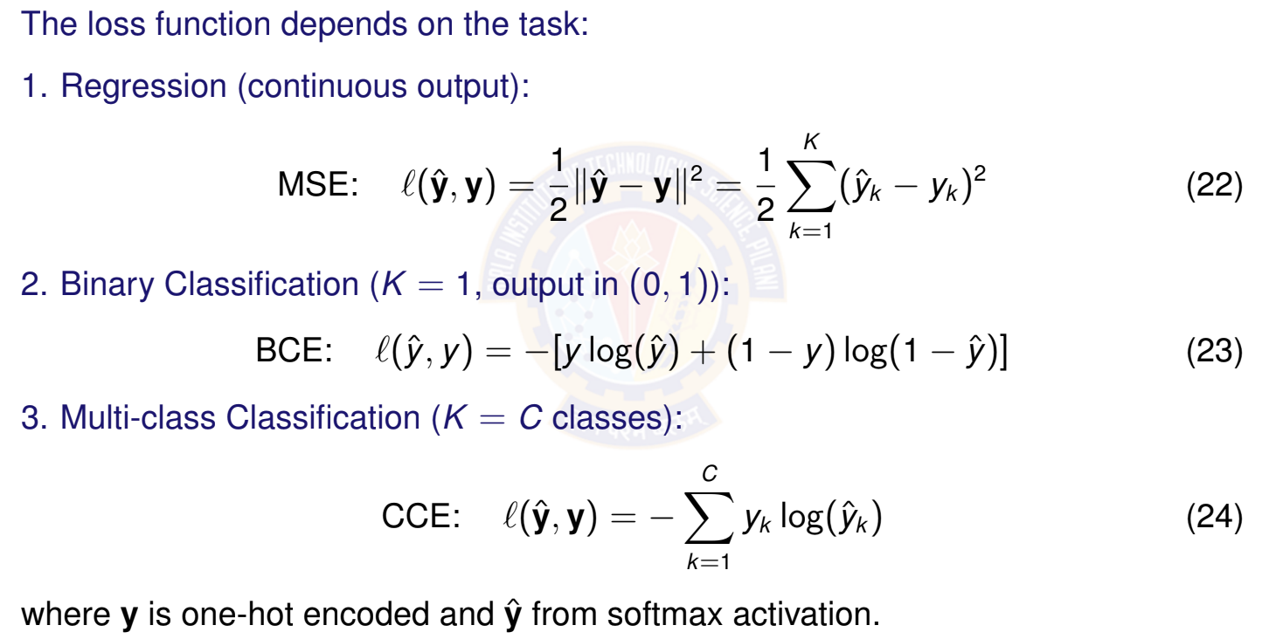

Loss Functions for Different Tasks
Deep Learning

Slide 23
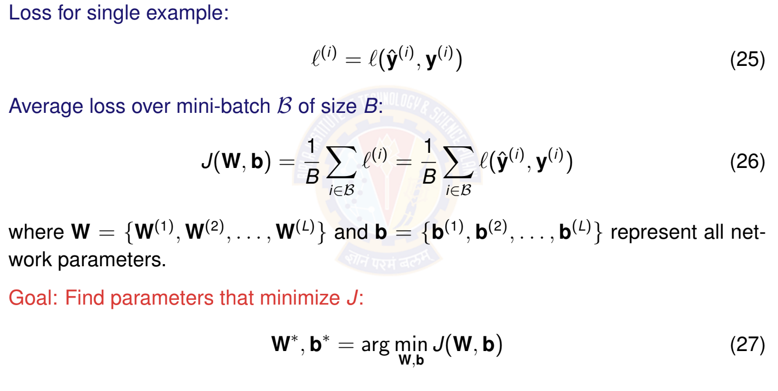
Total Loss Over Mini-Batch
Deep Learning

Slide 24
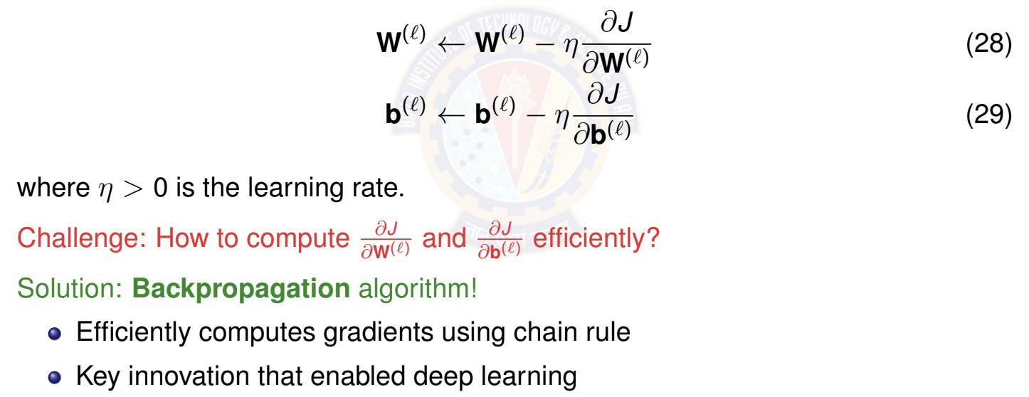
Mini-Batch Stochastic Gradient Descent
Core idea: Update parameters using gradients from mini-batches Update rule for layer l:
Deep Learning

Slide 25
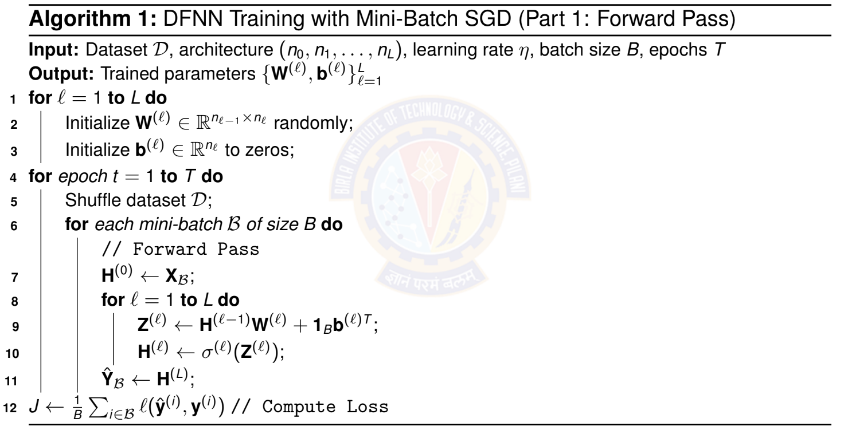
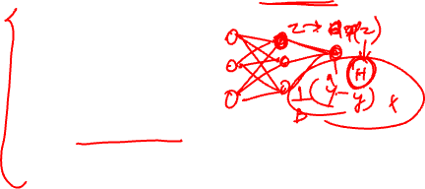
Training Algorithm: Mini-Batch SGD
Deep Learning

Slide 26
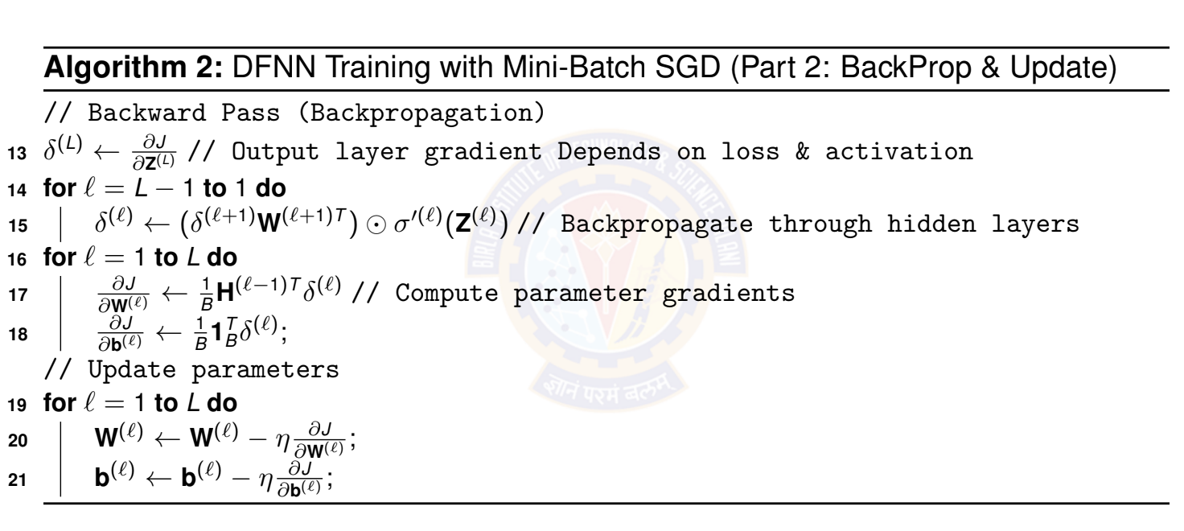
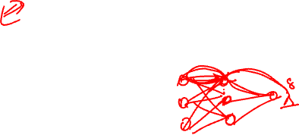
Training Algorithm: Mini-Batch SGD
Deep Learning

Slide 28

Table of Contents
Motivation: The XOR Problem
Non-Linearity in Neural Networks
The Four Components of DFNN
Training DFNN
Making Predictions
Impact of Depth and Width
DFNN Architecture Design Implementation Tips
Summary
1
2
3
4
5
6
7
8
9
Deep Learning

Slide 29
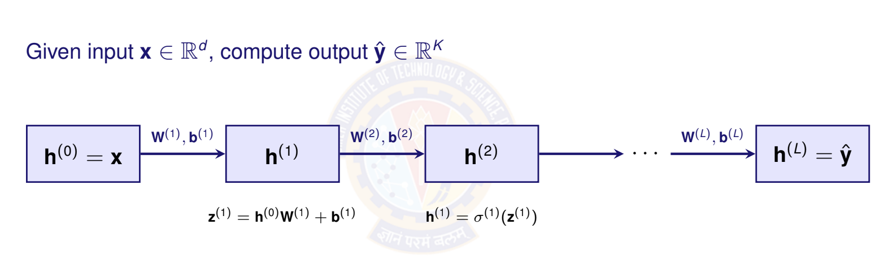
Forward Pass: Computing Predictions
Deep Learning

Slide 30
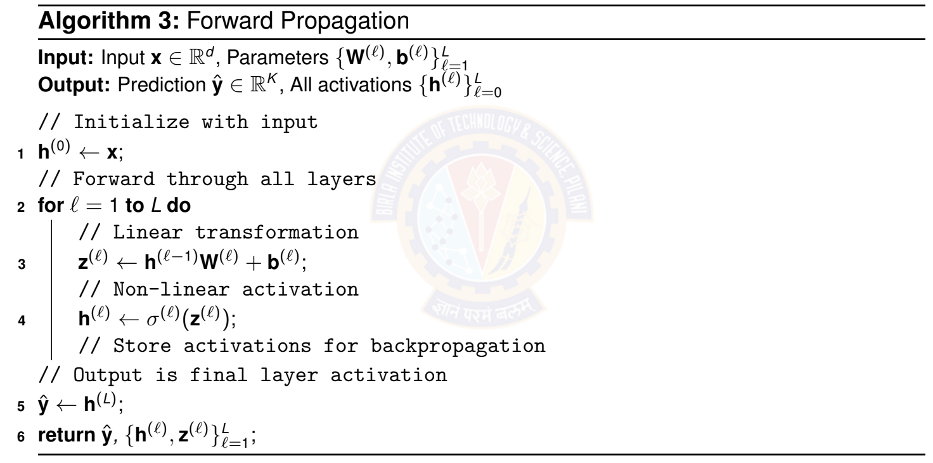
Forward Pass Algorithm
Deep Learning

Slide 31
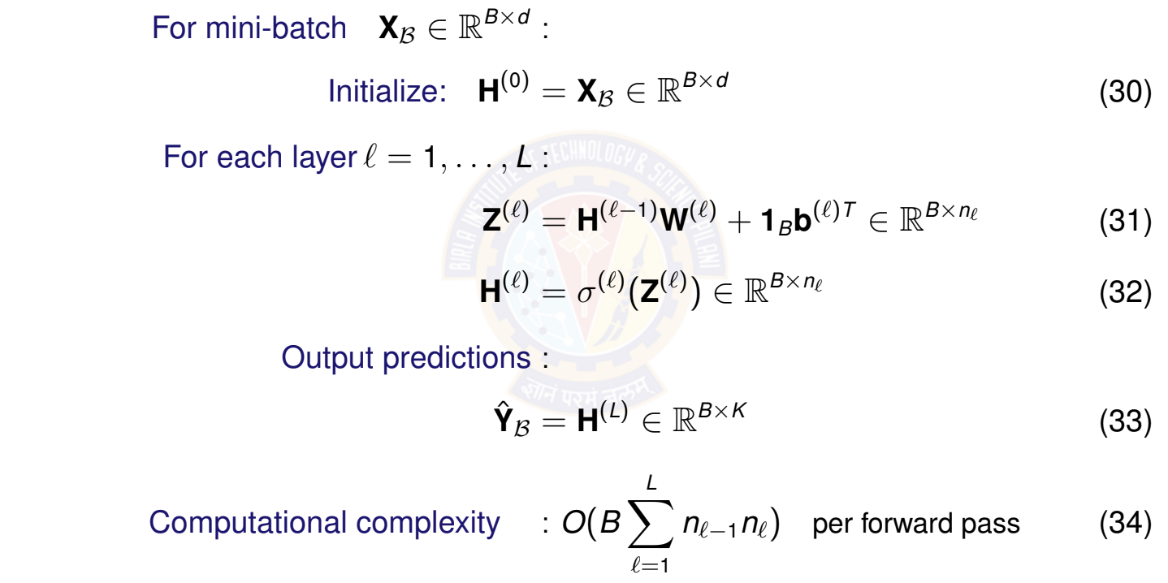
Forward Pass: Vectorized for Mini-Batch
Deep Learning

Slide 32
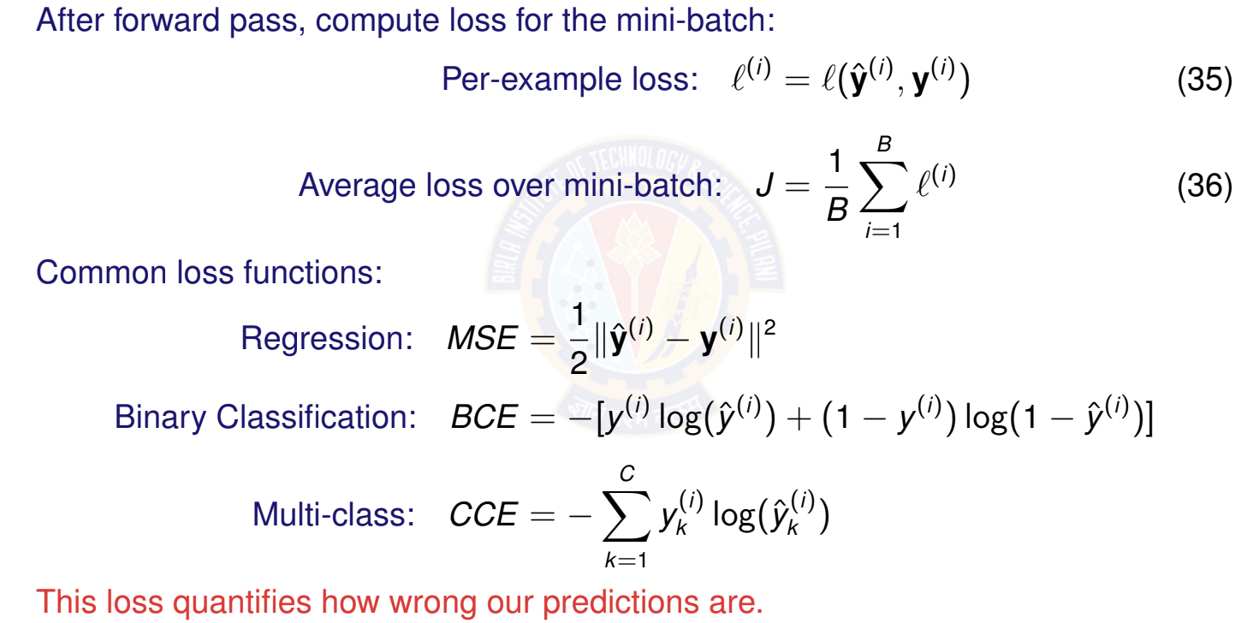
Loss Computation
Deep Learning

Slide 33
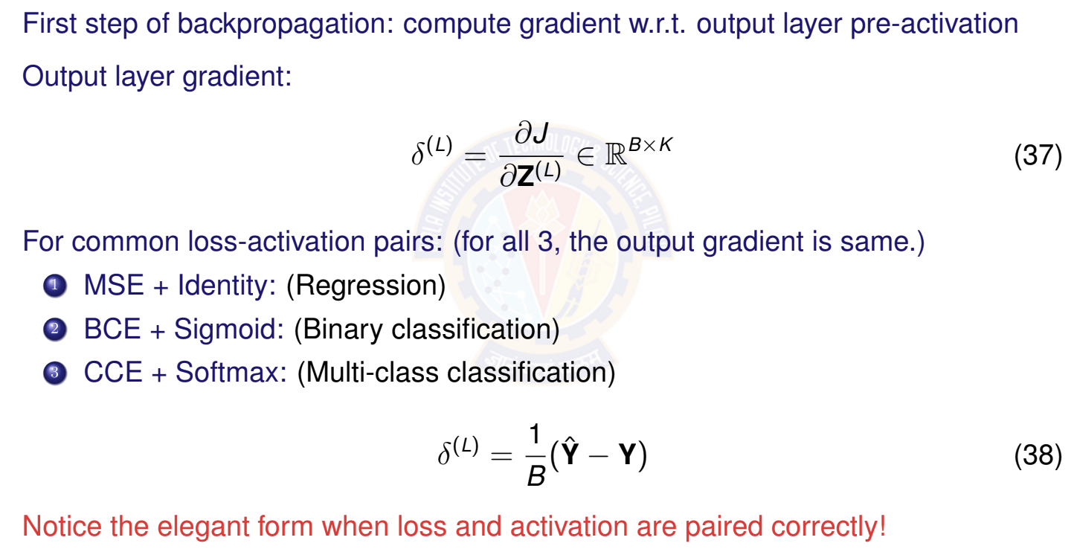
Output Layer Gradient
Deep Learning

Slide 35
Backpropagation: The Key Algorithm
Purpose
Backpropagation efficiently computes gradients of the loss w.r.t. all parameters by applying the chain rule backward through the network.
Key insight: Use chain rule recursively Notation: Define error signal for layer l:
_{δ}(l) ₌
∂J
_{∈ R}B×n_{Æ}
_{∂Z}(l)
(39)
Two main steps:
1
Backpropagate error signals: δ^{(L)} → δ^{(L—1)} → · · · → δ⁽¹⁾
2
Compute parameter gradients using error signals
Deep Learning

Slide 36
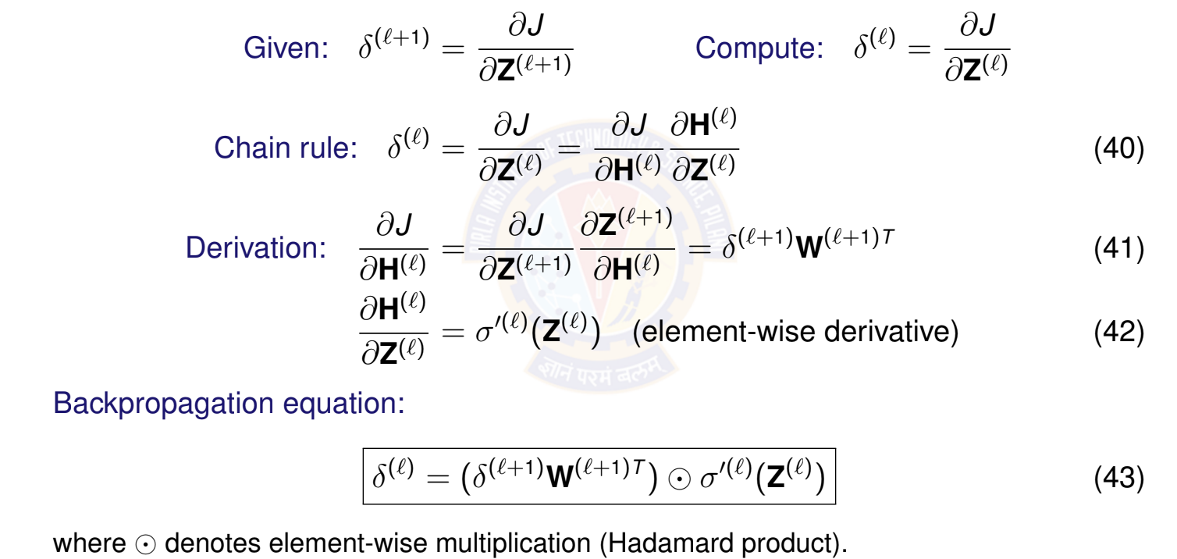
Backpropagating Error Signals
Deep Learning
34 / 67

Slide 37
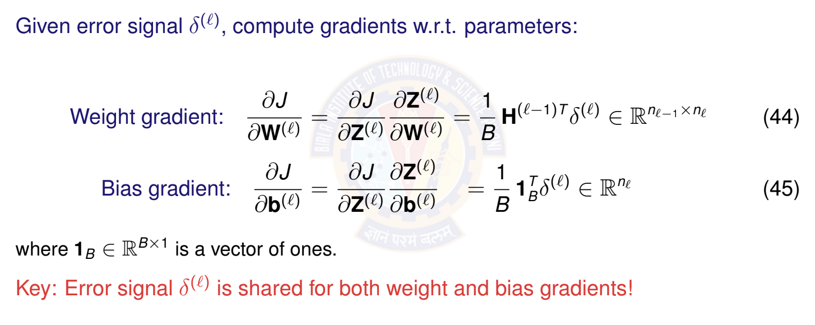
Computing Parameter Gradients
Deep Learning

Slide 38
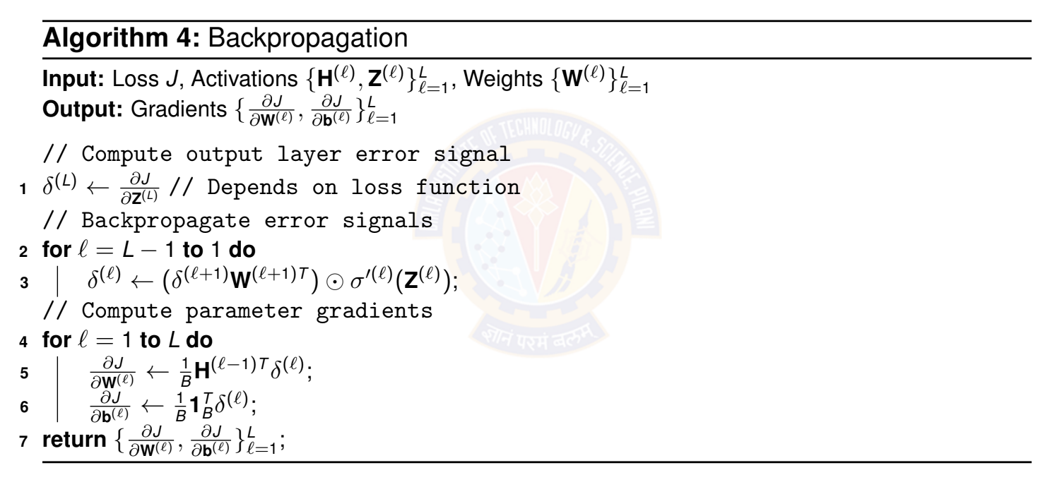
Backpropagation Algorithm
Deep Learning

Slide 39
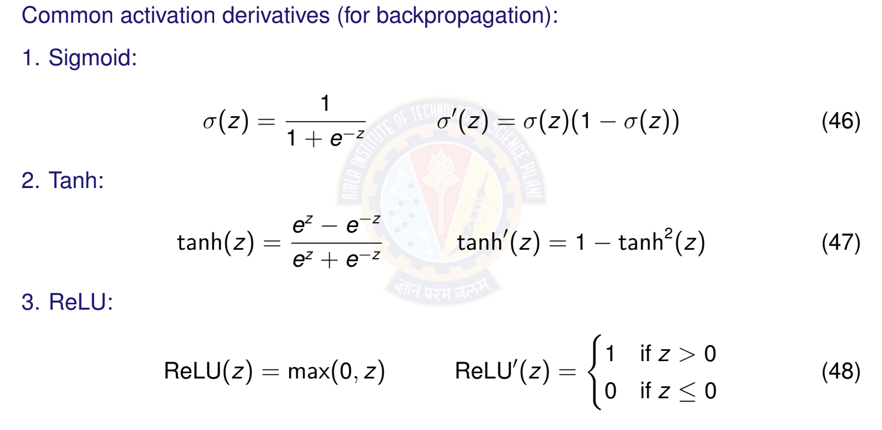
Activation Function Derivatives
Deep Learning

Slide 40
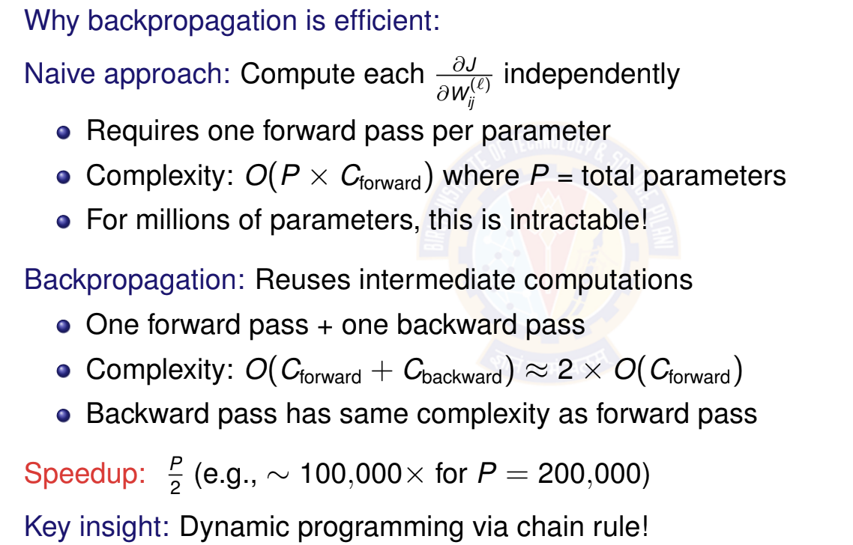
Computational Efficiency of Backpropagation
Deep Learning

Slide 41
Parameter Update Step
After computing gradients, update all parameters:
For each layer l = 1, . . . , L: (Vector form for single example)
_{W}(l) _{← W}(l) _{− ηh}(l—1)T _{δ}(l)
_{b}(l) _{← b}(l) _{− ηδ}(l)
(49)
(50)
where η > 0 is the learning rate.
This moves parameters in the direction that reduces the loss!
Deep Learning

Slide 42

Table of Contents
Motivation: The XOR Problem
Non-Linearity in Neural Networks
The Four Components of DFNN
Training DFNN
Making Predictions
Impact of Depth and Width
DFNN Architecture Design Implementation Tips
Summary
1
2
3
4
5
6
7
8
9
Deep Learning

Slide 43
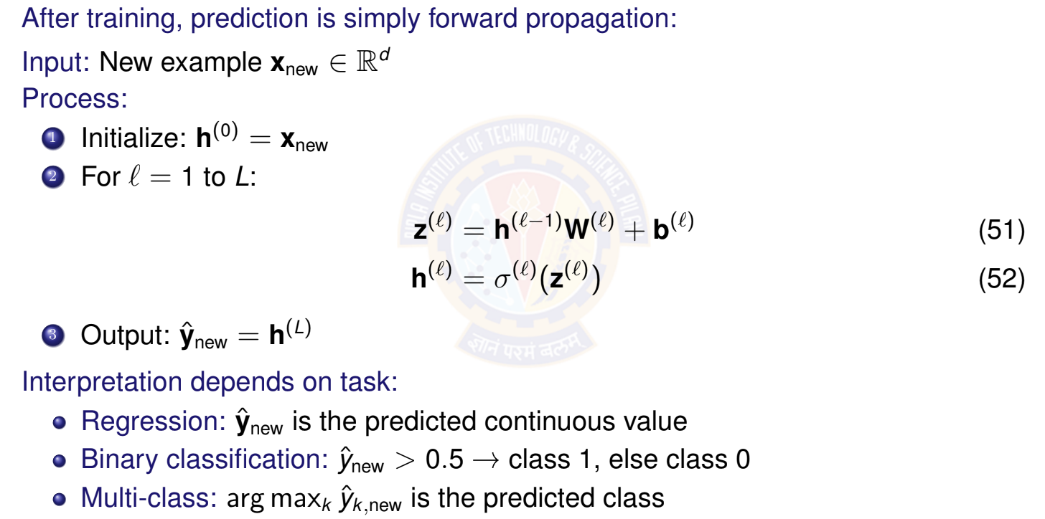
Using Trained DFNN for Prediction
Deep Learning

Slide 44
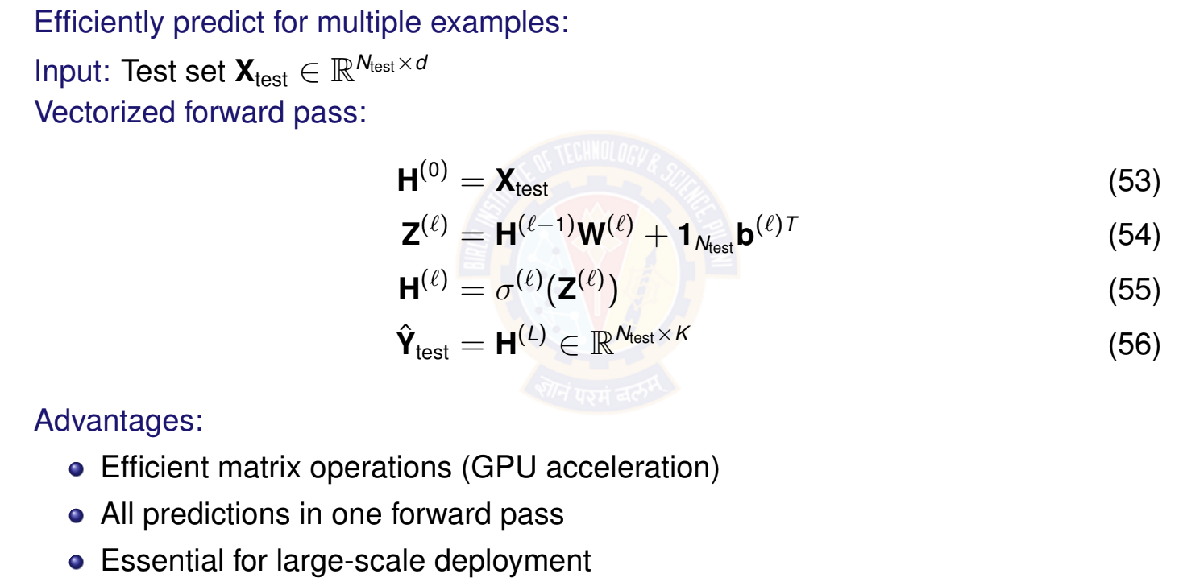
Batch Prediction
Deep Learning

Slide 45

Table of Contents
Motivation: The XOR Problem
Non-Linearity in Neural Networks
The Four Components of DFNN
Training DFNN
Making Predictions
Impact of Depth and Width
DFNN Architecture Design Implementation Tips
Summary
1
2
3
4
5
6
7
8
9
Deep Learning

Slide 46


Network Depth vs Width
Two ways to increase model capacity:
Width (more units per layer):
Depth (more layers):
Wide
Deep
Properties:
Hierarchical features More expressive Better generalization
Properties:
More parallel features Higher capacity
Risk of overfitting
Deep Learning

Slide 47
Why Depth Matters?
Deep networks learn hierarchical representations:
Simple
Low-level features (edges, textures)
Deep networks can represent exponentially more functions than shallow ones with the same number of parameters!
Mid-level features (parts, shapes)
Complex
High-level features (objects, concepts)
Example: Image classification
Layer 1: Detect edges and colors
Layer 2: Combine into textures and simple shapes Layer 3: Recognize object parts (eyes, wheels) Layer 4+: Identify complete objects (faces, cars)
Deep Learning

Slide 48
Universal Approximation Theorem
Theorem (Cybenko, 1989; Hornik et al., 1989)
A feed-forward network with a single hidden layer containing a finite number of neurons can approximate any continuous function on a compact subset of R^{n} , given an appropriate activation function.
What this means:
Theoretically, even shallow networks are powerful BUT: May require exponentially many hidden units Deep networks are much more parameter-efficient
Practice:
Deep networks learn better representations Achieve better performance with fewer parameters Generalize better to new data
Depth enables efficient learning of hierarchical structure!
Deep Learning
46 / 67

Slide 49
Challenges with Very Deep Networks
Problems that arise with increasing depth:
Vanishing Gradients:
Gradients become exponentially small in early layers Network fails to learn useful features
Solution: ReLU activations, careful initialization, normalization
Exploding Gradients:
Gradients become exponentially large Causes numerical instability (NaN/Inf values)
Solution: Gradient clipping, proper initialization
Degradation Problem:
Very deep networks harder to optimize Training error may increase with depth
Solution: Residual connections (ResNets), skip connections
Deep Learning

Slide 50

Table of Contents
Motivation: The XOR Problem
Non-Linearity in Neural Networks
The Four Components of DFNN
Training DFNN
Making Predictions
Impact of Depth and Width
DFNN Architecture Design Implementation Tips
Summary
1
2
3
4
5
6
7
8
9
Deep Learning

Slide 51
Design Considerations
Key decisions when designing a DFNN:
Number of layers L
> How deep should the network be?
Units per layer n₁, n₂, . . . , n_{L}
> How wide should each layer be?
Activation functions σ^{(l)}
> Which non-linearity for each layer?
Output layer design
> Depends on task (regression vs classification)
Regularization
> How to prevent overfitting?
1
2
3
4
5
No universal answer - depends on problem, data, and computational resources!
Deep Learning

Slide 52
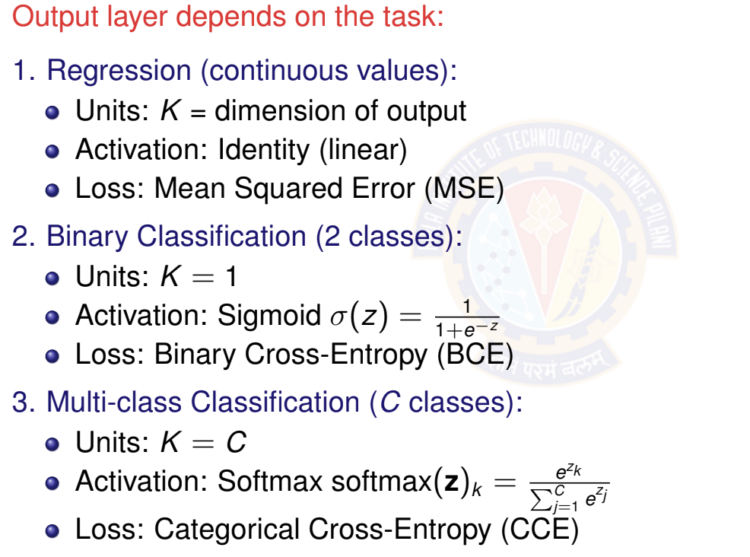
Output Layer Design
Deep Learning

Slide 53
General Architecture Guidelines
1. Start Simple:
Begin with 2-3 hidden layers
10-100 units per layer (depending on problem scale)
Gradually increase complexity if needed
Common Patterns:
Decreasing width: n₁ > n₂ > · · · > n_{L}
> Funnel architecture (compression)
Constant width: n₁ = n₂ = · · · = n_{L—1}
> Uniform representation
Hourglass: Wide → Narrow → Wide
> Learns compressed representations
Scale with Data:
More data → can support larger networks
Less data → keep networks smaller to avoid overfitting
Deep Learning
51 / 67

Slide 54
Hidden Layer Activation Functions
Activation | When to Use | Avoid When
ReLU | Default choice Fast, no vanishing gradient | Very deep networks (dying ReLU)
Leaky ReLU | Deep networks Fixes dying ReLU | Never (safe choice)
Tanh | Small networks Zero-centered | Very deep networks (vanishing gradient)
Sigmoid | Avoid for hidden layers (only for binary output) | Hidden layers (strong saturation)
Modern recommendation:
Default: ReLU for hidden layers
Alternative: Leaky ReLU, ELU for very deep networks
Avoid: Sigmoid/Tanh in hidden layers (unless specific reason)
Deep Learning

Slide 55
Regularization Techniques
Prevent overfitting with:
L2 Regularization (Weight Decay):
Dropout:
Early Stopping:
Batch Normalization:
Note: You will learn about this in Module 10 and 11
Deep Learning

Slide 56

Table of Contents
Motivation: The XOR Problem
Non-Linearity in Neural Networks
The Four Components of DFNN
Training DFNN
Making Predictions
Impact of Depth and Width
DFNN Architecture Design Implementation Tips
Summary
1
2
3
4
5
6
7
8
9
Deep Learning

Slide 57
Parameter Initialization
Proper initialization is critical for training success!
x Bad: Zero initialization
Good: Random initialization
Xavier/Glorot Initialization for Sigmoid / Tanh He Initialization for ReLU
Biases: Initialize to zero: b^{(l)} = 0
Note: You will learn about this in Module 10 and 11
Deep Learning

Slide 58
Training Hyperparameters to Tune
Learning Rate η:
Start with: η ∈ {0.001, 0.01, 0.1}
Consider adaptive methods (Adam with η = 0.001)
Batch Size B:
Common: B ∈ {32, 64, 128, 256}
Larger batch → faster but may hurt generalization Smaller batch → better generalization but slower Limited by GPU memory
Number of Epochs T :
Use early stopping based on validation loss Typically 50-200 epochs for moderate datasets Monitor for overfitting
Deep Learning

Slide 59
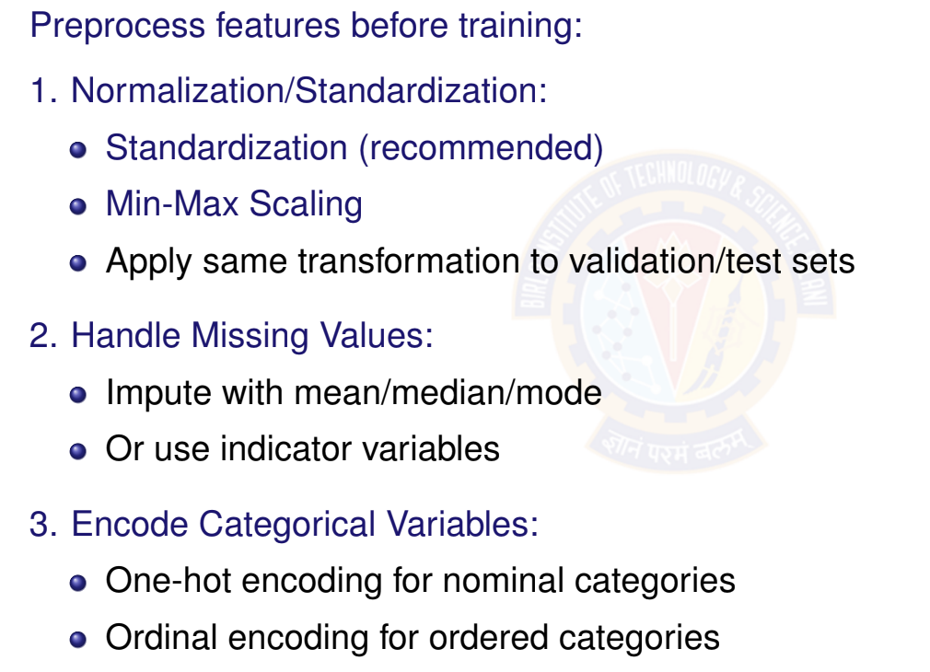
Feature Preprocessing
Deep Learning
57 / 67

Slide 60
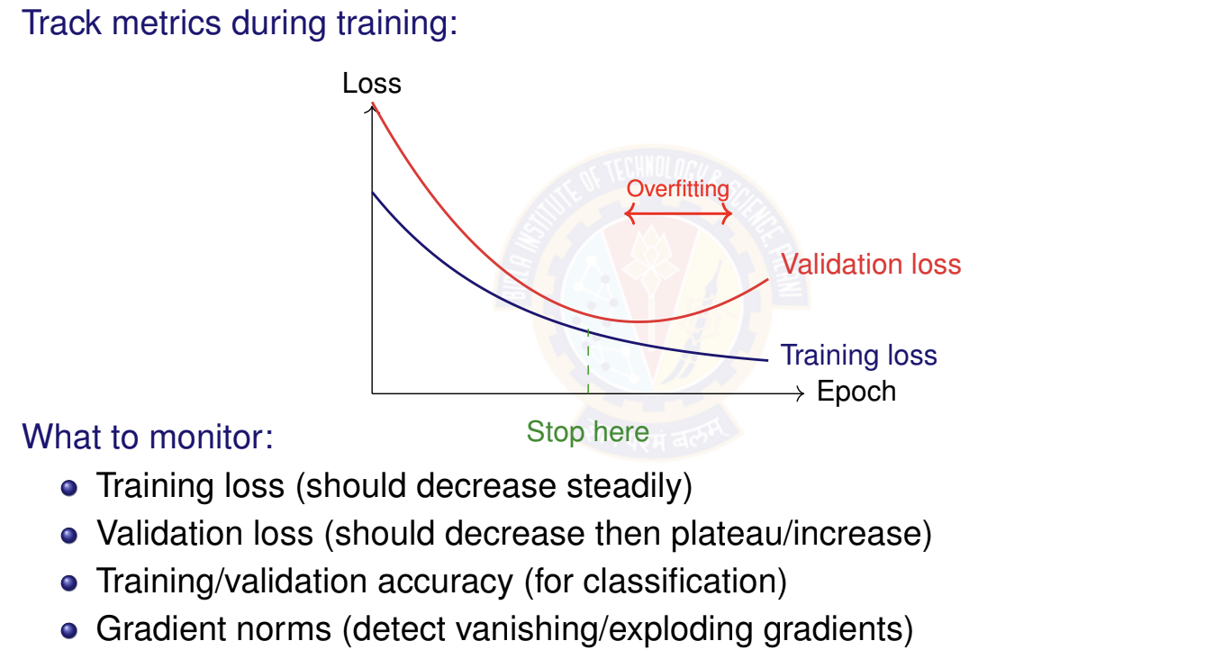
Monitoring Training Progress
Deep Learning

Slide 61
Diagnosing Training Issues
Symptom | Diagnosis | Solution
Loss = NaN/Inf | Numerical instability | Decrease η, check gradients, normalize inputs
Loss not decreas- ing | Learning rate too small OR bug | Increase η, verify gradient computation
Loss oscillating | Learning rate too large | Decrease η, use learning rate schedule
Training loss ↓, validation loss ↑ | Overfitting | Add regularization, dropout, more data
Both losses high | Underfitting | Increase capacity (wider/deeper), train longer
Slow convergence | Poor initialization OR bad features | Use proper init (He/Xavier), normalize features
Gradients → 0 | Vanishing gradients | Use ReLU, better init, batch normalization
Gradients → ∞ | Exploding gradients | Gradient clipping, decrease η
Deep Learning

Slide 62
Debugging Checklist
Before training:
Features normalized/standardized Data split into train/val/test
Output layer matches task (sigmoid for binary, softmax for multi-class) Loss function matches output activation
Weights initialized properly (not all zeros!)
During training:
Loss decreasing on training set Validation loss tracked separately Gradients neither vanishing nor exploding No NaN/Inf values in loss or activations Training accuracy improving
Sanity checks:
Try overfitting a small batch (should reach 0 loss) Verify shapes of all matrices/tensors
Test forward pass before adding backprop
Deep Learning

Slide 63
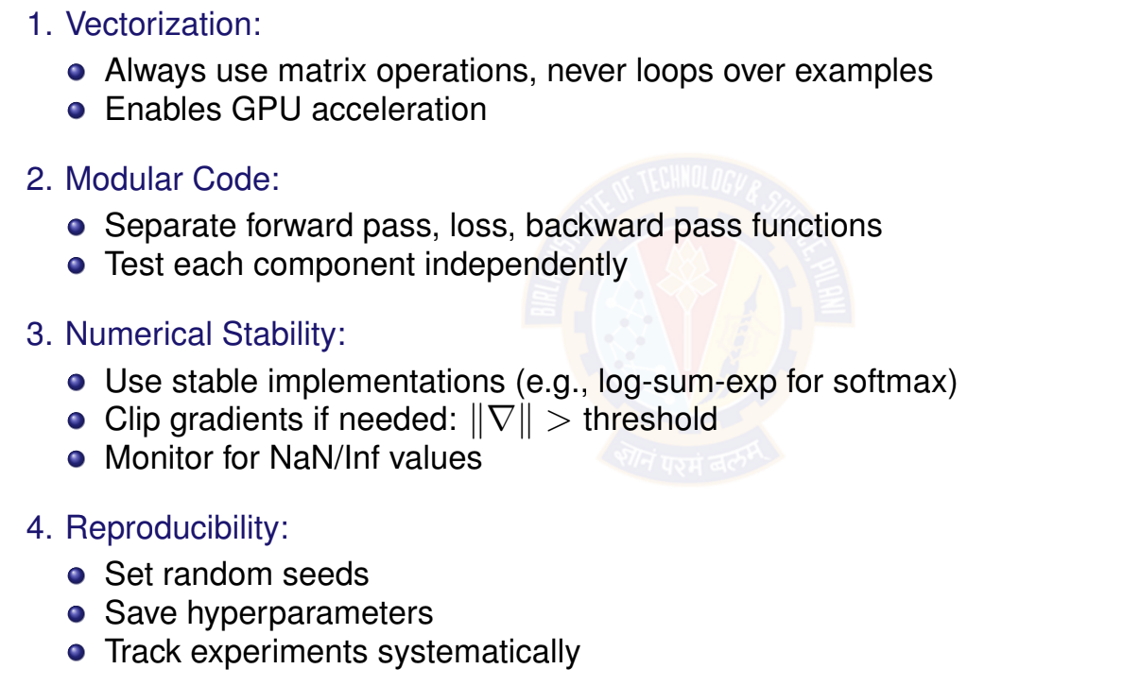
Implementation Best Practices
Deep Learning

Slide 64

Table of Contents
Motivation: The XOR Problem
Non-Linearity in Neural Networks
The Four Components of DFNN
Training DFNN
Making Predictions
Impact of Depth and Width
DFNN Architecture Design
Implementation Tips
Summary
1
2
3
4
5
6
7
8
9
Deep Learning

Slide 65
Key Takeaways
Non-linearity is essential for learning complex patterns; without it, deep networks collapse to linear models.
DFNN = stacked layers with non-linear activations, enabling hierarchical feature learning.
Four components: Data, Model (architecture), Objective (loss), Learning (backpropagation + SGD).
Backpropagation efficiently computes gradients using chain rule; enables training deep networks.
Depth enables learning hierarchical features and improves expressiveness. Width increases capacity within each layer but requires more data.
Proper initialization, normalization, and regularization are critical for successful training.
ReLU is the default activation for hidden layers; use task-specific activations for output.
Deep Learning

Slide 66
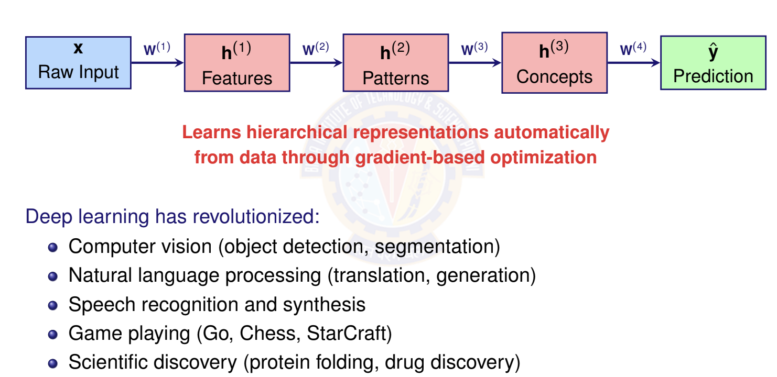
The Power of Deep Learning
Deep Learning

Slide 67
What Next?
Specialized Architectures:
Convolutional Neural Networks (CNNs): For images and spatial data Recurrent Neural Networks (RNNs): For sequences and time series Transformers: For attention-based models (GPT, BERT)
Graph Neural Networks: For graph-structured data
Advanced Topics:
Optimization algorithms (Adam, RMSprop, AdaGrad) Advanced regularization (Dropout, Batch Normalization) Transfer learning and pre-training
Model interpretability and explainability Efficient inference and model compression
DFNNs are the foundation - master them first!
Deep Learning
65 / 67

Slide 68
To become Proficient
Implement from scratch:
Write forward pass, backpropagation manually Verify with gradient checking
Train on simple datasets (XOR, MNIST)
Use frameworks effectively:
PyTorch, TensorFlow, JAX handle backprop automatically But understanding the math makes debugging easier Focus on architecture design and hyperparameter tuning
Experiment and iterate:
Start simple, gradually increase complexity Track experiments systematically
Learn from failures (most time spent debugging!)
Study successful architectures:
Read papers, examine code implementations Understand design choices and motivations
Deep Learning

Slide 69

References
Goodfellow et al. ”Deep Learning” - Chapter 6
http://www.deeplearningbook.org/
Zhang et al. ”Dive into Deep Learning” - Chapters 4, 5 https://d2l.ai/ Nielsen, M. ”Neural Networks and Deep Learning”
http://neuralnetworksanddeeplearning.com/
Deep Learning

