Slide 1
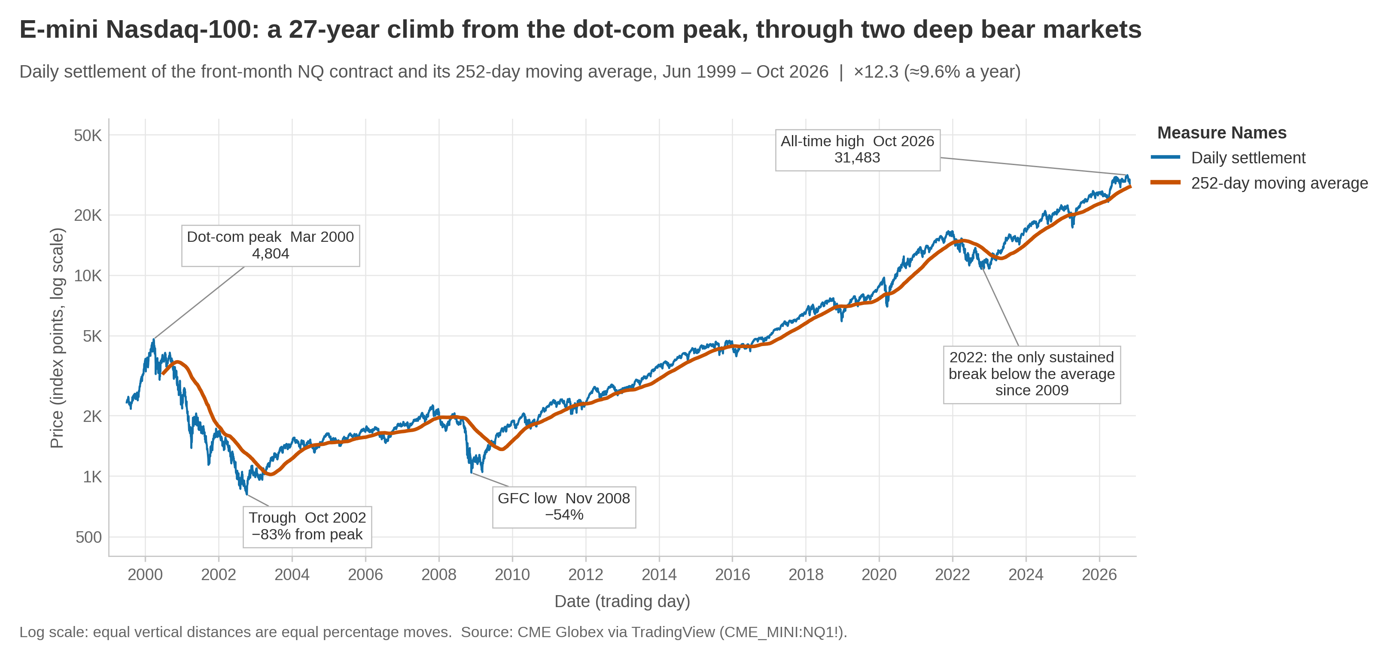
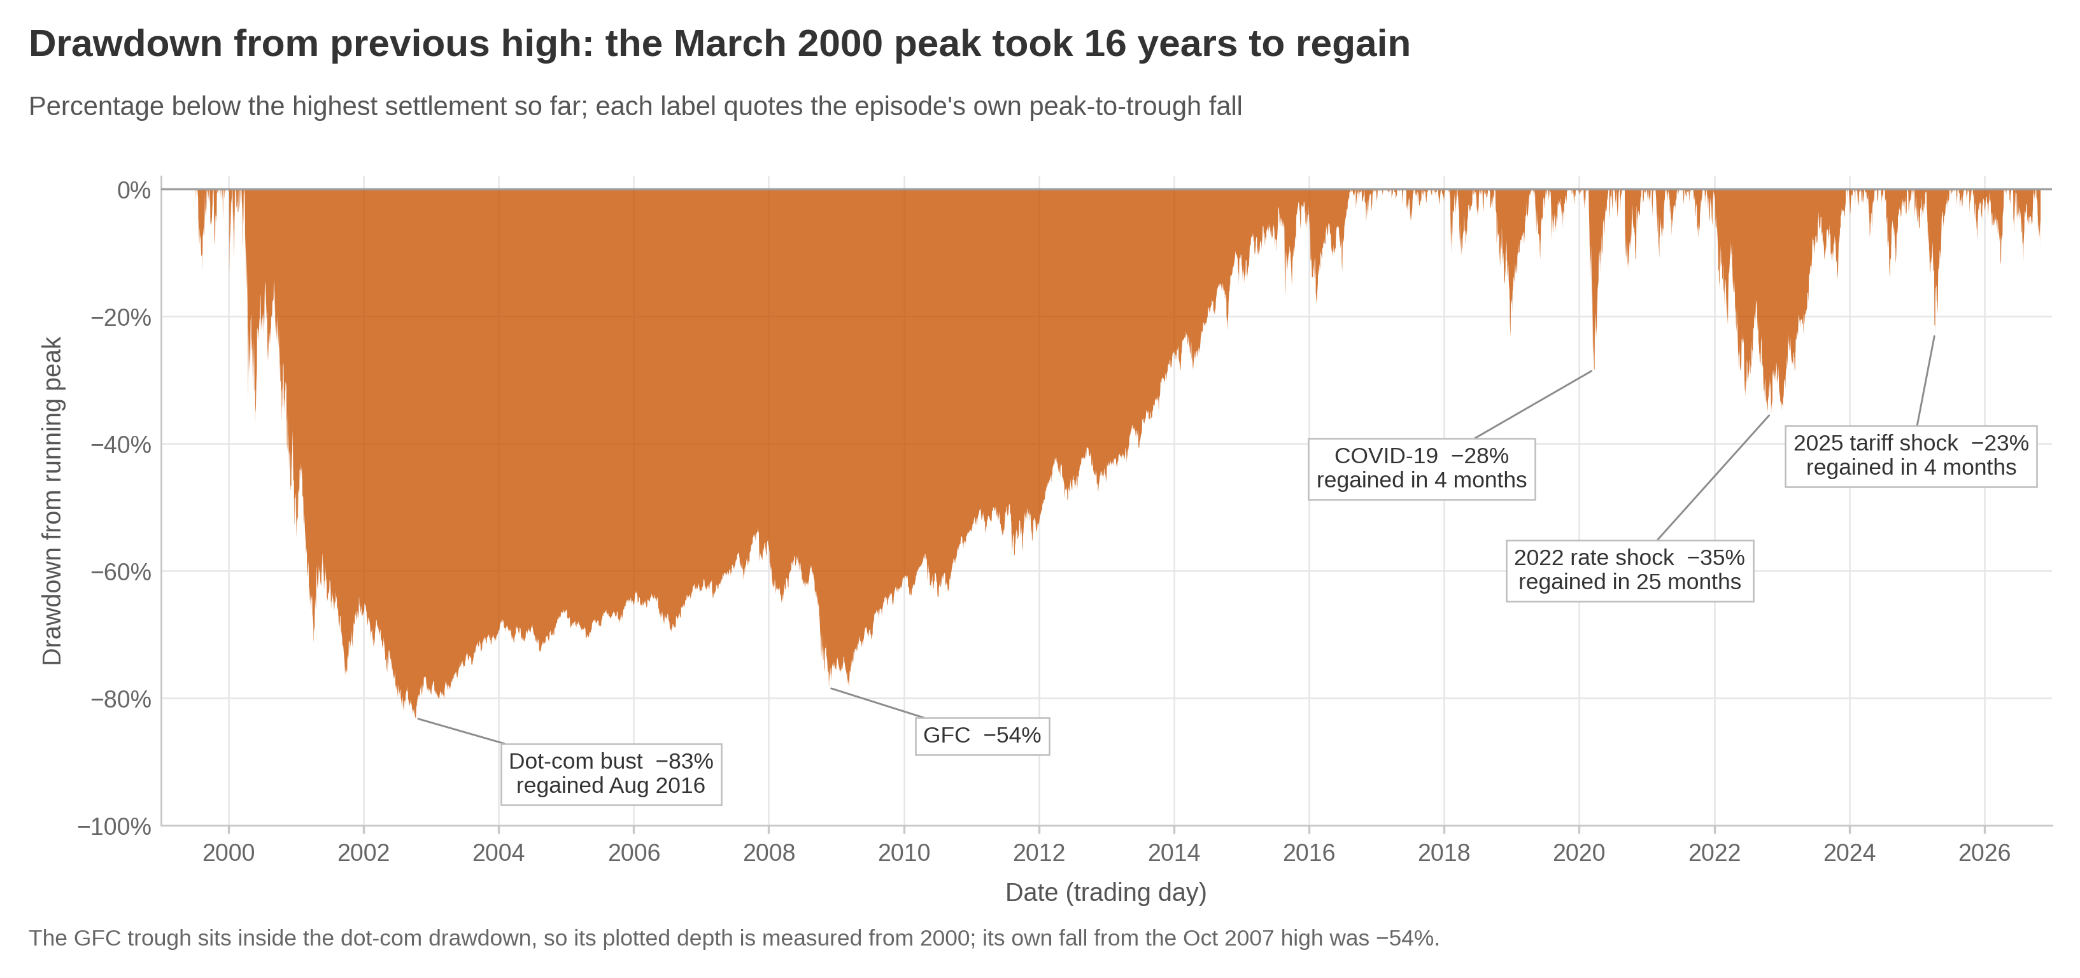
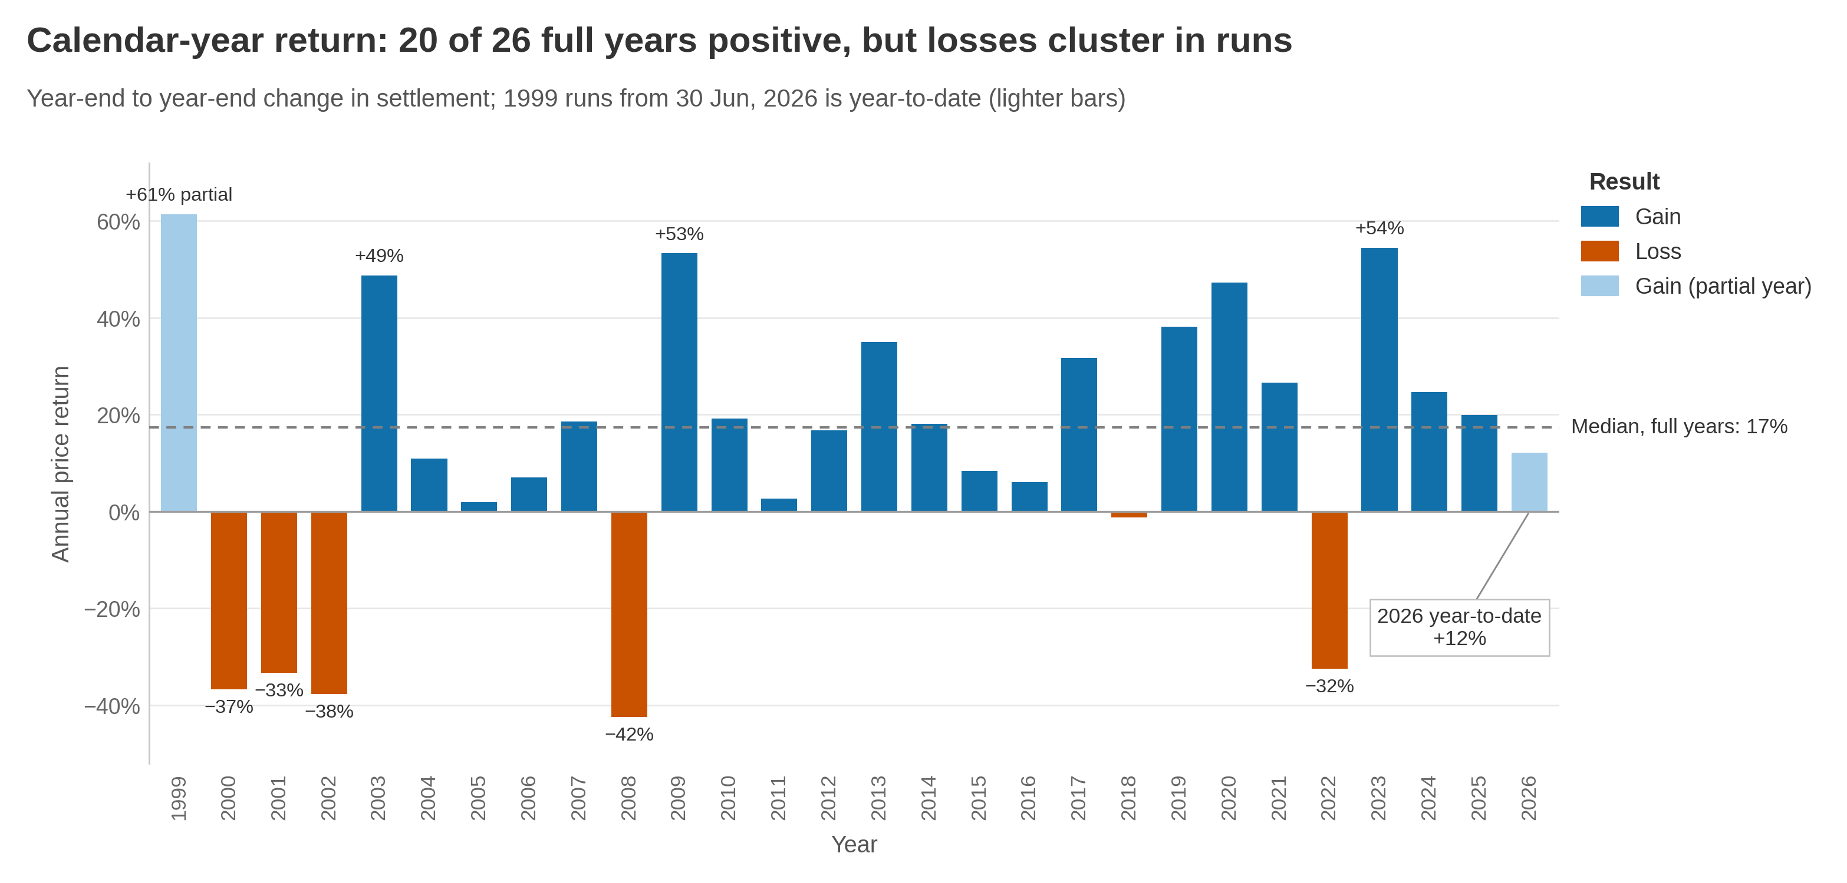
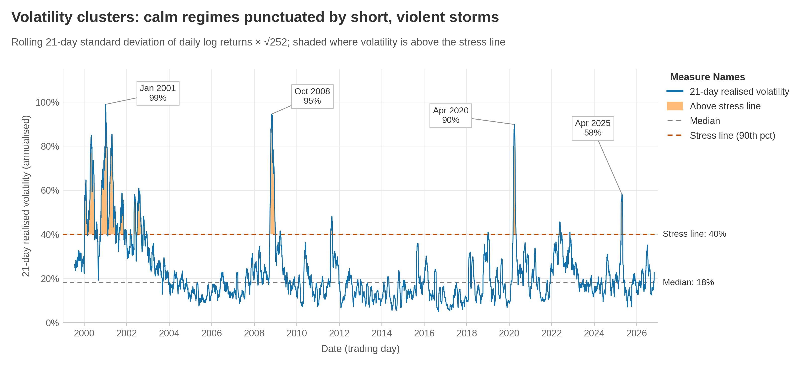
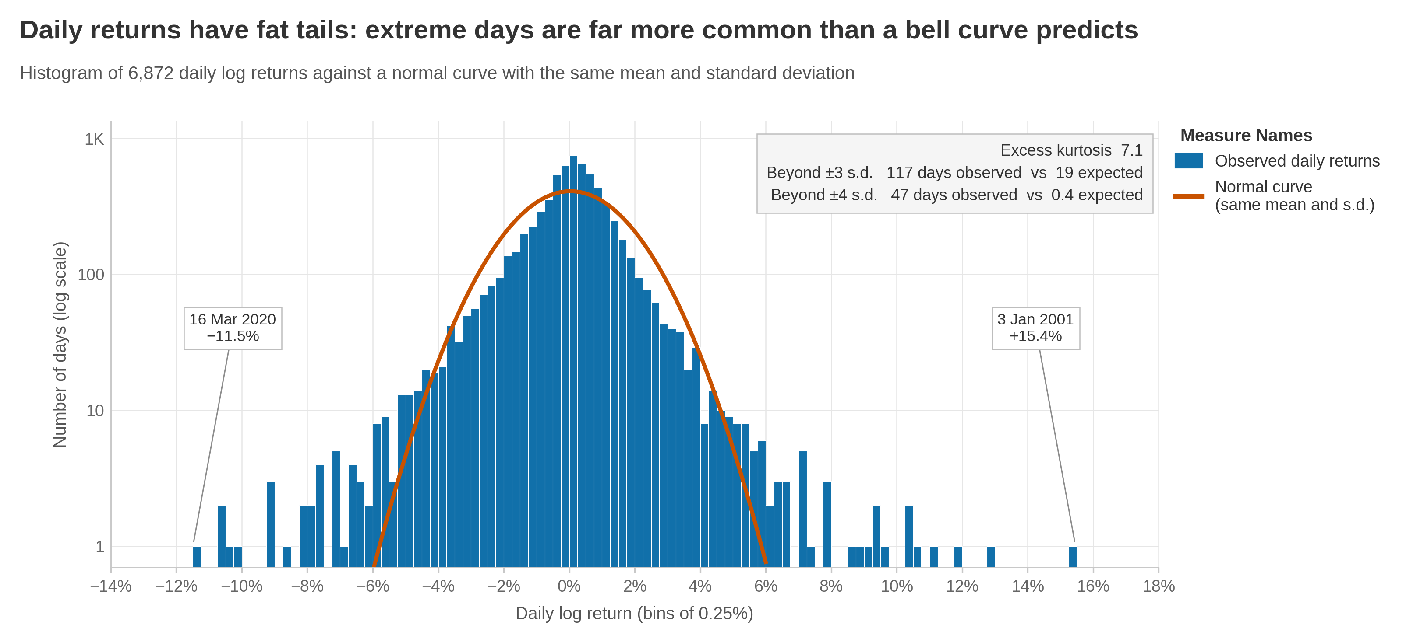
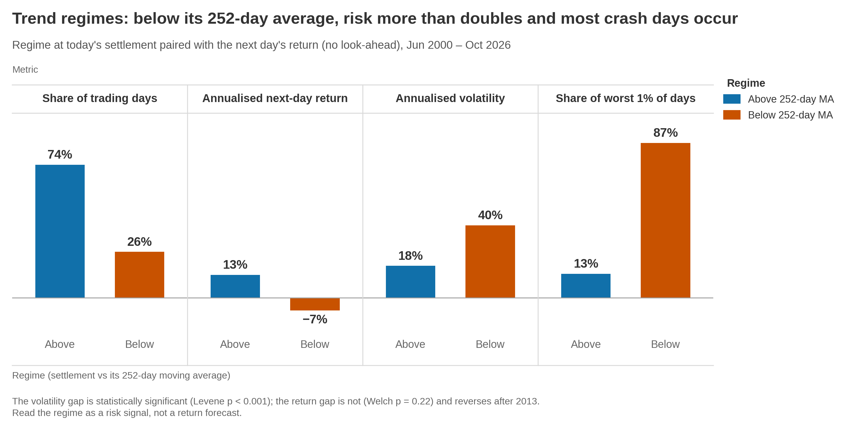
Trend, Volatility and Market States
in E-mini Nasdaq-100 Futures, 1999–2026
KEY MESSAGE
Twelvefold growth hid a 16-year loss, clustered storms and fat tails. A 252-day average flags changing risk, not future returns.
Santiago Cruz · Student ID 2584023 · 7CS079 Data Visualisation · University of Wolverhampton
1
Introduction
2
Data source and methodology
×12.3
−83%
The E-mini Nasdaq-100 future (NQ) is the most heavily traded derivative on the Nasdaq-100, the index behind the technology trackers many retail investors and pension savers hold (CME Group, n.d.; Nasdaq, 2024). Since 1999 its price has grown twelvefold, but long-run averages hide how unevenly that growth arrived. For a saver, what matters is not only how much the market grew, but how far, how long and how often it fell on the way.
Objective: use Tableau to show non-specialist investors and early-career traders what the averages hide.
O1 Trend RQ1 How deep and how long were the interruptions to the trend?
O2 Volatility RQ2 Is risk spread evenly over time and across days, as a bell curve assumes?
O3 Regimes RQ3 Does the 252-day average separate calm from turbulent markets?
Source: daily open, high, low and settlement prices of the continuous front-month contract CME_MINI:NQ1!, 30 Jun 1999 – 30 Oct 2026 (6,914 bars), exported from TradingView (2026), which redistributes CME Globex exchange data.
Why this dataset: 27 years of daily, exchange-sourced prices spanning four crises, on the instrument professionals use to trade Nasdaq-100 risk. ETF prices embed fees and dividends; generic Kaggle extracts lack clear provenance. Public prices only, so no personal-data issues. Chart choices follow Munzner (2014) and Tufte (2001): one axis per chart, direct labels and Tableau's colour-blind palette.
price growth since 1999
(9.6% a year)
worst fall (2000–02);
16 years to regain
1 Audit
Python
OHLC logic, 0.25-point tick grid and NYSE calendar checked
2 Clean
Python
38 holiday sessions and 1 bad print removed: 6,875 sessions
3 Visualise
Tableau
LOOKUP, RUNNING_MAX and WINDOW_STDEV fields; bins; reference lines
4 Test
Statistics
Welch t, Levene, bootstrap; four averages, two sub-periods
117 vs 19
2.3×
3-sigma days in 27 years:
actual vs bell curve
volatility below vs above
the 252-day average
3
Key visualisations and results
Six Tableau worksheets, tagged by objective: ■ O1 Trend ■ O2 Volatility ■ O3 Regimes
V1 · O1 Trend Log scale, so equal heights are equal percentage moves. The March 2000 peak of 4,804 fell 83% and was not regained until August 2016. Since 2009 the climb has been steeper, with 2022 the only sustained break below the 252-day average.
V2 · O1 Trend Drawdown shows what a holder lived through: the distance below the last peak. The dot-com and GFC losses ran together for 16 years, while COVID (−28%) and the 2025 tariff shock (−23%) recovered within 4 months and 2022 (−35%) in about two years.
V3 · O1 Trend 20 of 26 full years rose, with a median gain of 17%, but losses cluster: 2000–02 fell three years running. The two other large losses, 2008 (−42%) and 2022 (−32%), were each followed by a rebound above 50%.
V4 · O2 Volatility Volatility sits near its 18% median for years, then storms of 58–99% erupt. Storms persist: in one, there is a 65% chance of still being in one a month later (base rate 10%). Volatility also rises as prices fall (correlation −0.35).
V5 · O2 Volatility A bell curve with the same mean and spread predicts 19 three-sigma days in 27 years; the market produced 117, plus 47 four-sigma days where fewer than one is expected. Excess kurtosis is 7.1 and normality is rejected (Jarque-Bera p < 0.001).
V6 · O3 Regimes Below its 252-day average the contract spent only 26% of days, yet volatility more than doubled (40% vs 18%) and 87% of the worst 1% of days occurred. The return gap is not significant (Welch p = 0.22) and reverses after 2013.
4
Discussion and interpretation
5
Conclusion
References
O1 Trend Entry date mattered as much as holding period: a March 2000 buyer waited 16 years to break even, while a 2009 buyer gained more than tenfold. A long-run growth rate is a poor guide to any one investor's experience.
O2 Volatility Clustering and fat tails reproduce the stylised facts of returns (Mandelbrot, 1963; Cont, 2001). They are not an artefact of noisy early data: excess kurtosis is higher after 2003 (8.1).
O3 Regimes The 252-day line separates risk states for every average length (50–252 days) and in both sub-periods, but not returns, and the price crossed it 140 times with a median spell of five days. This fits the Adaptive Markets view (Lo, 2004) better than a trading rule.
So what? For non-specialists, an investment should be judged by its drawdowns and storms as well as its average return. Because these are in-sample results for one contract, they describe past risk rather than forecast it.
NQ's long-run growth was real but unrepresentative: it came with deep, clustered and fat-tailed risk.
RQ1: deep and uneven: −83% over 16 years, then 23–35% shocks that recovered within months to two years.
RQ2: no. Risk clusters in storms and has fat tails.
RQ3: yes for risk, no for returns.
Recommendations: show drawdown and volatility beside price on investor dashboards; never size positions or margin with a bell curve; read the 252-day line as a risk thermometer, not a signal.
Limitations and future work: bubble-peak start, unadjusted contract rolls, in-sample tests; next, GARCH and regime-switching models and a public Tableau dashboard.
CME Group (n.d.) E-mini Nasdaq-100 futures contract specs. cmegroup.com (Accessed: 31 Oct 2026).
Cont, R. (2001) Quantitative Finance, 1(2), pp. 223–236.
Lo, A.W. (2004) Journal of Portfolio Management, 30(5), pp. 15–29.
Mandelbrot, B. (1963) Journal of Business, 36(4), pp. 394–419.
Munzner, T. (2014) Visualization Analysis and Design. CRC Press.
Nasdaq (2024) Nasdaq-100 Index Methodology. Nasdaq, Inc.
TradingView (2026) CME_MINI:NQ1! daily data. tradingview.com (Accessed: 31 Oct 2026).
Tufte, E.R. (2001) The Visual Display of Quantitative Information. Graphics Press.
Notes:
A1 portrait poster (594 x 841 mm). Charts are the Tableau-style exports in poster_visuals_v2/; to swap in a direct Tableau export, right-click a chart > Change Picture > From a File (export at a similar aspect ratio, about 2.1:1). Before submitting: File > Export > PDF and confirm the page is 594 x 841 mm.

