Slide 1
Supplier Non-Compliance
Risk Prediction
AI Data Scientist Case Study — Qualifyze
Santiago Dominguez | July 2026

Slide 2
The Problem
Qualifyze evaluates suppliers for pharma/device companies
FDA inspects facilities → classifies as NAI (ok) / VAI (minor) / OAI (serious)
OAI = enforcement actions, warning letters, recalls
Only ~5% of inspections result in OAI — rare but very costly
GOAL: Predict which suppliers will get OAI before it happens
→ Enable proactive risk management instead of reactive response

Slide 3
Data & Processing

Slide 4
Data Sources (all public FDA)
Inspection Classifications 337K records NAI/VAI/OAI per facility
Citations (483 observations) 277K records Specific CFR violations
Warning Letters 3,608 records Formal enforcement notices
Enforcement / Recalls 57K records Product recalls by severity
Published Form 483s 1,973 records Detailed inspection reports
All linked via FEI Number (facility ID)
Warning letters + enforcement: fuzzy name matching (TF-IDF + location)
Coverage: WL 55% matched, Enforcement 82% matched. Remaining are online pharmacies with no inspection history.

Slide 5
Feature Engineering
Unit of analysis: one row per inspection
All features from PRIOR history only (no data leakage)
INSPECTION HISTORY n_prior_oai, n_prior_nai, trend, recency
CITATIONS total count, unique CFR codes, max in single inspection
WARNING LETTERS count, days since last (via entity matching)
ENFORCEMENT recall count, Class I count
483s count of published forms
CONTEXT product type, country, project area
22 features total | Temporal split: train < 2025, test ≥ 2025

Slide 6
Modeling

Slide 7
Approach & Decisions
Baseline: Logistic Regression (fully interpretable)
Main: XGBoost with class weighting (scale_pos_weight = 20)
Tuning: RandomizedSearchCV, 30 iterations, PR-AUC, TimeSeriesSplit
KEY DECISIONS:
• No SMOTE — 7,200 positives is enough; class weights suffice
• Removed last_classification_oai — model improved without it
(was overfitting to a trivial pattern; other features encode same info)
• Threshold optimized for recall (asymmetric cost in supply chain risk)

Slide 8
Model Performance
ROC-AUC
PR-AUC
Recall@80%
0.875
0.376
80%
Discrimination ability
7x better than random
Catches 4/5 OAIs
Model ROC-AUC PR-AUC
────────────────────────────────────────────────
Logistic Regression 0.739 0.254
XGBoost (weighted) 0.875 0.376 ← final
XGBoost (tuned) 0.870 0.358

Slide 9
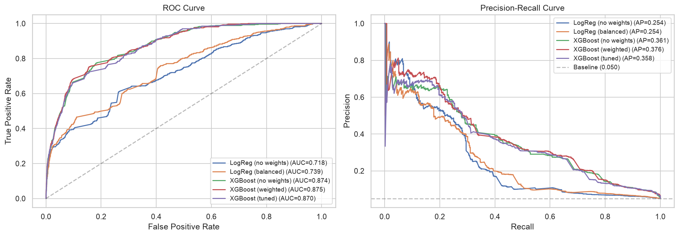
ROC & Precision-Recall Curves

Slide 10
Threshold: Business-Driven Choice
The model outputs a probability → we choose where to cut
FALSE POSITIVE (flag safe supplier) → analyst reviews it, low cost
FALSE NEGATIVE (miss risky supplier) → client gets enforcement action, high cost
Recall 80% | Precision 14% | ~6 false alarms per true alert
This is a SCREENING tool — flags for human review, not auto-reject
Threshold is configurable per client's review capacity

Slide 11
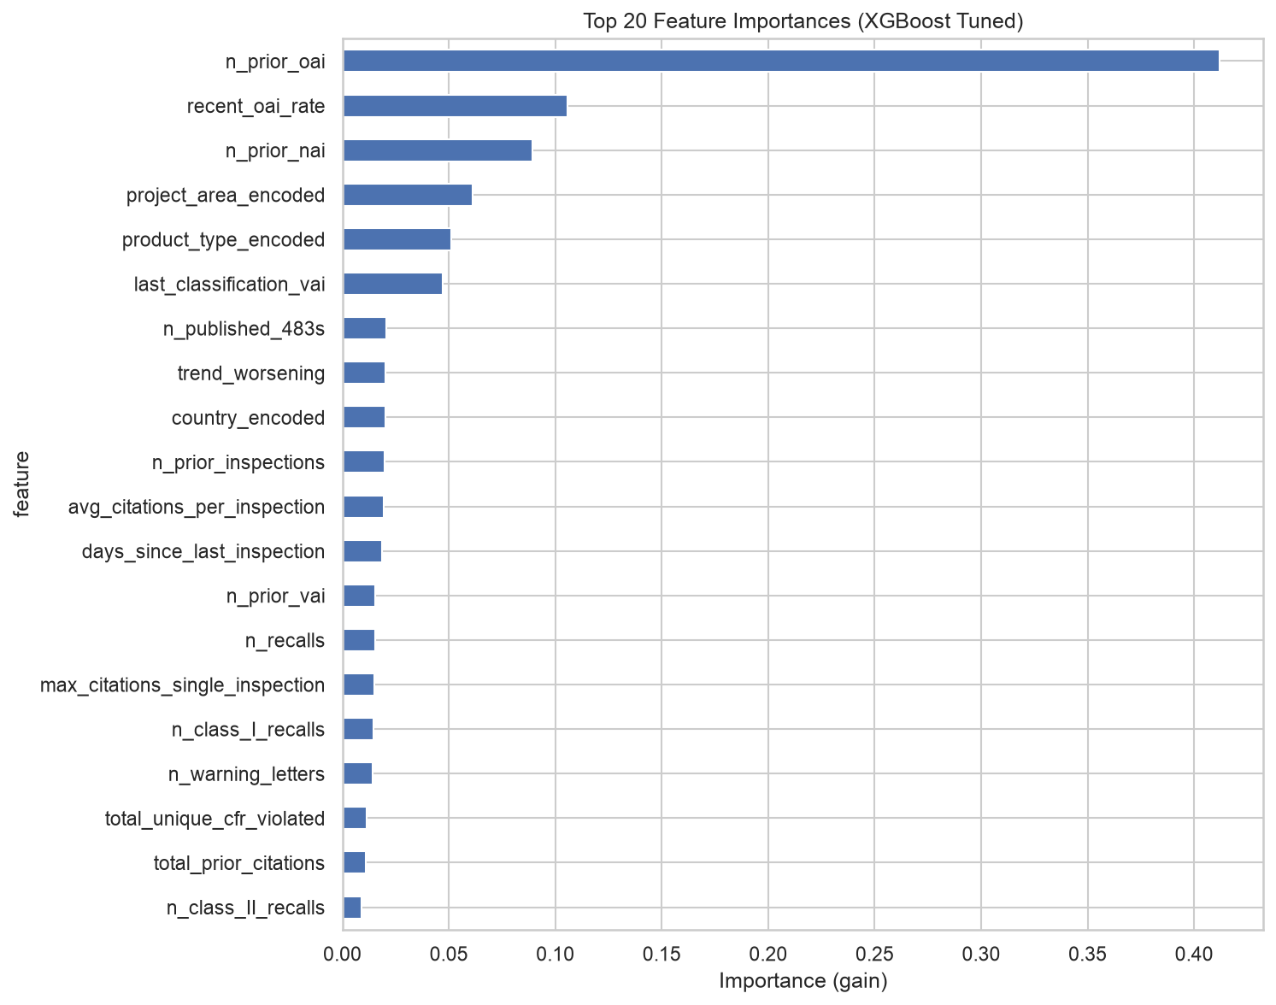
What Drives Risk? (Feature Importance)
n_prior_oai (41%) + recent_oai_rate (11%) + n_prior_nai (9%) — distributed, robust signal

Slide 12
Interpretability

Slide 13
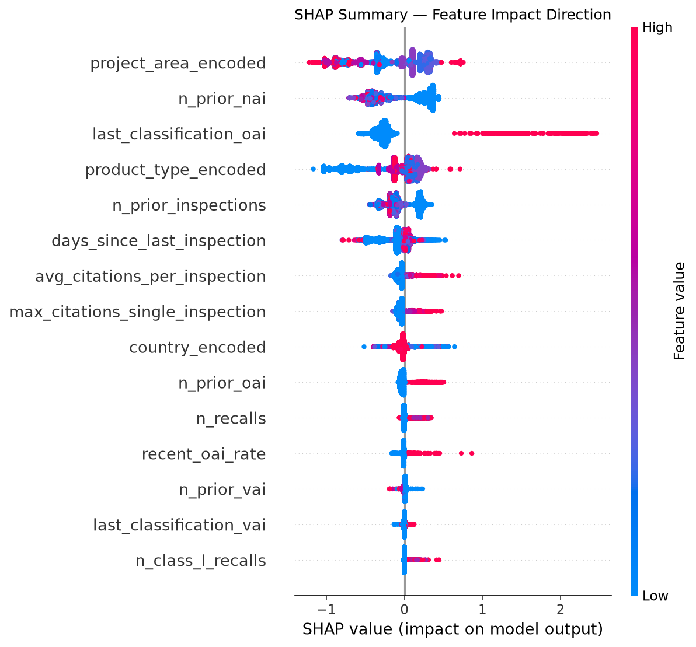
SHAP — Every Prediction is Explainable
Each dot = one inspection. Color = feature value (red=high). Position = impact on risk.

Slide 14
Supplier Risk Report (Production Output)
FACILITY: Acme Pharma (FEI: 3007058211)
RISK SCORE: 95.2% — CRITICAL
Risk Drivers:
↑ 2 prior OAI inspections (+25%)
↑ Recent OAI rate = 1.0 (+15%)
↑ 0 clean (NAI) inspections (+10%)
↑ Veterinary / high-risk sector (+5%)
Every prediction has a human-readable explanation
Full audit trail for regulatory compliance

Slide 15
Production & MLOps

Slide 16
Deployed System
LIVE APP: Streamlit on Azure App Service
→ Enter FEI → get risk score + SHAP explanation
→ qualifyze-risk-xxx.azurewebsites.net
CI/CD: GitHub Actions
→ PR → pytest → merge → tests pass → auto-deploy to Azure
→ Branch protection on main
ORCHESTRATION: Airflow (4 DAGs, local demo)
→ Weekly data refresh, feature pipeline, monthly retrain, batch scoring
→ Champion/challenger model promotion pattern
MONITORING: drift detection on score distribution (proposed)

Slide 17
Limitations & Next Steps
LIMITATIONS:
• Cannot predict first-time offenders (no prior history)
• FDA inspection database is not comprehensive
• Entity matching has noise for ~45% of warning letters
• ROC-AUC 0.87 is likely the ceiling with public data alone
HIGHEST-VALUE NEXT STEPS:
1. Integrate Qualifyze private audit data (biggest lift for first-offenders)
2. NLP on citation text (severity categorization beyond CFR codes)
3. Survival analysis (time-to-next-OAI, not just binary)
4. Active learning from analyst feedback on flagged suppliers

Slide 18
Thank You
Questions & Discussion
github.com/santiago-dc/qualifyze-case-study

