Slide 1

React & React Native
Fundamentals
Notes:
This is a workshop on the fundamentals of React.
No past experience with or knowledge of React is assumed, and we will go from the very bottom, from an empty HTML page, to building a modern app in a fully outfitted dev environment. The reason we'll be able to cover so much ground is that React is very simple. Its simplicity is why it's so brilliant.
(show of hands how many have worked with React, how many have worked with Angular, jQuery, or vanilla JS)

Slide 2
Overview
No experience with react is assumed
My goal is for you to understand how everything works, so please ask questions anytime
Bootcamp divided into 2 parts:
Part 1: React Fundamentals (can follow along in either web or native)
Part 2: React Native APIs

Slide 3
Part 1: Topics
What is React? - What is it for? - How does it work? - React vs React Native
Syntax and core constructs - Rendering and updating (no compilers) - Components & JSX
General design principles - State management and updating - The Redux philosophy
Development tools (native and/or web)
Working with remote data

Slide 4
What is React?
Abstract Declarative UI Library
Benefits
Portability
Efficient updating
Accessing native resources is expensive, use in-memory representation and take deltas
Enforces a state management pattern that is simple and scalable
Benefits
Efficient updating
Only run reconciliation algorithm when relevant state has changed
Scalable pattern
Notes:
React exists to abstract, simplify, and optimize the process of updating the views of your application. That's it.

Slide 5
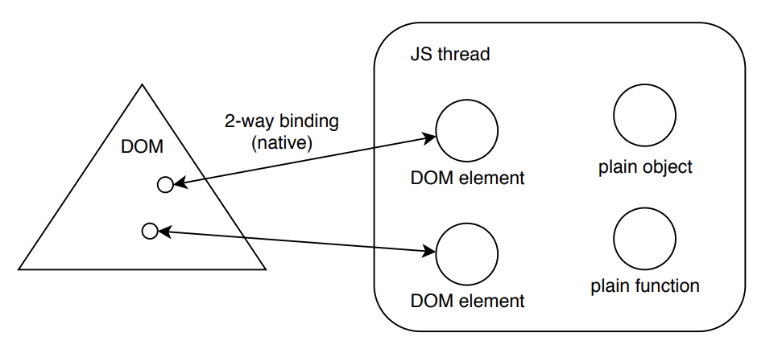
Freeform DOM manipulation
Notes:
React exists to abstract, simplify, and optimize the process of updating the views of your application. That's it.

Slide 6
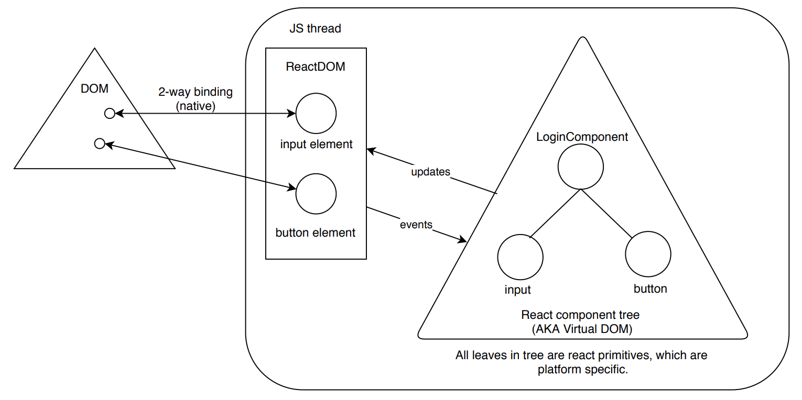
React web app
Notes:
React exists to abstract, simplify, and optimize the process of updating the views of your application. That's it.

Slide 7
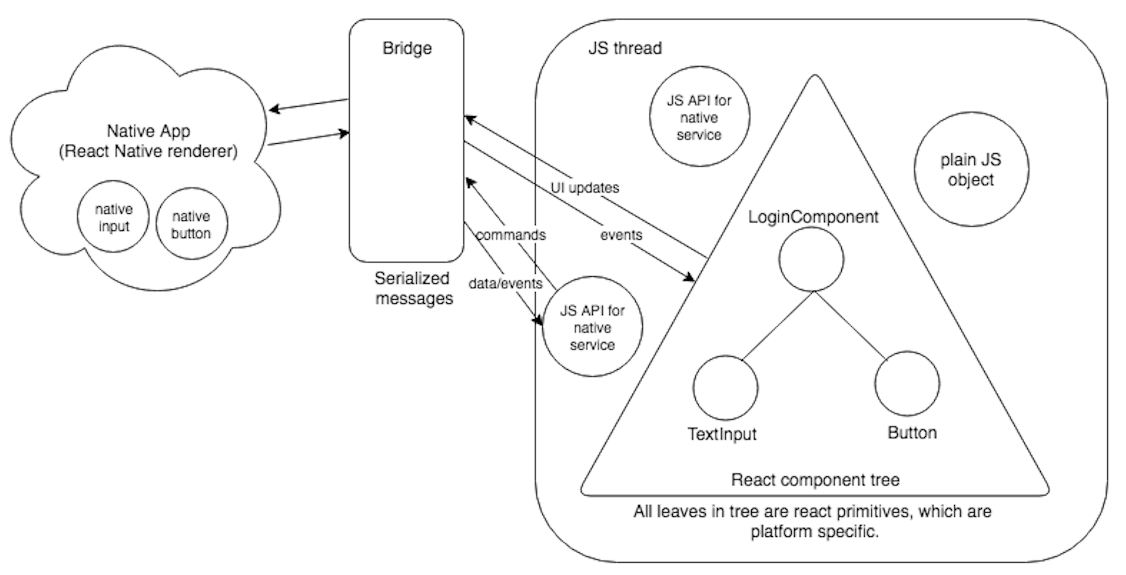
React native app
Notes:
React exists to abstract, simplify, and optimize the process of updating the views of your application. That's it.

Slide 8
State management non-strategies
Keep all state in native primitives
Slow updates
Updating more than necessary
Have to interact with native APIs to perform business logic
Maintain state in memory freeform, update native primitives directly when necessary
getElementById() / jQuery / getViewById()
Too much code
Complicated, not scalable
Notes:
React exists to abstract, simplify, and optimize the process of updating the views of your application. That's it.

Slide 9
Component pattern
Each component only knows about its internal state and its direct children
Components output abstract view representation of its current state upon request
You can remember the last abstract state of a component and compute the delta
Update native primitives by providing this abstract representation to a renderer
Notes:
React exists to abstract, simplify, and optimize the process of updating the views of your application. That's it.

Slide 10
Updating strategies
Manual flush
Responsibility on dev
Examples: Templating libraries, D3.js
Angular
Every time anything happens, check everything for deltas
Allows for freeform state representation within component
React
Keep all state in single plain object
Only update that object by calling a function provided by React which updates the object as requested, and then rerenders that component and its children
Notes:
React exists to abstract, simplify, and optimize the process of updating the views of your application. That's it.

Slide 11
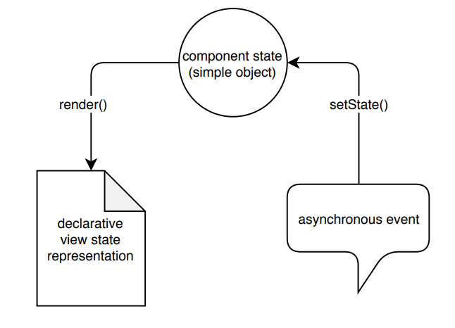
React.Component internal state management
Notes:
React exists to abstract, simplify, and optimize the process of updating the views of your application. That's it.

Slide 12
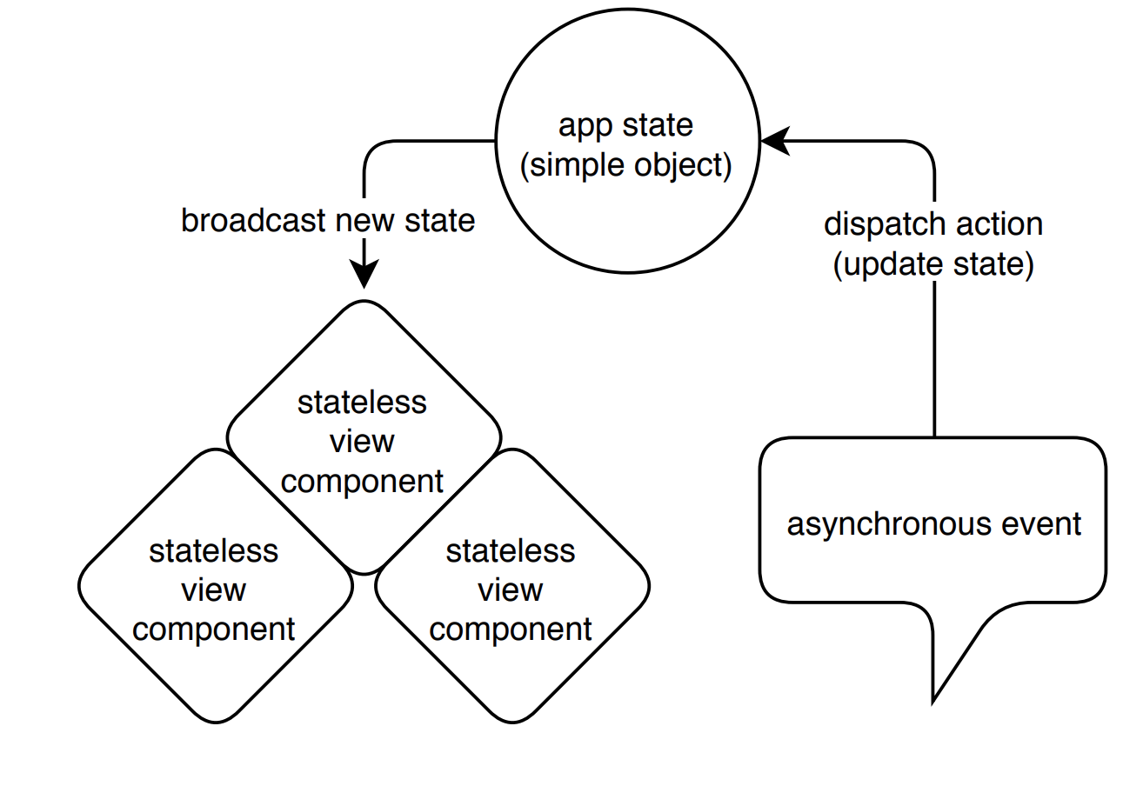
Redux application state management
Notes:
React exists to abstract, simplify, and optimize the process of updating the views of your application. That's it.

Slide 13
coding session #1
react-native-fun/1_bare-bones
Notes:
This is an easy and guided coding session.
It's ok if you just want to watch, and ask questions.
Bring up the chrome devtools extension during this demo.

Slide 14
coding session #2
react-native-fun/2_simple-app
Notes:
This is an easy and guided coding session.
It's ok if you just want to watch, and ask questions.
Bring up the chrome devtools extension during this demo.

