Slide 1

FINAL PROJECT CAPSTONE Car Accident Severity A case for New York city

Slide 2
Introduction
The effective treatment of road accidents and thus the enhancement of road safety is a major concern to societies due to the losses in human lives and the economic and social costs. Tremendous efforts have been dedicated by transportation researchers and practitioners to improve road safety. In European Union there has been a consistent reduction in fatalities. In 1991, 76,230 fatalities were recorded in EU, whilst in 2013 the total number of fatalities was 25,938 (CARE, 2015). Greece faces the same significant reduction in fatalities as well. When the type of vehicle.

Slide 3
Data Understanding
ID: This is a unique identifier of the accident record.
Severity: Shows the severity of the accident, a number between 1 and 4, where 1 indicates the least impact on traffic (i.e., short delay as a result of the accident) and 4 indicates a significant impact on traffic (i.e., long delay).
Start_time: Shows start time of the accident in local time zone.
End_time: Shows end time of the accident in local time zone. End time here refers to when the impact of accident on traffic flow was dismissed.
Temperature(F): Shows the temperature (in Fahrenheit).
Humidity (%): Shows the humidity (in percentage).
Pressure(in): Shows the air pressure (in inches).
Weather_Condition: Shows the weather condition (rain, snow, thunderstorm, fog, etc.)
.

Slide 4
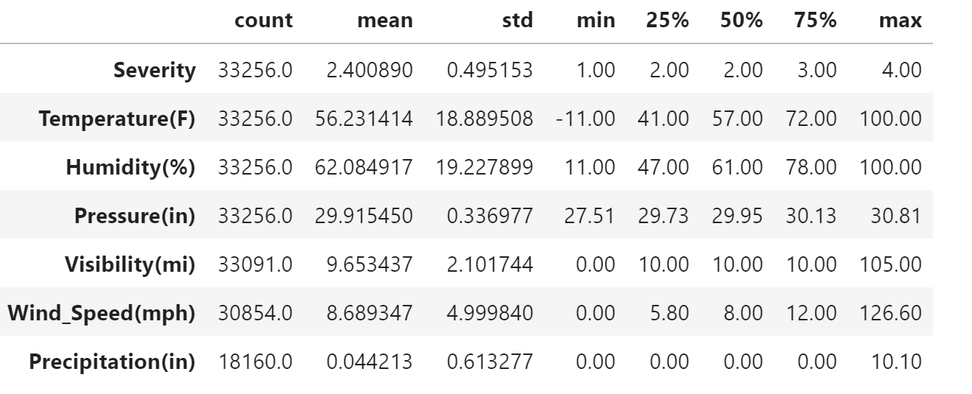
Data Preparation

Slide 5
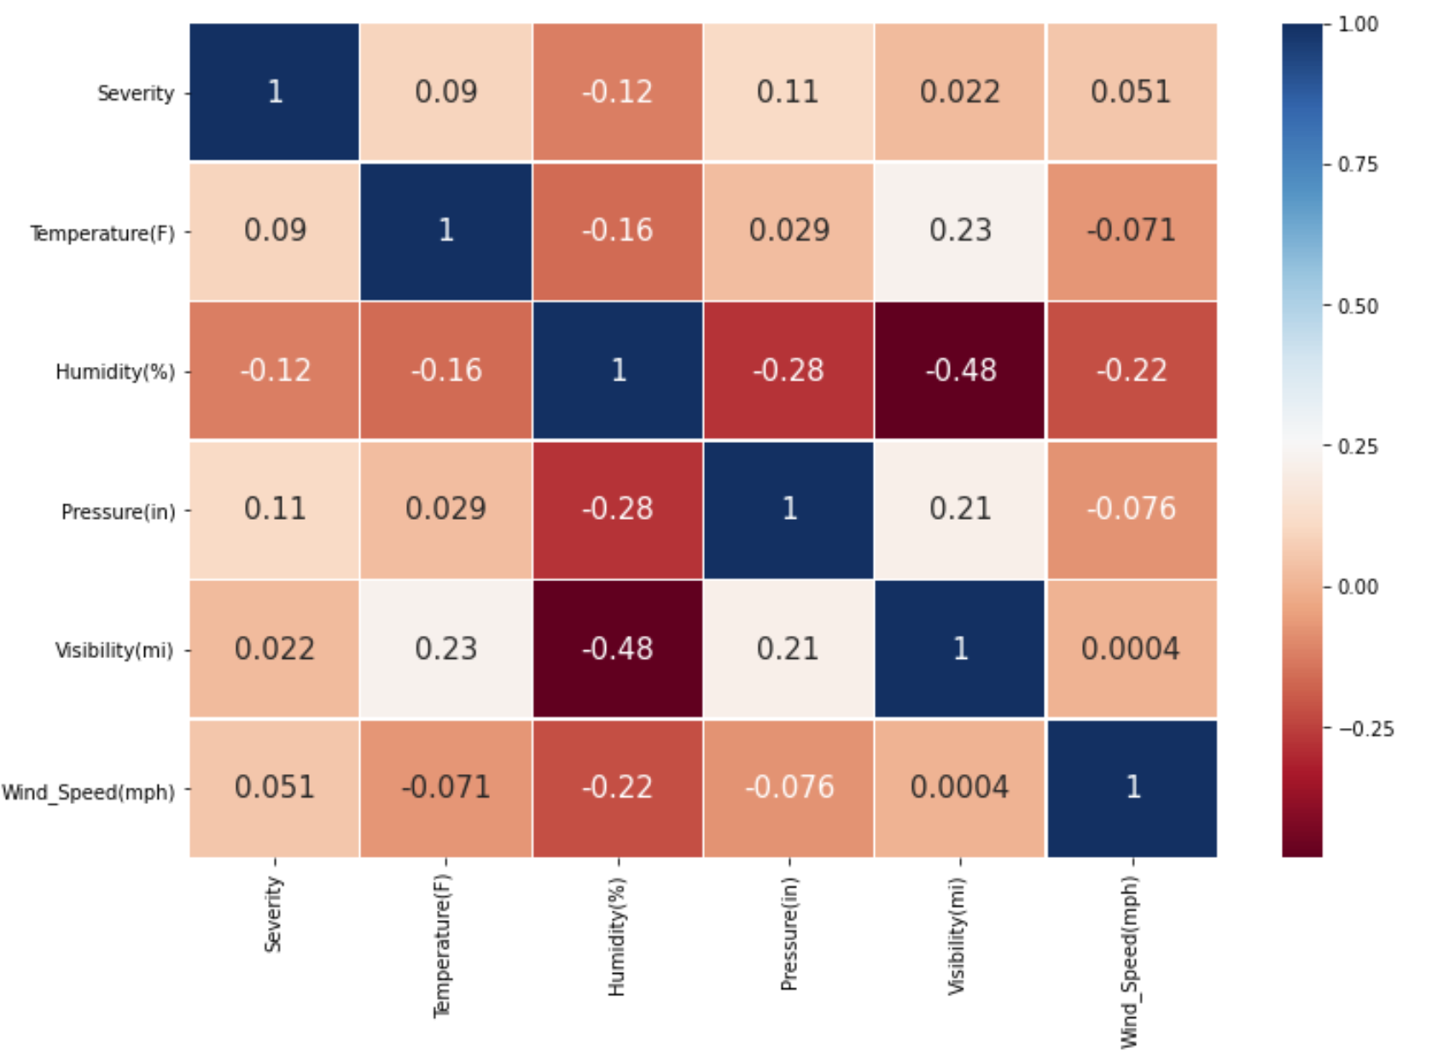
Exploratory Data Analysis

Slide 6
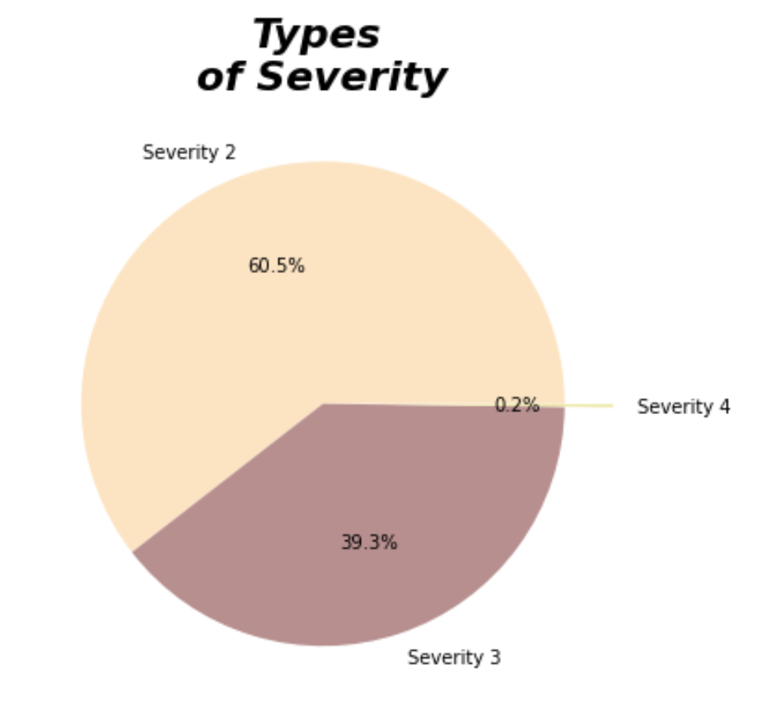

Slide 7
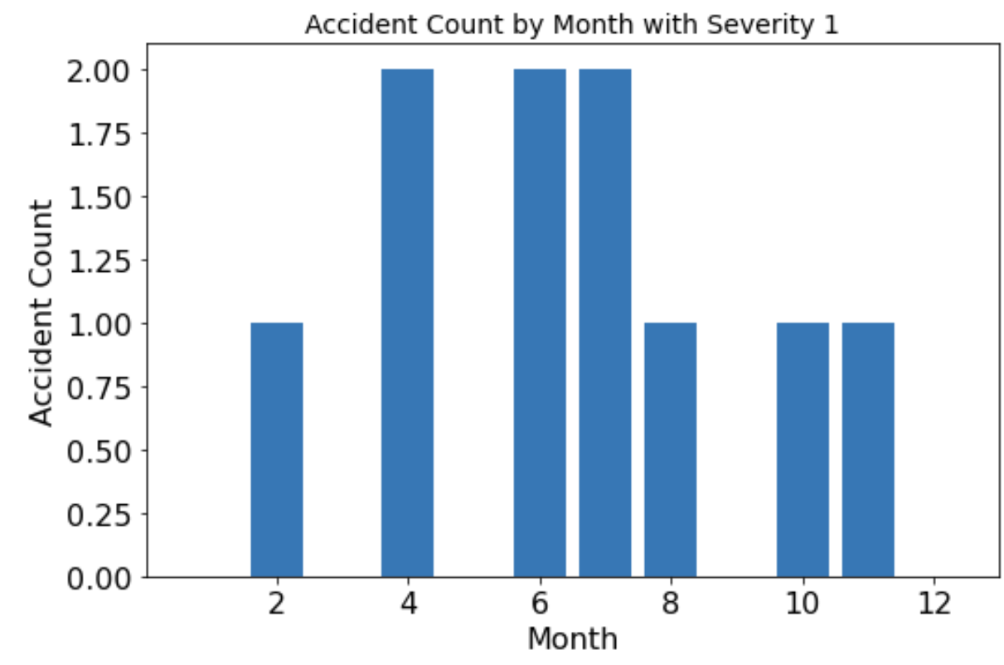
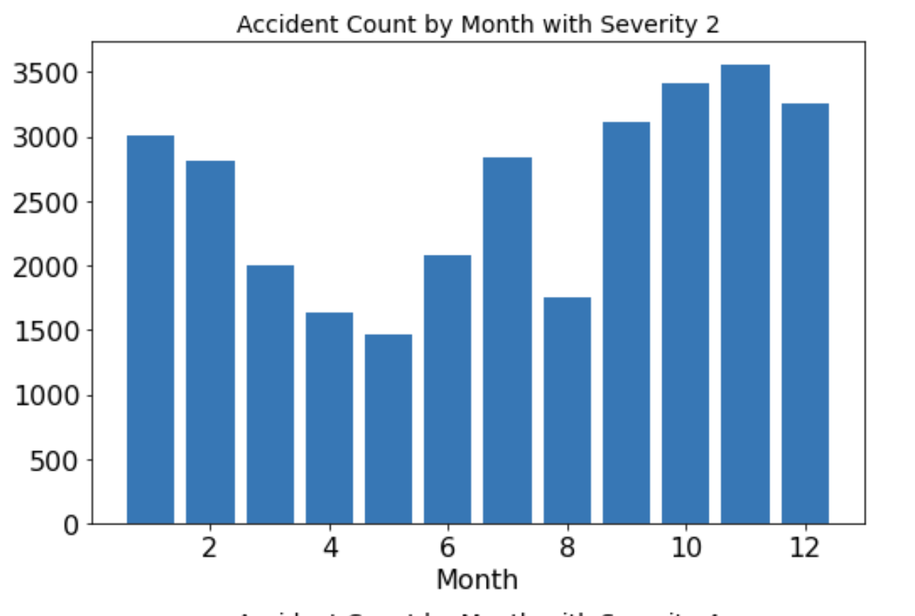
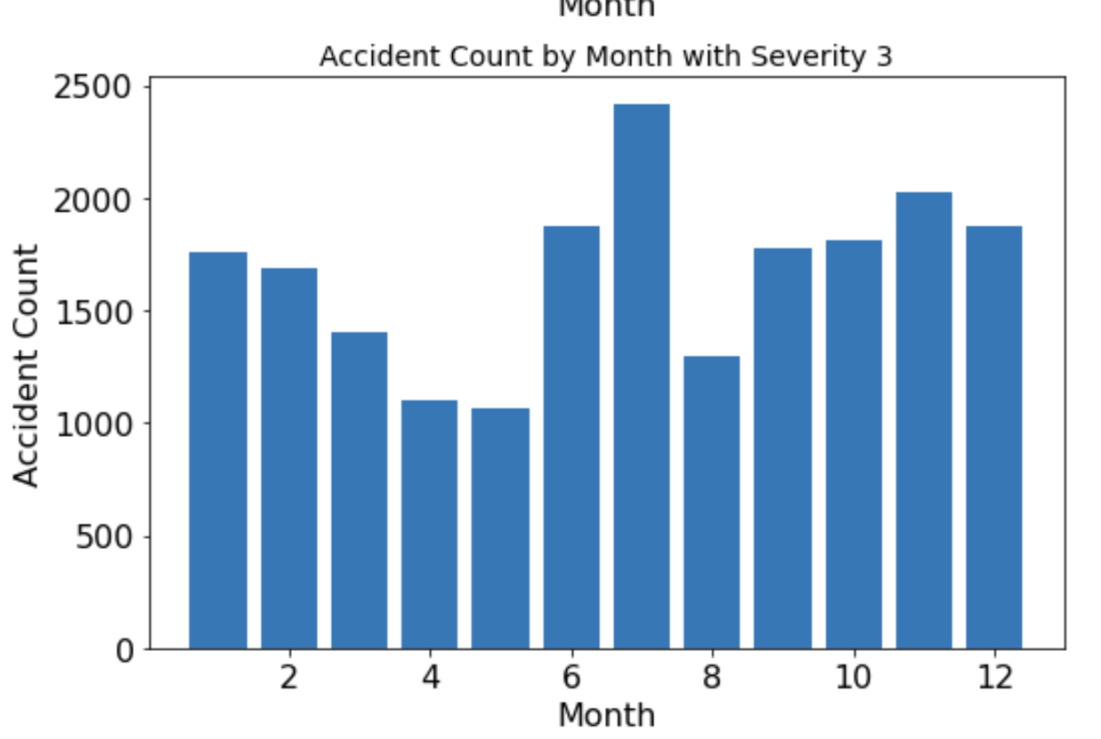
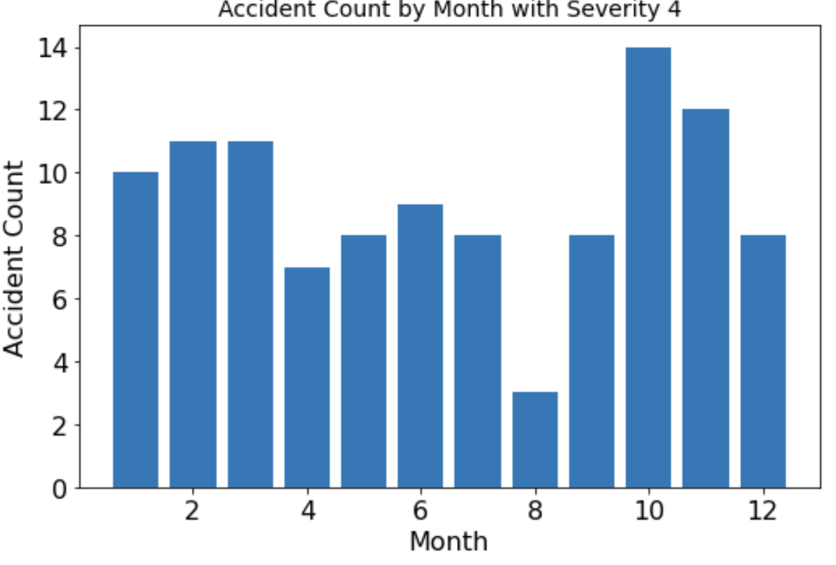

Slide 8
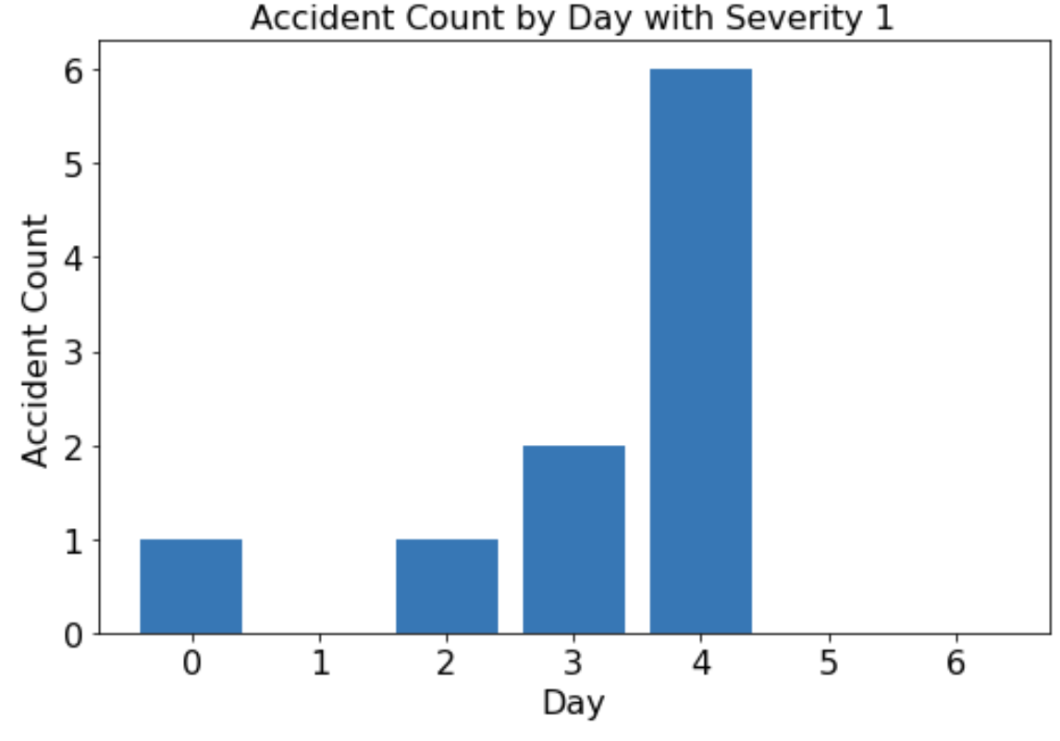
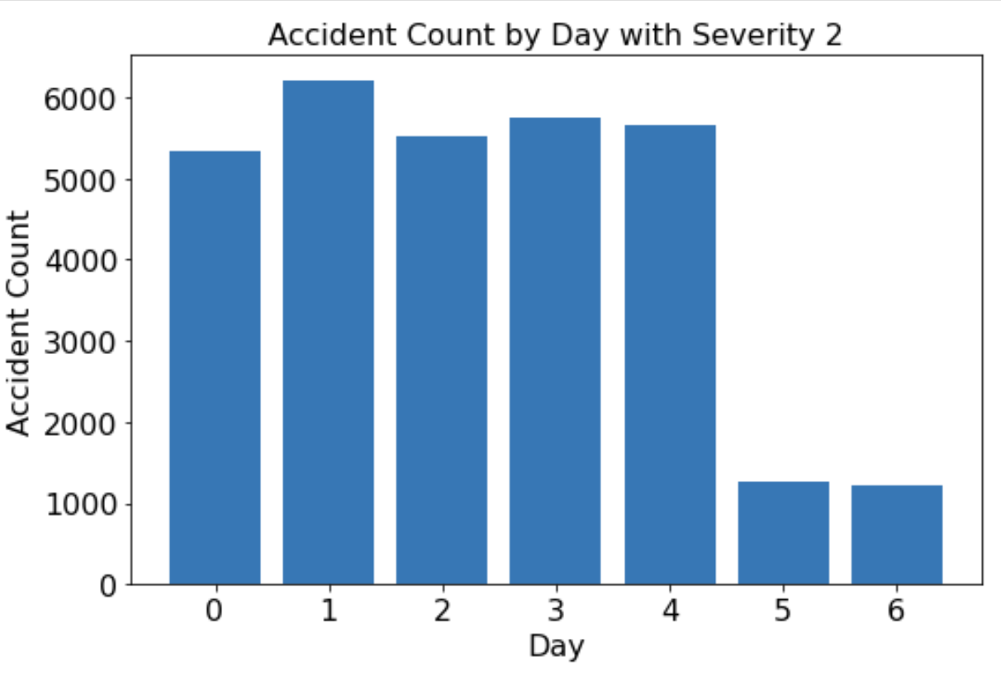
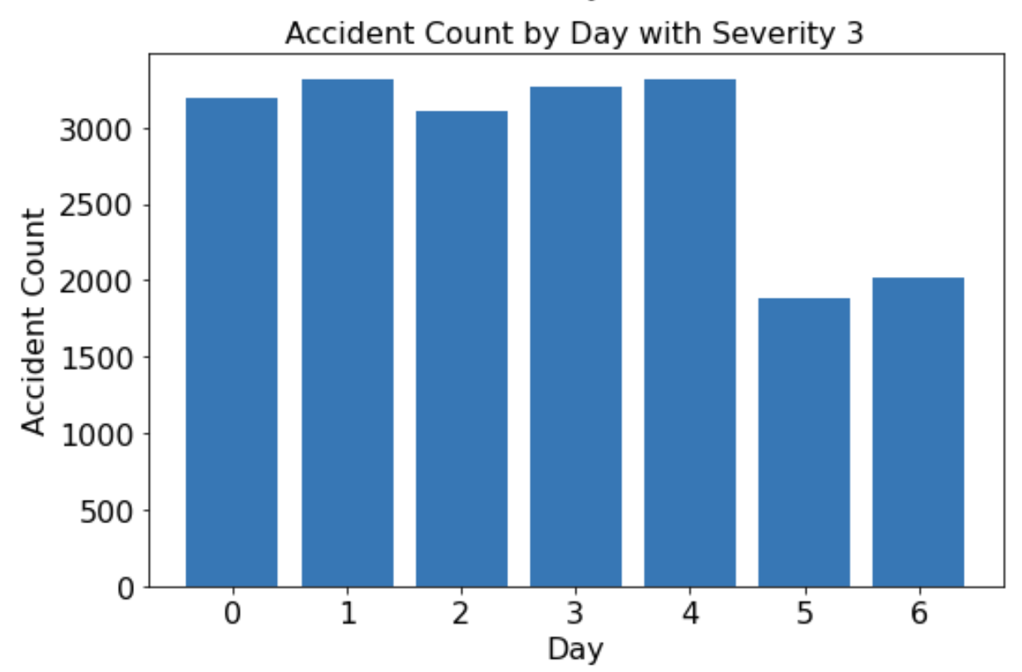
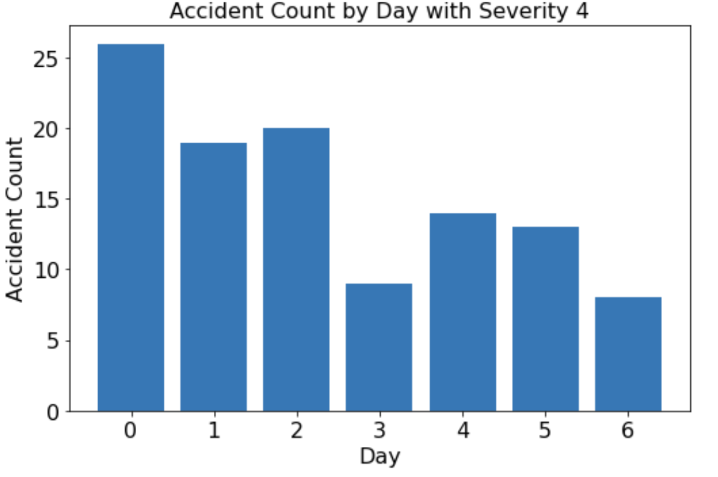

Slide 9
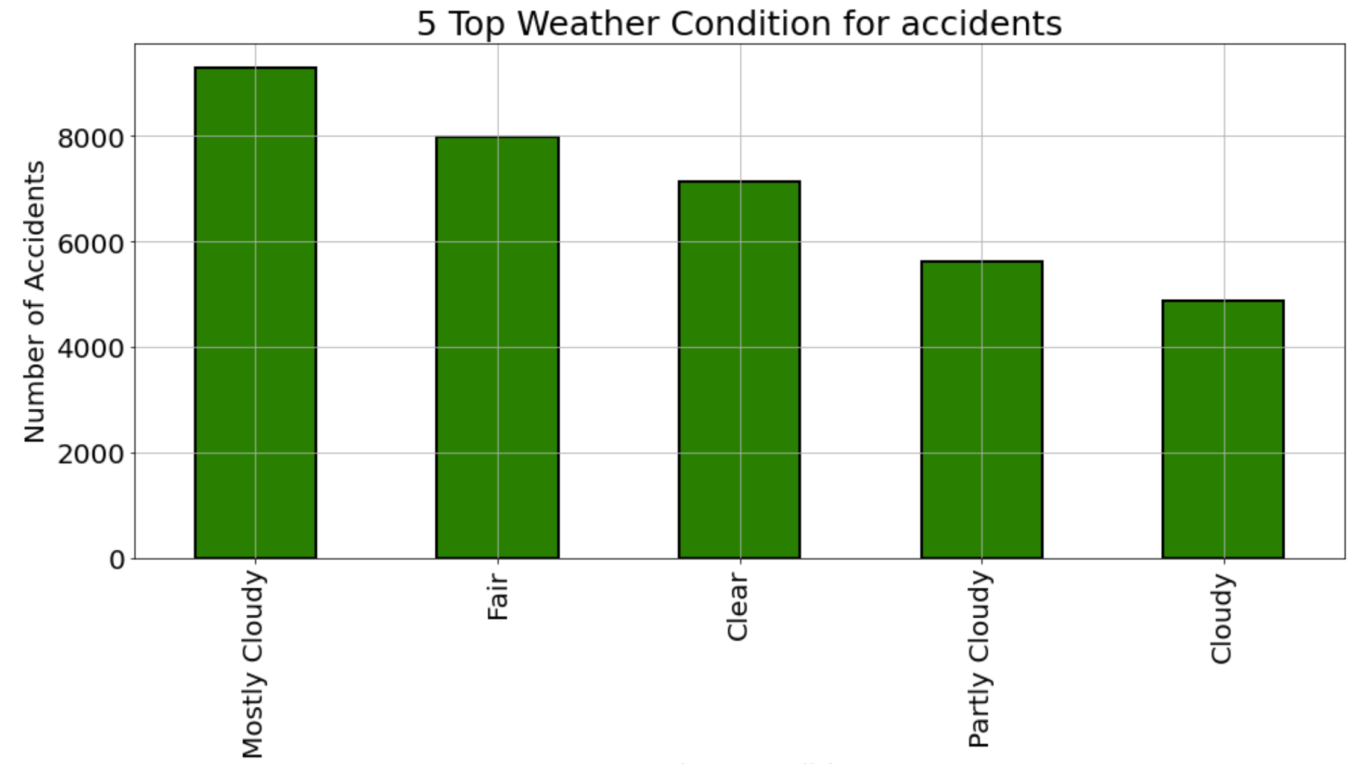

Slide 10
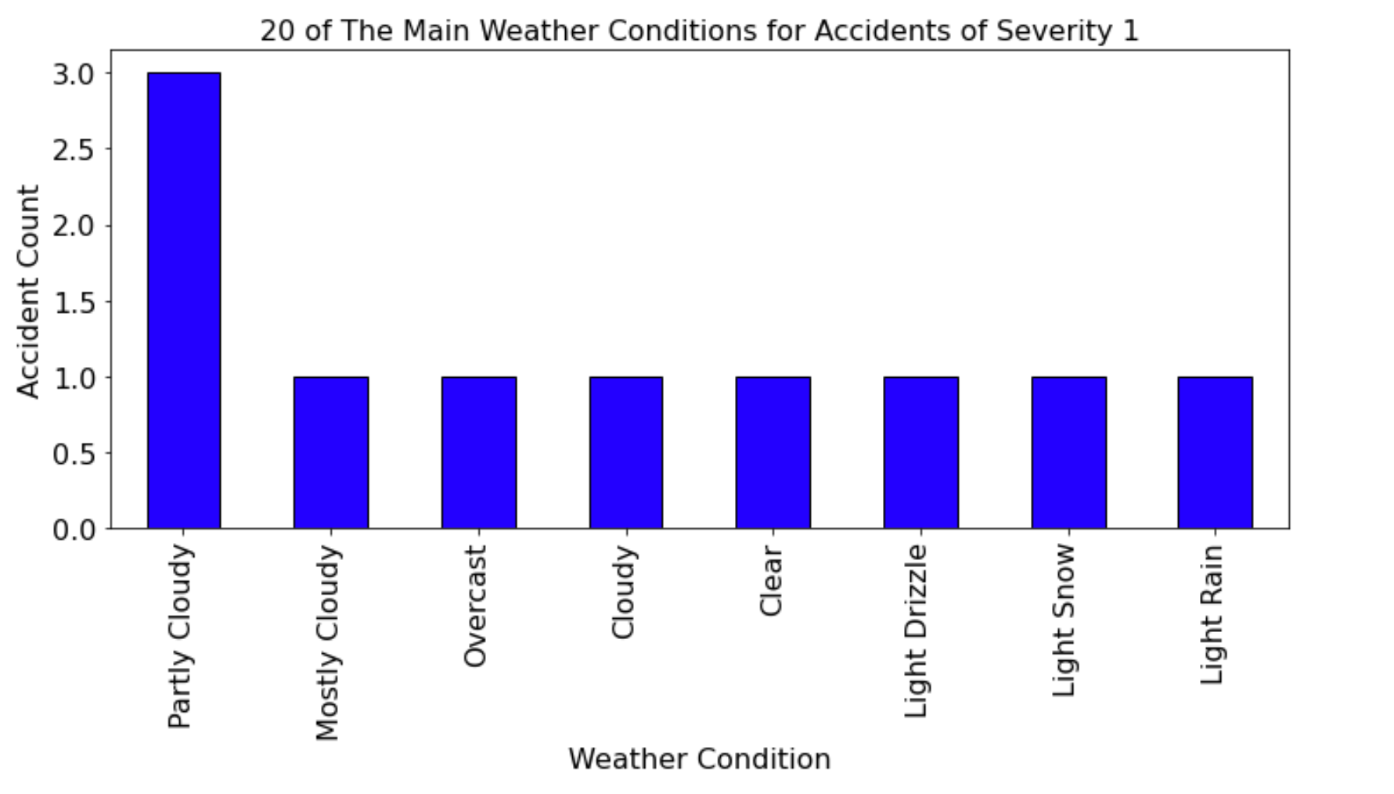
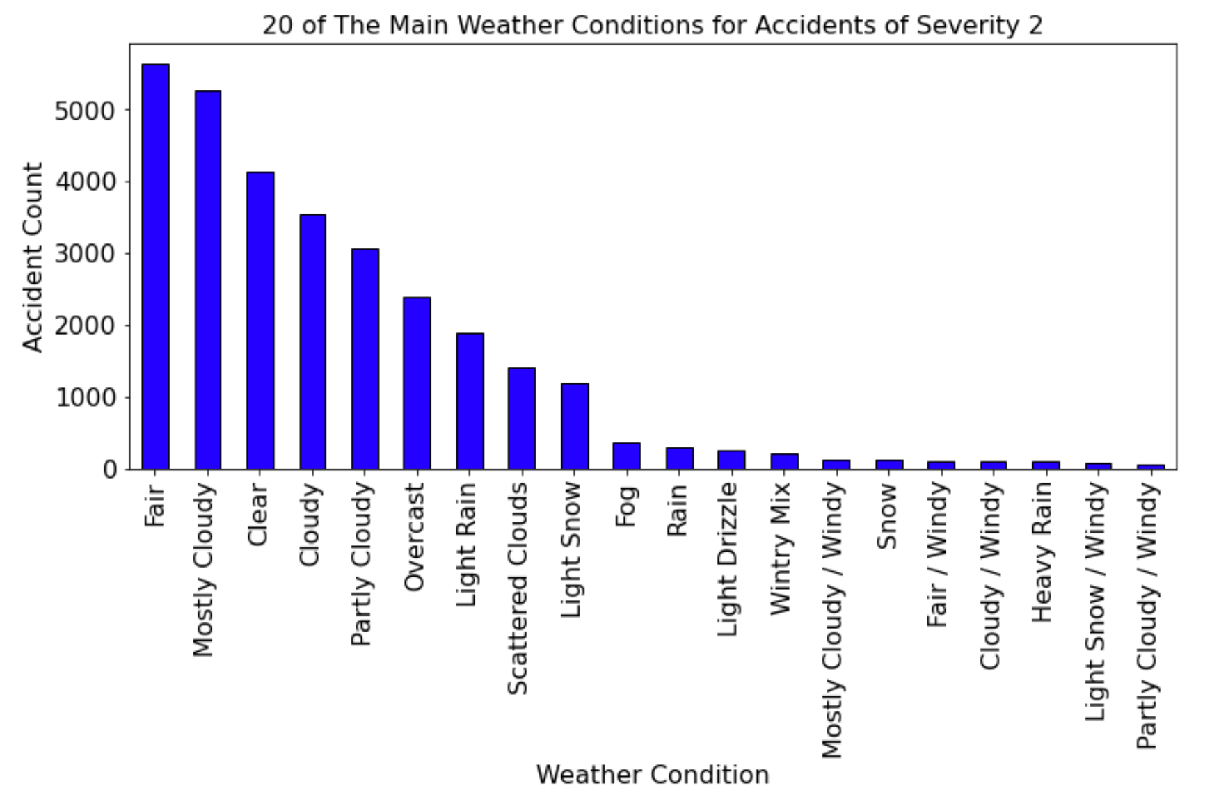
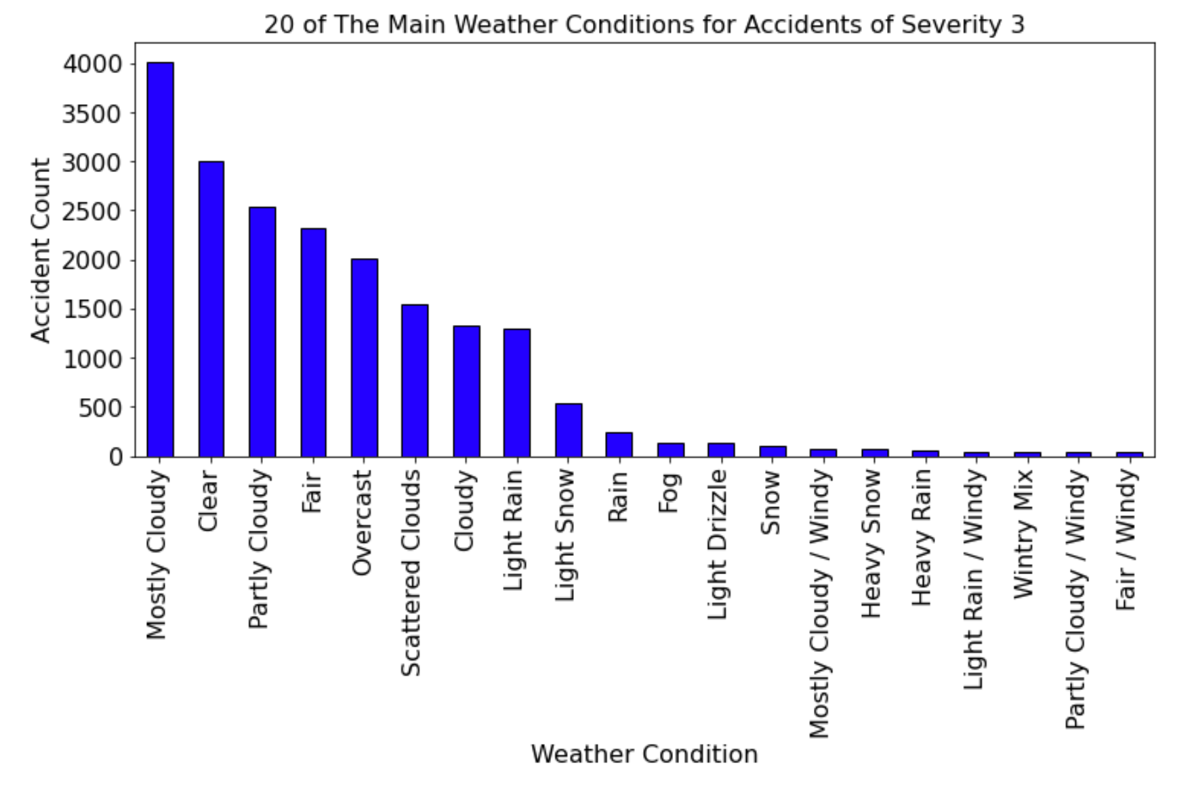
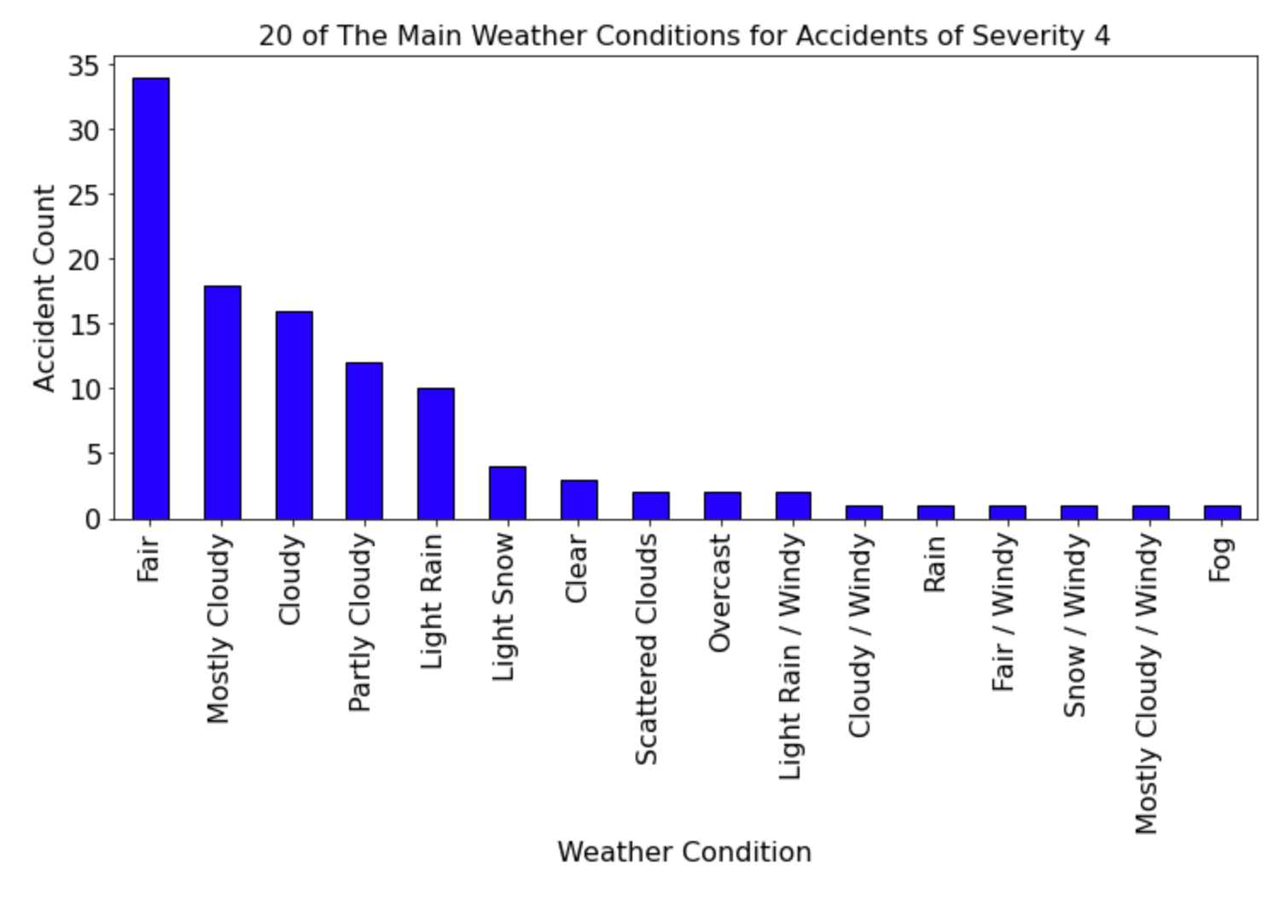

Slide 11
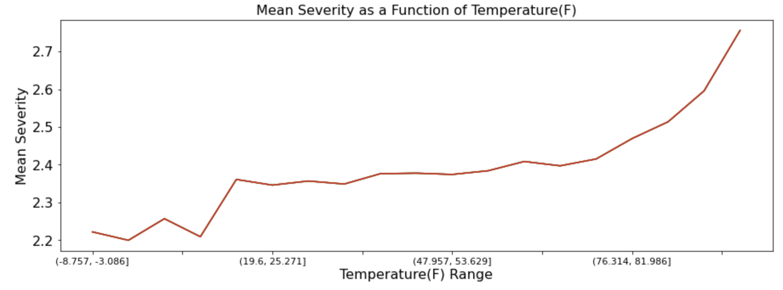
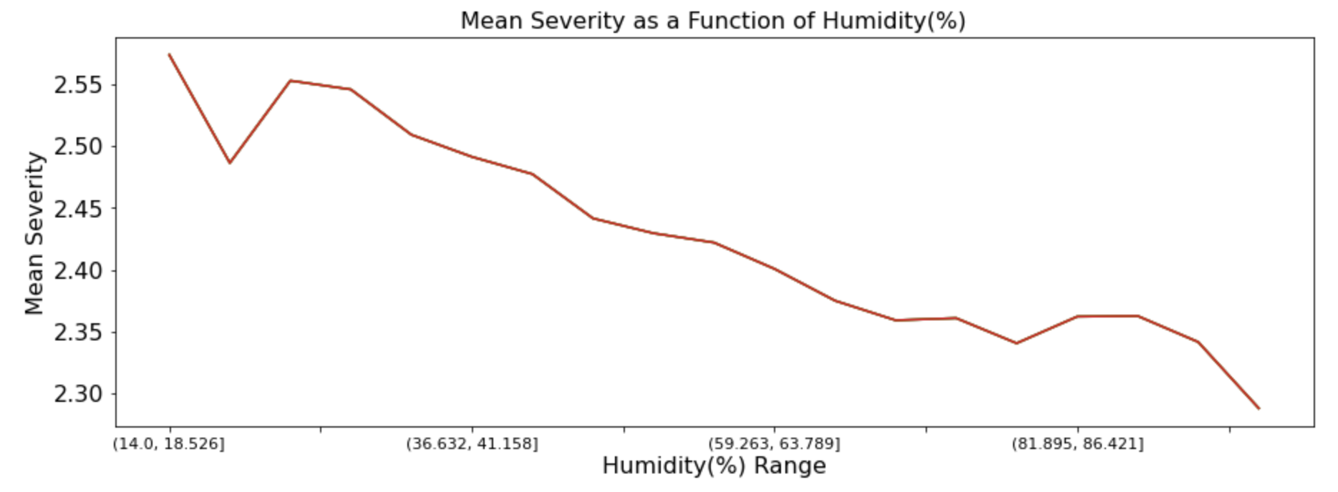
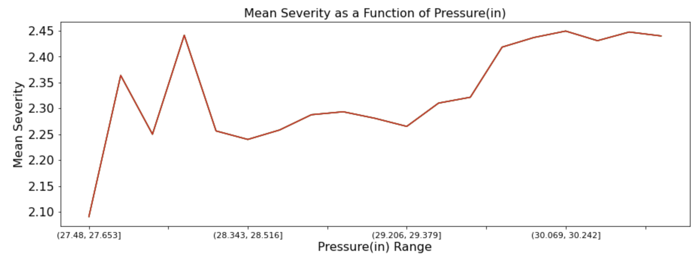

Slide 12
Modeling
As this is a classification problem, we will compare the performance of some common Machine learning algorithms:
K Nearest Neighbor (KNN)
Decision Tree
Support Vector Machine
Logistic Regression
. We train-test split our data, leaving 20% for testing. And before we run the the models, we normalize the data

Slide 13
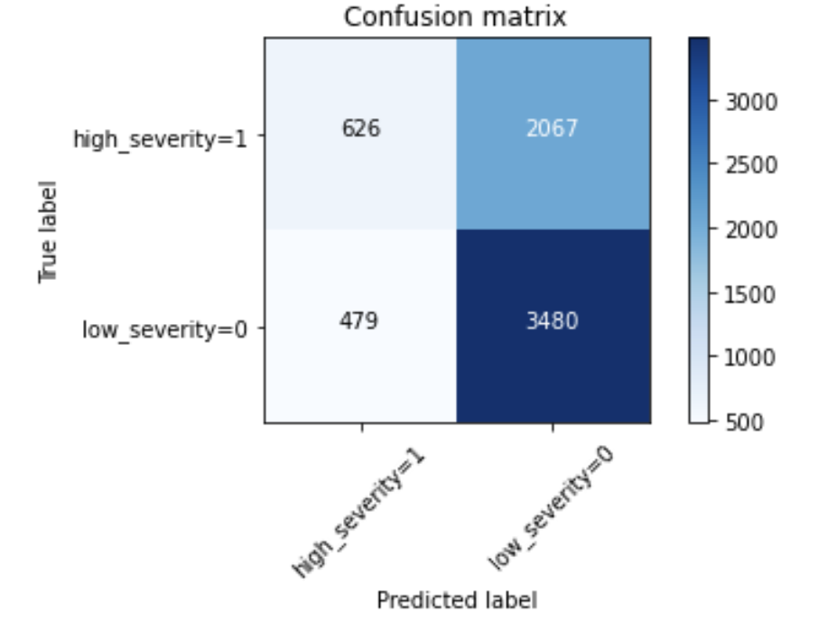
Results
Algorithm | Jaccard | F1-Score | Log-Loss
KNN | 0.6 | 0.59
Decision Tree | 0.59 | 0.59
SVM | 0.62 | 0.56
Logistic Regression | 0.62 | 0.57 | 0.65

Slide 14
Discussion
At this stage it is worth asking whether the scores can be improved with the features selected. But anyway, we can see that the prediction for a high severity is only 626 cases where the model predicted true and the real value is also true. On the other hand, we see that predicting the cases with low severity is better with 3480 values that are correct.
It is helpful to provide this kind of information because we can be aware of the probability to have a high severity car accident depending on the conditions.

Slide 15
Conclusion
Our original question, “What if we could predict the severity of an accident, if one were to occur, based on weather condition and environmental , and thereby provide information that could reduce their frequency?” we can see that when we have bad weather conditions it is necessary to drive safe because it increases the chance to have an accident with high severity

