Slide 1

SPSS
Tecnologico de Monterrey
EGADE Business School

Slide 2

Know your data

Slide 3
Principles
Customers produce data
Patterns in customers’ data
All/some customers differ
Customers are not irrational, but reasonable

Slide 4
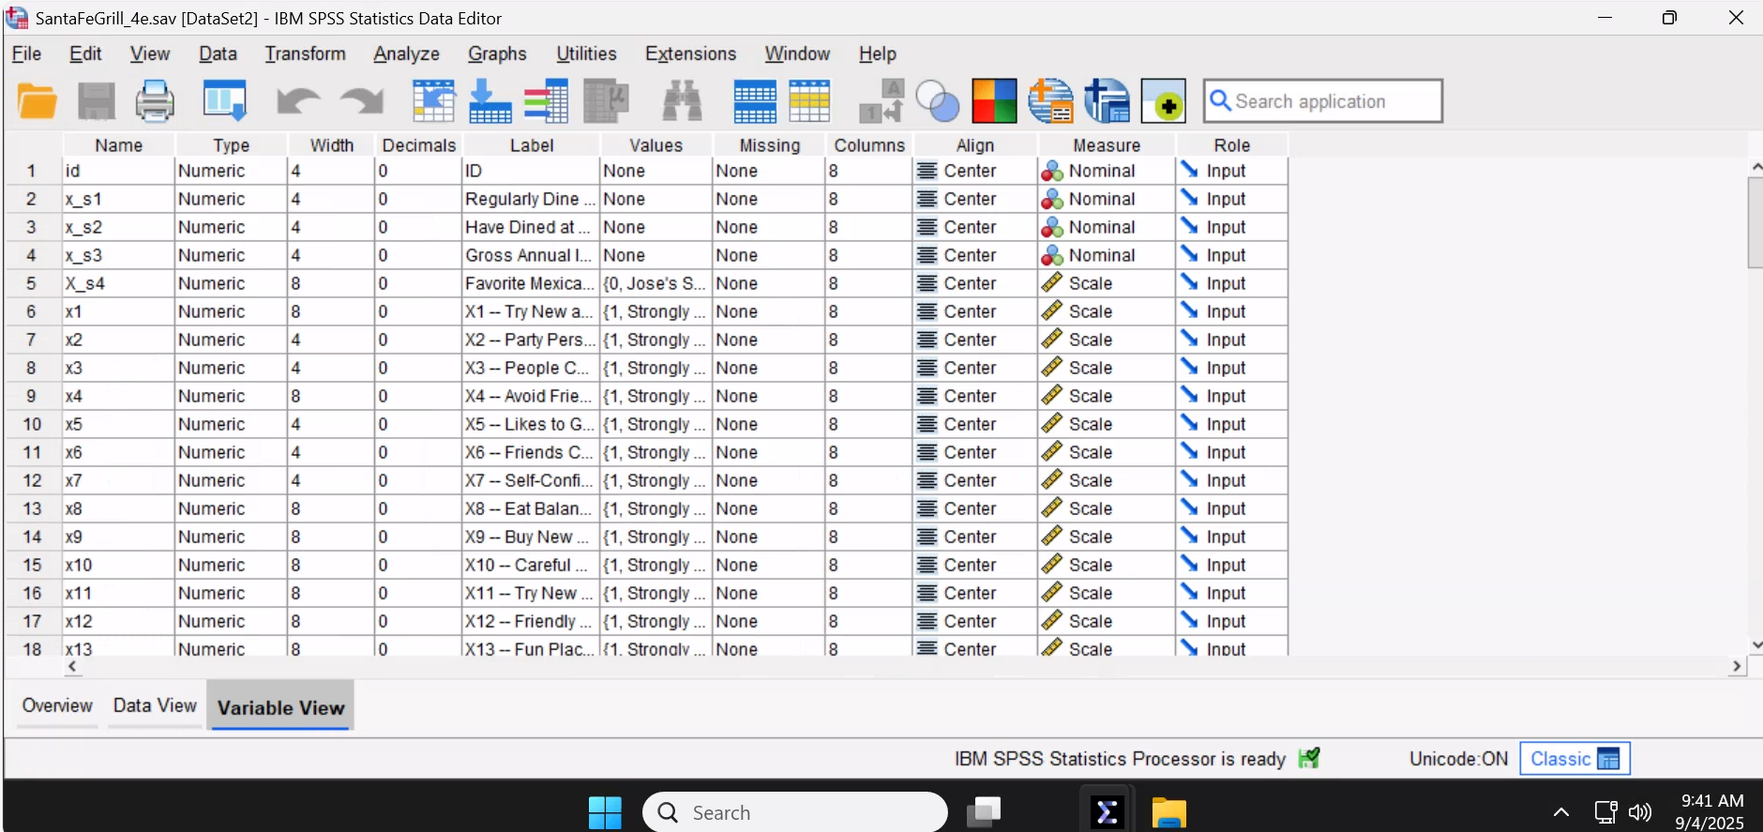
Know your data types.
In SPSS, go to variable view

Slide 5

Know your data readiness.
Analyzable: Data is structured and organized in a way that allows for analysis (e.g. dummy coding).
Interpretable: Data enables accurate interpretation (e.g. no category coding errors).
Complete: Data has all necessary information for analysis (e.g. no missing values).
Valid: Data adheres to predefined formats (e.g. survey is internally valid).
Accurate: Data reflects the true state of the information it represents (e.g. no outliers).
Consistent: Data is not contradictory (e.g. assets + liabilities = equity).
De-identified: No personally identifiable information, protecting privacy and complying with regulations.

Slide 6
Exploratory data analysis

Slide 7
Principles
Customers produce data
Patterns in customers’ data
All/some customers differ
Customers are not irrational, but reasonable

Slide 8
Exploratory Data analysis
Hadley Wickham recommends these two general questions to begin with (https://r4ds.hadley.nz/eda):
What type of variation occurs within my variables?
What type of covariation occurs between my variables?

Slide 9

Variation
Within a variable

Slide 10
Numeric variation
Let’s pick a NUMERIC variable in SPSS
Gross Annual Income

Slide 11
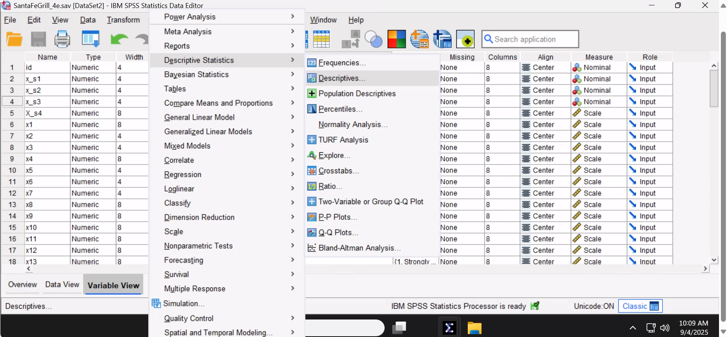
In SPSS: Analyze -> Descriptive Statistics -> Descriptives …

Slide 12
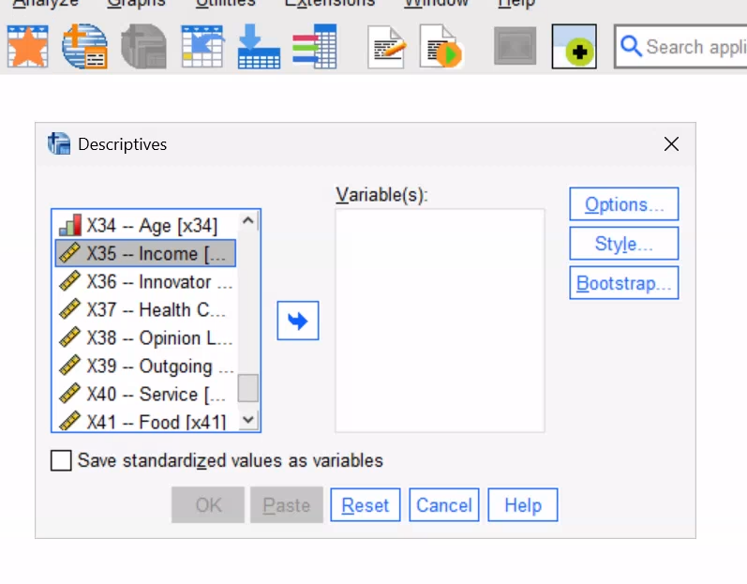
Select X35 - Income

Slide 13
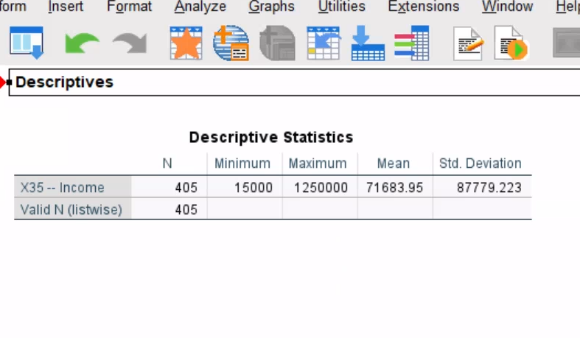

Slide 14
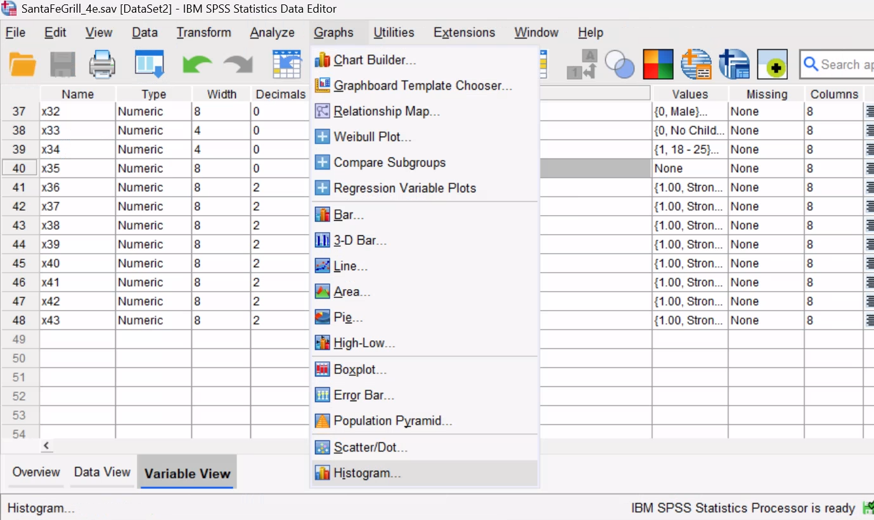
In SPSS: Graphs-> Histogram …

Slide 15
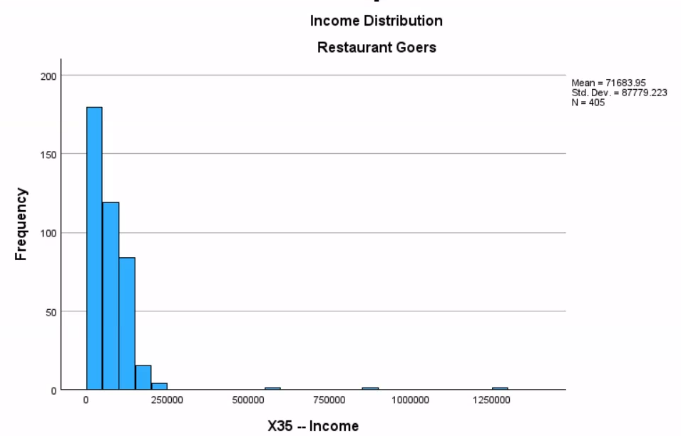

Slide 16
Patterns in customers’ data
Proposed pattern in customers:
They have variable income

Slide 17

Task 1:
Which statement is sustainable with the observed variation? Pick one, write why.
They have HIGHLY variable income
vs.
They have BARELY variable income
Think of a marketing strategy consequence of your pick.
Your answer (in-person):
Your AI agent answer:

Slide 18

CoVariation
Between
variables

Slide 19
Let’s start with bivariate covariation

Slide 20

Problem 1:
Spurious correlations (https://www.tylervigen.com/spurious-correlations)
Problem 2:
Too many potential bivariate combinations

Slide 21
Solution 1:
Theory / Business Knowledge / Intuition
Solution 2:
Correlation Matrix

Slide 22
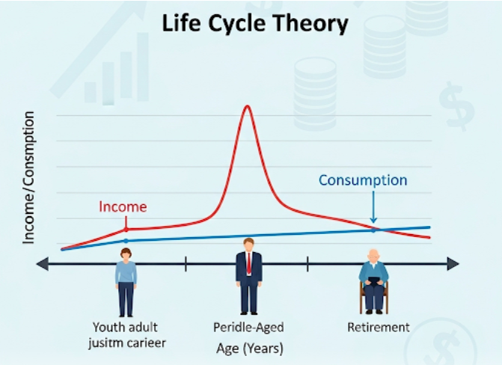
Let’s pick two NUMERIC variables
Solution 1:
Theory / Business Knowledge / Intuition
Income
Age

Slide 23
For this analysis, we will remove income outliers
That is, extreme incomes contaminate age-income relationships (valid? discuss)

Slide 24
Incomes > 300,000 USD are extreme for this data

Slide 25
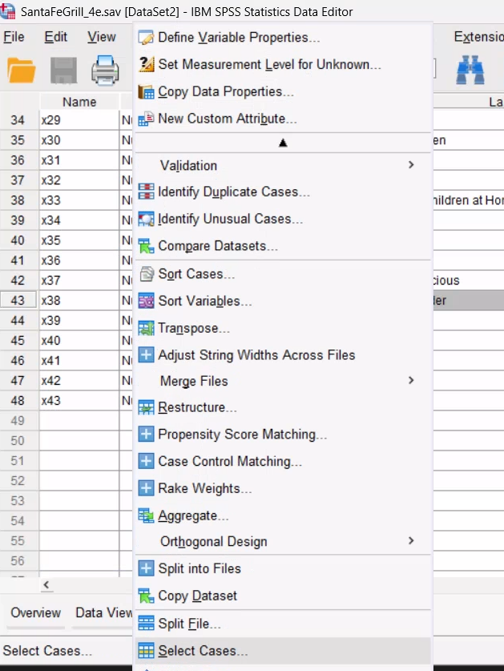
In SPSS: Data -> Select Cases

Slide 26
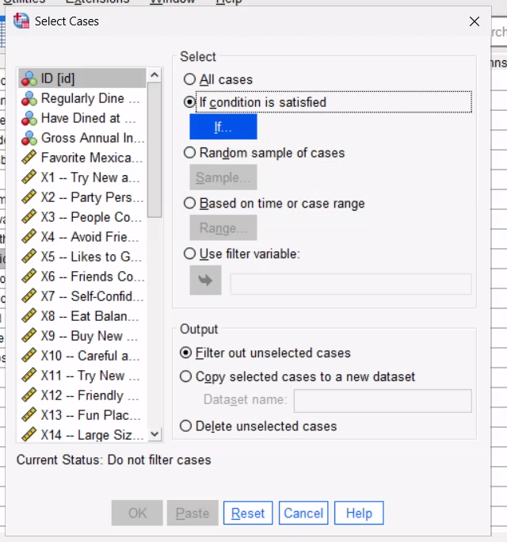
Select “if condition is satisfied”
Pick in the next screen the variable Income, and make it less than 300,000

Slide 27
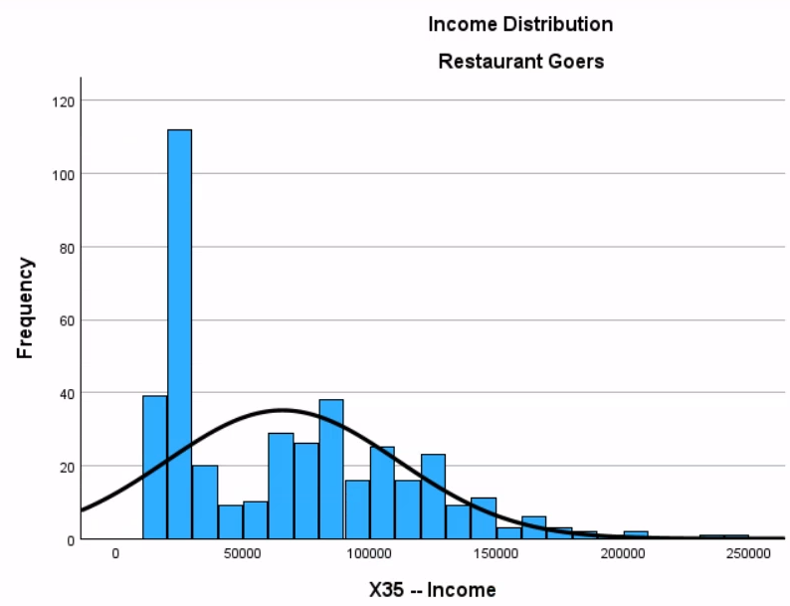
Plot the income distribution again
There should not be values above 300,000

Slide 28
Now the correlation

Slide 29
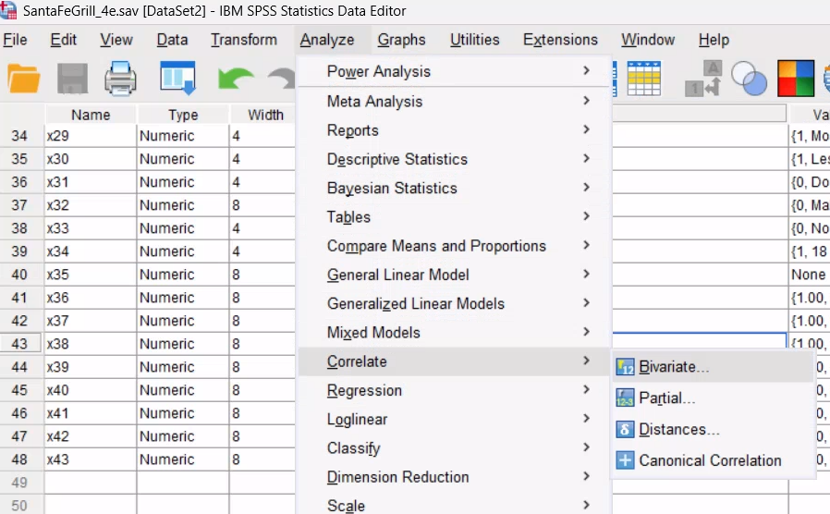
In SPSS: Analyze -> Correlate> Bivariate …

Slide 30
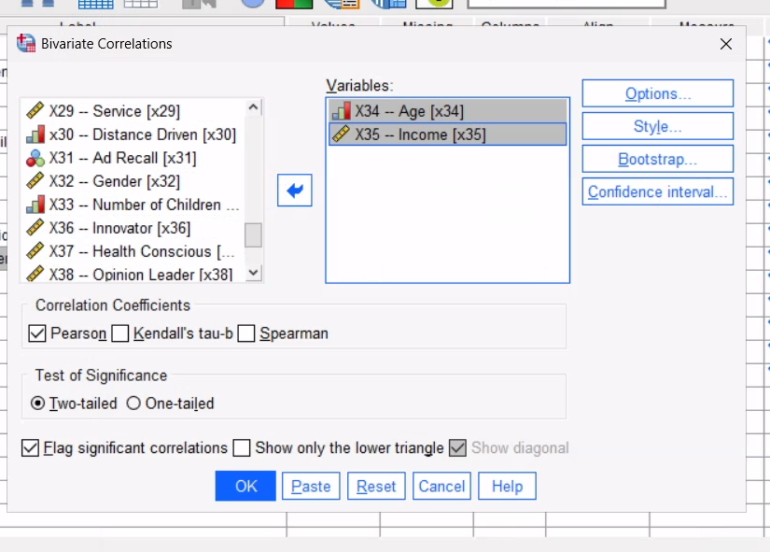
Select
X34 - Age
X35 - Income

Slide 31
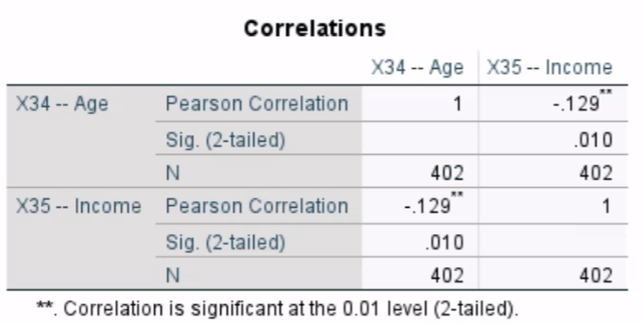
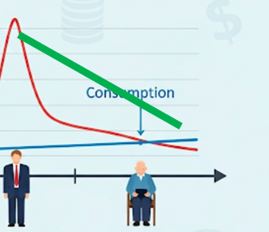
Negative correlation
Consistent with the life cycle theory

Slide 32
Task 2:
Pick a consumer behavior theory. Sources of consumer behavior theories:
Ask an LLM for a theory
Your own knowledge
From the Santa Fe’s data, pick two variables to correlate based on that theory. DO NOT ASK AN LLM FOR THE VARIABLES
Explain why, under that theory, they could correlate.
IT IS NOT NECESSARY TO RUN THE CORRELATION ON SPSS.
.

Slide 33

Solution 2:
Brute Force
Correlation matrix

Slide 34
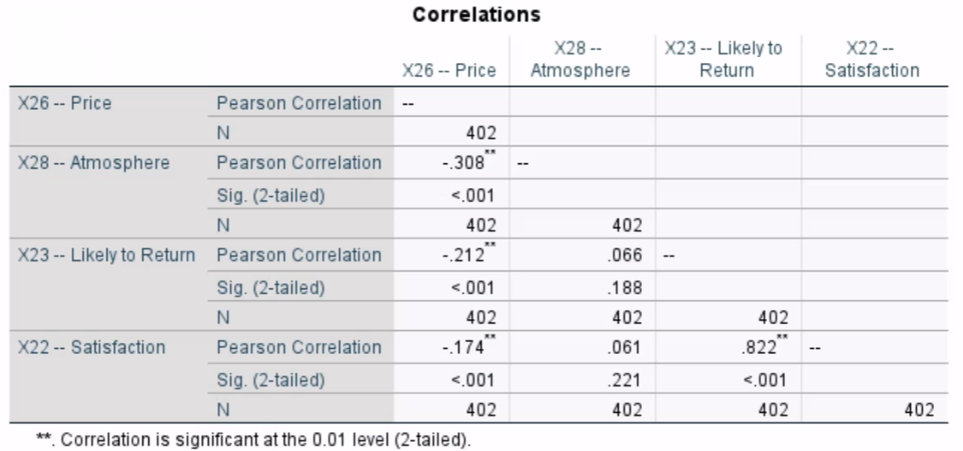
In SPSS (as before but include more variables): Analyze -> Correlate> Bivariate …

Slide 35
Task 3:
From the Santa Fe’s data, pick many variables to correlate (different from the ones in the explanation slide).
Run the analysis in SPSS.
Which ones are significant? Do the significant correlations make sense?
.

