Slide 1

SPSS
Tecnológico de Monterrey
EGADE Business School

Slide 2

Customer produce data
Patterns in customers’ data
All/some customers’ differ
Customers are not irrational, but reasonable
Principles:

Slide 3

Compare means

Slide 4
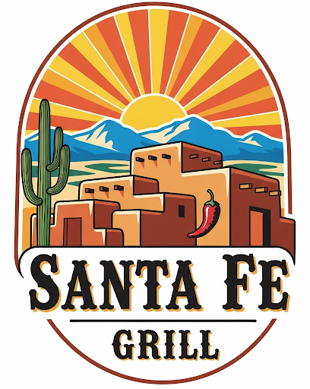
For pricing strategies, Santa Fe Grill wants to know if their clients earn more tan 60,000 USD

Slide 5
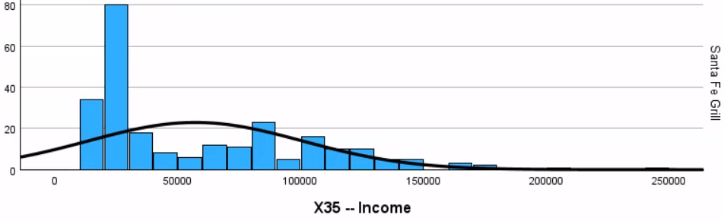
Do their client’s earn, on average, more than 60,000 USD?
Hard to tell, too noisy …
… we need stats!
Income
Santa Fe Grill’s Clients
Frequency
60,000 USD
Note:
No outliers: >300,000 USD

Slide 6
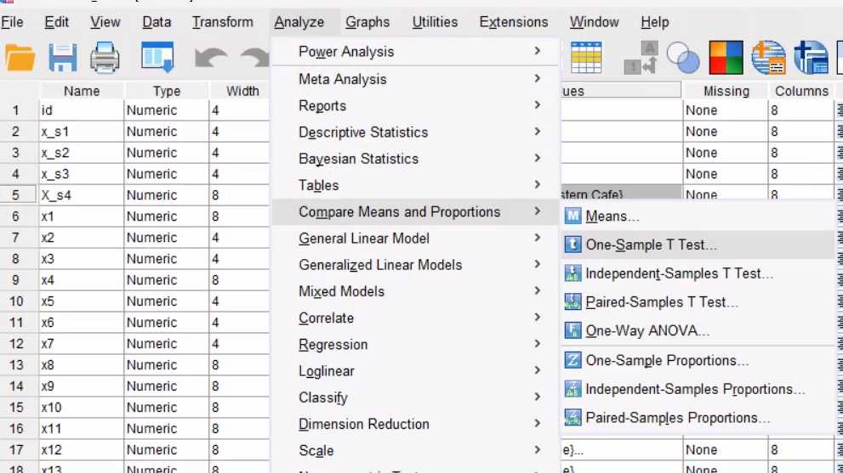
In SPSS:
Data->Select cases-> if condition met -> x35<300,000 and x_s4 = santa Fe
Analyze -> Compare Means and Proportions -> One-Sample T Test …

Slide 7
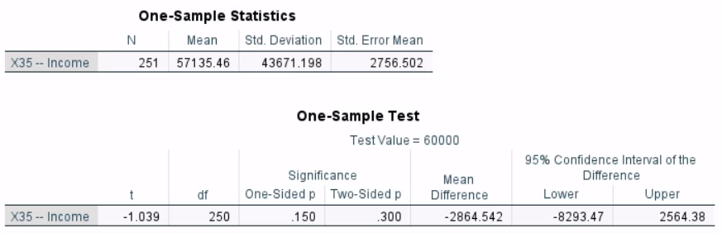
No! They do not earn more than 60,000 USD … see p value

Slide 8

Task 4
Imagine some Chief Marketing Office, without statistics, said that indeed the clients earned more than 60,000 USD, because “I have 30 years of experience”.
List a potential list of consequences for pricing strategies, and their positive or negative effects on Santa Fe grill, when the statistical reality is not >60,000 USD.
Your answer (in-person):
Your AI agent answer:

Slide 9
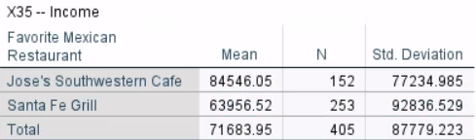
For marketing strategies, Santa Fe Grill wants to compare their clients to the competition
Let’s check income

Slide 10
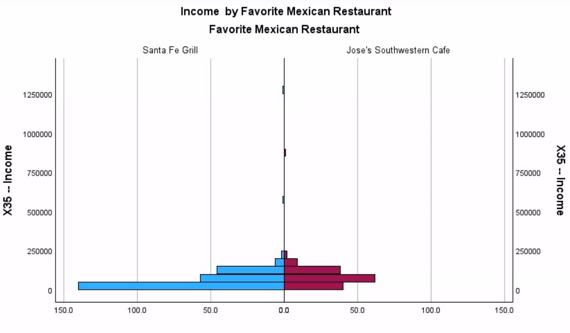
Clear difference?
Hard to tell, too noisy …
… we need Stats!

Slide 11
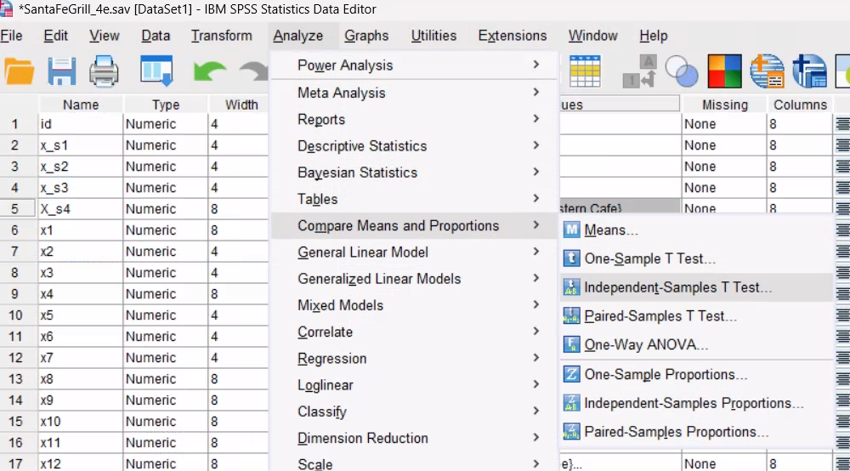
MAKE FAVORITE MEXICAN RESTAURANT A NOMINAL VARIABLE. THEN Do …
In SPSS: Analyze -> Compare Means and Proportions -> Independent Samples T Test …

Slide 12
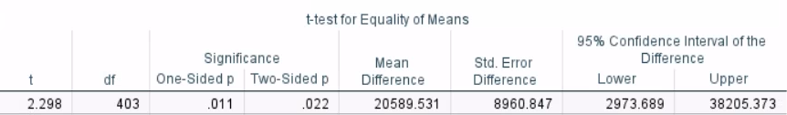
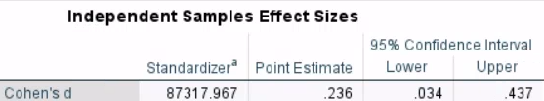
The test is significant (p<0.05) … Clients of the competition earn more
The effect size is small … but not too much more

Slide 13
Task 5
In SPSS, compare clients from both restaurants on their mean response on three other questions you find interesting (not income). Use a t-test for independent samples.
Interpret the results. The p value, the effect size, and the direction of the effect
Your answer (in-person):
Your AI agent answer:

Slide 14
For family marketing strategies, Santa Fe Grill wants to see satisfaction of different family types

Slide 15
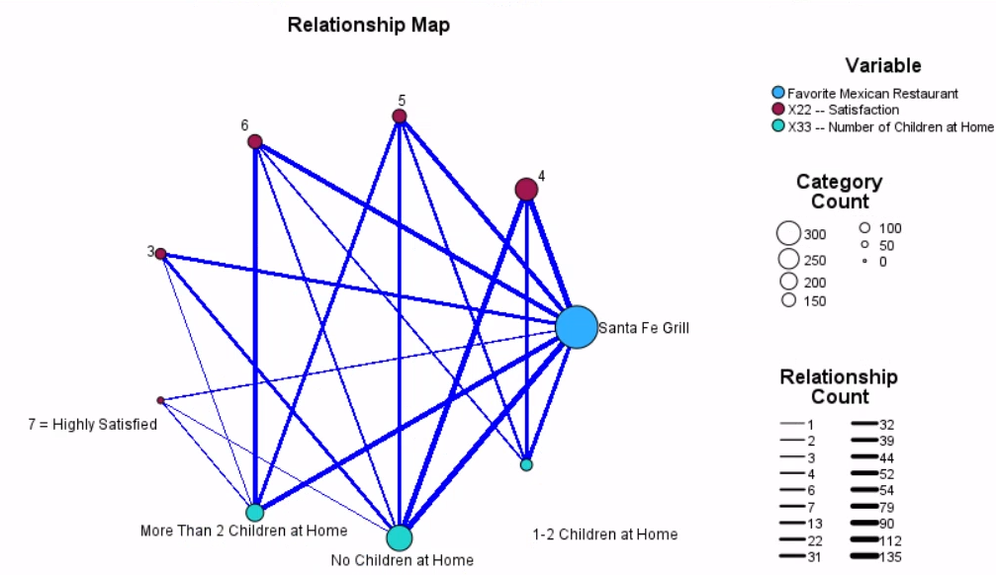
Any insights? With many categories things get complicated and noisy … we need stats!

Slide 16
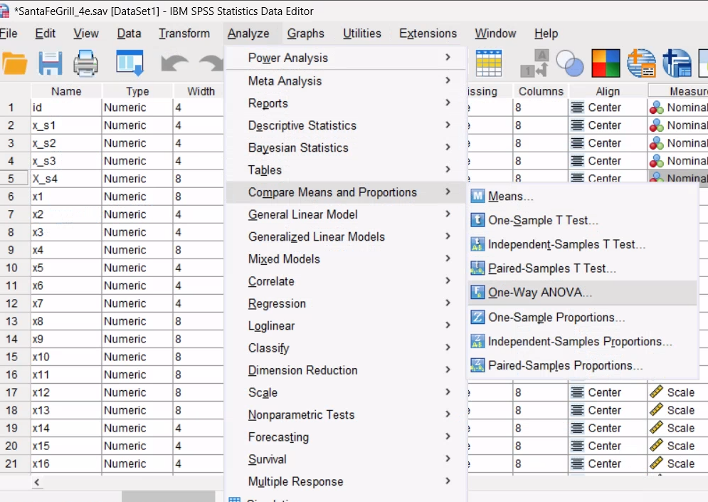
Select cases only santa fe (later example we will include southwestern) …
In SPSS: Analyze -> Compare Means and Proportions -> One-way ANOVA…

Slide 17
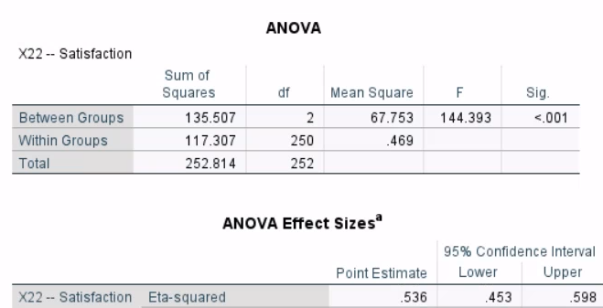
Satisfaction is different across family types! (high sig and effect sizes)

Slide 18
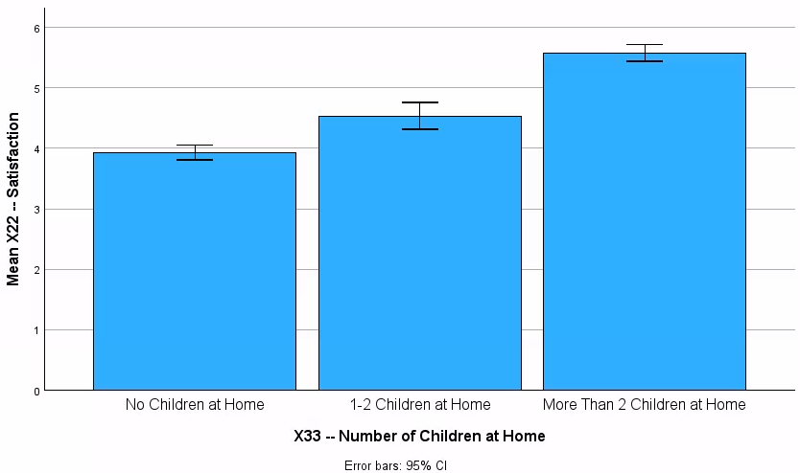

Slide 19
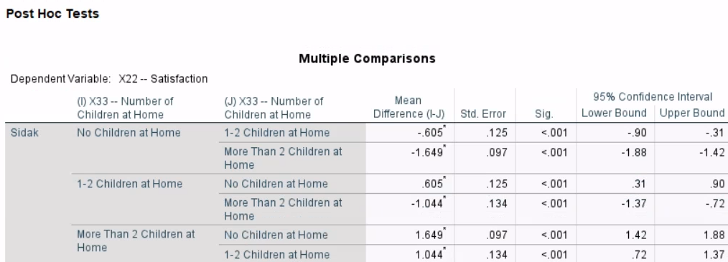

Slide 20
Task 6
What marketing strategy would you propose with the finding that family types differ in satisfaction?
Your answer (in-person):
Your AI agent answer:

Slide 21
For family marketing strategies, Santa Fe Grill wants to see satisfaction of different family types …
… and compare it with the competition

Slide 22
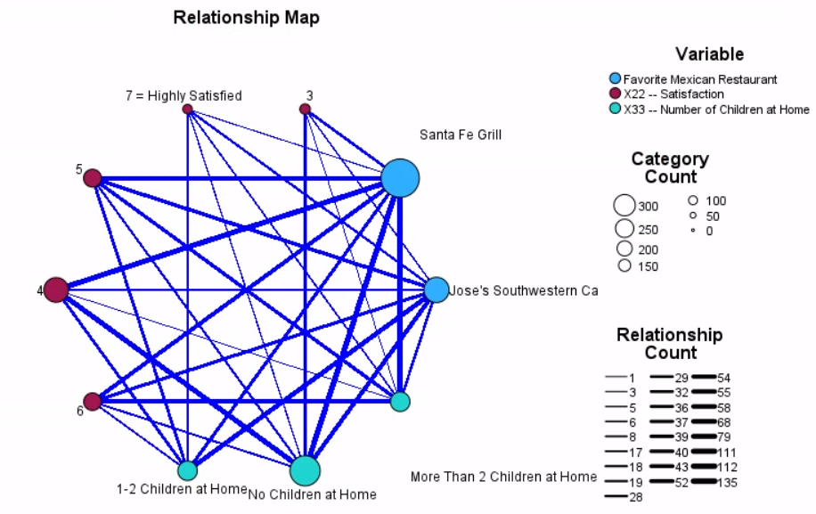
Any insights? With many categories things get complicated and noisy … we need stats!

Slide 23
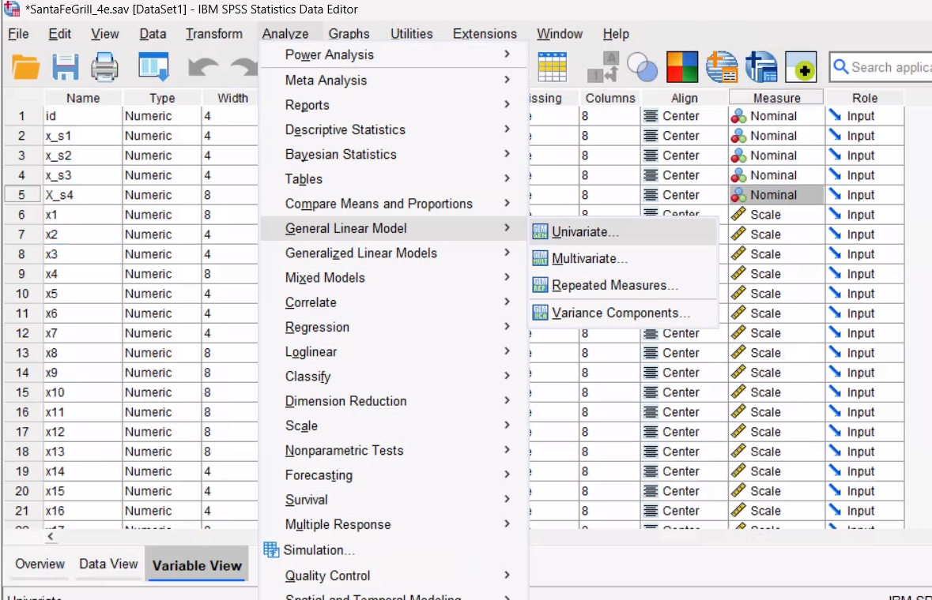
Select ALL cases …
In SPSS: Analyze -> General Linear model-> univariate…

Slide 24
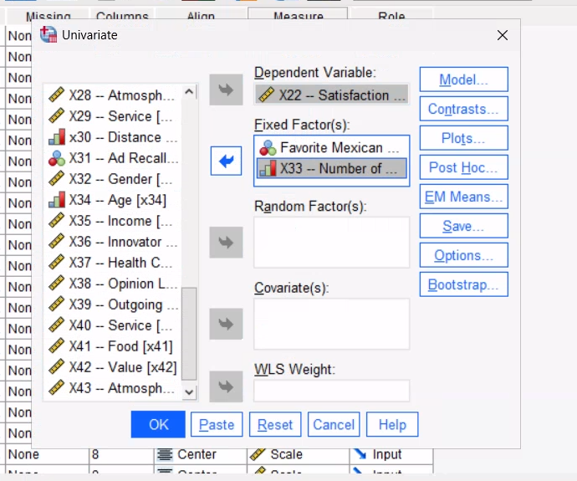

Slide 25
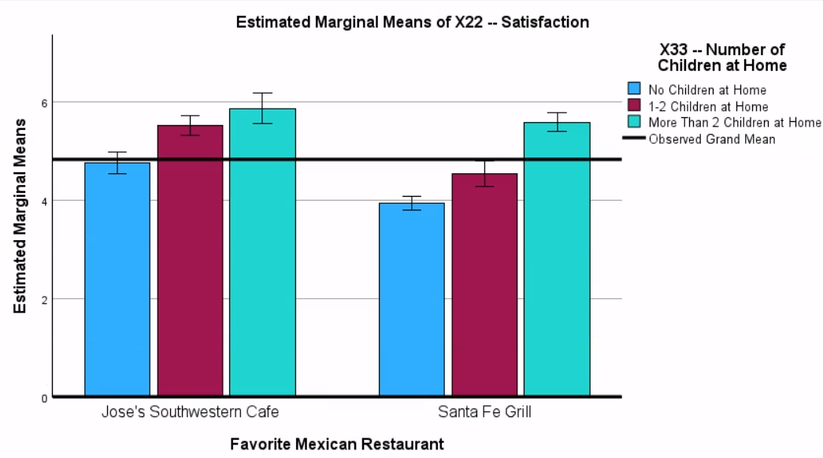
Santa Fe has satisfaction issues!
Absolute levels (heights) and slope of family type

Slide 26
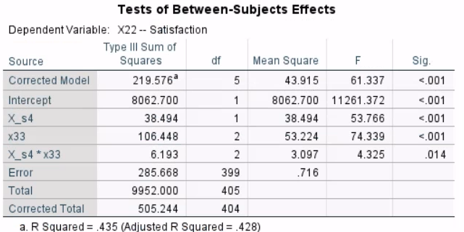
Here the statistical confirmation with a two-way ANOVA.
Fav. Rest.
Num. Children

Slide 27
Task 7
Do you change your strategic marketing decision with the new information about the competition? Yes, no, why?
Initial information
Updated information

Slide 28
Compare proportions

Slide 29
For marketing strategies, Santa Fe Grill wants to know if their clients differ from the competition
Let’s evaluate proportion of women

Slide 30
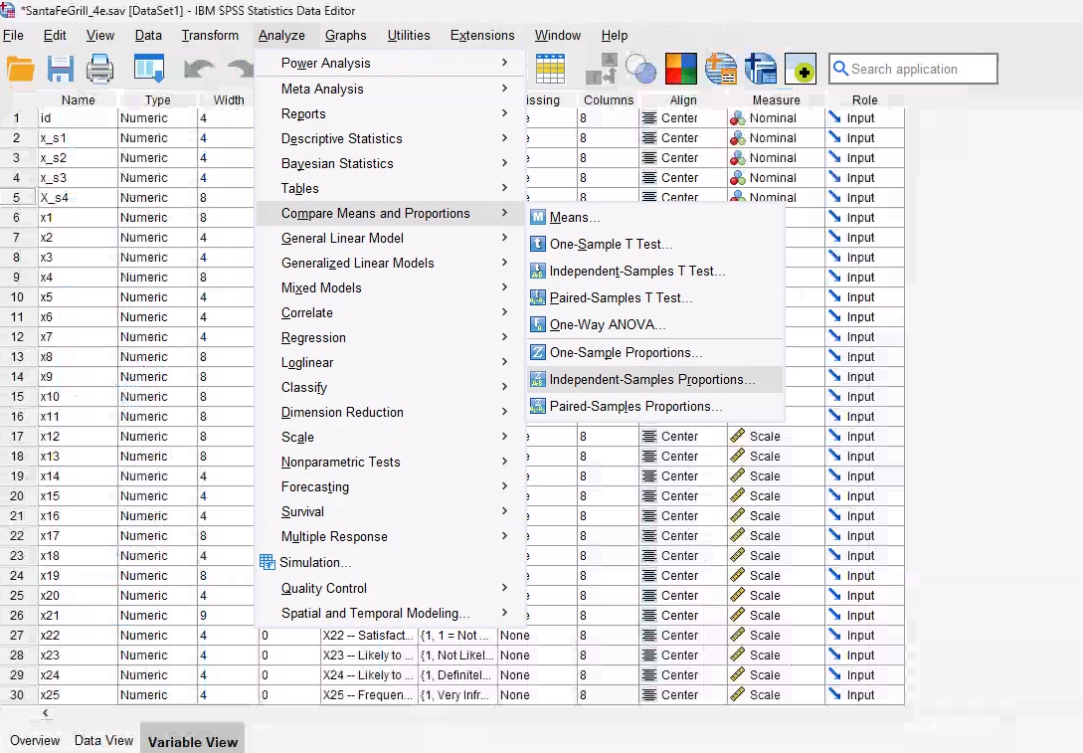
Select ALL cases …
In SPSS: Analyze -> Compare means and proportions> Independent-samples proportions…

Slide 31
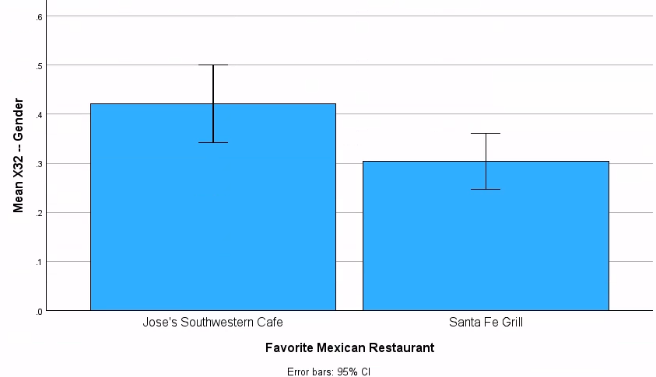
0: men, 1: women
There seems to be a lower proportion of women in Santa Fe grill

Slide 32
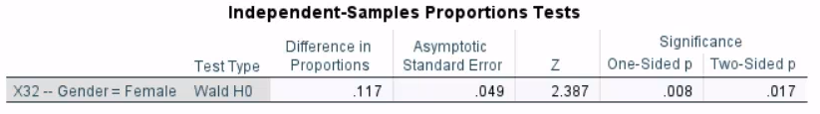
A proportion test confirms the observed gender difference preferences for Mexican restaurant

Slide 33
Task 8
Propose survey questions to help reverse this situation. Justify your proposed questions. Would you ask only women, only men, or both? Why?
Your answer (in-person):
Your AI agent answer:

