Slide 1
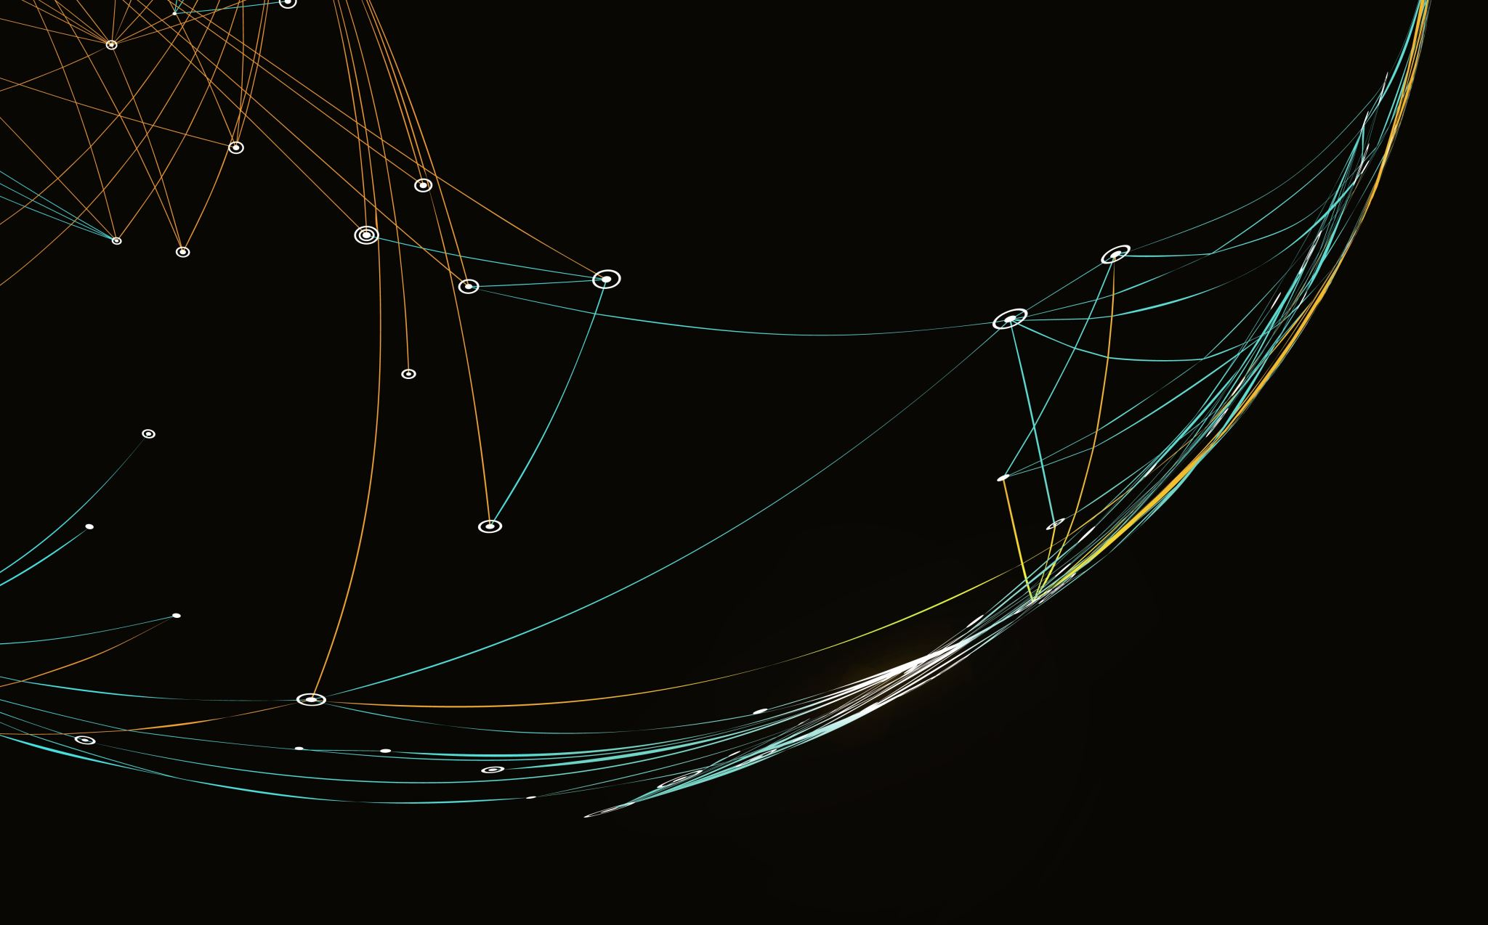
SPSS
Tecnológico de Monterrey
EGADE Business School

Slide 2

Principles:
Customers produce data
Patterns in customers’ data
All/some customers produce data
Customers are not irrational, they are reasonable

Slide 3
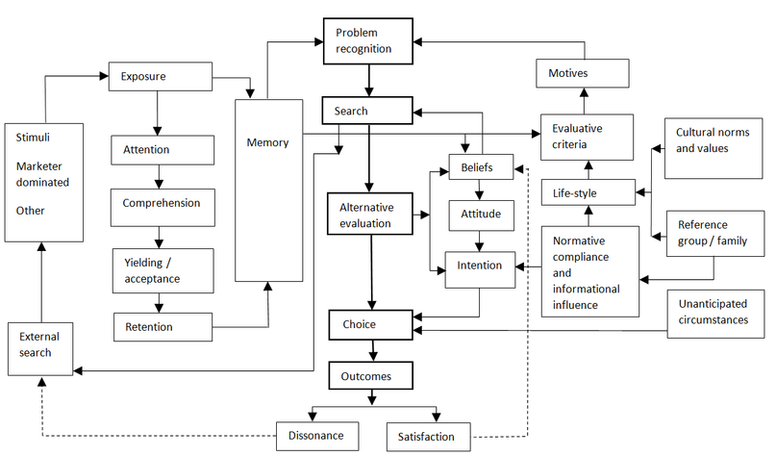
EBK model of consumer behavior
We need theories/frameworks
Consumers are complex and reasonable

Slide 4

A/B comparison

Slide 5
Let’s do an A/B test of a (tiny) portion of this theory …
… and just test a direct effect …
… from stimuli to higher order construct of “life -style” (a simplification indeed).
LIFE STYLE

Slide 6
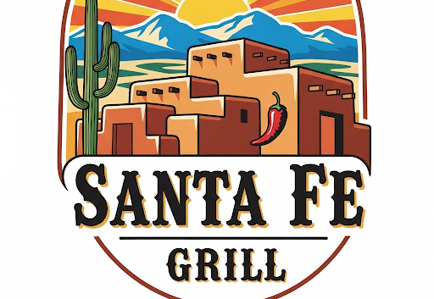
Santa Fe hired an advertising and marketing company to evaluate which style people like more

Slide 7
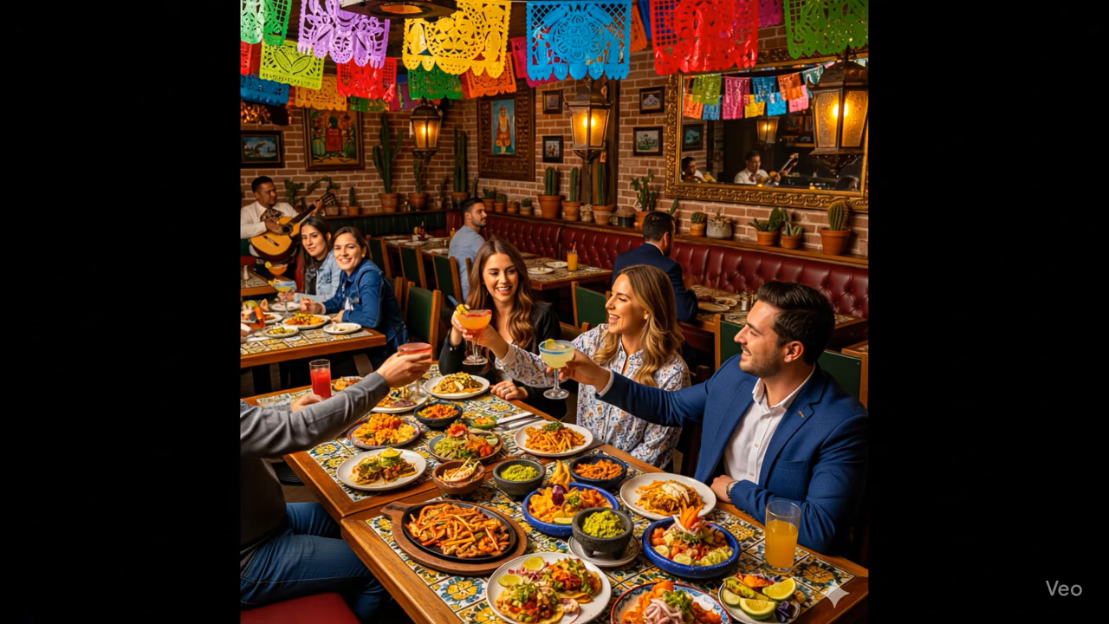
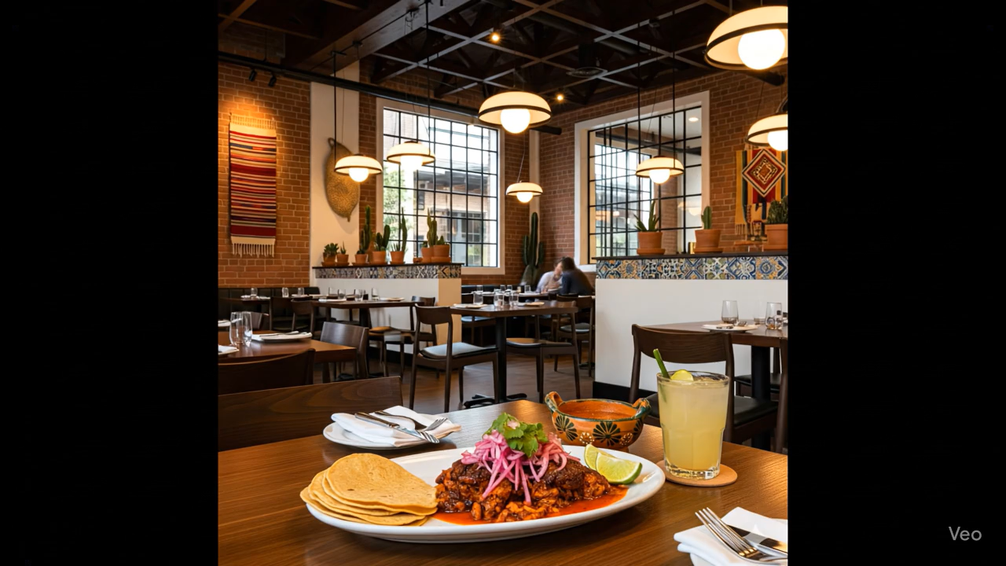
Lifestyle A/B test
Campaign A
(traditional look
N=30
Survey)
Campaign B
(modern look
N=30
Survey)

Slide 8
Abrir AB_test.xlsx

Slide 9
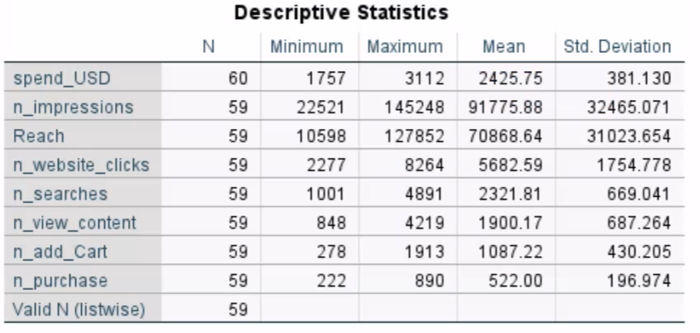
Always start simple, know your data

Slide 10
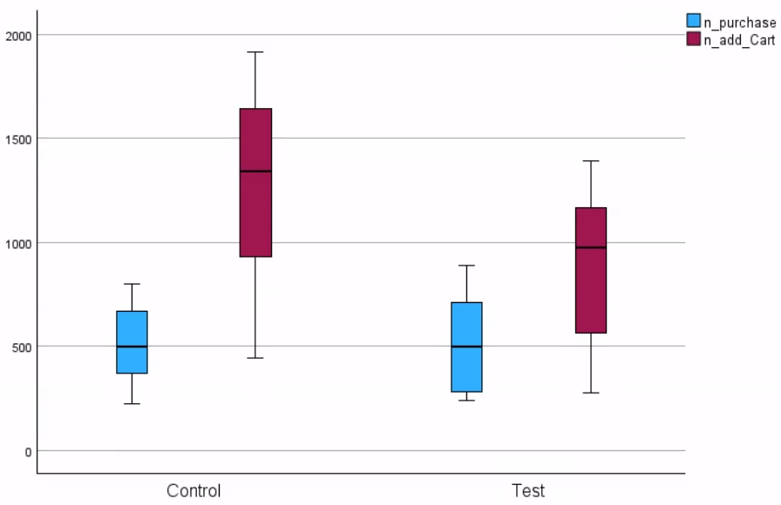
Always start simple, know your data

Slide 11
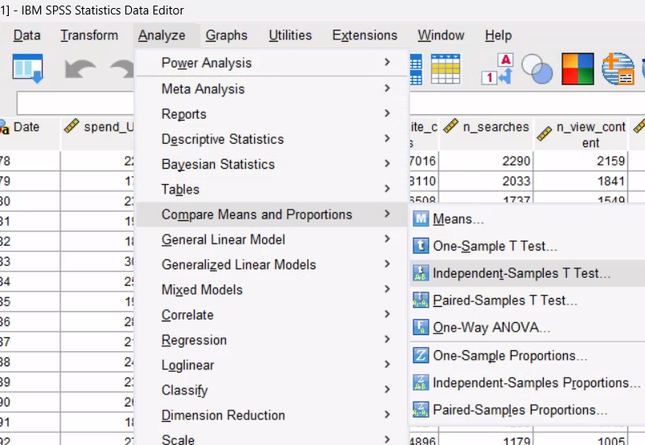
In SPSS: Analyze -> Compare means and proportions -> Independent Samples T-test

Slide 12
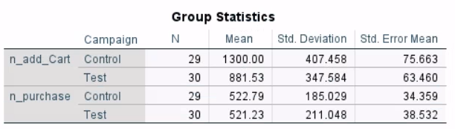
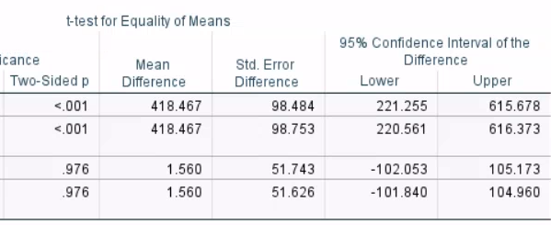
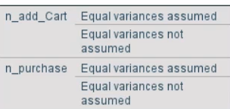
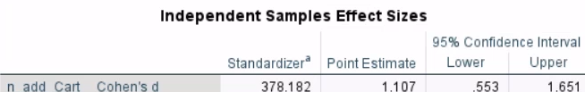
Consumers add more to the cart in the control group, strongly so, but do not purchase more (p, ES)

Slide 13

Task 9:
One of the campaigns makes people add more to the cart but do not increase purchases.
What marketing strategy could you think of to ameliorate such situation for that campaign?
Your answer (in-person):
Your AI agent answer:

Slide 14
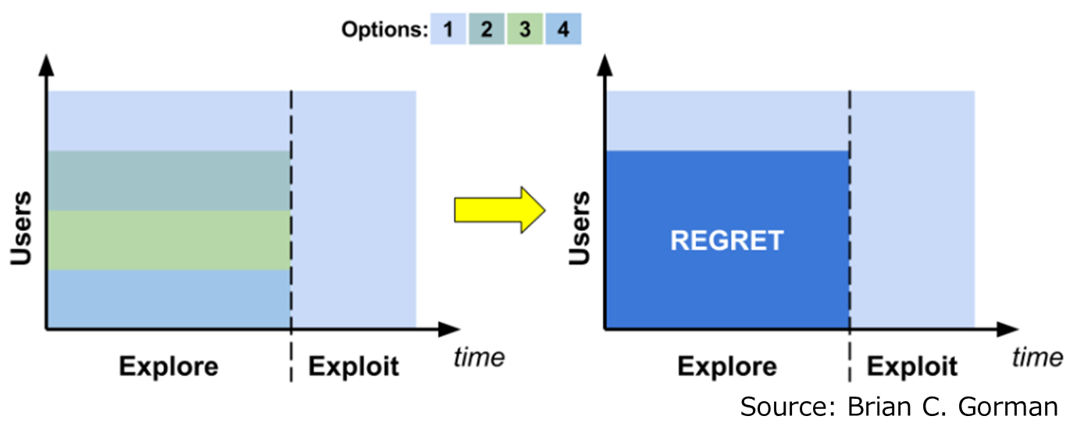
A reflection about AB tests
Static AB tests have costs:
Users who experience suboptimal AB options, experience disutility during the testing/exploratory period (regret in Gorman terms)
Notes:
https://github.com/brian-c-ogorman/ABanditTesting

Slide 15
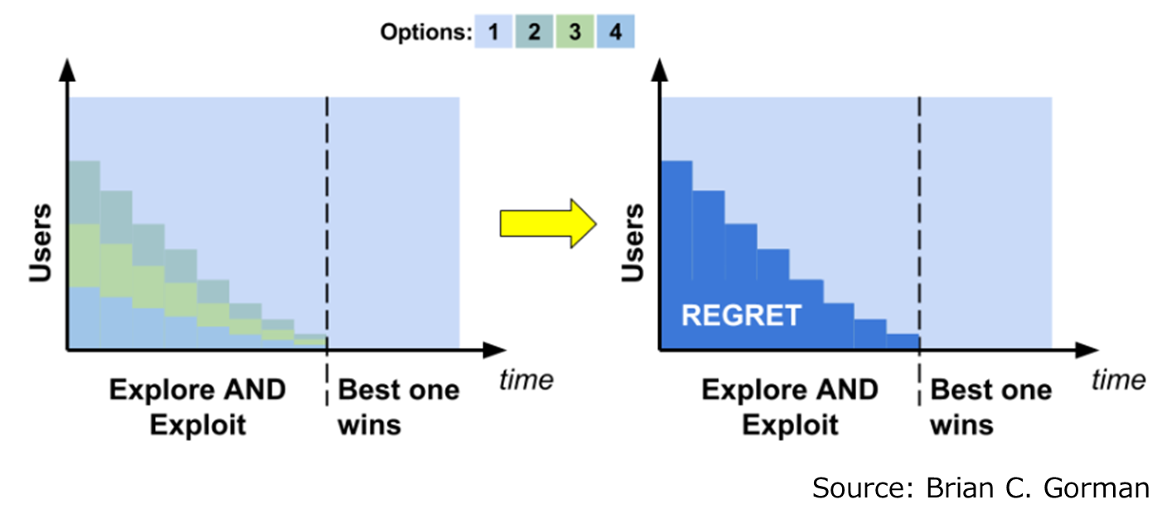
A reflection about AB tests
AB tests can be dynamic:
One could adaptably move some users to the best option so far, and reduce disutility of customers during the testing period.
Netflix, for instance, has used reinforced learning to do adaptable AB tests for their content recommendations.
Notes:
https://github.com/brian-c-ogorman/ABanditTesting

Slide 16
Discrete Choice Experiment

Slide 17
Santa Fe hired an advertising and marketing company to evaluate consumer characteristics

Slide 18
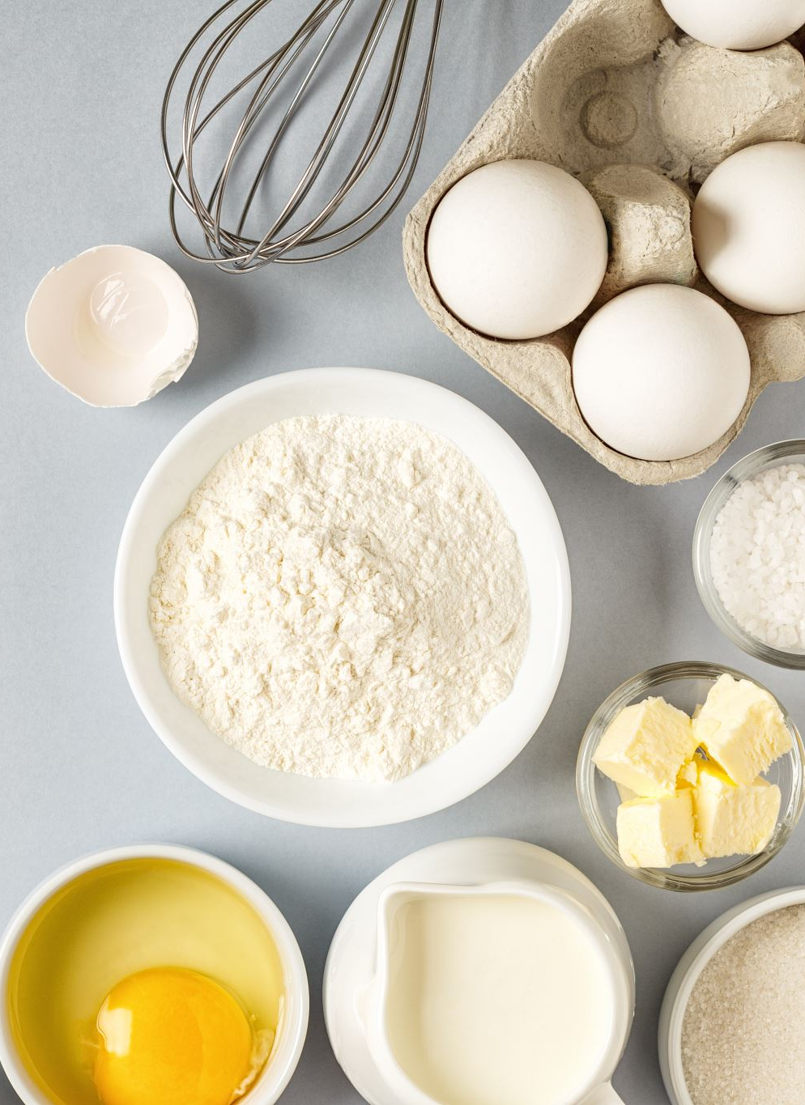
What mixture of features Santa Fe clients value more?
Menu Size
Location
Restaurant Size
Price

Slide 19
Each respondant (n=200) answers this ten times with different combinations

Slide 20
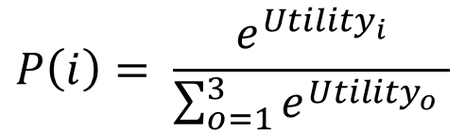
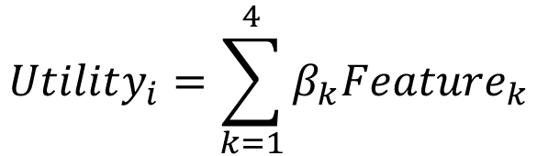
Discrete choice model:
The utility of a particular option i is a weighted sum of the value of the k features available in that option
$$Utility_{i}=\sum_{k=1}^{4}{β_{k}Feature_{k}}$$
The prob. of choosing option i depends on its utility relative to the utility of the other options o:
$$P\left(i\right)= \frac{e^{{Utility}_{i}}}{\sum_{o=1}^{3}{e^{{Utility}_{o}} }}$$

Slide 21

Let’s move to another statistical software (Python)

Slide 22
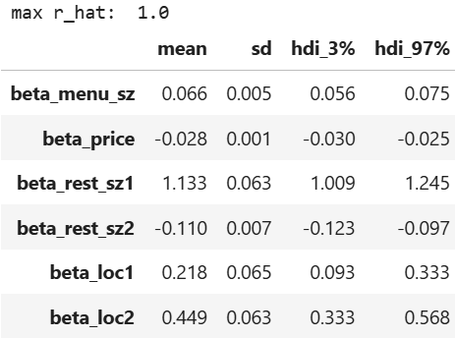
People value:
Larger menu sizes (+ beta)
Smaller prices (- beta)
Larger restaurants (+beta, _sz1 is linear rest_sz), up to a point (-beta, _sz2 is squared rest_sz)
They prefer suburban (loc1) and riverside (loc2) over a generic downtown location (ref).

Slide 23
Task 10:
The results indicate people like low prices, but you cannot compete with Southwestern in that dimension, you just do not know how they offer their low prices.
Based on the discrete choice and AB experiment results what would be your strategy?
Your answer (in-person):
Your AI agent answer:

