Slide 1






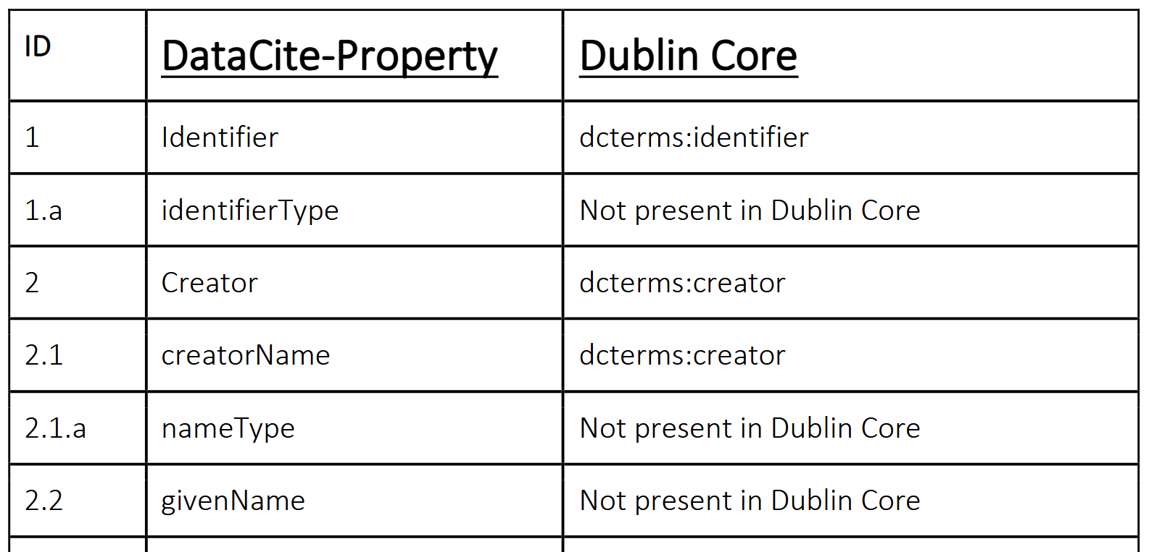
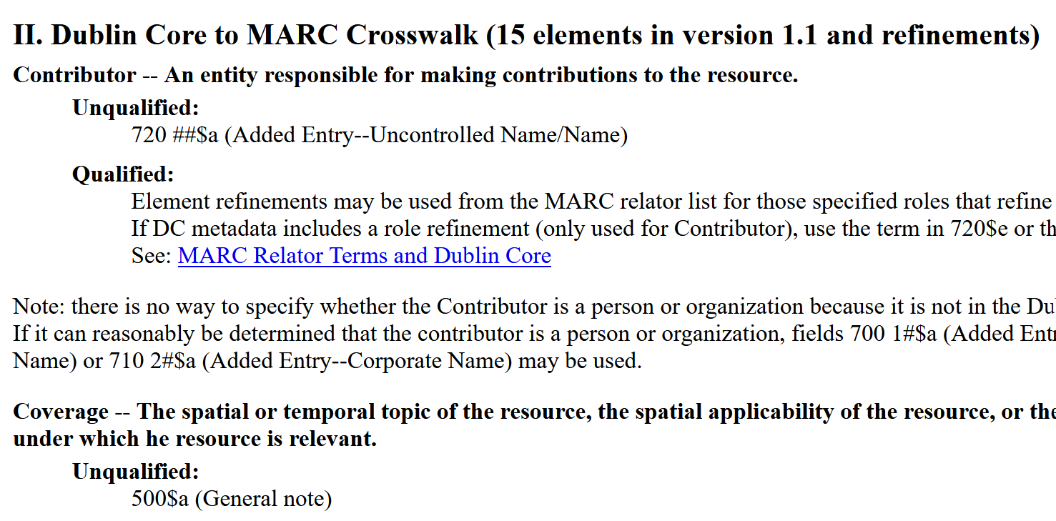

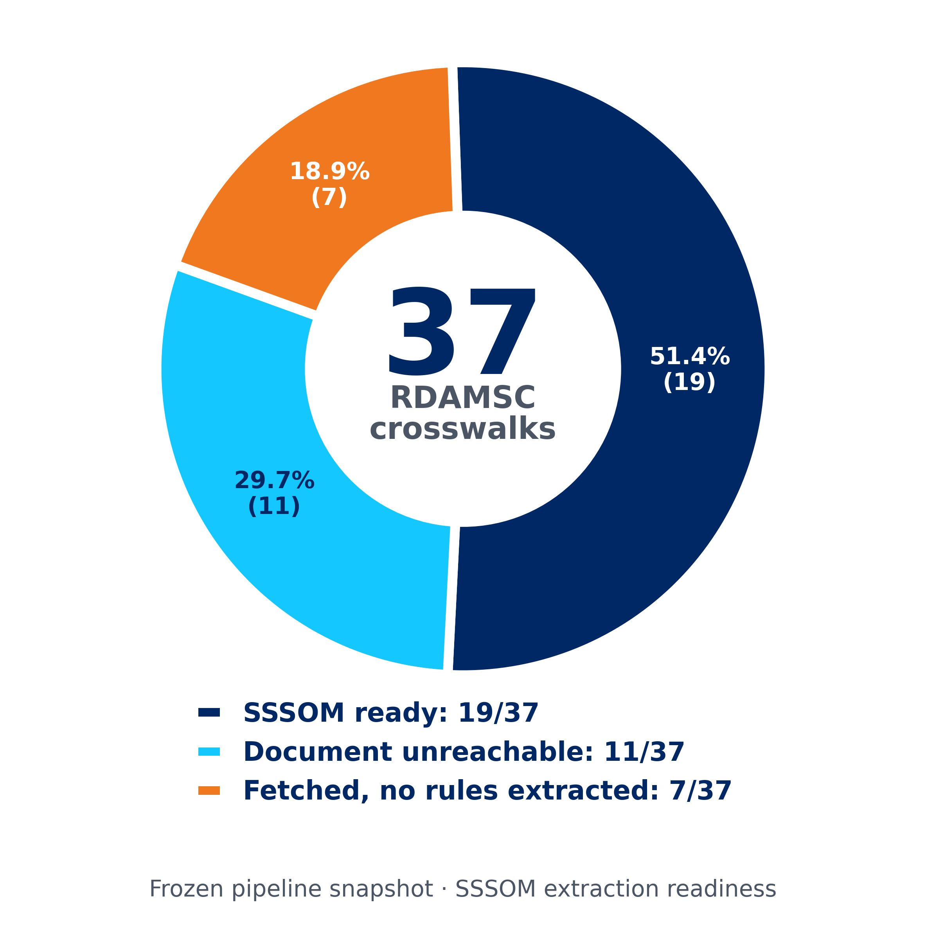
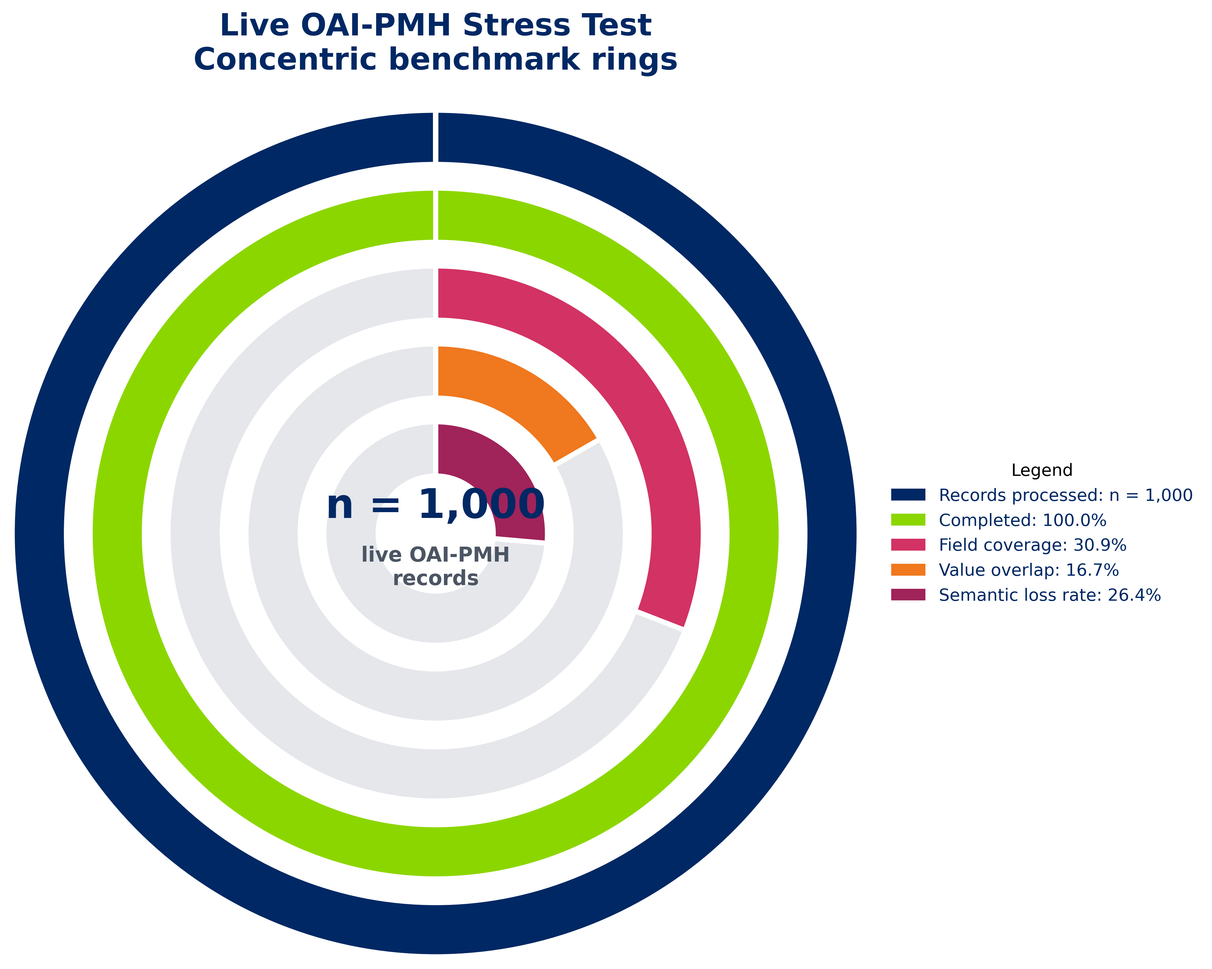
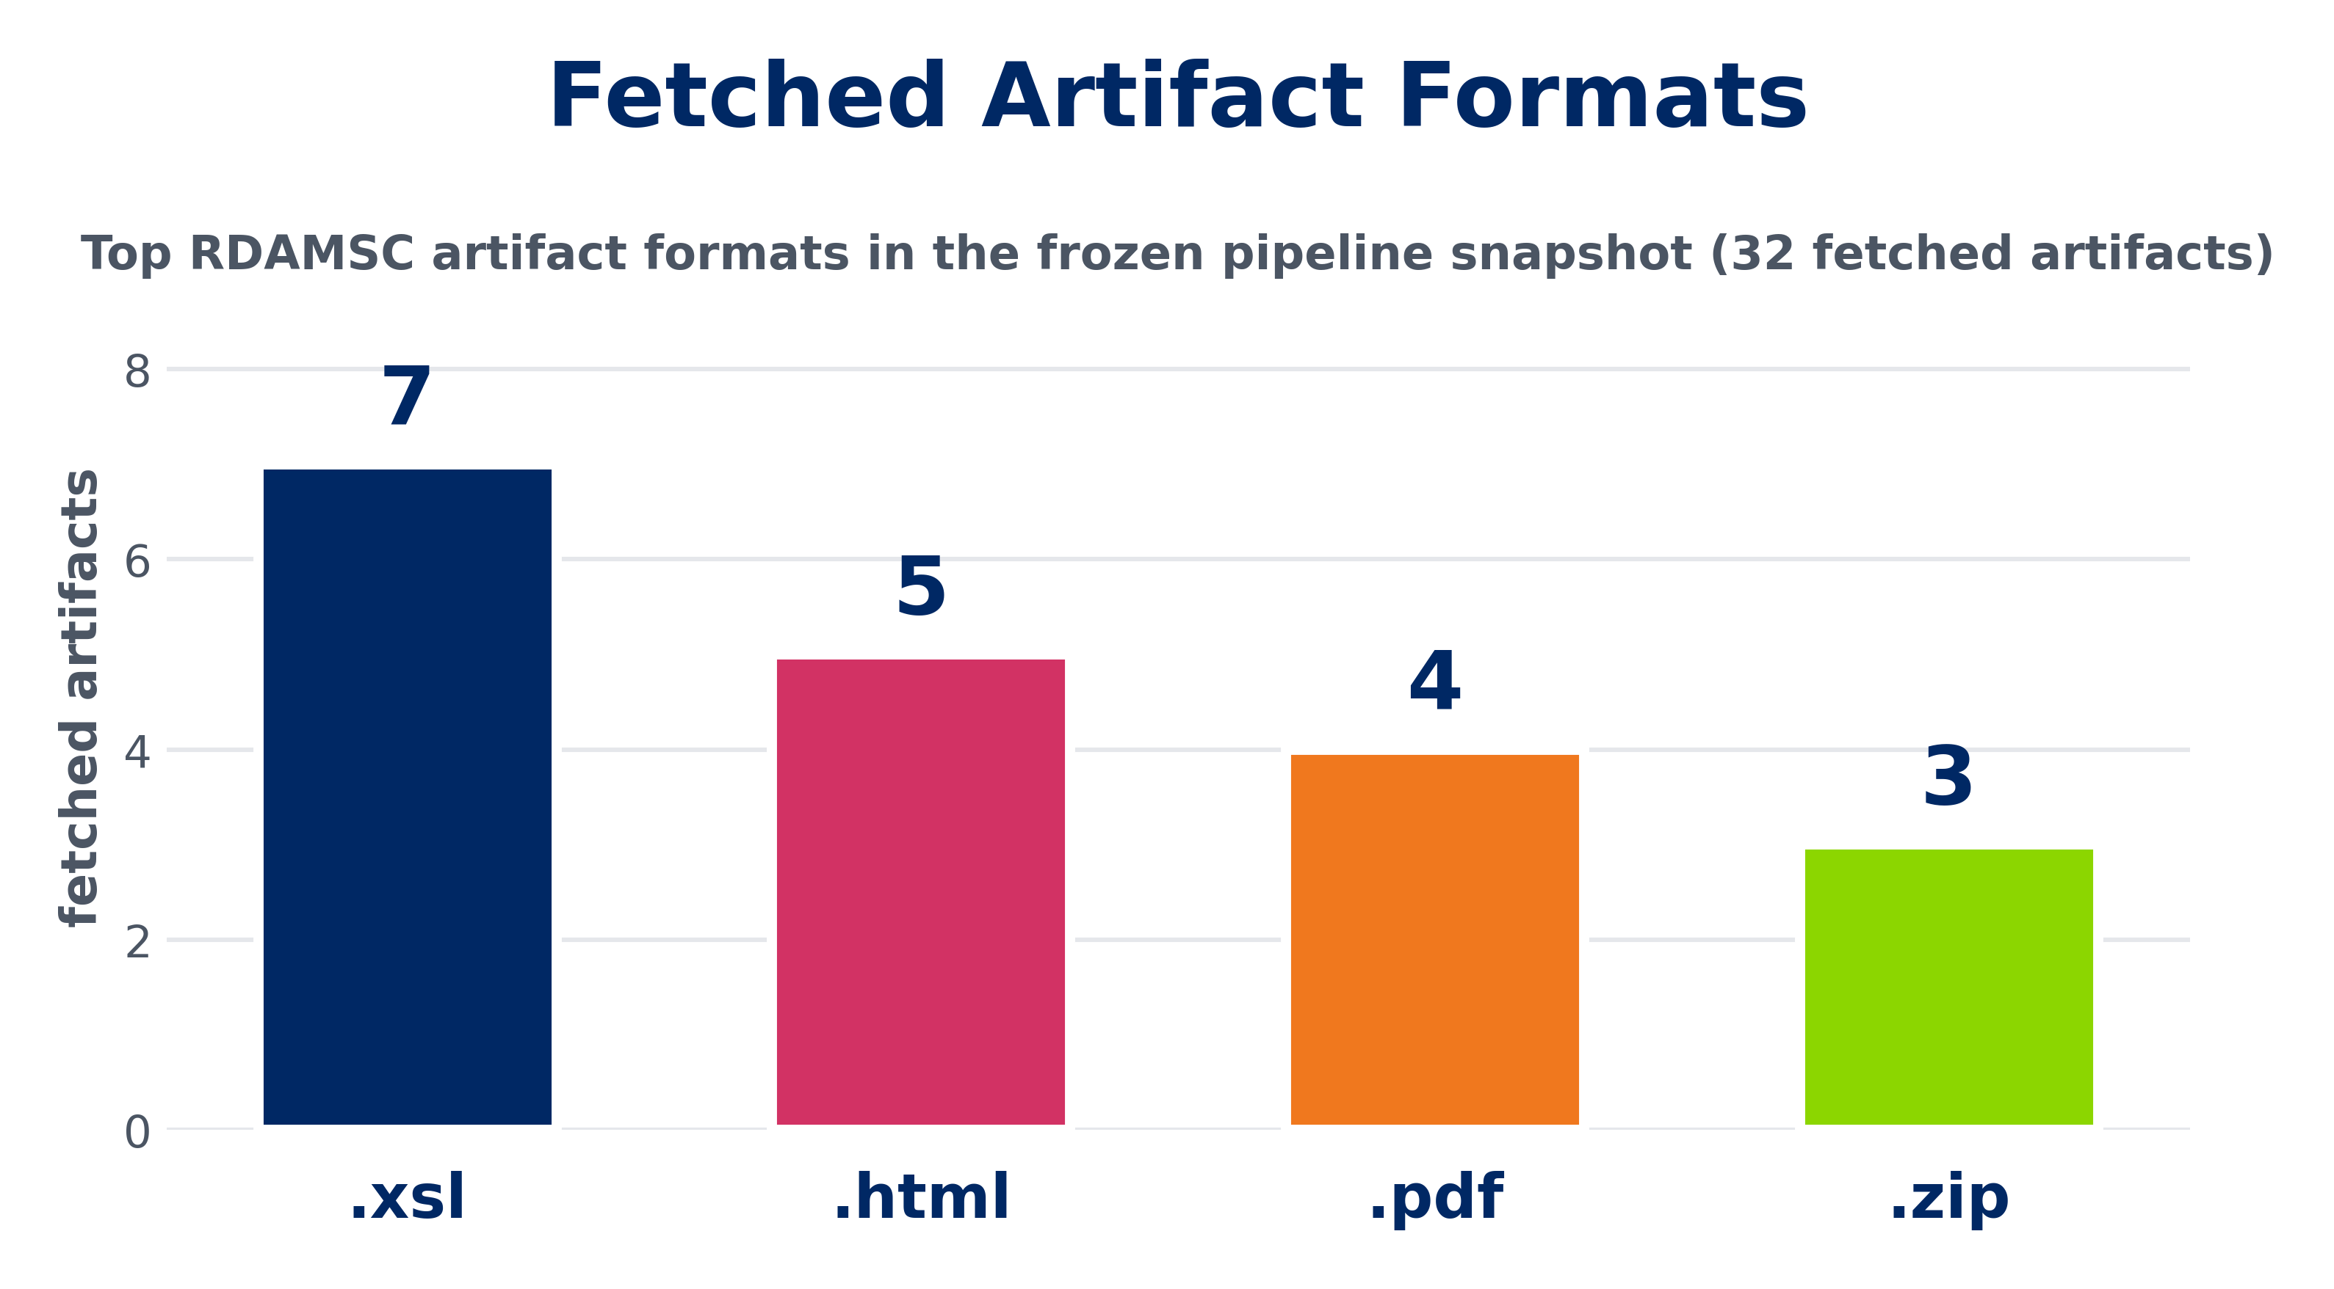
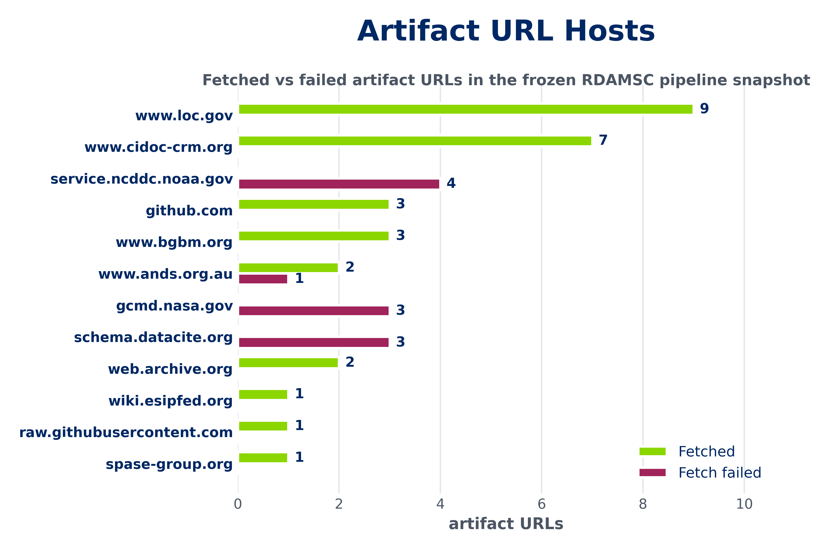
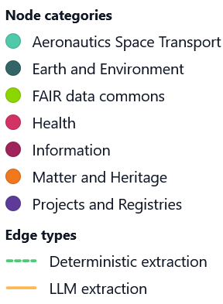
HELMHOLTZ AI CONFERENCE 2026 · MUNICH · 8–11 JUNE · TRACK: APPLICATIONS OF AI
M²S³OM-graph
A hybrid deterministic–LLM pipeline for automated metadata crosswalk extraction and graph-grounded interoperability
Gitlab Repository
Santiago Casas · Scientific Information, Deutsches Zentrum für Luft- und Raumfahrt (DLR)
orcid.org/0000-0002-4751-5138
ror.org/04bwf3e34
10.48805/ebsg-sx38
37
51%
993
75.2%
20
32/45
7
RDAMSC crosswalks evaluated
Solved by deterministic parsers
SSSOM mapping rows
DataCite -> DublinCore coverage
Metadata standards in the graph
Artifacts fetched
Domain categories represented
01 · BACKGROUND
02 · APPROACH
Metadata Crosswalks are document-based
Deterministic first, LLM only when needed
Mapping specifications are published as human-readable artifacts. No tool harvests them systematically.
Format-specific parsers carry the load. LLMs are reserved for artifacts that genuinely resist structure.
Research Data Alliance (RDA) provides mappings as documentation: https://rdamsc.bath.ac.uk/mapping-index
Mappings(=Crosswalks) live as human-readable artifacts — HTML tables, XSL stylesheets, PDFs, free text.
Semantic loss is rarely flagged.
No existing tool harvests these rules systematically across standards.
Without a machine-executable layer, every conversion is handled by hand at the data infrastructure provider.
Deterministic first. Format-specific parsers handle structured artifacts without any model call —> reproducible, auditable- Parsers were coded with Gen-AI (Blablador).
LLM as fallback. Blablador (Helmholtz-AI infrastructure) is invoked only when an artifact resists deterministic parsing.
SSSOM as target. Every rule is a row in a TSV as Simple Standard for Sharing Ontological Mappings (SSSOM) — community standard, diff-friendly, version-controlled.
TABLE · DATACITE ↔ DC
TEXT · DataCite ↔ MARC
03 · METHOD
Sync & artifact fetch
Convert to text
Deterministic
LLM fallback
SSSOM export
Graph load
Apply at runtime
MarkItDown normalises every artifact to markdown.
Format-specific parsers extract rules where structure permits.
BlaBlador targeted only on artifacts the parsers can’t handle.
Rules emitted as TSV with confidence level using the SKOS vocabulary, graph-ready
SurrealDB stores standards as nodes, rules as edges.
Conversion engine transforms harvested OAI-PMH records on demand.
Pipeline
API harvest of mapping documentation and artifact URLs. PDF · XSL · HTML · XML · DOC · RTF
04 · RESULTS
05 · BENCHMARK
06 · CORPUS
Crosswalk outcome distribution
DataCite → Dublin Core
Artifact formats & hosts
Applying the extracted rules end-to-end on a real n=1000 harvest.
Heterogeneous landscape: XSL and HTML dominate. NASA / NOAA endpoints account for most fetch failures.
doi: 10.48805/ebsg-sx38
51% of crosswalks have authoritative SSSOM output; 30% blocked by unreachable artifacts.
Lower overlap is expected: Dublin Core is a deliberately broad target schema, so rich DataCite metadata is compressed into fewer, less specific fields. The benchmark quantifies this semantic loss rather than indicating pipeline failure.
07 · GRAPH
Crosswalks as a knowledge graph
Standards are nodes; mapping rules are weighted edges. Direct mappings cover the easy pairs; transitive paths will unlock the long tail.
08 · TAKEAWAYS
EML
Standards become nodes; crosswalks become edges.
Each edge keeps the mapping rules, confidence, semantic-loss flags, and source evidence.
The graph makes indirect routes visible, e.g. A → B → C when no direct A → C crosswalk exists.
Provenance stays attached to the rule, not buried in the original PDF, HTML, or XSL file.
Conclusions
LIDO
RIF-CS
Structure beats guesswork: parse what is structured, use LLMs only where documents break down.
The main bottleneck is not only AI accuracy, but fragile metadata infrastructure: dead links, old formats, and implicit semantics.
Crosswalks become more useful when they stop being static documents and become executable, versioned SSSOM mappings.
The graph turns isolated mappings into an interoperability network: standards as nodes, crosswalks as navigable edges.
Provenance is the difference between “the model said so” and an inspectable mapping rule.
The benchmark shows the system can run on real records, and makes the remaining semantic gaps measurable.
CIDOC CRM
ANZLIC
MIDAS-Heritage
NetCDF
EAD
DDI
ISO 19115
Darwin Core
MARC
Dublin Core
EURISCO
DataCite
ABCD
MODS
OECD
HISPID
SPASE
09 · FUTURE WORK
Graph-RAG over the crosswalk graph
The same evidence chunks that justify extracted rules can propose new ones: retrieval-grounded, not hallucinated.
Transitive paths
Graph-RAG candidates
Confidence from retrieval
Curator feedback loop
Discover A → B → C routes through the graph when no direct crosswalk exists.
Retrieve evidence chunks from the graph to propose mappings for uncharted standard pairs.
Score candidate rules by retrieval quality, not just model self-report.
Accepted / rejected decisions feed back as supervised signal for the extractors.
CONTACT santiago.casas@dlr.de
HELMHOLTZ METADATA COLLABORATION · DLR, SCIENTIFIC INFORMATION
M²S³OM-graph

