Slide 1
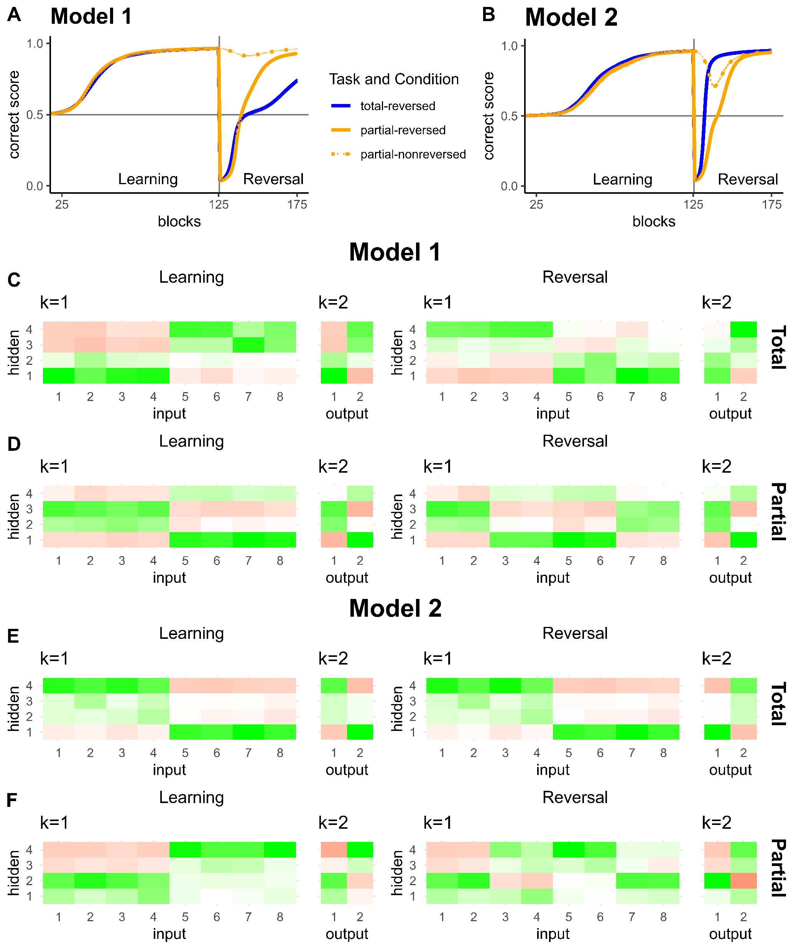
Category 2
Category 1
Category 1
Category 2
Category 2
Category 2
Category 1
Category 1

