Slide 1



OneReach x Oxford ChatGPT Expertiment 2
Riddhi J. Pitliya
8 Dec 2024

Slide 2
Demographic Information
Total |  | Counterbalance A |  | Counterbalance B
Property | Value | Property | Value | Property | Value
N | 117 | N | 62 | N | 55
Number of Males | 59 | Number of Males | 34 | Number of Males | 25
Number of Females | 57 | Number of Females | 27 | Number of Females | 30
Number of Other Gender | 1 | Number of Other Gender | 1 | Number of Other Gender | 0
Mean Age | 41.829 | Mean Age | 42.016 | Mean Age | 41.618
SD of Age | 6.177 | SD of Age | 6.630 | SD of Age | 5.678

Slide 3
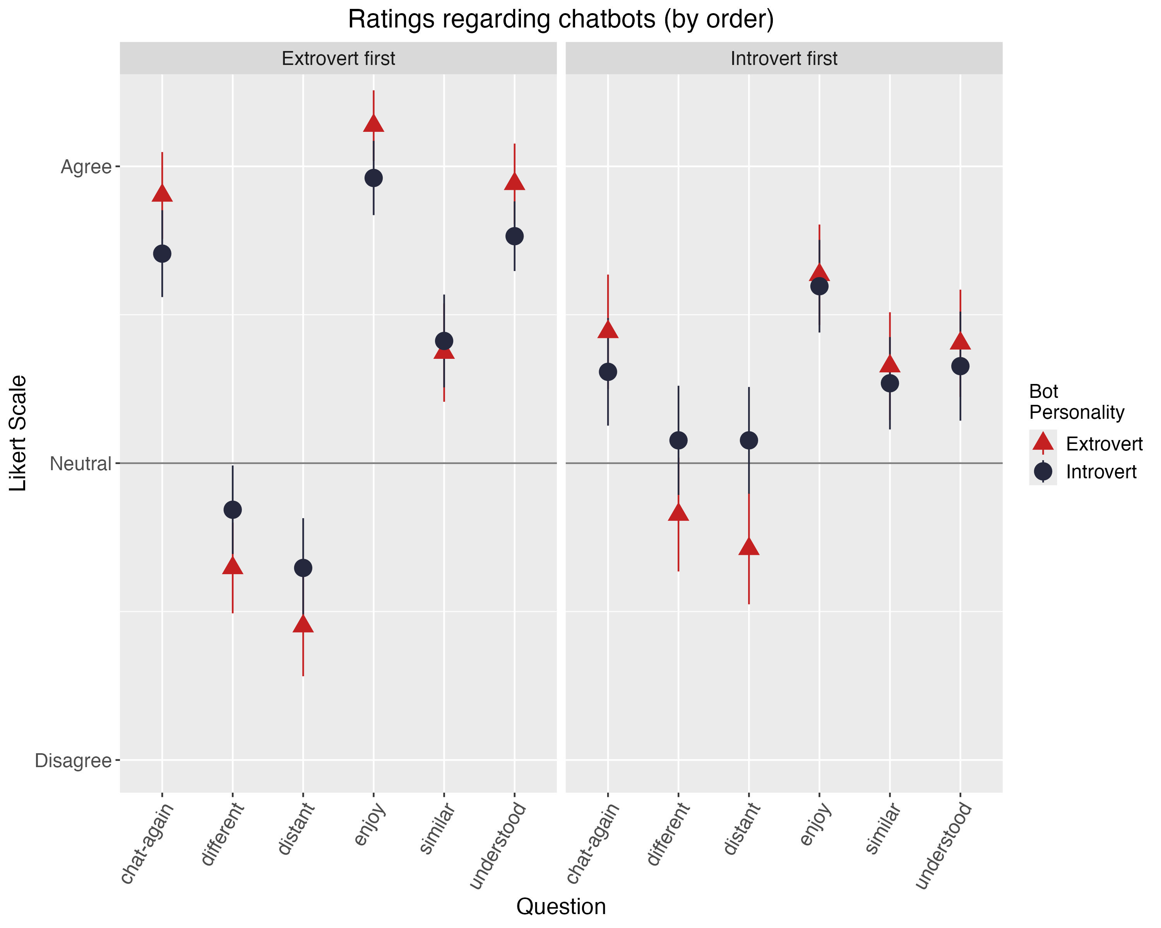
No significant order effect for:
Chat-again
Different
Distant
Similar
Significant order effect only (no interaction effect) for:
Enjoy
Understood
So, we combine the data for further analysis.
Notes:
Participants who interacted with the introverted chatbot first rated their enjoyment significantly lower compared to those who interacted with the extroverted chatbot first, (β = -0.503, t(202) = -2.463, p = .015). However, there was no statistically significant interaction between chatbot personality and order of presentation, (β = 0.138, t(202) = 0.478, p = .633), suggesting that the effect of chatbot personality on enjoyment does not depend on the order of interaction.
Participants who interacted with the introverted chatbot first rated their perception of being understood significantly lower compared to those who interacted with the extroverted chatbot first, (β = -0.537, t(202) = -2.413, p = .017). However, there was no statistically significant interaction between chatbot personality and order of presentation, (β= 0.100, t(202) = 0.316, p = .752), indicating that the chatbot's personality does not influence perceptions of being understood differently based on the order of interaction.
The analysis revealed that the main effects of chatbot personality were not statistically significant, indicating that chatbot personality alone does not significantly influence participants ratings. To confirm this finding, a sensitivity analysis was conducted by removing the order of chatbot interactions as a fixed effect from the model. The results of this simplified model were consistent, showing no significant main effects of chatbot personality.

Slide 4
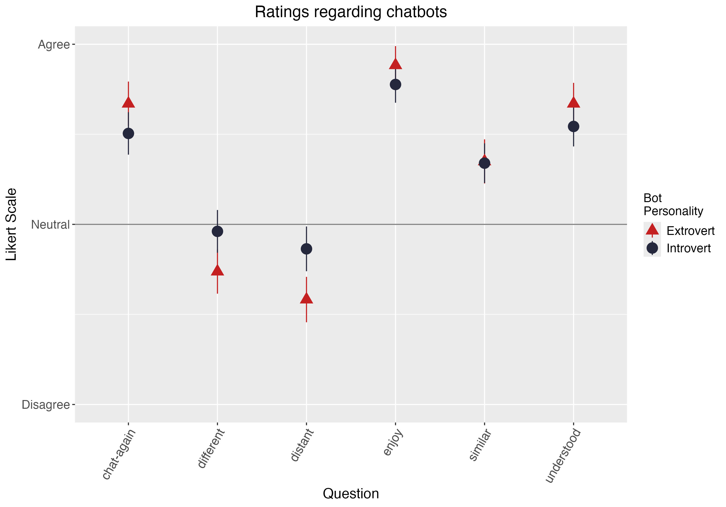

Slide 5
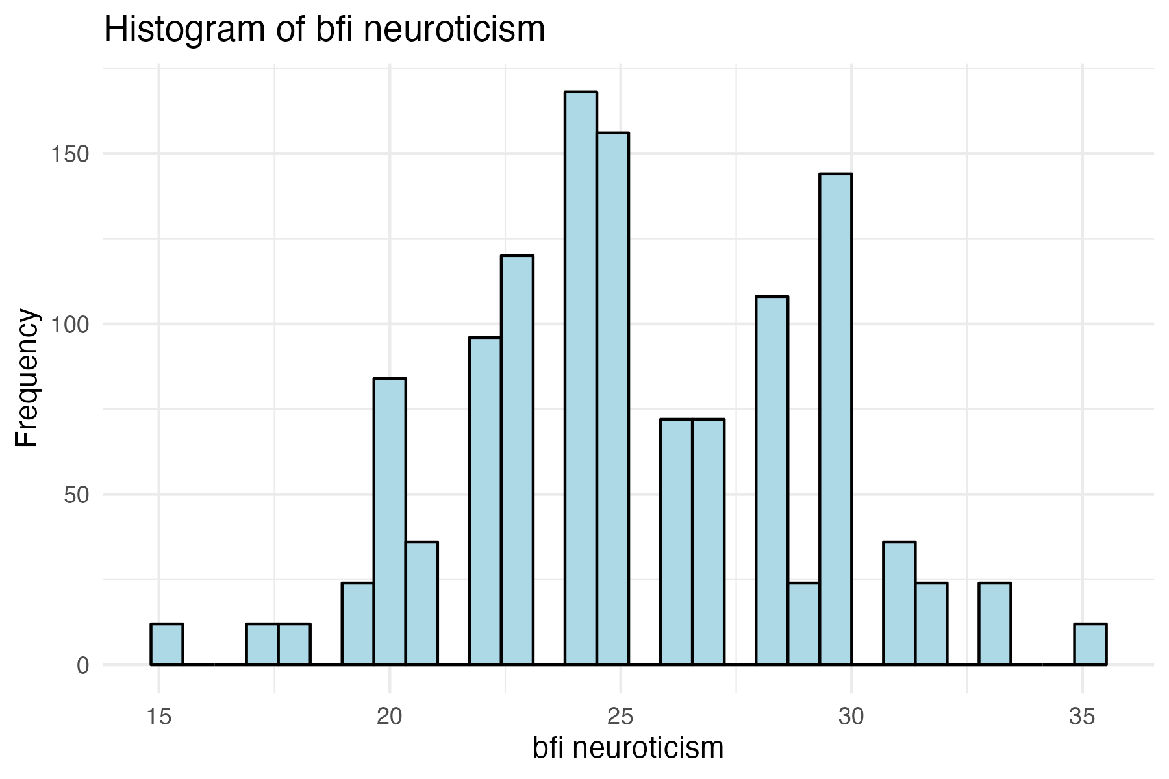
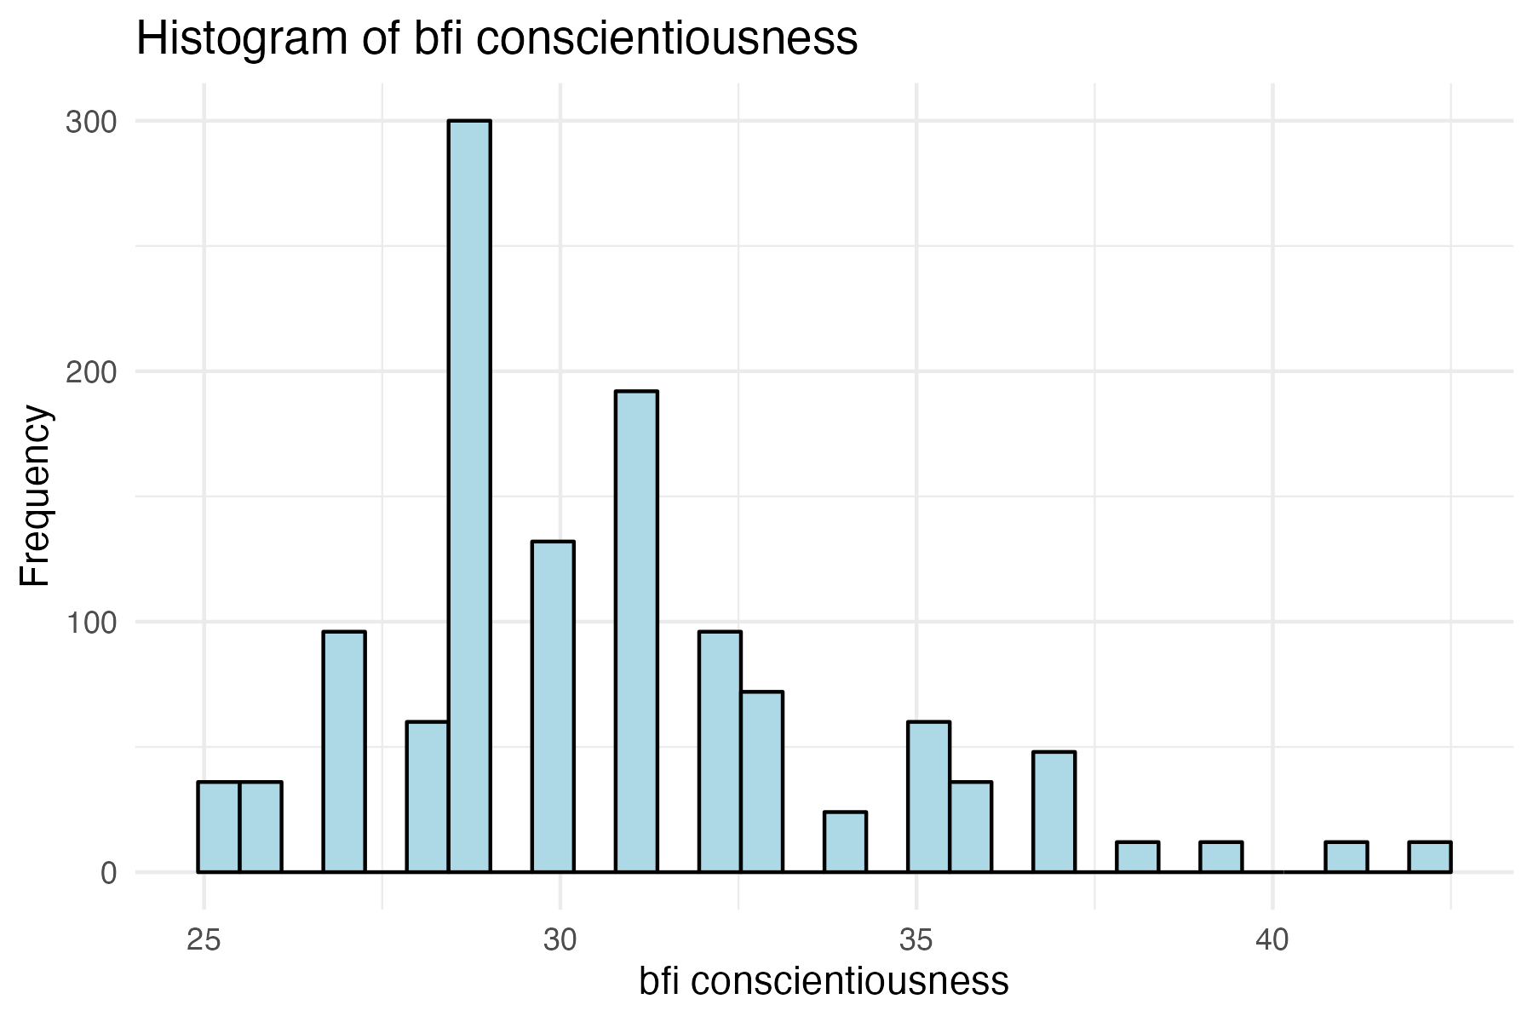
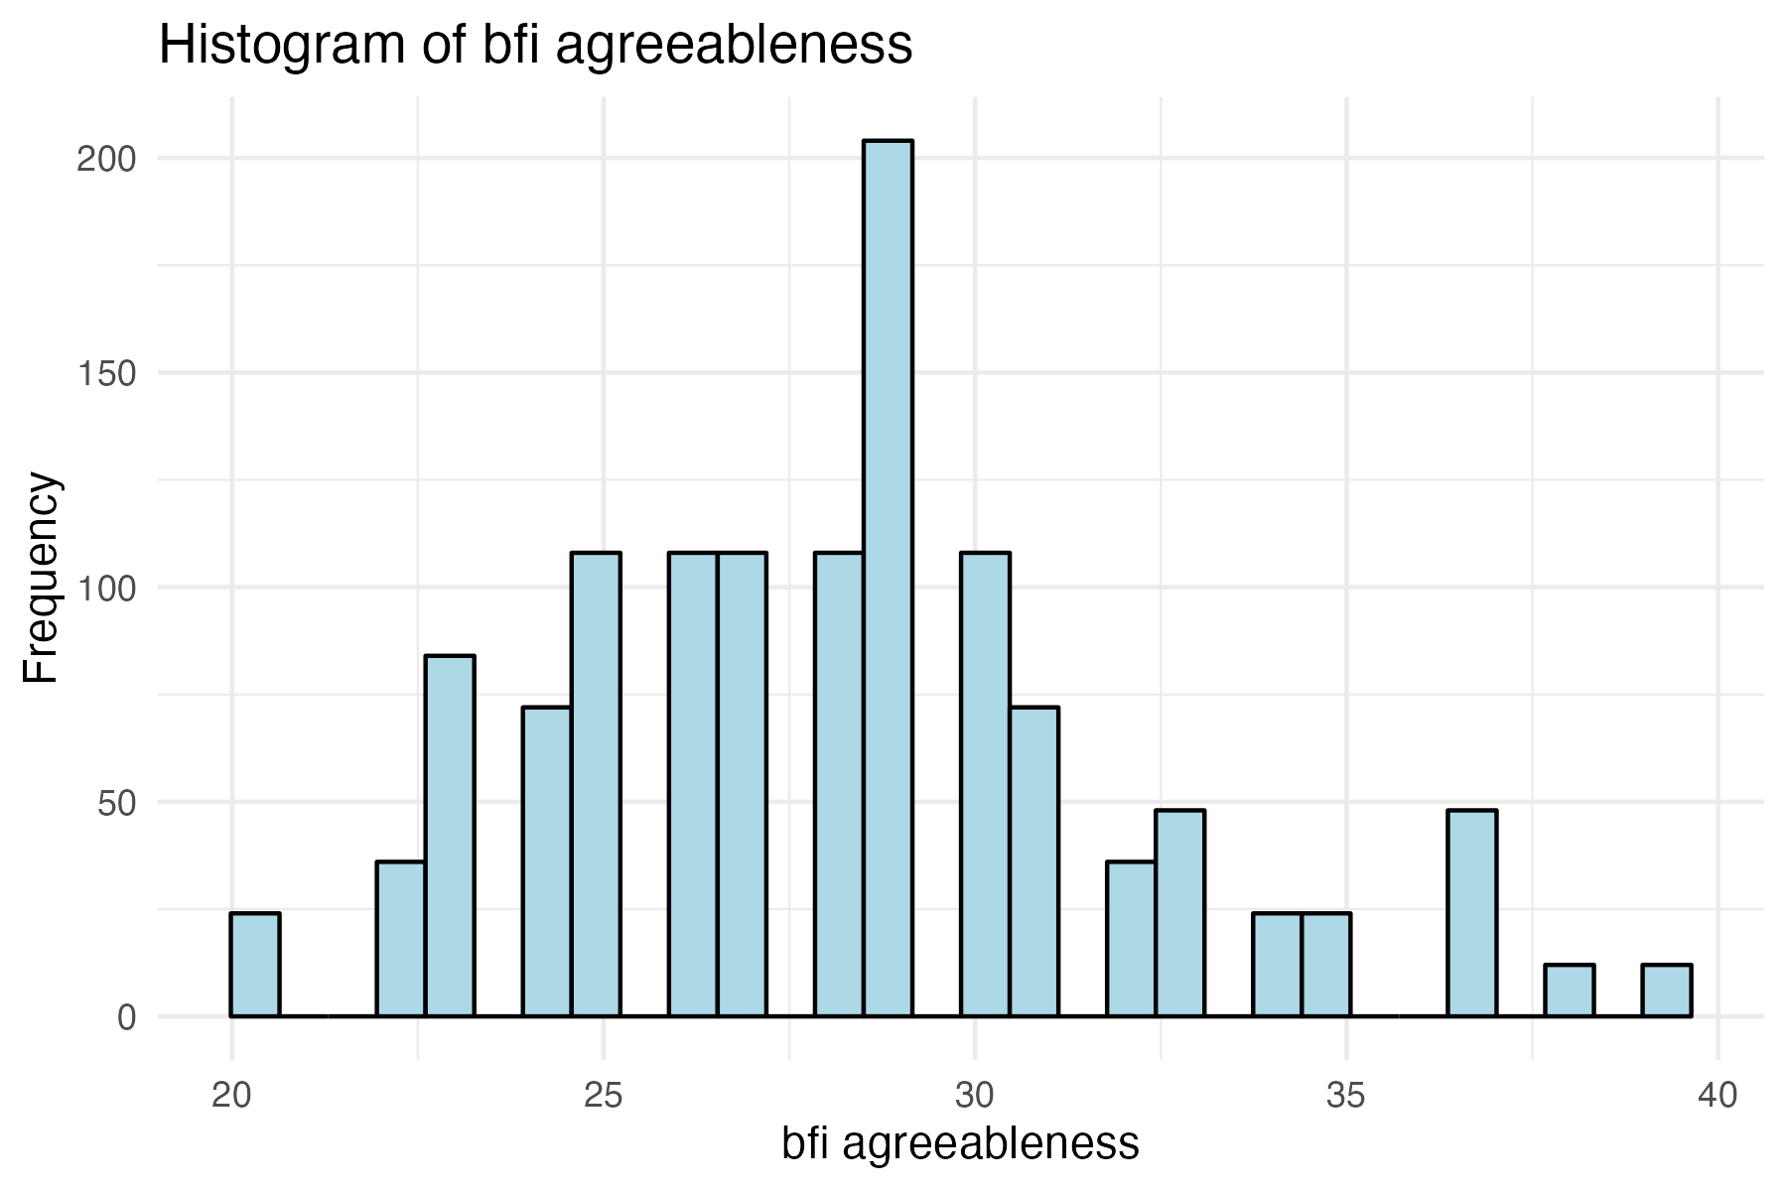
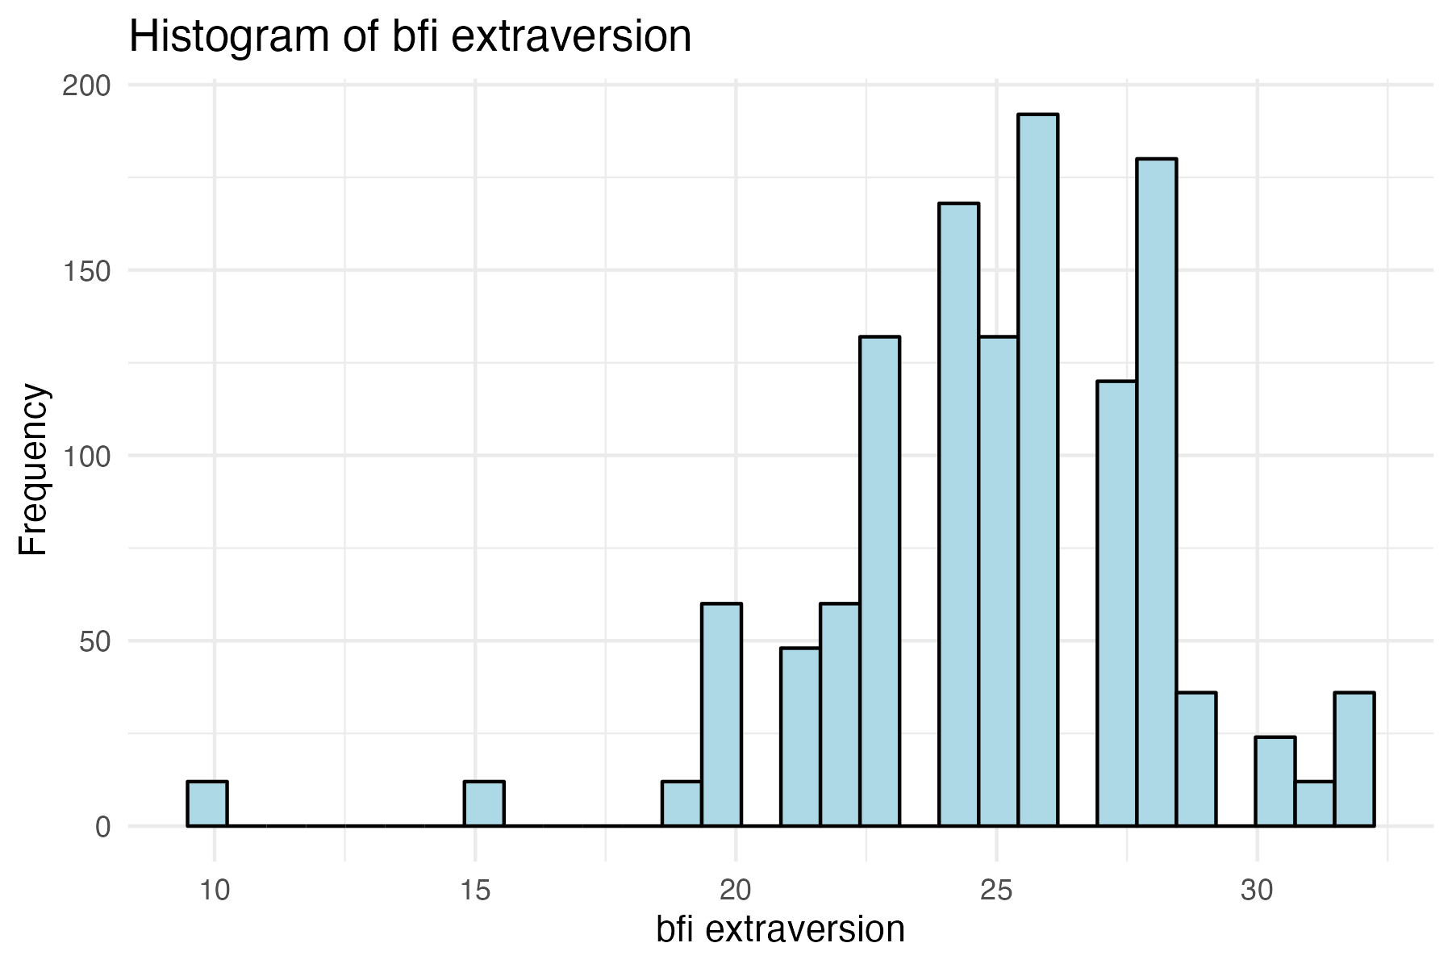
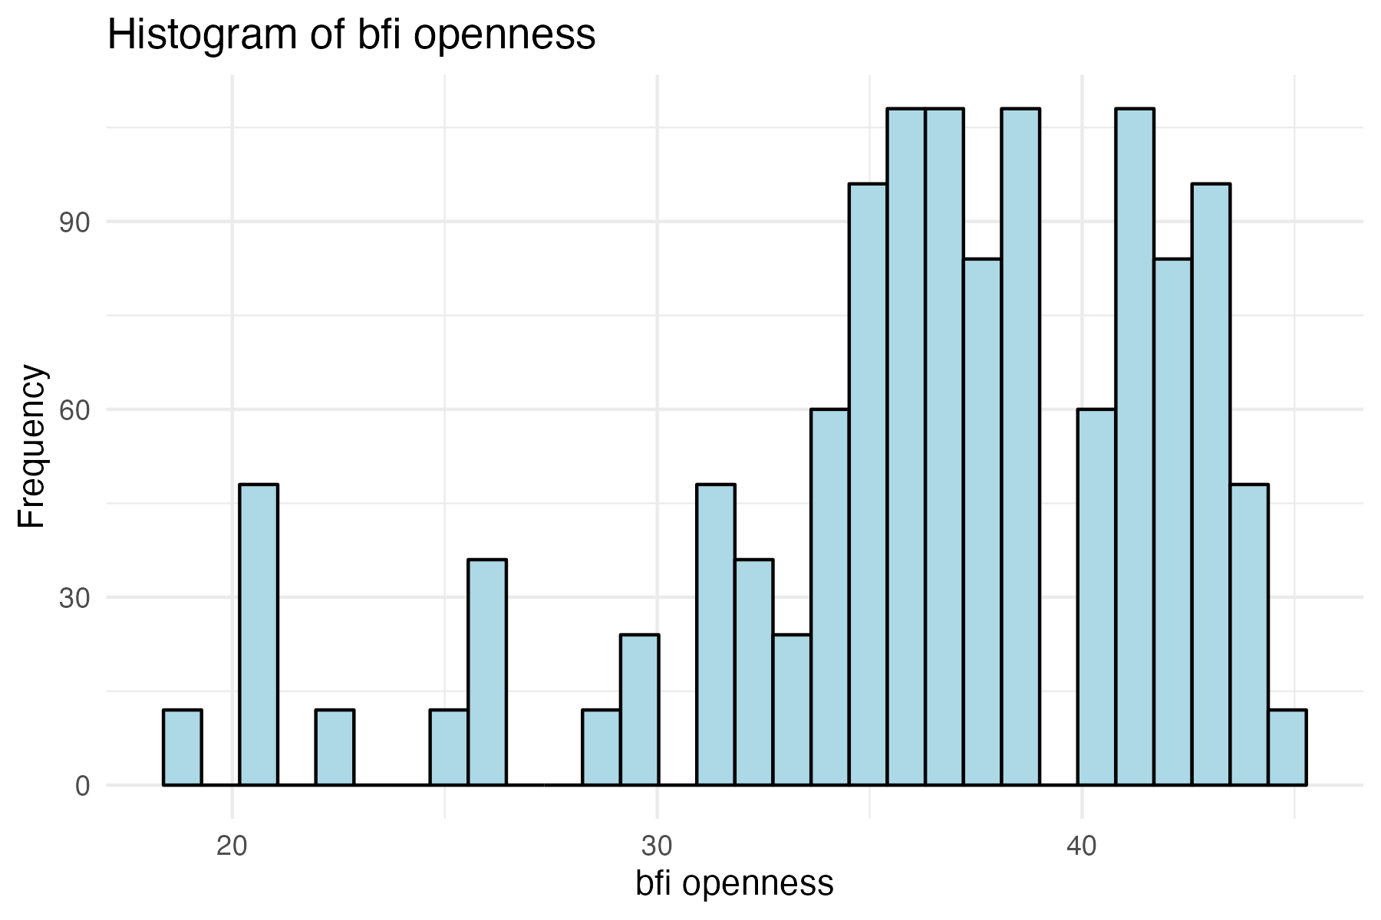
Histograms of the BFI factors

Slide 6
Ratings ~ chatbot * participant personality
Plots can be found in mega_plot.pdf
Statistical results can be found in chatbot_analysis_results.xlsx [NOT THE CSV FILE] (significant results highlighted in green)
Statistically significant items:
Main effect of BFI_extraversion regarding enjoy
Main effect of BFI_openness regarding understood
Interaction effect of chatbot_introvert*BFI_openness regarding enjoy
Interaction effect of chatbot_introvert*BFI_extraversion regarding similar
Interaction effect of chatbot_introvert*BFI_conscientiousness regarding similar

Slide 7
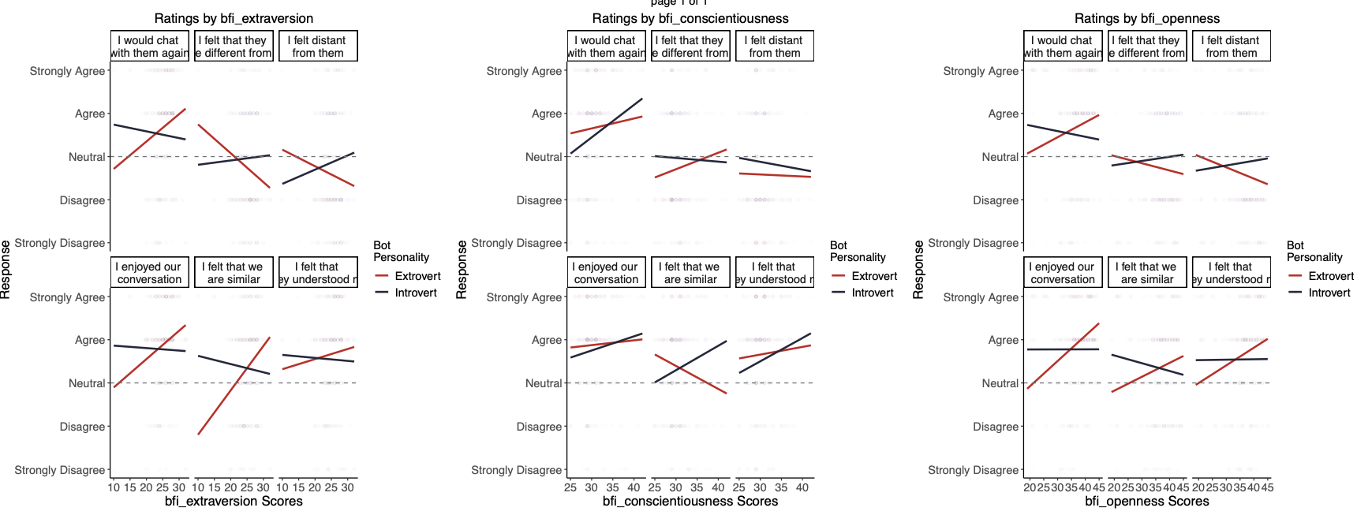
*
*
*
*
*
Notes:
Statistically significant items:
Main effect of BFI_extraversion regarding enjoy
Main effect of BFI_openness regarding understood
Interaction effect of chatbot_introvert*BFI_openness regarding enjoy
Interaction effect of chatbot_introvert*BFI_extraversion regarding similar
Interaction effect of chatbot_introvert*BFI_conscientiousness regarding similar

