Slide 1
Probabilidad

Slide 2
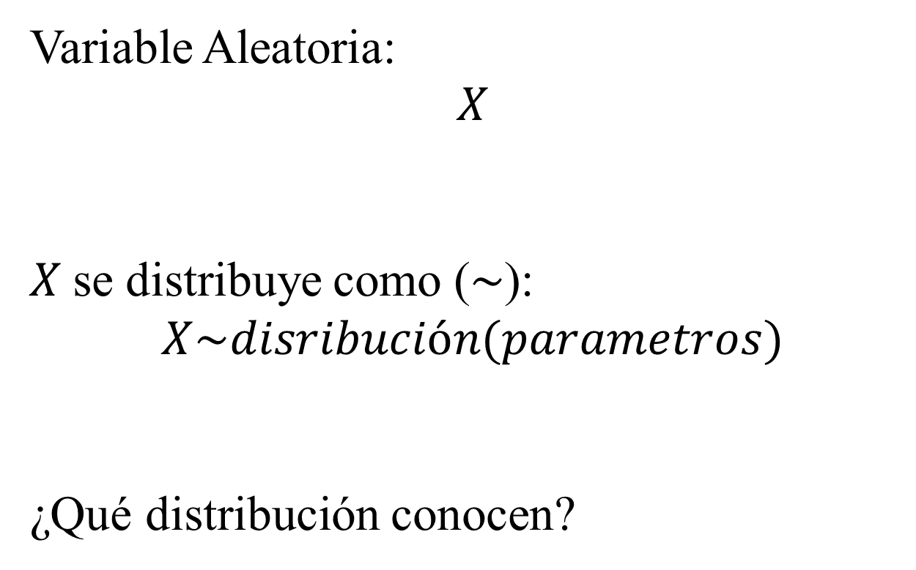
Variable Aleatoria:
$$X$$
$X$ se distribuye como ($\sim$):
$$X\sim disribución(parametros)$$
¿Qué distribución conocen?

Slide 3
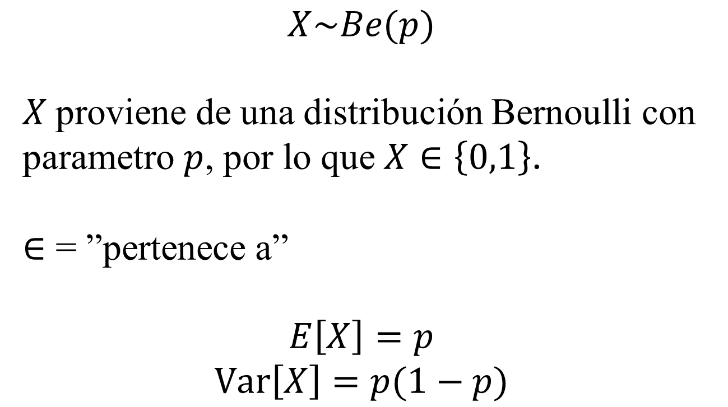
Distribución Bernoulli
$$X\sim Be(p)$$
$X$ proviene de una distribución Bernoulli con parametro $p$, por lo que $X∈\left\{0,1\right\}$.
$∈$ = ”pertenece a”
$$E\left[X\right]=p$$
$$Var\left[X\right]=p(1−p)$$

Slide 4
R_the_basics.R

Slide 5
DISTRIBUCIONES DE PROBABILIDAD
Discretas
e.g.
Distribución Binomial
Distribución de Poisson
Distribución Geométrica
etc…
Continuas
e.g.
Distribución Normal
Distribución Beta
Distribución Gama
etc…

Slide 6
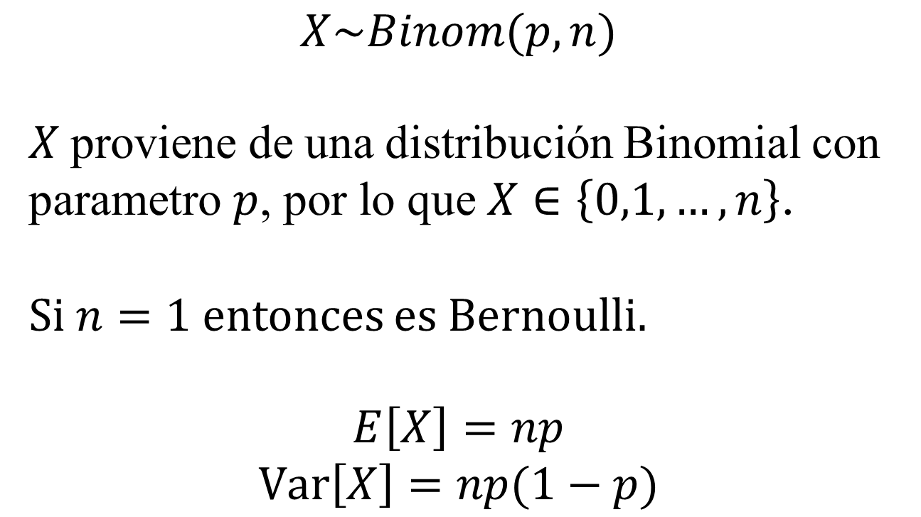
Distribución Binomial
$$X\sim Binom(p,n)$$
$X$ proviene de una distribución Binomial con parametro $p$, por lo que $X∈\left\{0,1,…,n\right\}$.
Si $n=1$ entonces es Bernoulli.
$$E\left[X\right]=np$$
$$Var\left[X\right]=np(1−p)$$

Slide 7
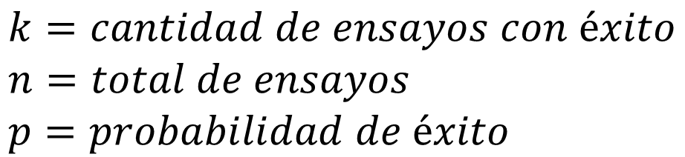
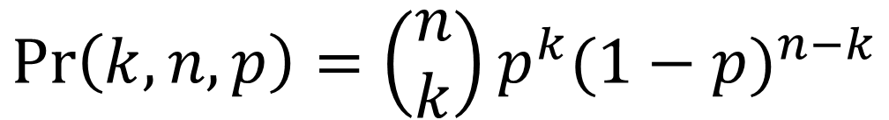
Distribución Binomial
$$\operatorname{Pr}\left(k,n,p\right)=\left(\begin{matrix}n \\ k\end{matrix}\right)p^{k}{(1−p)}^{n−k}$$
$$k=cantidad de ensayos con éxito \\ n=total de ensayos \\ p=probabilidad de éxito$$

Slide 8
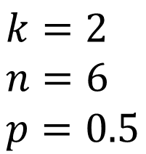
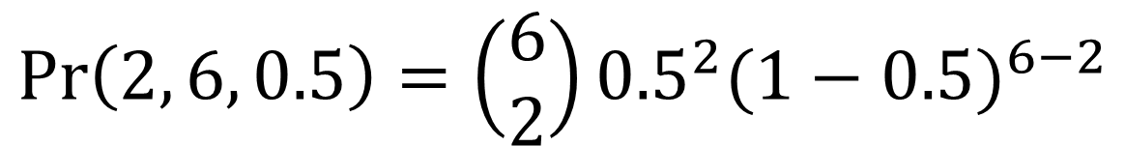
Distribución Binomial
$$\operatorname{Pr}\left(2, 6, 0.5\right)=\left(\begin{matrix}6 \\ 2\end{matrix}\right){0.5}^{2}{(1−0.5)}^{6−2}$$
¿Cuál es la probabilidad de obtener 2 águilas en 6 tiros con monedas?
$$k=2 \\ n=6 \\ p=0.5$$
$\operatorname{Pr}\left(k=2, n=6, p=0.5\right)=0.234375$ (en porcentaje 23.5%)

Slide 9
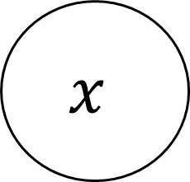
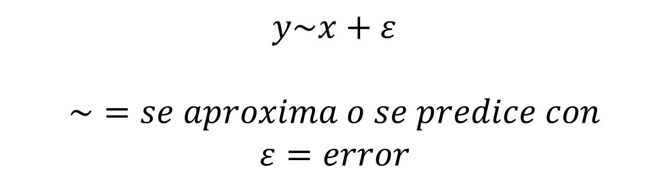
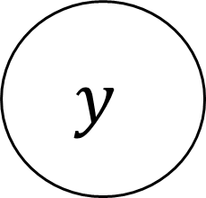
Generalizad Linear (Mixed) Model
$$x$$
$$y$$
$$y\sim x+ε$$
$$\sim =se aproxima o se predice con$$
$$ε=error$$

Slide 10

Generalizad Linear (Mixed) Model
$$x$$
$$y$$
$$y=b+mx$$
$$f\left(x\right)=b+mx$$

Slide 11
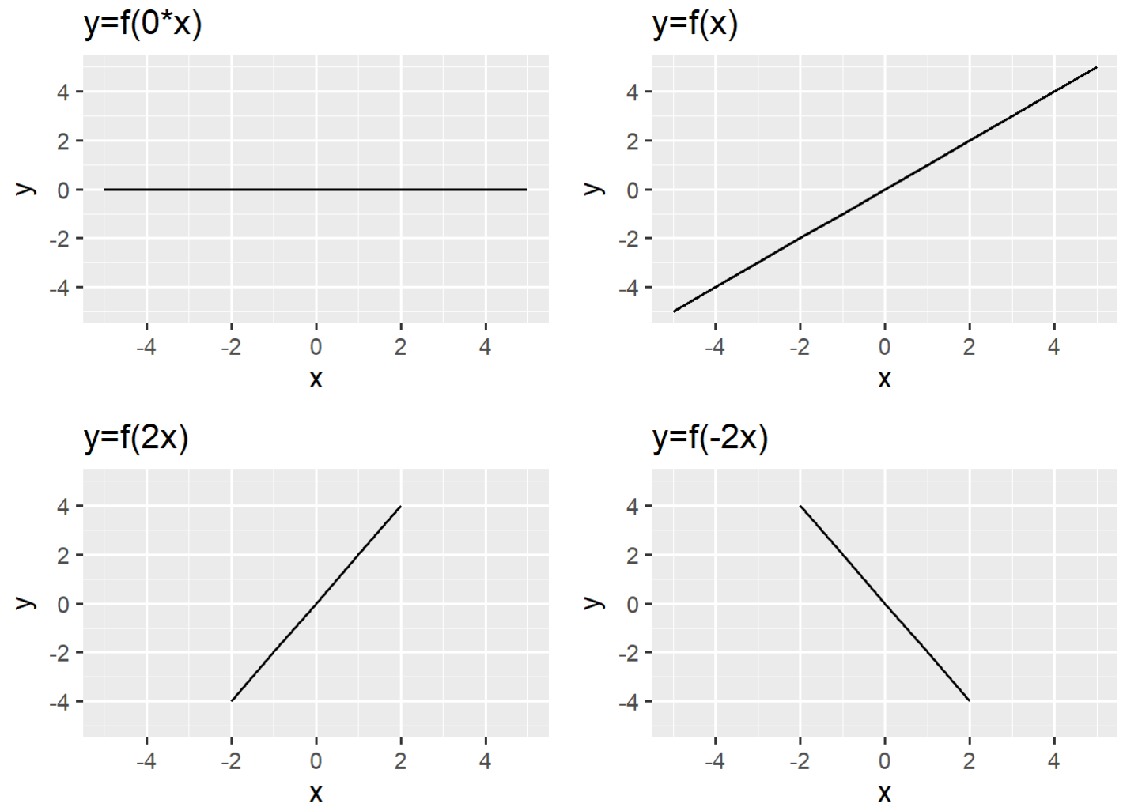

Slide 12
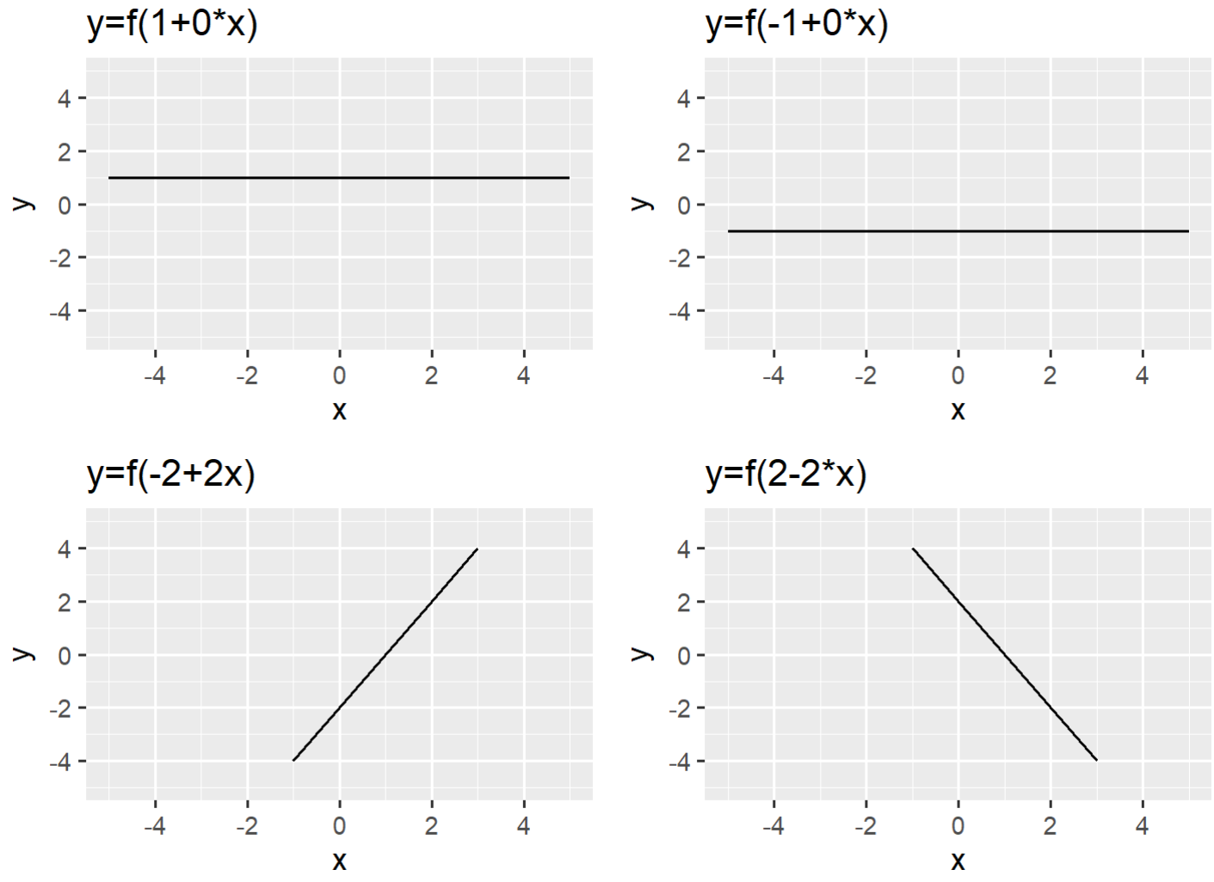

Slide 13
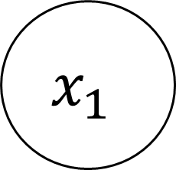
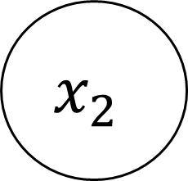


Generalizad Linear (Mixed) Model
$$x_{1}$$
$$x_{2}$$
$$y$$
$$x_{3}$$
$$y\sim x_{1}+x_{2}+x_{3}+ε$$

Slide 14
Generalizad Linear (Mixed) Model
$$x_{1}$$
$$x_{2}$$
$$y$$
$$x_{3}$$
$$y\sim β_{0}+β_{1}x_{1}+β_{2}x_{2}+β_{3}x_{3}+ε$$

Slide 15
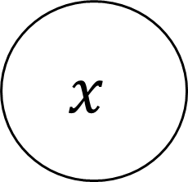

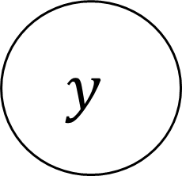
Generalizad Linear (Mixed) Model
$$m$$
$$x$$
$$y$$
$$y\sim x+m+xm$$

Slide 16
Generalizad Linear (Mixed) Model
$$m$$
$$x$$
$$y$$
$$y\sim β_{0}+β_{1}x+β_{2}m+β_{3}xm$$

Slide 17
Relacion_entre_variables.R

Slide 18
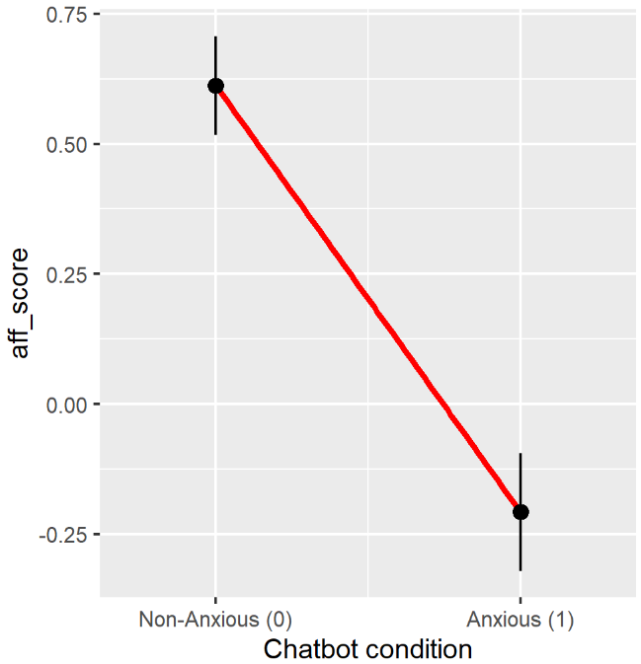
GLM and regression
$$y\sim β_{0}+β_{1}Chatbot(anxious=1)$$

Slide 19
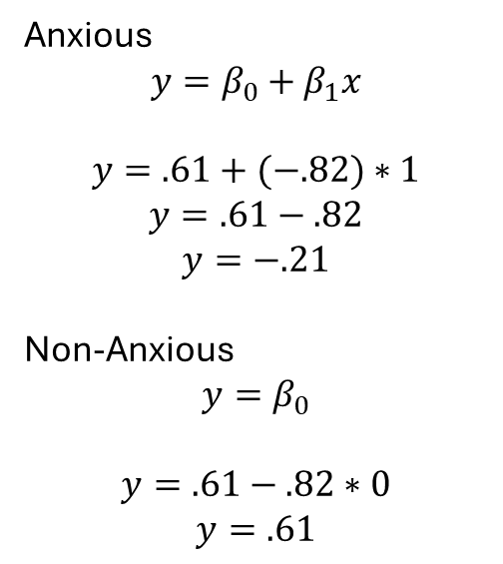
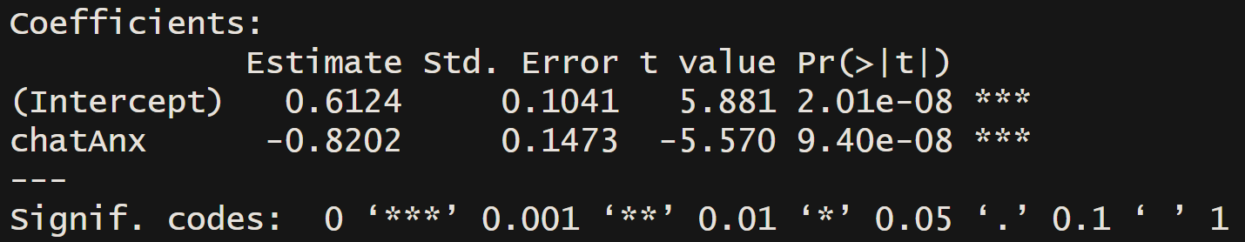
GLM and mean difference
Anxious
$$y=β_{0}+β_{1}x$$
$$y=.61+(−.82)∗1$$
$$y=.61−.82$$
$$y=−.21$$
Non-Anxious
$$y=β_{0}$$
$$y=.61−.82∗0$$
$$y=.61$$

Slide 20
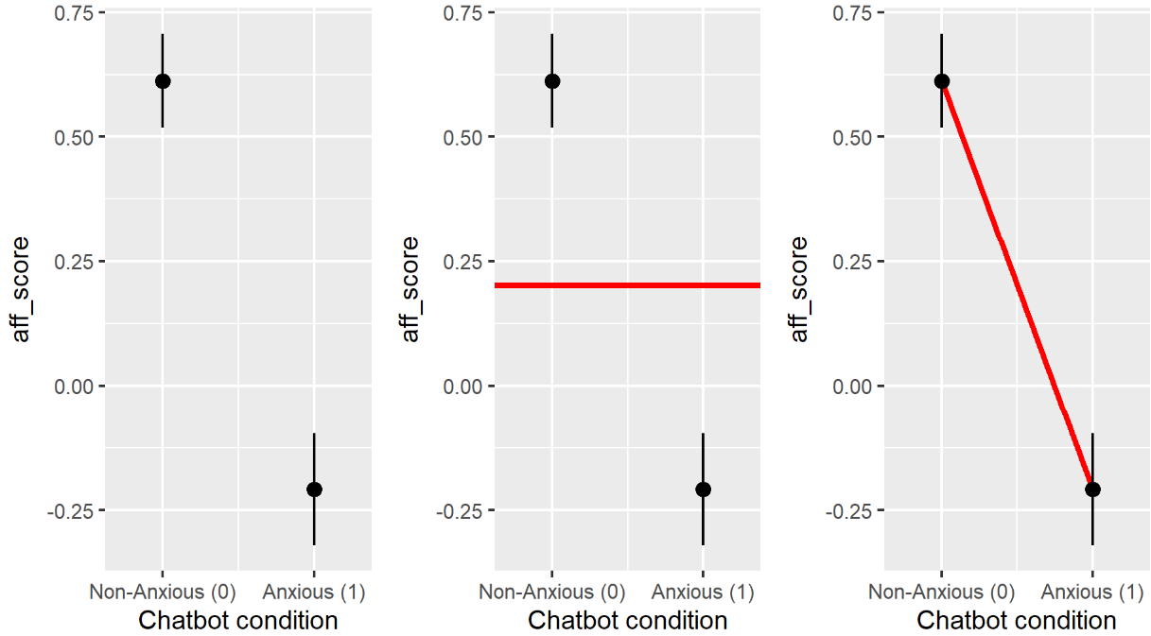


GLM and model comparison
$$aff_score\sim β_{0}$$
$$aff_score\sim β_{0}+β_{1}chatbot$$

Slide 21
Moderation or Interaction
Inter-vención
Tiempo
Des-enlace
$$y\sim β_{0}+β_{1}ti.+β_{2}int. +β_{3}ti.∗int.$$

Slide 22
Moderation or Interaction
anxiety
chatbot
affiliation
$$y\sim β_{0}+β_{1}x+β_{2}m+β_{3}xm$$

Slide 23
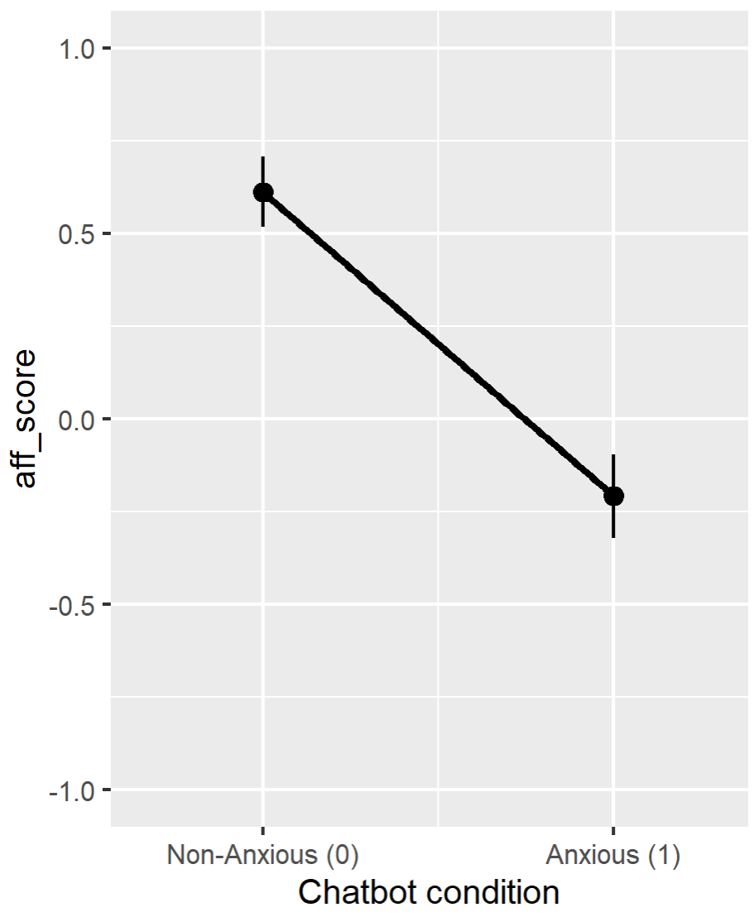
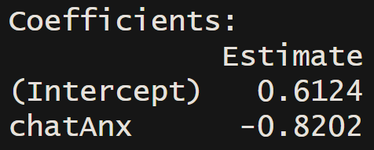
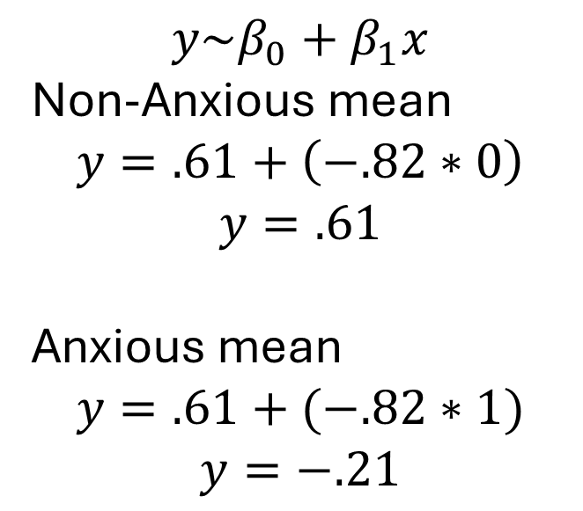
Interaction
$$y\sim β_{0}+β_{1}x$$
Non-Anxious mean
$$y=.61+\left(−.82∗0\right)$$
$$y=.61$$
Anxious mean
$$y=.61+(−.82∗1)$$
$$y=−.21$$

Slide 24
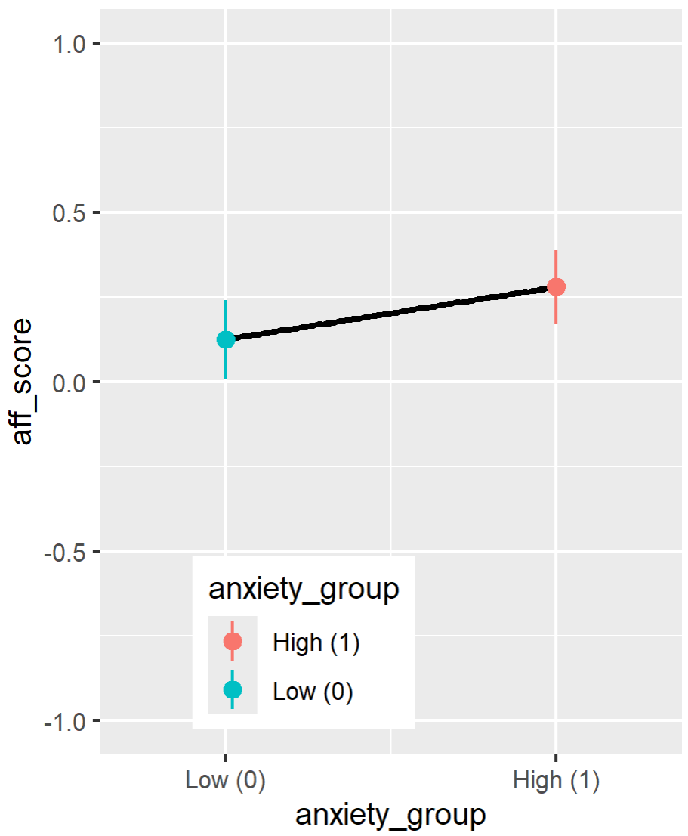
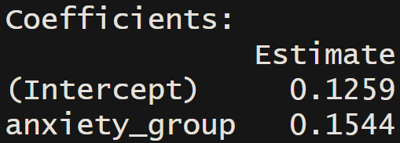
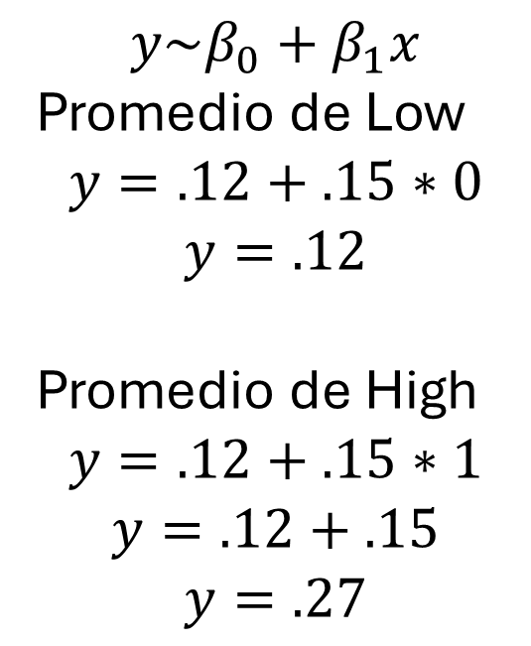
Interaction
$$y\sim β_{0}+β_{1}x$$
Promedio de Low
$$y=.12+.15∗0$$
$$y=.12$$
Promedio de High
$$y=.12+.15∗1$$
$$y=.12+.15$$
$$y=.27$$

Slide 25
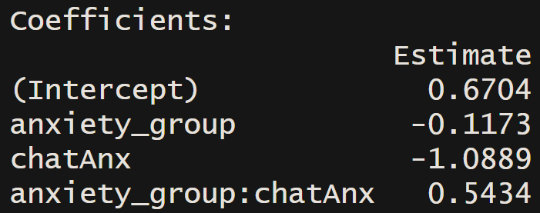
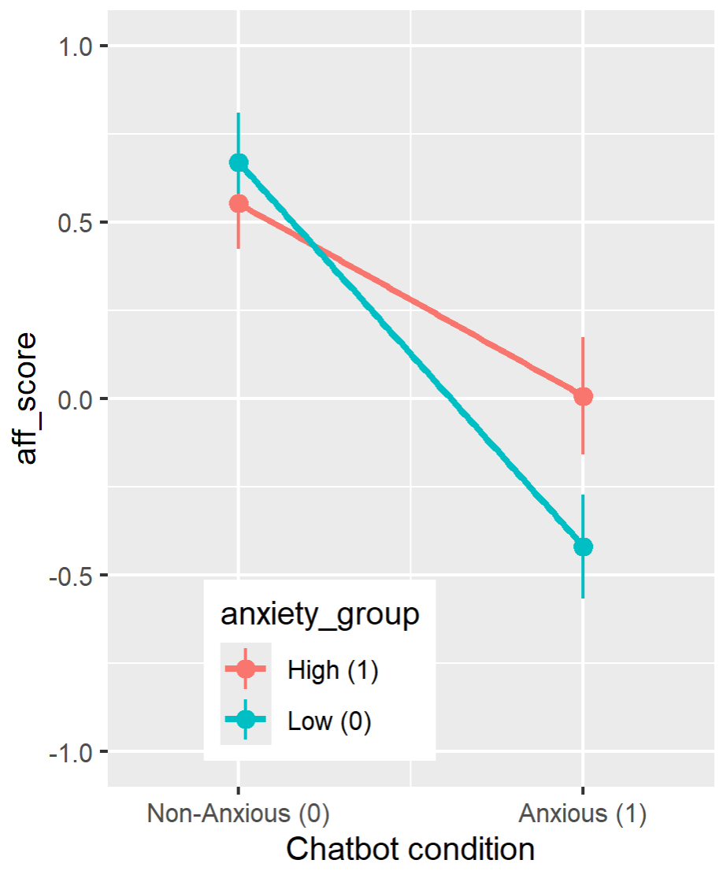
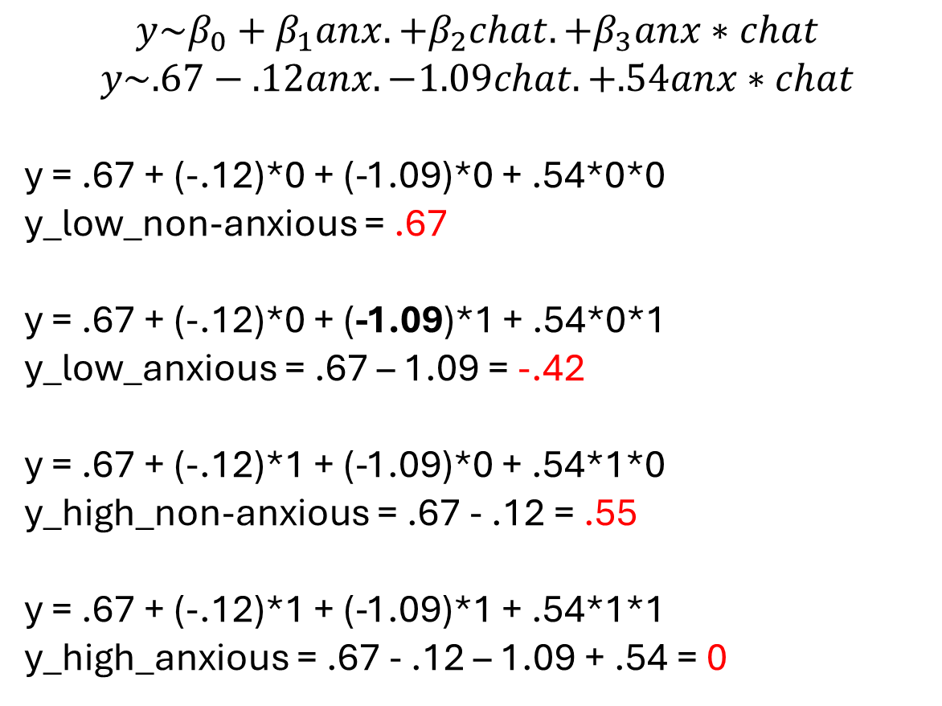
Interaction
$$y\sim β_{0}+β_{1}anx.+β_{2}chat.+β_{3}anx∗chat$$
$$y\sim .67−.12anx.−1.09chat.+.54anx∗chat$$
y = .67 + (-.12)*0 + (-1.09)*0 + .54*0*0
y_low_non-anxious = .67
y = .67 + (-.12)*0 + (-1.09)*1 + .54*0*1
y_low_anxious = .67 – 1.09 = -.42
y = .67 + (-.12)*1 + (-1.09)*0 + .54*1*0
y_high_non-anxious = .67 - .12 = .55
y = .67 + (-.12)*1 + (-1.09)*1 + .54*1*1
y_high_anxious = .67 - .12 – 1.09 + .54 = 0
High 0-.55 = -.55
Low -.42-67 = -1.09

Slide 26
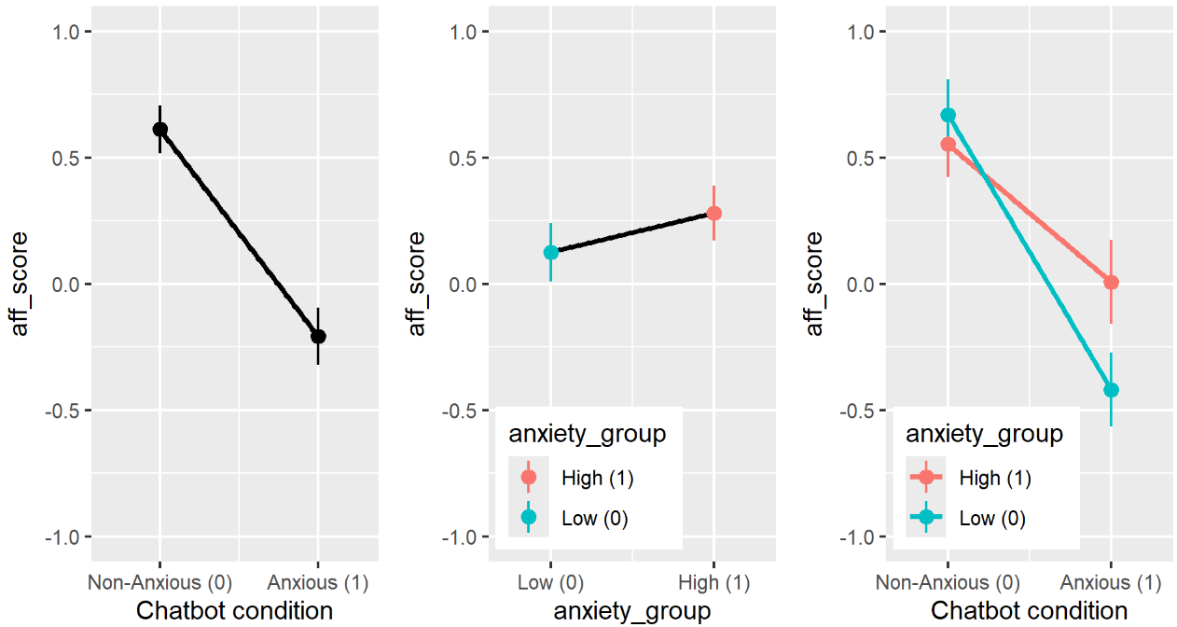
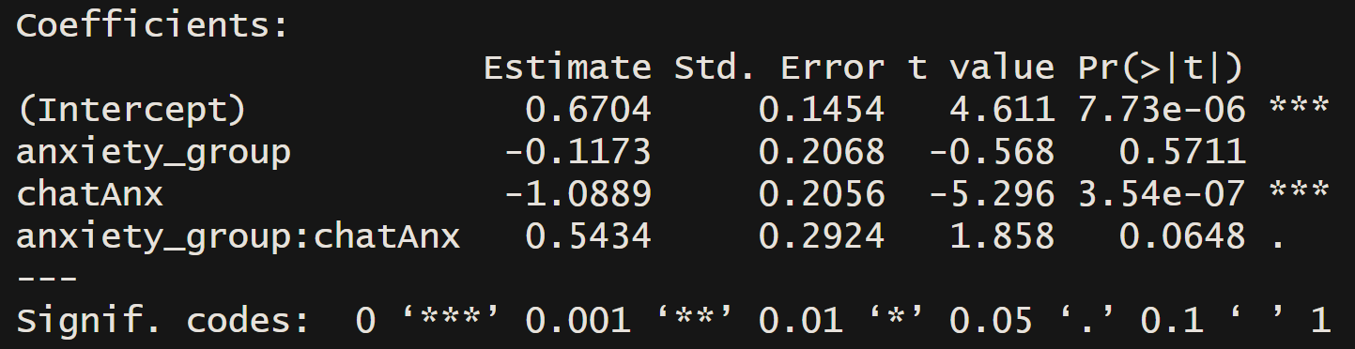
Interaction

Slide 27
DAGs: Directed Acyclic Graph

Slide 28
Directed Acyclic Graph (DAG): Moderation
$$m$$
$$x$$
$$y$$
$$y\sim β_{0}+β_{1}x+β_{2}m+β_{3}xm$$

Slide 29

Directed Acyclic Graph (DAG): Mediation
$$m$$
$$x$$
$$y$$
$$y\sim β_{1}x$$
$$m\sim β_{2}x$$
$$y\sim β_{1}x +β_{3}m$$

Slide 30

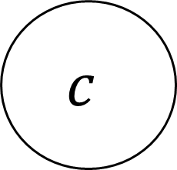
Directed Acyclic Graph (DAG): Confounder
$$c$$
$$x$$
$$y$$
$$y\sim β_{1}x$$
$$y\sim β_{1}x+β_{2}c$$

Slide 31


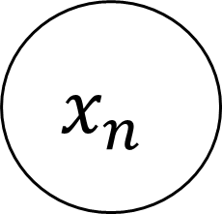
Directed Acyclic Graph (DAG): Covariates
$$x_{1}$$
$$…$$
$$y$$
$$x_{n}$$
$$y\sim β_{0}+β_{1}x_{1}$$
$$y\sim β_{0}+β_{1}x_{1}+…+{β_{n}x}_{n}$$

Slide 32
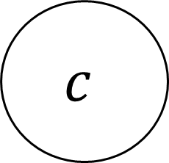



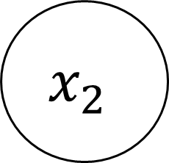


Structural Equation Modelling
$$me$$
$$mo$$
$$x_{1}$$
$$y$$
$$x_{2}$$
$$x_{3}$$
$$c$$

Slide 33
Generalizad Linear Mixed Model
$$x$$
$$y$$
$$y\sim x+ε$$
$$\sim =se aproxima o se predice con$$
$$ε=error$$

Slide 34
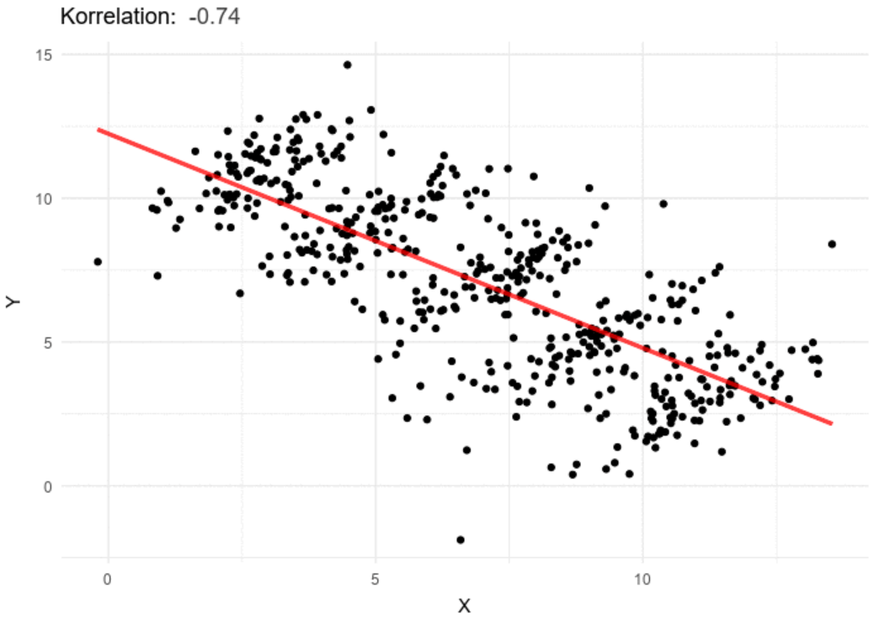
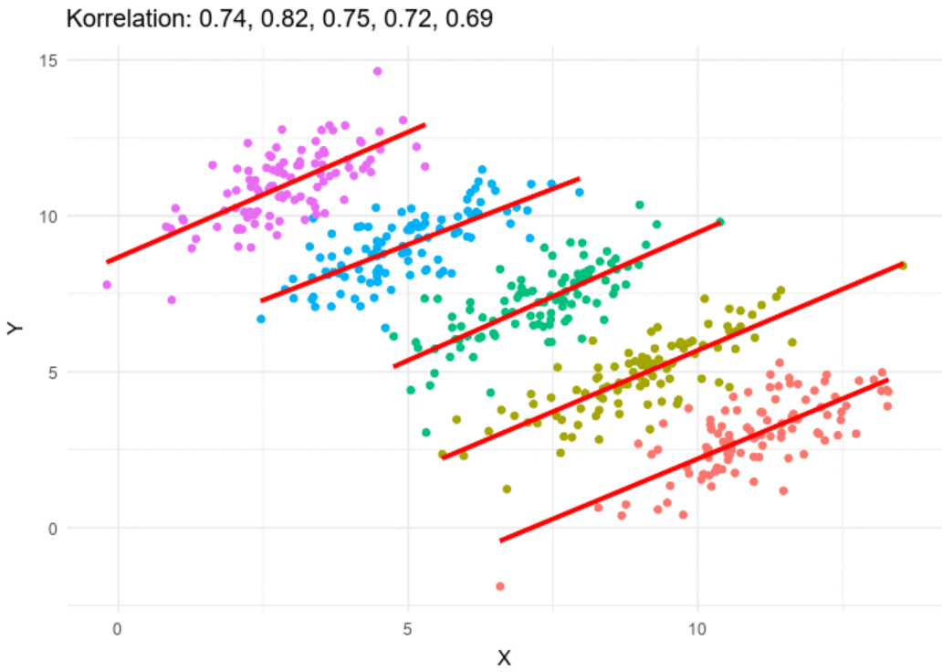
Simpson’s Paradox

Slide 35











Generalizad Linear Mixed Model
$$\text{escuela}$$
$$\text{salon}$$
$$\text{salon}$$
$$\text{salon}$$
$$\text{salon}$$
$$\text{alumno}$$
$$\text{alumno}$$
$$\text{alumno}$$
$$\text{alumno}$$
$$\text{alumno}$$
$$\text{alumno}$$

Slide 36







Multilevel Modelling
$$\text{hospital}$$
$$\text{salon}$$
$$\text{clinico}$$
$$\text{salon}$$
$$\text{clinico}$$
$$\text{paciente}$$
$$\text{paciente}$$
$$\text{alumno}$$
$$\text{paciente}$$
$$\text{alumno}$$
$$\text{paciente}$$

Slide 37







Hierarchical Linear Modelling
$$\text{group}$$
$$\text{individual}$$
$$\text{individual}$$
$$\text{observation}$$
$$\text{observation}$$
$$\text{observation}$$
$$\text{observation}$$

Slide 38
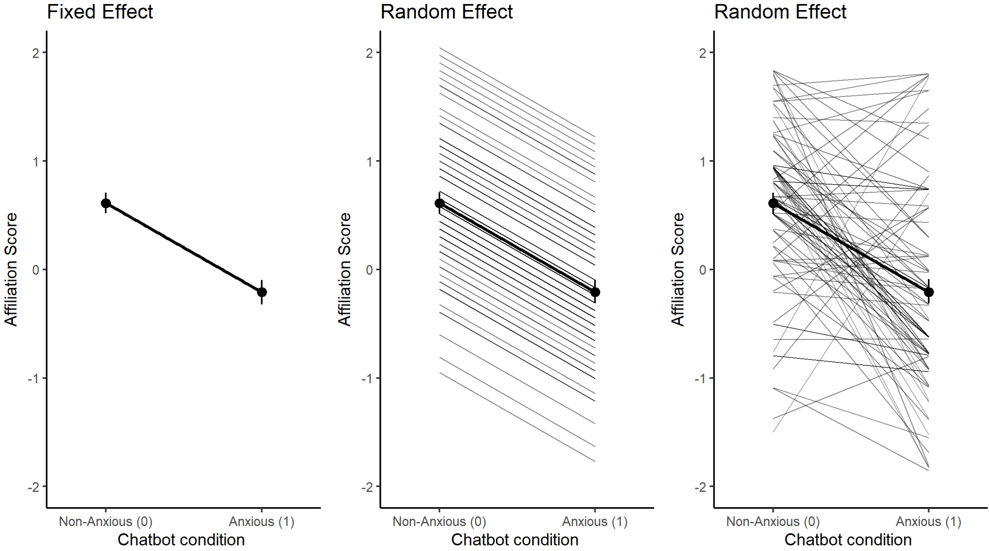



GLMM
$$x$$
$$y$$
Level 1
$$y_{i}=β_{0}+β_{1}∗x_{i}+ε_{i}$$

Slide 39

GLMM
$$x$$
$$y$$
Level 1
$$y_{i,j}=β_{0,j}+β_{1}∗x_{i,j}+ε_{i,j}$$
Level 2
$$β_{0,j}={\text{γ}}_{0,0}+μ_{0,j}$$

Slide 40
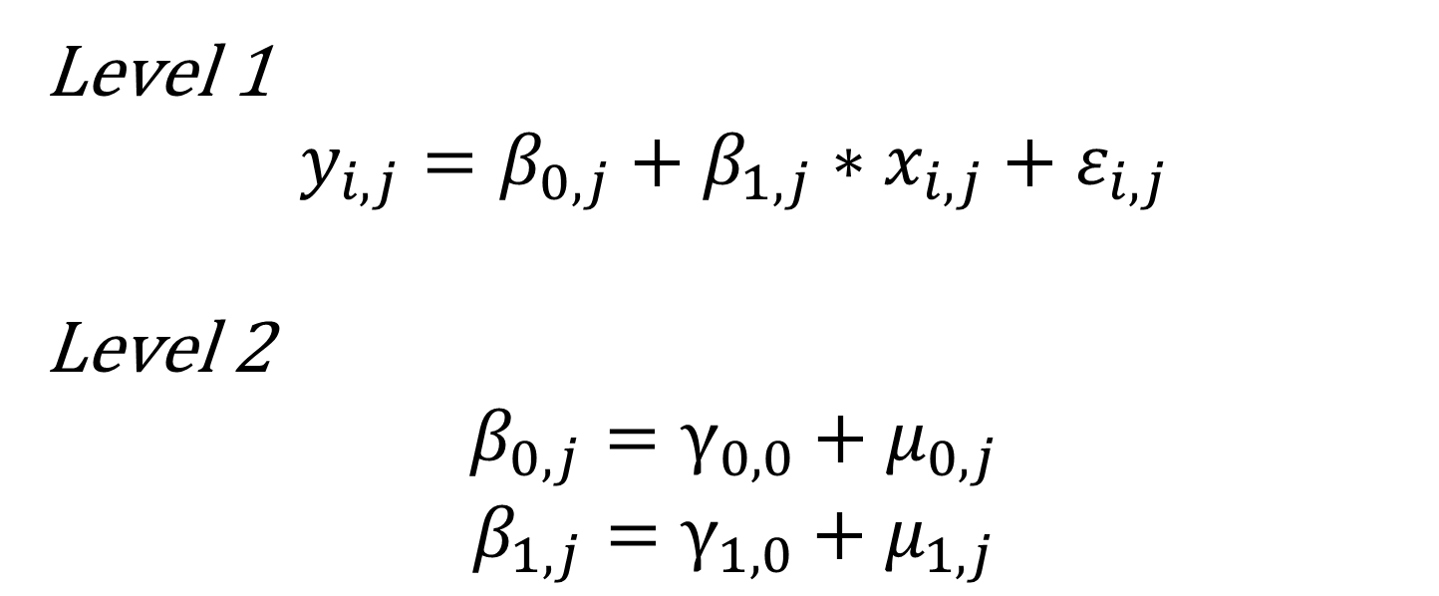
GLMM
$$x$$
$$y$$
Level 1
$$y_{i,j}=β_{0,j}+β_{1,j}∗x_{i,j}+ε_{i,j}$$
Level 2
$$β_{0,j}={\text{γ}}_{0,0}+μ_{0,j}$$
$$β_{1,j}={\text{γ}}_{1,0}+μ_{1,j}$$

Slide 41
GLMM

Slide 42
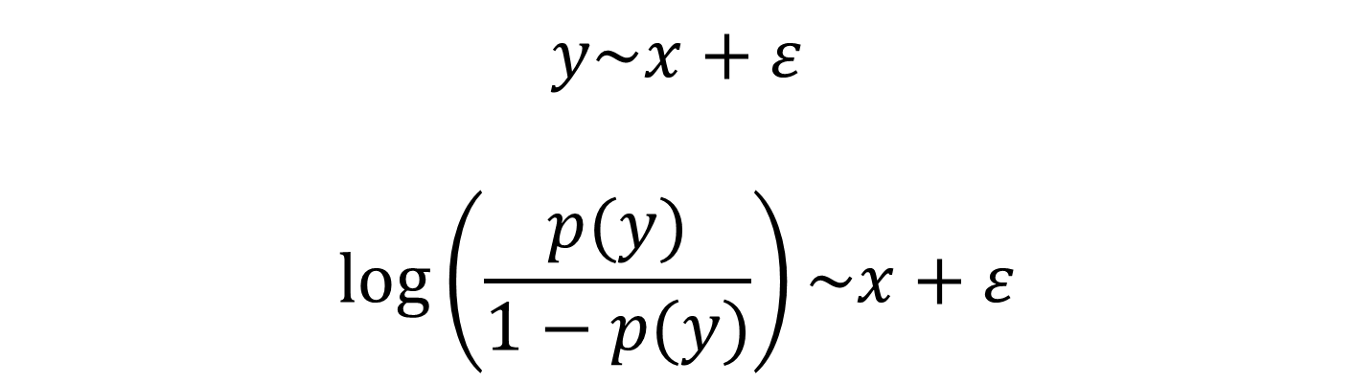
Generalizad Linear (Mixed) Model: Logistic
$$x$$
$$y$$
$$y\sim x+ε$$
$$log⁡\left(\frac{p(y)}{1−p(y)}\right)\sim x+ε$$

Slide 43
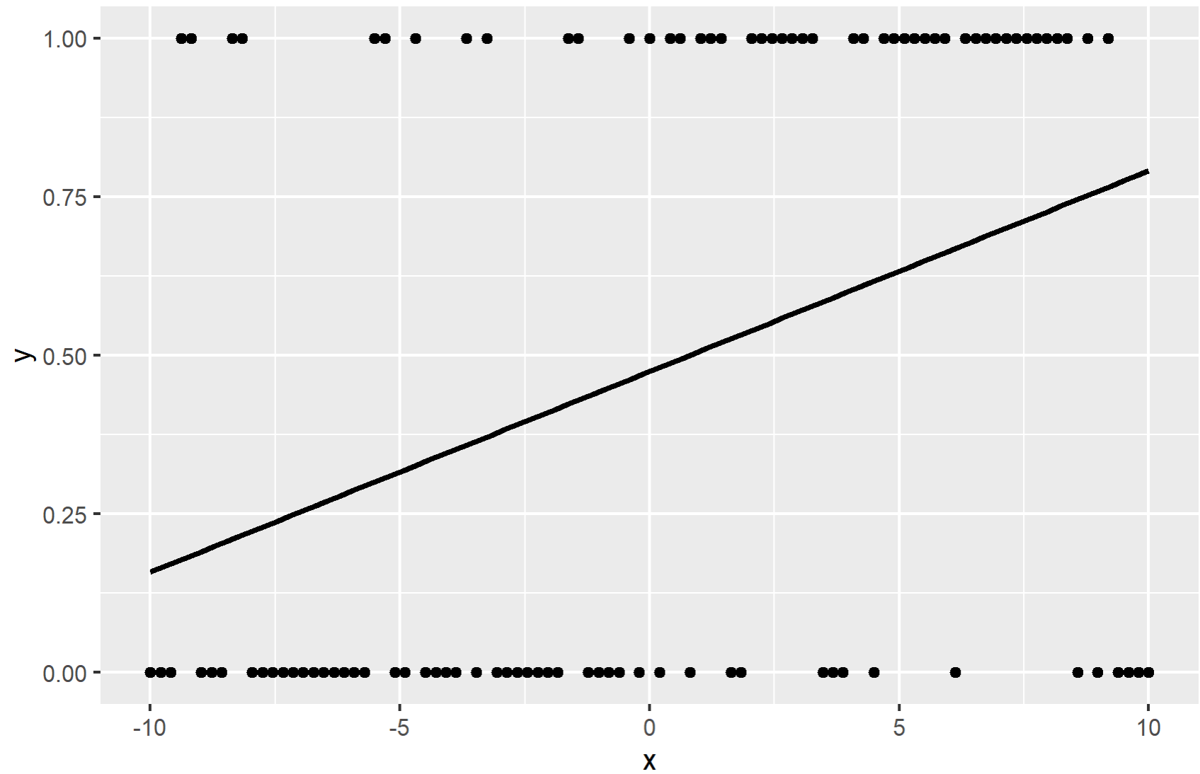
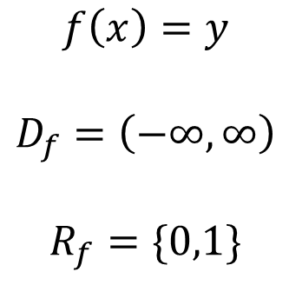
Linear Model?
$$f\left(x\right)=y$$
$$D_{f}=\left(−∞,∞\right)$$
$$R_{f}=\{0,1\}$$

Slide 44
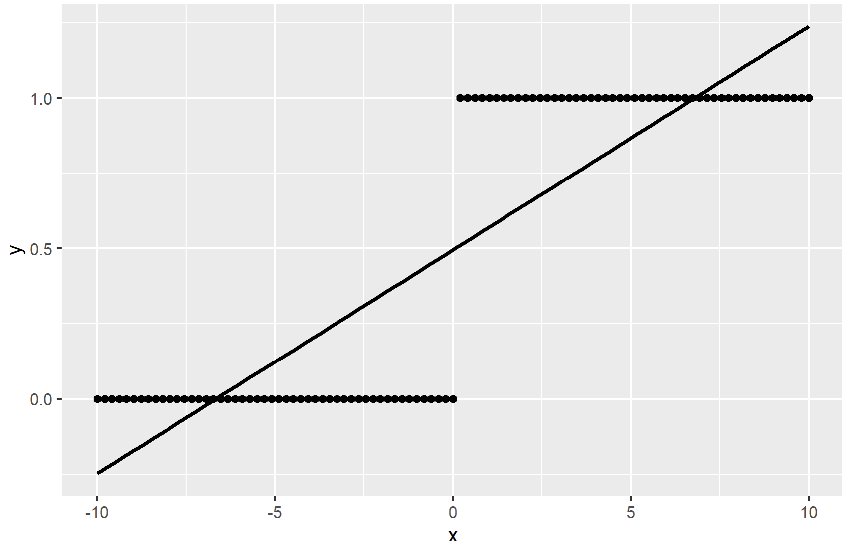
Linear Problems
$$f\left(x\right)=y$$
$$D_{f}=\left(−∞,∞\right)$$
$$R_{f}=\{0,1\}$$

Slide 45
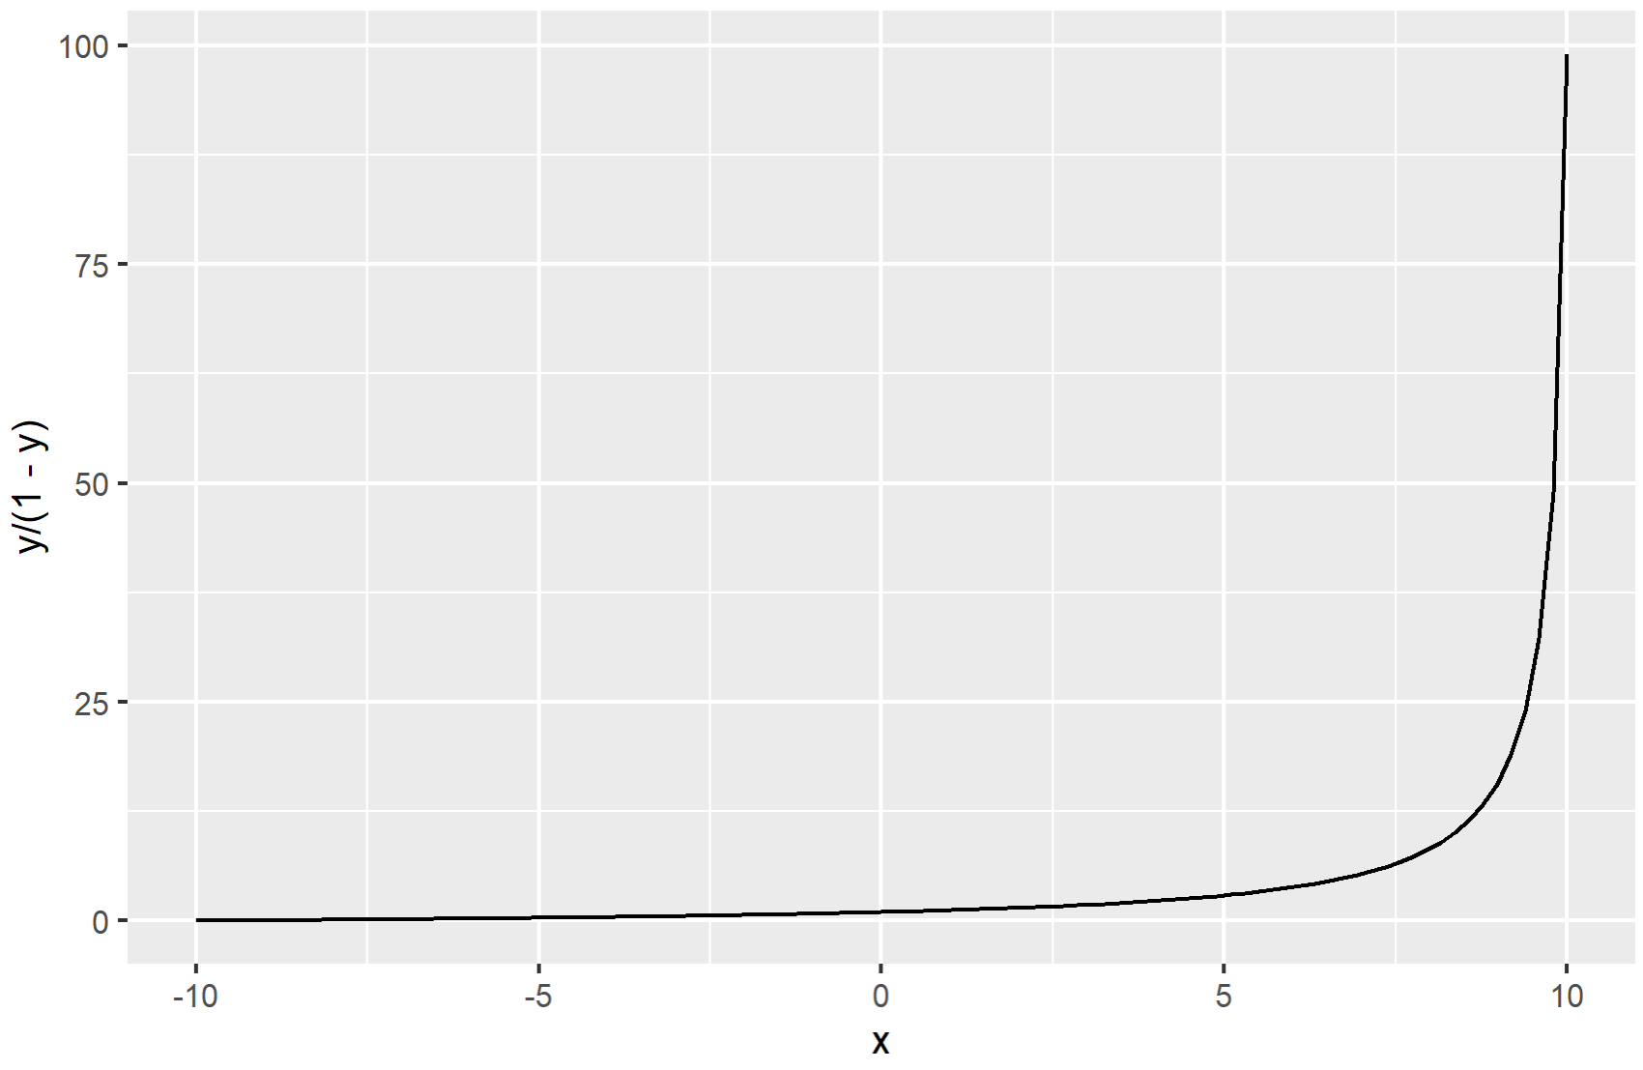
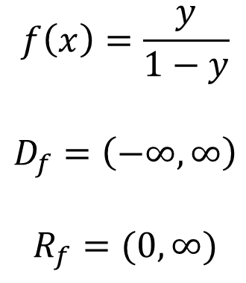
Odds (exponential)
$$f\left(x\right)=\frac{y}{1−y}$$
$$D_{f}=\left(−∞,∞\right)$$
$$R_{f}=(0,∞)$$

Slide 46
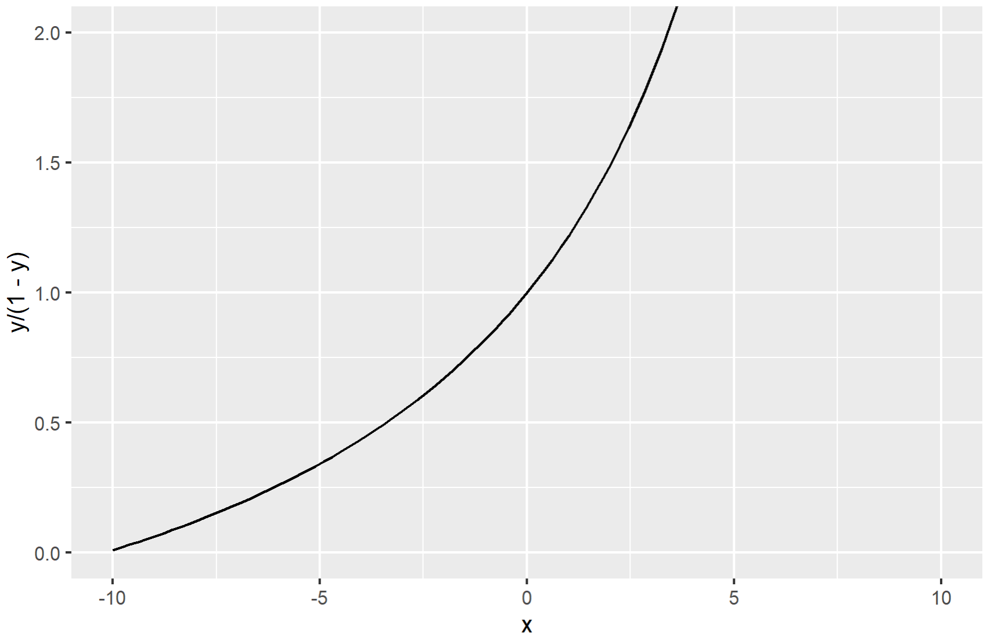
Odds (exponential)
$$f\left(x\right)=\frac{y}{1−y}$$
$$D_{f}=\left(−∞,∞\right)$$
$$R_{f}=(0,∞)$$

Slide 47
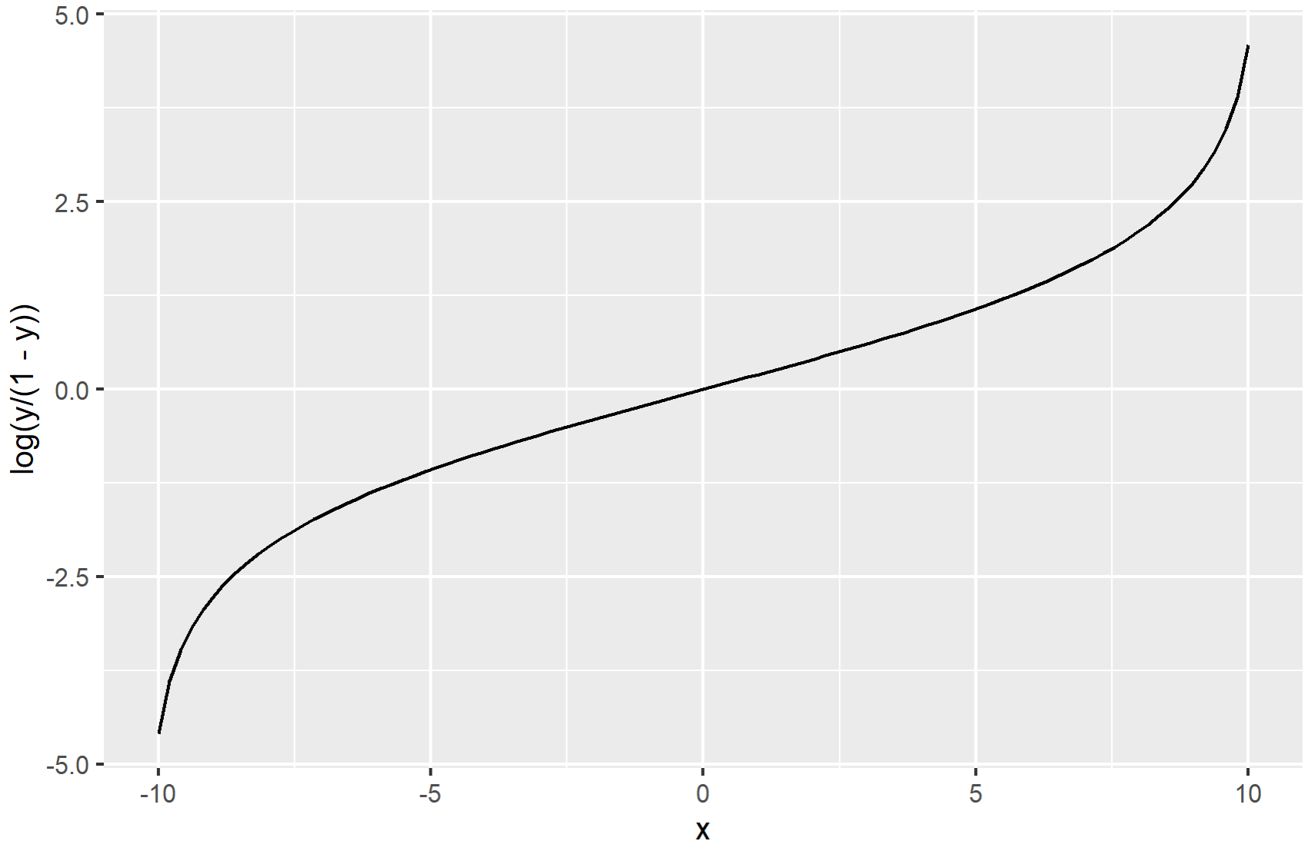
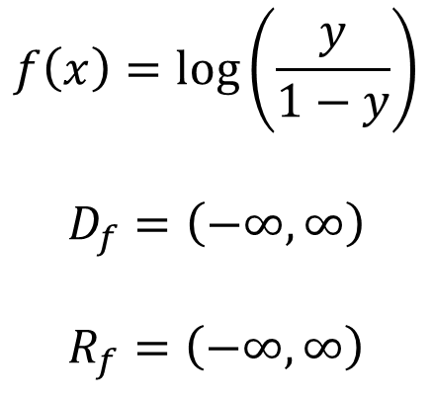
Logit transformation
$$f\left(x\right)=log⁡\left(\frac{y}{1−y}\right)$$
$$D_{f}=\left(−∞,∞\right)$$
$$R_{f}=\left(−∞,∞\right)$$

Slide 48
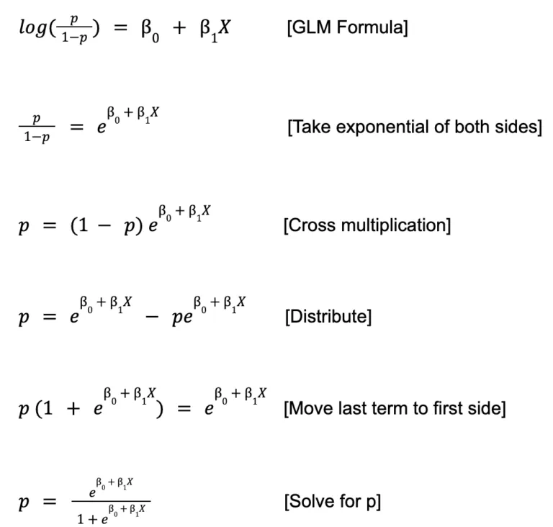
Logit → Sigmoidal

Slide 49


Logistic Model
$$f\left(x\right)=\frac{e^{β_{0}+β_{1}x}}{1+e^{β_{0}+β_{1}x}}$$
$$D_{f}=\left(−∞,∞\right)$$
$$R_{f}=\left(0,1\right)$$

Slide 50



Logistic (Mixed) Model
$$x$$
$$y$$
$$\log\left(\frac{p\left(y\right)}{1−p\left(y\right)}\right)=β_{0}+β_{1}x+ε$$
$$y=\frac{e^{β_{0}+β_{1}x+ε}}{1+e^{β_{0}+β_{1}x+ε}}$$

Slide 51
Directed Acyclic Graph (DAG): Confounder https://plato.stanford.edu/entries/paradox-simpson/
$$c$$
$$x$$
$$y$$
$$y\sim β_{1}x$$
$$y\sim β_{1}x+β_{2}c$$

