Slide 1
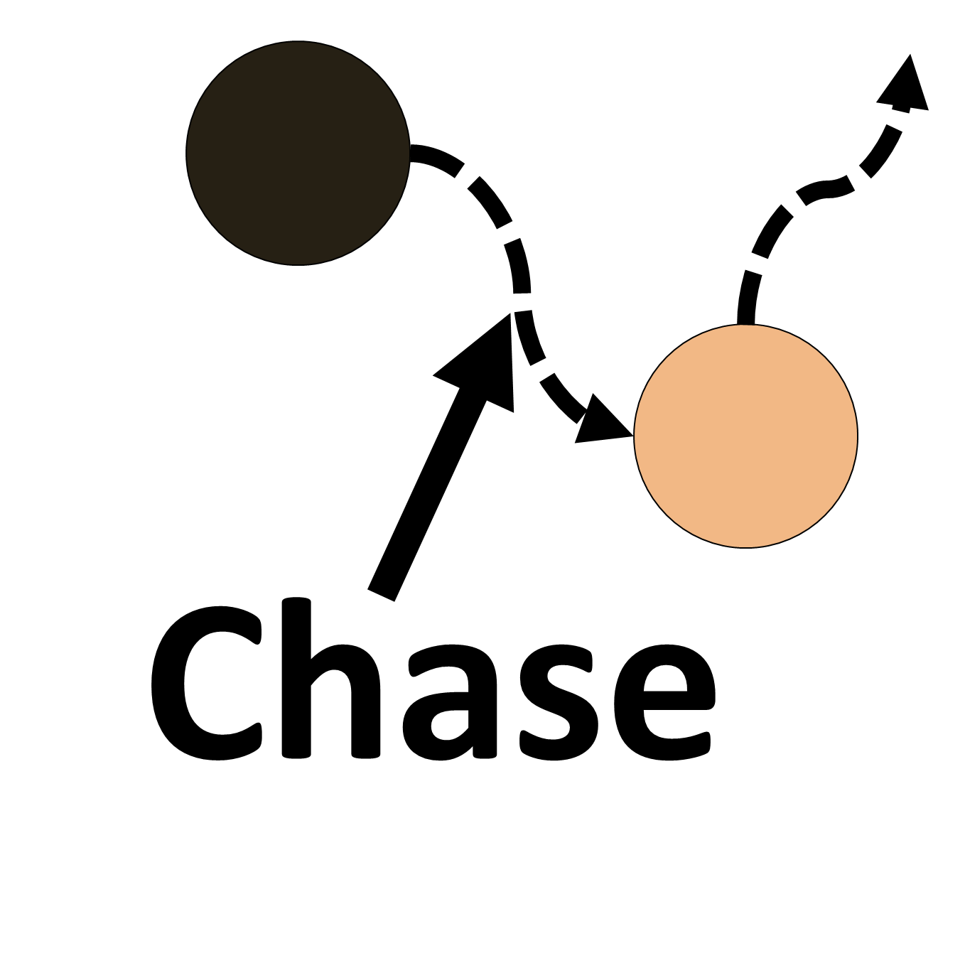
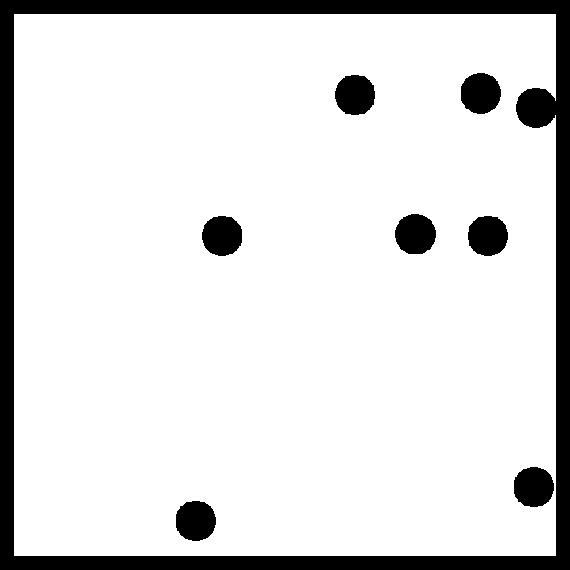
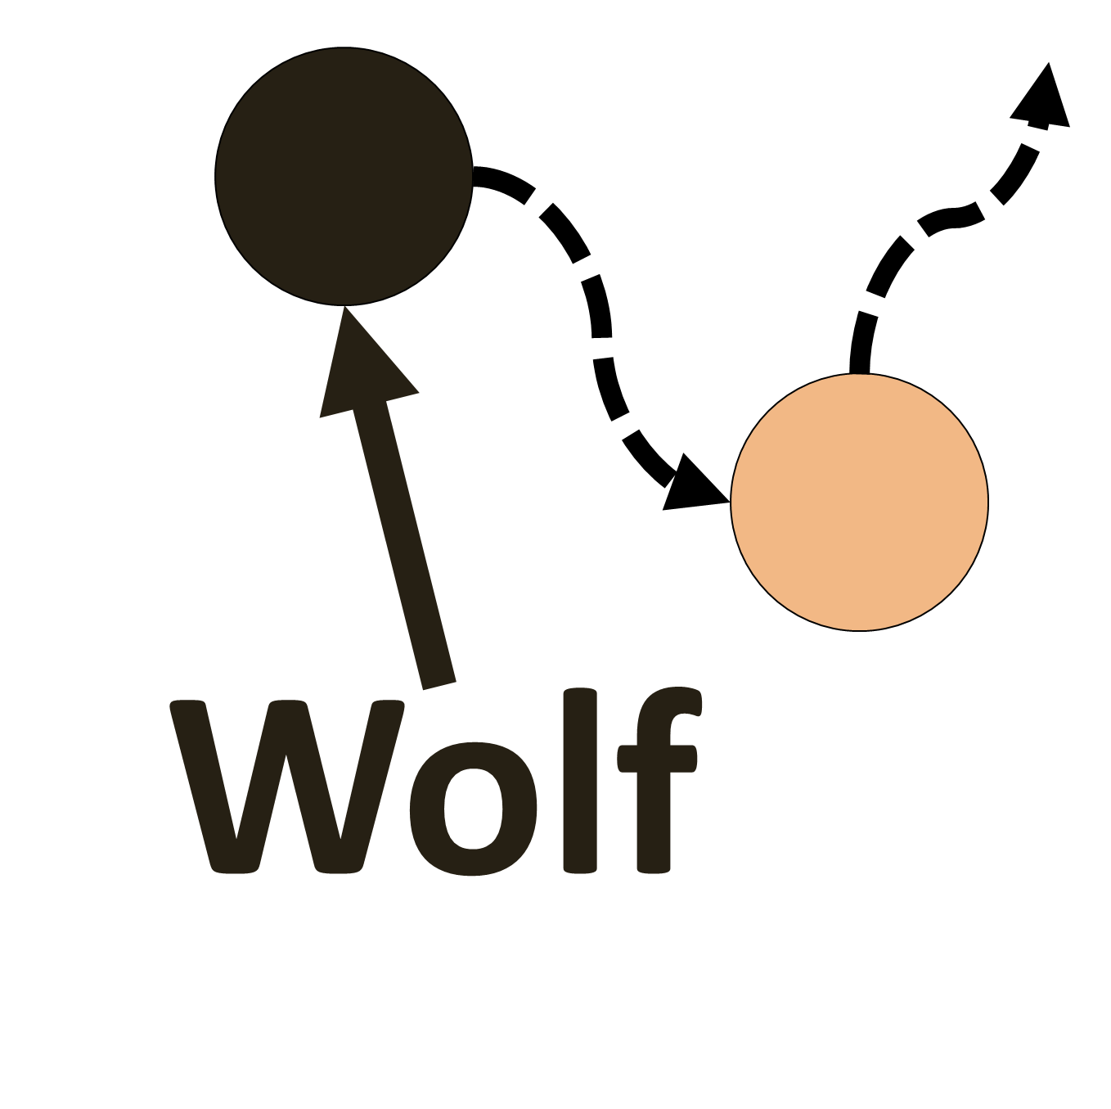
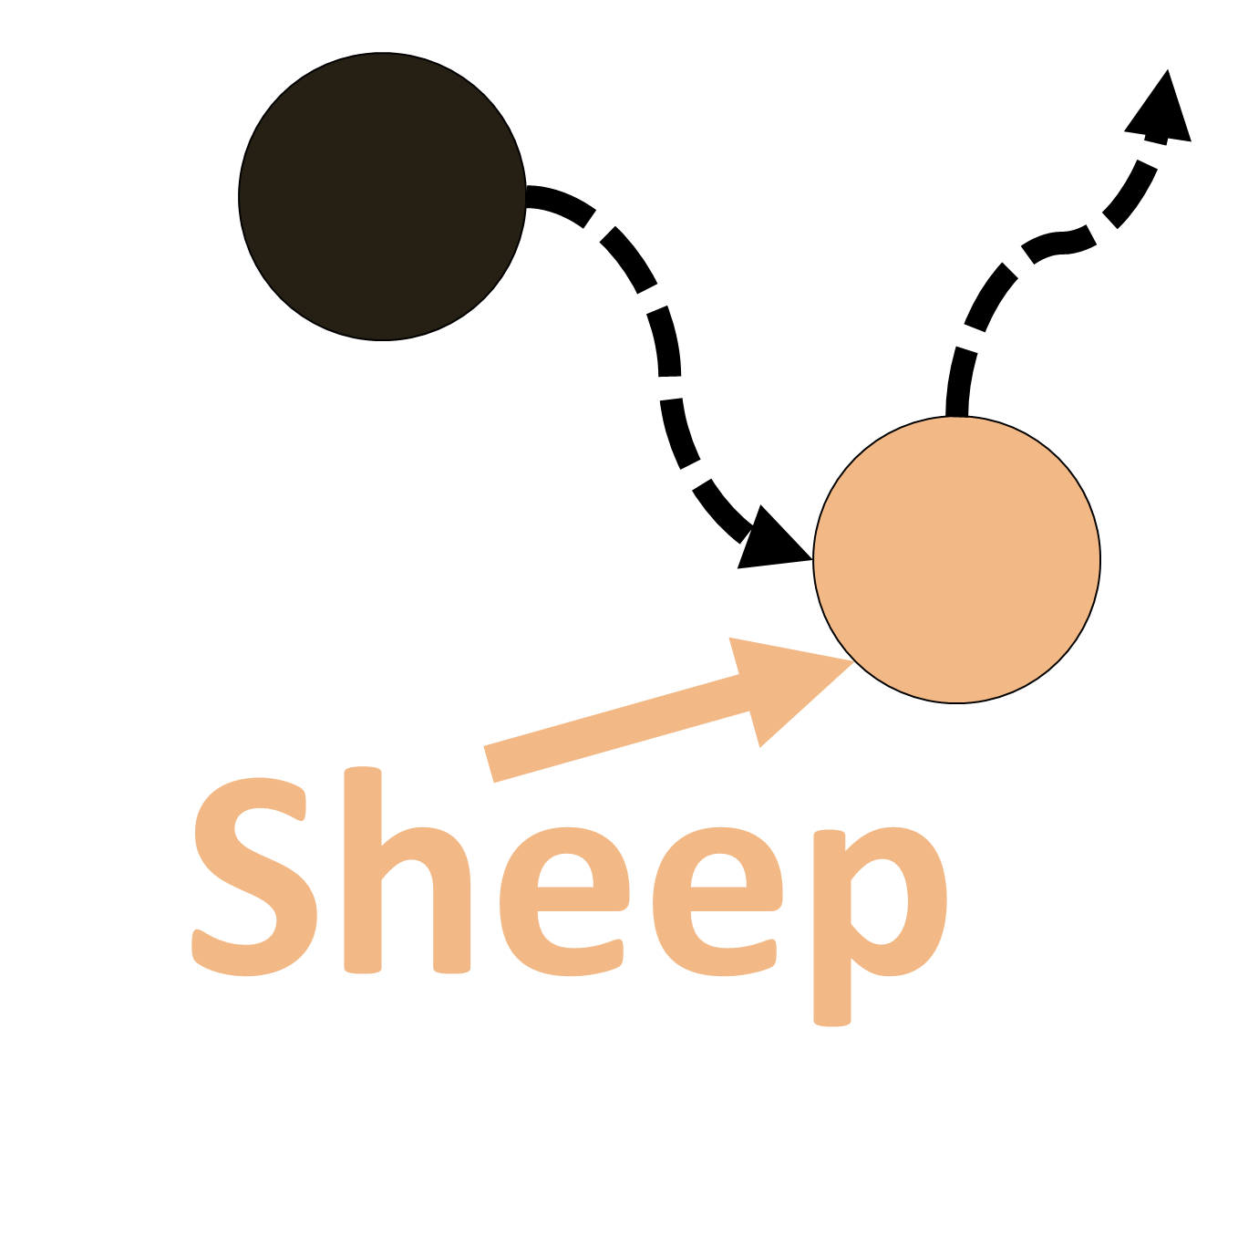
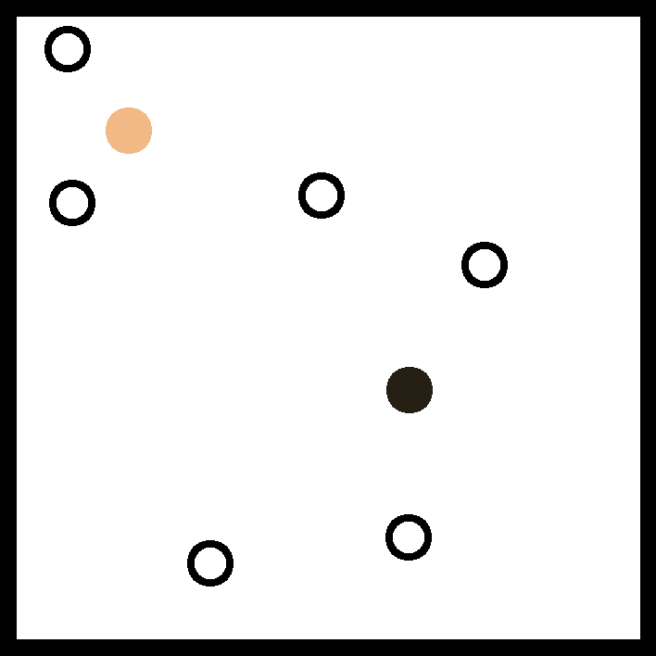
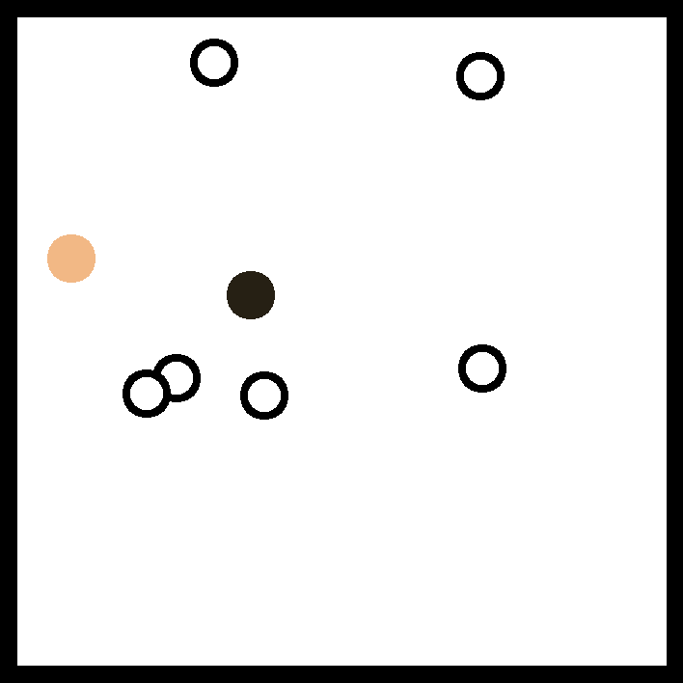
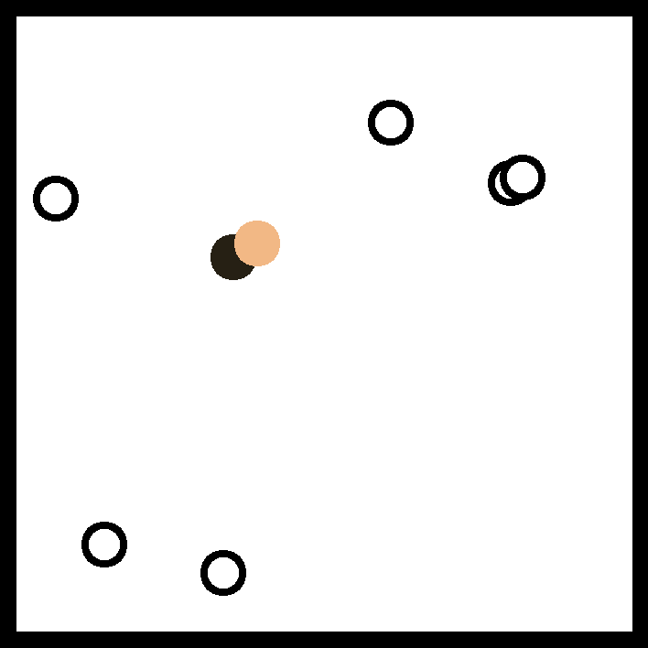
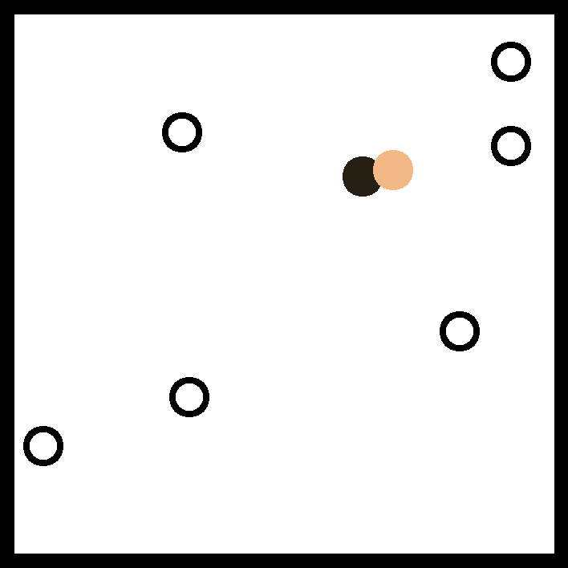
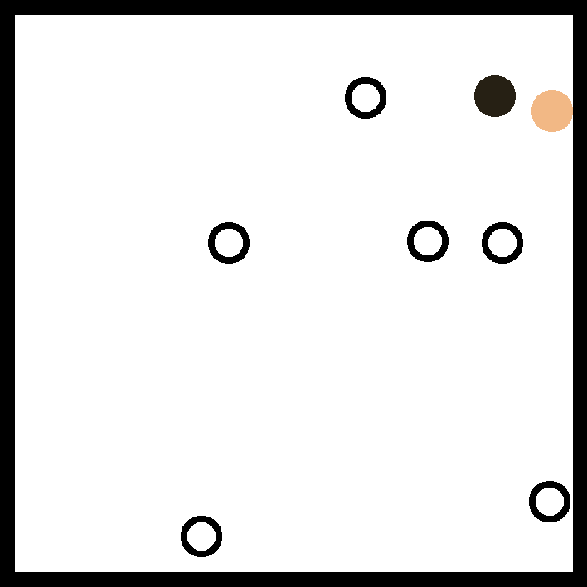
A Animacy Detection Task
3. Response:
4. Confidence:
Detect Chase
Exp. 1
1. Fixation:
500 ms
2. Trial:
~4000 ms
+
Detect Chase
How confident …?
Exp. 2
Identify Chaser
How confident …?
Exp. 3 (between)
Exp. 1: N = 120
Exp. 2: N = 114
Exp. 3[wolf]: N = 100
Exp. 3[sheep]: N = 100
Exp. 4a: N = 102
Exp. 4b[rep.]: N = 87
Total Sample Size: N = 623
Identify Chasee
How confident …?
Exp. 4a/4b (within)
B Example: chase-present trial
Colours were not displayed to participants
Frame 24
Frame 48
Frame 72
Frame 96
Frame 120

