Slide 1

ITI (200~800 ms)
Cue (500 ms)
Predictive response
Outcome (500 ms)
Ratings
+
cue
response
cue + sliding bar
Trial (1200~1800 ms)

Slide 2
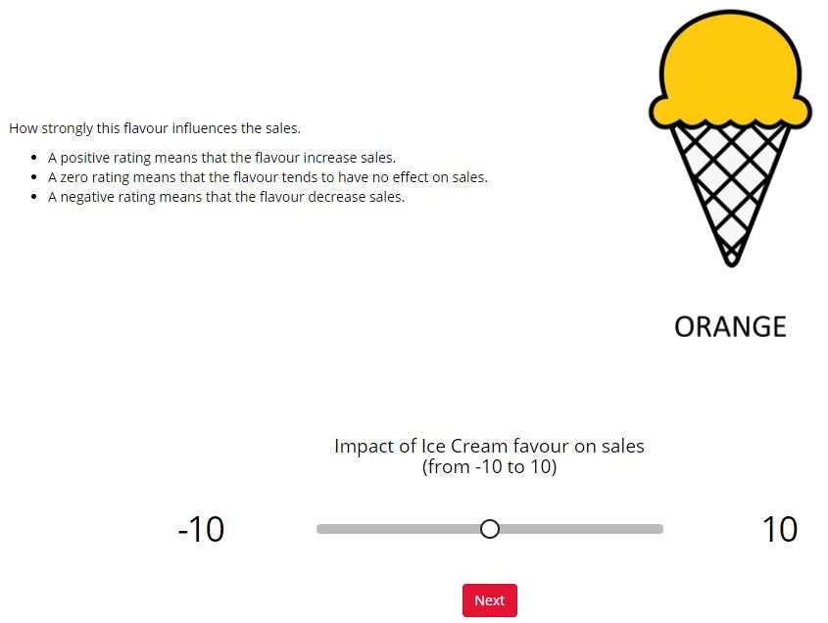



ITI (200~800 ms)
Cue (800 ms)
Predictive response
Outcome (500 ms)
Ratings
+
Up: press "U"; Down: press "D".
/
Trial (1700~2300 ms)

Slide 3
A. Experiment 1 and 2
ITI (500 ms)
Cue(s) (500 ms)
Response (500 ms)
Outcome (1000 ms)
Ratings
+
Up: press “B“
Down: wait…
/
Trial (~2500 ms)
B. Experiment 3
ITI (200~800 ms)
Cue(s) (800 ms)
Predictive response
Outcome (500 ms)
Ratings
+
Up: press "U"; Down: press "D".
/
Trial (1700~2300 ms)

