Slide 1
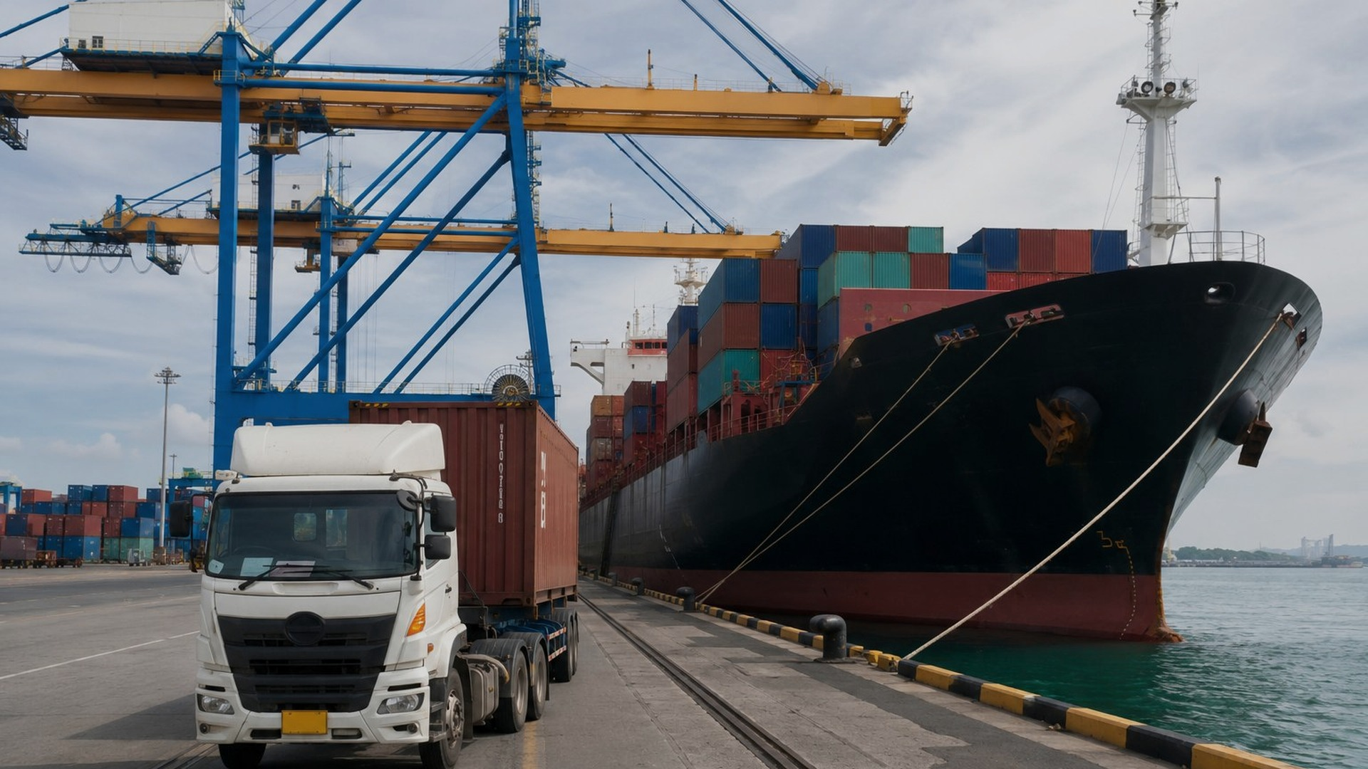

FULL-SERVICE GLOBAL LOGISTICS PROVIDER
Customs Brokerage
Freight Forwarding
Ocean · Air · Ground
Bonded Yard & Freight
Logistics Brokerage
Import & Export Solutions
COMPANY PROFILE · 2026
Take control
of your border.

Slide 2
WHO WE ARE
One team for the
entire border lifecycle.
35
ISN Customs Broker International simplifies cross-border trade — licensed U.S. customs brokerage and integrated logistics under one accountable team. Compliant shipments. Predictable costs. Freight that keeps moving.
YEARS ON THE U.S.–MEXICO BORDER
ISN CUSTOMS BROKER INTERNATIONAL
02 / 18

Slide 3
BY THE NUMBERS
Operational scale,
verified by uptime.
35+
24/7
100%
50+
Years on the U.S.–Mexico border
Operations 365 days a year
Licensed U.S. customs filings
U.S. ports cleared via Remote Filing
ISN CUSTOMS BROKER INTERNATIONAL
03 / 18

Slide 4
WHAT DRIVES US
VISION
MISSION
Simplify. Optimize. Deliver.
Lead with trust. Move with precision.
Your goods, simplified across the border. We remove obstacles, reduce duty exposure, and give you predictable transit times — through one trusted point of contact.
We treat your freight like it's our own — guided by C-TPAT validation and an unconditional dedication to safety, accuracy, and on-time delivery.
ISN CUSTOMS BROKER INTERNATIONAL
04 / 18

Slide 5
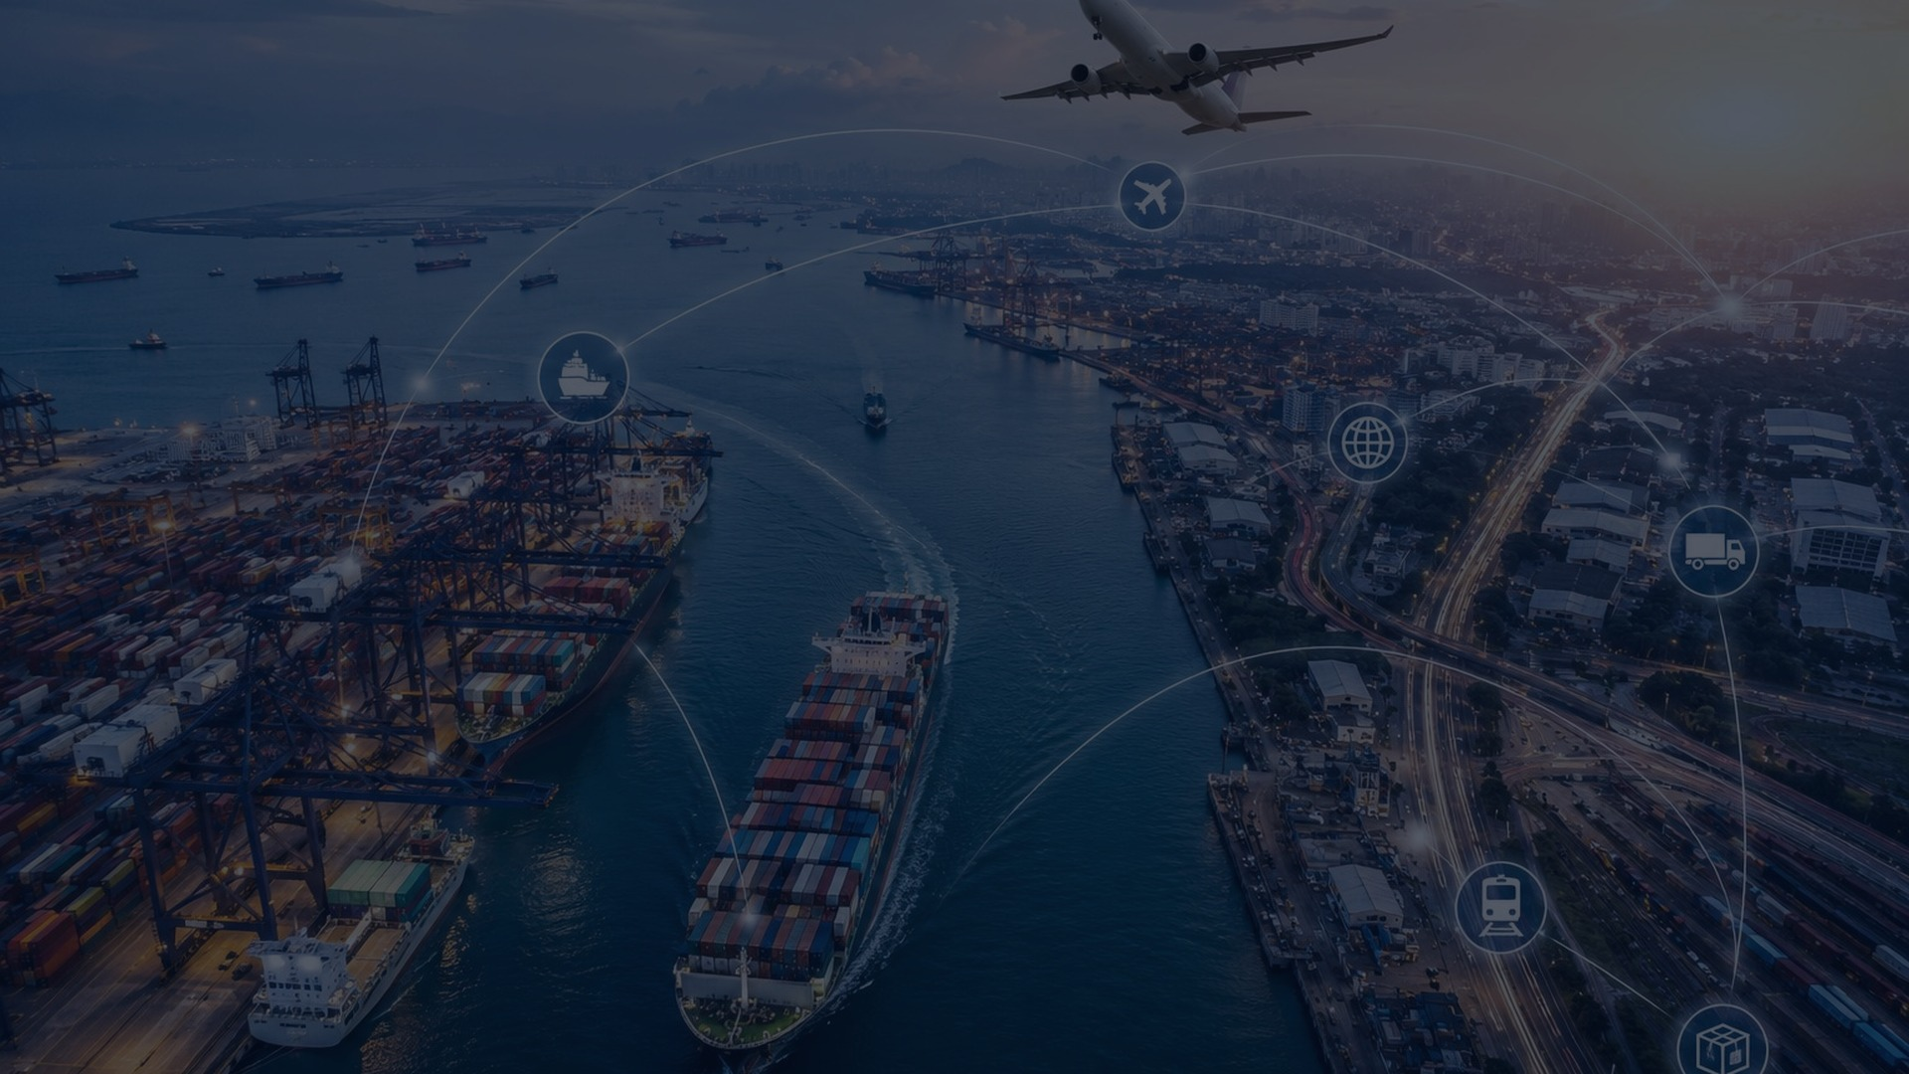
WHAT WE DO
Three integrated pillars.
One team. One invoice.
Customs clearance, freight movement, and bonded storage — orchestrated under a single accountable point of contact.
ISN CUSTOMS BROKER INTERNATIONAL
05 / 18

Slide 6
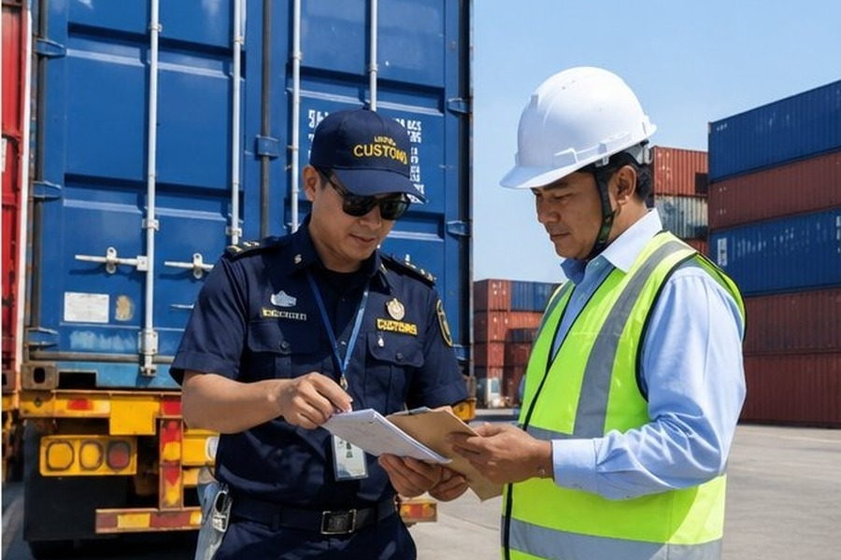
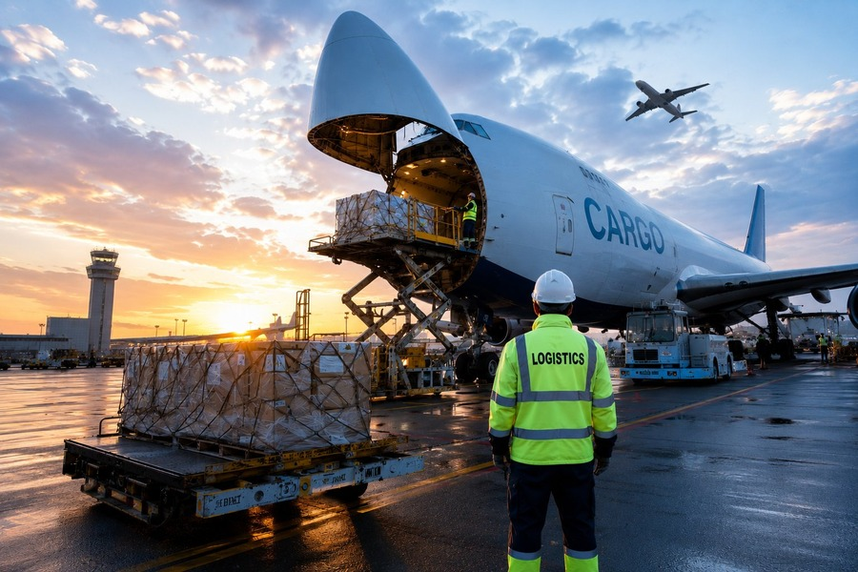
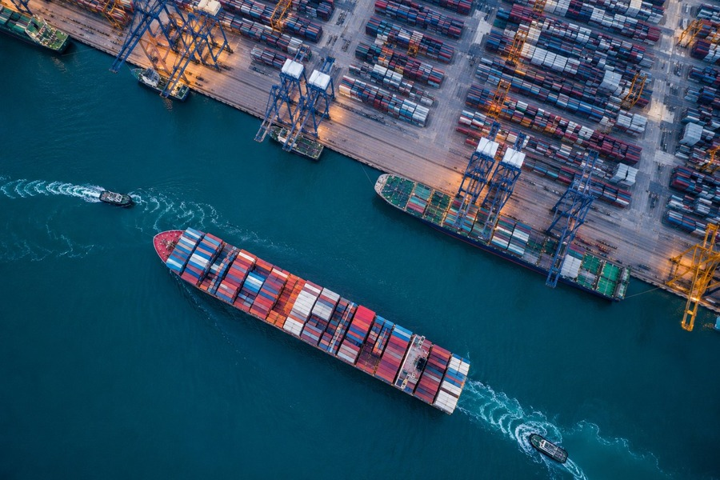
OUR SERVICES
Customs · Freight · Logistics
01
02
03
Customs
Freight
Logistics &
Brokerage
Forwarding
Warehousing
Licensed U.S. entry filing — ACE, ISF, AES, FTZ, in-bond, reconciliation, and bond services.
Northbound and southbound cargo by land, air, and ocean. HAZMAT-certified, cross-docked.
CBP-bonded warehouses, bonded yards, contract logistics. Forklifts and heavy equipment, 24/7.
ISN CUSTOMS BROKER INTERNATIONAL
06 / 18

Slide 7
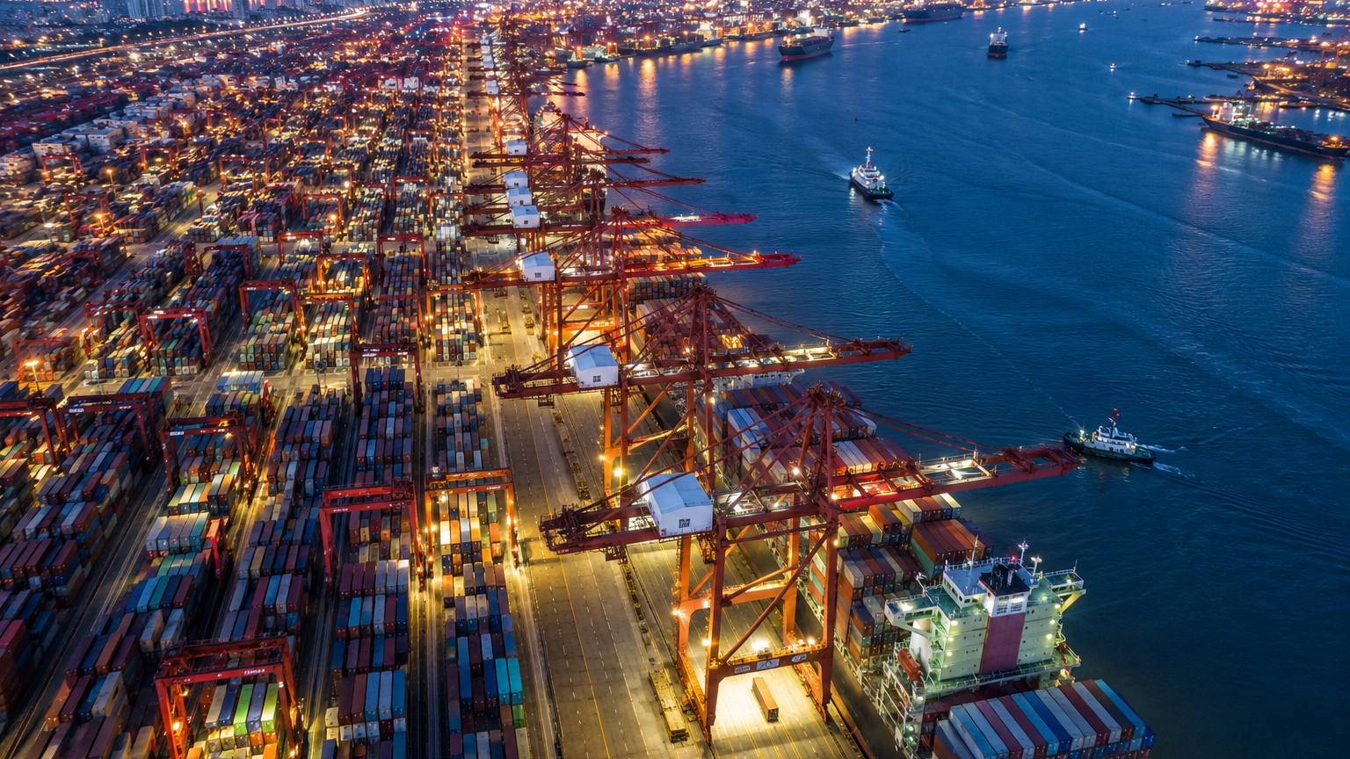
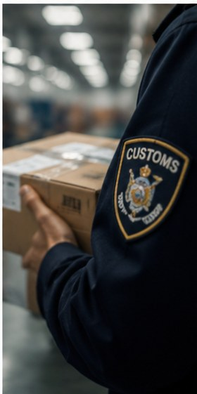

SERVICE 01 · CUSTOMS BROKERAGE
Licensed U.S.
customs clearance.
Licensed brokers handle the full lifecycle of an import or export entry — from pre-arrival filing to post-entry reconciliation. Proactive duty-and-penalty avoidance, built into every clearance.
ISN CUSTOMS BROKER INTERNATIONAL
07 / 18

Slide 8
CUSTOMS · FILING CAPABILITIES
Eight filings under one license.
ACE
ISF
AES
FTZ
ACE Entries
ISF 10+2 Filing
AES Export
Foreign Trade Zones
Pre-entry clearance via the Automated Commercial Environment.
Importer Security Filing submitted before vessel loading.
Automated Export System filing for U.S. outbound shipments.
Entries under FTZ status to defer or reduce duty.
IB
RC
TIB
ACH
In-Bond (QP/QX)
Reconciliations
Temporary Imports
ACH Payments
Bonded movement of merchandise between U.S. ports.
Post-entry reconciliation, GO, and Blue Letter responses.
TIB entries for goods entering the U.S. on a temporary basis.
ACH statements and customs bond management.
ISN CUSTOMS BROKER INTERNATIONAL
08 / 18

Slide 9

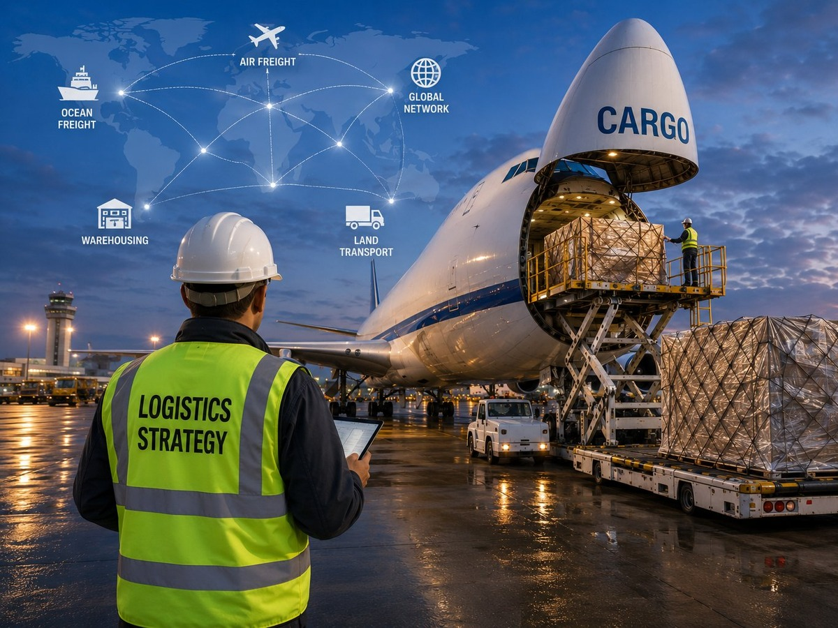


SERVICE 02 · FREIGHT FORWARDING
Moving cargo across
borders, oceans, and skies.
Physical movement of your goods across the U.S.–Mexico border and beyond — trucking, ocean, and air freight under one accountable team. One invoice. No handoff gaps.
ISN CUSTOMS BROKER INTERNATIONAL
09 / 18

Slide 10

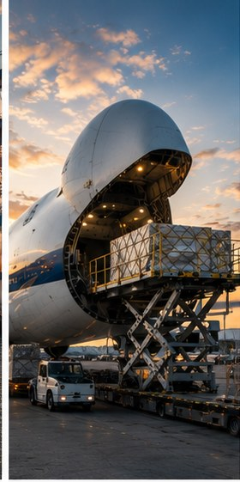

MODE · AIR FREIGHT
Air freight,
origin to destination.
Coordinated international air cargo from global suppliers
Time-critical handling at major U.S. gateways
Door-to-door visibility and customs pre-clearance
HAZMAT-certified handling, DOT/CBP compliant
ISN CUSTOMS BROKER INTERNATIONAL
10 / 18

Slide 11
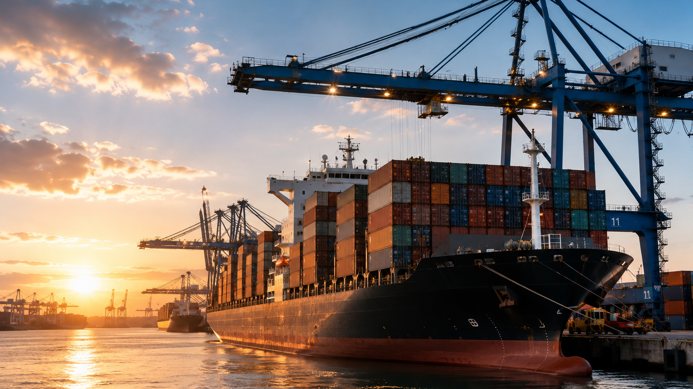
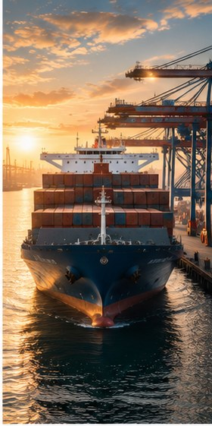

MODE · OCEAN FREIGHT
Ocean freight
& port coordination.
FCL and LCL ocean coordination worldwide
ISF 10+2 filing pre-loaded against every booking
Drayage and cross-dock at U.S. ports of arrival
Direct relationships with carriers and port terminals
ISN CUSTOMS BROKER INTERNATIONAL
11 / 18

Slide 12

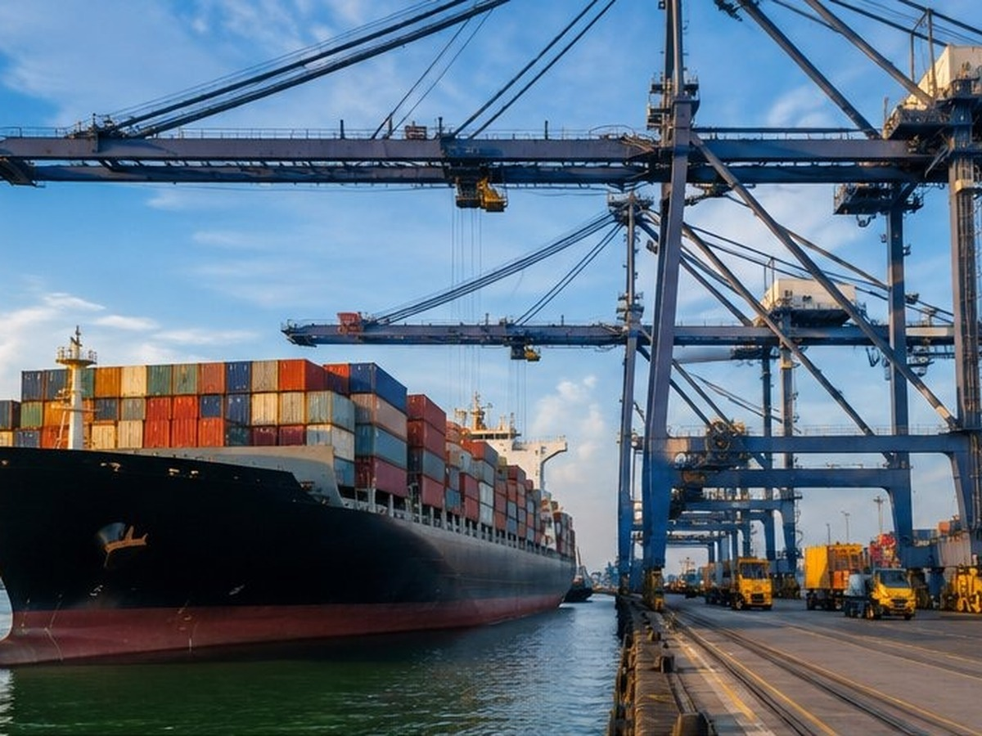
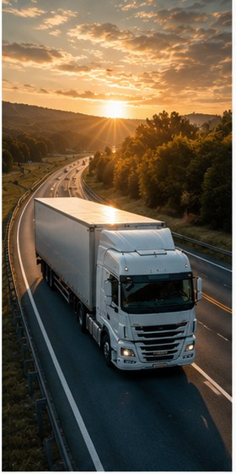

MODE · LAND & CROSS-BORDER TRANSPORT
Northbound &
southbound transfers.
Daily cross-border movements at Texas ports of entry
Dedicated lanes for time-sensitive shipments
HAZMAT-certified transfers, full DOT/CBP compliance
Cross-docking and trailer-to-trailer transfers
ISN CUSTOMS BROKER INTERNATIONAL
12 / 18

Slide 13
SERVICE 03 · LOGISTICS & WAREHOUSING
Bonded facilities,
always open.
Secured CBP-bonded warehouses and yards, contract logistics, and bonded carrier capability — with forklifts and heavy equipment on-site, 24/7, 365 days a year.
01
02
03
Bonded warehouses
Bonded yards
Contract logistics
CBP-bonded indoor storage. Cameras, access control, Class 1–11.
Outdoor bonded storage for heavy equipment, tanks, oversized cargo.
Dedicated programs tailored to ongoing client requirements.
04
05
06
Bonded carrier
Heavy equipment
Cross-docking
Licensed in-transit movements between U.S. ports.
Forklifts, cranes, top-loaders. Trained operators on standby.
Trailer-to-trailer transfers. Minimal handling, less dwell.
ISN CUSTOMS BROKER INTERNATIONAL
13 / 18

Slide 14
GLOBAL NETWORK
A border hub
with global reach.
Headquartered at one of the busiest commercial crossings on the U.S.–Mexico border, ISN clears and coordinates cargo at any U.S. port — and connects it to origin and destination markets on every continent.
ISN CUSTOMS BROKER INTERNATIONAL
14 / 18

Slide 15
OUR DIFFERENCE
No call centers.
No look-up delays.
01
02
03
Direct CBP access
National permit (RLF)
Single point of contact
Established relationships with U.S. Customs for faster resolution.
Clear shipments at any U.S. port from our Del Rio operations center.
A dedicated account team backs every shipment. Priority response.
04
05
06
C-TPAT validated
Tailored solutions
Regional leadership
The highest standard of supply chain security recognized by U.S. Customs.
Programs built around your commodity, volume, and timing.
Industry leaders across the Texas–Mexico border region.
ISN CUSTOMS BROKER INTERNATIONAL
15 / 18

Slide 16
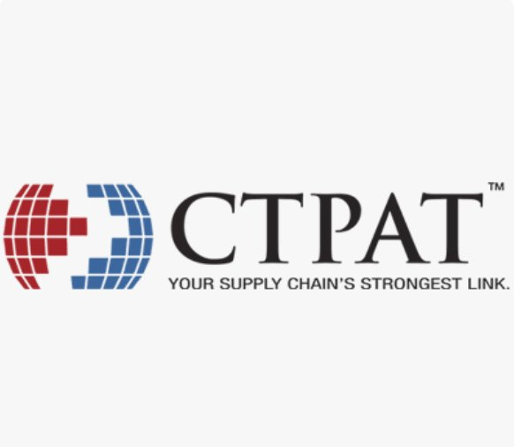
SUPPLY-CHAIN SECURITY
C-TPAT
validated member.
ISN participates in the Customs Trade Partnership Against Terrorism — the highest standard of supply chain security recognized by U.S. Customs and Border Protection. Validated processes. Verified people. Audited facilities.
ISN CUSTOMS BROKER INTERNATIONAL
16 / 18

Slide 17

























TRUSTED BY INDUSTRY LEADERS
Selected clients across
manufacturing, energy, automotive & industrial.
ISN CUSTOMS BROKER INTERNATIONAL
17 / 18

Slide 18
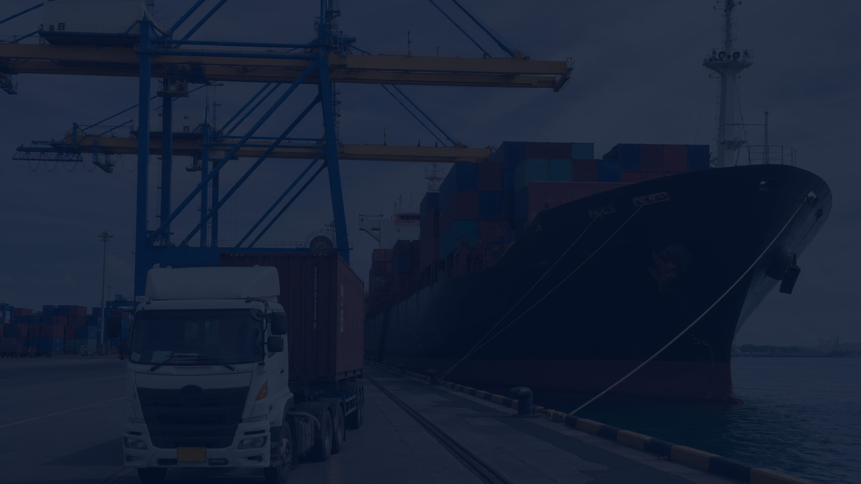
ISN CUSTOMS BROKER INTERNATIONAL
594 Industrial Blvd, Unit A
Del Rio, TX 78840 · USA
(830) 775-1666
isn@isnbroker.com
GET IN TOUCH
Let's move your
freight forward.
24 / 7 · 365 days a year
LICENSED U.S. CUSTOMS BROKER · RLF NATIONWIDE · C-TPAT VALIDATED

