Slide 1
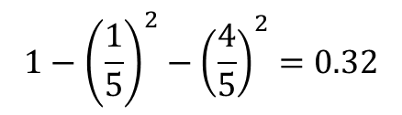
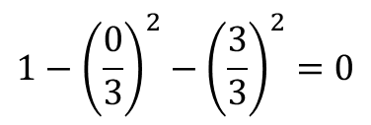
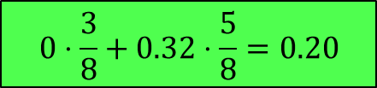
TRUE
ball_possession
ball_possession | shots_on_target | WIN
No | 2 | No
No | 5 | No
No | 7 | No
Yes | 10 | Yes
No | 12 | No
No | 18 | Yes
Yes | 19 | Yes
Yes | 20 | Yes
FALSE
WIN | shots_on_target
Yes | No
3 | 0
WIN | shots_on_target
Yes | No
1 | 4
$$1−{\left(\frac{0}{3}\right)}^{2}−{\left(\frac{3}{3}\right)}^{2}=0$$
$$1−{\left(\frac{1}{5}\right)}^{2}−{\left(\frac{4}{5}\right)}^{2}=0.32$$
$$0⋅\frac{3}{8}+0.32⋅\frac{5}{8}=0.20$$

Slide 2
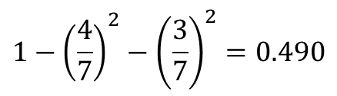
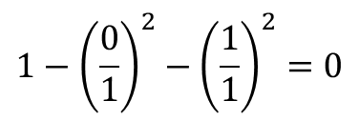
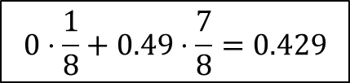
TRUE
shots_on_targe < 3.5
ball_possession | shots_on_target | WIN
No | 2 | No
No | 5 | No
No | 7 | No
Yes | 10 | Yes
No | 12 | No
No | 18 | Yes
Yes | 19 | Yes
Yes | 20 | Yes
FALSE
WIN | shots_on_target
Yes | No
0 | 1
WIN | shots_on_target
Yes | No
4 | 3
$$1−{\left(\frac{0}{1}\right)}^{2}−{\left(\frac{1}{1}\right)}^{2}=0$$
$$1−{\left(\frac{4}{7}\right)}^{2}−{\left(\frac{3}{7}\right)}^{2}=0.490$$
$$0⋅\frac{1}{8}+0.49⋅\frac{7}{8}=0.429$$

Slide 3
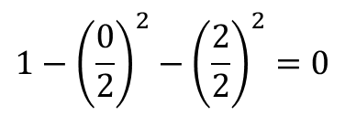
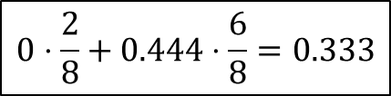
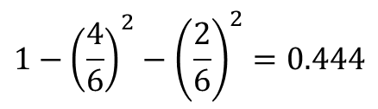
TRUE
shots_on_targe < 6
ball_possession | shots_on_target | WIN
No | 2 | No
No | 5 | No
No | 7 | No
Yes | 10 | Yes
No | 12 | No
No | 18 | Yes
Yes | 19 | Yes
Yes | 20 | Yes
FALSE
WIN | shots_on_target
Yes | No
0 | 2
WIN | shots_on_target
Yes | No
4 | 2
$$1−{\left(\frac{0}{2}\right)}^{2}−{\left(\frac{2}{2}\right)}^{2}=0$$
$$1−{\left(\frac{4}{6}\right)}^{2}−{\left(\frac{2}{6}\right)}^{2}=0.444$$
$$0⋅\frac{2}{8}+0.444⋅\frac{6}{8}=0.333$$

Slide 4
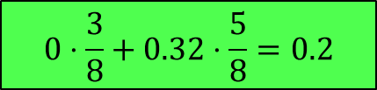
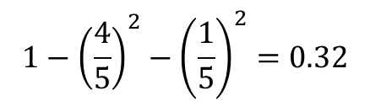
TRUE
shots_on_targe < 8
ball_possession | shots_on_target | WIN
No | 2 | No
No | 5 | No
No | 7 | No
Yes | 10 | Yes
No | 12 | No
No | 18 | Yes
Yes | 19 | Yes
Yes | 20 | Yes
FALSE
WIN | shots_on_target
Yes | No
0 | 3
WIN | shots_on_target
Yes | No
4 | 1
$$1−{\left(\frac{0}{3}\right)}^{2}−{\left(\frac{3}{3}\right)}^{2}=0$$
$$1−{\left(\frac{4}{5}\right)}^{2}−{\left(\frac{1}{5}\right)}^{2}=0.32$$
$$0⋅\frac{3}{8}+0.32⋅\frac{5}{8}=0.2$$

Slide 5
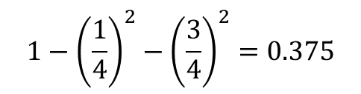
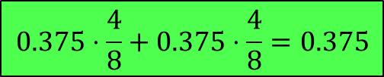
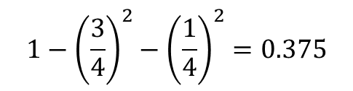
TRUE
shots_on_targe < 11
ball_possession | shots_on_target | WIN
No | 2 | No
No | 5 | No
No | 7 | No
Yes | 10 | Yes
No | 12 | No
No | 18 | Yes
Yes | 19 | Yes
Yes | 20 | Yes
FALSE
WIN | shots_on_target
Yes | No
1 | 3
WIN | shots_on_target
Yes | No
3 | 1
$$1−{\left(\frac{1}{4}\right)}^{2}−{\left(\frac{3}{4}\right)}^{2}=0.375$$
$$1−{\left(\frac{3}{4}\right)}^{2}−{\left(\frac{1}{4}\right)}^{2}=0.375$$
$$0.375⋅\frac{4}{8}+0.375⋅\frac{4}{8}=0.375$$

Slide 6
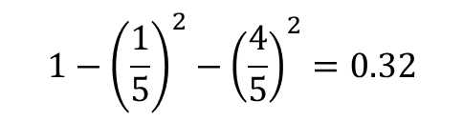
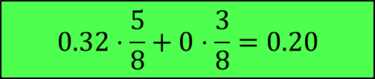
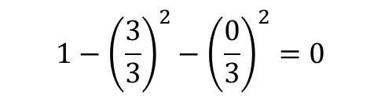
TRUE
shots_on_targe < 15
ball_possession | shots_on_target | WIN
No | 2 | No
No | 5 | No
No | 7 | No
Yes | 10 | Yes
No | 12 | No
No | 18 | Yes
Yes | 19 | Yes
Yes | 20 | Yes
FALSE
WIN | shots_on_target
Yes | No
1 | 4
WIN | shots_on_target
Yes | No
3 | 0
$$1−{\left(\frac{1}{5}\right)}^{2}−{\left(\frac{4}{5}\right)}^{2}=0.32$$
$$1−{\left(\frac{3}{3}\right)}^{2}−{\left(\frac{0}{3}\right)}^{2}=0$$
$$0.32⋅\frac{5}{8}+0⋅\frac{3}{8}=0.20$$

Slide 7
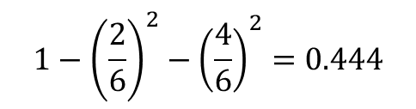
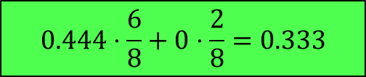
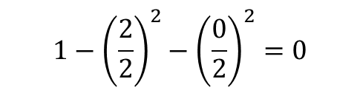
TRUE
shots_on_targe < 18.5
ball_possession | shots_on_target | WIN
No | 2 | No
No | 5 | No
No | 7 | No
Yes | 10 | Yes
No | 12 | No
No | 18 | Yes
Yes | 19 | Yes
Yes | 20 | Yes
FALSE
WIN | shots_on_target
Yes | No
2 | 4
WIN | shots_on_target
Yes | No
2 | 0
$$1−{\left(\frac{2}{6}\right)}^{2}−{\left(\frac{4}{6}\right)}^{2}=0.444$$
$$1−{\left(\frac{2}{2}\right)}^{2}−{\left(\frac{0}{2}\right)}^{2}=0$$
$$0.444⋅\frac{6}{8}+0⋅\frac{2}{8}=0.333$$

Slide 8
TRUE
shots_on_targe < 15
FALSE
WIN | shots_on_target
Yes | No
1 | 4
WIN | shots_on_target
Yes | No
3 | 0
TRUE
shots_on_targe < 15
FALSE
NO

Slide 9
ball_possession | shots_on_target | WIN
No | 2 | No
No | 5 | No
No | 7 | No
Yes | 10 | Yes
No | 12 | No
No | 18 | Yes
Yes | 19 | Yes
Yes | 20 | Yes
TRUE
shots_on_targe < 15
FALSE
ball_possession
NO
TRUE
FALSE
WIN | shots_on_target
Yes | No
3 | 0
WIN | shots_on_target
Yes | No
1 | 4

