Slide 1
XGBoost
Notes by: Santiago Zuluaga
From StatQuest

Slide 2
Notes
XGBoost is pretended to be used with large datasets (containing multiple variables).

Slide 3
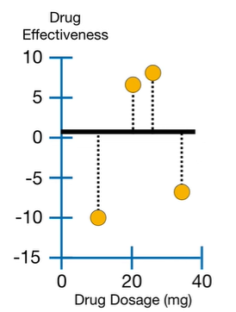
Initial Value
The initial prediction for Drup Effectiveness is 0.5

Slide 4
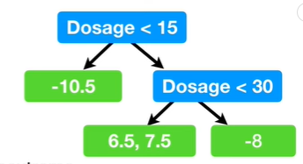
Regression Tree to the residuals
A XGBoost Tree is fitted to the residuals

Slide 5
Building a XGBoost Tree
Each tree starts out as a single leaf. All of the residuals go there.
Calculate Similarity Score for the Residuals.
-10.5, 6.5, 7.5, -7.5
$$Similarity Score(Residuales) =\frac{{\left(\sum{Residuals}\right)}^{2}}{Num Residuals+λ}$$
Regularization Parameter
$$Similarity Score\left(\left\{-10.6, 6.5, 7.5, -7.5\right\}\right)=\frac{{\left(−10.6+6.5+7.5−7.5\right)}^{2}}{4+0}=4$$
-10.6, 6.5, 7.5, -7.5
Similarity Score = 4

Slide 6
Building a XGBoost Tree
Is posible to do a better job spliting the residuals?
Dosage < 15
Similarity = 4
-10.5
6.5, 7.5, -7.5
Similarity = 110.25
Similarity = 14.08
Gain = 110.25 + 14.08 – 4 = 120.33

Slide 7
Building a XGBoost Tree
Dosage < 22.5
Similarity = 4
-10.5, 6.5
7.5, -7.5
Similarity = 8
Similarity = 0
Gain = 8 + 0 – 4 = 4

Slide 8
Building a XGBoost Tree
Gain (Splitting at Dosage < 15) = 120.33 > Gain (Splitting at Dosage < 22.5)
It’s also required to calculate the Gain (Splitting at Dosage < 30) but it’s lower compared when splitting at Dosage < 15. So Dosage < 15 Will be the threshold for the first Branch in the tree.

Slide 9
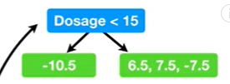
Building a XGBoost Tree
We continue splitting the leaf with 3 residuals

