Slide 1
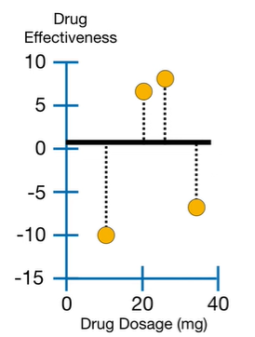









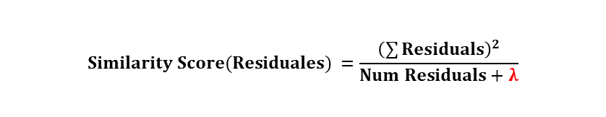


Initial Prediction
Initial Prediction
$$Drug Effectiveness=0.5$$
Fit a XGBoost Tree to the Residuals
-10.5, 6.5, 7.5, -7.5
$$Similarity Score =\frac{{\left(−10.6+6.5+7.5−7.5\right)}^{2}}{4+0}=4$$
Dosage < 15
Dosage < 22.5
Dosage < 22.5
-10.5
6.5, 7.5, -7.5
-10.5, 6.5
7.5, -7.5
-10.5, 6.5, 7.5
-7.5
$$Similarity$$
$$110.25$$
$$Similarity$$
$$14.08$$
$$Similarity$$
$$8$$
$$Similarity$$
$$0$$
$$Similarity$$
$$4.08$$
$$Similarity$$
$$56.25$$
$$Gain$$
$$110.25+14.08−4=120.33$$
$$Gain$$
$$8+0−4=4$$
$$Gain$$
$$4.08+56.25−4=56.33$$
WINNER
$$Similarity Score(Residuales) =\frac{{\left(\sum{Residuals}\right)}^{2}}{Num Residuals+λ}$$
Regularization Parameter. 0 for the tutorial

Slide 2



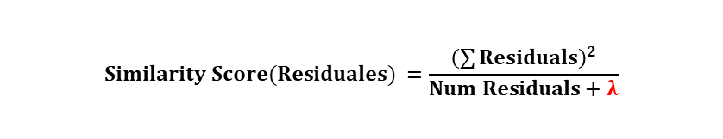











Fit a XGBoost Tree to the Residuals: Split 2, Splitting the WINNER
Dosage < 15
$$Gain$$
$$120.33$$
Dosage < 15
$$Gain$$
$$120.33$$
-10.5
Dosage < 22.5
$$Gain$$
$$28.17$$
-10.5
Dosage < 30
$$Gain$$
$$140.17$$
$$Similarity$$
$$110.25$$
$$Similarity=14.08$$
$$Similarity$$
$$110.25$$
$$Similarity=14.08$$
It’s not posible to split more this leaf
6.5
7.5, -7.5
6.5, 7.5
-7.5
$$Similarity$$
$$42.25$$
$$Similarity$$
$$0$$
$$Similarity$$
$$98$$
$$Similarity$$
$$56.25$$
$$Gain$$
$$42.25+0−14.08=28.17$$
$$Gain$$
$$98+56.25−14.08=140.17$$
WINNER
TREE_DEPTH_LEVELS = 2 -> No more splits!
TREE_DEPTH_LEVELS = 6 # Default value (more complex datasets)
Fit a XGBoost Tree to the Residuals: Prune the WINNER TREE
Shoud the Branch Dosage < 30 be removed?
$$Gain−γ≥0 →{Don}^{′}t REMOVE$$
$$140.17−γ≥0 →{Don}^{′}t REMOVE$$
$$Gain−γ<0 → REMOVE$$
$$140.17−γ<0 →REMOVE$$
$$Similarity Score(Residuales) =\frac{{\left(\sum{Residuals}\right)}^{2}}{Num Residuals+λ}$$
$$λ>0→Similarity Score is smallers →The Gains are smallers →It^{′}s easier to prune$$
It’s posible to get Negative Gains, so $λ=0$doesn’t imply not pruning

Slide 3
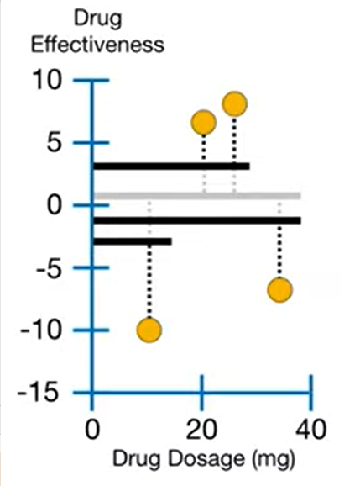





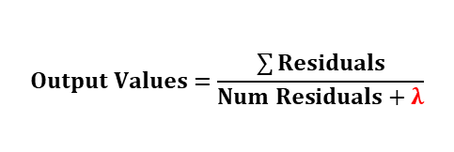



Output Values for the leaves (from the WINNER tree)
Dosage < 15
What would be the output value for the leaves?
-10.5
Dosage < 30
$$Output Values=\frac{\sum{Residuals}}{Num Residuals+λ}$$
6.5, 7.5
-7.5
What does $λ?$ Reduce the prediction sensivity. Example $λ=1$
$$Output Values\left(\left\{−10.5\right\}\right)=\frac{−10.5}{1+1}=\frac{−10.5}{2}=−5.25$$
$$Output Values\left(\{−10.5, −10.5, …\}\right)=−10.5×\frac{100}{101}=−10.39$$
98 times -10.5
Updating Prediction
Initial Predicted Drug Effectiveness
=
+
x
Dosage < 15
New Prediction
Learning Rate, $ε=0.3$
Called eta in documentation
0.5
-10.5
Dosage < 30
$$Output$$
-10.5
6.5, 7.5
-7.5
$$0.5+0.3×\left(7\right)=2.6$$
Output
$$7$$
Output
$$−7.5$$
$$0.5+0.3×\left(−7.5\right)=−2.65$$
$$0.5+0.3×\left(−10.5\right)=−2.65$$
New prediction
New Prediction
New Residuals
New Tree
Stops if Residuals are small or number of tree limit reached.

