Slide 1
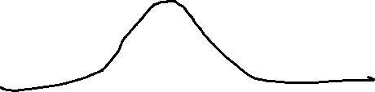
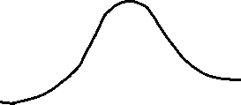
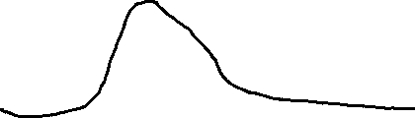
Undestanding Likelihood
Measurements for a person's height. It follows a normal distribution. What are the ‘maximum likelihood’ estimation for the mean and variance?
The distribution doesn’t fit good
The distribution doesn’t fit good
Good FIT!

Slide 2
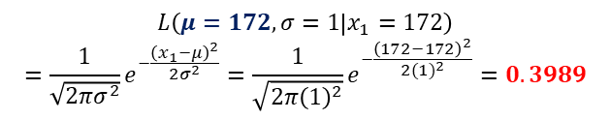

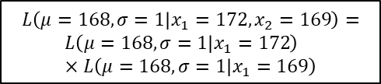

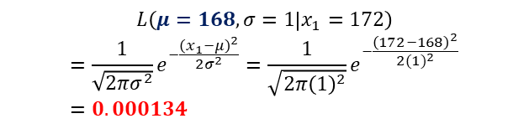
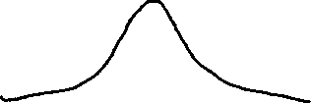

A simple point example
Suppose that it’s known that the $σ=1$, and we measured an observation
($x_{1}=172$), what will be the maximum likelihood estimation for the mean?
$$L\left(μ=168, σ=1 | x_{1}=172\right)$$
$$=\frac{1}{\sqrt{2πσ^{2}}}e^{−\frac{{\left(x_{1}−μ\right)}^{2}}{2σ^{2}}}=\frac{1}{\sqrt{2π{\left(1\right)}^{2}}}e^{−\frac{{\left(172−168\right)}^{2}}{2{(1)}^{2}}}=0.000134$$
168
170
172
174
$$L\left(μ=172, σ=1 | x_{1}=172\right)$$
$$=\frac{1}{\sqrt{2πσ^{2}}}e^{−\frac{{\left(x_{1}−μ\right)}^{2}}{2σ^{2}}}=\frac{1}{\sqrt{2π{\left(1\right)}^{2}}}e^{−\frac{{\left(172−172\right)}^{2}}{2{(1)}^{2}}}=0.3989$$
Maximum Likelihood
168
170
172
174
How to calculate likelihood for more than 1 data points
$$L\left(μ=168, σ=1 | x_{1}=172, x_{2}=169\right)=$$
$$L\left(μ=168, σ=1 | x_{1}=172\right)×L\left(μ=168, σ=1 | x_{1}=169\right)$$
If $x_{1}$ and $x_{2}$ are independent
$$x_{2}$$
$$x_{1}$$
168
170
172
174

Slide 3


Log Likelihood
With n data points:
$$L\left(μ, σ|x_{1}, x_{2}, …, x_{n}\right)=L\left(μ, σ | x_{1}\right)×L\left(μ, σ | x_{2}\right)×…×L\left(μ, σ | x_{n}\right)$$
$$L\left(μ, σ|x_{1}, x_{2}, …, x_{n}\right)=\frac{1}{\sqrt{2πσ^{2}}}e^{−\frac{{\left(x_{1}−μ\right)}^{2}}{2σ^{2}}}×\frac{1}{\sqrt{2πσ^{2}}}e^{−\frac{{\left(x_{2}−μ\right)}^{2}}{2σ^{2}}}×…×\frac{1}{\sqrt{2πσ^{2}}}e^{−\frac{{\left(x_{n}−μ\right)}^{2}}{2σ^{2}}}$$
$$\ln\left[L\left(μ, σ|x_{1}, x_{2}, …, x_{n}\right)\right]=\ln\left[\frac{1}{\sqrt{2πσ^{2}}}e^{−\frac{{\left(x_{1}−μ\right)}^{2}}{2σ^{2}}}×…×\frac{1}{\sqrt{2πσ^{2}}}e^{−\frac{{\left(x_{n}−μ\right)}^{2}}{2σ^{2}}}\right]$$
$$ln\left[L\left(μ, σ|x_{1}, x_{2}, …, x_{n}\right)\right]=−\frac{1}{2}\ln\left(2π\right)−\ln\left(σ\right)−\frac{{\left(x_{1}−μ\right)}^{2}}{2σ^{2}}−…−\frac{1}{2}\ln\left(2π\right)−\ln\left(σ\right)−\frac{{\left(x_{n}−μ\right)}^{2}}{2σ^{2}}$$
Derivating:
$$\frac{∂}{∂μ}\ln\left[L\left(μ, σ|x_{1}, x_{2}, …, x_{n}\right)\right]=0−0+\frac{x_{1}−μ}{σ^{2}}+…+\frac{\left(x_{n}−μ\right)}{σ^{2}}$$
Making the previous derivate equal to 0 (to find the maximum) and solving for $μ:$
$$\hat{μ}=\frac{x_{1}+x_{2}+…+x_{n}}{n}$$
Final Notes - Definition
According to Wikipedia (Likelihood function or likelihood):
represents the probability of random variable realizations conditional on particular values of the statistical parameters. (it is the probability of the data given the parameter value). Note that it’s $L\left(μ, σ | X\right)$ and NOT $p\left(μ, σ | X\right)$
$L\left(μ, σ | X\right)=P\left(X | μ, σ\right)$ but it’s often written as $L\left(μ, σ | X\right)$ to emphasize that it’s a function of the parameters $μ, σ$
when evaluated on a given sample, the likelihood function indicates which parameter values are more likely than others, in the sense that they would have made the observed data more probable. That’s why you choose the parameters values that maximizes the likelihood function.
According to https://www.youtube.com/watch?v=Dmy3AGIj7_U:
Probability of getting your datasets given your model or assumptions.
The best model throught Likelihood: Most likely to have produced our data.
Example: If you have data from a normal distribution, say 5 data, and the average of those data is 120, 120 is the value of the parameter of the mean with the maximum likelihood, given that having a normal distribution with a mean of 120 makes it more likely to obtain the sample data than any other.

