Slide 1
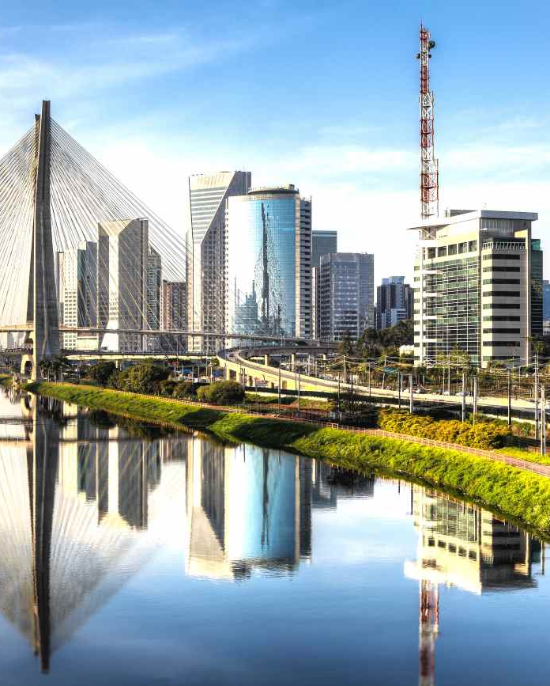
Subway Location Analysis

Slide 2
Topics
Subway Location
Social Sentiment
Overlap with McDonalds

Slide 3
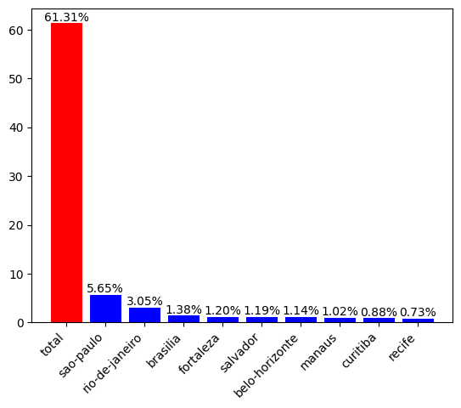
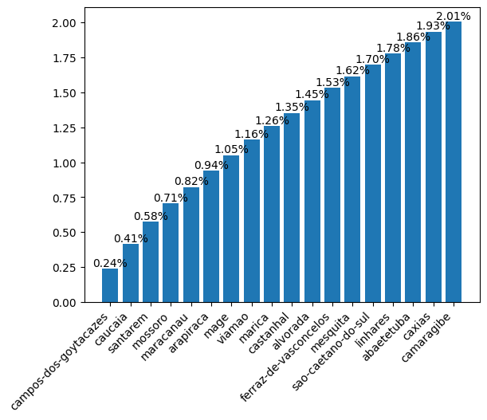
1. Subway Location
Currently, Subway is covering 61.31% of the cities within Brazil, in cities like Sao Paulo, Rio de Janeiro, Brasilia and so on. Despite this broad presence, to get to an additional 2% of the population Subway must open restaurants in 18 more cities such as the following.
Top 10 cities with restaurant
Cities without restaurant to reach 2%

Slide 4
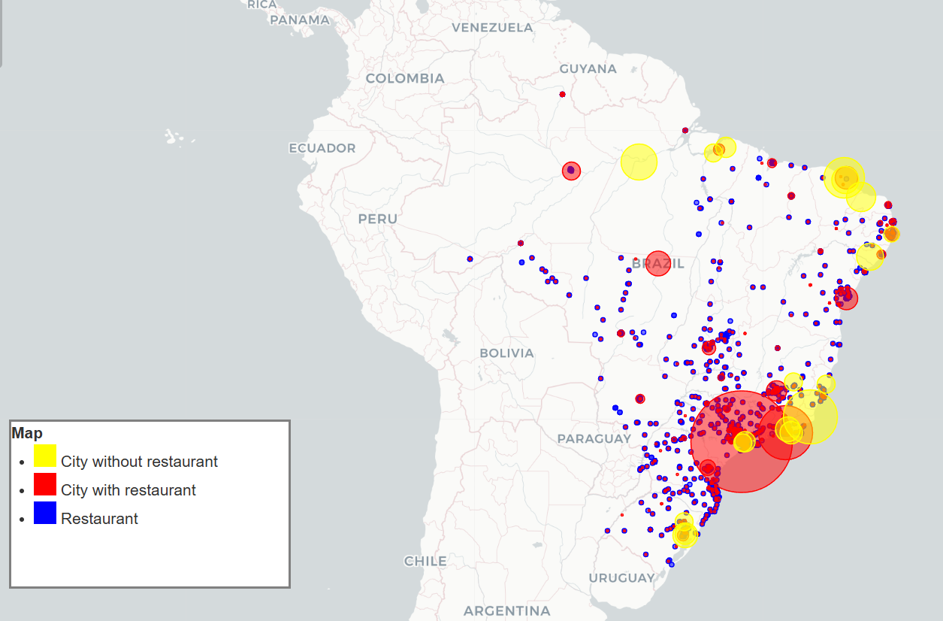
1. Subway Location
In the map is shown the locations that have restaurants and the locations where is an opportunity to open a new branch to get to the additional 2%, the size of the bubble indicates the population.
- The dynamic map is inserted for further exploration.

Slide 5
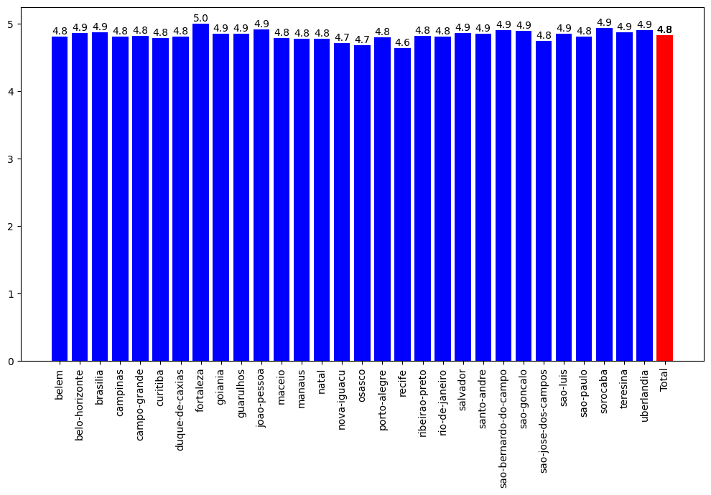
2. Social Sentiment Analysis
Web scrapping was made in the subway pages of the 700 main restaurants in Brazil to find excellent performance and rating with an average rate of 4.8 of 5.
Sentiment rating per city

Slide 6
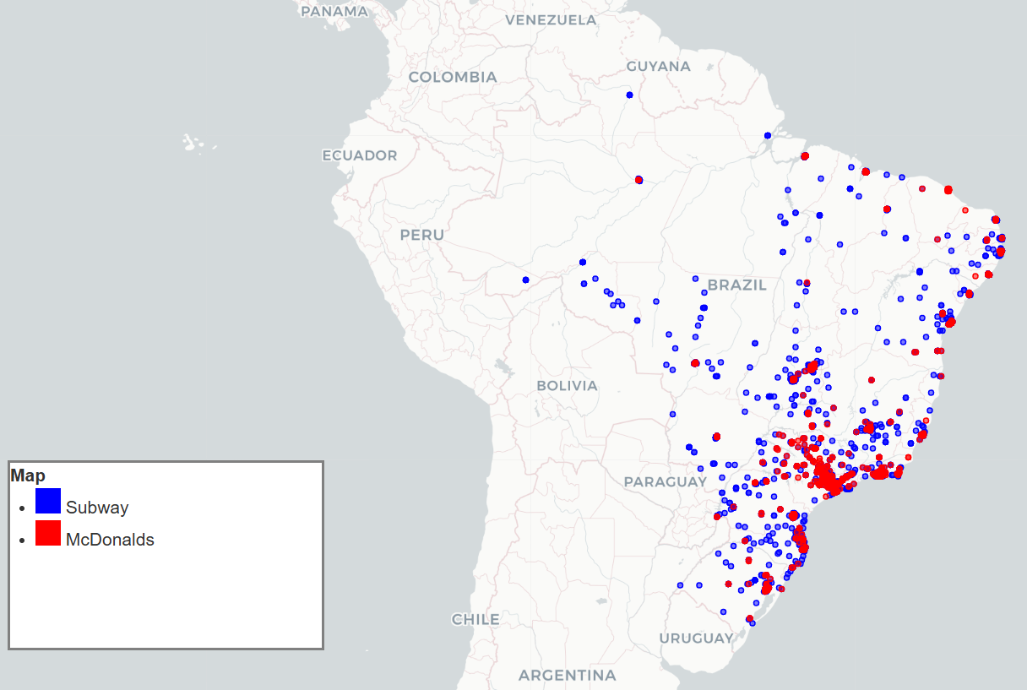
3. Overlap with McDonalds
In the map is shown the locations overlapped with McDonalds.
Map of the locations of Subway and McDonalds.
Percentage overlap with McDonald's within 1 km: 41.6%.
Percentage overlap with McDonald's within 5 km: 72.12%
Percentage overlap with McDonald's within 10 km: 78.09%
Few Subway locations overlap with McDonald's within 1 km. Opportunity for growth.
High competition in 5 km zones. Consider targeting less competitive areas.
High competition in 10 km zones. Focus on underserved locations.
Based on the map, Subway has more opportunity to grow in the east and north-east that McDonalds is less concentrated.
- The dynamic map is inserted for further exploration.

