Slide 1
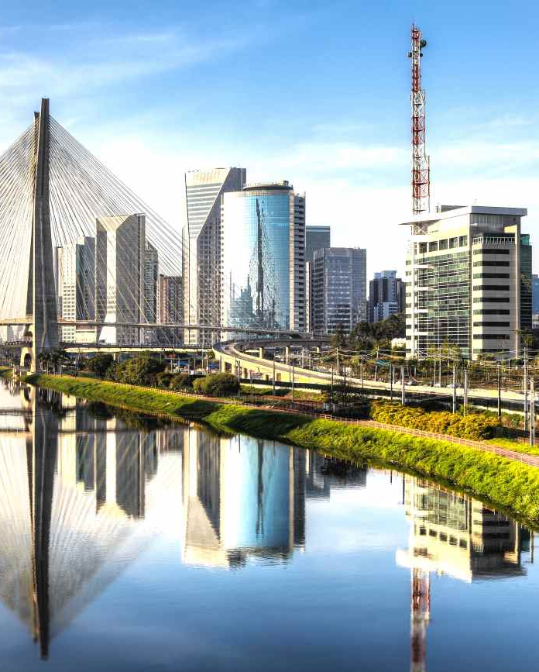
Warehouses

Slide 2
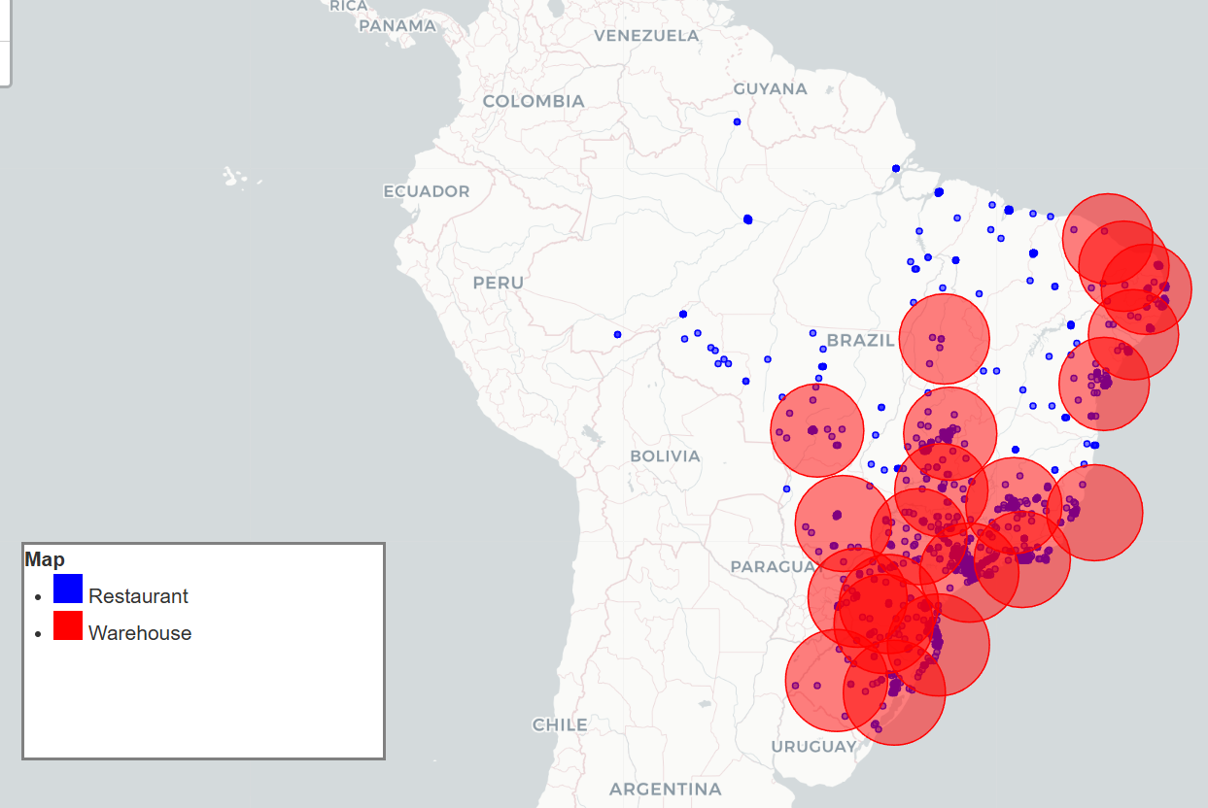
1. Warehouse Location
Currently the coverage of the warehouses is over the 90%, however, the number of restaurants unserved is something to work out. With the new warehouses could get to the 100%, especially remote areas.
Map of the existent Warehouses.
- The dynamic map is inserted for further exploration.

Slide 3
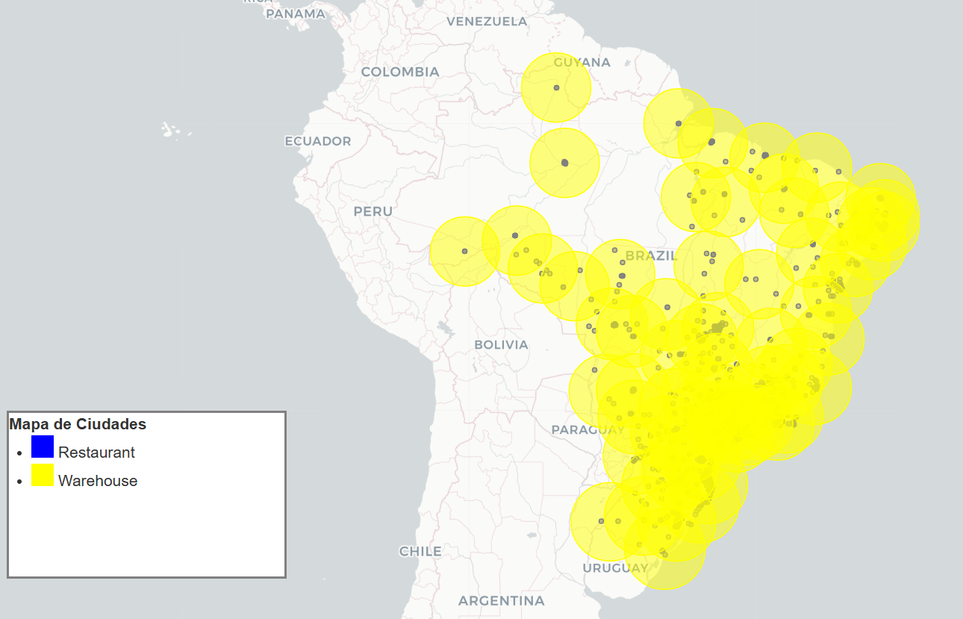
1. Warehouse Location
As is shown, all the restaurants are covered inserting 67 warehouses. The size of the bubble is 300 km that is the coverage radio.
Map of the new Warehouses.
- The dynamic map is inserted for further exploration.

