Slide 1

AMD Developer Hackathon ACT II | Track 2: Video Captioning
Dockerized • Grounded • Structured

Slide 2
THE CHALLENGE
A caption is only useful when it stays faithful
One short clip must become four distinct voices without inventing what the camera never showed.
01
Visual grounding
Describe only subjects and actions supported by sampled frames.
02
Four style targets
The evaluation also expects machine-perfect delivery, not just creative writing.
Formal, sarcastic, humorous tech, and everyday humor.
03
Strict output contract
Every requested key must appear in valid results.json.
04
Runtime resilience
Finish within ten minutes and exit cleanly on handled failures.
LUNALENS | AMD DEVELOPER HACKATHON ACT II
02

Slide 3
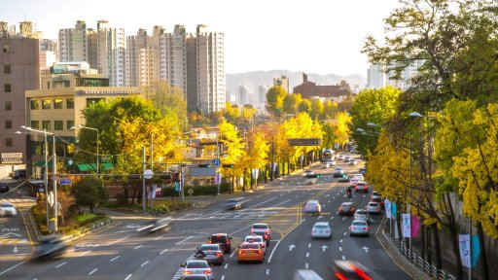
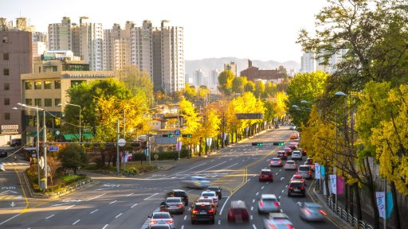
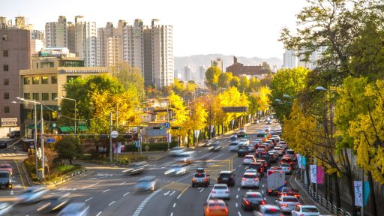
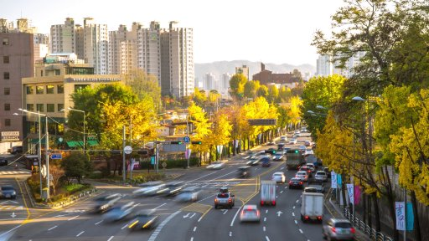
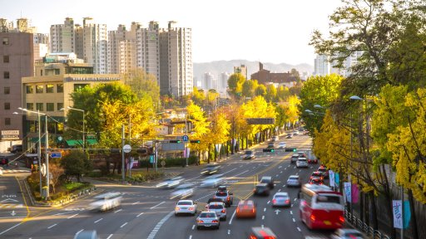
HOW IT WORKS
The pipeline turns sparse frames into grounded voices
t1
t2
t3
t4
t5
1
2
3
4
5
6
Ingest
Sample
Observe
Create
Judge
Deliver
tasks.json
8 JPEG frames
visual facts
style candidates
faithfulness first
results.json
Only sampled frames leave the container; the full video does not.
OpenCV → GPT-5.6 Luna → JSON Schema
LUNALENS | AMD DEVELOPER HACKATHON ACT II
03

Slide 4
WHY IT HOLDS UP
Reliability is designed into every model call
01
02
03
Ground first
Constrain output
Fail gracefully
The vision pass extracts subjects, actions, setting, mood, and uncertainty before any humor is written.
Strict JSON schemas require every style key, while local validation enforces one sentence and 8–22 words.
Model-access fallback, safe captions, atomic file writes, and exit code 0 protect the evaluation contract.
Faithfulness outranks humor at the final self-check.
LUNALENS | AMD DEVELOPER HACKATHON ACT II
04

Slide 5
MEASURED RUN
High reasoning still finishes comfortably inside the limit
8
59.5s
4/4
frames sampled
end-to-end
styles returned
Evenly distributed across the clip
Latest successful local evaluation
No requested caption style missing
Cost controls
512px frames • JPEG compression • bounded candidates • output budgets tuned for high reasoning
Measured on one representative sample clip; runtime varies with network and API load.
LUNALENS | AMD DEVELOPER HACKATHON ACT II
05

Slide 6
EXAMPLE OUTPUT
One scene, four voices, all grounded
FORMAL
Vehicles travel through multiple marked lanes on a busy boulevard lined with yellow autumn trees, apartment towers, and distant hills.
SARCASTIC
Apparently, even a bright autumn boulevard needs multiple lanes, white arrows, and yellow lines to keep traffic moving.
HUMOROUS TECH
Traffic appears to be running a crowded program across multiple lanes, with buses, arrows, and yellow lines in the interface.
HUMOROUS NON-TECH
Cars and buses share the boulevard, apparently agreeing that several lanes are better than taking turns.
Validated English • one sentence • 8–22 words
LUNALENS | AMD DEVELOPER HACKATHON ACT II
06

Slide 7
READY FOR EVALUATION
Grounded captions.
Four distinct voices.
One reliable container.
linux/amd64 Docker image
/input/tasks.json → /output/results.json
No hardcoded sample answers
Safe fallback and exit code 0
LunaLens Video Captioning Agent
LUNALENS | AMD DEVELOPER HACKATHON ACT II
07

