Slide 1

MAREA 2. Design and Optimization of a Distributed Communications Middleware
Santi Pérez Fernández
Director: Juan López Rubio
November 2013

Slide 2
Index
Objectives
System architecture
Network system architecture
Service container
Tools & Libraries
Performance results
Conclusions
Future work

Slide 3
Objectives
Performance optimization
Network system architecture
New features
Service implementation based on deployment unit concept
Naming service

Slide 4
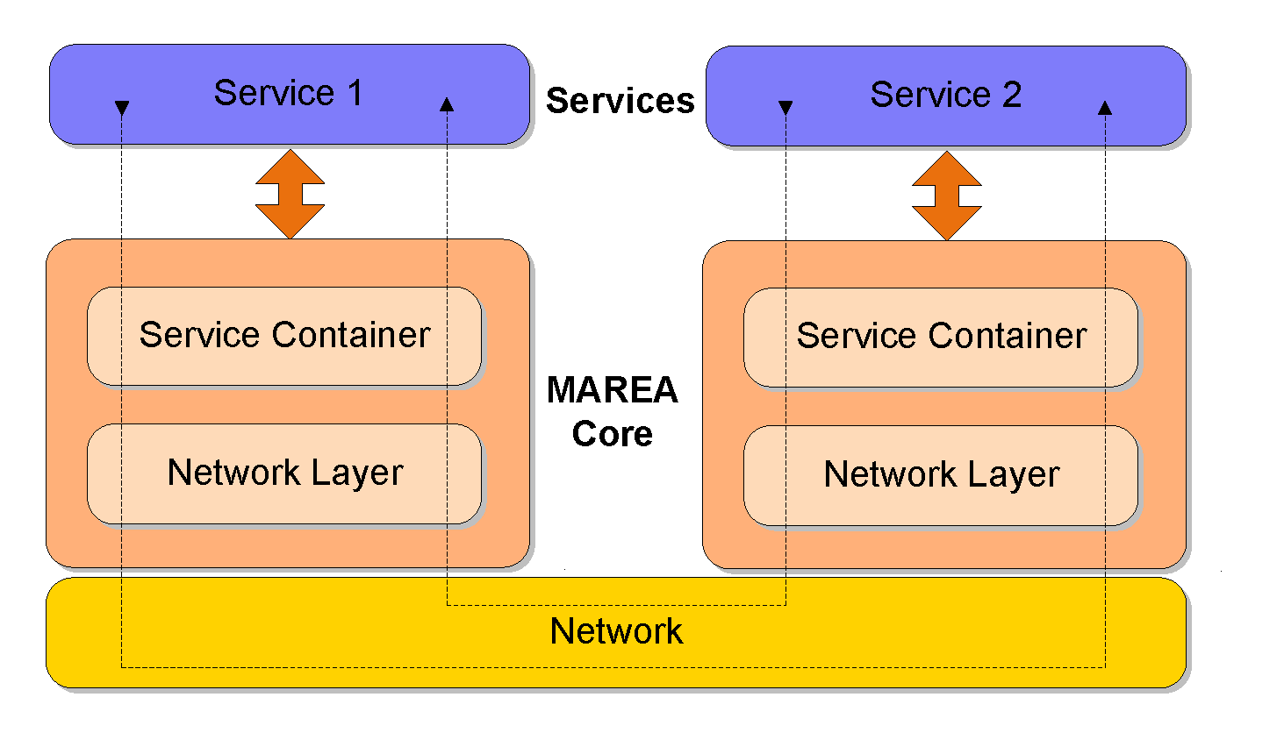
System Architecture

Slide 5
Network System Architecture: Router
Creates and manages network lanes
Lane: A set of references to the bindings establish between the different network architecture elements (encoder and transports) used at a particular moment
Lane implementation: linked lists of delegates or multicast delegates
Router & network lanes build a highly reconfigurable and adaptive architecture

Slide 6
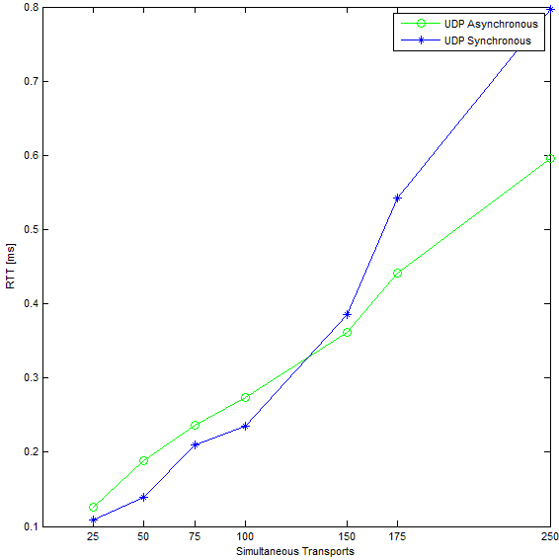
Network System Architecture: Transports
Provides communication facilities to send and receive data (byte sequences) from the network (TCP & UDP protocols)
One thread for each individual transport
Drawbacks: Poor management of large number of threads, memory overhead (1 MB/thread native and CLR)
Improvement: TCP and UDP asynchronous transports based on asynchronous I/O operations (without threads)

Slide 7
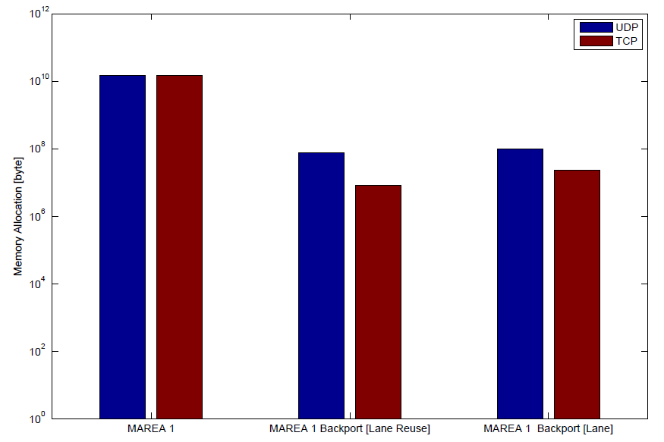
Network System Architecture: NetworkMessage Pool
Problem: Garbage collection executed by .NET virtual machine can introduce non deterministic pauses
Solution: Use a memory pooling mechanism. Reduce the amount of work that has to be done by the garbage collector and consequently minimize the time used by its own execution
Implementation: NetworkMessage pool based on FIFO queue discipline
Echo test (requester side)
1000 Bytes, 10000 times, 100 Hz

Slide 8
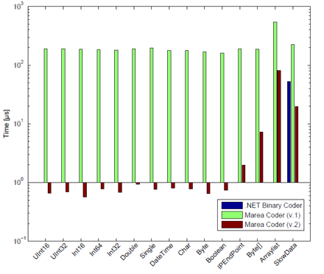
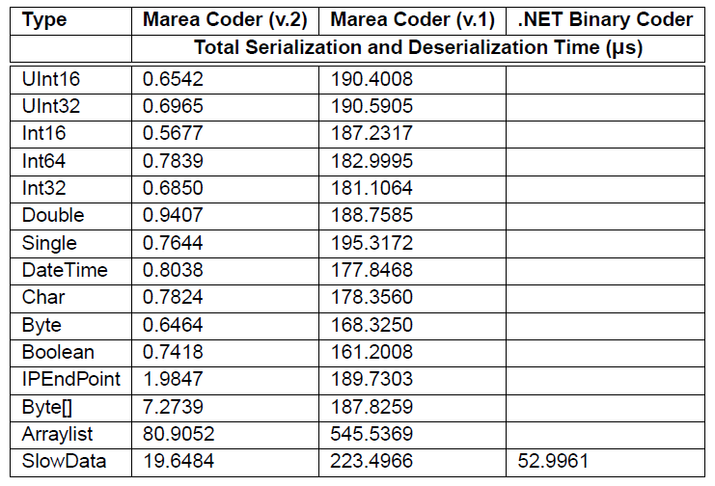
Network System Architecture: Coder layer
Several encoding layer implementations
Drawbacks:
XMLSerializer, BinaryFormatter: Overhead
MAREA Coder (v.1): Custom serialization drawbacks: complexity and maintenance
Improvements:
MAREAGen tool: Automatic serialization/deserialization code generation for classes marked as serializable
Long switch statements are avoided

Slide 9
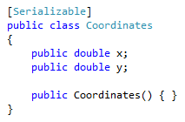

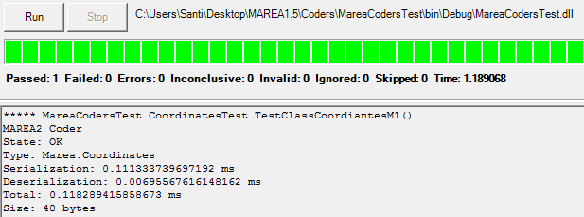
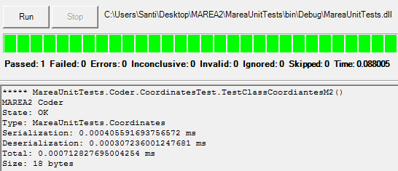
Network System Architecture: Coder layer
MAREAGen
Eliminates the need for MAREA programmers to implement specific serializing and deserializing code
Creates proxies automatically
Reduces the size of the serialized data
*.cs files
MAREA Gen
MAREA
Test
Service
MGenTypes.dll
MAREA 1
48 B
118.28 µs
MAREA 2
18 B
0.71 µs

Slide 10
Network System Architecture: Coder layer
Limitation removal:
Compatibility with UTF8 character encoding
Overflow exceptions for high values (double.MaxValue) in double types
Support for run-time/dynamic Enum types
Full support of polymorphic capabilities: Inheritance and control of null objects in object trees
New features:
Support for some of the most commonly used .NET collection types (e.g. lists, dictionaries and hash tables)

Slide 11
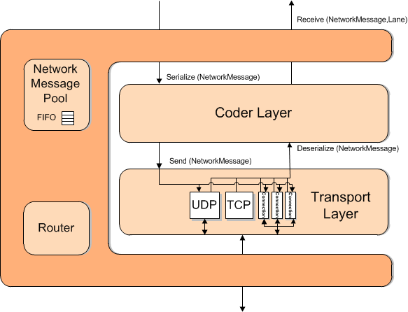
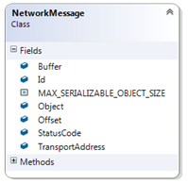
Network System Architecture
Protocol Message
Output lane
Serialize (NetworkMessage)
Send (NetworkMessage)
Input lane
Deserialize (NetworkMessage)
Receive (NetworkMessage)

Slide 12
Naming service
The naming service allows MAREA to find, share and access services and its communication primitives hiding the network complexity.
Service identifier-> four different hierarchical levels
/<subsystem>/<node>/<instance>/<service>/<primitive>
Types
Single addressing: represent a unique primitive or service
e.g. /Vehicle 1/Devices/Main/GPS
Query addressing: represent a group of primitive or services inside the network or MAREA domain
e.g. */Vehicle 1/Devices/*/GPS

Slide 13
Service Container: Deployment Unit Concept
Deployment Unit: compressed file that contains a module of code loadable by the service container
Interface Deployment Units (IDU): Contains the interface and description of the service
Service Deployment Units (SDU): Contains the implementation of the service. It has a dependency with its corresponding IDU
Library Deployment Units (LDU): Contains libraries or other dependencies required by the service
Benefits
Types and parameters of service description and implementation are checked at compile time
Provides flexibility to change parts of a module/sub-system at anytime
Freedom to change implementations and not break them
IAltimeter
Service Description
BarometricAlt : IAltimeter
RadoelectricAlt: IAltimeter
Service Implementations

Slide 14
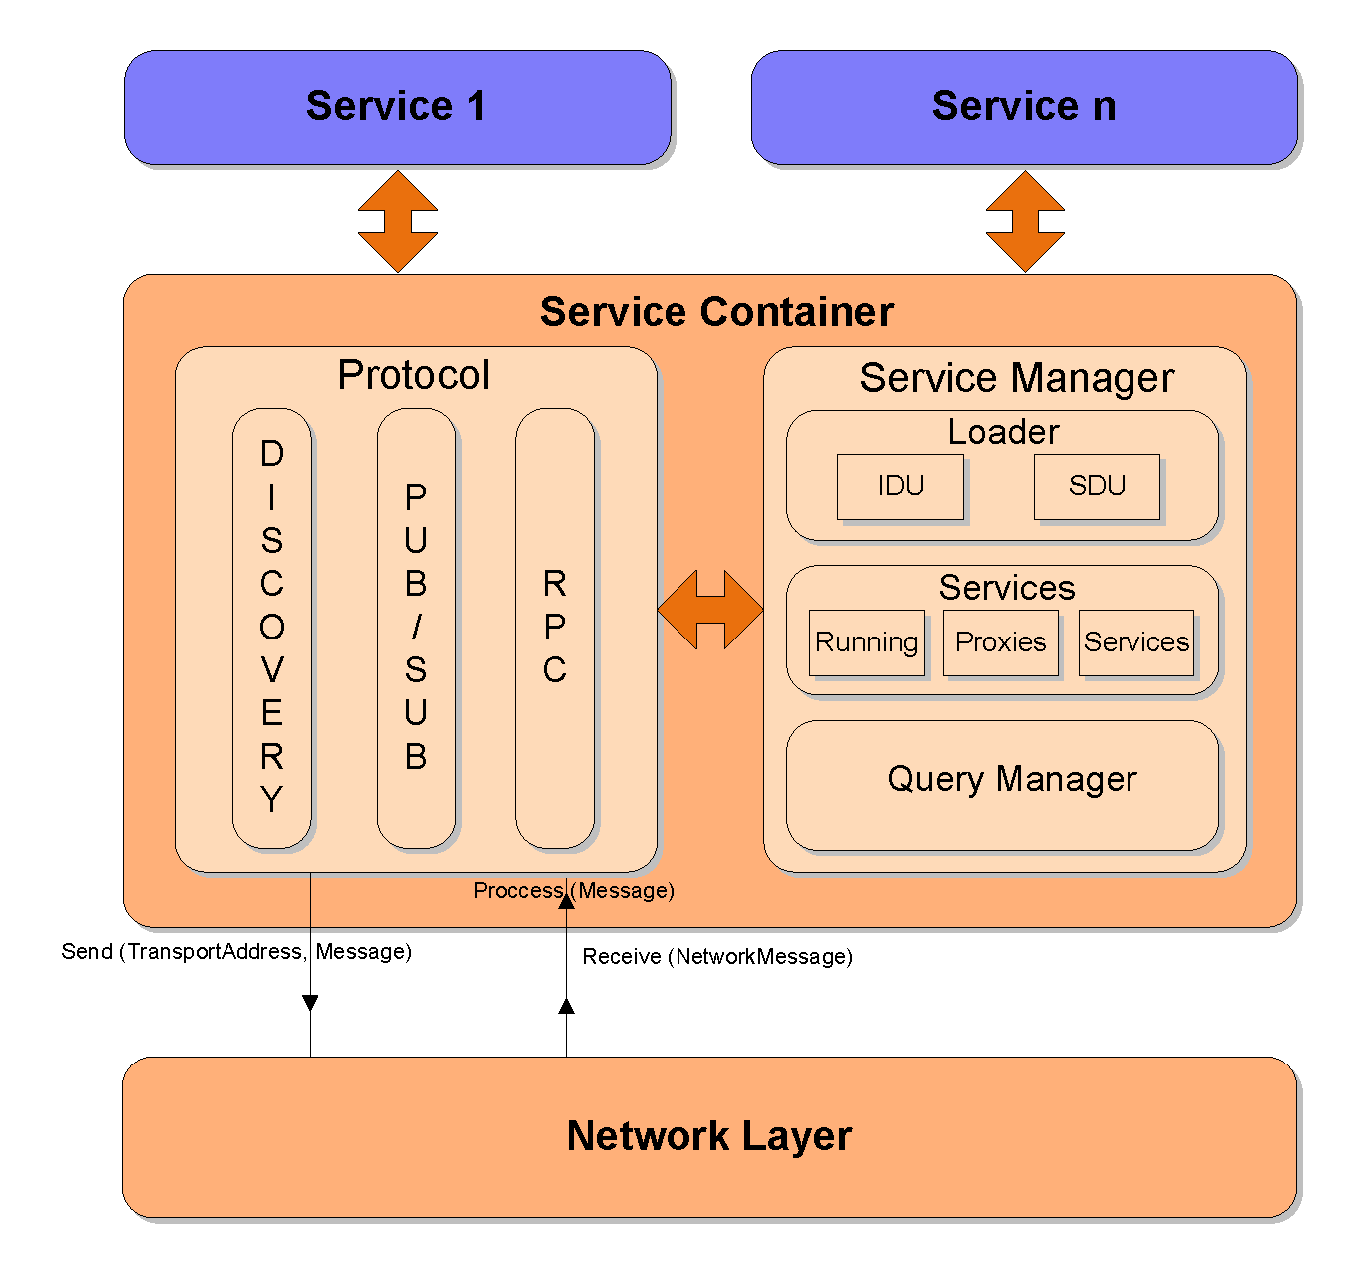
Service Container
MAREA 2 offers an pluggable protocol layer.
New protocols can be added and removed easily
Service management and discovery is independent of protocol implementation

Slide 15
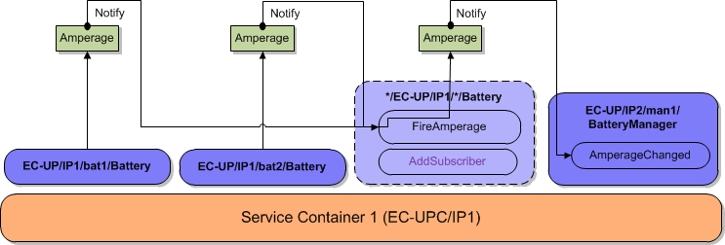
Service Container: Proxies
Are objects that could represent a remote service or set of services selected by a query.
Characteristics:
Same interface as the represented service
Act as redirectors. Not extra specific functionality
Types:
Remote producer proxy: implement transparent communications
Query proxy: used to support the naming service

Slide 16
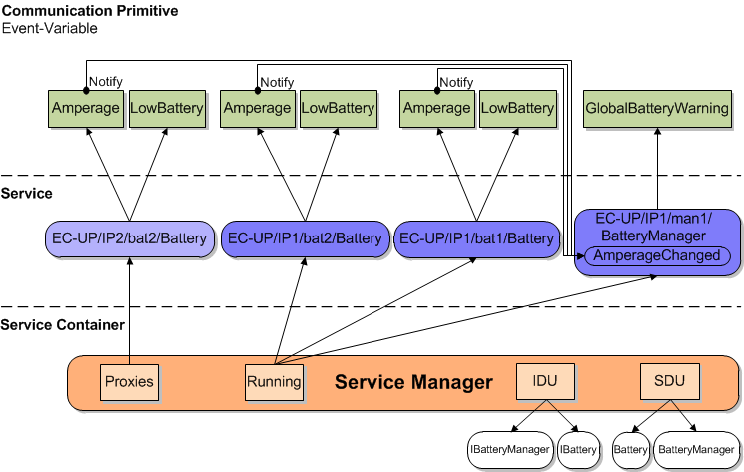
Service Container: Service Manager

Slide 17
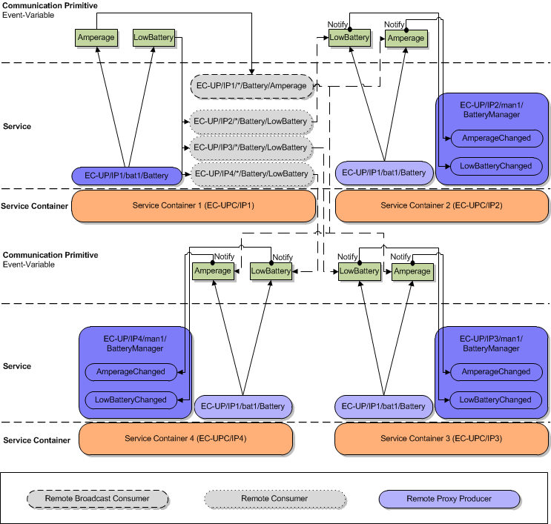
Service Container: Remote & Proxy services

Slide 18
Protocol Layer
Service discover of remote services and specific remote message management for each communication primitive
Protocols
Discovery: Advertise and discover services
Publish-Subscribe: Subscription and data transfer of variable and event primitives
RPC: Point to point synchronous communication to implement remote invocation primitive

Slide 19
Protocol Layer
Enhancements
The new design decouples the different protocols into smaller independent modules
Easily allow to plug additional protocols for implementing other primitives and other communication features
Discovery protocol is accomplished at service level
Less network traffic (low throughput networks)
Support of session tokens as a way to avoid reply attacks in remote invocation primitive

Slide 20




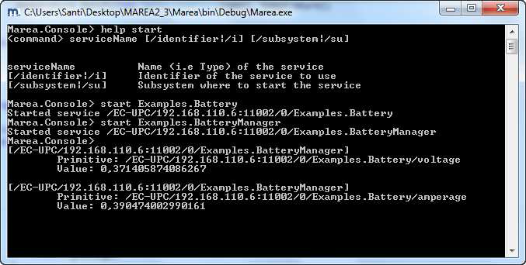
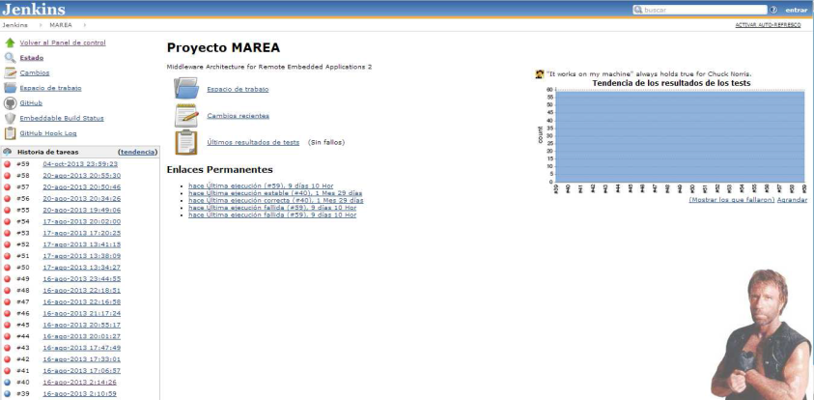


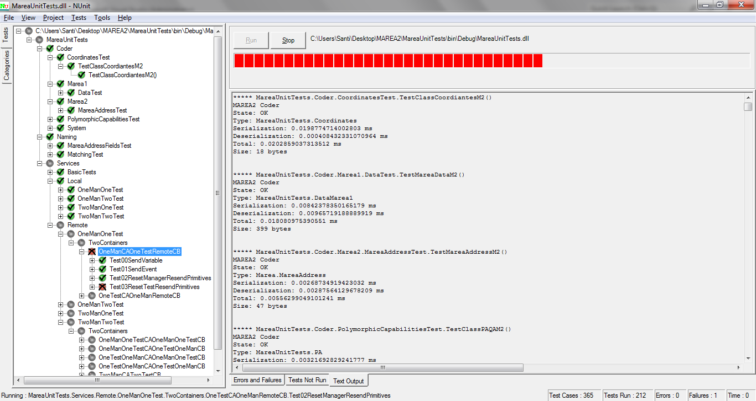
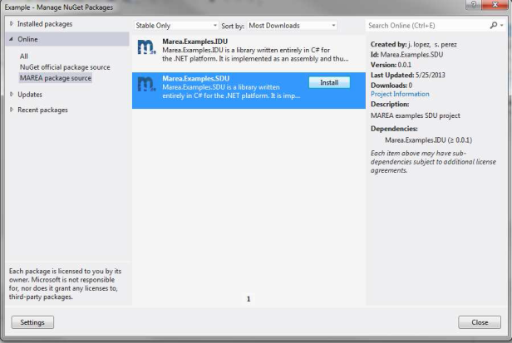


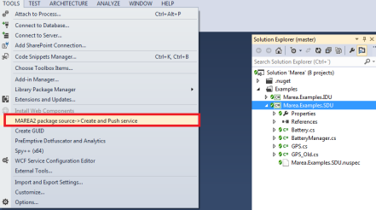
Tools & Libraries
Thorn

Slide 21
Tools & Libraries
Unit testing and Continuous integration allows the automated test of functionalities without user intervention. 365 tests assure MAREA 2 correct behavior

Slide 22
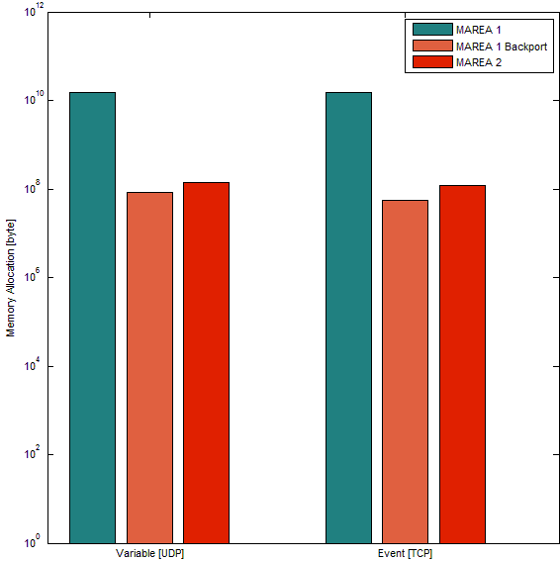
Performance Results: Memory Allocation
Bytes Allocated | MAREA 1 | MAREA Backport | MAREA 2
Variable | 15834797234 | 85587107 | 139311411
Event | 14805029654 | 54609735 | 122285449
MAREA 2 Memory Allocation Reduction:
Variables -> 99.12%
Events -> 99.17%

Slide 23
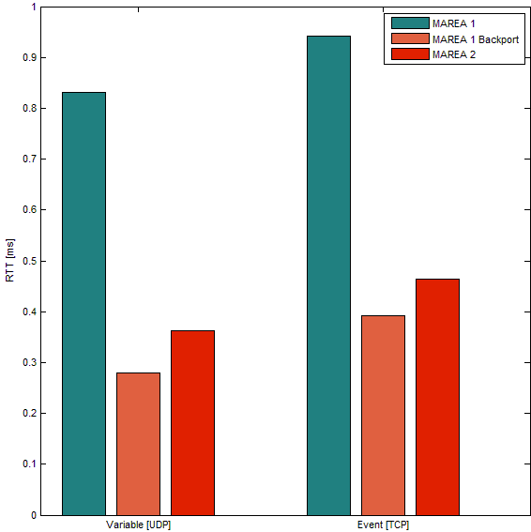
Performance Results: RTT
RTT [ms] | MAREA 1 | MAREA 1 Backport | MAREA 2
Variable | 0.8312 | 0.2797 | 0.3622
Event | 0.9421 | 0.3921 | 0.4633
STD-RTT [ms] | MAREA 1 | MAREA 1 Backport | MAREA 2
Variable | 0.6594 | 0.2992 | 0.4081
Event | 0.5453 | 0.5221 | 0.5737
MAREA 2 RTT Reduction:
Variables -> 56.42%
Events -> 50.82%

Slide 24
Future Work
Addition of new protocols: file-based data transfer protocol, P2P
Static name resolution support
Extend capabilities to other platforms: .NET Compact framework, .NET Microframework, Mono & IOSharp (Raspberry)
Performance optimization: Service container, new implementation in C++, Alternative
QoS control mechanisms: adaptive message QoS control in the service container
Software usability: Specific Visual Studio project templates (IDU & SDU), service distribution (NuGet)

Slide 25
Conclusions
A new version of the middleware MAREA 1, has been designed and implemented
MAREA 2 presents a more modular, flexible and reusable architecture. Starting point for providing reflective and adaptive capabilities
The new service implementation based on the deployment unit concept takes benefit from interfaces and the Composite Reuse Principle
Support of a naming service based on dynamic name resolution. Provides fault tolerance to the system
Performance optimization work is focused in the components of the network layer (MAREAGen/MAREA Coder, memory pool mechanism, TCP and UDP asynchronous transports)

Slide 26


Slide 27
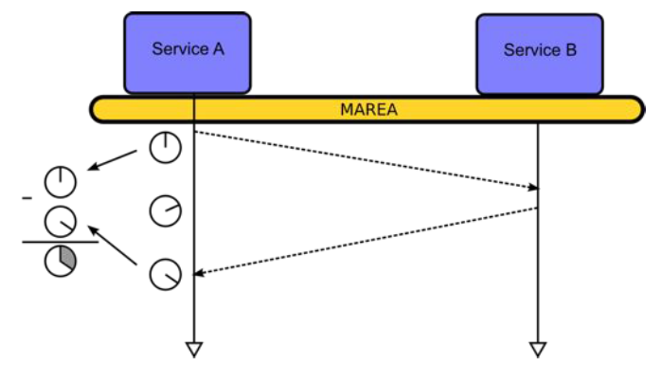
Performance Optimization Results
Echo test
Middlewares: MAREA 1, MAREA 1 network backport, MAREA 2
Test configuration: 100 Hz, 1000 Bytes, 10k times
Key performance parameters: RTT, memory allocation

Slide 28
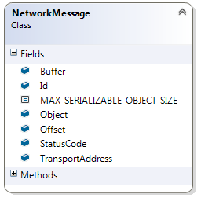
Network System Architecture: Coder layer
Serialization: Hastable of delegates
Deserialization: Array of delegates
Message Ids from MAREA protocol messages are reused in the service container to proccess the incoming messages
Keys | Values
0 | *FromPublish
1 | *FromDiscover
MAREA protocol messages
Compatible Signatures
Serialization
(object o, byte[] buffer, ref int offset)
Deserialization
(byte[] buffer, ref int offset)
64 | -
Null
65 | *FromInt32
66 | *FromUInt32
Basic types
127 | -
Not null
128 | *FromTransportAddress
129 | *FromPosition
Other

