Slide 1






Pooch
A friend to fetch your data files
Santiago Soler
www.santisoler.com
@santisoler

Slide 2
Downloading data files
Easy and with simple code
Reuse downloaded files
Check if files are corrupted

Slide 3
Pooch
fatiando.org/pooch
github.com/fatiando/pooch
Downloads files
Caches locally
Checks integrity

Slide 4
How to use it?

Slide 5
Download a single file
import pooch
file_path = pooch.retrieve(
url="https://awesome.data.com/file.txt",
known_hash="md5:70e2afd3fd7e336ae478b1e740a5f08e",
)

Slide 6
Choosing where to download
import pooch
file_path = pooch.retrieve(
url="https://awesome.data.com/file.txt",
known_hash="md5:70e2afd3fd7e336ae478b1e740a5f08e",
path="/home/pycascades/my_data/",
)

Slide 7
Different protocols
import pooch
file_path = pooch.retrieve(
url="ftp://basement.org/file.txt",
known_hash="md5:70e2afd3fd7e336ae478b1e740a5f08e",
)

Slide 8
Download files from DOIs
Supports DOIs from Zenodo, figshare and Dataverse
import pooch
doi = "10.6084/m9.figshare.13643837"
fname = "australia-ground-gravity.csv"
file_path = pooch.retrieve(
url=f"doi:{doi}/{fname}",
known_hash="md5:d47fef200d92c682dc8b63fe31b80364",
)

Slide 9
Manage multiple files
Useful for creating sample datasets for your package
puppy = pooch.create(
path=pooch.os_cache("my-package"),
base_url="https://www.somewebpage.org/science/data/",
registry={
"temperature.csv": "sha256:19uheidhlkjdwhoiwuhc...",
"gravity-disturbance.nc": "sha256:1upodh2ioduhw...",
},
)
file_path = puppy.fetch("temperature.csv")

Slide 10
Modular design
⚡ Plug your own classes! 🔌
Processors (post-download actions):
  Unpack archives (zip, tar, gz, etc)
Downloaders
  Add protocols
  Download from any API

Slide 11



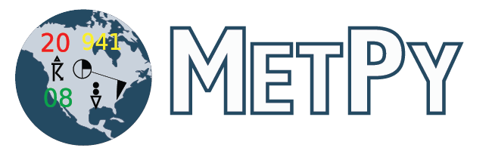




Who uses Pooch?

Slide 12


Check Pooch docs
www.fatiando.org/pooch
www.fatiando.org
Pooch is part of the Fatiando a Terra project

Slide 13

Thank you!
www.fatiando.org/pooch
Slides available under Creative Commons Attribution International 4.0 License

