Slide 1

Modernizing gravity processing:
use the gravity disturbance
Santiago Soler
University of Houston | April 23 2024
Earth, Ocean and Atmospheric Sciences
University of British Columbia

Slide 2
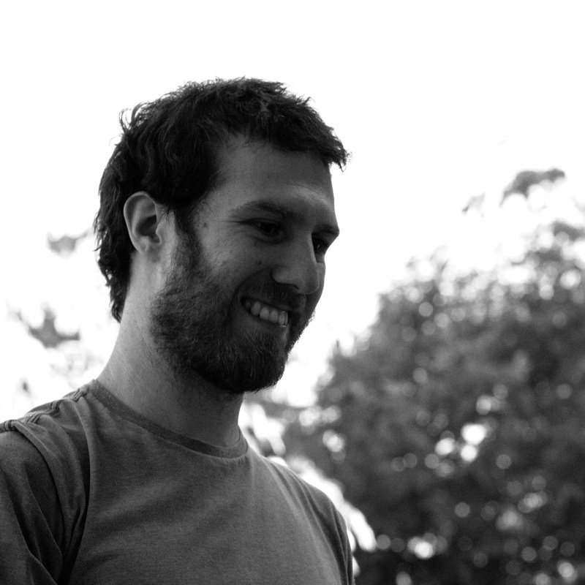
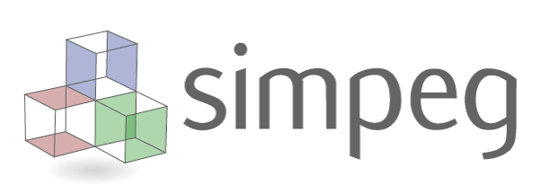

A little bit about me
PhD in Geophysics from Argentina
Postdoctoral Research Fellow at UBC
Develops and maintains open-source projects:
  SimPEG
  Fatiando a Terra
santisoler.com

Slide 3
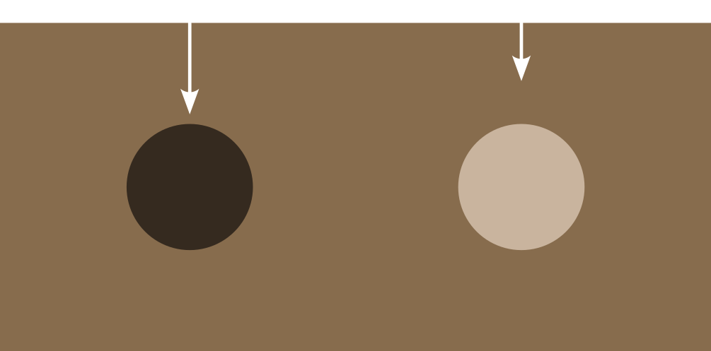
Motivation: why do we measure gravity fields?

Slide 4
Motivation: why do we measure gravity fields?
We can infer location of bodies with density contrast.
But the gravity effects of these bodies are usually very small.
We need to be very accurate on meassuring
and processing it!

Slide 5
Refresher on gravity theory

Slide 6

Gravity acceleration and potential
Gravity
acceleration
Gravity
potential
Gravitational
potential
Centrifugal
potential
Gravitational
acceleration
Centrifugal
acceleration

Slide 7

Equipotential Surfaces
Geoid:
Equipotential surface that coincides with the sea level

Slide 8
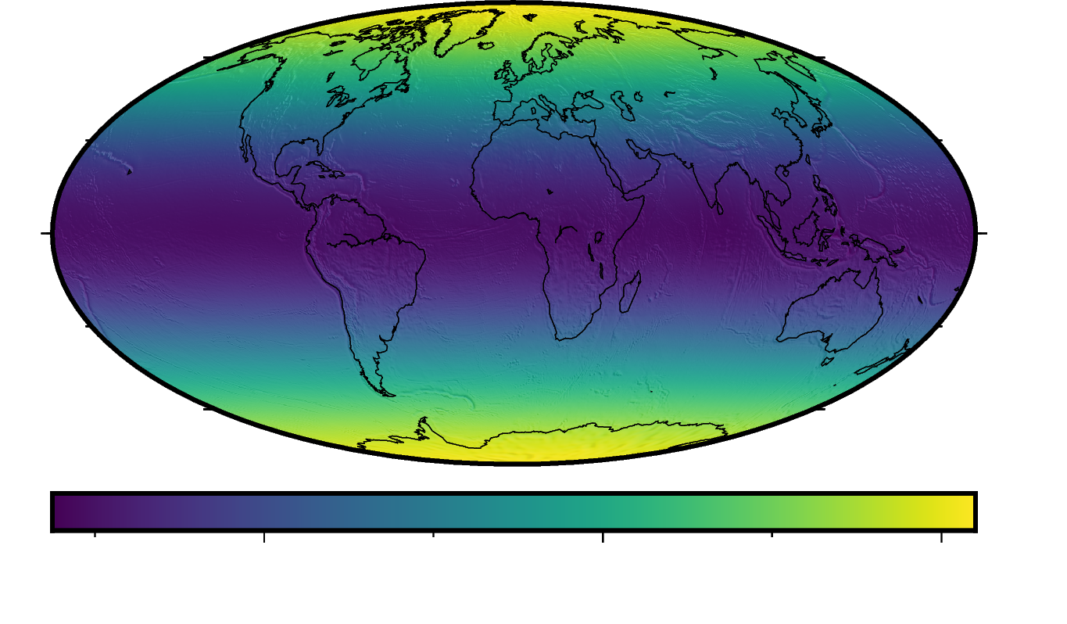
What do we measure?
Observed gravity:
Gravity signal of the whole Earth.
To see “anomalous” bodies we need to define a “normal Earth”.

Slide 9
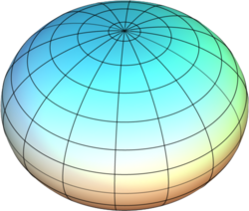
Reference Ellipsoid
Reference ellipsoid:
ellipsoid of revolution that approximates the geoid.
Gravitational
potential of ellipsoid
Centrifugal
potential
Ellipsoid image from Wikipedia, CC-BY

Slide 10
Normal gravity

Slide 11
Normal Gravity
Normal gravity vector:
Normal gravity:
Normal gravity on the surface of the ellipsoid
(Somigliana equation):
Normal gravity on the ellipsoid

Slide 12
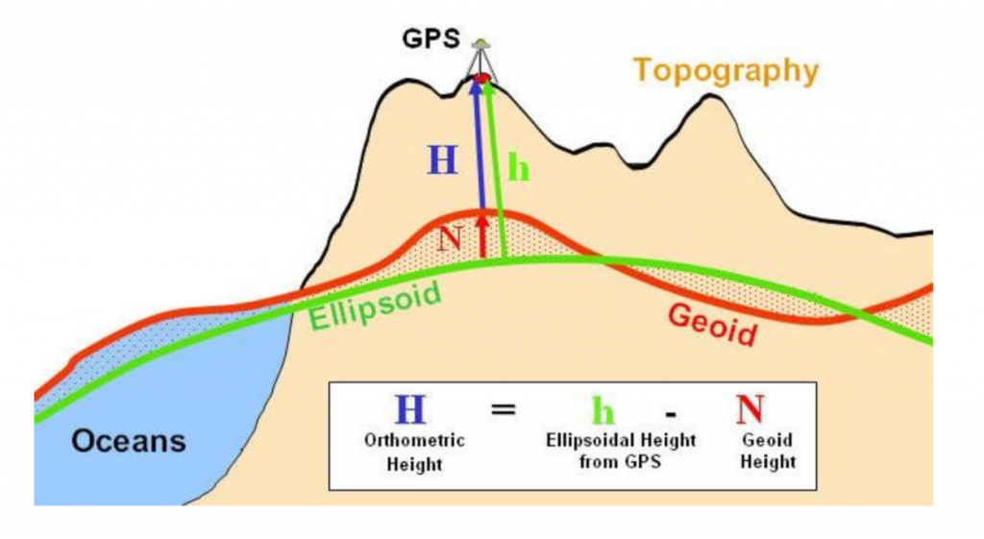
Gravity Anomaly vs Gravity Disturbance
Gravity anomaly:
Normal gravity on the ellipsoid
Gravity disturbance:
Image form Sun et al., Potential Field Methods of Geophysical Exploration, CC-BY-NC

Slide 13
Gravity Disturbance
Definition:
Observed
gravity
Normal gravity
Accounts for:
Effect of the anomalous masses

Slide 14
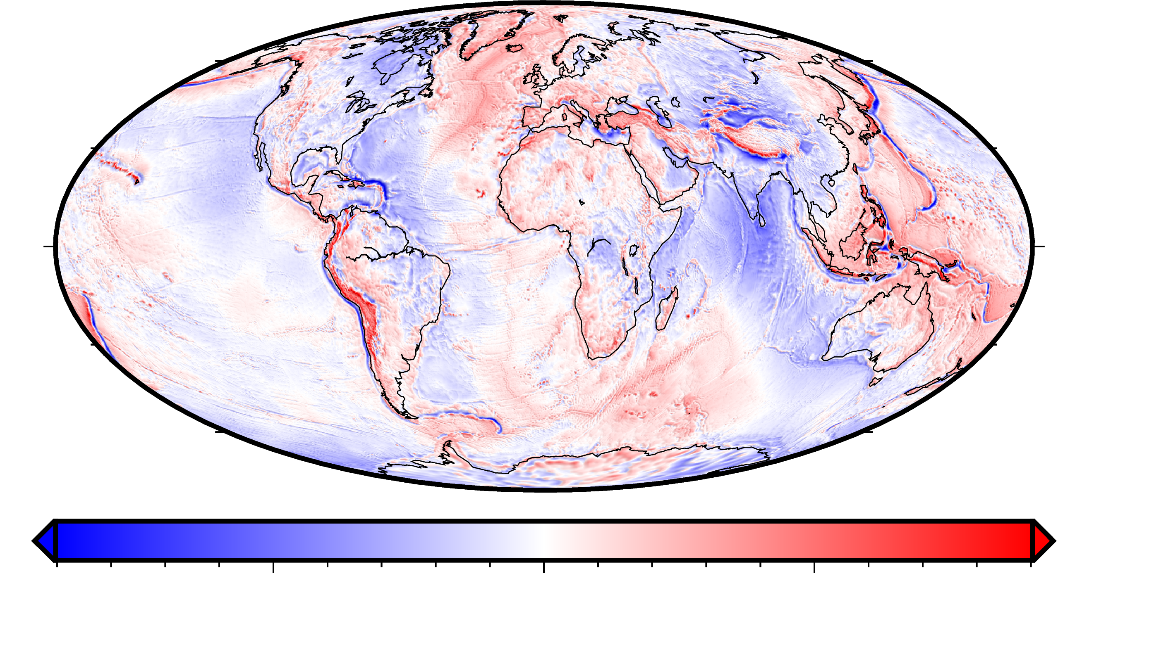
Gravity Disturbance

Slide 15
Gravity Anomaly
Definition:
Observed
gravity
Normal gravity on the ellipsoid
Accounts for:
Effect of the anomalous masses
+
Effect of not accounting observation height
in the normal gravity term

Slide 16
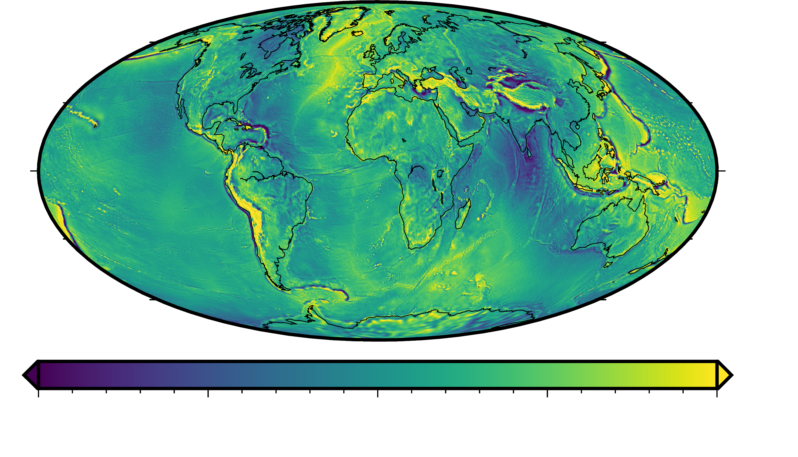
Gravity Anomaly

Slide 17
Free-air anomaly

Slide 18
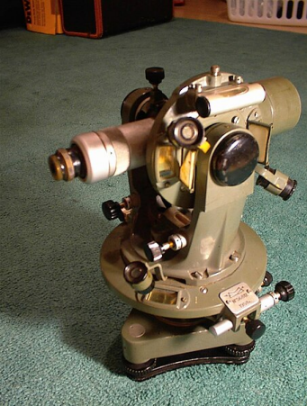
Free-air correction
A little bit of history:
Before GPS, geodesists were only able to accurately determine orthometric heights (above the geoid).
Image of theodolite from Wikipedia, CC-BY

Slide 19
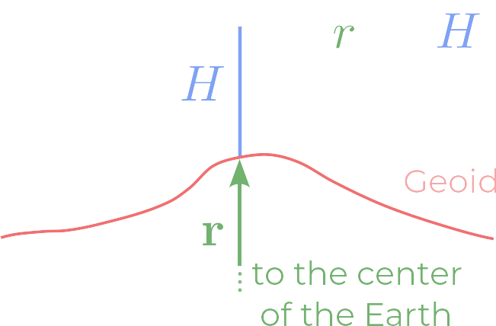
Free-air correction
normal gravity at point p
normal gravity on the geoid
free-air correction
Since , this looks like a Taylor series expansion:

Slide 20
Free-air correction
Approximating it by first order we get:
If we approximate by the gravity of a sphere:
Then:
Free-air correction:
(SI and mGal)

Slide 21
Free-air Anomaly
Gravity anomaly minus the free-air correction:

Slide 22
Gravity Anomaly
Definition:
Observed
gravity
Normal gravity on the ellipsoid
Accounts for:
Effect of the anomalous masses
+
Effect of not accounting observation height
on the normal gravity term

Slide 23
Free-air Anomaly
Definition:
Observed
gravity
Normal gravity on the ellipsoid
Free-air correction
Accounts for:
Effect of the anomalous masses
+
Effect of not accounting observation height
in the normal gravity term

Slide 24
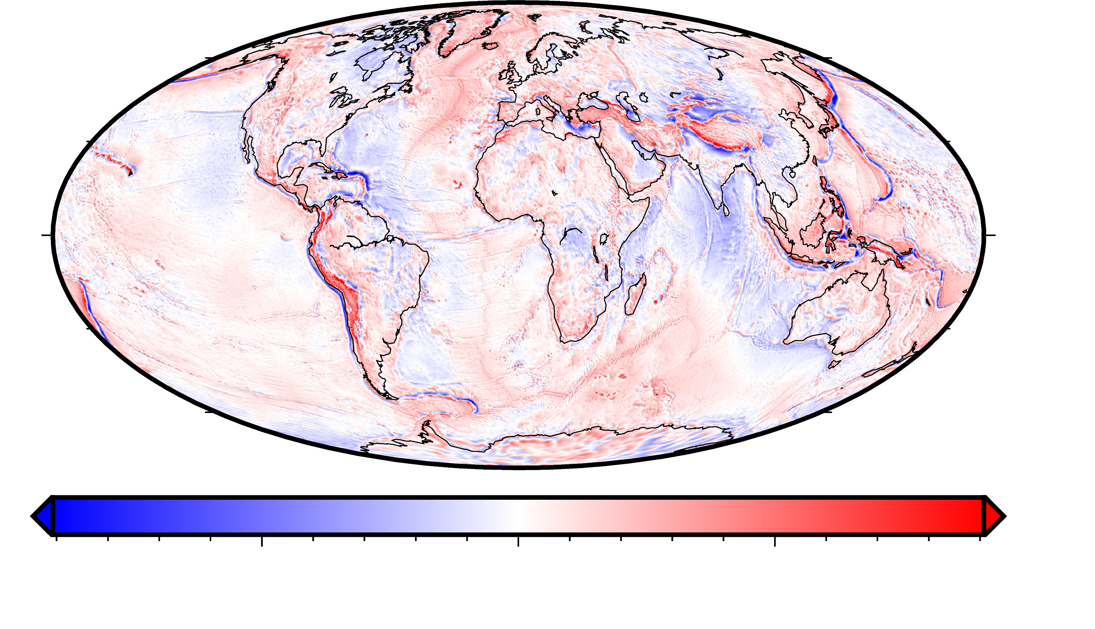
Free-air Anomaly

Slide 25
But...

Slide 26
Free-air Anomaly: Disadvantages
It’s a first* order approximation of the normal gravity
Makes use of orthometric heights:
  Doesn’t account for height corrections between ellipsoid and the geoid.
  Orthometric heights change in time.
  Ellipsoidal heights are ubiquitous since GPS.
Multiple definitions (see Barthelmes, F. (2013))

Slide 27
Use the gravity disturbance

Slide 28
Calculating gravity disturbance
Need to compute normal gravity on any point
Observed
gravity
Normal gravity
Li and Götze (2001): Closed-form formula for

Slide 29
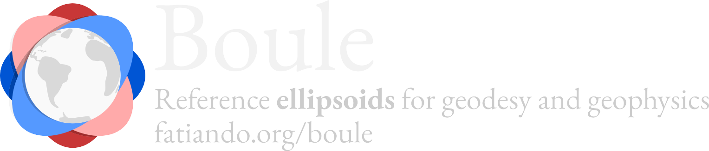
Gravity disturbance with OSS Python tools
import boule as bl
# Define WGS84 ellipsoid
ellipsoid = bl.WGS84
# Calculate the normal gravity on any point
houston_latitude = 29.749907
normal_gravity = ellipsoid.normal_gravity(
latitude=houston_latitude,
height=1500
)

Slide 30
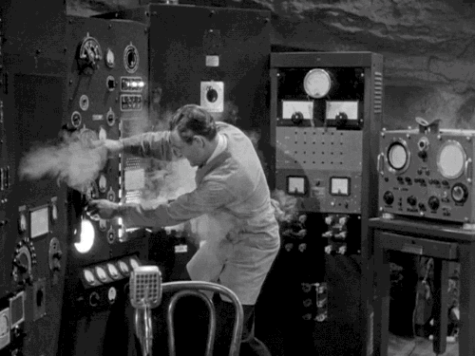
Demo time

Slide 31
References
Barthelmes, F. (2013). Definition of functionals of the geopotential and their calculation from spherical harmonic models (ICGEM).
doi: 10.2312/GFZ.B103-0902-26
Blakely, R. (2009). Potential theory in gravity and magnetic applications (Nachdr.). Cambridge Univ. Press.
Hofmann-Wellenhof, B., & Moritz, H. (2005). Physical geodesy (1st ed). SpringerWienNewYork.
Li, X., & Götze, H. (2001). Ellipsoid, geoid, gravity, geodesy, and geophysics. GEOPHYSICS, 66(6), Article 6. https://doi.org/10.1190/1.1487109

Slide 32
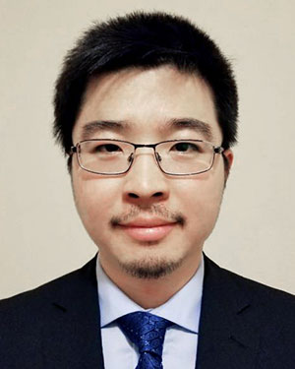



Acknowledgements
Jiajia Sun for the invitation.
University of Houston for hosting the talk.
Leo Uieda for all the discussions we had around
gravity processing.
The open-source communities!

Slide 33
Useful links
Fatiando a Terra: www.fatiando.org
Slides:
GitHub repository with notebooks: github.com/santisoler/2024-uh

Slide 34
Thank you!

