Slide 1









Pooch
A friend to fetch your data files
Santiago Soler
SciPy 2024
fatiando.org/pooch
santisoler.com
@santisoler

Slide 2
What is Pooch?
Download and cache data files from the web
Check integrity of the files
Easy to use and extend

Slide 3
Different use cases
Researcher, data scientist, teacher
  Easily download data files from the web
  Reproducible workflows
  Provide files to students
Package maintainer
  Sample datasets for tutorials and examples

Slide 4

Researcher
Thimbleweed Park

Slide 5

Download a file using Pooch
Download atmospheric CO2 data
from Mauna Loa record:
Scripps CO2 website

Slide 6



Download files from DOI
Supported platforms:

Slide 7

Download files from DOI
Land and ocean temperature record:
doi: 10.5281/zenodo.3634713

Slide 8
Fetching multiple files
Handling multiple files with pooch.retrieve can be cumbersome:
import pooch
fname_1 = pooch.retrieve(
path="custom_dir",
url="https://mysite.com/file1.txt",
known_hash="md5:70e2afd3fd7e336ae478b1e740a5f08e",
)
fname_2 = pooch.retrieve(
path="custom_dir",
url="https://mysite.com/file2.nc",
known_hash="md5:fdaea5f08e478b1e770e7e3362afd340",
)

Slide 9
Fetching multiple files
Handling multiple files with pooch.retrieve can be cumbersome:
import pooch
fname_1 = pooch.retrieve(
path="custom_dir",
url="https://mysite.com/file1.txt",
known_hash="md5:70e2afd3fd7e336ae478b1e740a5f08e",
)
fname_2 = pooch.retrieve(
path="custom_dir",
url="https://mysite.com/file2.txt",
known_hash="md5:fdaea5f08e478b1e770e7e3362afd340",
)
Let’s use the pooch.Pooch class instead!

Slide 10
Unpack files
Download archives and unpack them with processors.
Processors: perform tasks after file is downloaded
Builtin processors or bring your own

Slide 11

Unpack files
Global and regional glacier mass changes:
doi: 10.5281/zenodo.3557199

Slide 12
More features
Download archives and unpack them with processors.
fnames = pooch.retrieve(
url="https://mysite.com/zipped_file.zip",
known_hash="sha1:35b7b51433f65b71edfe943c381a8ba6739b88ea",
processor=pooch.Unzip(),
)
fnames
['~/.cache/pooch/70e2ade478b1efd3f740a7e336a5f08e-zipped_file.zip.unzip/file_1.txt',
'~/.cache/pooch/70e2ade478b1efd3f740a7e336a5f08e-zipped_file.zip.unzip/file_2.nc',
'~/.cache/pooch/70e2ade478b1efd3f740a7e336a5f08e-zipped_file.zip.unzip/file_3.csv']

Slide 13
More features
Define your custom downloader callable.
def my_downloader(url, output_file, pooch):
"""Define downloader for another service/protocol."""
...
fname = pooch.retrieve(
url="foo://my.website.com/file.nc",
known_hash="md5:70478b1336a5f0efde2ade3f740a7e8e",
downloader=my_downloader,
)

Slide 14
Package
maintainer
Thimbleweed Park

Slide 15
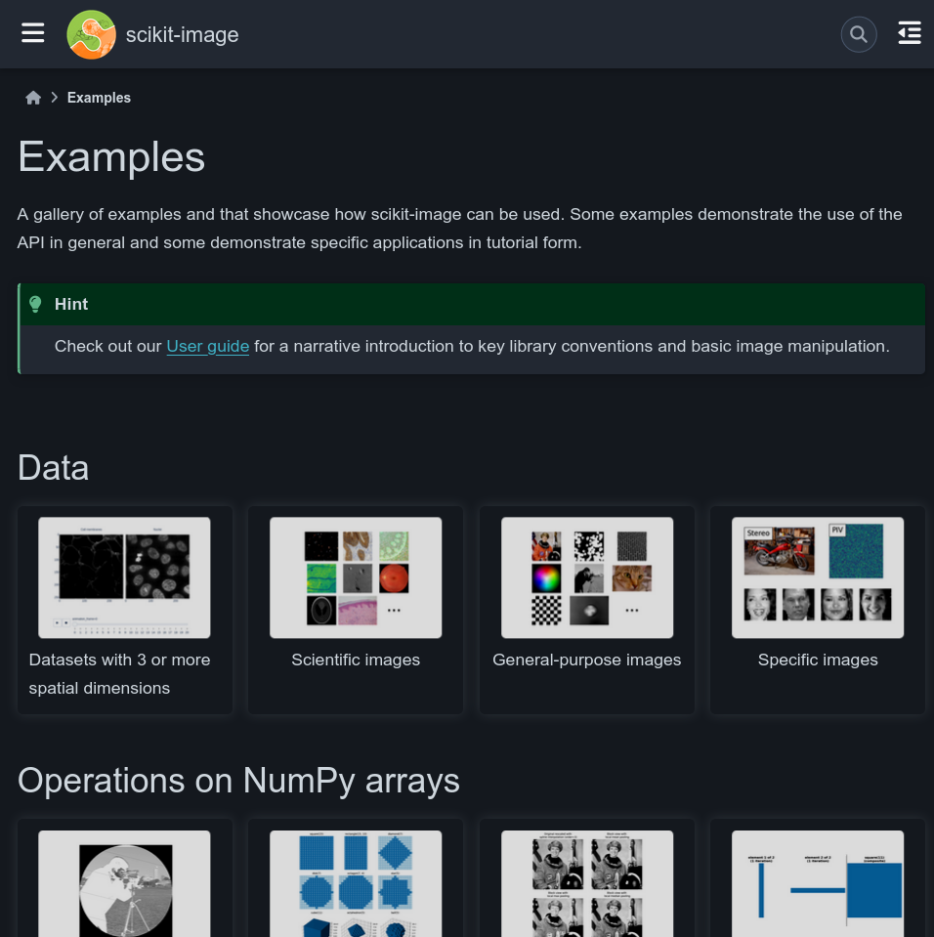
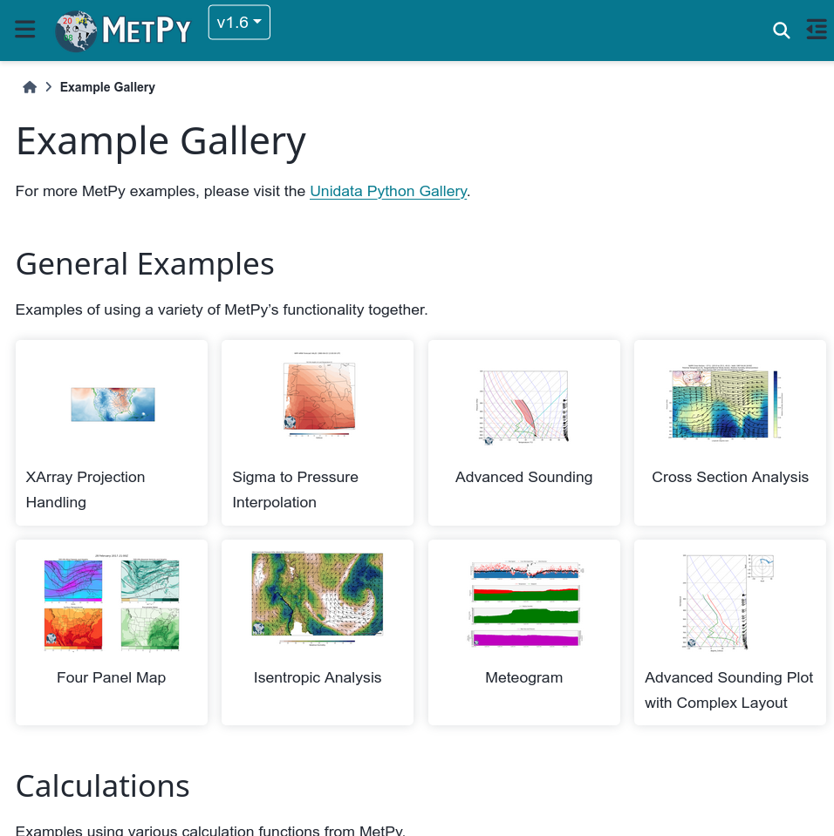
Examples and tutorials

Slide 16
Examples and tutorials
They often need sample datasets
Need to distribute the datasets to users
❌ Packaging them with the code.
✅ Provide utilities for fetching them when needed.

Slide 17

Fetching sample datasets
Sample repository with datasets:
github.com/santisoler/ice-sheets

Slide 18
A little bit about Pooch

Slide 19
Pooch

Slide 20

Pooch
part of

Slide 21

Pooch
born in
a sprint
part of

Slide 22


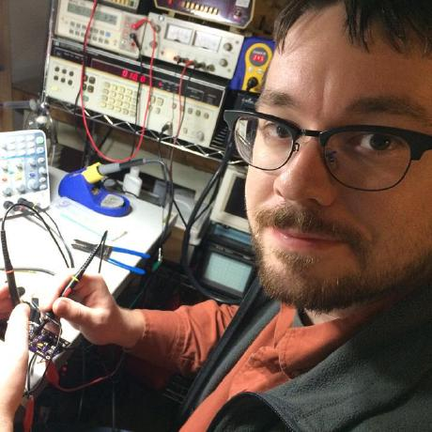
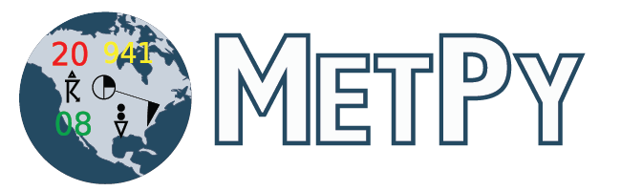
Pooch
born in
a sprint
part of
in collaboration with
@leouieda
@dopplershift
@jrleeman

Slide 23








Who uses Pooch?

Slide 24
Future roadmap

Slide 25
Towards Pooch 2.0
Use standard file format for the registry (e.g. JSON).
Have a single registry: include urls and hashes.
Improve the logging:
  Make it more flexible and configurable.
Implement a plugin system:
  The community can develop and share their own downloaders for other services.

Slide 26

Check Pooch docs
fatiando.org/pooch
fatiando.org

Slide 27

Thank you!
fatiando.org/pooch
Slides available under Creative Commons Attribution International 4.0 License

