Slide 1


Presented By Santitham Prom-on
The 40th International Technical Conference on Circuits/Systems, Computers and Communications
ITC-CSCC 2025
A Super-Resolution Network for Gastrointestinal Endoscopic Imaging via Adaptive Convolutional Feature Fusion
Authors: Naveed Sultan, Santitham Prom-on
Department of Computer Engineering,
Faculty of Engineering, King Mongkut’s University of Technology Thonburi, Thailand
Email: naveed.sult@kmutt.ac.th, santitham.pro@kmutt.ac.th

Slide 2
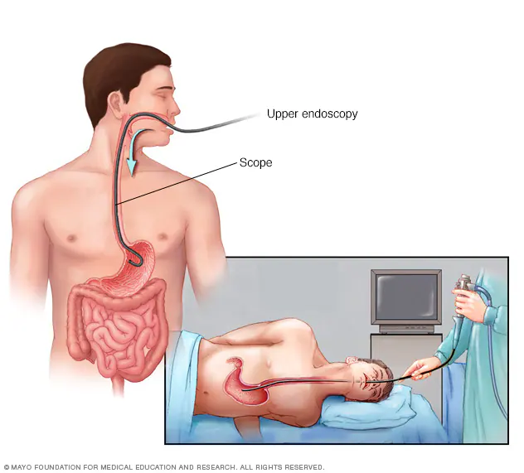
Gastrointestinal Endoscopic
Gastrointestinal (GI) diseases affect the digestive system, including the stomach, intestines, and colon.
They can range from mild conditions, such as acid reflux, to more serious illnesses, such as inflammatory bowel disease (IBD) and colorectal cancer (CRC).
Certain GI conditions, such as ulcerative colitis and Crohn’s disease, cause chronic inflammation in the colon, increasing the risk of cancer over time.
Endoscopic imaging plays a vital role in early detection, which can reduce mortality rates.
https://www.mayoclinic.org/tests-procedures/endoscopy/about/pac-20395197

Slide 3
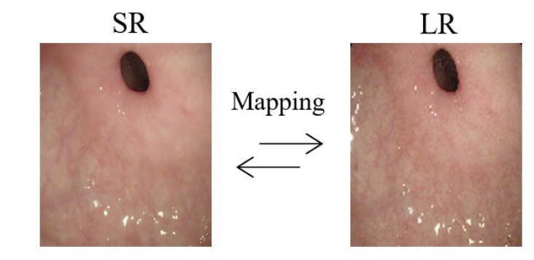
Gastrointestinal Endoscopic Super-Resolution
However, traditional endoscopy systems suffer from low image resolution, including noise and visual artifacts, which can lead to a higher risk of misdiagnosis, especially for small polyps.
Super-resolution (SR) reconstructs high-resolution images from low-resolution ones.
Enhances:
Texture clarity
Structural visibility
Diagnostic accuracy
Works without needing new hardware
cost-effective upgrade
Mapping between Super and Low-Resolution Image

Slide 4
Key challenges in GI endoscopic image super-resolution:
Inadequate modeling of spatial relationships between pixels.
Loss of fine-grained structural features (e.g., mucosal patterns, small lesions).
High computational load, making clinical deployment impractical.
Need for a lightweight yet powerful SR model that:
Preserves clinically relevant structures.
Adapts to the varied scale and texture of anatomical features.
Maintains low computational cost.
Key Challenges

Slide 5
Our Contributions
Challenges | Proposed Solution
Uniform treatment of all regions | Feature-Oriented Spatial Attention (FOSA) preserves key anatomical structures (e.g., mucosal patterns, ulcers, polyps)
Loss of fine textures and lesion details | Multiscale Feature Projection (MSFP) captures diverse spatial features (fine-to-large scale) using 3×3, 5×5, 7×7 kernels
Ignoring channel dependencies | Channel-Wise Feature Refinement (CWFR) enhances critical diagnostic channels (vascular, mucosal)
Poor contextual consistency | Hierarchical Dilated Pooling (HDP) preserves structural coherence with dilation rates 1, 4, 8
High computational cost | Convolutional Feature Fusion Block (CFFB) uses lightweight P-Conv + DW-Conv to maintain efficiency

Slide 6
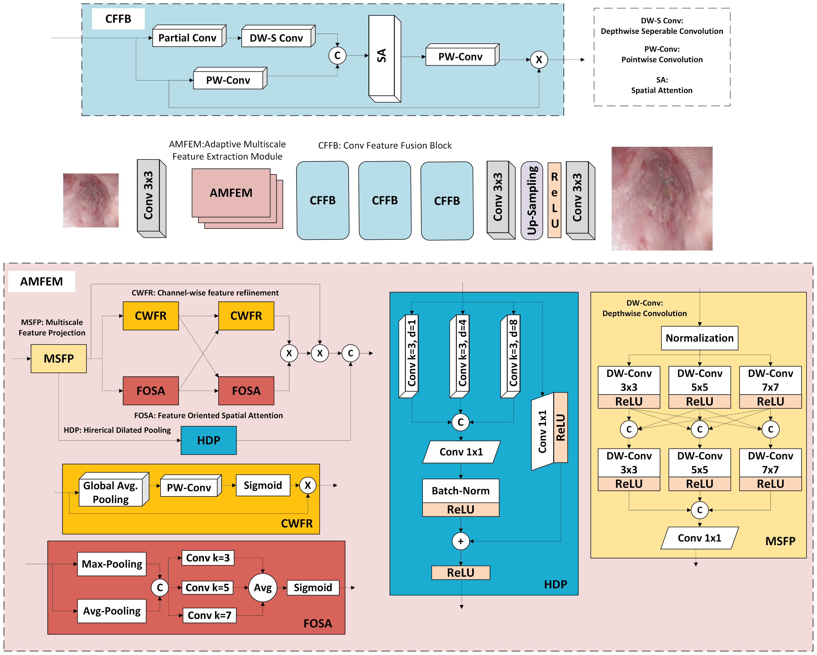
Methodology
This architecture integrates two customized modules:
AMFEM – Adaptive Multiscale Feature Extraction Module
CFFB – Convolutional Feature Fusion Block
Goal: capture critical texture and anatomical details while maintaining low computational cost.

Slide 7
Adaptive Multiscale Feature Extraction Module (AMFEM)
Purpose: Extract and refine diverse texture and anatomical features.
Components:
MSFP (Multiscale Feature Projection): Uses 3×3, 5×5, and 7×7 DW convolutions.
HDP (Hierarchical Dilated Pooling): Captures spatial context with dilation rates 1, 4, and 8.
CWFR (Channel-Wise Feature Refinement): Enhances inter-channel dependencies using global average pooling + pointwise convolution.
FOSA (Feature-Oriented Spatial Attention): Enhances local + global spatial details using max/avg pooling & multi-kernel attention.

Slide 8
Convolutional Feature Fusion Block (CFFB)
Purpose: Integrate AMFEM features and reduce computational cost.
Steps:
Apply Partial Convolution and Depthwise Separable Convolution.
Use Pointwise Convolution to reweight and integrate features.
Lightweight yet effective at reconstructing sharp textures and clear anatomical boundaries.
Final output generated through:
3×3 convolution (refines features)
Pixel Shuffle (up-samples to HR)
Produces a super-resolved image with:
High contrast
Sharp textures
Minimal artifacts

Slide 9
Experimental Setup
Dataset & Preprocessing
Dataset: Kvasir GI Endoscopic Dataset
Total: 2,000 images
Split: 1,600 (train), 200 (val), 200 (test)
Ground Truth Size: 1024×1024 pixels
Preprocessing:
Data augmentation: flipping, rotation, cropping
Bicubic down-sampling for ×2, ×4, ×8 scale factors
Real-world noise simulated with:
Anisotropic Gaussian blur
White Gaussian noise
Training Details
Framework: Python, PyTorch
Optimizer: ADAM
Learning Rate: 1 × 10⁻⁴
Epochs: 1,000
Batch Size: 16 (across all scales)
Device: NVIDIA GeForce RTX 4090 GPU
Evaluation Metrics:
PSNR (Peak Signal-to-Noise Ratio)
SSIM (Structural Similarity Index)

Slide 10
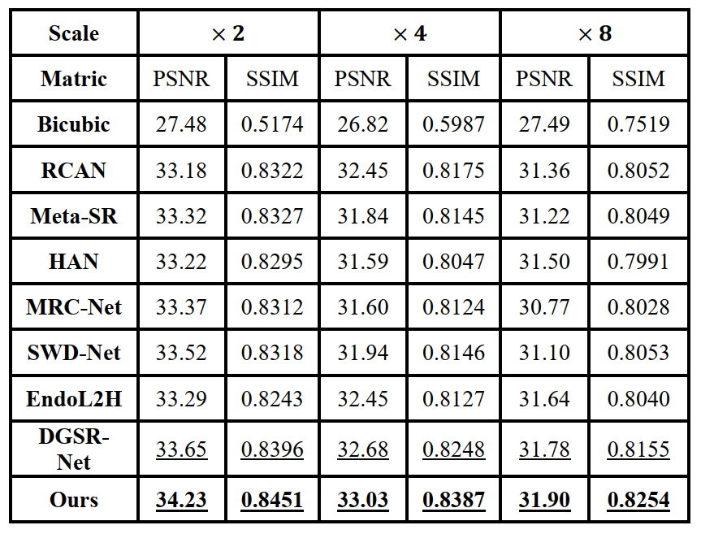
Comparison with State-of-the-Art
×2 Scale: Outperforms SWD-Net by +0.71 dB
×4 Scale: Beats EndoL2H by +0.58 dB
×8 Scale: Surpasses DGSR-Net by +0.12 dB
Balanced performance even at challenging ×8 scale

Slide 11
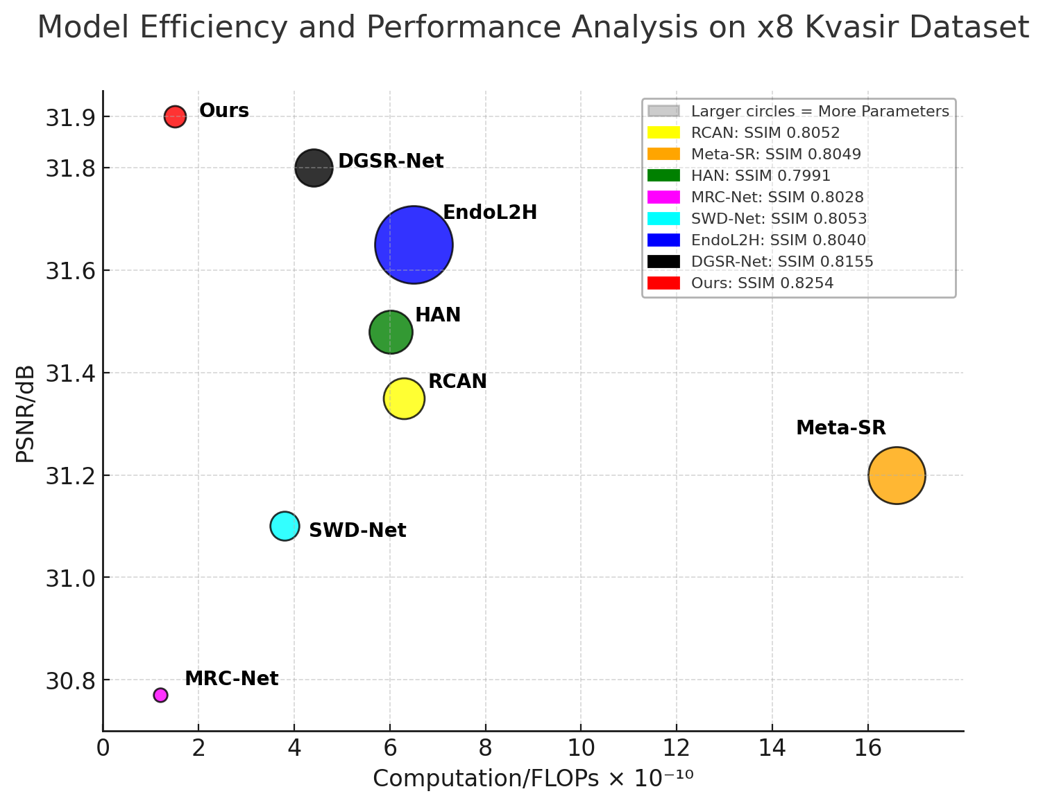
Computational Efficiency
X-axis: FLOPs (computational cost)
Y-axis: PSNR (performance)
Circle size: Number of parameters
Our model:
Lowest parameter count
Lower FLOPs
Best PSNR
Efficient and high-performing

Slide 12
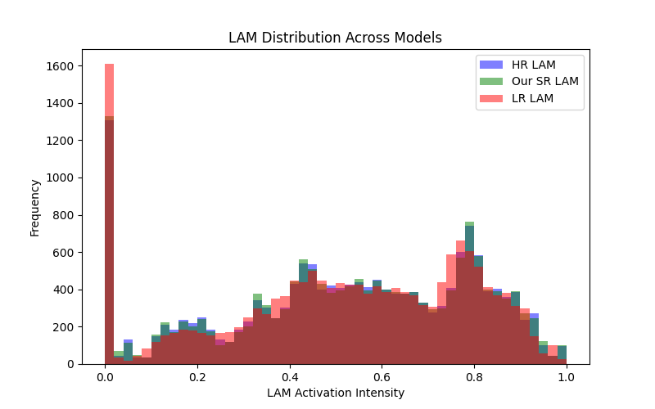
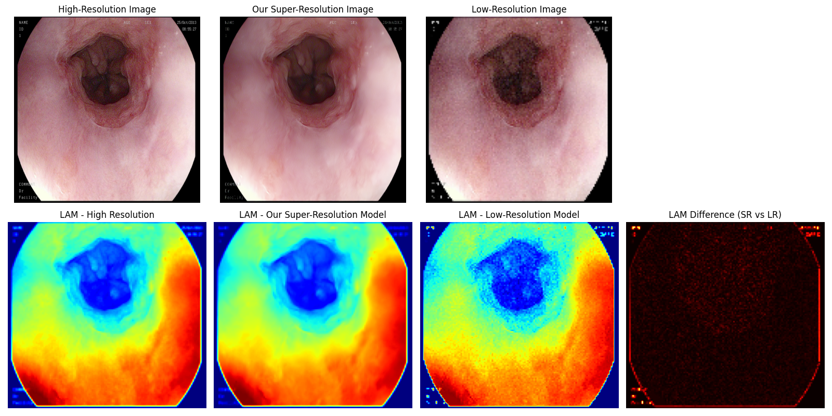
Visual Comparison with State-of-the-Art

Slide 13
Conclusion and Future Work
This work presents a novel super-resolution network for gastrointestinal endoscopic imaging.
Key contributions:
AMFEM – captures multiscale texture and anatomical details
CFFB – lightweight fusion for enhanced refinement
Superior results in PSNR, SSIM, and visual clarity
The model maintains a balance between accuracy and efficiency, making it suitable for real clinical applications.
Expand to other medical imaging modalities (e.g., ultrasound, CT)
Explore real-time deployment in clinical environments
Investigate self-supervised learning for data-scarce scenarios

Slide 14
Thank You! Q & A?
Contact: Santitham Prom-on – santitham.pro@kmutt.ac.th
Naveed Sultan – naveed.sult@kmutt.ac.th King Mongkut’s University of Technology Thonburi Bangkok, Thailand

