Slide 1


Deep Learning based Driver Drowsiness Detection System
Aldel Education Trust’s
St. John College of Engineering and Management, Palghar
NAAC Accredited with Grade A (2017-2022)
Department of Information Technology
Santoshi Sabat [EU1184002]
Parth Patel [EU1184017]
Chirag Pavesha [EU1184005]
Ms. Shraddha More | Assistant Professor
April 27, 2022

Slide 2
Contents
Abstract
Introduction
Literature Review
Problem Statement
Scope
Proposed System
Implementation
Result
Technologies used
Conclusion
Reference

Slide 3
Abstract
A large number of road accidents occur due to the driver drowsiness. As drowsiness detection has gained attention in field of deep learning. The system proposed is that this technology which will be developed will help to prevent accidents caused by driver feeling drowsy.
This system will monitor the driver’s eyes using neural network and camera and by an deep learning techniques. By alarm sound signal driver will be alarmed for his drowsiness and also Email will be sent to concerned person.
Keywords: CNN, Deep Learning, Drowsiness, Yawn.

Slide 4
Introduction
Sleepiness can be dangerous when performing tasks that require constant concentration, such as driving a vehicle. When a person is sufficiently fatigue while driving, they will experience drowsiness and this leads to increase the factor of road accident.
Fig 1: Road Accidents Graph
From Figure, car and taxi type of vehicles shows about nearly 400,000 cases of road accident has been recorded. It keeps increasing every year.
2015
2016
2017
2018
2019

Slide 5
Introduction
The aim of this project is to develop a simulation of drowsiness detection system. The focus will be placed on designing a system that will accurately monitor the open or closed state of the driver’s eyes and mouth.
The analysis of face images is a popular research area with applications such as face recognition, and human identification and tracking for security system.
The system will look at the entire image of face and detect the eye and mouth region and once the regions are detected then it will decide the drowsiness of the driver.
For Realtime video input, the proposed method had a 96% of accuracy.

Slide 6
Literature Review
Sr. No. | Paper Title [Ref.] | Author names | Conclusion | Research Gaps
[1] | Driver Behavior Recognition via Interwoven Deep Convolutional Neural Nets With Multi-Stream Inputs – (2020) | Chaoyun Zhang , Rui LI, Woojin Kim, Daesub Yoon, & Paul Patras. | By using, Interwoven Convolutional Neural Network (InterCNN) it performs driver behavior recognition. Experiments conducted using real-world data set it can classify drivers behaviour with accuracy ranging of 73.97% to 81.66% | It needs to build more robust driver behavior recognition systems that can operate in more challenging conditions, such as driving at night & should provide more accuracy

Slide 7
Literature Review
Sr. No. | Paper Title [Ref.] | Author names | Conclusion | Research Gaps
[2] | Driver Distraction Detection using Deep Learning and Computer Vision – (2019) | Kusuma.S1, Divya Udayan.J2, Aashay Sachdeva | In this system it detects the driver’s drowsiness by using deep learning and computer vision. They used convolutional Neural Network based object detection for hand, eye, and face to make the detection more precise & got overall accuracy of 89.33% | Deep learning techniques could be used to reduce the training time. Instead of hand detection, they could have done mouth detection which would make system more effective & accurate.

Slide 8
Literature Review
Sr. No. | Paper Title [Ref.] | Author names | Conclusion | Research Gaps
[3] | Real-Time Driver-Drowsiness Detection System Using Facial Features (2019) | Wanghua deng,ruoxue wu | In this paper proposed a new method of analyzing the facial expression of the driver through Hidden Markov Model (HMM)based dynamic modeling to detect drowsiness. They have implemented the algorithm using a simulated driving setup. | The HMM needs to be trained on a set of seed sequences and generally requires a larger seed than the simple Markov model. It is more expensive.

Slide 9
Literature Review
Sr. No. | Paper Title [Ref.] | Author names | Conclusion | Research Gaps
[4] | Robust Drowsiness Detection for Vehicle Driver using Deep Convolutional Neural Network (2020) | A. f.m saifuddin saif, Zainal rasyid mahayuddin | In this paper driver drowsiness is detected by extracting facial features initially and then performs face alignment CNN based machine learning approach and achieved accuracy rate of 83% and pass through CNN based deep learning model. | Proposed research performed extensive experimentation where accuracy rate of 98.97% was achieved using frame rate of 35 fps which is higher comparing with previous research results. Experimental results reveal the effectiveness of the proposed methodology.

Slide 10
Literature Review
Sr. No. | Paper Title [Ref.] | Author names | Conclusion | Research Gaps
[5] | Integrated Intelligent Drowsiness Detection System Based on Deep Learning – (2020) | Lin J. | The system is created using the wearable for heartrate detection and facial features for drowsiness detection | The wearable device would create a disturbance and uses vibration of the wearable as alerting signal which is not feasible

Slide 11
Literature Review
Sr. No. | Paper Title [Ref.] | Author names | Conclusion | Research Gaps
[6] | A Deep Learning Approach to Detect Drowsy Drivers in Real Time (2019) | Anshul Pinto, Mohit Bhasi, Durvesh Bhalekar, Pradyoth Hegde. | The results section evaluated the performance of CNN with a blink detection algorithm that uses a metric called EAR. EAR approach gave 80.4% accuracy. | Implementing a mechanism to detect yawns, which could be combined with the state of the eyes to serve as a metric to detect the vigilance of the driver.

Slide 12
Literature Review
Sr. No. | Paper Title [Ref.] | Author names | Conclusion | Research Gaps
[7] | Driver Drowsiness Detection System Based on Visual Features (2018) | Fouzia, Roopalakshmi R, Jayantkumar A Rathod, Ashwitha S Shetty, Supriya k | In this paper, a Drowsiness detection framework based on shape predictor algorithm, detects the eyes, and also counts the eye blink rate followed by drowsiness detection at real time. | The detection of yawning of the driver would be implemented using same frame work for detecting further details about the drowsiness of driver.

Slide 13
Literature Review
Sr. No. | Paper Title [Ref.] | Author names | Conclusion | Research Gaps
[8] | Driver Drowsiness Classification based on Eye Blink and Head Movement Features using the k-NN Algorithm (2020) | Mariella Dreißig, Mohamed Hedi Baccour, Tim Sch¨ack, Enkelejda Kasneci | In this paper the eyelid movement was studied using classification kNN algorithm on dataset which contain 134 hours of recording and with Karolinska Sleepiness Scale (KSS) values it became easy to determine the drowsiness. | In kNN output completely relies on nearest neighbours which may not be good choice and if the value of k is chosen wrong the classification would not give satisfactory result.

Slide 14
Literature Review
Sr. No. | Paper Title [Ref.] | Author names | Conclusion | Research Gaps
[9] | Portable Prevention and Monitoring of Driver’s Drowsiness Focuses to Eyelid Movement using Internet of Things (2018) | Menchie Miranda, Alonica Villanueva, Mark Jomar Buo, Reynald Merabite, Sergio Paulo Perez, and John Michael Rodriguez. | In this paper a IoT based device is made using Raspberry Pi and camera. Using camera and OpenCV python script the eyelid of the driver id detected and a random alarm turns on when the eyelids are closed for more than 3 seconds and the data is sent to a website which the vehicle owner can access later. | Eyelid detection at night does not give accurate results and other facial landmarks are not taken into consideration.

Slide 15
Literature Review
Sr. No. | Paper Title [Ref.] | Author names | Conclusion | Research Gaps
[10] | Study on Training Convolutional Neural Network to Detect Distraction and Drowsiness –(2018) | Kim, W., Choi, H.-K., & Jang, B.-T. | Convolutional neural networks is used with various datasets to detect both driver distraction and drowsiness. | It addresses behavioral based measures but not vehicle based measures.

Slide 16
Literature Review
Sr. No. | Paper Title [Ref.] | Author names | Conclusion | Research Gaps
[11] | Drowsiness Alert, Alcohol Detect and Collision Control for Vehicle Acceleration. (2020) | Patnaik, R., Krishna, K. S., Patnaik, S., Singh, P., & Padhy, N. | Drivers state of drowsiness is detected and alarming system is established. | This does not include more facial features like head tilt and yawning.

Slide 17
Problem Statement
Current drowsiness detection systems monitoring the driver’s condition requires complex computation and expensive equipment, not comfortable to wear during driving and is not suitable for driving conditions; for example, Electroencephalography (EEG).
A drowsiness detection system which use a camera placed in front of the driver is more suitable to use. Lighting intensity and while the driver tilt their face left or right are the problems occur during detection of eyes and mouth region.
This project aims to propose a method to detect drowsiness by using video or webcam and send a mail to the concerned person in case of consecutive fatigue alarms.

Slide 18
Scope
There are many products out there that provide the measure of fatigue level in the drivers which are implemented in many vehicles. The driver drowsiness detection system provides the similar functionality but with ease to the driver and quicker response.
Even in high level of fatigue cases the reporting system will provide precise location of the driver.
With the behavioral aspects of the driver taken into consideration such as eye blink, yawning, head tilt, the model predicts the drowsiness of the driver.

Slide 19
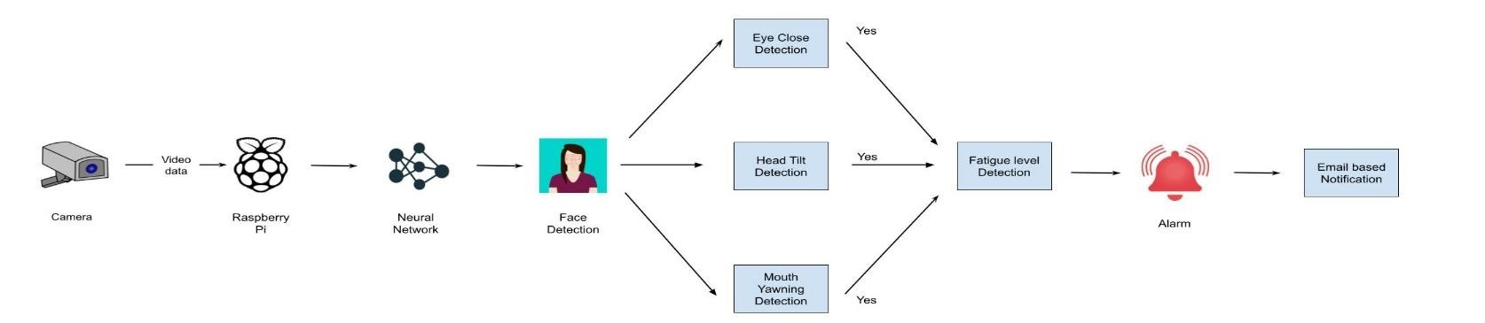
Proposed System
Fig. 2.1 : System Architecture

Slide 20
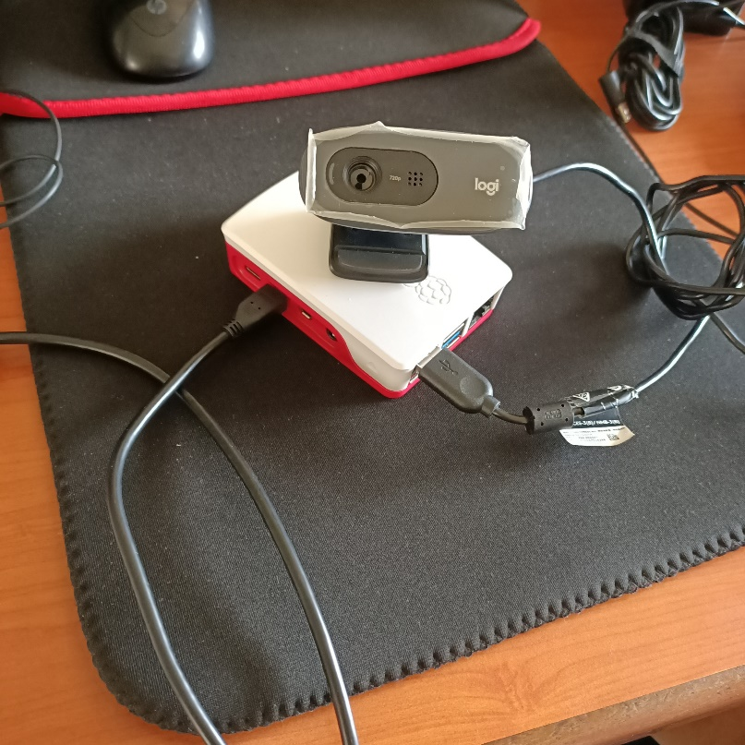
Proposed System
Fig 2.2: Prototype

Slide 21
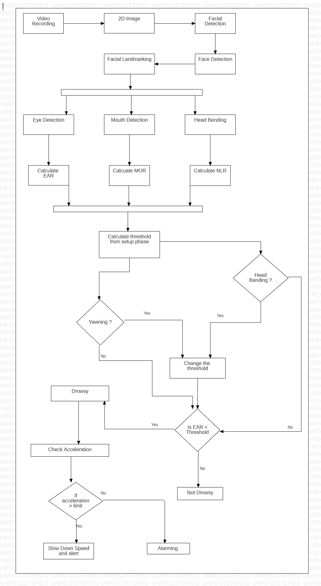
Implementation
Fig. 3.1: Flow Chart

Slide 22
Implementation
Fig. 3.2: Flow Chart

Slide 23
Psuedo Code
import cv2
import dlib
sound = assign (alarm.wav)
EAR_threshold = 0.25
YAWN_threshold = 30
HEAD threshold = 300
function alarm (message) :
var alarm
s = “espeak” + message
execute (s)
function eye_aspect_ratio (eye) :
A,B,C = euclidean.distance ( eye[point] )
ear = (A+B ) / (2.0 * C)
function final_ear (shape):
leftEAR = eye_aspect_ratio (leftEye)
rightEAR = eye_aspect_ratio (rightEye)
ear = leftEAR + rightEAR
function lip_distance :
top_lip = shape[50:53]
low_lip = shape [56:59]

Slide 24
Psuedo Code
distance = abs (top_lip – low_lip )
function nose length:
noselength = shape [27:30]
detector = cv2. Cascadefile(“haarcascade_file”)
predictor = dlib.shape_prediction(“ shape_prediction.dat ”)
while True:
shape = rectangle ( x, y, width, height)
eye = final ear (shape)
lip = shape [48:60]
distance = lip_distance(shape)
if ear < EAR_threshold:
alarm_status = True
sound.play ()
alarm (“Drowsiness Alert”)
else if distance > YAWN_threshold:
alarm_status2 = True
sound.play ()
alarm (“ Take a break ”)
else if nose_length > HEAD threshold:
alarm = True
sound.play()
Else:
alarm = False
if key = stop:
break

Slide 25
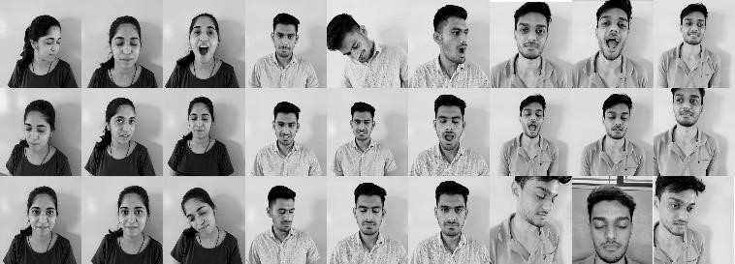
Dataset
The dataset contains 80,000 images divided into train and test data where images indicate different facial features of eye open and close pictures, mouth opening and closing and lastly head tilt feature. The images are converted to grayscale for the algorithm to easily identify the landmarks.
Fig.3.3 Dataset Screenshot

Slide 26
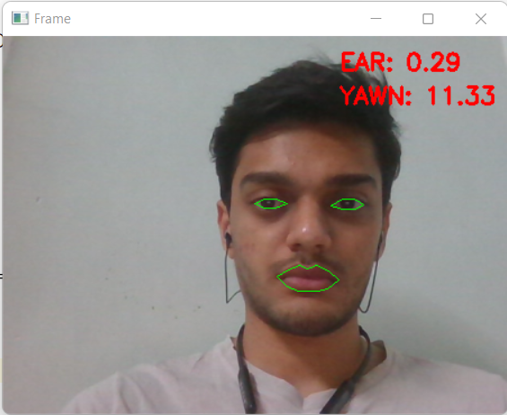
Result and Discussion
As the result of the execution of the code and the output using Open CV and dlib we have identified the the facial features i.e eyes and mouth in real time and if the eyes is closed then the EAR value drops which triggers alarm and if the subject yawns, the MOR value increases which triggers the alarm.
Fig.3.4 Score when eyes are open and subject is not yawning

Slide 27
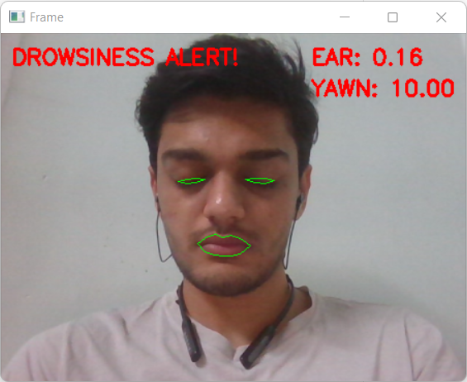
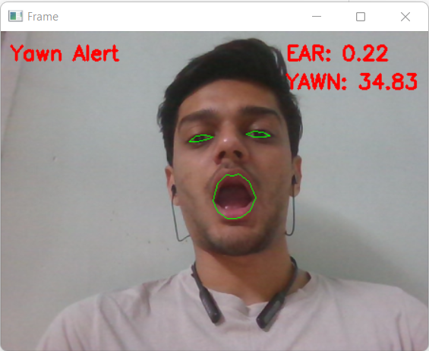
Result and Discussion
Fig 3.5 Score when eyes are closed
(Alarming Situation)
Fig 3.6 Score when yawning
(Alarming Situation)

Slide 28
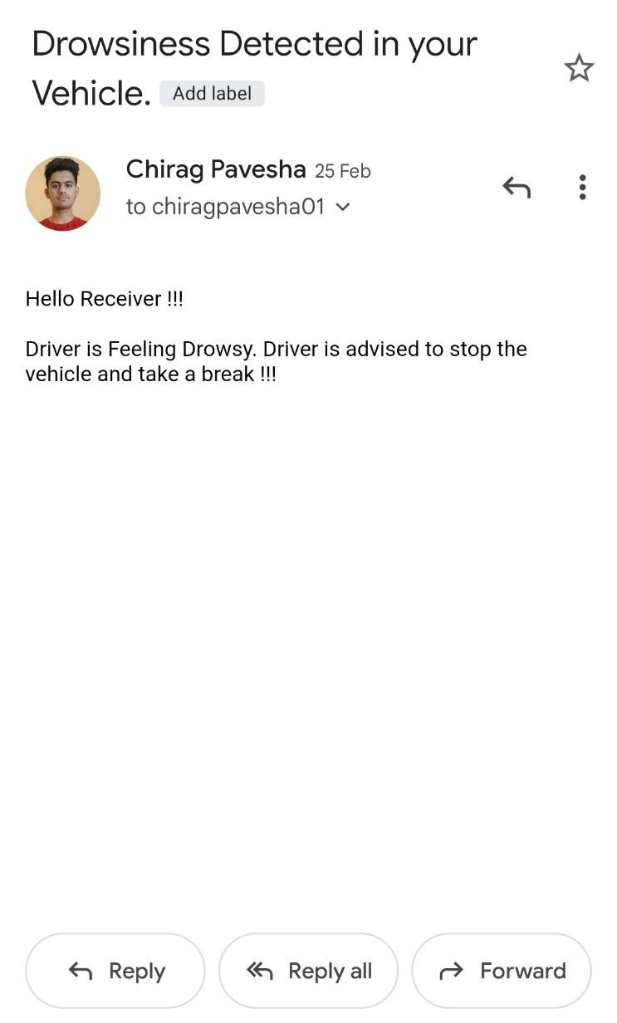
Result and Discussion
Fig. 3.7 : Alert using Email
If the driver offend the drowsiness alert multiple time consecutively then an alert email is delivered to the concerned person alerting him of the drowsy driver.

Slide 29
Technologies Used
Python is an interpreted, object-oriented, high-level programming language with dynamic semantics.
Machine learning (ML) is a type of artificial intelligence that allows software applications to become more accurate at predicting outcomes without being explicitly programmed to do so.
Deep learning is a type of machine learning and artificial intelligence (AI) that imitates the way humans gain certain types of knowledge
Dlib is an open source C++ library implementing a variety of algorithms, including classification, regression, clustering, data transformation, and structured prediction.
Convolutional Neural Network (CNN) is a type of artificial neural network, which is widely used for image/object recognition and classification. Deep Learning thus recognizes objects in an image.

Slide 30
Conclusion
With the literature review and the research gaps we have prototyped a model in which we detect the eye lid and mouth using deep learning which is the facial feature for drowsiness Detection of the driver webcam for capturing real time video of the driver and alarming the driver with the beeps of 200 – 300 Hz for alerting the driver. In case of detection of drowsiness multiple times consecutively, a mail is sent to the concerned person.

Slide 31
Future work
Additional Features such as adaptive cruise control could be added for better decision making of driver in many cases.
Capture individual driver’s steering activity while drowsy.
Conduct additional simulator experiments to validate the algorithm, test additional road conditions, and test a more diversified group of drivers.

Slide 32
Reference
[1] Chaoyun Zhang, Rui Li, Woojin Kim, Daesub Yoon,And Paul Patras (2020). Driver Behavior Recognition via Interwoven Deep Convolutional Neural Nets With Multi-Stream Inputs. (2020) Electronics and Telecommunications Research Institute (ETRI), Daejeon, South K
[2] Kusuma, S., Divya Udayan, J., & Sachdeva, A. (2019). Driver Distraction Detection using Deep Learning and Computer Vision. 2019 2nd International Conference on Intelligent Computing, Instrumentation and Control Technologies (ICICICT).
[3] Lin, J. (2020). Integrated Intelligent Drowsiness Detection System Based on Deep Learning. 2020 IEEE International Conference on Power, Intelligent Computing and Systems (ICPICS).
[4] Patnaik, R., Krishna, K. S., Patnaik, S., Singh, P., & Padhy, N. (2020). Drowsiness Alert, Alcohol Detect and Collision Control for Vehicle Acceleration. (2020) International Conference on Computer Science, Engineering and Applications (ICCSEA).
[5] Kim, W., Choi, H.-K., & Jang, B.-T. (2018). Study on Training Convolutional Neural Network to Detect Distraction and Drowsiness. 2018 IEEE Region Ten Symposium (Tensymp)
[6] Anshul Pinto;Mohit Bhasi;Durvesh Bhalekar;Pradyoth Hegde;Shashidhar G. Koolagudi (2019). A Deep Learning Approach to Detect Drowsy Drivers in Real Time. IEEE 16th India Council International Conference (INDICON)

Slide 33
Reference
[7] Fouzia;R. Roopalakshmi;Jayantkumar A. Rathod;Ashwitha S. Shetty;K. Supriya (2018). Driver Drowsiness Detection System Based on Visual Features. Second International Conference on Inventive Communication and Computational Technologies (ICICCT)
[8] Mariella Dreißig, Mohamed Hedi Baccour, Tim Schäck, Enkelejda Kasneci (2020). Driver Drowsiness Classification Based on Eye Blink and Head Movement Features Using the k-NN Algorithm. 2020 IEEE Symposium Series on Computational Intelligence (SSCI)
[9] Menchie Miranda*, Alonica Villanueva, Mark Jomar Buo, Reynald Merabite, Sergio Paulo Perez, and John Michael Rodriguez (2018). Portable Prevention and Monitoring of Driver’s Drowsiness Focuses to Eyelid Movement using Internet of Things. IEEE 10th International Conference on Humanoid, Nanotechnology, Information Technology,Communication and Control, Environment and Management
[10] Wanghua Deng, Ruoxue Wu (2019). Real-Time Driver-Drowsiness Detection System Using Facial Features. IEEE Access
[11] A. f.m saifuddin saif, Zainal rasyid mahayuddin(2020). Robust Drowsiness Detection for Vehicle Driver using Deep Convolutional Neural Network.(IJACSA) International Journal on Advanced Computer Science and Applications,Vol. 11

Slide 34
Thank You !!!

Slide 35
Q & A

