Slide 1

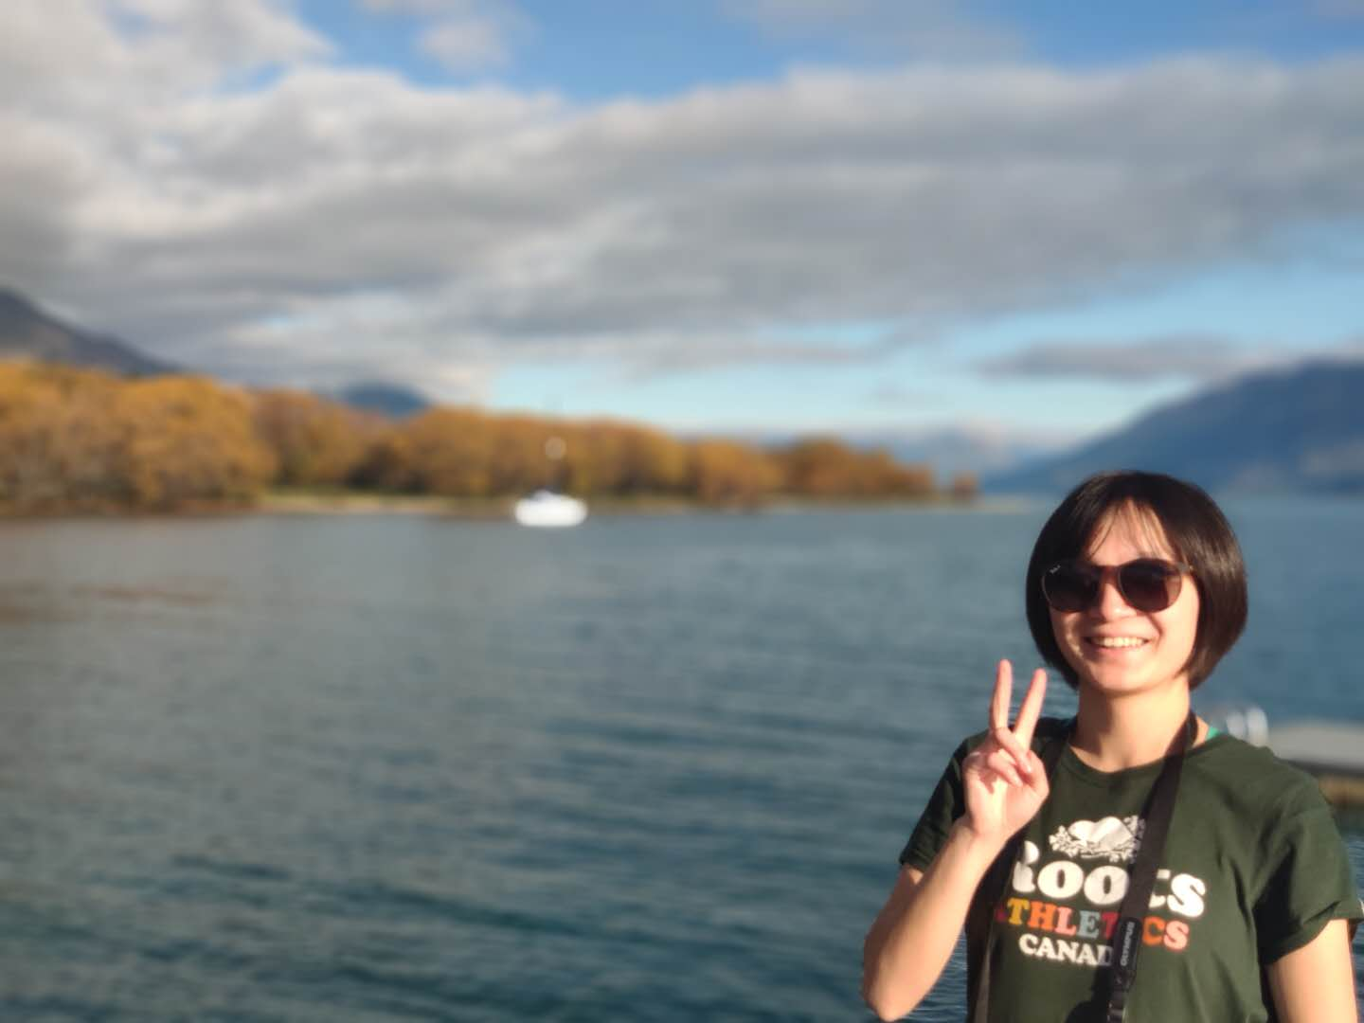


Home
About
Projects
Gallery
Contact
Hi, I’m
SHAUN MENG
Programmer

Slide 2
Coding
Home
About
Design
Passion
Projects
Gallery
Contact
Responsibility
Learning
I’m a graduate of Computer Science at the University of Canterbury. I have a passion for coding which makes me feel inner peace and like to solve puzzles which makes me exciting. Meanwhile, I also love the design which always makes me don't want to stop.
Through a few trying of career, finally, I find the loving one which I would love to donate my whole life time. With the passion and can do attitude, I'm not afraid to trying and learning anything about that and make it perfect.

Slide 3
Projects
Home
These are some sections I’ve done.
For more detail works you can visit me on github.
About
Projects
Gallery
Contact
#F57F6B

Slide 4
Projects
Home
These are some sections I’ve done.
For more detail works you can visit me on github.
About
Projects
Gallery
Contact
#34C3C0

Slide 5
Projects
Home
These are some sections I’ve done.
For more detail works you can visit me on github.
About
Projects
Gallery
Contact
#5DA7F4

Slide 6
Projects
Home
These are some sections I’ve done.
For more detail works you can visit me on github.
About
Projects
Gallery
Contact
#E7E767

Slide 7
Projects
Home
These are some sections I’ve done.
For more detail works you can visit me on github.
About
Projects
Gallery
Contact
#A6A6A6

Slide 8
Projects
Home
These are some sections I’ve done.
For more detail works you can visit me on github.
About
Projects
Gallery
Contact
#9C94C6

Slide 9
Home
About
My happy life
Projects
Gallery
Gallery
Contact

Slide 10
Home
About
Projects
Gallery
Contact

Slide 11
Home
About
Projects
Gallery
Contact

Slide 12
Home
About
Projects
Gallery
Contact

Slide 13
Home
About
Projects
Gallery
Contact

Slide 14


Slide 16


in

