Slide 1
PROJECT | Natural Language Processing Challenge
Santiago Baron, Benny Michel, Edwin Santiago
Fake News Detection: A Comparative Study of Machine Learning Architectures
February 2026

Slide 2
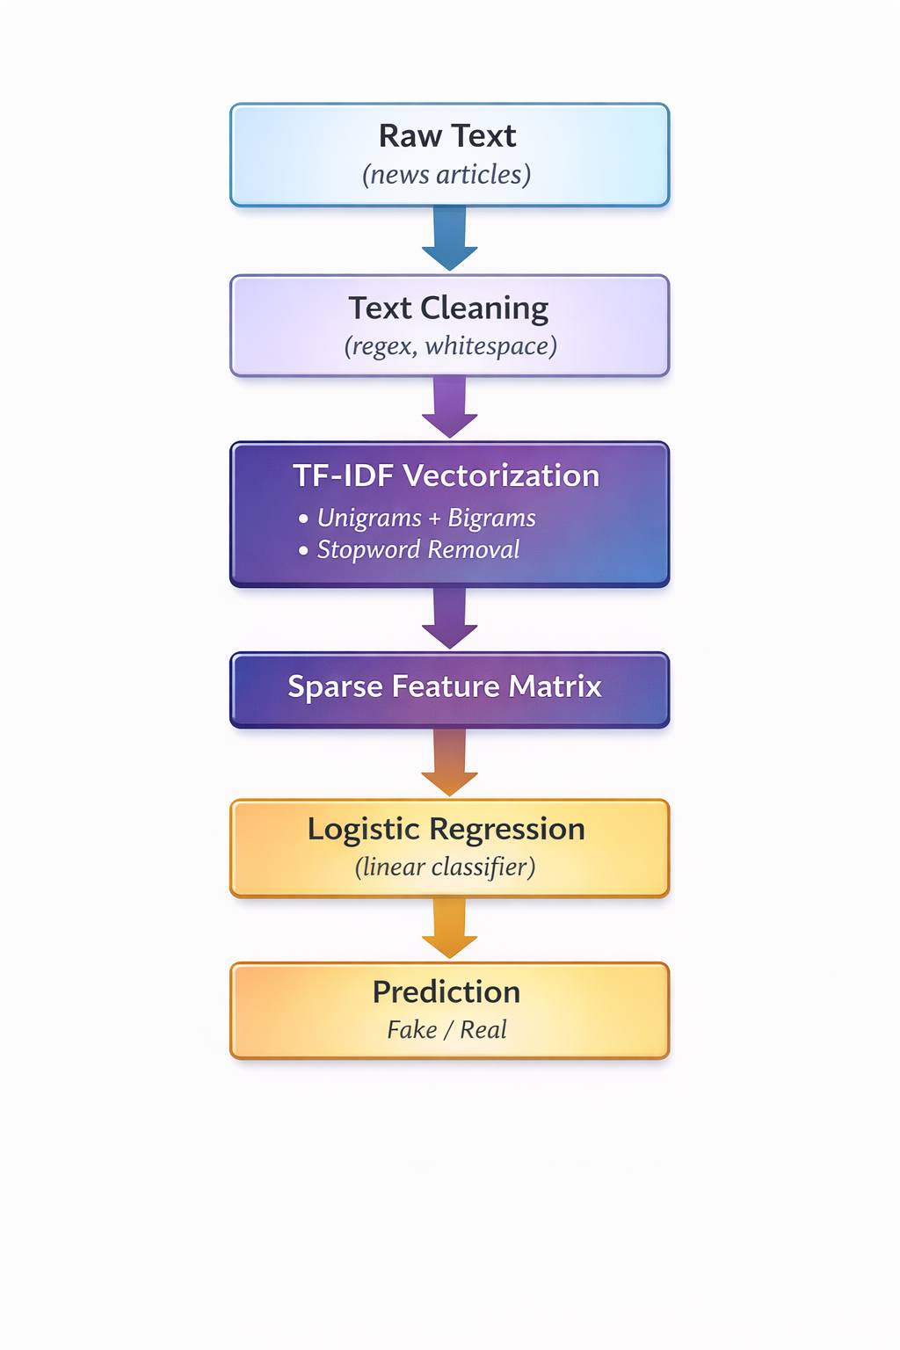
Executive summary
Logistic Regression + TF-IDF. Accuracy: 94%
Other Models:
TF-IDF + Random Forest
Word2Vec + XGBoost
TF-IDF + Naive Bayes
Preprocessing
Benchmark of models

Slide 3
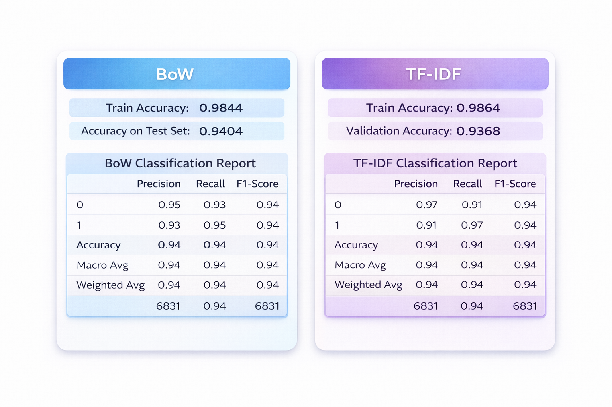
Preprocessing techniques
General preprocessing:
- Quick EDA of format and values
- Class balance check
- Regex filter
- Stopword removal
Preprocessing techniques tested:
- TF-IDF vs BoW
- Unigrams vs unigrams + bigrams vs n-grams
- Stemmers and lemmatizers
- Parameter tuning (different in each model)

Slide 4
Embeddings
WORD2VEC + XGBOOST
TF-IDF + NAIVE BAYES

Slide 5
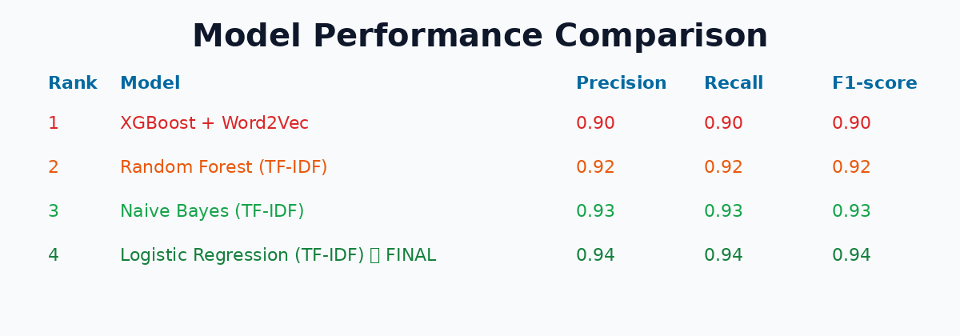
Models and methods •Explain the models you tried and why
4 different architectures to find the best trade-off between semantic depth and statistical precision.

Slide 6
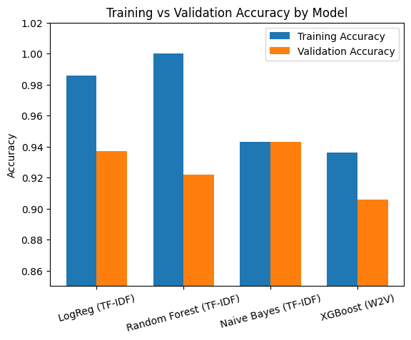

Slide 7
Takeaways
Recap:
Logistic Regression with TF-IDF achieved the best overall performance, reaching 94% accuracy.
Challenges:
Selecting the right feature representation, preventing overfitting in complex models.
Key learnings:
Feature engineering had a greater impact than model complexity, and simpler models generalized better.

