Slide 1



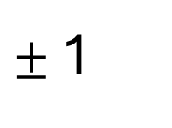




Fermions
Bosons
u
d
e
ν
γ
g
H
$$\text{+}\frac{\text{2}}{\text{3}}$$
$$\text{−}\frac{\text{1}}{\text{3}}$$
- 1
0
0
0
0
1st Gen
e
Up
Down
Electron
Electron Neutrino
Photon
Gluon
Higgs Boson
c
s
μ
ν
Z
W
$$\text{+}\frac{\text{2}}{\text{3}}$$
$$\text{−}\frac{\text{1}}{\text{3}}$$
- 1
0
0
$±$1
2nd Gen
μ
Charm
Strange
Muon
Muon Neutrino
Z Boson
W Boson
t
b
τ
ν
$$\text{+}\frac{\text{2}}{\text{3}}$$
$$\text{−}\frac{\text{1}}{\text{3}}$$
- 1
0
3rd Gen
τ
Top
Bottom
Tau
Tau Neutrino
Quarks
Leptons
Vector Bosons
Scalar Boson

Slide 2
Fermions
Bosons
u
d
e
ν
γ
g
H
$$\text{+}\frac{\text{2}}{\text{3}}$$
$$\text{−}\frac{\text{1}}{\text{3}}$$
- 1
0
0
0
0
e
Up
Down
Electron
Electron Neutrino
Photon
Gluon
Higgs Boson
c
s
μ
ν
Z
W
$$\text{+}\frac{\text{2}}{\text{3}}$$
$$\text{−}\frac{\text{1}}{\text{3}}$$
- 1
0
0
$±$1
μ
Charm
Strange
Muon
Muon Neutrino
Z Boson
W Boson
t
b
τ
ν
$$\text{+}\frac{\text{2}}{\text{3}}$$
$$\text{−}\frac{\text{1}}{\text{3}}$$
- 1
0
τ
Top
Bottom
Tau
Tau Neutrino
Quarks
Leptons
Vector Bosons
Scalar Boson

Slide 3
Fermions
Bosons
u
d
e
ν
γ
g
H
$$\text{+}\frac{\text{2}}{\text{3}}$$
$$\text{−}\frac{\text{1}}{\text{3}}$$
- 1
0
0
0
0
e
Up
Down
Electron
Electron Neutrino
Photon
Gluon
Higgs Boson
c
s
μ
ν
Z
W
$$\text{+}\frac{\text{2}}{\text{3}}$$
$$\text{−}\frac{\text{1}}{\text{3}}$$
- 1
0
0
$±$1
Scalar Boson
μ
Charm
Strange
Muon
Muon Neutrino
Z Boson
W Boson
t
b
τ
ν
$$\text{+}\frac{\text{2}}{\text{3}}$$
$$\text{−}\frac{\text{1}}{\text{3}}$$
- 1
0
Vector Bosons
τ
Top
Bottom
Tau
Tau Neutrino
Quarks
Leptons

Slide 4
Fermions
Bosons
u
d
e
ν
γ
g
H
$$\text{+}\frac{\text{2}}{\text{3}}$$
$$\text{−}\frac{\text{1}}{\text{3}}$$
- 1
0
0
0
0
e
Up
Down
Electron
Electron Neutrino
Photon
Gluon
Higgs Boson
c
s
μ
ν
Z
W
$$\text{+}\frac{\text{2}}{\text{3}}$$
$$\text{−}\frac{\text{1}}{\text{3}}$$
- 1
0
0
$±$1
Scalar Boson
μ
Charm
Strange
Muon
Muon Neutrino
Z Boson
W Boson
t
b
τ
ν
$$\text{+}\frac{\text{2}}{\text{3}}$$
$$\text{−}\frac{\text{1}}{\text{3}}$$
- 1
0
Vector Bosons
τ
Top
Bottom
Tau
Tau Neutrino
Quarks
Leptons

Slide 5
Fermions
Bosons
u
d
e
ν
γ
g
H
$$\text{+}\frac{\text{2}}{\text{3}}$$
$$\text{−}\frac{\text{1}}{\text{3}}$$
- 1
0
0
0
0
e
Up
Down
Electron
Electron Neutrino
Photon
Gluon
Higgs Boson
c
s
μ
ν
Z
W
$$\text{+}\frac{\text{2}}{\text{3}}$$
$$\text{−}\frac{\text{1}}{\text{3}}$$
- 1
0
0
$±$1
Scalar Boson
μ
Charm
Strange
Muon
Muon Neutrino
Z Boson
W Boson
t
b
τ
ν
$$\text{+}\frac{\text{2}}{\text{3}}$$
$$\text{−}\frac{\text{1}}{\text{3}}$$
- 1
0
Vector Bosons
τ
Top
Bottom
Tau
Tau Neutrino
Quarks
Leptons

Slide 6
Fermions
Bosons
u
d
e
ν
γ
g
H
$$\text{+}\frac{\text{2}}{\text{3}}$$
$$\text{−}\frac{\text{1}}{\text{3}}$$
- 1
0
0
0
0
e
Up
Down
Electron
Electron Neutrino
Photon
Gluon
Higgs Boson
c
s
μ
ν
Z
W
$$\text{+}\frac{\text{2}}{\text{3}}$$
$$\text{−}\frac{\text{1}}{\text{3}}$$
- 1
0
0
$±$1
Scalar Boson
μ
Charm
Strange
Muon
Muon Neutrino
Z Boson
W Boson
t
b
τ
ν
$$\text{+}\frac{\text{2}}{\text{3}}$$
$$\text{−}\frac{\text{1}}{\text{3}}$$
- 1
0
Vector Bosons
τ
Top
Bottom
Tau
Tau Neutrino
Quarks
Leptons

Slide 7
Fermions
Bosons
u
d
e
ν
γ
g
H
$$\text{+}\frac{\text{2}}{\text{3}}$$
$$\text{−}\frac{\text{1}}{\text{3}}$$
- 1
0
0
0
0
e
Up
Down
Electron
Electron Neutrino
Photon
Gluon
Higgs Boson
c
s
μ
ν
Z
W
$$\text{+}\frac{\text{2}}{\text{3}}$$
$$\text{−}\frac{\text{1}}{\text{3}}$$
- 1
0
0
$±$1
Scalar Boson
μ
Charm
Strange
Muon
Muon Neutrino
Z Boson
W Boson
t
b
τ
ν
$$\text{+}\frac{\text{2}}{\text{3}}$$
$$\text{−}\frac{\text{1}}{\text{3}}$$
- 1
0
Vector Bosons
τ
Top
Bottom
Tau
Tau Neutrino
Quarks
Leptons

Slide 8
Fermions
Bosons
u
d
e
ν
γ
g
H
$$\text{+}\frac{\text{2}}{\text{3}}$$
$$\text{−}\frac{\text{1}}{\text{3}}$$
- 1
0
0
0
0
e
Up
Down
Electron
Electron Neutrino
Photon
Gluon
Higgs Boson
c
s
μ
ν
Z
W
$$\text{+}\frac{\text{2}}{\text{3}}$$
$$\text{−}\frac{\text{1}}{\text{3}}$$
- 1
0
0
$±$1
Scalar Boson
μ
Charm
Strange
Muon
Muon Neutrino
Z Boson
W Boson
t
b
τ
ν
$$\text{+}\frac{\text{2}}{\text{3}}$$
$$\text{−}\frac{\text{1}}{\text{3}}$$
- 1
0
Vector Bosons
τ
Top
Bottom
Tau
Tau Neutrino
Quarks
Leptons

Slide 9
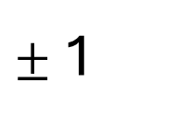






Fermions
Bosons
u
d
e
ν
γ
g
H
$$\text{+}\frac{\text{2}}{\text{3}}$$
$$\text{−}\frac{\text{1}}{\text{3}}$$
- 1
0
0
0
0
e
POSIÇÕES MAL
Up
Down
Electron
Electron Neutrino
Photon
Gluon
Higgs Boson
c
s
μ
ν
Z
W
$$\text{+}\frac{\text{2}}{\text{3}}$$
$$\text{−}\frac{\text{1}}{\text{3}}$$
- 1
0
0
$±$1
μ
Charm
Strange
Muon
Muon Neutrino
Z Boson
W Boson
t
b
τ
ν
$$\text{+}\frac{\text{2}}{\text{3}}$$
$$\text{−}\frac{\text{1}}{\text{3}}$$
- 1
0
τ
Top
Bottom
Tau
Tau Neutrino
Quarks
Leptons
Vector Bosons
Scalar Boson

Slide 10
Fermions
Bosons
u
d
e
ν
γ
g
H
$$\text{+}\frac{\text{2}}{\text{3}}$$
$$\text{−}\frac{\text{1}}{\text{3}}$$
- 1
0
0
0
0
e
POSIÇÕES MAL
Up
Down
Electron
Electron Neutrino
Photon
Gluon
Higgs Boson
c
s
μ
ν
Z
W
$$\text{+}\frac{\text{2}}{\text{3}}$$
$$\text{−}\frac{\text{1}}{\text{3}}$$
- 1
0
0
$±$1
Scalar Boson
μ
Charm
Strange
Muon
Muon Neutrino
Z Boson
W Boson
t
b
τ
ν
$$\text{+}\frac{\text{2}}{\text{3}}$$
$$\text{−}\frac{\text{1}}{\text{3}}$$
- 1
0
Vector Bosons
τ
Top
Bottom
Tau
Tau Neutrino
Quarks
Leptons

Slide 11


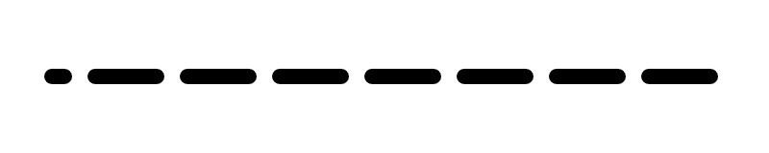
Fermions
Bosons
u
d
e
ν
γ
g
H
$$\text{+}\frac{\text{2}}{\text{3}}$$
$$\text{−}\frac{\text{1}}{\text{3}}$$
- 1
0
0
0
0
e
Up
Down
Electron
Electron Neutrino
Photon
Gluon
Higgs Boson
c
s
μ
ν
Z
W
$$\text{+}\frac{\text{2}}{\text{3}}$$
$$\text{−}\frac{\text{1}}{\text{3}}$$
- 1
0
0
$±$1
μ
Charm
Strange
Muon
Muon Neutrino
Z Boson
W Boson
t
b
τ
ν
$$\text{+}\frac{\text{2}}{\text{3}}$$
$$\text{−}\frac{\text{1}}{\text{3}}$$
- 1
0
τ
Top
Bottom
Tau
Tau Neutrino
Quarks
Leptons
Vector Bosons
Scalar Boson

Slide 12
Fermions
Bosons
u
d
e
ν
γ
g
H
$$\text{+}\frac{\text{2}}{\text{3}}$$
$$\text{−}\frac{\text{1}}{\text{3}}$$
- 1
0
0
0
0
e
Up
Down
Electron
Electron Neutrino
Photon
Gluon
Higgs Boson
c
s
μ
ν
Z
W
$$\text{+}\frac{\text{2}}{\text{3}}$$
$$\text{−}\frac{\text{1}}{\text{3}}$$
- 1
0
0
$±$1
μ
Charm
Strange
Muon
Muon Neutrino
Z Boson
W Boson
t
b
τ
ν
$$\text{+}\frac{\text{2}}{\text{3}}$$
$$\text{−}\frac{\text{1}}{\text{3}}$$
- 1
0
τ
Top
Bottom
Tau
Tau Neutrino
Quarks
Leptons
Vector Bosons
Scalar Boson

Slide 13
The Standard Model of Particle Physics (SM)

Slide 15
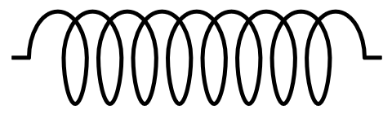






Strong Sector of the SM
u
d
g
$$\text{+}\frac{\text{2}}{\text{3}}$$
$$\text{−}\frac{\text{1}}{\text{3}}$$
0
+
Quantum Chromodynamics (QCD)
Up
Down
Gluon
c
s
$$\text{+}\frac{\text{2}}{\text{3}}$$
$$\text{−}\frac{\text{1}}{\text{3}}$$
Charm
Strange
t
b
$$\text{+}\frac{\text{2}}{\text{3}}$$
$$\text{−}\frac{\text{1}}{\text{3}}$$
Top
Bottom

Slide 16
Strong Sector of the SM
u
d
g
$$\text{+}\frac{\text{2}}{\text{3}}$$
$$\text{−}\frac{\text{1}}{\text{3}}$$
0
+
Quantum Chromodynamics (QCD)
Up
Down
Gluon
c
s
$$\text{+}\frac{\text{2}}{\text{3}}$$
$$\text{−}\frac{\text{1}}{\text{3}}$$
Make up protons, neutrons, other particles
Charm
Strange
t
b
$$\text{+}\frac{\text{2}}{\text{3}}$$
$$\text{−}\frac{\text{1}}{\text{3}}$$
Top
Bottom

Slide 17
Strong Sector of the SM
u
d
g
$$\text{+}\frac{\text{2}}{\text{3}}$$
$$\text{−}\frac{\text{1}}{\text{3}}$$
0
+
Quantum Chromodynamics (QCD)
Up
Down
Gluon
c
s
$$\text{+}\frac{\text{2}}{\text{3}}$$
$$\text{−}\frac{\text{1}}{\text{3}}$$
Make up protons, neutrons, other particles
Keeps nucleons together in nuclei
Charm
Strange
t
b
$$\text{+}\frac{\text{2}}{\text{3}}$$
$$\text{−}\frac{\text{1}}{\text{3}}$$
Top
Bottom

Slide 18
Strong Sector of the SM
u
d
g
$$\text{+}\frac{\text{2}}{\text{3}}$$
$$\text{−}\frac{\text{1}}{\text{3}}$$
0
+
Quantum Chromodynamics (QCD)
Up
Down
Gluon
c
s
$$\text{+}\frac{\text{2}}{\text{3}}$$
$$\text{−}\frac{\text{1}}{\text{3}}$$
Make up protons, neutrons, other particles
Keeps nucleons together in nuclei
Never observed alone: Colour Confinement
Charm
Strange
t
b
$$\text{+}\frac{\text{2}}{\text{3}}$$
$$\text{−}\frac{\text{1}}{\text{3}}$$
Top
Bottom

Slide 19
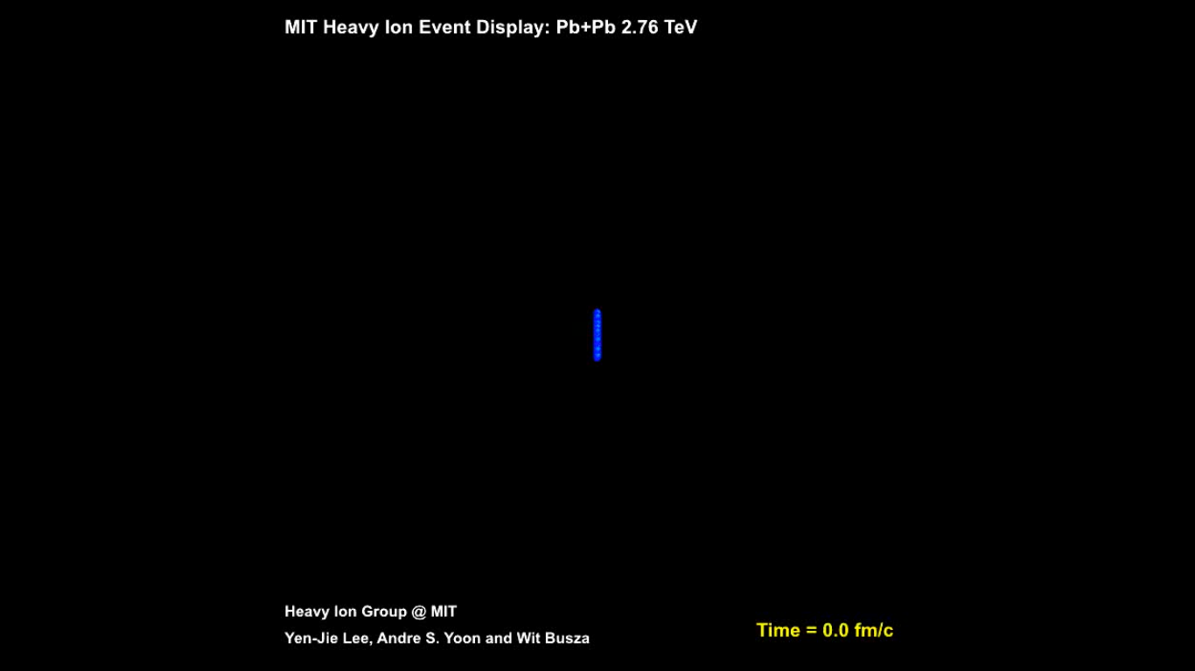

Slide 20
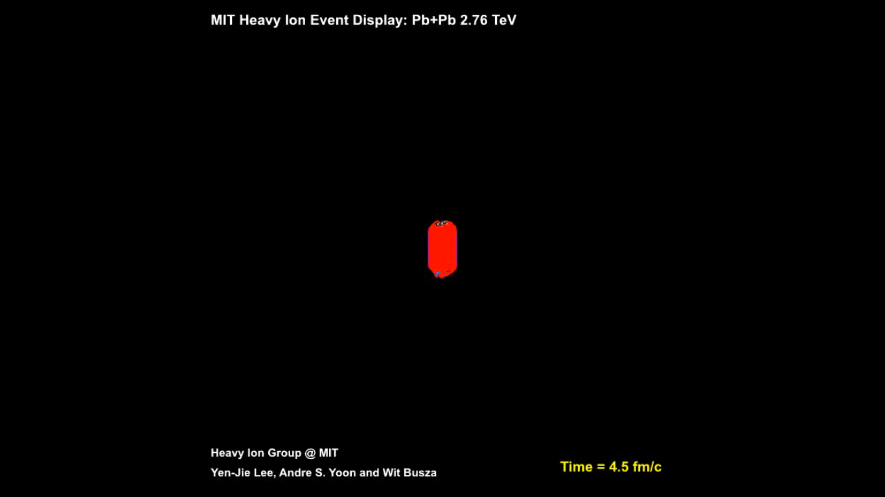

Slide 21
Hard probe
(quark or gluon)

Slide 22
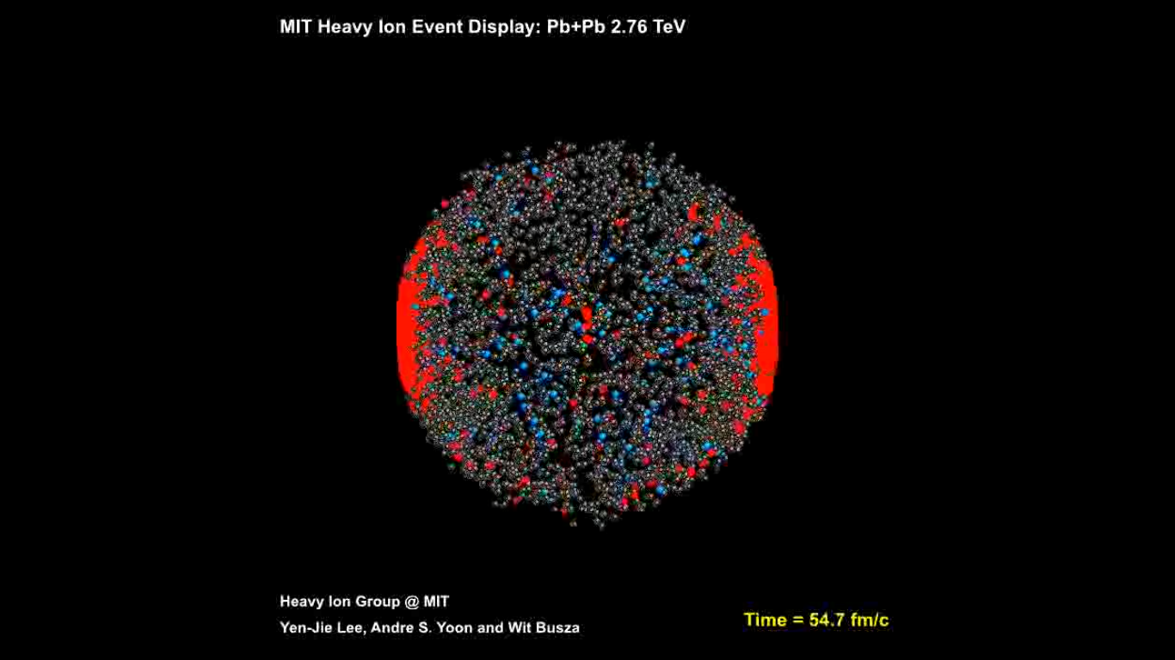
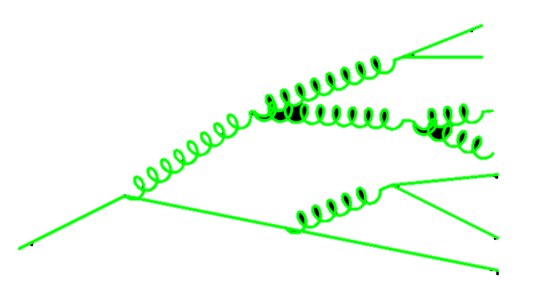
Hadronisation

Slide 23
Jet
(of hadrons)
Hadronisation

Slide 24
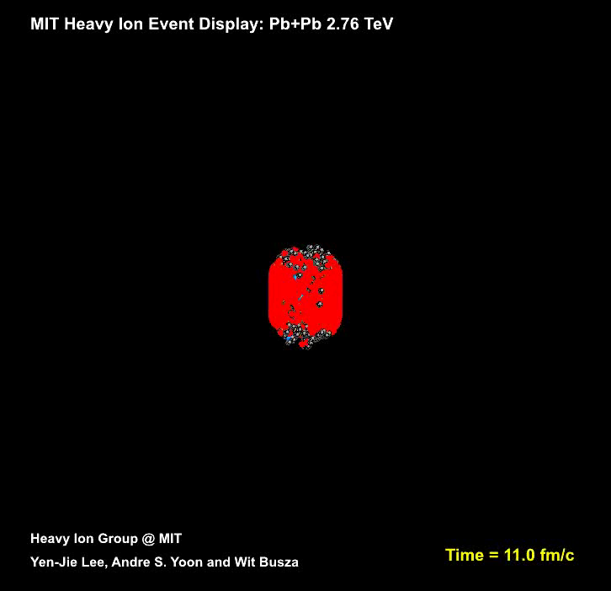
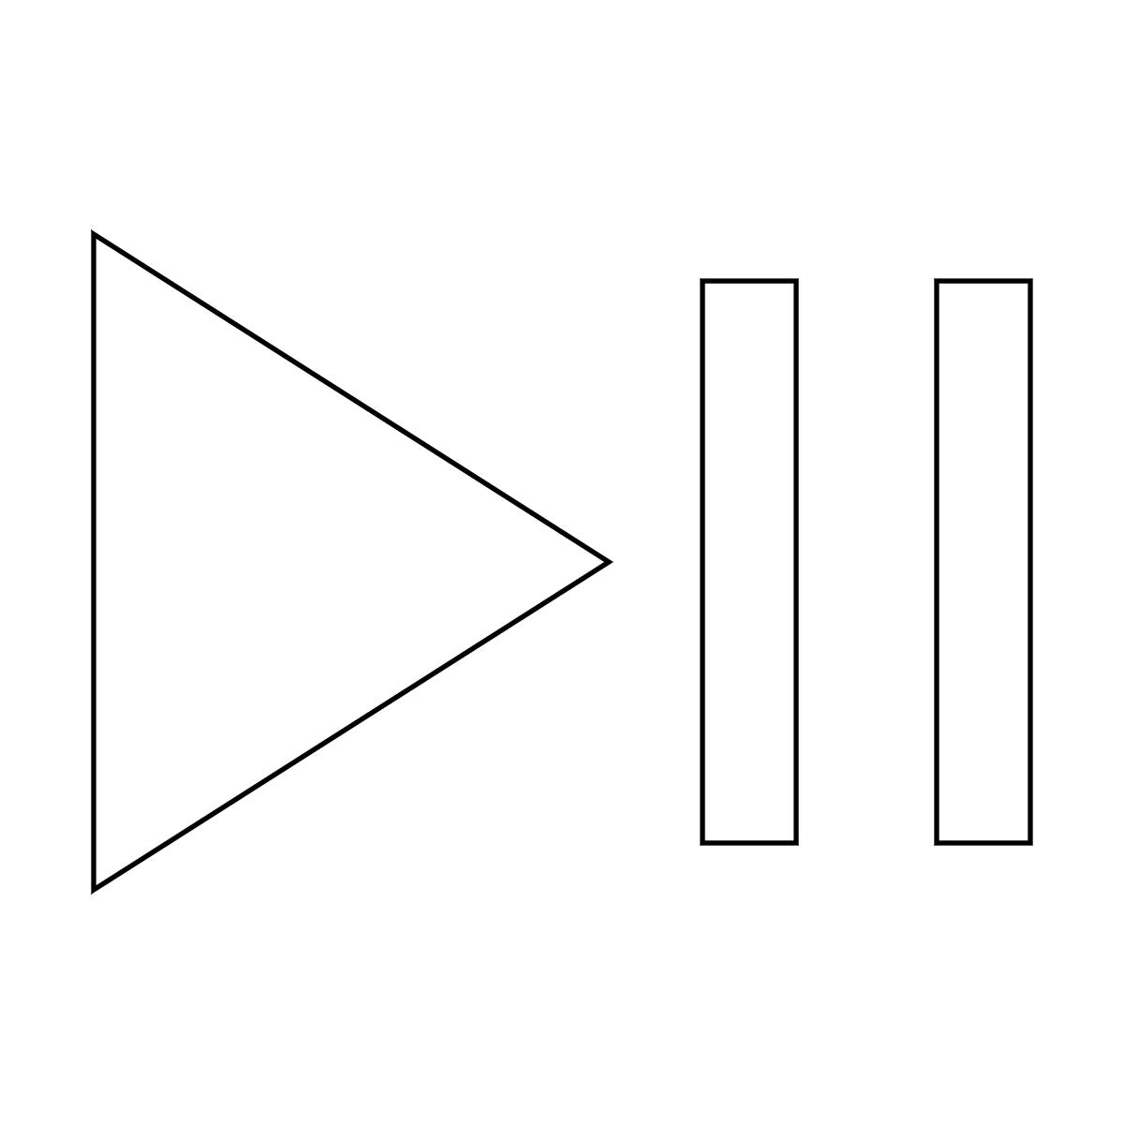
Quark-Gluon Plasma
Fluid (Hydrodynamic)
Strongly coupled
Very low viscosity

Slide 25
Quark-Gluon Plasma

Slide 27
Thank you!

Slide 28
Credits
Collider animation: CERN, “Heavy Ion Collision Event Animation”, ID: CERN-VIDEO-2010-214-001, 2010-11-26
Heavy Ion Collision animation, showing QGP in red: Yen-Jie Lee, Andre S. Yoon and Wit Busza, Heavy Ion Hroup @ MIT, “MIT Heavy Ion Event Display: Pb+Pb 2.76 Tev”. Referenced in W. Busza et al., “Heavy Ion Collisions:The Big Picture, and the Big Questions”, 2018. arXiv:1802.04801v2
Play/Pause button: Travis Avery, The Noun Project, under the Creative Commons Attribution 3.0 Unported license. https://creativecommons.org/licenses/by/3.0/deed.en

