Slide 1
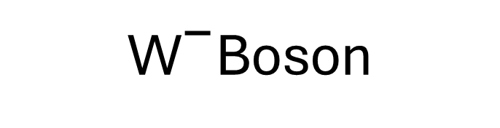


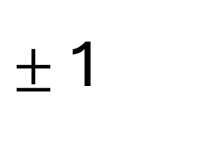


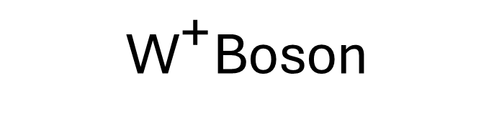




$$\text{+}\frac{\text{2}}{\text{3}}$$
u
$$\text{+}\frac{\text{2}}{\text{3}}$$
c
$$\text{+}\frac{\text{2}}{\text{3}}$$
t
γ
g
0
0
Up
Charm
Top
Photon
Gluon
$$\text{−}\frac{\text{1}}{\text{3}}$$
d
$$\text{−}\frac{\text{1}}{\text{3}}$$
s
$$\text{−}\frac{\text{1}}{\text{3}}$$
b
Z
W
0
$±$1
Down
Strange
Bottom
Z Boson
W Boson
e
μ
τ
H
- 1
- 1
- 1
0
Electron
Muon
Tau
Higgs Boson
ν
ν
ν
0
0
0
e
μ
τ
Electron Neutrino
Muon Neutrino
Tau Neutrino
$${\text{W} }^{\text{+}}$$
$${\text{W} }^{\text{−}}$$
+ 1
- 1
${\text{W}}^{\text{+}}$Boson
${\text{W}}^{\text{−}}$Boson

Slide 2

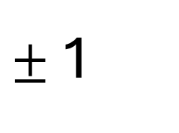





$${\text{W} }^{\text{+}}$$
$${\text{W} }^{\text{−}}$$
+ 1
- 1
${\text{W}}^{\text{+}}$Boson
${\text{W}}^{\text{−}}$Boson
Fermions
$$\text{+}\frac{\text{2}}{\text{3}}$$
u
$$\text{+}\frac{\text{2}}{\text{3}}$$
c
$$\text{+}\frac{\text{2}}{\text{3}}$$
t
Up
Charm
Top
$$\text{−}\frac{\text{1}}{\text{3}}$$
d
$$\text{−}\frac{\text{1}}{\text{3}}$$
s
$$\text{−}\frac{\text{1}}{\text{3}}$$
b
Down
Strange
Bottom
e
μ
τ
- 1
- 1
- 1
Electron
Muon
Tau
ν
ν
ν
0
0
0
e
μ
τ
Electron Neutrino
Muon Neutrino
Tau Neutrino
Bosons
Z
W
γ
g
0
$±$1
0
0
Z Boson
W Boson
Photon
Gluon
H
0
Higgs Boson

Slide 3
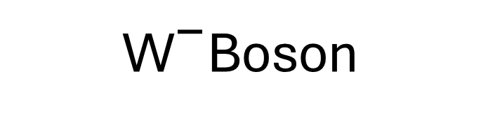

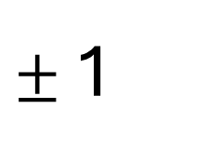



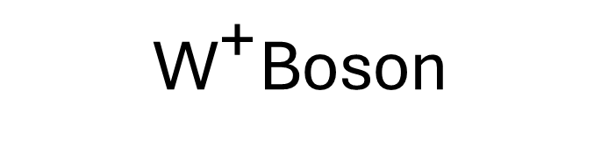




Fermions
Bosons
$$\text{+}\frac{\text{2}}{\text{3}}$$
u
$$\text{−}\frac{\text{1}}{\text{3}}$$
d
e
ν
γ
g
H
- 1
0
0
0
0
e
Up
Down
Electron
Electron Neutrino
Photon
Gluon
Higgs Boson
$$\text{+}\frac{\text{2}}{\text{3}}$$
c
$$\text{−}\frac{\text{1}}{\text{3}}$$
s
μ
ν
Z
W
- 1
0
0
$±$1
Scalar Boson
μ
Charm
Strange
Muon
Muon Neutrino
Z Boson
W Boson
$$\text{+}\frac{\text{2}}{\text{3}}$$
t
$$\text{−}\frac{\text{1}}{\text{3}}$$
b
τ
ν
- 1
0
Vector Bosons
τ
Top
Bottom
Tau
Tau Neutrino
Quarks
Leptons
$${\text{W} }^{\text{+}}$$
+ 1
${\text{W}}^{\text{+}}$Boson
$${\text{W} }^{\text{−}}$$
- 1
${\text{W}}^{\text{−}}$Boson

Slide 4
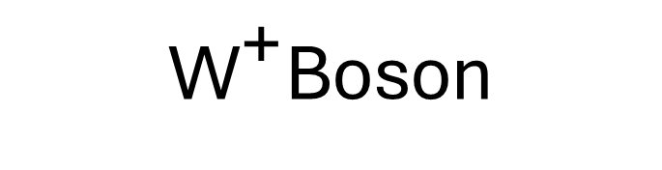

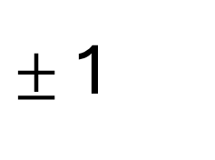

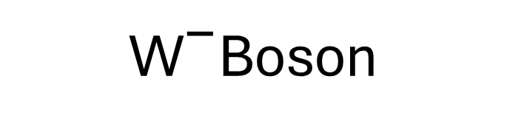
γ
$${\text{W} }^{\text{+}}$$
g
0
+ 1
0
Photon
${\text{W}}^{\text{+}}$Boson
Gluon
Z
$${\text{W} }^{\text{−}}$$
W
H
0
- 1
$±$1
0
Z Boson
${\text{W}}^{\text{−}}$Boson
W Boson
Higgs Boson

