Slide 1
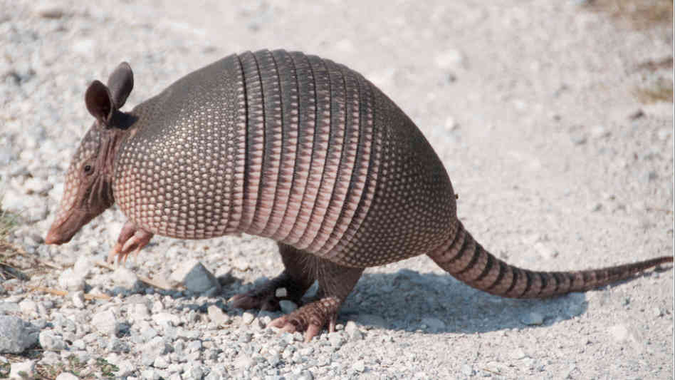


Slide 2
Project overview
QT 5
mbed TLS v2.2.1
Server role
Registers and verifies clients
Supplies clients with time limited certificates (x.509)
Supplies clients with list of available clients
Server-Client - TLS
Client role
All communication between clients is organized without server
Diffie-Helman protocol establishes limited-time key
Messages encrypted and authenticated by AES-256 and HMAC-SHA512

Slide 3
Server-client communication
24hr valid client-side certificates
Communication established through TLS
Lifeline of communication
Server verifies login information of client
Client creates RSA pair and sends public key to server
Server signs public key and sends back signed public key

Slide 4
Client-client communication
Prerequisities – each client has own certificate
Forward secrecy realised through Diffie-Helman protocol
Lifeline of communication:
Initial exchange of certificates
They verify each other
Both sides agree on keys through DH
Keys used for 10 messages max
After 10 messages new DH is chosen and appended
Other side automaticaly responds with part of new key

Slide 5
Client-client example
Alice
Bob
certificate
certificate
verification
Initial Diffie-Helman
Result: key1
key1
01Message[key1][DH]
02Message[key1]
10Message[key1]
key2
[DH2]
key2
11Message[key2][DH]

