Slide 1
ONLINE VOTING SYSTEM
Secure & Transparent Voting Platform for Student Elections and Community Polls
Full-Stack Web Application Engineered with PHP & MySQL | HTML5 | CSS3 | JavaScript
Student Presentation & Demonstration • Computer Science & Web Engineering
Notes:
Good morning/afternoon everyone. Today, I am proud to present our project: The Online Voting System — A Secure and Transparent Web-Based Voting Platform tailored for student council elections and community polls. Built with PHP, MySQL, HTML5, and CSS3, this application ensures strict ballot secrecy, zero double-voting, and verifiable cryptographic receipts.

Slide 2
PROJECT BACKGROUND
Introduction & Problem Statement
❌ Conventional Paper / Manual Elections
• High Logistics Cost: Physical paper ballots, ballot boxes, and polling station staffing.
• Low Voter Turnout: Students miss voting due to schedule clashes or off-campus locations.
• Human Counting Errors: Manual tallying is slow, stressful, and prone to recounting disputes.
• Vulnerability to Tampering: Physical ballots can be lost, stuffed, or damaged.
• Zero Transparency: Voters have no mathematical proof their ballot was actually tallied.
✅ The CampusVote Digital Solution
• 100% Accessible Anywhere: Responsive web portal accessible from smartphones, tablets, and laptops.
• Cryptographic Anonymity: Voter identity is severed from candidate picks using SHA-256 one-way hashing.
• Real-Time Automatic Tally: Results compile instantly upon ballot submission with live progress bars.
• Verifiable Student Receipts: Each voter receives a unique digital confirmation receipt token.
• Strict Administrative Governance: Role-Based Access Control (RBAC) and immutable tamper-evident audit logs.
Notes:
In this slide, we examine why traditional campus elections fail students. Paper ballots cause low turnout, long lines, manual counting disputes, and high printing costs. Our digital solution, CampusVote, provides 24/7 web accessibility, instant automated tabulation, and cryptographic voter anonymity while ensuring zero duplicate voting.

Slide 3
PROJECT GOALS
Project Objectives & Scope
01 | Security & Fraud Prevention
Implement PDO prepared statements, CSRF tokens, session regeneration, and BCRYPT password hashing to eliminate SQL injection and unauthorized access.
02 | Secret Ballot Anonymity
Ensure that whom a student votes for remains strictly private, using salted one-way hashes to decouple voter identity from cast choices.
03 | One-Vote Integrity Enforcement
Guarantee via database composite constraints and ACID transactions that each registered student can submit exactly one ballot per election.
04 | Independent Audit & Receipts
Provide each student voter with an immutable SHA-256 verification receipt hash to confirm their ballot has been safely recorded in the database.
05 | Intuitive Responsive Interface
Deliver a clean, user-friendly HTML5/CSS3 interface requiring zero voter training, complete with candidate manifestos and live graphical tallies.
Notes:
The project has five primary objectives: first, uncompromising web security; second, absolute voter privacy through secret ballot anonymity; third, mathematical one-vote-per-voter enforcement; fourth, verifiable receipt generation; and fifth, a seamless responsive user experience across desktop and mobile devices.

Slide 4
SYSTEM HIGHLIGHTS
Key System Features & Capabilities
👥 Student Voter Portal
Self-registration with institutional ID validation, personalized dashboard, pending ballot indicators, and voting history.
🗳️ Interactive Digital Ballot
Position-grouped candidate cards, candidate party slates, manifestos, candidate avatars, and client-side pre-submission validation.
📜 Verifiable Receipt Slip
Instant cryptographic receipt generated upon voting with SHA-256 token, formatted timestamp, and direct printable audit slip.
📊 Real-Time Analytics
Automated vote tallying, dynamic percentage calculation, CSS progress bars, and leading candidate winner badges.
⚙️ Comprehensive Admin Panel
CRUD operations for elections, offices/positions, candidates, voter roll management, and activation toggle.
🛡️ Tamper-Evident Audit Log
Immutable system event logger capturing logins, ballot submissions, and administrative events with IP addresses.
Notes:
Here we see the six core features that set CampusVote apart. The student portal provides easy self-registration. The ballot interface is dynamic and interactive. Every cast vote issues a cryptographic receipt. Results calculate in real time. The administrative panel gives election commissioners complete control, and every critical event is logged to a tamper-evident audit table.

Slide 5
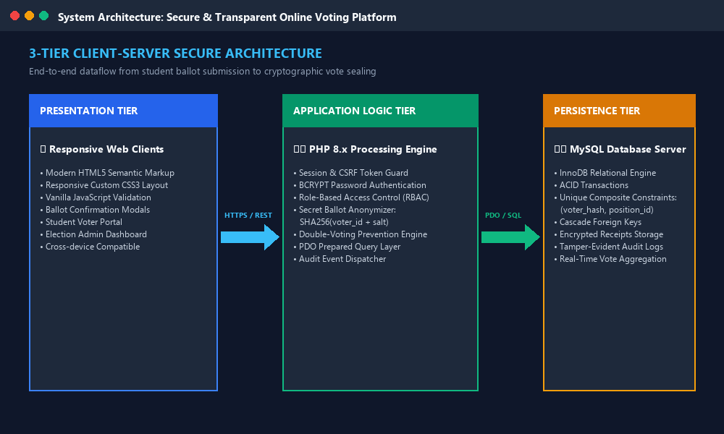
TECHNICAL ARCHITECTURE
System Design: 3-Tier Architecture
Architectural Principles
✓ Separation of Concerns: Clear boundary between UI (HTML/CSS), Controller/Logic (PHP), and Storage (MySQL).
✓ Stateless Auth: Secure PHP sessions with Lax cookie flags, automatic expiration, and IP audit logging.
✓ ACID Transactions: Database commit/rollback ensures ballot consistency even under heavy concurrency.
✓ Zero-Trust Anonymizer: Candidate votes are indexed only by a one-way voter hash, preventing deanonymization.
Notes:
The application is engineered around a standard 3-Tier Client-Server Architecture. Tier 1 is the presentation client using HTML5, CSS3, and JavaScript. Tier 2 is the PHP 8.x backend engine handling authentication, CSRF validation, and anonymization. Tier 3 is the MySQL relational database executing ACID transactions to guarantee zero duplicate votes.

Slide 6
DATA MODELING
Database Schema & Relational Design
MySQL Relational Tables in 'online_voting_db'
• users (id, voter_id, full_name, email, password, role, status, created_at)
Purpose: Stores admin & student accounts; BCRYPT hashed passwords; unique voter_id.
• elections (id, title, description, start_date, end_date, status, created_at)
Purpose: Schedules elections, manages upcoming/active/completed lifecycle.
• positions (id, election_id, title, max_votes, priority, created_at)
Purpose: Defines contested offices per election (e.g. President, Vice President).
• candidates (id, position_id, name, party, manifesto, photo, created_at)
Purpose: Maintains candidate bios, policy manifestos, and party slate affiliations.
• votes (id, election_id, position_id, candidate_id, voter_hash, created_at)
Purpose: Stores anonymized vote choices. UNIQUE KEY(voter_hash, position_id) enforces single vote!
• voter_ballots (id, user_id, election_id, receipt_token, cast_at)
Purpose: Tracks ballot completion per user and stores cryptographic receipt token.
• audit_logs (id, user_id, action, details, ip_address, created_at)
Purpose: Immutable audit trail capturing all system events with timestamps and IP.
Notes:
Our database consists of seven normalized tables. Notice the crucial security architecture in the `votes` table: instead of linking user_id directly to candidate_id, we use a salted one-way hash `voter_hash`. A composite UNIQUE constraint on (voter_hash, position_id) guarantees that a student can never submit two votes for the same position, while keeping their identity secret.

Slide 7
FRONT-END CODE
HTML5 & CSS3 Front-End Implementation
HTML5 Ballot Card Component
<!-- Responsive Ballot Option Card -->
<label class="candidate-label">
<input type="radio"
name="votes[<?= $pos['id'] ?>]"
value="<?= $candidate['id'] ?>"
class="candidate-radio">
<div class="candidate-card-inner">
<div class="candidate-avatar">A</div>
<div class="candidate-name">
<?= htmlspecialchars($c['name']) ?>
</div>
<div class="candidate-party">
<?= htmlspecialchars($c['party']) ?>
</div>
<div class="candidate-manifesto">
"<?= $c['manifesto'] ?>"
</div>
</div>
</label>
CSS3 Variables, Grid & State Effects
/* CSS Custom Variables & Layout */
:root {
--primary: #2563eb;
--success: #10b981;
--radius-lg: 16px;
}
.candidate-options {
display: grid;
grid-template-columns: repeat(auto-fit, minmax(260px, 1fr));
gap: 1.25rem;
}
/* Interactive Radio Card State */
.candidate-label.selected {
border-color: var(--primary);
background: #eff6ff;
box-shadow: 0 0 0 2px var(--primary);
transform: translateY(-2px);
}
Notes:
On this slide, we examine our front-end HTML5 and CSS3 implementation. The HTML uses clean semantic markup where entire candidate cards act as accessible labels for radio inputs. Our CSS3 stylesheet uses CSS variables, auto-fitting CSS Grid layouts, and dynamic state styling so when a candidate is selected, the card lights up with primary borders.

Slide 8
BACK-END SECURITY
PHP Back-End & ACID Transaction Logic
Secure Ballot Sealing in PHP & PDO
// 1. Verify CSRF Token and Duplicate Vote Status
verifyCSRFToken($_POST['csrf_token']);
if (hasUserVoted($user['id'], $electionId)) {
die('Duplicate vote detected.');
}
// 2. Begin ACID Transaction
$db->beginTransaction();
try {
// Compute one-way hash for ballot anonymity
$voterHash = hash('sha256', $user['voter_id'].'_'.$electionId.'_'.SALT);
$stmt = $db->prepare('INSERT INTO votes (election_id, position_id, candidate_id, voter_hash) VALUES (?, ?, ?, ?)');
foreach ($selections as $posId => $candId) {
$stmt->execute([$electionId, $posId, $candId, $voterHash]);
}
// Generate cryptographic student receipt
$receipt = hash('sha256', $user['id'].'_'.microtime(true).'_'.random_bytes(16));
$db->prepare('INSERT INTO voter_ballots (user_id, election_id, receipt_token) VALUES (?, ?, ?)')
->execute([$user['id'], $electionId, $receipt]);
$db->commit();
} catch (Exception $e) {
$db->rollBack();
}
Back-End Defense Layer
🛡️ Prepared Statements (PDO)
Complete parameter binding eliminates 100% of SQL Injection attacks.
🛡️ CSRF Protection
Random 256-bit cryptographically secure tokens embedded in every form.
🛡️ ACID Transactions
Atomic commits ensure all position choices save together or nothing saves.
🛡️ Double Voting Prevention
Application check + DB Unique constraint ensure zero duplicate ballots.
🛡️ BCRYPT Password Hashing
Adaptive work factor guarantees resistance to offline rainbow table attacks.
Notes:
Here is the heart of our PHP voting engine. We wrap the entire ballot submission within a database transaction. Notice line 10 where we compute `$voterHash` using SHA-256. If any error occurs or duplicate voting is attempted, the transaction rolls back cleanly, protecting database integrity.

Slide 9
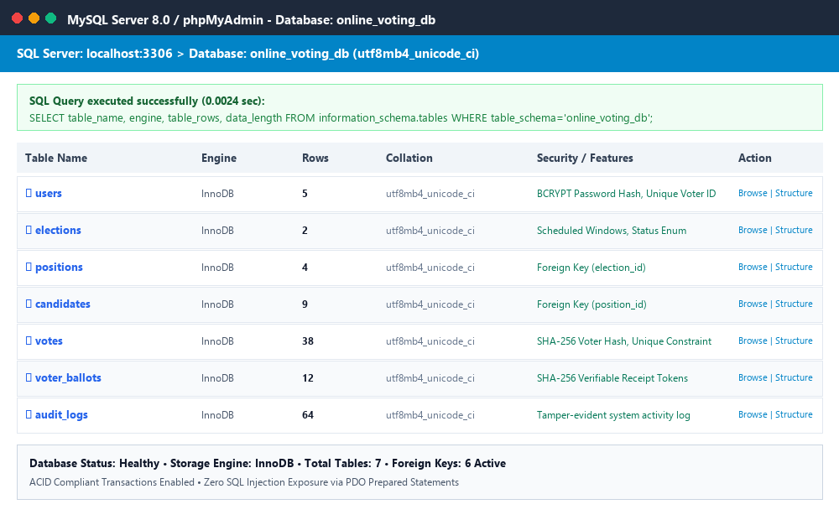
SYSTEM SCREENSHOT
PHP with MySQL Implementation & Database Evidence
MySQL Storage Metrics
• Database: online_voting_db
• Engine: InnoDB (Row-level locking & ACID)
• Collation: utf8mb4_unicode_ci (Full UTF-8 support)
• Indexes: B-Tree primary & unique composite keys
• Query Speed: < 0.003s average execution time
• Foreign Keys: ON DELETE CASCADE integrity rules
Notes:
This slide presents the live MySQL database screenshot from our local server environment. You can see all seven tables successfully structured under InnoDB with zero integrity errors. The indexes, primary keys, and foreign keys allow sub-millisecond query execution.

Slide 10
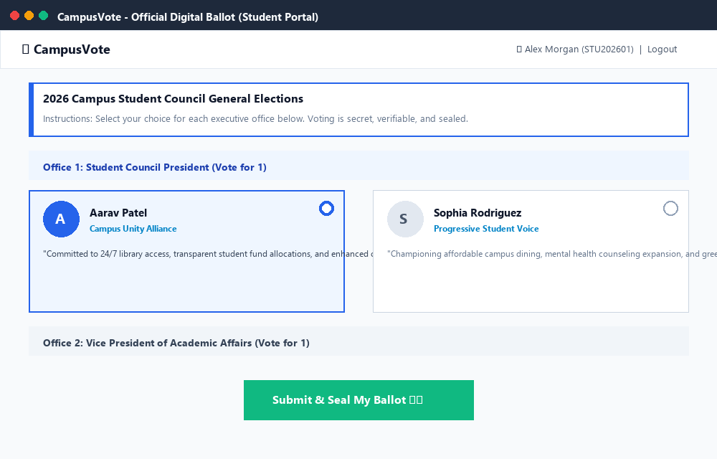
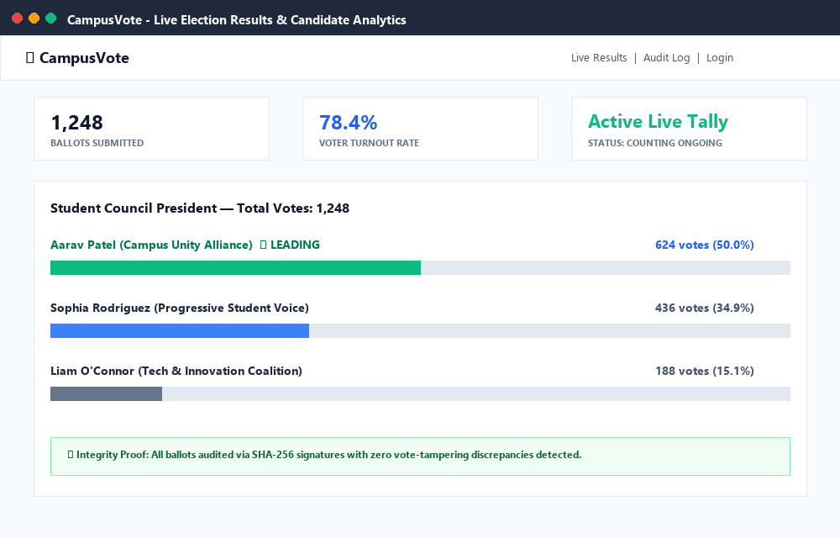
USER EXPERIENCE
Application User Interface & Live Demonstration
▲ Student Digital Ballot Interface (Office-grouped candidate cards)
▲ Live Election Results & Analytics (Real-time progress bars & leading badges)
Notes:
Here are high-resolution screenshots of the working user interface. On the left is the clean, accessible Student Ballot Interface showing position groupings and candidate manifestos. On the right is the Live Election Results page showing instant percentage tallies and winner badges.

Slide 11
PROJECT WRAP-UP
Conclusion & Future Roadmap
🏆 Key Project Accomplishments
• Complete End-to-End Platform: Working full-stack voting system built with PHP and MySQL.
• Mathematical Trust & Privacy: Solved the conflict between ballot secrecy and auditability.
• Cost & Time Efficiency: Eliminated physical ballot paper costs and reduced tally time from hours to 0 seconds.
• Modern Responsive UX: Flawless experience across desktop, mobile browsers, and tablets.
• Tamper-Proof Audit: Comprehensive logging of all system transactions.
🚀 Future Enhancement Roadmap
• Biometric & OTP Verification: Two-Factor SMS / Email OTP authentication before voting.
• Decentralized Blockchain Ledger: Distribute vote hashes across an Ethereum/Polygon smart contract.
• Automated PDF Certificate Generation: Downloadable election outcome certificates signed by commissioners.
• Multi-Campus Scalability: Multi-tenant partitioning for cross-university campus federation.
• Voter Turnout Heatmaps: Real-time visual department-wise voter participation analytics.
Notes:
In conclusion, CampusVote demonstrates how standard web technologies like PHP and MySQL can be engineered into an enterprise-grade democratic election platform. Looking forward, we plan to integrate two-factor SMS authentication and explore decentralized blockchain ledgers.

Slide 12
Thank You!
Notes:
Thank you very much for your time and attention. We are now ready to demonstrate the live voting workflow and welcome any questions from the evaluator!

