Slide 1
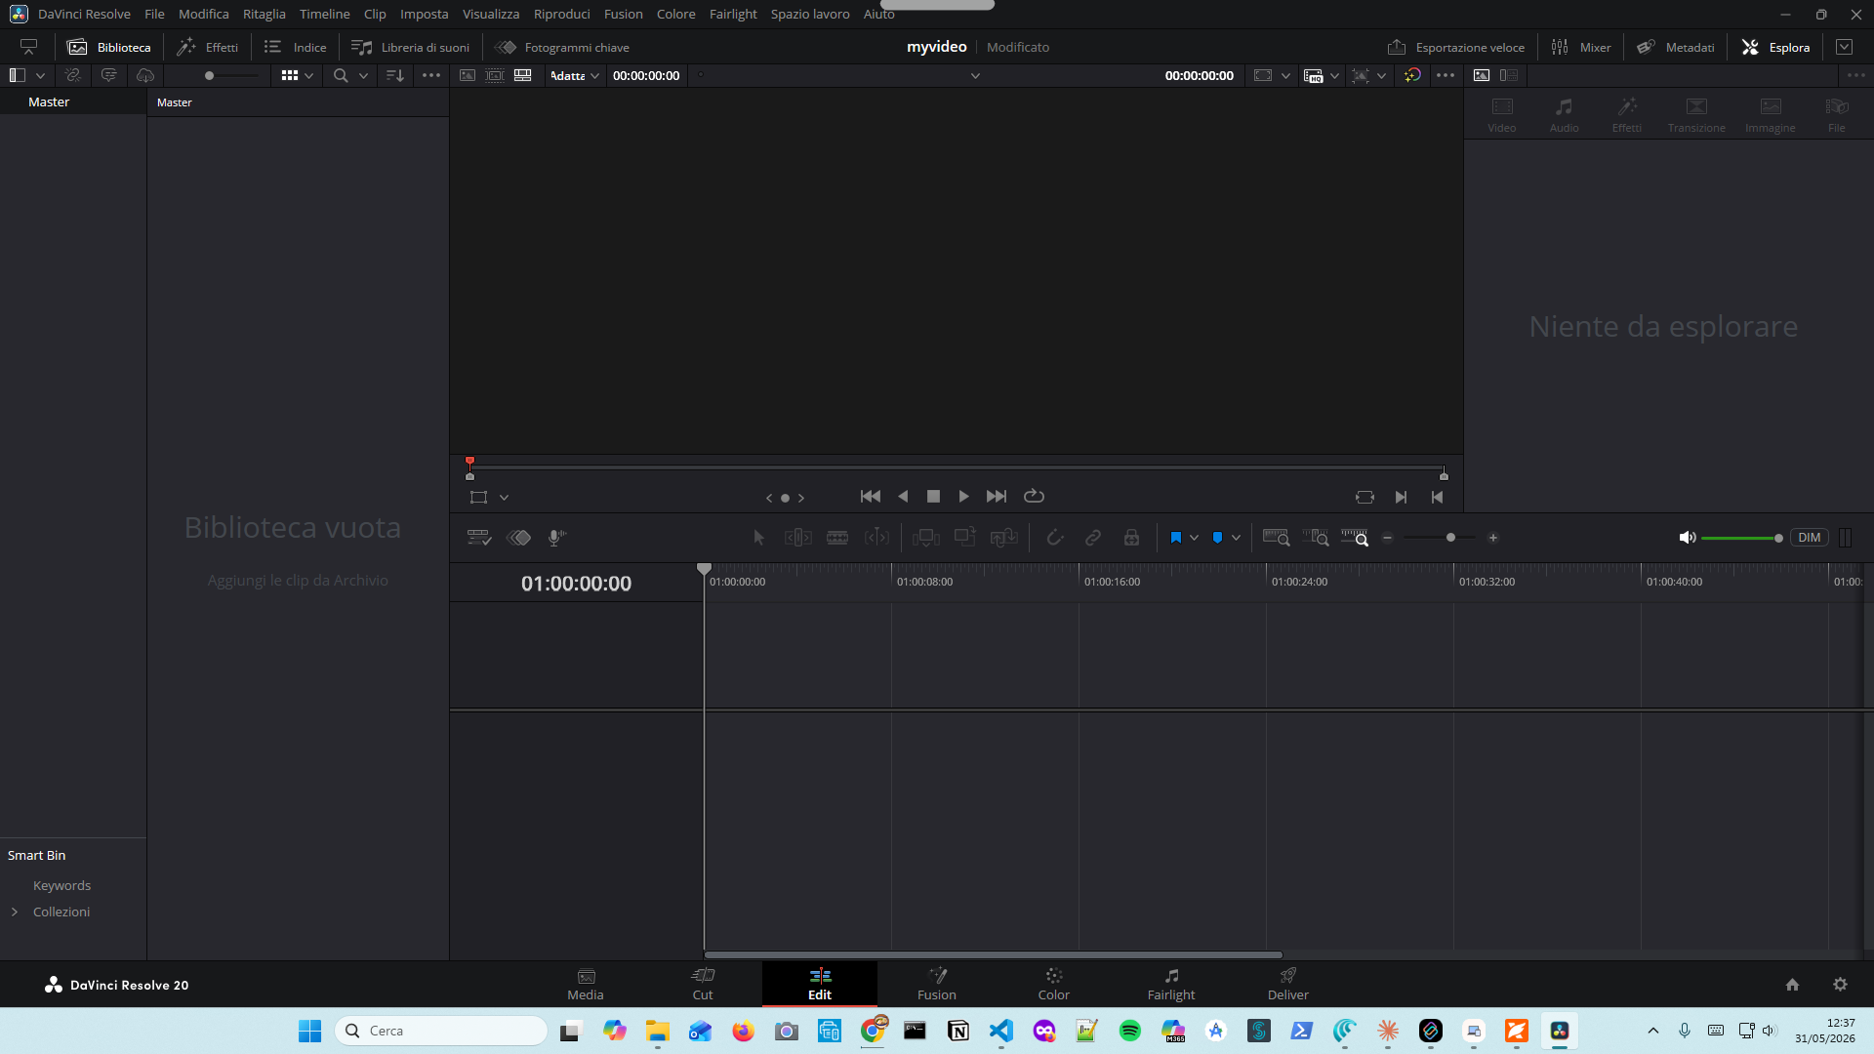
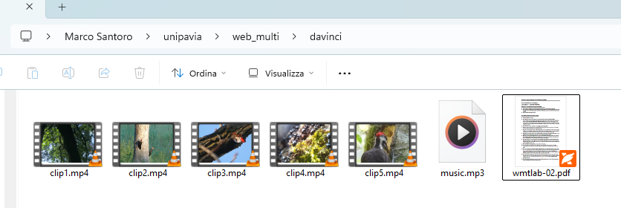
Step 1-3(Create folder – Save file)

Slide 2
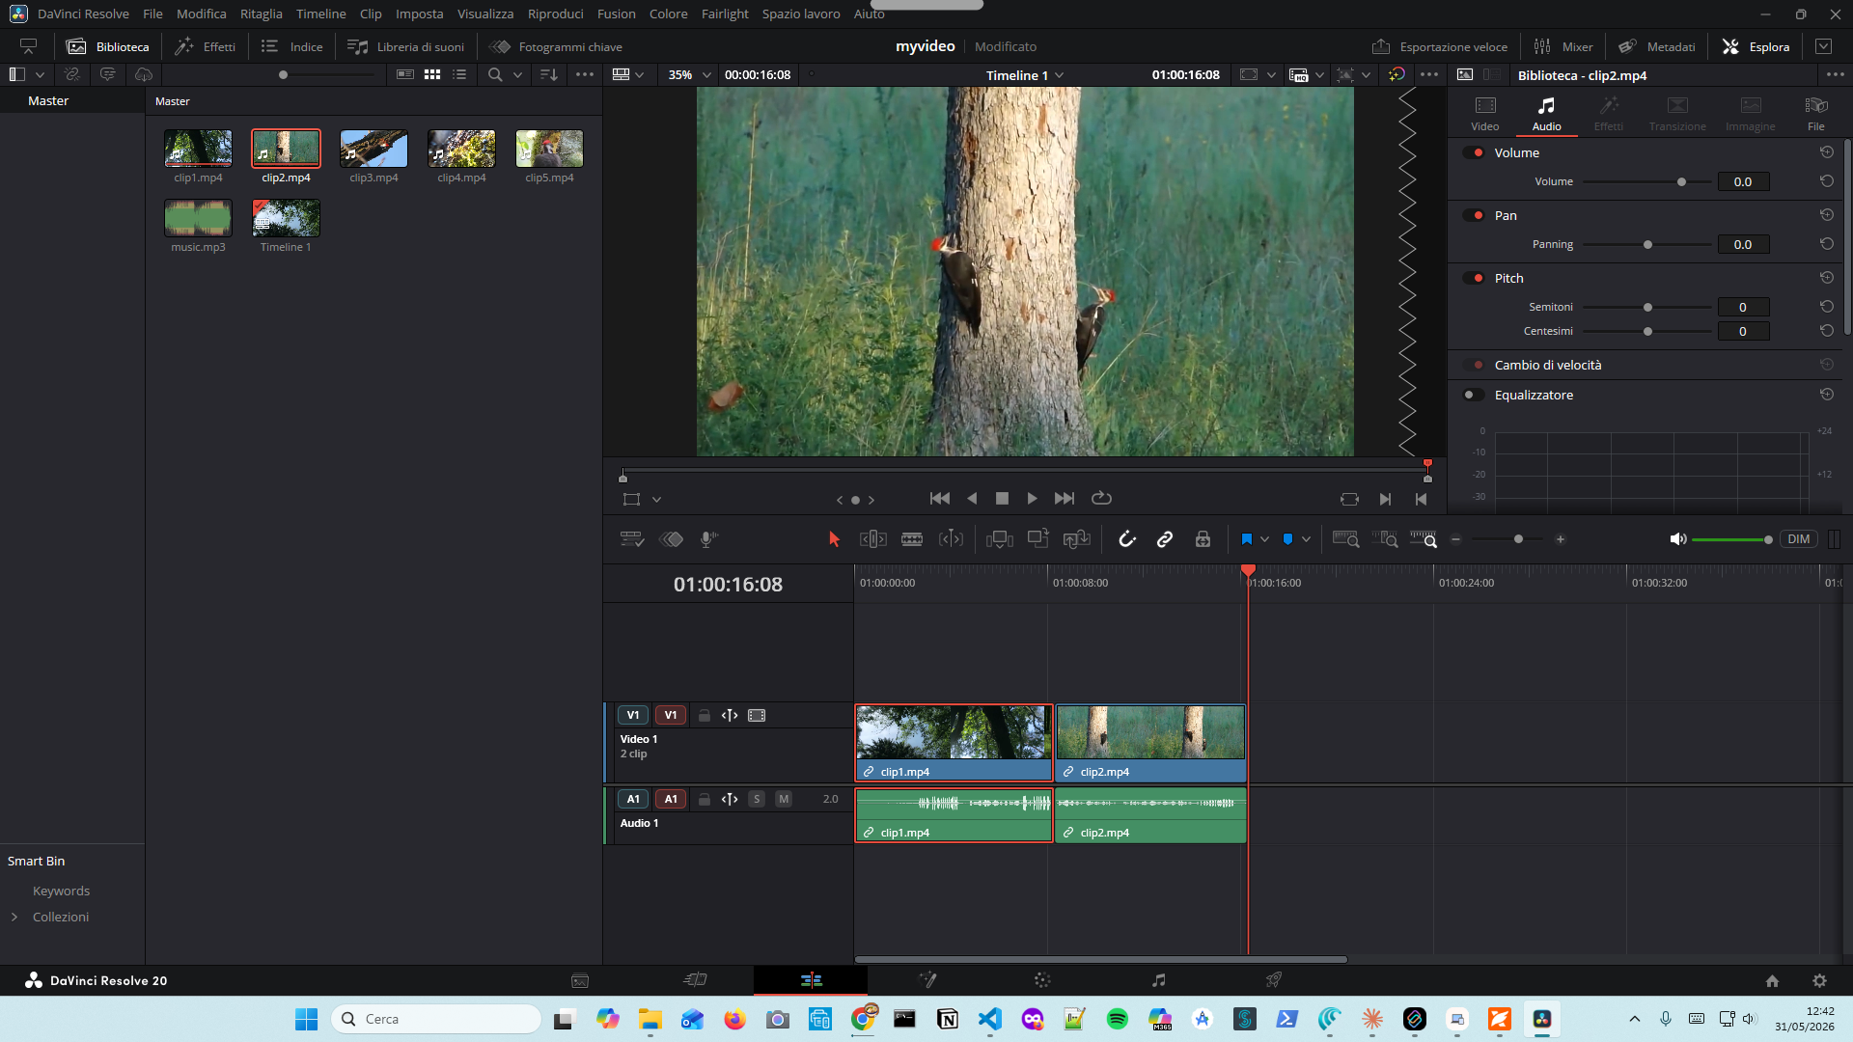
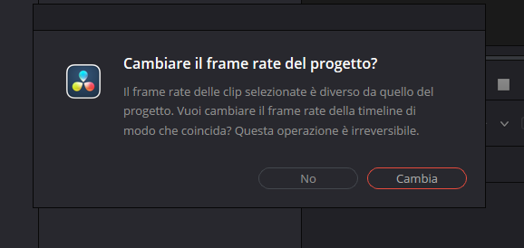
Step 4-5(Media Pool)

Slide 3
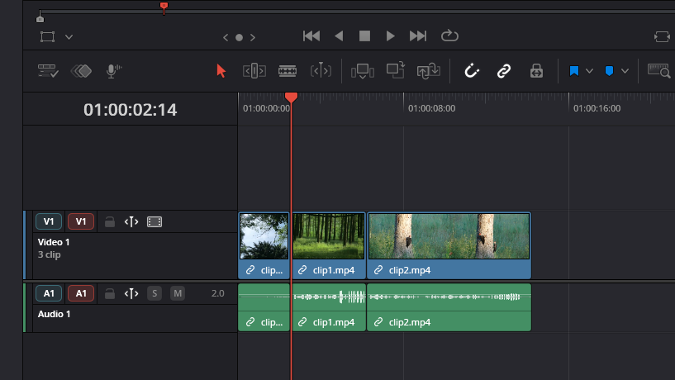
Step 6-8 (Drag – Blade Selection)

Slide 4
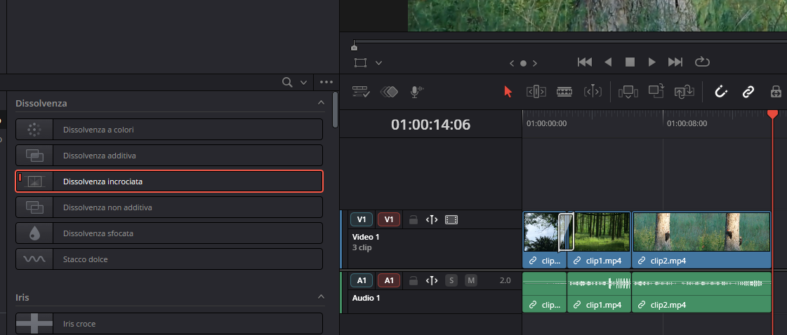
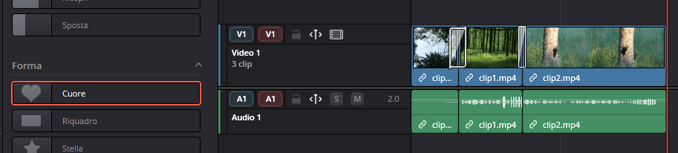
Step 9-11 (Effects-Video Transitions-Dissolve)

Slide 5
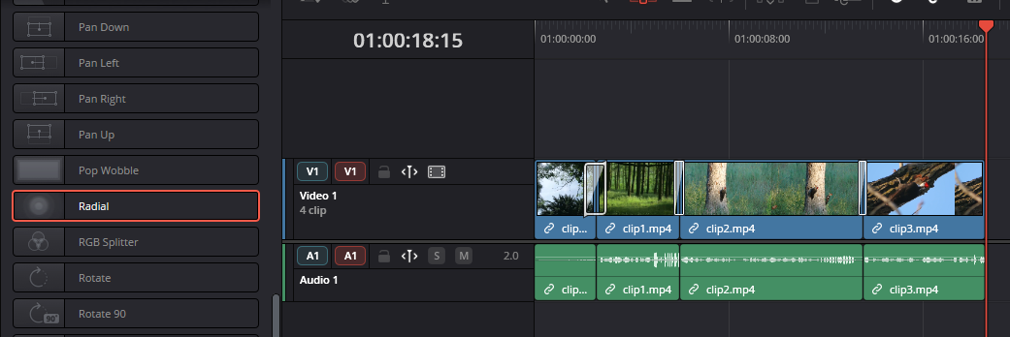
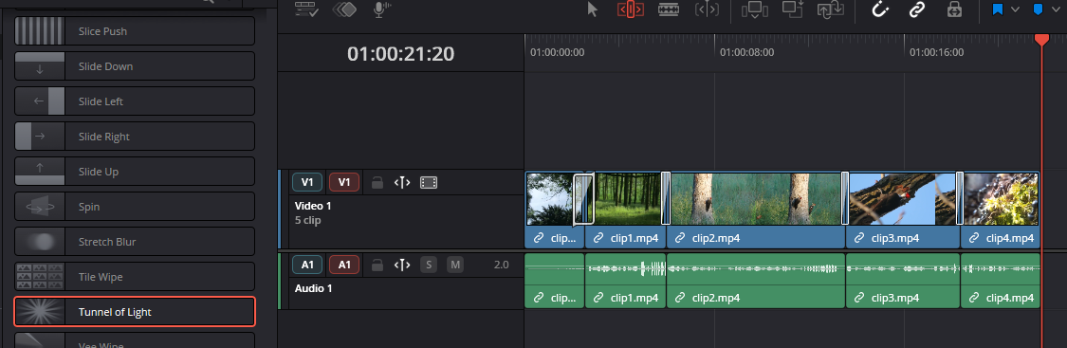
Step 12-13 (Wipe Radial – Tunnel of Light)

Slide 6
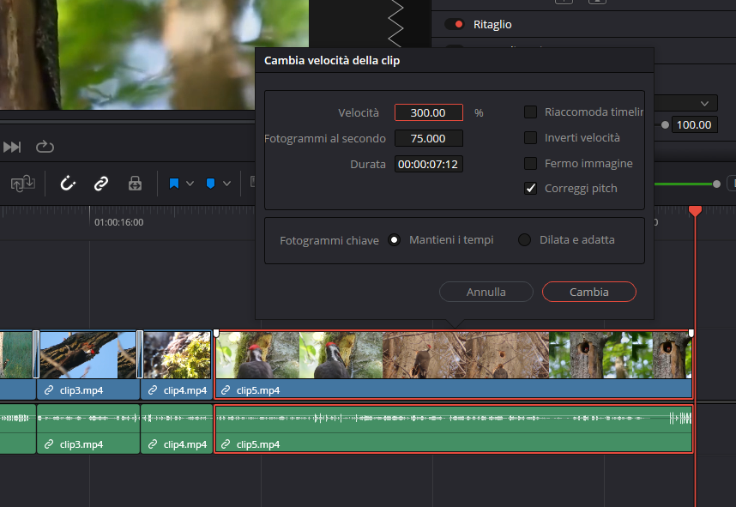
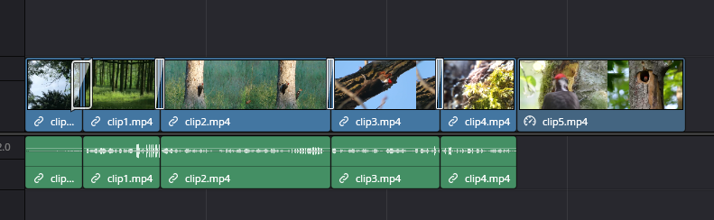
Step 14-16 (Change Clip Speed – Drag Clip)

Slide 7
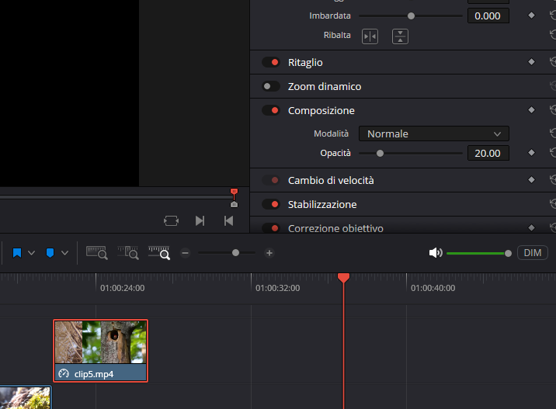
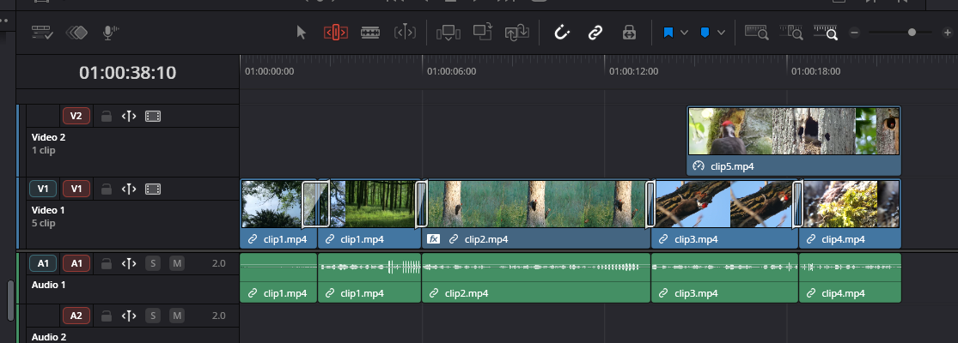
Step 17-18 (Drag - Trasparency)

Slide 8
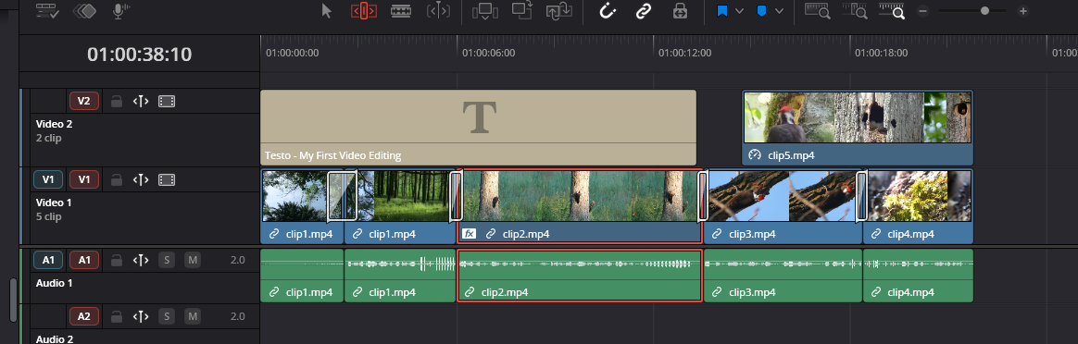
Step 19-22 (Title Text – Mosaic Blur FX)

Slide 9
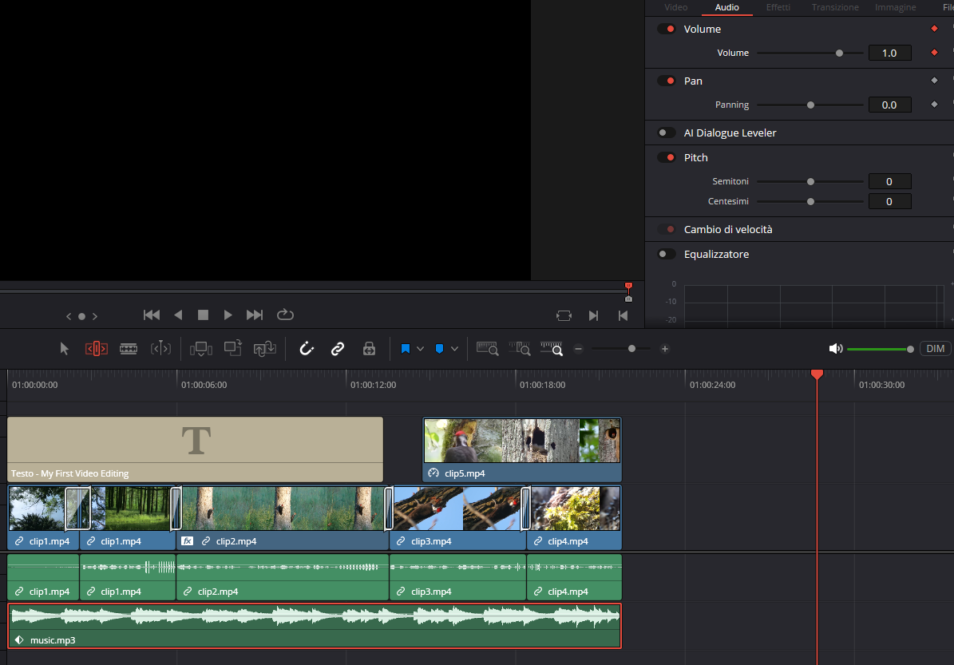
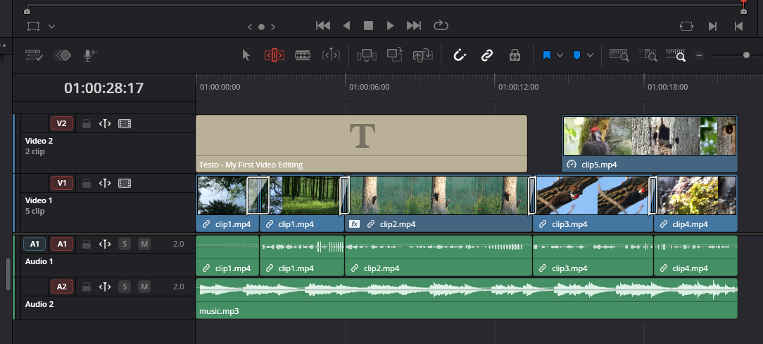
Step 23-25 (Drag music – Volume Clips)

Slide 10
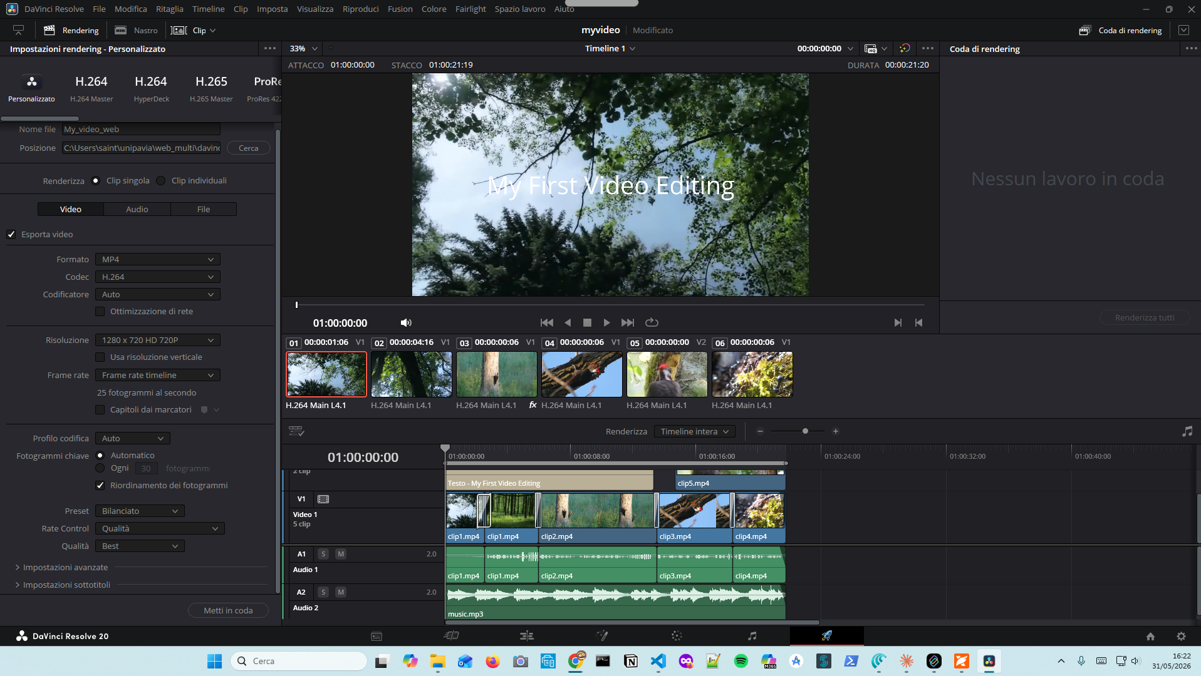
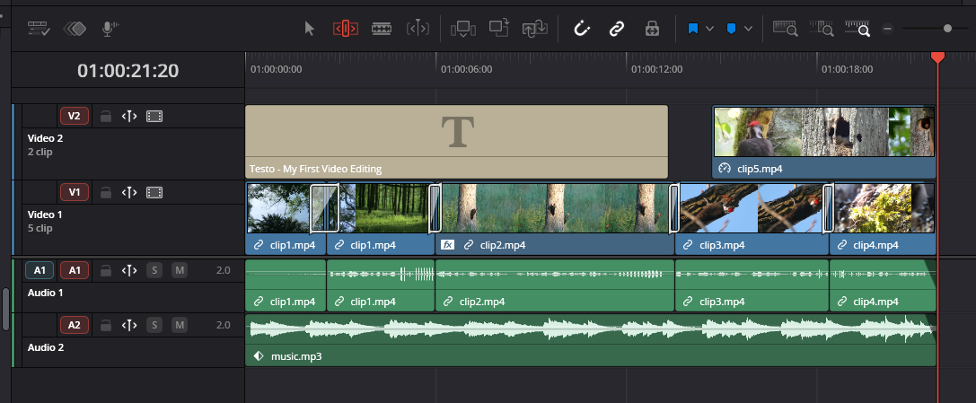
Step 26 - 27(Smooth Ending – Deliver Clip)

Slide 11
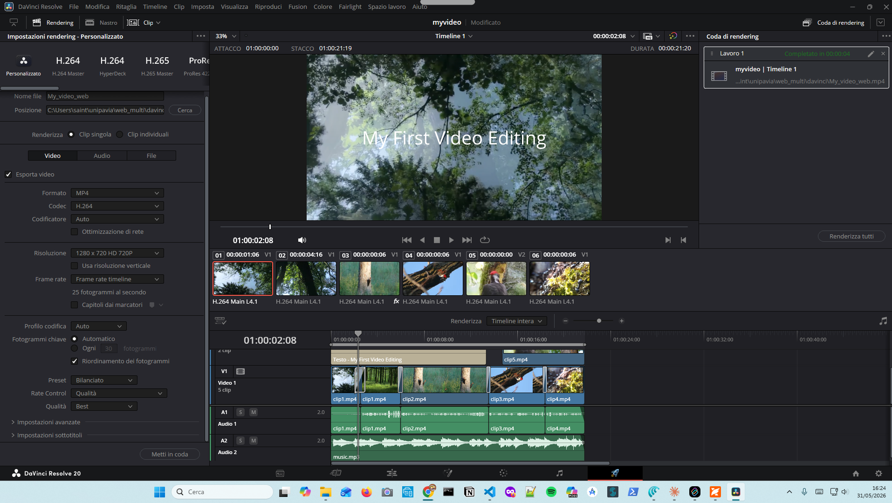
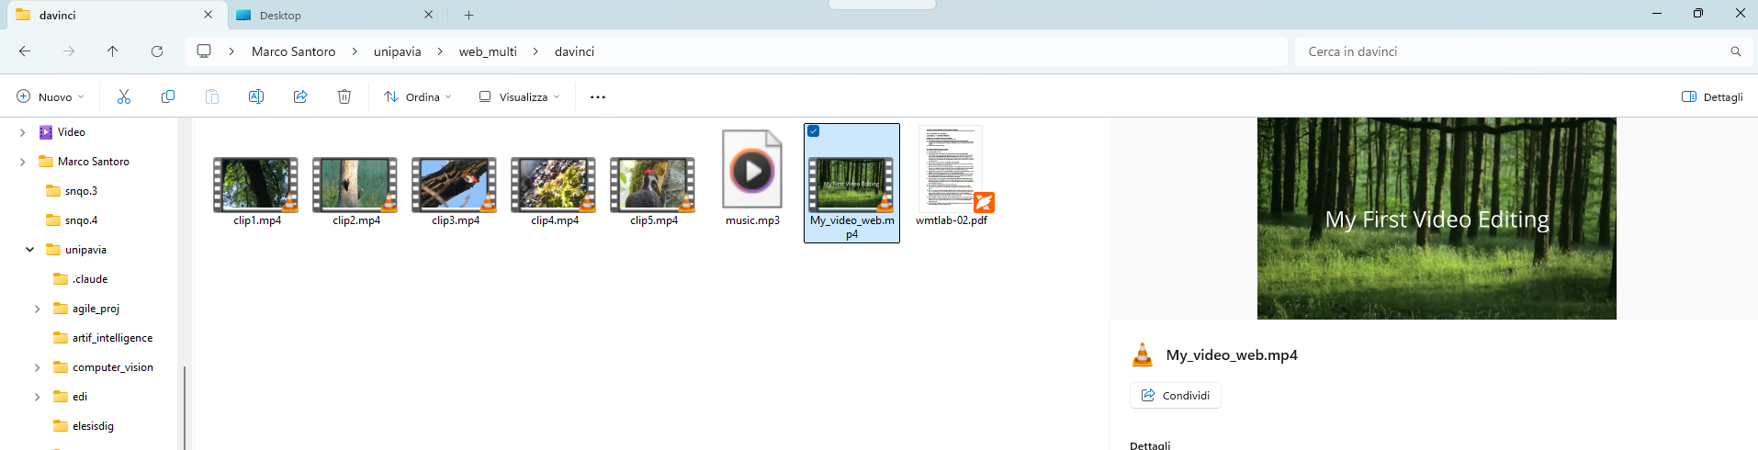
Step 28-30 (Render Settings-Render All )

