Slide 1
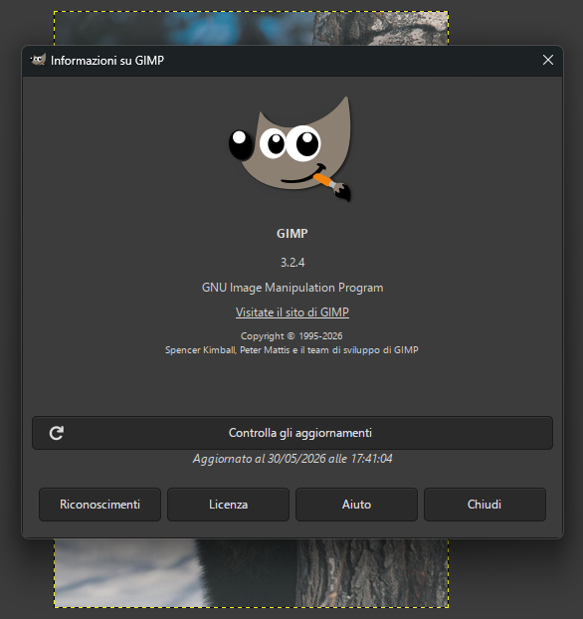
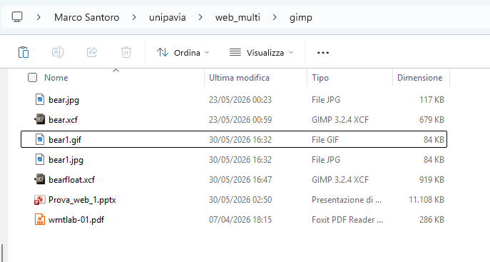
Step 1-3 (Create – Install – Open GIMP)

Slide 2
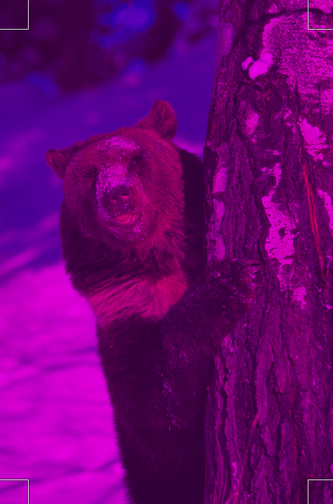
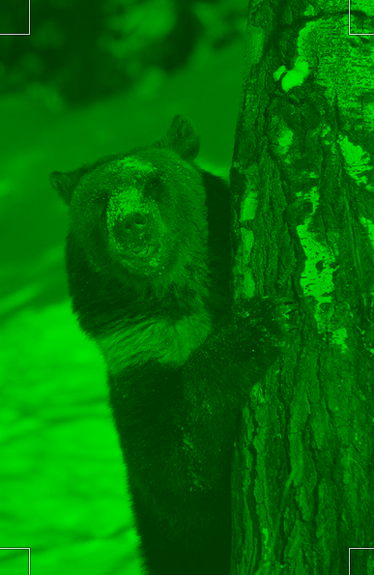
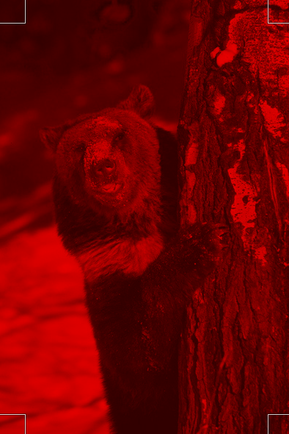
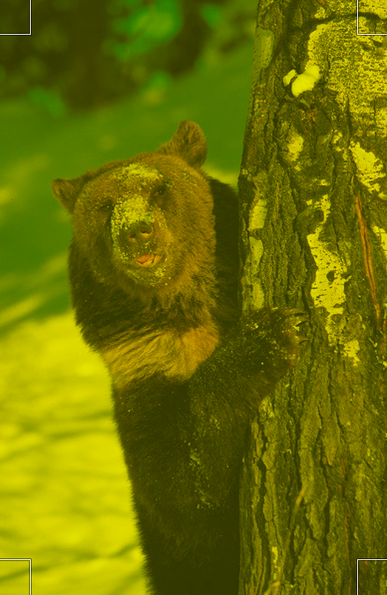
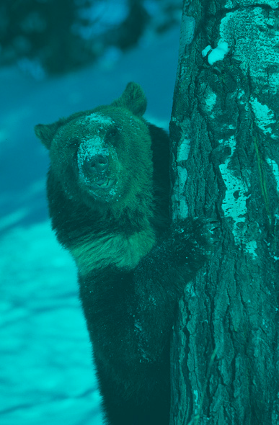
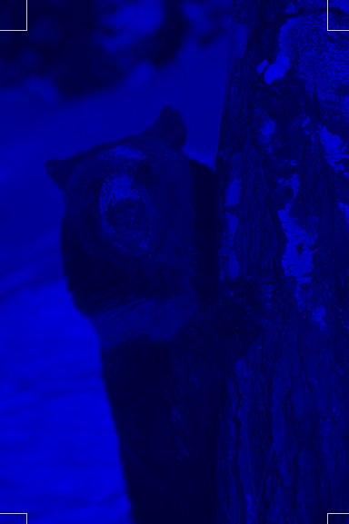
Step 4 – RGB Channels
Canale R+B
Canale G
Canale R
Canale R+G
Canale B+G
Canale B

Slide 3
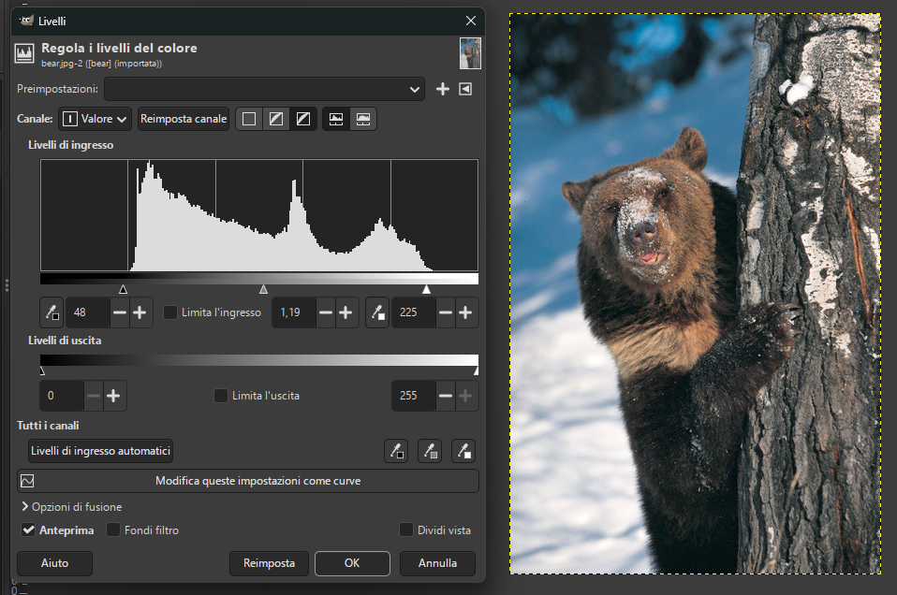
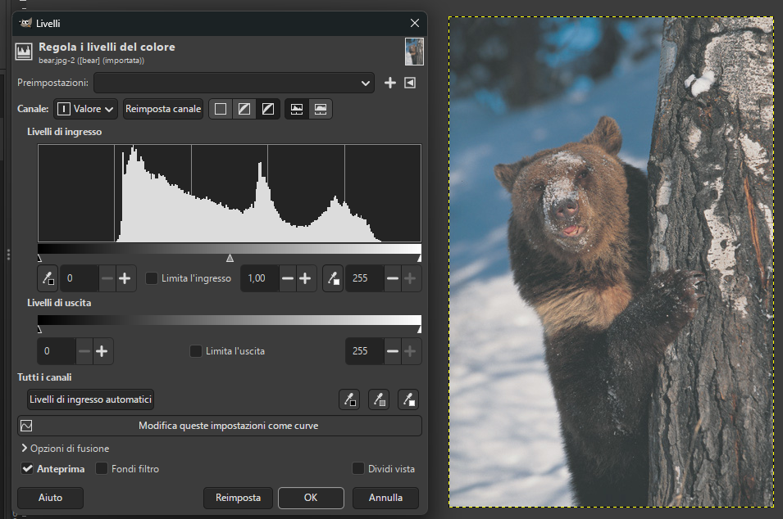
Step 5 (colors-Level)

Slide 4
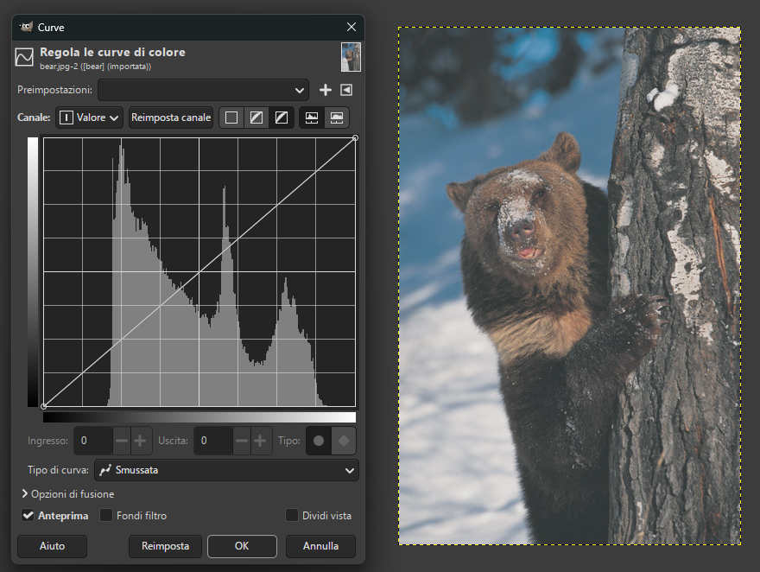
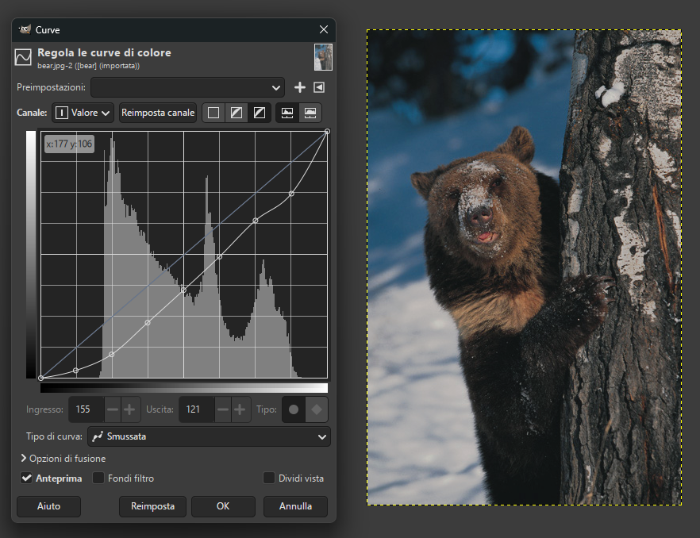
Steps 6 -7 (Colors – Curves)

Slide 5
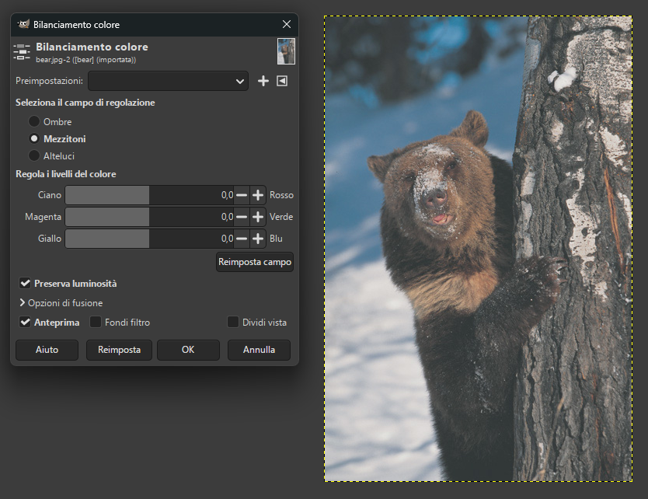
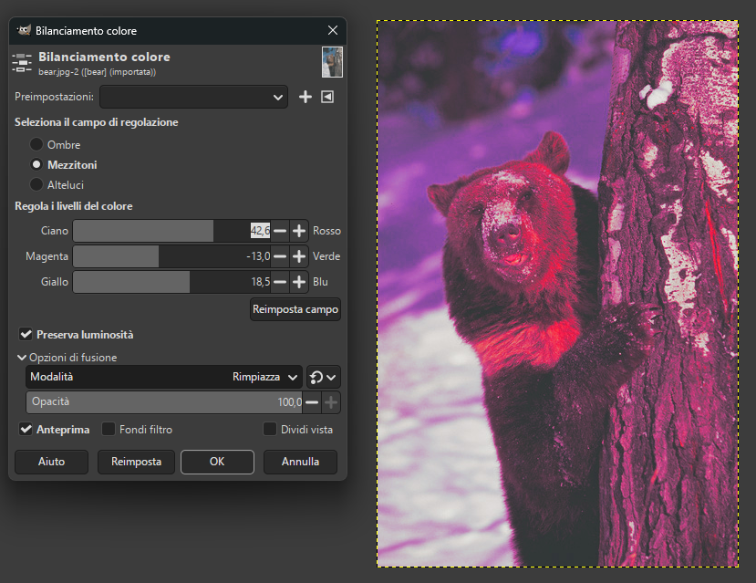
Step 8 (Colors – Color Balance)

Slide 6
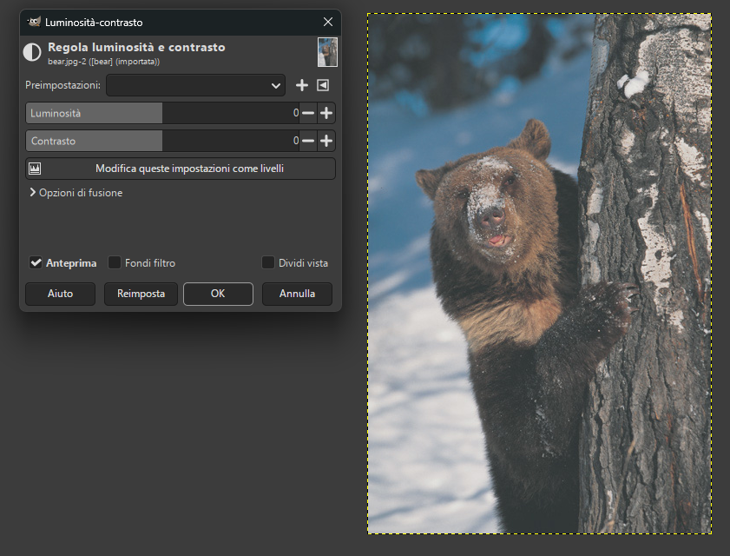
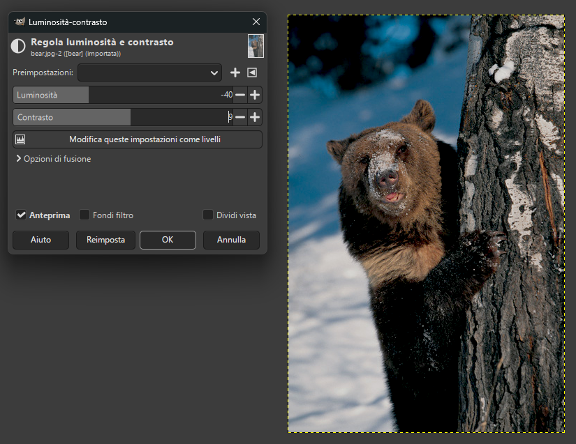
Step 9 (Colors – Brightness Contrast)

Slide 7
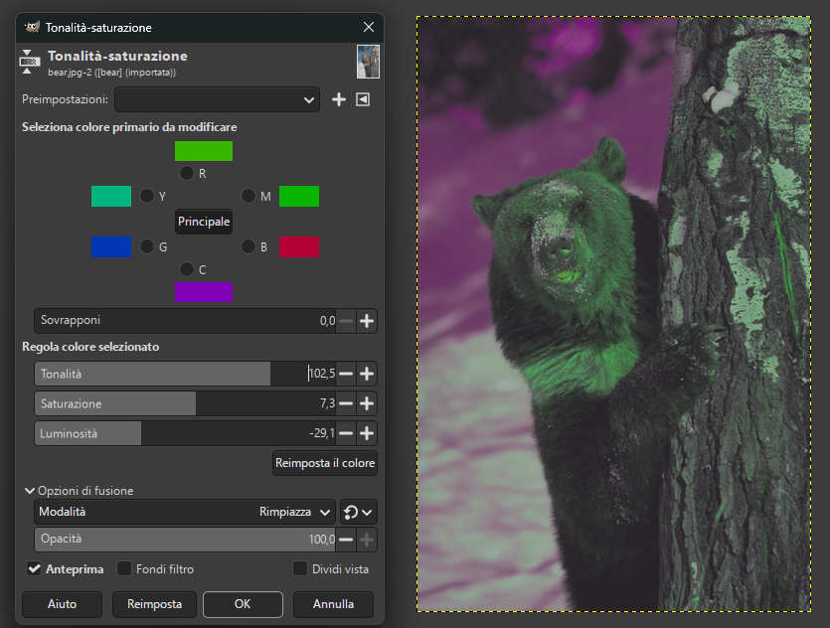
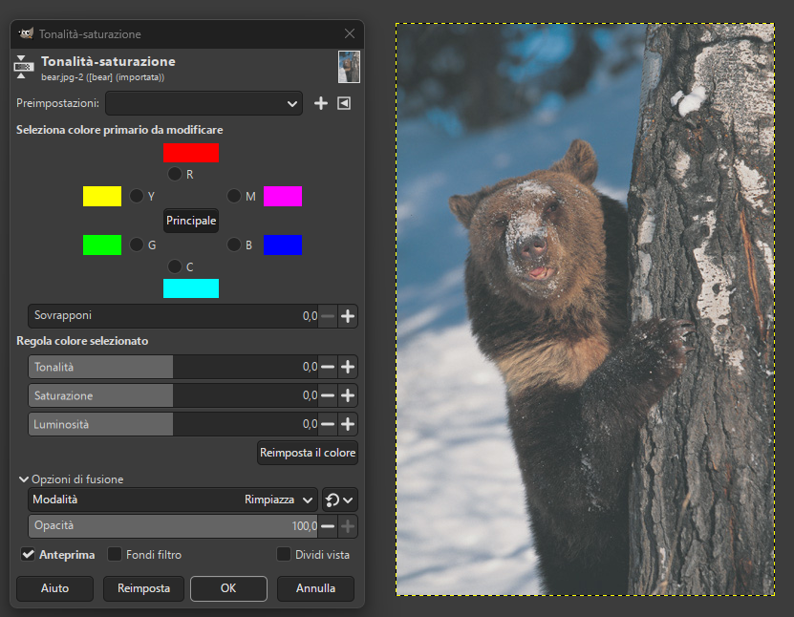
Step 10 (Colors – Hue-Saturation)

Slide 8
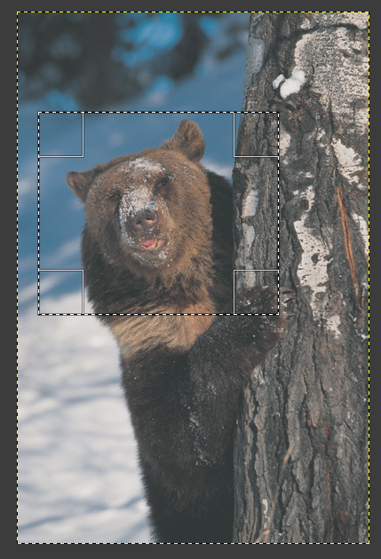
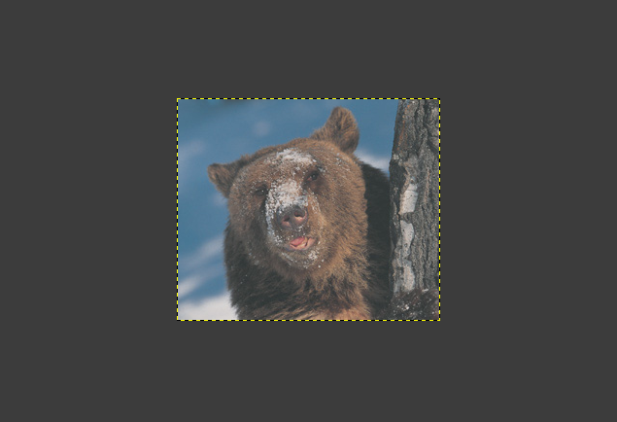
Step 11-12-13 (Rectangle Selection Tool)

Slide 9
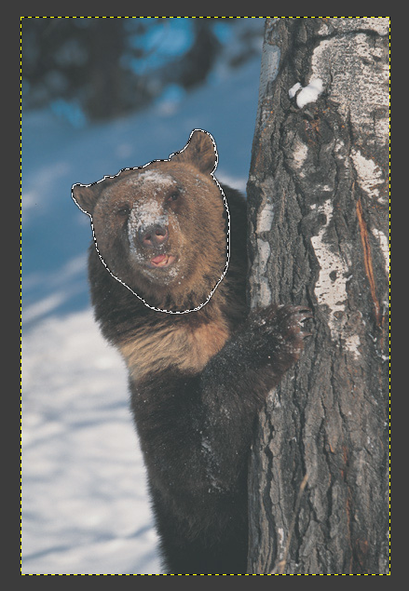
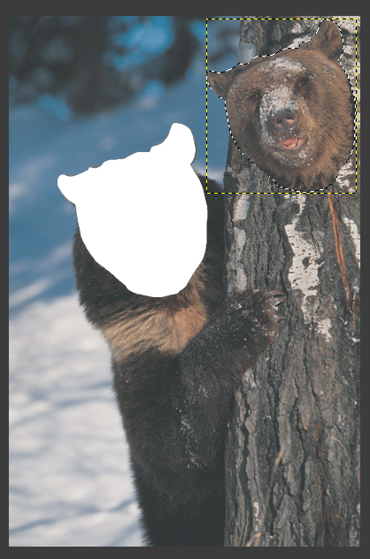
Step 14-15 (Free Select Tool - Float)

Slide 10
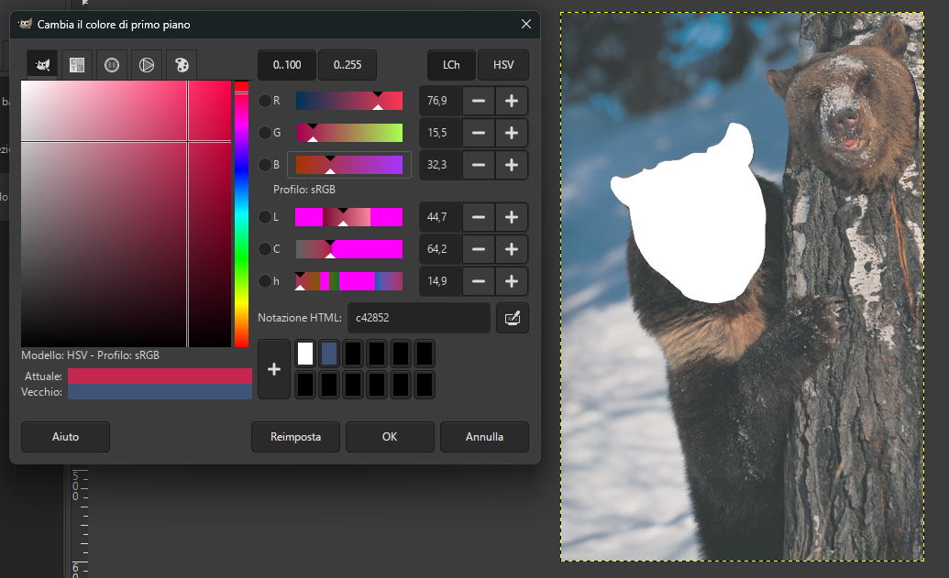
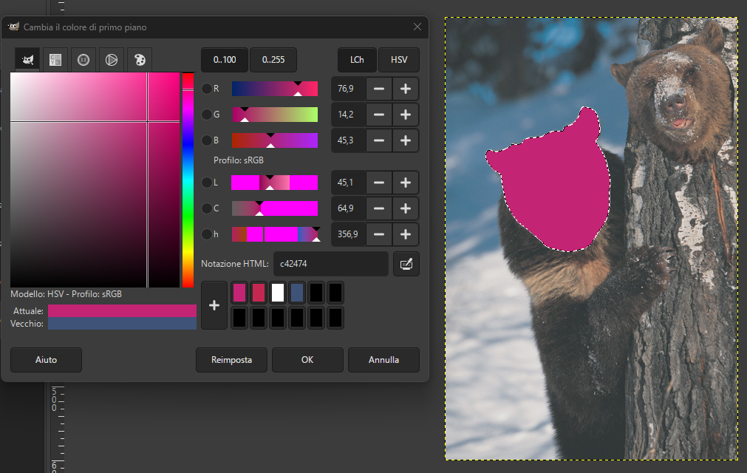
Step 16-17 (Change Foreground Color – Bucket Fill Tool)

Slide 11


Step 18-19 (Painbrush Tool – Eraser Tool)

Slide 12
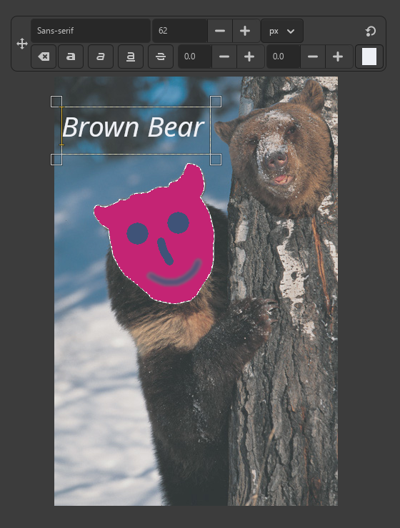

Step 20-21 (Blur Sharpen Tool – Text Tool)

Slide 13

Step 22-23 (Drawing - Selection Tool)

Slide 14
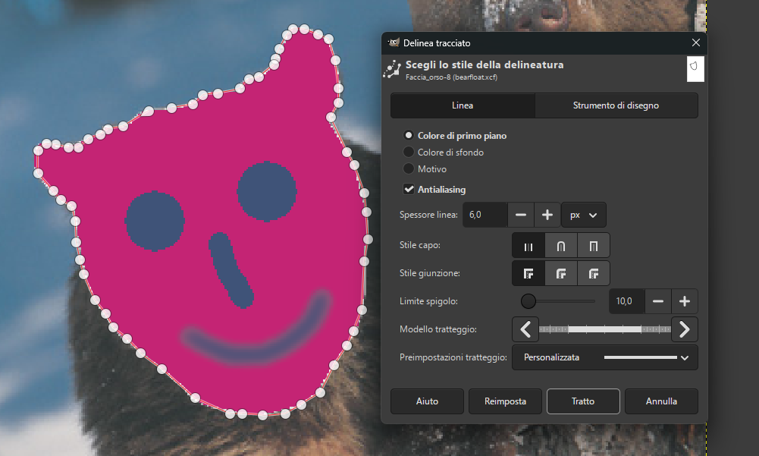
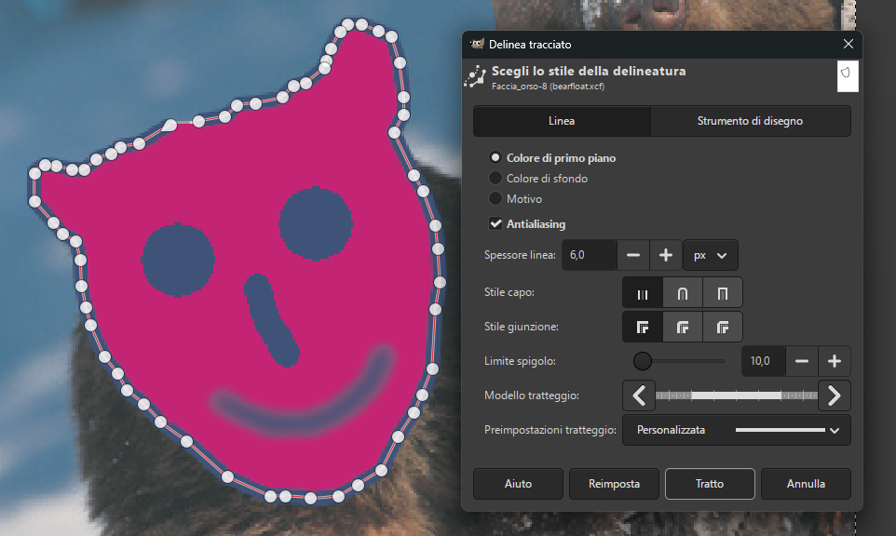
Step 24-26 (Layer – Paths Tools – Stroke Path)

Slide 15
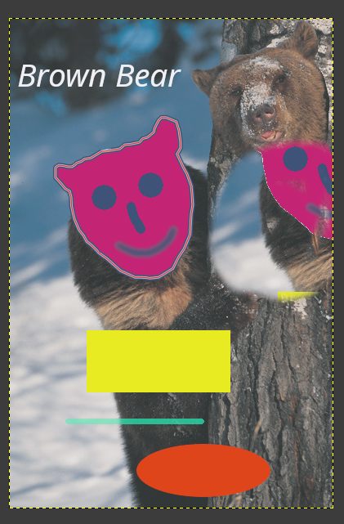
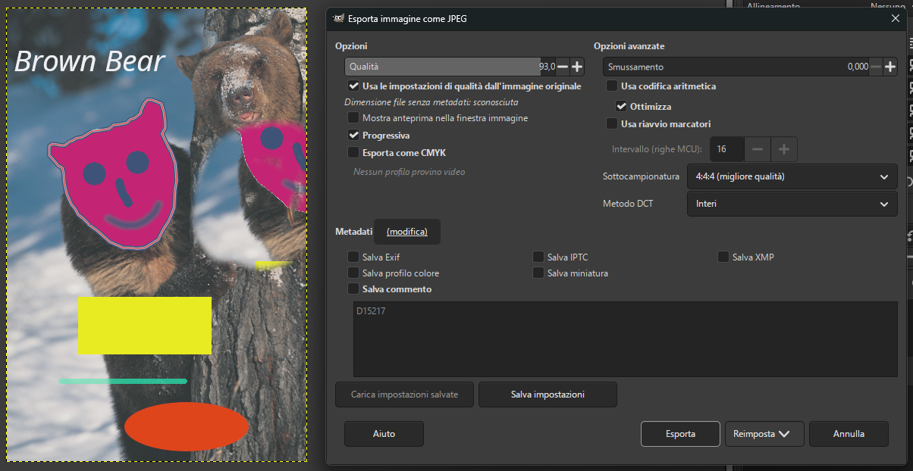
Step 27-30 (Clone Tool-Export As JPG)

Slide 16
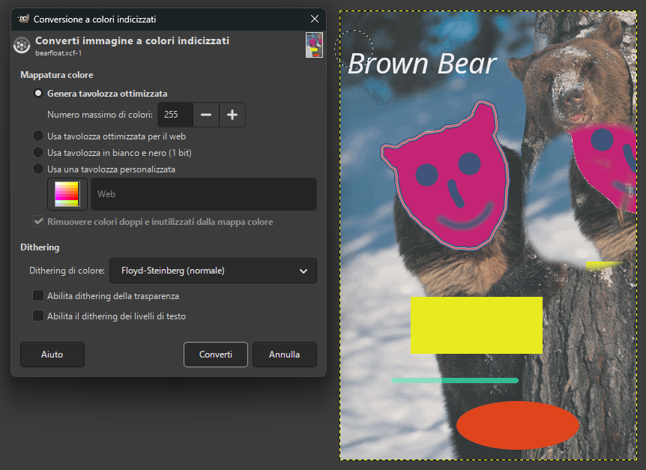
Step 31 (Indexed Colors)

Slide 17
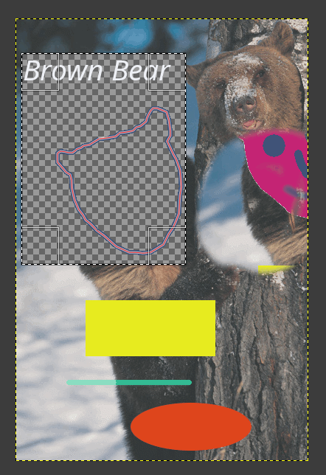
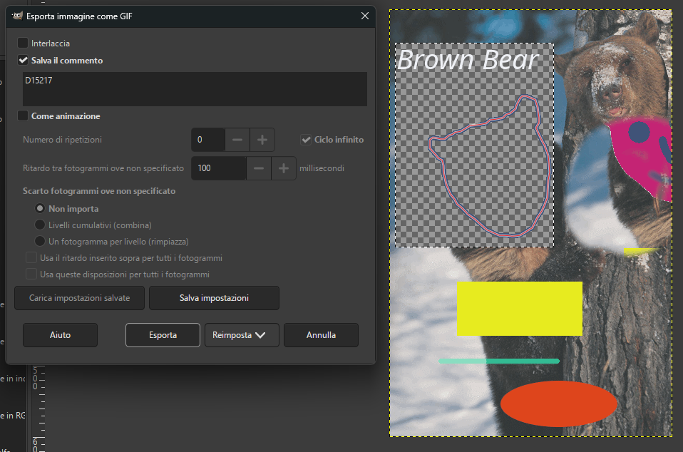
Step 32-34 (Alpha Channel-Export As Gif)

Slide 18
Step 27-30 (Clone Tool-Export As)

Slide 19
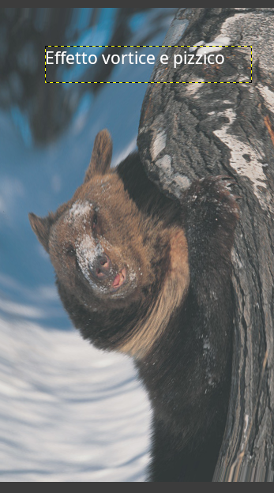
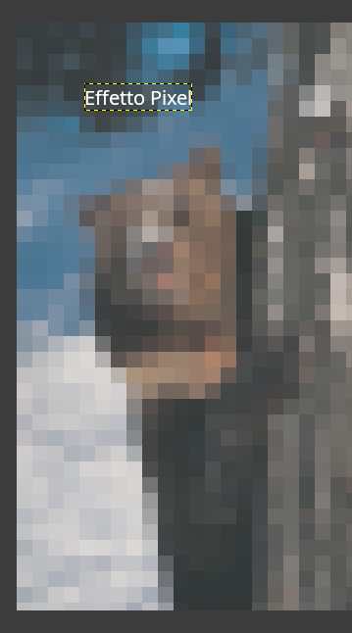
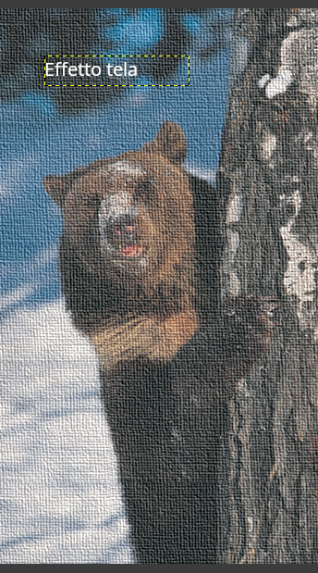
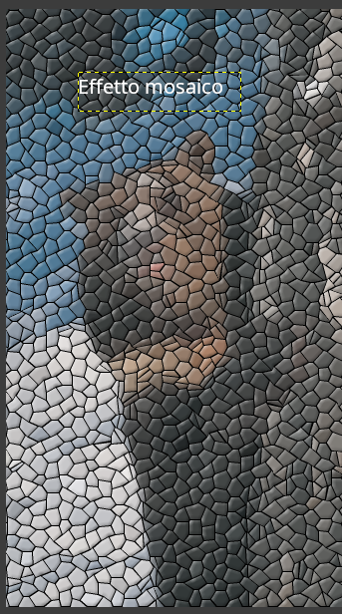
Step 35-36 (Apply Filters)

Slide 20
Thanks for your attention!
Marco Santoro
Master’s Degree – Computer Enigeering
Università di Pavia

