Slide 1
Elements of the WIMP interface

Slide 2
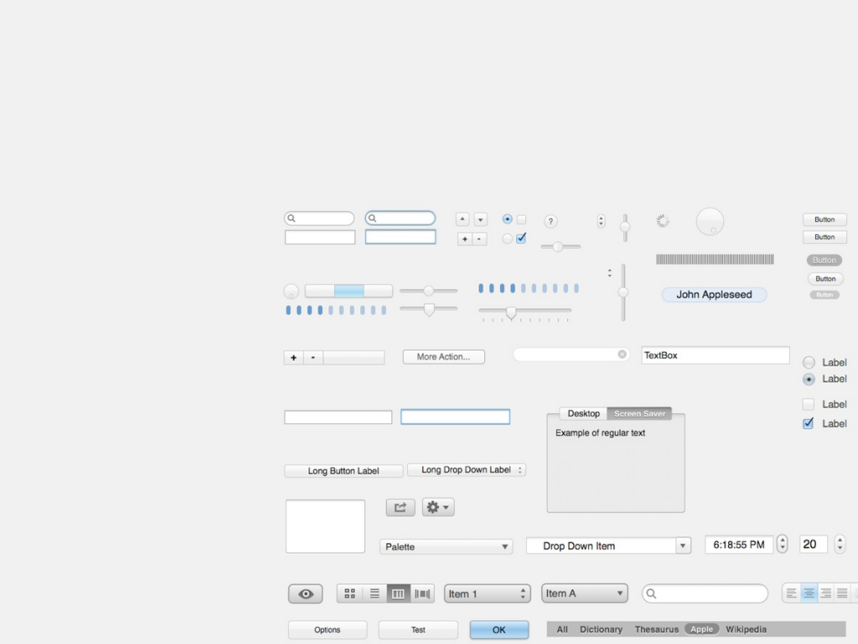
Elements of the WIMP interface
Besides windows, icons, menus, pointers .. buttons, toolbars, palettes, dialog boxes
Different toolkits offer the same set of widgets (whose aspect and behaviour can differ)

Slide 3
Windows
Areas of the screen that behave as if they were independent
can contain text or graphics
can be moved or resized
can overlap and obscure each other, or can be laid out next to one another (tiled)
scrollbars
allow the user to move the contents of the window up and down or from side to side
title bars
describe the name of the window
Notes:
The fact that they are visible simultaneously allows you to carry out separate tasks at the same time

Slide 4
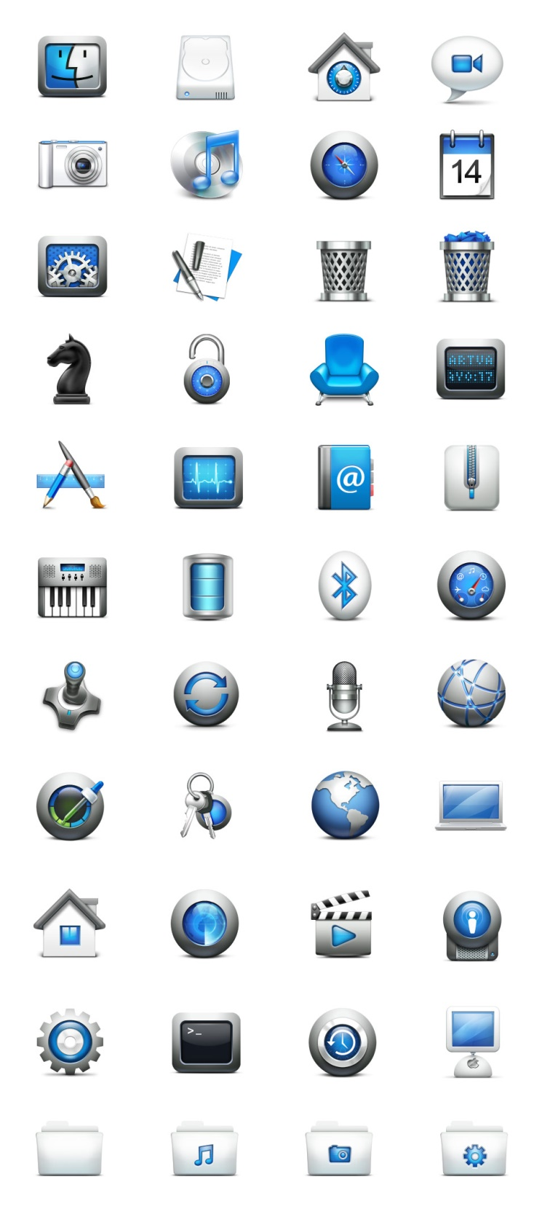
Icons
small picture or image
represents some object in the interface
- often a window or action
windows can be closed down (iconized)
- many accessible windows
icons can be many and various
- highly stylized
- realistic representations.

Slide 5

Icons advantages
With respect to textual representations
allow a faster and more precise recognition
require less space
work (not always) with different languages and cultures
.. but they need to be properly designed in order not to confuse the user

Slide 6
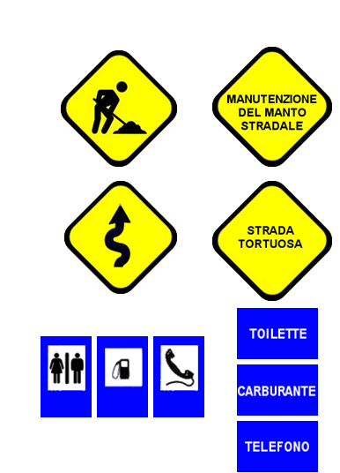
Use icons when..
quick and accurate recognition of a message is necessary (e.g., warnings).
displaying visual or spatial concepts (e.g., augmented signage).
the user (e.g. a driver) will be performing a visual search of alternatives.
continues…
YES NO

Slide 7

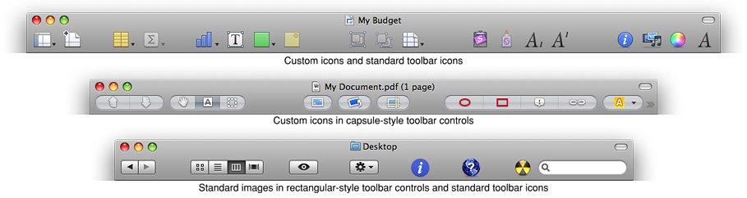
Use icons when..
one already exists and has a generally accepted meaning.
the amount of space on the display is limited and presenting the information textually will take up more space than is available.

Slide 8



Types of visual icons
Image-related: highly pictorial representations of the object or act they represent (directly comprehended, use wherever possible)
Concept-related: are based on an example or property of a real object or action (use if the user can be expected to comprehend the context in which the icon is presented)
Arbitrary: become meaningful only through convention and education (can be difficult to recognize, hard to learn, and hard to remember). They should only be used if both context and special knowledge are present.

Slide 9
Tips for designing icons 1/2 Apple Human Interface Guidelines
For great-looking icons, have a professional graphic designer create them.
Perspective and shadows are the most important components of making good icons. Use a single light source with the light coming from above the icon.
Use universal imagery that people will easily recognize. Avoid focusing on a secondary aspect of an element. For example, for a mail icon, a rural mailbox would be less recognizable than a postage stamp.
Strive for simplicity. Try to use a single object that captures the icon’s action or represents the control. Start with a basic shape.

Slide 10
Tips for designing icons 2/2 Apple Human Interface Guidelines
Use color judiciously to help the icon tell its story; don’t add color just to make the icon more colorful. Smooth gradients typically work better than sharp delineations of color.
Don’t use replicas of Apple hardware products in your icons. These symbols are copyrighted, and hardware designs change frequently.
Don’t reuse Mac OS X system icons in your interface; it can be confusing to users to see the same icon used to mean slightly different things in multiple locations.

Slide 11

Pointers
Important component (WIMP style relies on pointing and selecting things)
Use mouse, trackpad, joystick, trackball, cursor keys or keyboard shortcuts
Wide variety of graphical images to - distinguish different operating modes - inform about the status of the system - indicate sensible areas (e.g. links)

Slide 12
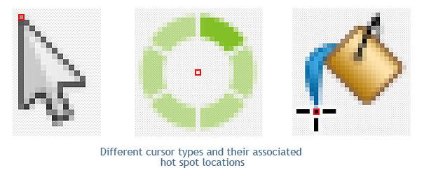
Pointers
The active zone (usually the tip of the arrow) must be clearly identified

Slide 13
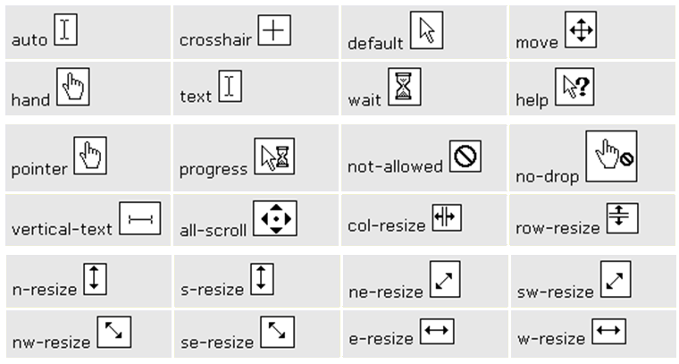
Cursors and CSS
<a href="hci.html“ style="cursor:crosshair">crosshair</a>

Slide 14
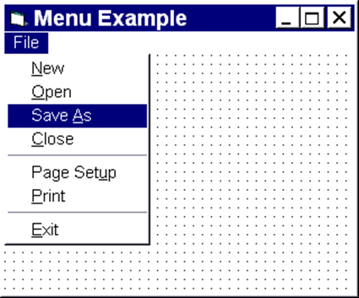
Menus
Choice of operations or services offered on the screen Required option selected with pointer
Problem – take a lot of screen space
Solution – pop-up: menu appears when needed

Slide 15
Menus
Conventions and guidelines: - place top-left (more variety within web sites) - feedback (color change), - greyed items.. - chunking (with separators)
Notes:
The selectable element must provide feedback (change color ...) when you hover over it. Elements that cannot be selected must be recognizable.

Slide 16
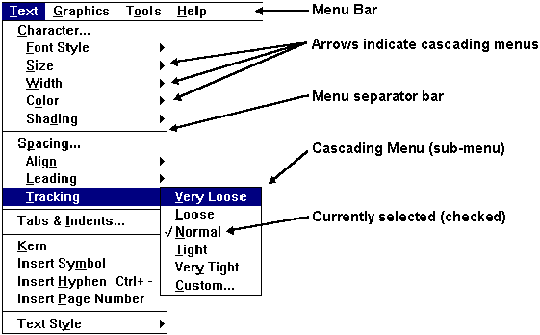
Menus
Menus are not effective when they contain too many items.. therefore… sub-menus
Cascading menus are difficult to use when the entry is very long and it is difficult to move the mouse horizontally.

Slide 17
Kinds of Menus
Menu Bar at top of screen (normally), menu drags down pull-down menu - mouse hold and drag down menu drop-down menu - mouse click reveals menu fall-down menus - mouse just moves over bar!

Slide 18
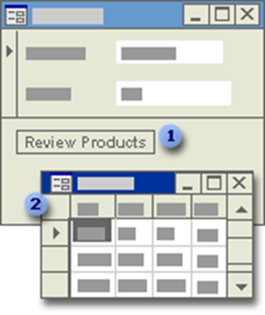
Kinds of Menus
Contextual menu - appears where you are - pop-up menus with actions for selected object
You can also create a pop-up form to display information to a user or to prompt a user for data.
Notes:
You can create a pop-up form to display information to a user or to prompt a user for data.
A pop-up form stays on top of other open forms, even when another form is active.
A pop-up form can be modeless or modal.
A modal pop-up form is called a custom dialog box.
When a pop-up form is modeless, you can access other objects and menu commands while the form is open.

Slide 19
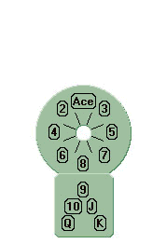
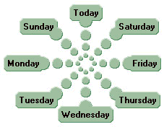
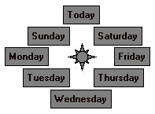
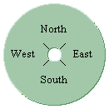
Pie-Menus
Arranged in a circle: the cursor starts out in the center of the pie.
Easier to select item (larger target area) therefore.. low error tate
Quicker (same distance to any option) … but not widely used (space needed)
Notes:
The cursor starts out in the center of the pie, so all targets are large, nearby, and in different directions.
Fitts' Law explains the advantages of pie menus, relating their fast selection speed and low error rate to their large target size and small distance.
Pie menus are easy for novice users, who just follow the directions,
and efficient for experienced users, who can quickly "mouse ahead" once they know the way.

Slide 20
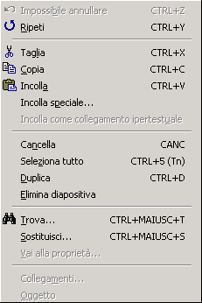
Keyboard accelerators
Short-cut keys can reduce the number of interactions for a given task
Two kinds: - active when menu open usually first letter - active when menu closed usually Ctrl + letter
Ideal maximum: 2 keys (+)
Not usable with cascading menus
Icons to.. familiarize
Notes:
Users who work with one application all the time are willing to invest time to learn short cuts
They begin to lose patience with long menu sequences when they know exactly what they want to do
Short-cut keys can reduce the number of interactions for a given task
Designers can provide macro facilities for users to create their own short-cuts
The purpose of the icon that appears next to some items is to familiarize the user with the meaning of the icon.

Slide 21
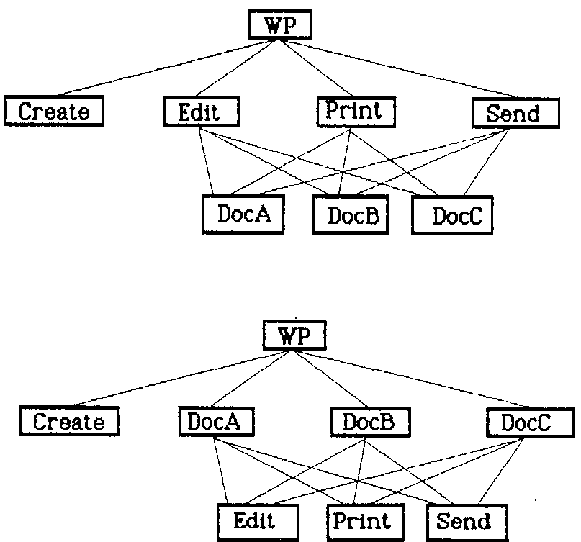
Menus design issues
which kind to use
what to include in menus at all
words to use (action or description) (make item brief; begin with keyword; use consistent grammar, layout, terminology)
how to group items
choice of keyboard accelerators
order (frequency, sequence, separate opposite functions)

Slide 22

Buttons
Individual and isolated regions within a display that can be selected to invoke an action, to change the status or to select options within a form
They may provide a feedback on the status of the sytem
Special kinds - radio buttons (set of mutually exclusive choices) - check boxes (set of non-exclusive choices)
Notes:
A radiobutton cannot be deselected if it is not connected to other radiobuttons!

Slide 23
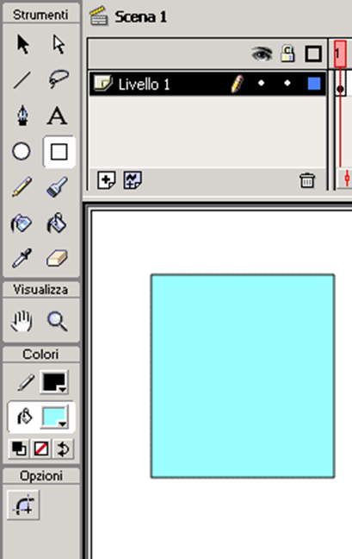
Palettes (and tear-off menus )
Problem: menu not there when you want it. Solution: palettes – little windows of actions
Shown / hidden via menu option (e.g. available shapes in drawing package)
Tear-off and pin-up menus: menu ‘tears off’ to become palette

Slide 24
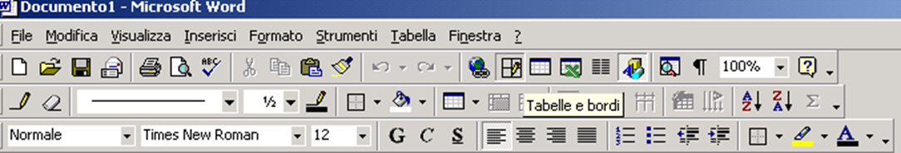
Toolbars
Long lines of icons…
Fast access to common actions
Often customizable: choose which toolbars to see choose what options are on it
tooltip

Slide 25
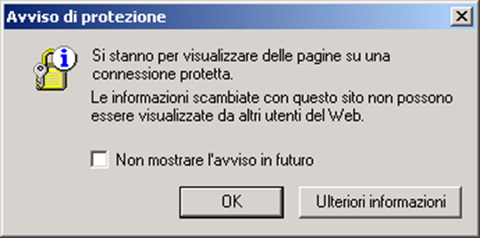
Dialogue boxes
Information windows that pop up to inform of an important event or request information.. and once used.. disappear
E.g: when saving a file, a dialogue box is displayed to allow the user to specify the filename and location. Once the file is saved, the box disappears.
Philosophy: divide complex tasks into simpler steps

Slide 26
Look and feel
WIMP systems have the same elements (windows, icons., menus, pointers, buttons, etc.) but different window systems behave differently (e.g. MacOS vs Windows menus)
appearance + behaviour = look and feel

