Slide 1
Design: some additional notes and exercises
Notes:
Warning! You are not allowed to distribute or publish this powerpoint

Slide 2
Grids: a powerful tool for designers

Slide 3
What are grids?
In graphic design, a grid is a structure (usually two-dimensional) made up of a series of intersecting straight (vertical, horizontal, and angular) or curved lines (grid lines) used to structure content. The grid serves as an armature or framework on which a designer can organize graphic elements (images, glyphs, paragraphs, etc.) in a rational, easy-to-absorb manner. A grid can be used to organize graphic elements in relation to a page, in relation to other graphic elements on the page, or relation to other parts of the same graphic element or shape. (from Wikipedia)

Slide 4
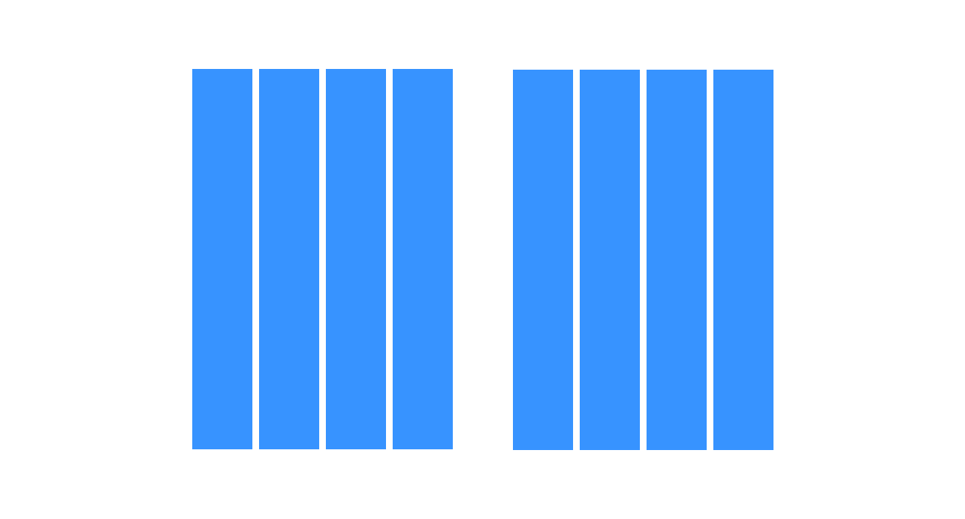
Column grid
Column grid. This is the most common type of grid used by graphic and web designers. It involves taking a page and splitting it into a number of vertical fields, which objects are then aligned to. Newspapers and magazines use column grids extensively.
Notes:
There are a lot of different types of grid, and they all serve different purposes.
Here are a couple of main examples

Slide 5

Modular grid
Modular grid. Kind of an extension of the column grid, a modular grid involves taking a column grid and adding rows to it. The intersecting rows and columns create “modules” that can then be used to govern layout decisions. Magazines and corporate reports often use modular grids.
Notes:
There are a lot of different types of grid, and they all serve different purposes.
Here are a couple of main examples

Slide 6
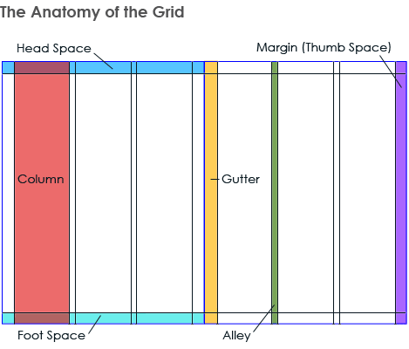
Consistency
The grids make the layout consistent across the various pages while still offering a large number of options.

Slide 7
Look at the next examples and try to understand how grids are used!

Slide 8
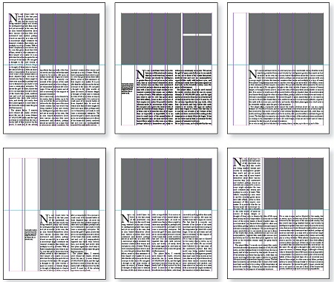
Grids Examples

Slide 9
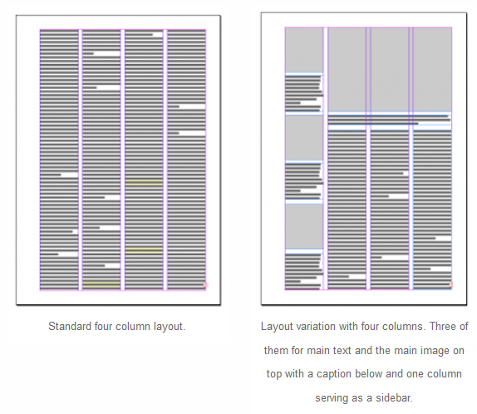
Grids Examples

Slide 10
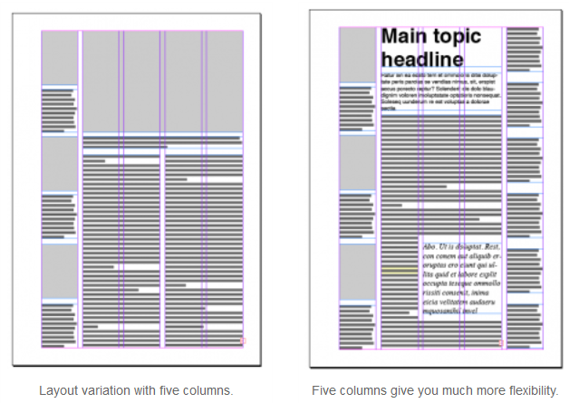
Grids Examples

Slide 11
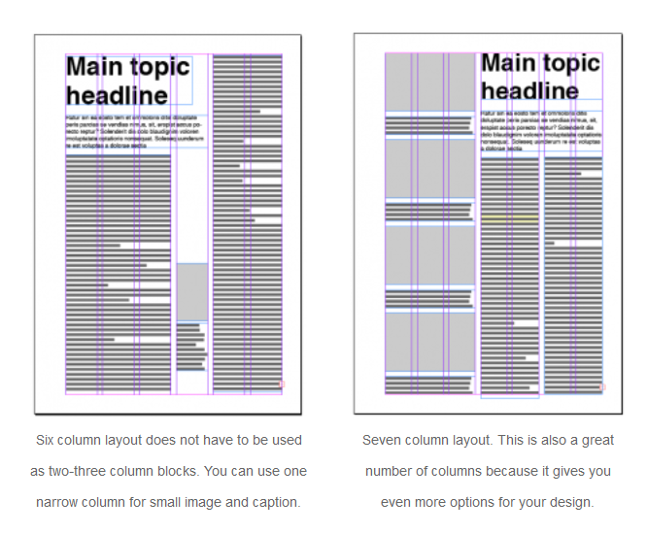
Grids Examples

Slide 12
If you are a web developer, you most likely know the Bootstrap Grid System.
Do not worry! At the exam you will not be asked to remember the code! But with the next slides, if you don't already know it, you can get an idea about it.

Slide 13
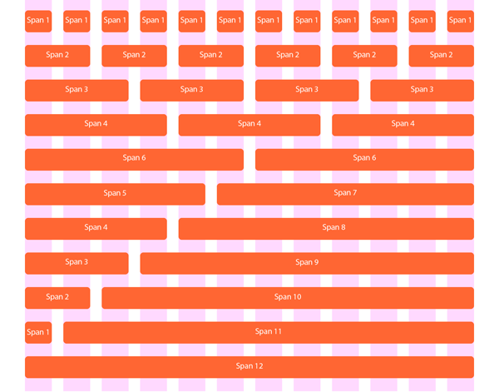
Grids for the web – Bootstrap grid system

Slide 14
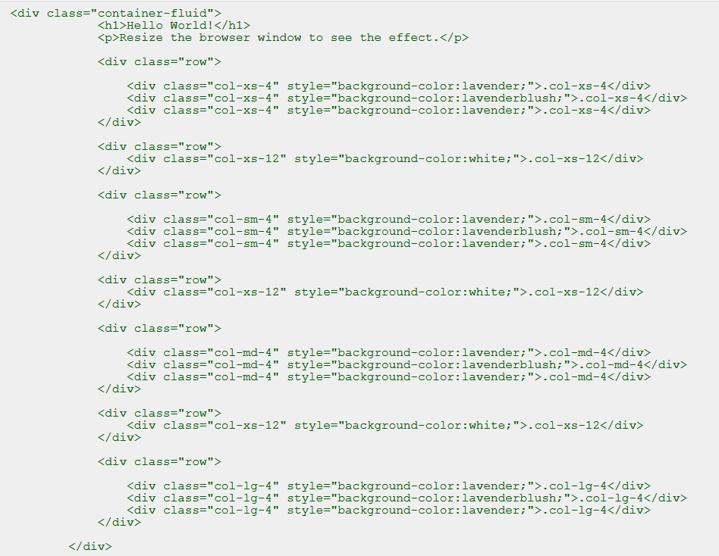
Grids for the web – Bootstrap grid system

Slide 15
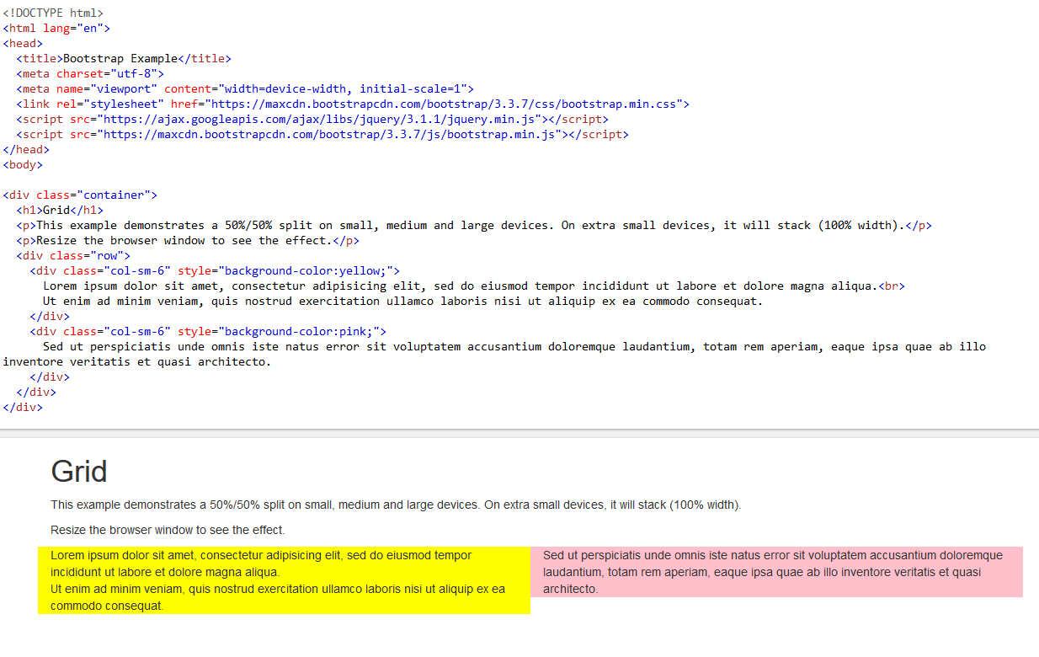
Grids for the web – Bootstrap grid system

Slide 16
A simple test about proximity

Slide 17
An example with a very long title
This is the first sentence.
This is the second sentence.
The author of this page is frightened by white space.
What is wrong within this slide?
Notes:
Which of these arrows should be the longest?

Slide 18
The same example with a new interline: multiple 0.8
This is the first sentence.
This is the second sentence.
The author of this page is no longer afraid of white spaces.
Vertical spacing = organization
Notes:
Be careful of line spacing when using large fonts

Slide 19
A test about physical controls.
What criteria have been followed in the design of the panel layout?

Slide 20
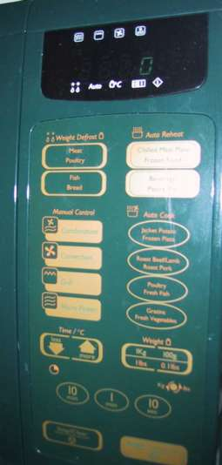
physical controls
Notes:
These slides were made by the authors of the textbook
This is microwave.
What criteria have been followed in the design of the panel layout?

Slide 21
physical controls
grouping of items
defrost settings
type of food
time to cook
defrost settings
type of food
time to cook

Slide 22
physical controls
grouping of items
order of items
type of heating
temperature
time to cook
start
1) type of heating
1
2) temperature
3) time to cook
2
4) start
3
4

Slide 23
physical controls
grouping of items
order of items
decoration *
different colours for different functions
lines around related buttons
different colours for different functions
lines around related buttons (temp up/down)
Notes:
* common region, similarity, repetition

Slide 24
physical controls
grouping of items
order of items
decoration
alignment
centered text in buttons ? easy to scan ?
centred text in buttons
? easy to scan ?

Slide 25
physical controls
grouping of items
order of items
decoration
alignment
white space *
gaps to aid grouping
gaps to aid grouping
Notes:
* proximity

Slide 26
Iteration ad prototyping.
Read section 5.8 of the textbook and try to understand what a hill-climbing approach is!

Slide 27
iteration and prototyping
getting better …
… and starting well

Slide 28
prototyping
you never get it right first time
if at first you don’t succeed …
OK?
design
prototype
evaluate
done!
re-design

Slide 29
pitfalls of prototyping
moving little by little … but to where?
1. need a good start point
2. need to understand what is wrong
Notes:
You don't have to get caught in the local peaks!
So, you have to work on multiple initial ideas.

