Slide 1
PROJECT STRUCTURE R 251102
Project structure roadmap
Step 1 From Requirements to Project Products
Step 2 From Project Products to Project Activities
Step 3 Organizing the project
Step 4 Defining project work packages
Step 5 Timelining the project
Step 6 Setting the milestones
Summary
Assignment
Appendix

Slide 2
Project structure roadmap
In whatever approach, a project should be structured
Key structural elements include:
Project organization, which defines the roles in the project
Project milestones, which define when decisions go/stop will be made
Project activities which identify the project life cycles in software development, infrastructure, and organization
Project products and deliverables
Project work packages which define the assignments to project teams
These structural elements are needed to manage the project
The project work packages (which realize the project lifecycle) can be run according a variety of approaches: Incremental, Predictive. Hybrid
This section illustrates a roadmap to create the project structure

Slide 3
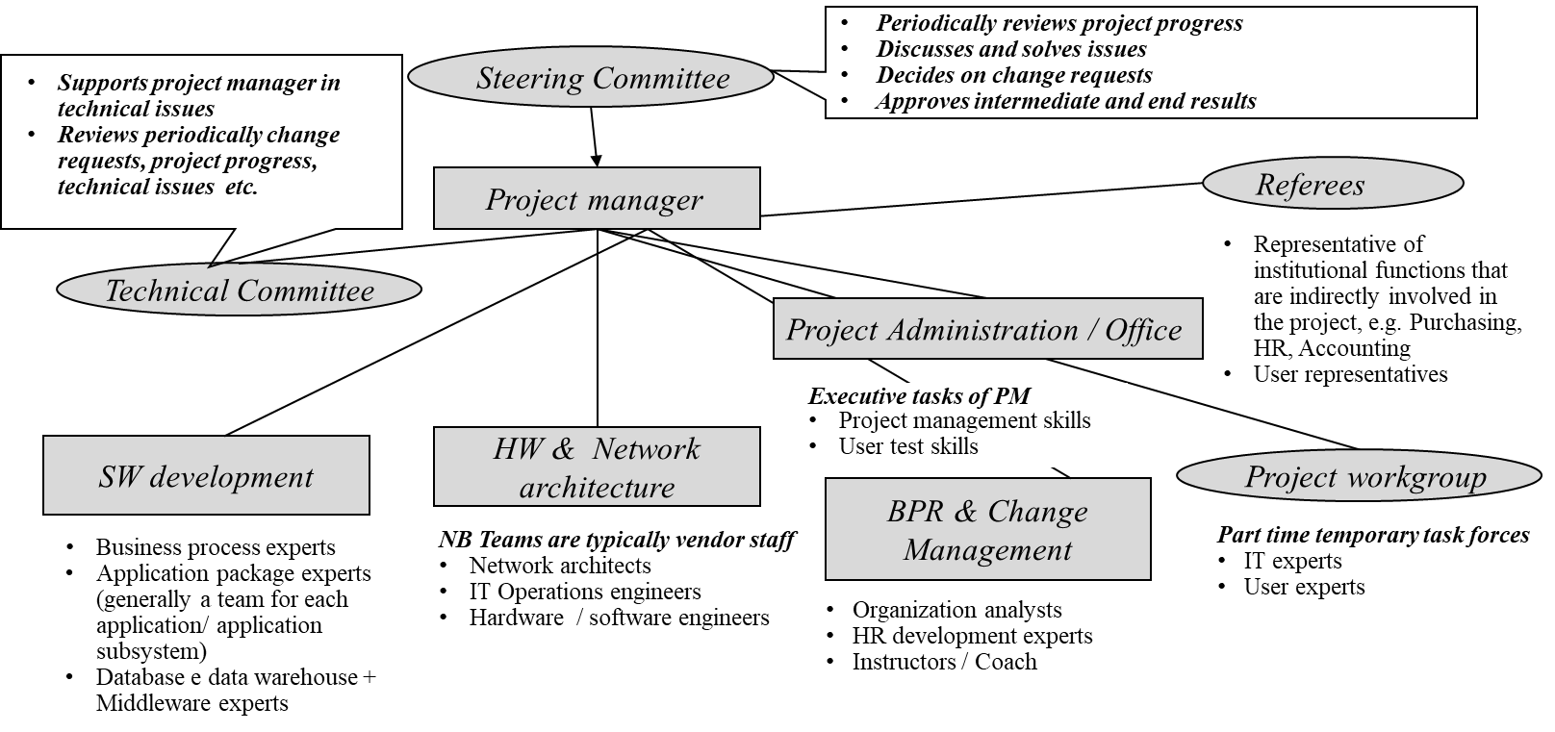
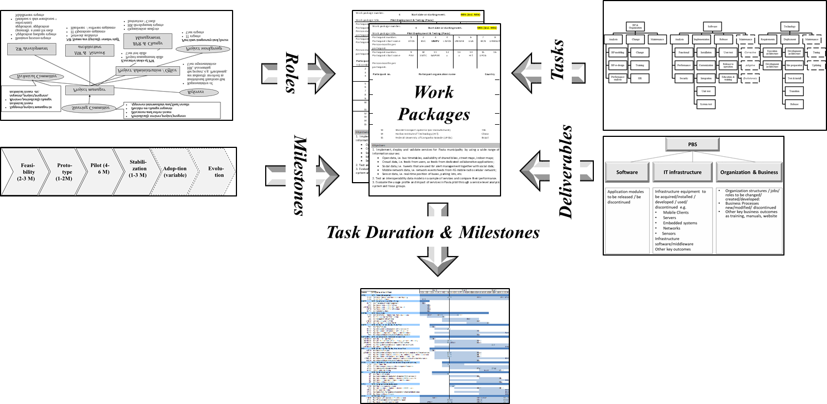
Project Structure Roadmap
Organization
Activities
Milestones
Products /deliverables
In our roadmap, Gantt/PERT is the final step of the project structure
In our roadmap, Gantt/PERT is the final step of the project structure
Gantt/PERT

Slide 4
PROJECT STRUCTURE
Project structure roadmap
Step 1 From Requirements to Project Products
Step 2 From Project Products to Project Activities
Step 3 Organizing the project
Step 4 Defining project work packages
Step 5 Timelining the project
Step 6 Setting the milestones
Summary
Assignment
Appendix

Slide 5
Product Breakdown Structure
Activities
Organization
Step 1
Milestones
The Product Breakdown Structure shows the products to be released in each project domain.
Products /deliverables
Gantt/PERT

Slide 6
From Requirements to Project Products
Step 1.1 List of candidate deliverables
Step 1.2 Aggregation / Division
Step 1.3 Product Breakdown Structure
By Requirements Analysis, candidate project products are identified and listed (Step 1.1).
Then, such candidate products are aggregated or split (Step 1.2), thus obtaining the items of the Product Breakdown Structure for Software, Technology, Organization, and Security (Step 1.3).
Such Product Breakdown Structure is the portfolio (“backlog” in the Agile jargon) of products the project shall implement.

Slide 7
Product Breakdown Structure Step 1.1 Candidate deliverables by domain
Software
Technology
Organization
Software
Technology
Organization
SOFTWARE (from structure diagram )
Visit reservation
Reception
GP’s diagnosis
Exam Reservation
Follow-up Visit
Health Data Warehouse and reporting
Architecture
Patient Mobile
General Practitioner
Extranet
Virtual Shared Database
Technology elements
Mobile technology
Cloud
Organization transformation
GP training
User support
Lab support
GP reward/evaluation
Organizational Business Processes
New visit /booking rules
Other key business outcomes
Manuals, Patient website
Business actions
Marketing
Contacts with GP and Hospitals
EXAMPLE

Slide 8
Product Breakdown Structure Step 1.1 Candidate deliverables: comments
Deliverables can be structured in various ways :
Area / content (like in the example)
Software applications
IT infrastructure
Organization change
User departments, e.g.:
GP: Visit Reservation, Diagnosis, Reception, etc.
IT department: Cloud, Virtual Shared Database, etc.
Exam Lab: Reception. Ticket Payment
Supplier organization e.g.:
Systems Integrators
Hardware / Software Vendors
Strategic consultants
IT department
Human Resources Department
Etc.

Slide 9
Product Breakdown Structure Step 1.2 Aggregation / Division
Software
Technology
Organization
Software
Technology
Organization
SOFTWARE (from structure diagram )
Visit reservation 1
Reception 1
GP’s diagnosis 2
Exam Reservation 1
Follow-up Visit 1
Health Data Warehouse and reporting 3
Architecture
Patient Mobile 1
General Practitioner 2
Extranet 1
Virtual Shared Database 1
Technology elements
Mobile technology 1
Cloud 3
Organization transformation
GP training 1
User support 2
Lab support 2
GP reward/evaluation 1
Organizational Business Processes
New visit /booking rules 1
Other key business outcomes
Manuals, Patient website
Business actions
Marketing 2
Contacts with GP and Hospitals 1
EXAMPLE

Slide 10
Product Breakdown Structure Step 1.3 Product List
Software
Technology
Organization
Software
Technology
SOFTWARE (from structure diagram )
Patient Management
Visit reservation
Reception
Exam Reservation
Follow-up Visit
GP’s diagnosis
Health Data Warehouse and reporting
New Architecture
Patient Mobile/ Mobile technology
Extranet
Virtual Shared Database
General Practitioner Network
Cloud
GP
GP training
New visit /booking rules
GP reward/evaluation
Contacts with GP and Hospitals
Support
User support
Lab support
Marketing
EXAMPLE

Slide 11
Product Breakdown Structure Check
Software
Technology
Organization
Software
Technology
Organization
SOFTWARE (from structure diagram )
Backlog of software deliverables to be developed / modified/ discontinued
Services / equipment to be acquired/installed / customized/ discontinued related to
Mobile Clients, Servers
Embedded systems, Sensors
Networks
System software / middleware
Hardware Technologies
Others
Organization: structures / jobs/ roles to be changed/ created/developed:
Business Processes : processes to be created /modified/ discontinued (= Business Process Backlog)
Other key business outcomes as training, manuals, website
Business actions
Security
Security items to be developed /deployed/ customized modified/ discontinued
You should be sure to cover all domain items subdomains.
Hence check your draft PBS against the above checklist

Slide 12
PBS (Product Breakdown Structure) Incident
Put down a draft PBS of the project
Just list the products you should obtain in each project domain
Software
Infrastructure
Business /organization
Other
Please consider that the relative weight of each domain varies in each project
You are free to ask information to the teacher
Hint: start from the business process (if you have already analyzed it) to sketch the products for business, software, infrastructure, etc.

Slide 13
PROJECT STRUCTURE R 210917
Project breakdown structure roadmap
Step 1 From Requirements to Project Products
Step 2 From Project Products to Project Activities
Step 3 Organizing the project
Step 4 Defining project work packages
Step 5 Timelining the project
Step 6 Setting the milestones
Summary
Assignment
Appendix

Slide 14
Activity Breakdown Structure
Step 2
Activities
Organization
Milestones
The Activity Breakdown Structure lists the activities to be performed for each project product.
Activities reflect the lifecycles of each project product: activities of a software product may be Waterfall or Agile or Hybrid
Products /deliverables
Gantt/PERT

Slide 15
From Project Products to Product Activities
Step 2.1 Define lifecycle models
Step 2.2 Customize / detail the lifecycle models
Step 2.2 : Define the appropriate lifecycle model for each item of the Product Breakdown Structure as listed in the following pages
2.1.1 Software products
2.2.2 Technology
2.2.3 Organization
2.2.4 Security
Step 2.2 : Detail the lifecycle model for the specific project environment

Slide 16
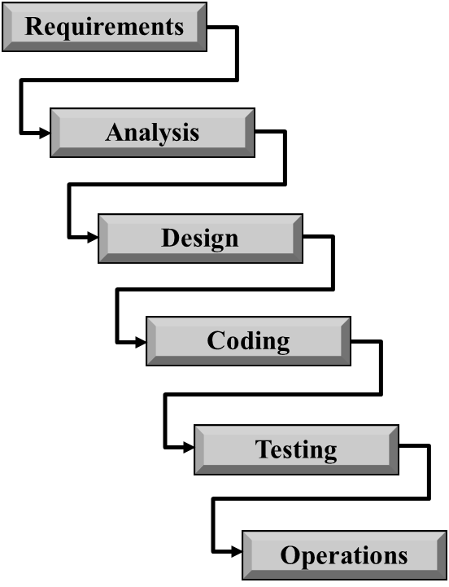
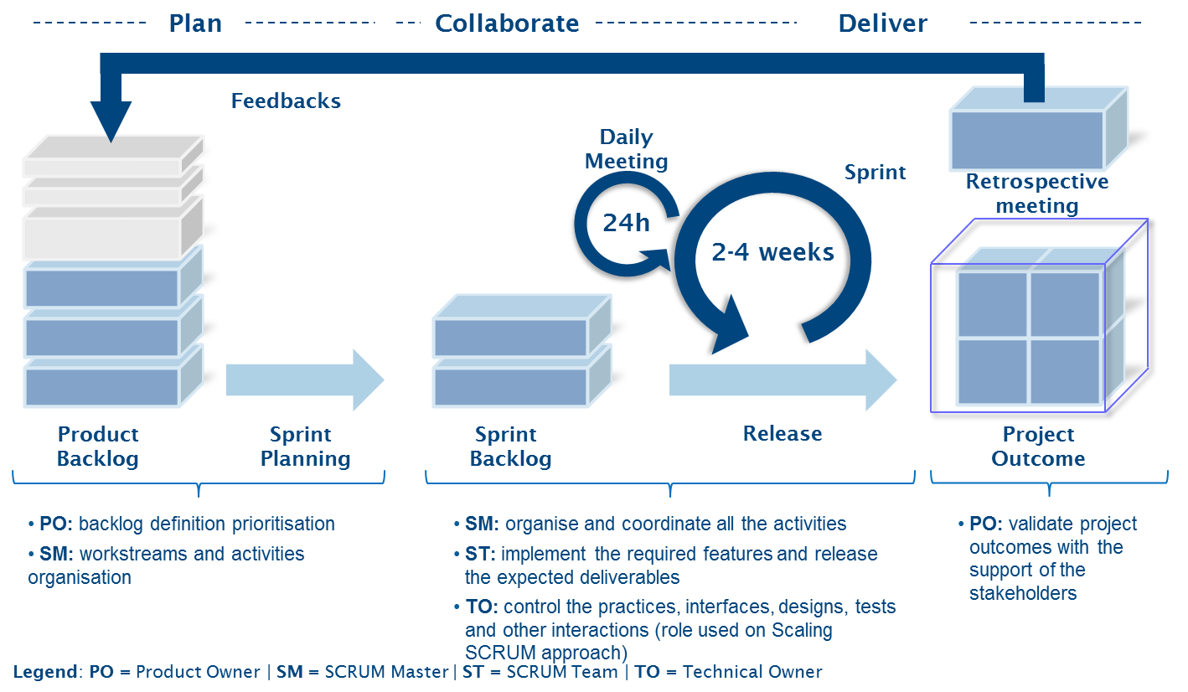
From Project Products to Product Activities: 2.1.1 Software
Patient Management
Visit reservation (Agile)
Reception (Agile)
Exam Reservation (Fit-Gap)
Follow-up Visit (Waterfall)
GP’s diagnosis (Agile)
Health Data Warehouse and reporting (Hybrid)
EXAMPLE
The model for each project software product is selected (waterfall, agile, hybrid)

Slide 17
From Project Products to Product Activities: 2.1.2 Organization
A structure for each organization product is defined
It may be created from scratch or mapped on the reference lifecycle shown here
As-is Business Analysis
Interviews
To-be Business Organization Design
Change
Document Analysis
Maintenance
Structure Change
Staff Training
HR Project
GP
GP training
New visit /booking rules
GP reward/evaluation
Contacts with GP and Hospitals
Support
User support
Lab support
Marketing
EXAMPLE

Slide 18
From Project Products to Product Activities: 2.1.3 Infrastructure
An applicable structure for each infrastructure product is defined
It may be created from scratch or mapped on the reference lifecycle shown here
Updating
Requirements Analysis
Design of the execution architecture
Deployment
Site preparation
Test & install
Transition
Release
Maintenance
Tuning
New Architecture
Patient Mobile/ Mobile technology
Extranet
Virtual Shared Database
General Practitioner Network
Cloud
EXAMPLE

Slide 19
2.2 Customize / detail the lifecycle models
1 Software
1.1. Requirements collection & analysis
1.2 Implementation & test
1.3 Test & release
1.4 Maintenance
1.1.1 Functional
Requirements
1.1.2 Non-Functional Requirements
1.1.3 Security
Requirements
1.1.1.1 Identify users
1.1.1.2 Prepare interviews
1.1.1.3 Execute interviews
1.1.4 Model requirements
1.1.1.5 Fit gap analysis
1.1.6 Document requirements
EXAMPLE
A complete ABS breaks a project down into elementary activity, namely a task that is homogeneous in terms of output, competences, techniques. In a full detailed ABS, each elementary activity is to be described in terms of:
Input
Outcome / output
Steps of the activity
Techniques, namely the models to be used to perform the activity
Tools and software support
Best practice and examples

Slide 20
Activity Breakdown Structure Incident
Put down a draft ABS for the software domain
You can use either Agile or Waterfall for the software backlog
You are free to ask information to the teacher
Hint: start from the PBS list and make table
PBS element
Approach (agile, predictive, hybrid)
Justification of the approach

Slide 21
PROJECT STRUCTURE R 210917
Project structure roadmap
Step 1 From Requirements to Project Products
Step 2 From Project Products to Project Activities
Step 3 Organizing the project
Step 4 Defining project work packages
Step 5 Timelining the project
Step 6 Setting the milestones
Summary
Assignment
Appendix

Slide 22
Step3 Organizing the project
Step 3 Organization
Activities
Milestones
Project organization roles are at different levels:
Execution: teams that produce organizational, software and technology outcomes of the project
Administration: Project office, that handles communications, control and planning activities
Governance: Steering / governance structures that ensure the involvement of stakeholders and user organizations
Products /deliverables
Gantt/PERT

Slide 23
Project Organization: reference model
Project
Governance
Administration
Plan/Control
Execution
Political
Technical
Legal
Accounting
Quality
Software
Technology
Business
Organization change
Miscellaneous
Project is a temporary structure
People are involved in a project either part-time or full-time
People involved in a project play various roles:
Governance
Administration
Execution

Slide 24
Project Organization : political governance
Project
Governance
Political
Technical
Legal
Political Governance typically relies on a “Steering Committee”(SC) that includes the commissioner of the project, representative of user organizations, and, also, representatives of other stakeholders
SC typically meets monthly or at deadlines of the project
In Digital Projects, SC typically includes managers of the corporate IT department
SC is a decision body that approves or rejects project results
SC typically discusses:
Project budget and progress
Project staffing policy
Project results (intermediate and final)
Major changes in Software Apps or Organizations
Critical issues
The project manager connects Governance with Administration and Execution organizations

Slide 25
Project Organization: technical and legal governance
Project
Governance
Political
Technical
Legal
Technical and Legal governance make sure that project complies with relevant regulations and standards, which in digital domain typically include:
GDPR https://eugdpr.org
Software standards
Deployment standards
Accessibility standards
Etc.
Such governance is typically staffed by “on-demand referees”, i.e., experts assigned to the project as consultants / reviewers.
In Agile / Scrum approach, specific roles as the Technical Owner make sure that software is not only consumable but also technically compliant.

Slide 26
Project Organization : Project Administration
Project
Administration
Plan/control
Accounting
Quality
Miscellaneous
Administration supports the integration of Project Areas
Administration is performed by a Project Office (PO),which is generally staffed by non-technical people
PO typically accounts 10 to 15% of project staff

Slide 27
Project Organization : Administration: Plan/control
Project
Administration
Plan/control
Accounting
Quality
Miscellaneous
Project planning and control is a primary mission of a PO
PO typically edits plans & reports on:
Project Activities: baseline and updated plan, progress report, etc.
Project Communications: project presentations for project organization and stakeholders
Change and Risk management: make sure that changes and risks are properly documented, monitored, and solved.

Slide 28
Project Organization : Administration: Accounting and Quality
Project
Administration
Plan/control
Accounting
Quality
Miscellaneous
Accounting:
The project accounting team tracks expenses against the project budget, based on a specific project Cost Breakdown Structure (CBS) which is a (project) chart of accounts
However, digital projects generally do not require a dedicated CBS, and accounting is performed as a service by the Corporate Accounting Department
Quality:
Large projects can have quality reviewers, who make sure that the appropriate quality standards are planned and enforced.
Miscellaneous:
In large projects, Administration can be staffed to cover all Project Management areas

Slide 29
Project Organization : Execution
Project
Execution
Software
Technology
Business
Organization change
Execution includes the teams who develop solutions
In digital projects, relevant domains are:
Software, where project teams develop/ customize/ discontinue/modify software apps;
Technology, where project teams deploy software apps on cloud or internal infrastructure, and acquire / deploy software infrastructures as DBMS, OS, Drivers, etc.;
Business, which is critical with e-commerce and social projects, where teams develop and implement business plans and models;
Organization change, critical with enterprise digital projects, where teams design /change/discontinue business process, create/change jobs, train and sensitize users and stakeholders, etc.

Slide 30
Project Organization : Execution: Software
Project
Execution
Software
Technology
Business
Organization change
Software teams can be structured according to a variety of models:
Mixed teams (aka “Feature team”) where expert users, business process analysts and software developers work together - it fits customization projects
Dedicated teams (aka ”Component teams”) , in which each team is allocated to a specific project outcome: analysis and user requirements, software development, database, etc. - it fits large waterfall projects
Agile approach, in which multiple teams work a software product backlog, which was created in a previous analysis phase – it fits uncertain requirements with an average innovation
Hybrid approach, a combination of the above models

Slide 31
Project Organization : Execution: Technology
Project
Execution
Software
Technology
Business
Organization change
Dedicated technology teams exist (only) in very innovative projects
Typical enterprise or social projects develop apps on available technologies, and, therefore, rely on an external support:
DBMS and Software Platforms vendors assist acquisition and installation
Hardware vendors provide, install and sometimes manage hardware equipment (severs, wearable devices, sensors, etc.)
Service vendors provide, install and operate cloud services etc.

Slide 32
Project Organization : Execution: Business
Project
Execution
Software
Technology
Business
Organization change
Dedicated business teams are critical in e-commerce and social systems where profitability and/or social acceptance are critical success factors.
They interact with software teams in project scoping (where they contribute to shape the software product backlog) and system roll-out (where they assist the market roll-out)
Typical outcomes are business plans, marketing plans, social communication plans, surveys, etc.
Business teams typically have business administration or marketing background

Slide 33
Project Organization : Execution: Organization Change
Project
Execution
Software
Technology
Business
Organization change
Organization change is critical in large projects, because:
Users may be 000s
Business process flow and activities may change radically
Organization structure may change to a large extent
New jobs are created and old jobs discontinued
New skills may be required in user departments
Because of these reasons, specific teams should be created for:
Redesigning business processes
Redesigning business rules (e.g. chart of accounts, payment rules, etc.)
User training, including computer-based education
Managing HR change

Slide 34
Project Organization : a large enterprise system project
CEO
Other staff
Consumer
Division
Business
Division
Network
VP
IT services
Sales
Branches
Projects
Marketing
Customer
care
Network
Planning
Network
Systems
(OSS)
Network
Operations
Service &
Construction
IT
architecture
CRM
Development
ERP
Development
Operations
Corporate user Departments
Corporate IT Department
Project organization
Technical Committee
Project
Manager
Steering Committee
Project
Office
Team1
Team 2
Team 3
Hardware & Software Vendors
Software Platforms
Vendors
Consultants
Systems Integrator
Software houses

Slide 35
Project Organization : a large enterprise system project (one location)
Periodically reviews project progress
Discusses and solves issues
Decides on change requests
Approves intermediate and end results
Supports project manager in technical issues
Reviews periodically change requests, project progress, technical issues etc.
Steering Committee
Project manager
Referees
Representative of institutional functions that are indirectly involved in the project, e.g. Purchasing, HR, Accounting
User representatives
Technical Committee
Project Administration / Office
Executive tasks of PM
Project management skills
User test skills
SW development
HW & Network architecture
Project workgroup
BPR & Change Management
Business process experts
Application package experts (generally a team for each application/ application subsystem)
Database e data warehouse + Middleware experts
NB Teams are typically vendor staff
Network architects
IT Operations engineers
Hardware / software engineers
Part time temporary task forces
IT experts
User experts
Organization analysts
HR development experts
Instructors / Coach

Slide 36
Project Organization: a multinational ERP project (multilocation)
Project Champion
(CFO)
WW Program Manager
Global Leader
Measur
+ Change control
Global bimonthly global meeting
GL
Color Print
User leader Europe
GL
Video
User Leader
Asia
GL
Corporate
User Leader Americas
Functional Experts
Functional Experts
Functional Sub Teams
Sub Teams
Test Sub Teams
Regional Deployment
Product Development

Slide 37
Project Organization: ERP project in a large company (one location)
Engagement
Director
Engagement
Manager
Engagement
Manager / Accounting
Engagement
Manager /IT
Software Team
Accounting team
BI team
Program Office
IT
Activities
Chart (Act .3 )
Engines (Act.5)
Role:
Implement the consolidate Chart of Accounts customize to Divisions
Staffing
Consultants
Divisions
Activities
Coding rules (Act.1)
Chart (Act. 2)
Role:
Assure a top - down design
Assure accounting consistency
Unified Reporting
Staffing
Consultants
HQ
Activities
Test new BI software
Role:
Assess pilot engine
Integrate SAP
Staffing
Consultants
Activities
Program Office
Role :
Plan & control time and cost
Meeting scheduling
Document.
Communic.
Staffing
Consultants
HQ
Activities
Sofwtare Changes
EIS-DB and ETL
Infrastructure optimization
Role:
Assure consistent IT infratsructure
Install new servers
Prepare test environment
Staffing
IT/Development
IT/Operation

Slide 38
Project Organization: Incident
Put down a draft OBS of the project
You are free to ask information to the teacher
Hint: start from the PBS list
Identify the stakeholders of each PBS backlog, who shall be represented in the project governance (Project Steering Committee or equivalent)
Identify the possible teams for each PBS backlog, who shall be work teams in the project organization
Draw the project organization chart
Make sure that Privacy, Security and Legal requirements are planned and controlled in the project organization
Make sure that all user classes (sponsor, manager of user organizations, end user, key user) are properly represented by checking the organizationn reference model

Slide 39
PROJECT STRUCTURE R 210917
Project structure roadmap
Step 1 From Requirements to Project Products
Step 2 From Project Products to Project Activities
Step 3 Organizing the project
Step 4 Defining project work packages
Step 5 Timelining the project
Step 6 Setting the milestones
Summary
Assignment
Appendix

Slide 40

The Work Package (WP)
A project includes a plurality of WPs
A WP is an assignment an organization should accomplish

Slide 41
Work Package (WP) properties
A WP ideally:
Is led by 1 Organization Unit
Produces a PBS element (1 at least)
Addresses 1 project domain
Ideally, WPs in a project are around 10-15
Project Management is a separate WP
Other WPs address execution
A WP contains multiple Activities (= Tasks) that
Can be realistically and confidently estimated;
Make no sense to break down any further;
Produce a measurable deliverable;
Form a unique package of work which can be outsourced or contracted out.
Are performed within a project control cycle, such as 1 month or 1 milestone

Slide 42
Work Package (WP) comments
The WP structure can fit Agile oriented approaches
Some WPs can be implemented by an Agile approach while other WPs can be performed by a predictive approach
In an Agile approach
the Project Management Office defines the packages
the Agile’s Product Owner is the Organization thay leads the WP
A WP task is roughly equivalent to a set of Sprints

Slide 43
WP description template /1
The WP template DOES describe project elements
That WP template DOES NOT describe nor mention techniques, tools or technologies used in performing the WP
Summary
Objectives
Roles
WP
Task summary
Task details
Deliverable lists
WP Milestones

Slide 44
WP description template / 2
WP # & Name
WP leader
Duration: from Month m to Month n
Participants & Effort per Participant (month-person or FTE)
Summary
Objectives
Roles
WP
Task summary
Task details
Deliverable lists
WP Milestones

Slide 45
WP description template / 3
Objectives are results to be achieved
No more than 2 or 3 objectives
1-page description
Summary
Objectives
Roles
WP
Task summary
Task details
Deliverable lists
WP Milestones

Slide 46
WP description template / 4
All the organizations involved in the work package (mentioned in the WP summary) should play a role
1-page description, with 1 line for each organization
Summary
Objectives
Roles
WP
Task summary
Task details
Deliverable lists
WP Milestones

Slide 47
WP description template / 5
A short description of the rationale used to define and sequence tasks
Tasks should be numbered within each WP: T4.1 is Task 1 in WP4
Task summary can be supported by diagram
Summary
Objectives
Roles
WP
Task summary
Task details
Deliverable lists
WP Milestones

Slide 48
WP description template / 6
Each task is a step in accomplishing the WP
Task detail is a 1-page description of each task in plain English
The description can be supported by a diagram
Summary
Objectives
Roles
WP
Task summary
Task details
Deliverable lists
WP Milestones

Slide 49
WP description template / 7
The list includes all the deliverables released by WP tasks
Each task should produce a deliverable (at least one)
Deliverables are classified e.g.
R: Document, report (excluding periodic and final reports)
DEM: Demonstrator, pilot, prototype, plan designs
DEC: Websites, patents filing, press & media actions, videos, etc.
OTHER: Software, technical diagram, etc.
Deliverables should be numbered within the WP: D4.1 is deliverable 1 in WP4
Summary
Objectives
Roles
WP
Task summary
Task details
Deliverable lists
WP Milestones

Slide 50
WP description template / 8
Each WP can be controlled by milestones = decision points where the customer decides whether to continue, repeat or stop
For each milestone you should define
date (= month of the project as for example M06)
deliverable (auch as D4.1 = Deliverable 4.1)
Milestones should be reported in the project Gantt and/or in a Milestone Plan
Summary
Objectives
Roles
WP
Task summary
Task details
Deliverable lists
WP Milestones

Slide 51
WP (Work Package) Incident
Put down a draft list of WPs of Elio project
You are free to ask information to the teacher
You can sequence WPs
Based on PBS (=outcome driven);
Based on OBS (=organization driven);
Based on hybrid criteria
Project WPs are ideally around 10
If you cannot reduce WPs to 10 or so, you can split the project accordingly
Detail one WP at your choice

Slide 52
PROJECT STRUCTURE R 210917
Project structure roadmap
Step 1 From Requirements to Project Products
Step 2 From Project Products to Project Activities
Step 3 Organizing the project
Step 4 Defining project work packages
Step 5 Timelining the project
Step 6 Setting the milestones
Summary
Assignment
Appendix

Slide 53
The Gantt Diagram (WP)
Gantt diagram provides a one-page project summary by displaying WPs and related Deliverables, Milestones, Organizations
It can be modeled by various software e.g. Excel (very flexible), MS project (very powerful)

Slide 54
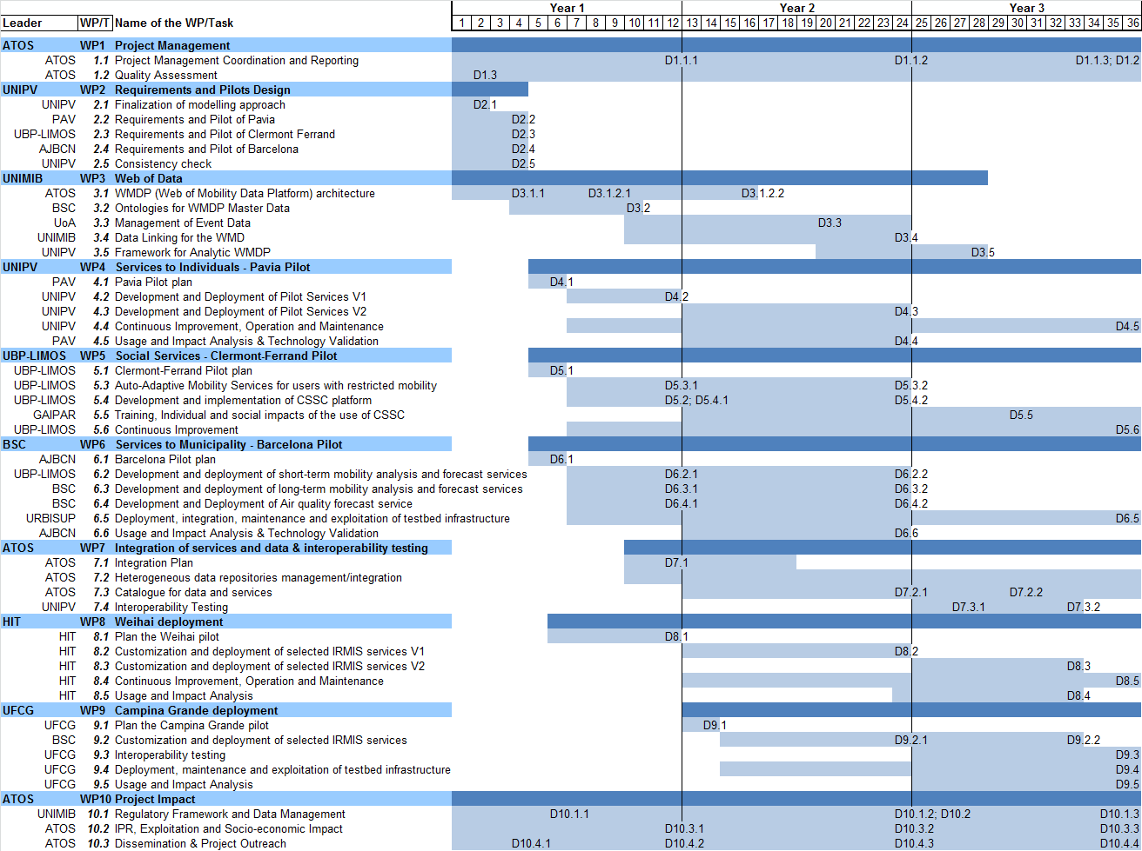
Gantt diagram IRMA case study
Project Gantt diagram displays the duration and tasks of the project of WPs
In our case study Gantt diagram shows:
WPs (blue) and related leader organization
The tasks of each WP the leader of each WP and the related organization
The duration of each WP and task
The related deliverables
Our example is a DRAFT Gantt
A draft Gantt is a preliminary plan, and defines duration only

Slide 55
Gantt diagram IRMA case study

Slide 56
PROJECT STRUCTURE R 210917
Project structure roadmap
Step 1 From Requirements to Project Products
Step 2 From Project Products to Project Activities
Step 3 Organizing the project
Step 4 Defining project work packages
Step 5 Timelining the project
Step 6 Setting the milestones
Summary
Assignment
Appendix

Slide 57
Project Milestones
Milestones are key deadlines in a project life, where the project government either approve or reject the outcome of project work
Milestones can be at two levels
Work package milestones concern the approval (or rejection) of a work package task
Project milestones concern the approval (or rejection) of a whole work package or project phase
We address project milestones, and we illustrate a prototype-based milestone model, oriented to large projects.

Slide 58
Project Milestones: a case study in financial systems
Sem 0
Jul
Aug
Sep
Oct
Nov
Dec
Jan
Feb
Mar
Apr
May
Jun
Sem 2
Sem 3
03
Functional Acceptance (= concept)
Project Milestones = relevant project events:
End of project phases ;
Reaching key objectives;
Completion of key deliverables;
Key decisions.
Pilot Acceptance (= small case experiment )
Approval of procedures
Authorization to invest
Order Issue
Release I
Release II
Release III
Updated Plan
Baseline (plan used to approve and launch the project)
Progress against the updated plan (assessed on the actual completion (earned value))
Re-planned activity
Baseline
Progress

Slide 59
Prototype-based milestone model
Feasi-bility
(2-3 M)
Proto-type
(1-2M)
Pilot (4-6 M)
Stabili-zation
(1-3 M)
Roll-out
(variable)
Evolution
We here illustrate a milestone model based on demo (prototype) and pilot phases, which is oriented to
Large enterprise projects, where pilot and demo foster the acceptance of the system
Research projects, where demo and prototype allow to iterate development as needed
This model fits both Waterfall, Fit-gap and Agile; indeed, Agile approach can be used within pilot and stabilization segments

Slide 60
Prototype-based milestones: Feasibility
Feasi-bility
(2-3 M)
Proto-type
(1-2M)
Pilot (4-6 M)
Stabili-zation
(1-3 M)
Roll-out
(variable)
Evolution
Purpose: to gather technical, organizational and economic elements to decide whether to go or not to go
Characteristics:
Organization : to be architecture
Software: conceptual modeling (key elements) and software selection
Technology: architecture blocks, capacity planning and partners selection
Output:
To-be Architecture
Project Plan
Business Case / Cost-benefit Analysis / Impact Analysis
Project Risk analysis

Slide 61
Prototype-based milestones: Prototype
Feasi-bility
(2-3 M)
Proto-type
(1-2M)
Pilot (4-6 M)
Stabili-zation
(1-3 M)
Roll-out
(variable)
Evolution
Purpose: to demonstrate the future system and assess its consistency
Characteristics: the prototype demonstrates only key points
Organization: few key points of the structure an activities
SW: only sample functions
Technology: integration issues / opportunities (NOT performances)
Output:
Prototype (from a running software or a simple mock-up)
Gap analysis (i.e., modules to be fixed / changed)

Slide 62
Prototype-based milestones: Pilot
Feasi-bility
(2-3 M)
Proto-type
(1-2M)
Pilot
(4-6 M)
Stabili-zation
(1-3 M)
Roll-out
(variable)
Evolution
Purpose: test the running solution on a sample and get a quick win
Characteristics:
BPR and organization elements : pilot unit totally configured (typically small size, easy to change)
Application SW: consumable
Infrastructure: functionally complete
Output:
Running process / system (preliminary installation)

Slide 63
Prototype-based milestones: Stabilization
Feasi-bility
(2-3 M)
Proto-type
(1-2M)
Pilot (4-6 M)
Stabili-zation
(1-3 M)
Roll-out
(variable)
Evolution
Stabilization
Purpose : to remove anomalies, tune performances, refine BPR, refine adoption plan (change management & education)
Characteristics:
BPR and organization elements : project review
Application software: changes (corrections & improvements ) + tuning
Technology: tuning and fine capacity definition
Output:
Stabilized system
At the end of stabilization, the project team ceases

Slide 64
Prototype-based milestones: Roll-out
Feasi-bility
(2-3 M)
Proto-type
(1-2M)
Pilot
(4-6 M)
Stabili-zation
(1-3 M)
Roll-out
(variable)
Evolution
Purpose: deploy throughout the corporation / all intended users
Characteristics:
Typical to companies geographically distributed (banks, utilities, telecoms)
Variable duration (years in MNCs)
Typically run by region (for example 1 region a month)
Run by release teams guided by a release plan
Output: fully operational business process / system
Roll-out releases include training and help-desk

Slide 65
Prototype-based milestones: Evolution
Feasi-bility
(2-3 M)
Proto-type
(1-2M)
Pilot
(4-6 M)
Stabili-zation
(1-3 M)
Roll-out
(variable)
Evolution
Purpose: the system / process fits changes arising from usage or context / technology evolution
Characteristics:
Typically performed by periodical releases (bi-monthly or quarterly)
Each release = a set of modified or new functions or business activities
Output: updated system / business process

Slide 66
Project Milestones Incident
Put down a draft list of project milestones for Elio project or a project of your choice
You are free to ask information to the teacher
You can sequence milestones
Based on prototype/pilot framework (illustrated before)
Waterfall and Big-bang approach
Any composite approach
Project milestones should be around 10
Detail one milestone at your choice

Slide 67
PROJECT STRUCTURE R 210917
Project structure roadmap
Step 1 From Requirements to Project Products
Step 2 From Project Products to Project Activities
Step 3 Organizing the project
Step 4 Defining project work packages
Step 5 Timelining the project
Step 6 Setting the milestones
Summary
Assignment
Appendix

Slide 68

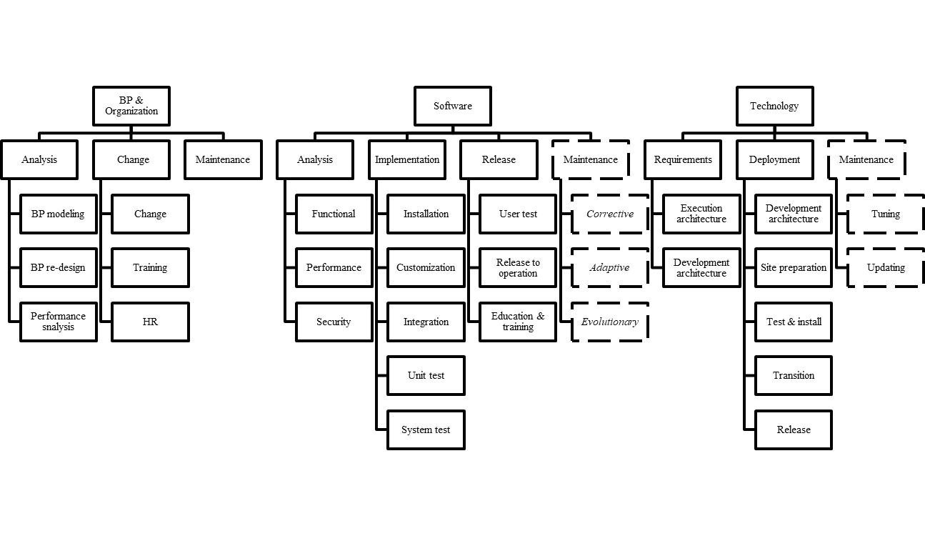
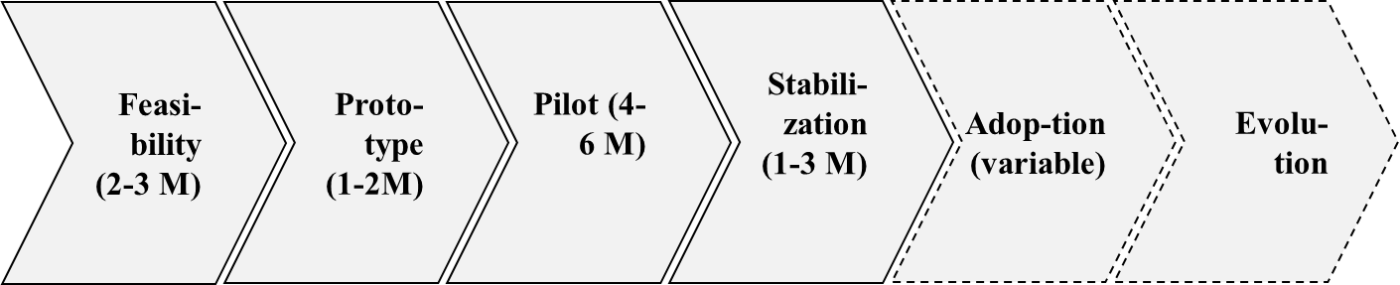
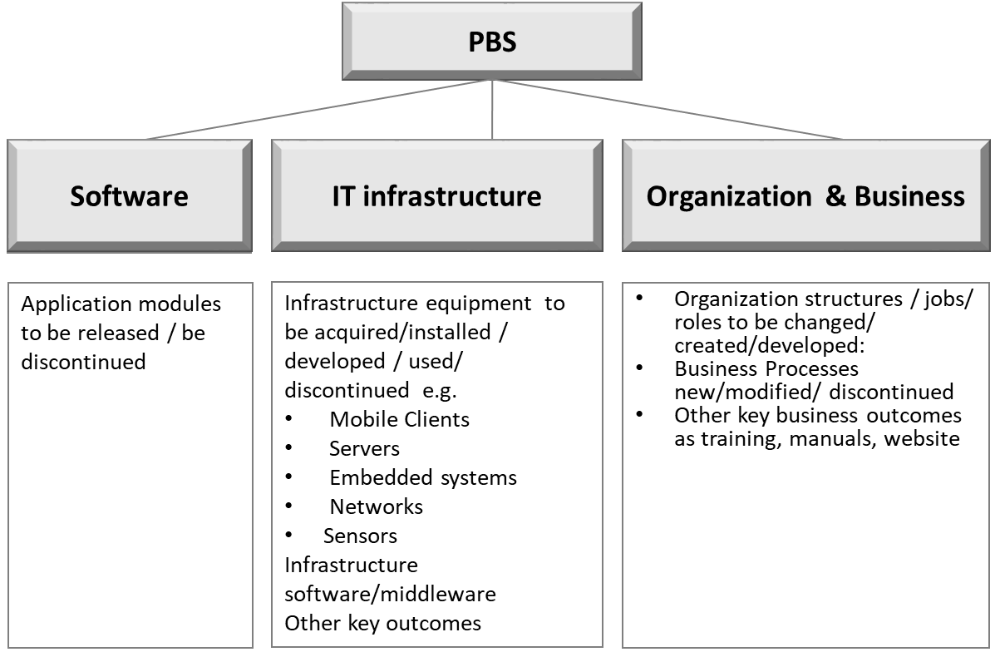
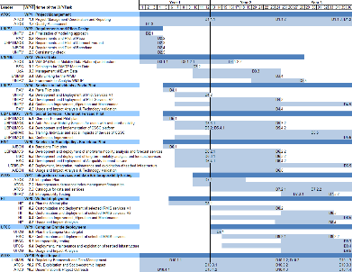
Session Summary: Project Structure Roadmap
Organization
Activities
Tasks
Roles
Work
Packages
Milestones
Deliverables
Milestones
Task Duration & Milestones
Products
Gantt

Slide 69
Project Structure and PMBOK
Introduction
PMBOK section | PBS | ABS | OBS | WP
Integration
Scope
Time
Cost
Quality
HR
Communications
Risk
Procurement
Stakeholder
Project Domains
Project Structures
Project Work Packages
Project Milestones
Summary

Slide 70
Review questions
Introduction
Illustrate project structures
PBS (Products / Deliverables)
ABS (Activities)
OBS (Organization)
WP (Work Package)
Illustrate the purpose of a WP and the content of its sections (Heading, Objectives, Tasks, Deliverables, Roles, Milestones)
Illustrate the relations of the WP with PBS, OBS, ABS
What is a project milestone?
Illustrate the main project milestones
Feasibility,
Prototype,
Pilot,
Stabilization,
Adoption
Project Domains
Project Structures
Project Work Packages
Project Milestones
Summary

Slide 71
PROJECT STRUCTURE R 210917
Project structure roadmap
Step 1 From Requirements to Project Products
Step 2 From Project Products to Project Activities
Step 3 Organizing the project
Step 4 Defining project work packages
Step 5 Timelining the project
Step 6 Setting the milestones
Summary
Assignment
Appendix

Slide 72
Assignment Assessment
The Assignment describes the Project Structure and Plan of the assigned project
The assignment is assessed in terms of:
Completeness: all assignment sections should be developed
Correctness: analysis / project diagrams and assignment structure should be well formed and not violate relevant syntax rules
Readability
Correct English
Visible colors (no Yellow, no Light Green)
Accessible font size

Slide 73
Assignment structure
Step 1 From Requirements to Project Products
Step 2 From Project Products to Project Activities
Step 3 Organizing the project
Step 4 Defining project work packages
Step 5 Timelining the project
Step 6 Setting the milestones
A scope (project) is assigned to each student team
Students’ assignment should reflect contents illustrated in the previous pages
Cover page: Name and ID of team members; Assignment release
All pages: Authors (= who oversees the page)

Slide 74
1. Products
Step 1 From Requirements to Project Products
Step 2 From Project Products to Project Activities
Step 3 Organizing the project
Step 4 Defining project work packages
Step 5 Timelining the project
Step 6 Setting the milestones
The Product Breakdown Structure (PBS)
Should list the outcomes of the assigned project for Software, Infrastructure, Organization
It may be sketched as a hierarchy or indented list
Can contain multiple levels (hint: 2-3)
Each product element should be specific to the assigned project, e.g.
Patient’s Android Mobile App for Visit Management)
Website for downloading Patient’s App
…..
Comments on the PBS are welcome

Slide 75
2. Product Activities
Step 1 From Requirements to Project Products
Step 2 From Project Products to Project Activities
Step 3 Organizing the project
Step 4 Defining project work packages
Step 5 Timelining the project
Step 6 Setting the milestones
The assignment
Should list the steps of the assigned project for each relevant Software, Technology, and Organization product
It may be sketched as a hierarchy or indented list
Can contain multiple levels (hint: 2-3)
Each element should be specific to the assigned project
Comments on the structure of Product Activities are welcome

Slide 76
3. Organization
Step 1 From Requirements to Project Products
Step 2 From Project Products to Project Activities
Step 3 Organizing the project
Step 4 Defining project work packages
Step 5 Timelining the project
Step 6 Setting the milestones
The Organization section
Should identify the organizations working/involved in the assigned project
Can be described by an organization chart or an indented list
The project organization should be consistent with PBS: each PBS element should be related to an organization unit of the project (please show that relation by a double entry table)

Slide 77
4. Work Packages
Step 1 From Requirements to Project Products
Step 2 From Project Products to Project Activities
Step 3 Organizing the project
Step 4 Defining project work packages
Step 5 Timelining the project
Step 6 Setting the milestones
The assignment should describe at least 2 WPs:
Project Management
1 WP chosen by students
The WP description should follow the Work Package template

Slide 78
5. PERT Diagram
Step 1 From Requirements to Project Products
Step 2 From Project Products to Project Activities
Step 3 Organizing the project
Step 4 Defining project work packages
Step 5 Timelining the project
Step 6 Setting the milestones
It shows the sequence of project Work Packages (WP), where:
WPs should be around 10
Project Management is WP1
Other WPs reflect any suitable combination of Activity, Product, and Organization.
It is modeled by an oriented diagram (or graph)
The diagram is supplemented by an explanation that illustrates the concepts followed in modeling the PERT
WP 1 Project Management
WP 2
WP3
WP5
WP 4
Example
WP 6
WP7

Slide 79
5. Gantt diagram
Step 1 From Requirements to Project Products
Step 2 From Project Products to Project Activities
Step 3 Organizing the project
Step 4 Defining project work packages
Step 5 Timelining the project
Step 6 Setting the milestones
The Gantt diagram displays the duration of WPs and WP tasks
Gantt diagram shows:
WPs (blue) and related leader organization
The tasks of each WP
The leader of each WP and his organization
The duration of each WP and task
The WP and task deliverables
The Gantt is a baseline, and enumerates months as “M1, M2, … “

Slide 80
B3. Milestones
Step 1 From Requirements to Project Products
Step 2 From Project Products to Project Activities
Step 3 Organizing the project
Step 4 Defining project work packages
Step 5 Timelining the project
Step 6 Setting the milestones
Milestone | Deadline YYMMDD | Actions | Decisions to be made
Milestone 1
Milestone 2
…….
Miestone n
The Milestone Grid
lists all milestones of the project
should be consistent with PERT and WPs
deadlines shall be relative: days/months after the day/month 0
deadlines are to be displayed in the project Gantt

Slide 81
PROJECT STRUCTURE R 210917
Project structure roadmap
Step 1 From Requirements to Project Products
Step 2 From Project Products to Project Activities
Step 3 Organizing the project
Step 4 Defining project work packages
Step 5 Timelining the project
Step 6 Setting the milestones
Summary
Assignment
Appendix

Slide 82
IRMA case study:
Introduction
IRMA is integrated ecosystem to support a full range of mobility services for multiple stakeholders - municipalities, transport providers, third parties, and individuals.
Objectives :
Information integration:
publication of geo-referenced mobility data;
integration of multiple sources (open data, crowd data, social network, sensor/IOT );
structural and real time operational interoperability across geographical areas.
Services to multiple stakeholders:
individual users who move using multimodal transport systems;
elderly and disabled users with specific mobility needs;
municipalities for integrated management of long and short term, and emergency mobility, and for control of mobility related pollution;
transport providers for the analysis of mobility flows and demand..
Scenarios:
Pavia (targeting individual mobility services);
Clermont-Ferrand (targeting disabled users);
Barcelona (targeting municipal mobility services including pollution).
International deployment: Brazil and China
WP map
WP
description

Slide 83
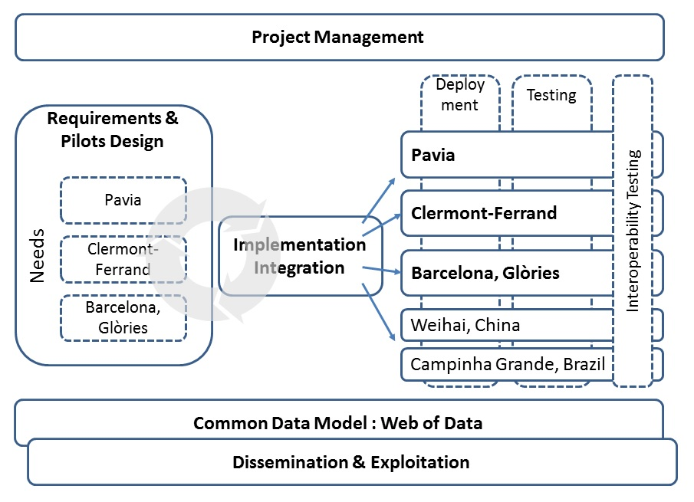
IRMA case study: WP map
Introduction
WP map
WP
description
IRMA’s WPS reflect both
ABS lifecycle (Requirements, Implementation and Integration, etc.)
OBS (Pavia, Clermont Ferrand, Barcelona, etc.)
Project Management is a separate WP

Slide 84
WP Summary IRMA case study
Introduction
WP #: | 4 |  |  | Start date or starting event: |  |  |  | M05 (End: M36)
WP title: | Pilot Deployment & Testing (Pavia)
Participant # | 1 | 2 | 3 |  | 4 | 5 | 6 |  | 7 | 8
Participant | SYS | ESP | UNIPV |  | FRANCE | MILAN | GREECE |  | ESP2 | CONS
Effort
Participant #: | 9 | 10 | 11 |  | 12 | 13 | 14 |  | 15 | 16
Participant | PAVIA | TRANSP | BLIND |  | x | x | PRC |  | BRA
Effort
WP map
Participant #. | Participant name | Country
1 (Coordinator) | SYS Systems Integration Company. (SYS) | Spain
2 | Supercomputing Center (ESP) | Spain
3 | Pavia University (UNIPV) | Italy
4 | French Research Lab (FRANCE) | France
5 | Milan University (MILAN) | Italy
6 | University (GREECE) | Greece
7 | Municipality (ESP2) | Spain
8 | Public Transit Consulting, S.L. (CONS) | Spain
9 | PAVIA Municipality (PAVIA) | Italy
10 | Municipal Transport Authority (TRANSP) | France
11 | Blind society (BLIND) | France
12 | Long distance (railway) transport operator | TbC
13 | Shared transport operator (car manufacturer) | TbC
14 | Institute of Technology (PRC) | China
15 | Brazlian University (BRA) | Brazil
WP
description

Slide 85
WP Objectives IRMA case study
Introduction
1. Implement, deploy and validate services for Pavia municipality by using a wide range of information sources:
Open data: bus timetables, availability of shared bikes, street maps, indoor maps;
Crowd data: feeds from users, as feeds from dedicated collaborative applications;
Social data: tweets that are used for alert management;
Mobile network data: network events from 4G mobile radio cellular network;
Sensor data: real-time position of buses, parking lots, etc.
2. Test an interoperability data model on a sample of services.
3. Evaluate the usage profile of services in Pavia pilot by service level analysis and focus groups.
WP map
WP
description

Slide 86
WP Roles IRMA case study
Introduction
UNIPV leads the work package.
PAVIA cooperates in validating the plan (Task 4.1) and in user test by focus groups (Task 4.2, 4.3, 4.4).
PAVIA leads Task 4.5 with the cooperation of UNIPV, that involves also SYS as a project manager.
SYS will focus on Task 4.2 that involves data on mobility taken from cells and cooperates as needed in the evaluation of technology and user impact.
WP map
WP
description

Slide 87
WP Tasks summary IRMA case study
Introduction
The WP 4 includes two releases:
simpler business services
complex business services
Each release embraces the whole software lifecycle, namely:
Development
Test focus group: use the service, stress the software, report shortcomings and faults
Deployment: release to Pavia end users, and deployment n the cloud.
WP map
WP
description

Slide 88
WP tasks detail IRMA case study
Introduction
Task 4.1 Pilot plan (M05-M06, PAVIA)
The plan will detail:
WBS (Work Breakdown Structure).
GANTT and check points
Reporting system on WP progress (monthly control).
Technology infrastructure for development, test, and operation.
The agenda of the WP
WP map
WP
description

Slide 89
WP tasks detail IRMA case study
Introduction
Task 4.2 Pilot Services V1 (M07-M12, UNIPV)
Pavia’s Trip Planner on bus and shared bikes, and, partially, shared cars.
City Feed and Alert Manager, to process social generated feeds on transport (jams, road bumps, any mobility disruption, etc.).
Mobility Analyzer, a business intelligence application for Pavia’s Municipality, that tracks flows and delays of transport systems, and processes both real-time information and time i.e.
Data from public transports
Data from shared transports
Feeds from open social network (Twitter) or community network (City Feed)
Alerts generated by Municipality on public events
Transit data from Municipality sensors (WIFI, Traffic jam etc.) that will be positioned in critical city points
Aggregated traffic information on flows of vehicles and pedestrian in terms of transit time, speed and direction based on the cellular data (3G or 4G)
WP map
WP
description

Slide 90
WP tasks detail IRMA case study
Task 4.3 Development and Deployment of Pilot Services V2 (M13-M24, UNIPV)
Elderly services to select points of interest and itineraries for older people
Accessible routing to select accessible itineraries
Indoor Navigation, for navigation inside complex buildings, based on indoor maps and specific orientation technology (Wi-Fi, Magnetic Fields, Vision).
Reengineered Pavia’s Trip Planner to fit the interoperability data model V1.
Introduction
Project Domains
Project Structures
Project Work Packages
Project Milestones
Summary

Slide 91
WP tasks detail IRMA case study
Introduction
Task 4.4 Continuous Improvement, Operation and Maintenance (M07-M36, UNIPV) (throughout the whole WP)
Configuration and version management to make sure that original requirements, actual software implementation and deployment instructions and procedures are maintained and updated.
Continuous improvement.
Software bugs or analysis errors are identified, evaluated and fixed.
Improvement requests on beta versions are processed and implemented as needed (some can be implemented in the integration work package)
Task 4.5 Usage and Impact Analysis (M13-M24, PAVIA)
Focus group tests
Dashboard systems to report usage information
WP map
WP
description

Slide 92
WP Deliverables (1 task = 1 deliverable at least) IRMA case study
Introduction
Nature keys:
R: Document, report (excluding periodic and final reports)
DEM: Demonstrator, pilot, prototype, plan designs
DEC: Websites, patents filing, press & media actions, videos, etc.
OTHER: Software, technical diagram, etc.
Dissemination keys:
PU = Public, fully open, e.g. web
CO = Confidential, restricted under conditions set out in Model Grant Agreement
CI = Classified, information as referred to in Commission Decision 2001/844/EC
D4.1 Pavia Pilot Plan (UNIPV, R, CO, M06)
Plan of deployment and test, focus group, task details,
Data sources
D4.2 1st level services (UNIPV, DEM, PU, M12)
Downloadable App for Android
Source code
Analysis manual and User manual
Deployment guide.
D4.3 2nd level services (UNIPV, DEM, PU, M24)
The second level services rely on the common data model. They include the evidence as the first level services.
D4.4 Usage and Impact Analysis (PAV, DEC+R+DEM, PU, M24)
Dashboard software on the usage of released services, clips with interviews to key users, a report
D4.5 Final pilot report (UNIPV, R, PU, M36)
WP map
WP
description

Slide 93
WP Milestones IRMA case study
Introduction
M4.1 Pavia Pilot Plan (M06) (D4.1)
M4.2 Pilot Implementation 1 (M12) (D4.2)
M4.3 Pilot Implementation 2 (M24) (D4.5)
M4.4 End (M36) (D4.5)
A WP contains milestones, i.e. a decision point where the customer decides whether to continue, revise or stop
For each milestone are defined
date (i.e. month of the project, e.g. M06 = 6th Month)
deliverable (e.g. D4.1 = deliverable 4.1)
WP map
WP
description

Slide 94
Appendix
Project lifecycle in enterprises A case in Telecommunications

Slide 95
Product Development Process (1/9)
Synergies Identification
Control & Manage
UR/PR
Definitions
Technical
Analysis &
Business Case
Planning
Feasibility
Analysis &
Functional Specs
Development
& Test
User
Acceptance
Definition of the implementation road-map
User Requirements Document Acquisition
Validation of Internal Client’s requirements
Need Classification: e.g. change request, new project, kit, etc.
Methodology and document standards usage and evidence of the meeting of the issued requirements.
Concept Definition
Requests acquisition and classification
User requirement validation
User requirement
refining
Concept
User Requirement
UR = User Requirememts
PR = Product Requirements
The internal customer defines a product concept driven by local innovation, customers needs and market analysis
Internal customers work with IT management to support ideas and ensure completeness of requirements
User requirements document acquisition
Needs classification: e. g. change request, new project, kit, etc.
Internal customer’s requirements validation
Standard methodology and template documents to highlight requirements which can or cannot be satisfied

Slide 96
Product Development Process (2/9)
Synergies Identification
Control & Manage
UR/PR
Definitions
Technical
Analysis &
Business Case
Planning
Feasibility
Analysis &
Functional Specs
Development
& Test
User
Acceptance
Support the presentation of the investment request
Approval of macro- solution and effort proposed in feasibility analysis
Developing Business Metrics
Technical Involvement
Development approval
Customer or internal Benefit
Break Even
IT Risks
Analysis
Project Approved
Going Live
-
Costs
Analysis
-
Under examination
Rejected
Project Costs
The soundness and commercial rationale of the product idea are proofed via a broad business case
ARPU (Average Revenue Per Unit ) analysis and broad risk assessment are performed to establish marketing and investment gains
A technical review is performed in order to identify technical constraints and evaluate technical feasibility (e.g. major impeding issues and rough costs)
Investment request approval
Macro-solution approval and booking of budget forecasted by feasibility
Definition of an implementation road-map

Slide 97
Product Development Process (3/9)
Synergies Identification
Control & Manage
UR/PR
Definitions
Technical
Analysis &
Business Case
Planning
Feasibility
Analysis &
Functional Specs
Development
& Test
User
Acceptance
Business milestones verification and prioritization of initiatives.
Verification of operational planning, IT priorities, available capacity within IT to manage the customer’s needs.
Definition of the main projects planning, based on the Customer’s priorities and IT capacity.
Identification of economical and physical resource needs
Budget Building and Allocation
WBS definition
OBS definition
RAM definition
Work Breakdown Structure break downs a project into several levels of work packages and tasks so to optimise process planning and control
WBS is produced by Project Manager using a top-down approach
Organisation Breakdown Structure identifies which work packages must be assigned to a particular sub-structure of the organisation
OBS design helps Project Manager to correctly manage and monitor project development
Resource Assignment Matrix is the instrument which assigns the ownerships of project work packages to people belonging to project OBS
RAM allows to univocally identify project work packages ownerships

Slide 98
Product Development Process (4/9)
Synergies Identification
Control & Manage
UR/PR
Definitions
Technical
Analysis &
Business Case
Planning
Feasibility
Analysis &
Functional Specs
Development
& Test
User
Acceptance
Business milestones verification and prioritization of initiatives.
Verification of operational planning, IT priorities, available capacity within IT to manage the customer’s needs.
Definition of the main projects planning, based on the Customer’s priorities and IT capacity.
Identification of economical and physical resource needs
Budget Building and Allocation
Critical path definition
Gantt Design
Resources MGMT & Costs Planning
Attività 1
Attività 2
Attività 3
Attività 4
Attività 5
Critical Path is a method to manage work packages and tasks whose completing cannot be postponed
Critical Paths can be identified by project network analysis
Gantt Diagram allows to define project milestones and work elapsed times; it helps Project Manager to monitor project status update and to re-design project plan in case of effort updates
Resources MGMT focuses on the resources effort calculation aimed to complete work package on time and on budget
Cost Planning allows to assign costs to each WP, define project budget and design costs S curve

Slide 99
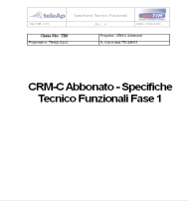
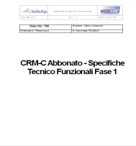
Product Development Process (5/9)
Synergies Identification
Control & Manage
UR/PR
Definitions
Technical
Analysis &
Business Case
Planning
Feasibility
Analysis &
Functional Specs
Development
& Test
User
Acceptance
Support the definition of the solution to be implemented (functional architecture)
Evaluation of the technical/economical feasibility of the solution hypothesys
Feasibility
Technical Analysis
Analisi
Tempi
Analisi
Rischi IT
Analisi
Costi
Modello dati
concettuale
<<entity>>
<<entity>>
Feedback Repository
Answers Repository
articleRelevance : Integer
answerText : BLOB
0..n
articleUsefulness : Integer
0..n
comments : BLOB
Architecture
Costs/Benefits
Analysis
Retrieve Data()
Retrieve Data()
Retrieve Answer()
Store Customer Feedback()
Store Answer()
Schedule Answer()
Solution definition (functional architecture)
Evaluation of technical and economic feasibility of proposed solution
Compose application technical specification and perform functional quality assurance about designed technical solution

Slide 100

Product Development Process (6/9)
Synergies Identification
Control & Manage
UR/PR
Definitions
Technical
Analysis &
Business Case
Planning
Feasibility
Analysis &
Functional Specs
Development
& Test
User
Acceptance
Functional support to the detailed application technical specifications
Coordination and functional quality assurance of the technical solution
Communication enabler between Users and Development departments
Functional Quality Assurance on the developed solution
Support to the user test plan engineering
Solution Development
Testing
Develop product software code and perform functional quality assurance on implemented solution
Execute integration test
Perform User Acceptance Test
Check, prioritize and solve anomalies experienced during test

Slide 101
Product Development Process (7/9)
Synergies Identification
Control & Manage
UR/PR
Definitions
Technical
Analysis &
Business Case
Planning
Feasibility
Analysis &
Functional Specs
Development
& Test
User
Acceptance
Functional Support to Integration Tests
Support during User Acceptance Tests
Support, verify and prioritization on bugs experienced during tests
Support to the design of release and deployment plan
Support to training
User Acceptance Test
Deployment
Client tests product functionalities identifying possible issues or features not compliant with requirements
If client completely approves, product can be deployed
Plan release definition and deployment
Provide training
Perform operation support
(23-09-10) - Pag. 101

Slide 102
Product Development Process (8/9)
Control & Manage
Synergies Identification
UR/PR
Definitions
Technical
Analysis &
Business Case
Planning
Feasibility
Analysis &
Functional Specs
Development
& Test
User
Acceptance
Overview of technical contents in order to identify stratecic and synergic implementation
Coordination of multifunxtional working teams
Identification of cross customer synergies
Definition of integrated planning approaches

Slide 103
Product Development Process (8/9)
Synergies Identification
Control & Manage
UR/PR
Definitions
Technical
Analysis &
Business Case
Planning
Feasibility
Analysis &
Functional Specs
Development
& Test
User
Acceptance
Overview of technical contents in order to identify stratecic and synergic implementation
Coordination of multifunxtional working teams
Identification of cross customer synergies
Definition of integrated planning approaches
Architectural Review
Integrated Approach Definition
From the very beginning, ICT Architectural Function identifies potential synergic solution in order to get an integrated approach
In accordance with Customer’s priorities, define integrated approach to avoid extra costs and useless architectural redundancy
(23-09-10) - Pag. 103

Slide 104
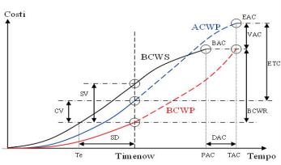
Product Development Process (9/9)
Synergies Identification
Control & Manage
UR/PR
Definitions
Technical
Analysis &
Business Case
Planning
Feasibility
Analysis &
Functional Specs
Development
& Test
User
Acceptance
Planning, issues and resources analysis on several projects
Data verification and control on project approval phase and variances during project lifecycle
Problem management and definition of recovering actions (even if cross projects)
Planning Control and Management
Resources, Costs and Project Issue/Risk Management
Attività 1
Attività 2
Attività 3
Attività 4
Attività 5
Control and react on milestones and activities delay, on project rescheduling
Monitor external projects impacting project plan and cooperate with external Project Manager to identify common milestones and priorities
Resources MGMT focuses on the resources effort calculation aimed to complete work package on time and on budget
Cost Planning allows to assign costs to each WP, define project budget and design costs S curve

