Slide 1
Gianmario Motta, motta05@unipv.it Revision 2 251021
Health Care case study
Part 1- Background

Slide 2
The National Health Care (NHC)
Summary
Organization
Systems
As-is User Process
The Servizio Sanitario Nazionale (SSN) is the National Health Care service (NHC) that funds all healthcare services, with few exceptions, as dentists and spa.
Operations and hospitalizations are free and unlimited
Other services are co-payed (“contribution ticket”)
In tests, diagnostic procedures and prescriptions, co-payments may be up to 30%.
40% of the population (e.g., elderly, pregnant women, kids) are exempt from co-payments.
NHC is funded by ad-hoc taxes, which are 10.6% of income for the first €20,660 and to 4.6% of income between €20,510 and €77,480.
NHC pays the services of hospitals, clinics, labs, etc., based on a price list called DRG (Diagnosis Related Group).

Slide 3
As-is HC: summary
Radiology-exam
As-is user process
Multilevel organization
As-is systems
Summary
Organization
Systems
As-is User Process
Ministry (1)
Regions (20)
Local Authorities (100+)
HC budget
Standards (DRG, EPR, etc.)
GP initial visit
Reservation
Specialist
GP prescription
Exam booking
Ticket payment
Lab Check-in
Lab Exam
Lab Referral
Referral withdrawal
GP follow up visit
Regional HC System
DRG, EPR
Etc.
Region Budget
HC Apps
Regional rules
Hospital Information System
HIS DB
Social services
Monitoring
Quality Assurance
Hospital & Clinics
Emergency
Patient care
Paid DRG
Lab Information System
Exam data
Labs
Exams
Paid on DRG
Pharmacies
Drugs
Paid on DRG
Booking System
(Call centers)
Reser-vations
GPs & PAEDs
Paid on capitation
Up to 1,5K patients
Visit & prescriptions
General Practicioner (GP)
GP data
Specialists
Paid on DRG
Visits

Slide 4
Organization roles
Summary
Organization
Systems
As-is User Process
The service includes 3 main organization roles:
Governance,
Operational Units,
Family Doctors (aka GP/ General Practitioners)
Let us illustrate their responsibilities and activities
Governance
GPs
Ope-rations

Slide 5
Organization roles: Governance
Summary
Organization
Systems
As-is User Process
Health Minister decides on:
Drug licenses and prices
Pricelist of healthcare services, called DRG (Diagnosis Related Groups).
Reimbursable drugs
National healthcare budget
Regions (20) manage:
Their assigned budget
Their Health Care IT system
The Quality of Service
The reimbursement to operational units, which is based on DRG* and regional laws
Local authorities (100+):
Govern health care services.
Control local operational units
Control family doctors
Provide some local and social services
NHC
Governance
Ministry
Regions
Provinces / Local HC authorities
Family Doctors
Operational Units
* DRG = Diagnostic Research Group = Pricelist of healthcare services

Slide 6
Organization roles: Family Doctors
Summary
Organization
Systems
As-is User Process
General Practitioners (GP)
AKA Family Doctors
Responsible for citizens’ health
Authorize prescriptions and complex cares (e.g., operation)
Care up to1,500 patients
Chosen by citizens
Paid on capitation
Pediatricians
GP for children
Specialists
Practice a specific field e.g., otolaryngologist, cardiologist, neurologist.
Usually professionals.
Reimbursed on DRG*
NHC
Governance
Family Doctors
GPs
Paediatricians
Specialists
Operational Units
* DRG = Diagnostic Research Group = Pricelist of healthcare services

Slide 7
Organization roles: Operations
Summary
Organization
Systems
As-is User Process
NHC
Governance
Family Doctors
Operational Units
Hospital
Clinic
Ambulatory
Lab
Pharmacies
Hospitals (public and private)
Emergency services, operation rooms, hospitalization, day hospital services, labs, miscellaneous services.
Clinics
Alike hospitals, but without emergency
Focus on a specific issue e.g., rehabilitation.
Ambulatories
Smaller version of clinics
For outpatients to be treated in daytime.
Labs
Technology-based services, as radiology, TAC (Axial Computerized Tomography), analyses and so on.
Self-contained units – like Diagnostic Centers – or hospital sections.
Pharmacies
Licensed by government
Sell all licensed drugs

Slide 8
Italian Regions
Summary
Organization
Systems
As-is User Process
Region | Capital | Area | Population
Valle d’Aosta | Aosta | 3,263 | 128,298
Piemonte | Torino | 25,402 | 4,424,467
Liguria | Genoa | 5,422 | 1,583,263
Lombardia (Lombardy) | Milano | 23,844 | 10,002,615
Veneto | Venice | 18,399 | 4,927,596
Trentino-Alto Adige/Südtirol | Trento | 13,607 | 1,055,934
Friuli-Venezia Giulia | Trieste | 7,858 | 1,227,122
Emilia-Romagna | Bologna | 22,446 | 4,450,508
Toscana | Firenze | 22,993 | 3,752,654
Marche | Ancona | 9,366 | 1,550,796
Umbria | Perugia | 8,456 | 894,762
Lazio | Roma | 17,236 | 5,892,425
Campania | Napoli | 13,590 | 5,861,529
Abruzzo | L'Aquila | 10,763 | 1,331,574
Molise | Campobasso | 4,438 | 313,348
Puglia | Bari | 19,358 | 4,090,105
Basilicata | Potenza | 9,995 | 576,619
Calabria | Catanzaro | 15,080 | 1,976,631
Sardegna | Cagliari | 24,090 | 1,663,286
Sicilia | Palermo | 25,711 | 5,092,080

Slide 9
Key data of Lombardy Health Care
Summary
Organization
Systems
As-is User Process
GP: 5,500
GP/Patients: 1,600
GP/Patients std: 1,200
Capitation for 1,500 patients: € 52,500 (gross income)

Slide 10
Layers of Systems
Summary
Organization
Systems
As-is User Process
Each unit at each organization level runs its own systems
Systems are numerous (over 500 in Italy) and independent; they process transactions that are peculiar to each organization level
At any level, systems share
Electronic Patient Record
Patient’s Card: records patient’s ID number and other key data
DRG (Diagnostic Research Group) which is the price list of Health Care Services
Minister (1)
Provinces (ca 100)
Hospitals (1.000+)
Labs (1.000 +)
Regions (20)
GPs (30.000 + )

Slide 11
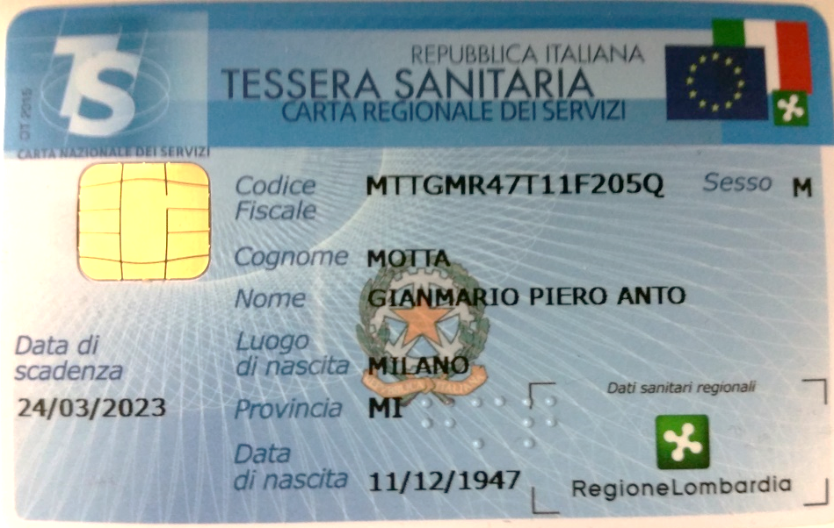
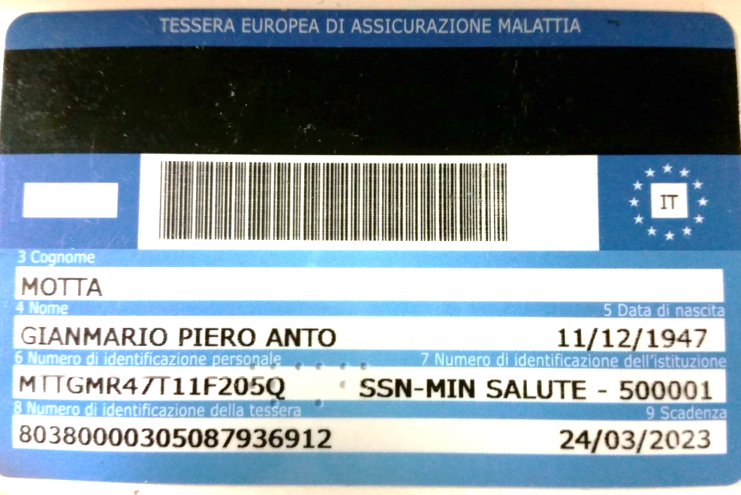
Systems: Patient’s Card
Summary
Organization
Systems
As-is User Process
It contains Master data, tax code and other key data
It allows to access the National Health Service and provides the access to health services in EU countries.
It is made of polycarbonate, with a microprocessor and a memory.
It can exchange information with computers to identify the user (digital signature), and exchange and store information with high security levels.
Patient’s Card information is stored in the EPR

Slide 12
Systems: EPR (Electronic Patient Record) and EHR Adapted from: https://www.fascicolosanitario.regione.lombardia.it/web/fserl-pubblica/
Summary
Organization
Systems
As-is User Process
The traditional EPR (Electronic Patient Record) will be replaced by an extended database, called Electronic Health Record (HER)
EHR, described in the Decree “Electronic Health Record 2.0” of 7th September 2023, contains the patient's clinical history and comprehends services provided outside the National Health Service.
HER is a future development and includes
Documents issued by Healthcare Services, which are the core of the EPR database
Additions: Patient’s Summary (issued by the GP), Patient’s Notebook (crated by the patient)
HER Reference: https://en.wikipedia.org/wiki/Electronic_health_record

Slide 13
Systems: HER (Electronic Health Record) Adapted from: https://www.fascicolosanitario.regione.lombardia.it/web/fserl-pubblica/ Main contents: core (blue) and additions (orange)
Summary
Organization
Systems
As-is User Process
EPR /EHR
Identification and administrative patient data
Radiology reports
Specialist outpatient reports
Pathological anatomy reports
Emergency Room Reports
Hospital discharge letters
Prescriptions
Specialist prescriptions
Medical records
Provision of drugs paid or not by NHS
Single vaccination cards
Vaccination certificates
Provision of specialist assistance services
Facility bearer card
nvitations for screening, vaccination or other prevention
Laboratory reports
Reports
Pharmaceutical prescriptions
Personal health record
Patient notebook
Additions
Patient Summary

Slide 14
Systems: HER/EPR Adapted from: https://www.fascicolosanitario.regione.lombardia.it/web/fserl-pubblica/ Main contents: original core
Summary
Organization
Systems
As-is User Process
EPR /EHR
Identification and administrative patient data
Radiology reports
Specialist outpatient reports
Pathological anatomy reports
Emergency Room Reports
Hospital discharge letters
Prescriptions
Specialist prescriptions
Medical records
Provision of drugs paid or not by NHS
Single vaccination cards
Vaccination certificates
Provision of specialist assistance services
Laboratory reports
Reports
Pharmaceutical prescriptions

Slide 15
Systems: HER/EPR (Electronic Patient Record) Adapted from: https://www.fascicolosanitario.regione.lombardia.it/web/fserl-pubblica/ Extensions
Summary
Organization
Systems
As-is User Process
EPR /EHR
GP
Other
Facility bearer card
invitations for screening, vaccination or other prevention paths
Patient
Personal health record
Patient Summary
Patient notebook

Slide 16
Systems: HER/EPR (Electronic Patient Record) Adapted from: https://www.fascicolosanitario.regione.lombardia.it/web/fserl-pubblica/
Summary
Organization
Systems
As-is User Process
The Patient Summary
is a socio-health document updated by the General Practitioner (GP) or the Pediatrician that summarizes patient’s clinical history and current situation.
intends to enable a rapid classification of the patient at contact with health services, without prejudice for the right of obscuration by the patient, as per art. 9 (art. 4, paragraph 2).
allows only the patient to consult obscured documents (art. 4, paragraph 3).
If the GP/Pediatrician is changed, the new GP/ Pediatrician writes a new Patient Summary (art. 4, paragraph 6).

Slide 17
Systems: HER Adapted from: https://www.fascicolosanitario.regione.lombardia.it/web/fserl-pubblica/
Summary
Organization
Systems
As-is User Process
Patient’s Notebook
Patient’s Notebook is a private section of the EHR that only the patient can access, modify and delete. It is generated by medical devices and/or wearables, and personal documents relating to treatment paths, as well as additional information as listed in Annex A (art. 5, paragraph 1).
Data and documents in the patient's notebook are uncertified and must be distinguishable from those recorded by the subjects referred to in the art. 12 (art. 5, paragraph 2).

Slide 18
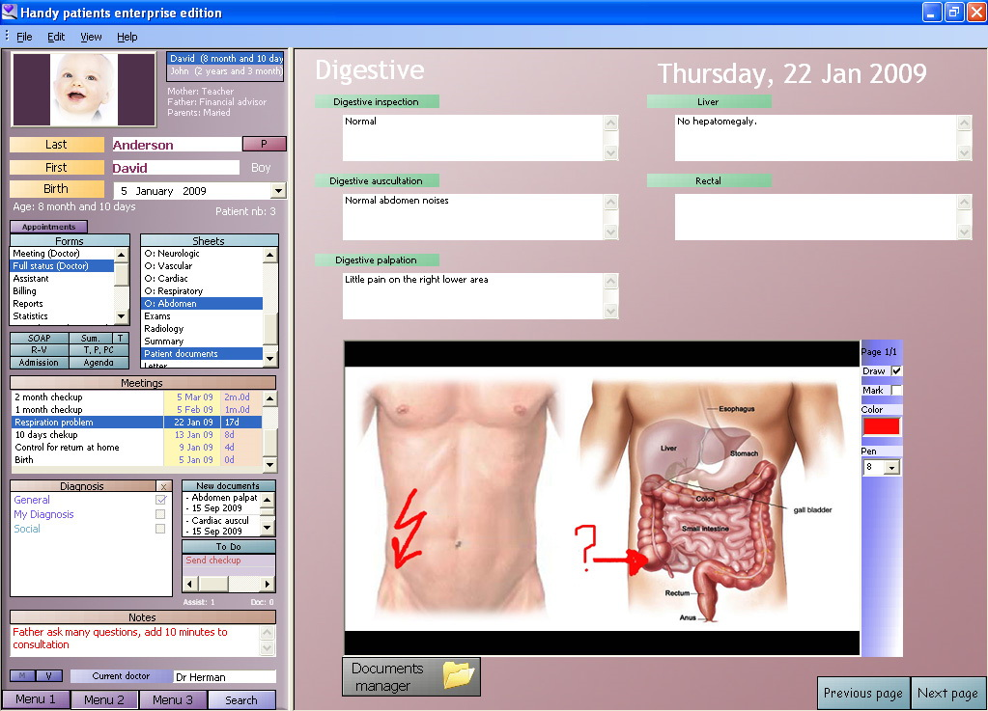
EHR screen By Oguntoye patients electronic medical record (free opensource version), GPL, https://commons.wikimedia.org/w/index.php?curid=8894074
Summary
Organization
Systems
As-is User Process

Slide 19
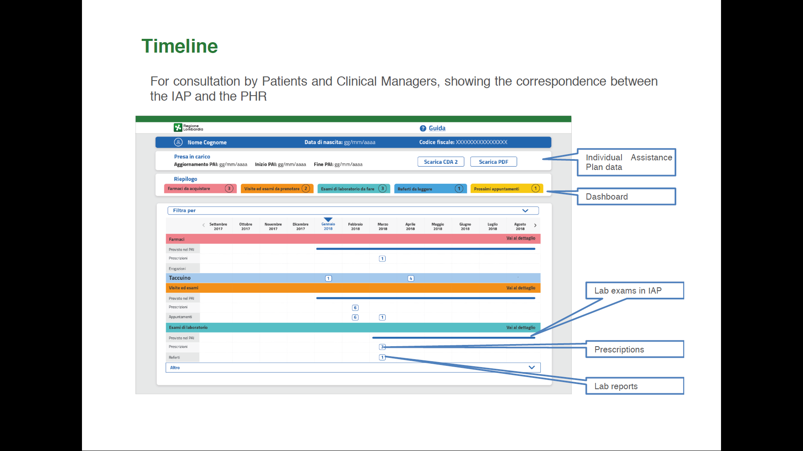
Potential extensions of EPR (Electronic Patient Record) (from www.lispa.it/wps/portal/LISPA/Home)
Summary
Organization
Systems
As-is User Process
EPR extensions can be
IAP (Individual Assistance Plan). suggests (based on the statistical health profile) exams and good practices.
PHR (Personal Health Record)
records the related transactions
is mapped against IAP to the benefit of patients and their GPs

Slide 20
Systems: DRG data base
Summary
Organization
Systems
As-is User Process
The DRG database contains 12.432 diagnosis and 3.733 procedure/surgery items
This information is used to compute the DRG of an individual patient.
In the discharge transactions, an individual DRG is assigned to each patient by a software that processes a set of patients' variables such as
age,
sex,
discharge,
main diagnosis,
supplementary diagnosis,
procedures/surgery.
The related records are added to the patient record and submitted to the Region which will pay the hospital accordingly.

Slide 21
Layers of Systems
Summary
Organization
Systems
As-is User Process
The most important IT department is the Region, which conceives, designs, implements, run, and manage the HC system
Provinces have only some specific software application
Each Hospital / Clinic has its own Hospital Management System typically based on a commercial platform (e.g., SAP)
General Practitioners and Specialists rely on a variety of software apps and custom-made software
Minister (1)
Provinces (100)
Hospitals (+1,000)
Labs (+1.000)
Regions (20)
GPs (ca 30K)
IT Dpt of the Ministery
Regional IT Dpt
Province IT Dpt
Hospital IT Dpt
Typically rely on a parent Hospital
Various Software & Service Providers

Slide 22
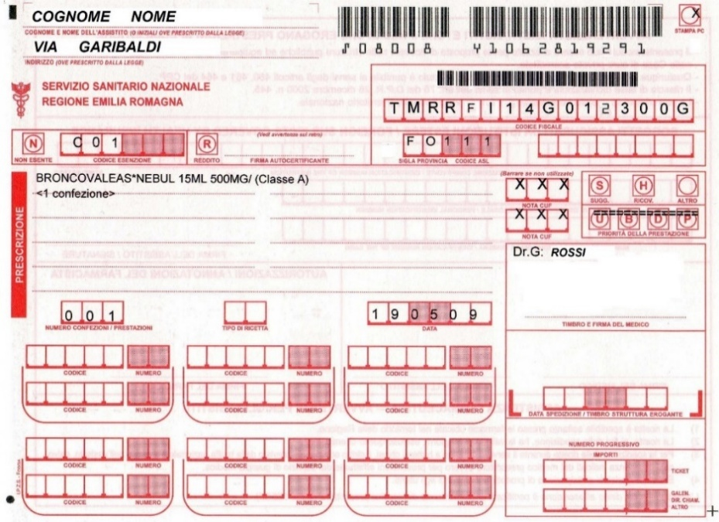
Systems: GP
Summary
Organization
Systems
As-is User Process
GP systems process prescriptions that are recorded in the Patient Record
The GP system, ideally, could
Provide professional support to diagnosis, prognosis, and treatment, through Decision Support Systems, Knowledge bases, AI-related technology, Patient Support Systems (tele-medicine)
Access professional and legal information, e.g., Medicine List, Hospital List, Lab List, etc.

Slide 23
Systems: Reservation System
Summary
Organization
Systems
As-is User Process
By reservation services, called CUP (Centro Unico Prenotazione). patients book lab tests, operations and other health services. The transactions follow this path:
The patient identifies himself by tax and health-card codes and enters the prescription number (which has been previously entered by the doctor).
The system, after checking the patient data, displays the agenda of the appropriate labs and hospitals, and the patient chooses.
The system updates the agenda accordingly, and the patient receives the related notification (a print-out with the counter, a message with the call center or an email or SMS).
Many hospitals have their own reservation systems and call centers, but they all refer to the EPR.

Slide 24
Systems: Lab Information Systems (LIS)
Summary
Organization
Systems
As-is User Process
The lab system manages data of the patients and tests. It includes
Transactions processing:
Reception (Check-in) processes administrative transactions of the exam life cycle (booking, check-in, scheduling, exam validation, payment, referral delivery).
The information on the Health Card enables identifying the patient and accessing the Electronic Patient Record.
Sample management:
Samples may be received from another lab or hospital or directly brought by the patient.
Since a same sample can go through multiple tests, the sample and all sub-samples are labelled by a unique identifier;
Also, the patient receives a bracelet with that same identifier, that is printed on a paper receipt and recorded in the lab database
Referral support:
In its simplest form, it is a prefilled template, that automates paperwork.
It can be by a knowledge base or AI-driven system that helps doctor in interpreting the results.
Referral and related evidence, which, in radiology, includes images, are archived.

Slide 25
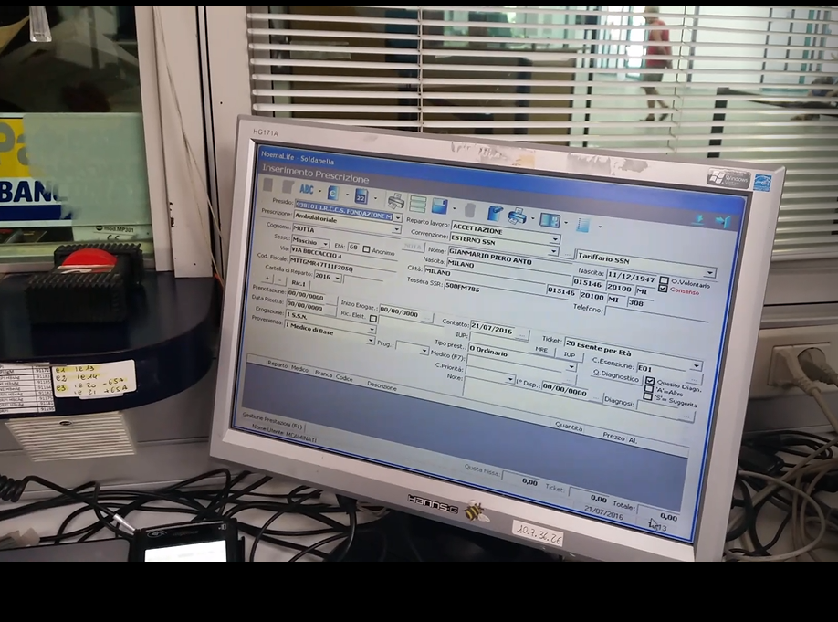
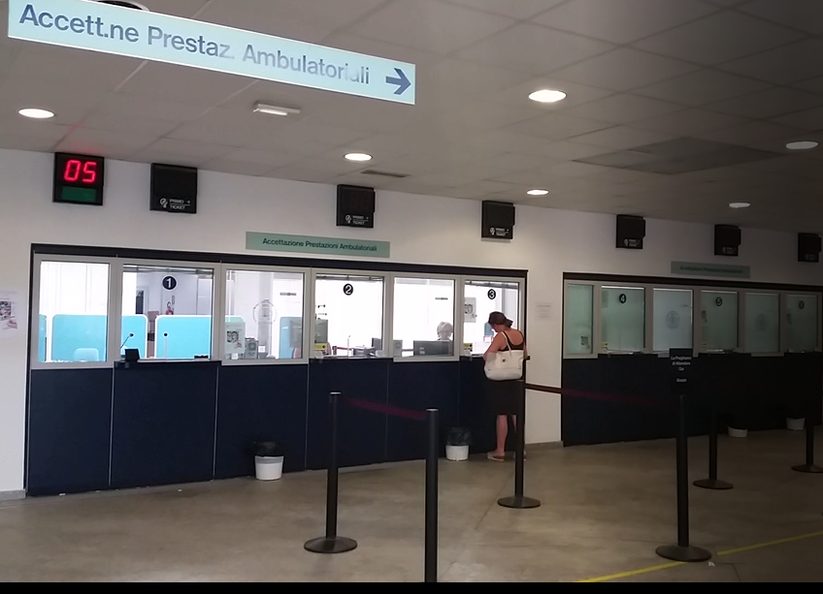
Systems: Lab Information Systems (LIS)
Summary
Organization
Systems
As-is User Process
Check-in screen developed by the clinic IT staff
Check-in counters in a clinic lab

Slide 26
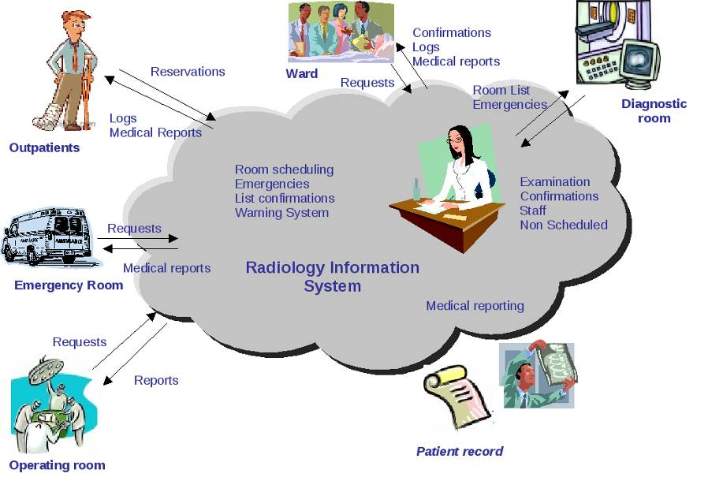
Systems: Lab Information Systems (LIS)
Summary
Organization
Systems
As-is User Process
Lab systems are increasingly integrated with lab equipment and applications and can create control files that are "fed" into the equipment and direct operations on a physical item such as a sample tube or sample plate. Conversely, lab systems import equipment results. In short, lab integration is like CIM (Computer Integrated Manufacturing).

Slide 27
Systems: Hospital Information System
MANAGEMENT INFORMATION
Summary
Organization
Systems
As-is User Process
ERP
Interface to Regional Systems
Finance & Control
Purchase
Payables
Asset
Billing
Receivables
Materials Management
CLINIC / DAY HOSPITAL
Clinic Patient Record
Care management
HOSPITAL
General Patient Record
Therapy Management
Order Management
Discharge Letter
EMERGENCY
LIS
RIS
RECEPTION
(BOOKING AND ACCEPTANCE)
TAC
CRM
Other systems
Image Archives
Shared Services
INTEGRATION MIDDLEWARE
CENTRAL MASTER INFO
CLINICAL DATA REPOSITORY
PORTAL

Slide 28
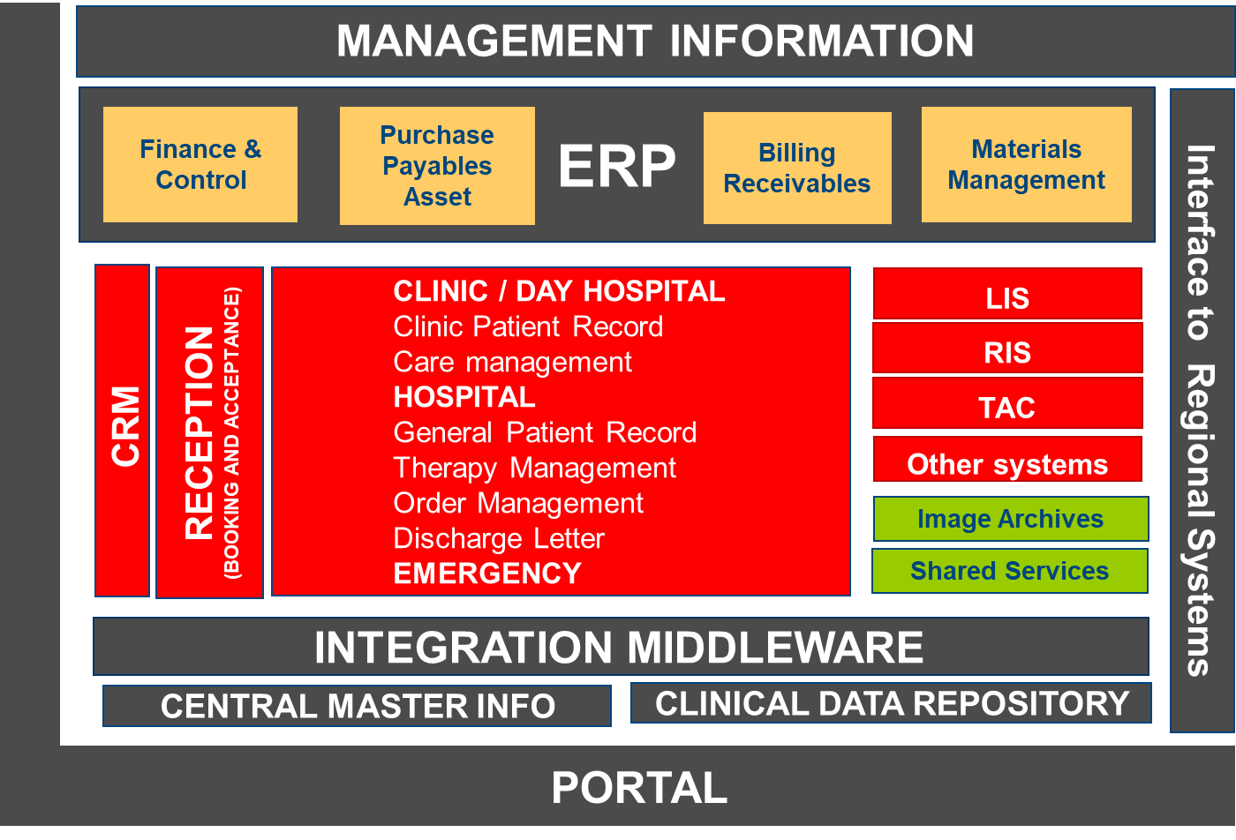
by
Summary
Organization
Systems
As-is User Process
Lab systems support the exam cycle of patients from check-in to referral
LIS (Lab Information System)
See the previous slide
RAD (Radiology)
Similar to the generic LIS
Critical : diagnosis of Radiographies
TAC (Axial Computerized Tomography)
Similar to the generic LIS
Critical: diagnosis of tomograèhy
Hospitals are structured in Departments that provide a variety of services e.g.:
Booking /Reception
Emergency
Intensive Care
Day Hospital
Long-term care
Labs
Surgery
Etc.

Slide 29
An example of a user’s process for Radiology Exam (condensed)
Summary
Organization
Systems
As-is User Process
Franco goes to the doctor Rapetti’s office. After one hour, the nurse calls him. Franco explains his pain and the doctor examines him. After the visit, the doctor prescribes a specific exam by an orthopedist.
After the doctor’s prescription, Franco reserved an orthopedic specialist who prescribed him a radiography.
Franco goes to the radiology lab. He checks in and surrenders his prescription, National Health ID, and the receipt of ticket payment. The clerk prints a receipt with the exam data.
Franco goes to diagnosis room. After one hour, he is called. After the exam, the patient waits until the film has been developed, and both the doctor and engineer evaluate results (10% of the exams are repeated because of incorrect position or exposure). The radiologist writes the referral; his signature and seal validate the process.
The outpatients get the medical reports and images at the delivery desk, by showing their receipt. To protect patient's privacy, medical reports should be delivered only to the patient or to a delegate. Four days later, Franco came to have the referrals and went to Doctor Rapetti, to have a prognosis.

Slide 30
