Slide 1
COSTS AND BENEFITS OF DIGITAL PROJECTS R250816 - REVISED November 24th 2025
COST-BENEFIT ANALYSIS
SUMMARY AND REVIEW QUESTIONS
PROJECT BUDGET MANAGEMENT
ASSIGNMENT

Slide 2
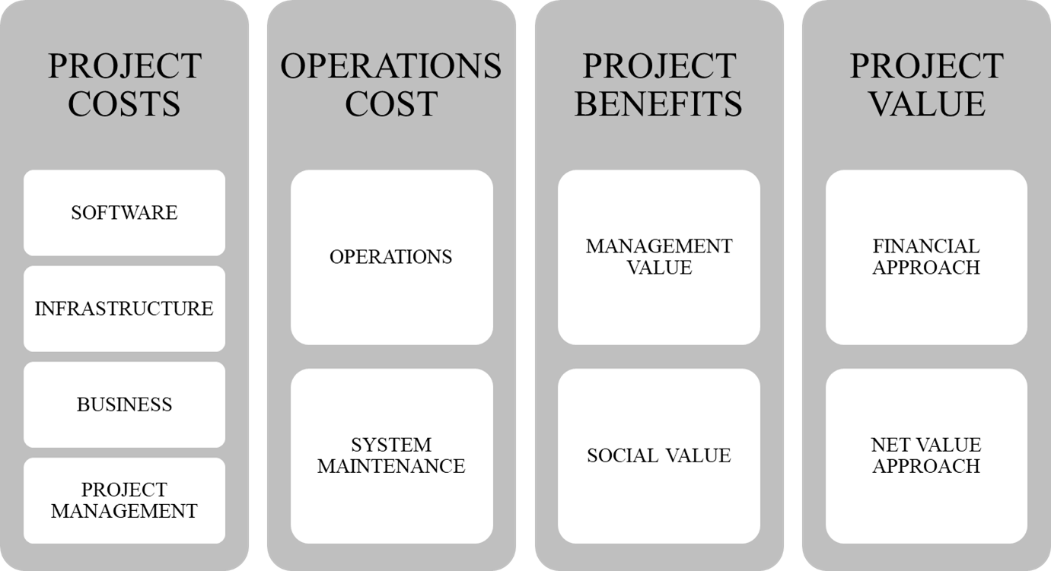
Analysis scope
Management approve projects based on their returns
Returns stem from the project impact on business/organization, software, technology/infrastructure
Returns are both financial, called “tangible”, and non-financial, called “intangible”
Our scope includes:
The whole lifecycle of a system
Whole project impact: tangible and intangible returns

Slide 3
PROJECT COSTS
PROJECT COSTS
SOFTWARE
PROJECT BENEFITS
MANAGEMENT VALUE
PROJECT VALUE
FINANCIAL APPROACH
INFRASTRUCTURE
BUSINESS
SOCIAL VALUE
NET VALUE APPROACH
OPERATIONS COST
OPERATIONS
SYSTEM MAINTENANCE
PROJECT MANAGEMENT

Slide 4
Software Project Costs
Analysis is the activity in which requirements are defined (modelled)
In an agile approach, analysis defines Themes / Epics of the backlog
Analysis hardly can be analytically estimated; roughly it ranges from 10% to 20% of development cost
Development
Software project
System Test
Analysis (modelling)
Miscellaneous
User Test

Slide 5
Software Development /1
It includes costs of a development cycle, as defined by a sprint in agile approach
In predictive approaches, it includes
Development environment
Detailed analysis of use cases or functions (State Chart, Class Diagram)
Coding
Documentation
Unit Test
Statistically, development ranges 50% to 70% of the total software cost
Development
Software project
System Test
Analysis (modelling)
Miscellaneous
User Test

Slide 6
Software Development/2
In Agile, the development effort can be extrapolated from the number of sprints
E.g. by assuming a sprint of 5 people x 1 month, a project with 100 sprints would require an effort of 5x100 = 500 person-month /10 =50 FTE
Alternatively, the development effort may be based on the Use-Cases, weighted in terms of Function Points (www.ifpug.org); you can find a summary on the Internet
Development
Software project
System Test
Analysis (modelling)
Miscellaneous
User Test

Slide 7
Software Development/3: Customization
Some projects customize existing software by an editing environment or a Software Development Kit
Customization typically
Adds new services
Tailors existing services
Integrates new services into the existing enterprise’s software
Costs include the development life cycle, e.g.:
Setting of development environment
Detailed analysis of use case or function (State Chart, Class Diagram)
Coding
Documentation
Unit Test
Estimation is based on experience
Development
Software project
System Test
Analysis (modelling)
Miscellaneous
User Test

Slide 8
System Test & User Test
System Test
We assume that a system test is 10-20% of Development effort
It includes integration and system test and is needed for the transition form development to production environment
It may grow with higher risk
User Test
It includes definition of the test case and context, expected results, documentation
It cannot last less than one month for a significant system
Statistically we assume that each use case or user story (= 1 elementary activity equals N use cases) requires at least 2 man-days
Development
Software project
System Test
Analysis (modelling)
Miscellaneous
User Test

Slide 9
SOFTWARE PROJECT COST: TYPICAL BREAKDOWN
Software project cost
Analysis (modelling)
Development
System Test
User Test

Slide 10
PROJECT COST – SOFTWARE
Cost Item | Algorithm | Comment
Analysis | Consulting fee * FTE | FTE are assumed as a % of SW development
Development | FTE = Sprints*5*1,2 | You can use Function Points instead of Sprints
System Test | 1/3 of development effort | Assumed as up to 1/3 of development teffor
User Test | 2 man days for each Agile Epic | User tests address how friendly and usable software is
FTE (Full Time Equivalent) = 200 days of one person
Reference cost for software engineers is 500 EUR/day = 100K for FTE (junior 250/day, mid 500/day, senior 800/day)

Slide 11
PROJECT COSTS
PROJECT COSTS
SOFTWARE
PROJECT BENEFITS
MANAGEMENT VALUE
PROJECT VALUE
FINANCIAL APPROACH
INFRASTRUCTURE
BUSINESS
SOCIAL VALUE
NET VALUE APPROACH
OPERATIONS COST
OPERATIONS
SYSTEM MAINTENANCE
PROJECT MANAGEMENT

Slide 12
Technology: Hardware
It includes the full range of hardware acquired or expanded for the project
Mobile / Tablets
Laptop/ Desktop
Server
Other equipment (router etc.)
Sensors
Ad hoc devices
Note:
Purchased hardware is considered an investment and, therefore, allocated to project cost
Rented hardware is considered as a current cost, and, therefore, is allocated to annual systems costs
Technology
LAN/ Clients /EUC
Servers
Miscellaneous
Mobile
Cloud services
Software Platform

Slide 13
Technology: Additional hardware required by the HC project
Architecture:
Central database with a replica
Network for labs: extranet
Network for mobile users: public internet
Database:
EPR (10 M users)
Reservations (100M records)
Links to the HISs for referral and radiography
Other data (DRG, Pharmacies, GP data, etc.)
MOBILE USERS Expected transactions
Login/identification
Query
Reservation
Cancellation
Miscellaneous requests
Each mobile transaction relies on 5 microservices
Load curve of mobile users
Monday peak:12k
Other weekdays: 8k
Hourly peak (9-10 am): 6k
Lab transactions:
Patient scheduling /rescheduling
Check-in
Payment
Exam assignment (2 for each check-in)
Exam referral (2 for each check-in)
Miscellaneous (1 for each admission)
Lab systems load:
Admissions per day (Lombardy): 1,7M a year / 250 days = 6,8 k / day
Hourly peak: 80% on 7-9 am = 5,5k
No weekly peak because of schedule

Slide 14
Technology: Cloud Services
Cloud services can concern:
Infrastructure (IaaS): network, processing, etc.
Software (SaaS): applications running on a cloud infrastructure.
Platform (PasS): development environment
The cloud deployment can be:
Private: company’s infrastructure and software are charged by some form of internal contract
Public: cloud is run by one or more 3d-party vendors (Google, Azure, IBM, etc.)
Hybrid: a combination of private and public cloud
Cloud services are regulated by a Service Level Agreement and controlled by a Service Level Management System
Technology
LAN/ Clients /EUC
Servers
Miscellaneous
Mobile
Cloud services
Software Platform
See Cloud on Wiki

Slide 15
Technology: Software Platform
It includes:
Application platform purchased or installed for the application system to be run
Middleware platforms: DBMS, EAI, etc.
Cost includes incremental license costs:
100% if the platform is purchased
A percentage if the license is extended (nominal users added to an existing DBMS)
License costs typically include
One-time license price (that is included in project cost) that can be computed as
Absolute cost
Cost per user or alike variable
Absolute cost + cost per user
Annual support fee that entitles the customer to receive assistance and support and normally account about 20 % to 10% (that is included in operational cost)
Technology
LAN/ Clients /EUC
Servers
Miscellaneous
Mobile
Cloud services
Software Platform

Slide 16
PROJECT COST – TECHNOLOGY
Cost Item | Algorithm | Comment
EUC/LAN/Sensors | Number of users (EUC) | Depreciation on 3 years if purchased
Mobile | Number of users /agents to be equipped | Depreciation on 3 years if purchased
Servers | Expected workload | Depreciation on 3 years if purchased
Software platforms | Number of users or processing load | Annual license or upfront payment
Cloud services | Based on the expected workload | Annual service fee
User companies typically issue a request for proposal by specifying the profile of the required infrastructure
Server costs can be estimated by or using Amazon or Azure website and entering workload parameters (see the subsequent page)

Slide 17
PROJECT COSTS
PROJECT COSTS
SOFTWARE
PROJECT BENEFITS
MANAGEMENT VALUE
PROJECT VALUE
FINANCIAL APPROACH
INFRASTRUCTURE
BUSINESS
SOCIAL VALUE
NET VALUE APPROACH
OPERATIONS COST
OPERATIONS
SYSTEM MAINTENANCE
PROJECT MANAGEMENT

Slide 18
Business Project (alias Business Process Reengineering - BPR)
Analysis
Includes
Organizational performance analysis : KPI, Benchmarking, etc.
Benchmarking
Generally estimated in days by organization unit
Education /training / change
Includes
The out-of-pocket cost of training and education (effort + premises and rents)
Costs of promotion, HR development, re-training and alike
Does not include the opportunity cost of trained people
Miscellaneous
Include contingency costs
Contingency is typically assumed as 20% of costs
Education / Training
BPR
Analysis (modelling)
Miscellaneous

Slide 19
PROJECT COST – BUSINESS
Cost Item | Algorithm | Comment
Analysis | Interview days * 3 | With 50 interviews = 150 consulting days
Education | A 2 day class for user group = 4 days of business consulting | With 20 user groups = 80 consulting days
Miscellaneous | Website for system promotion | Reference value can be 0,5 FTE of a business consultant
Business Consultant = 800 EUR / day = 160k FTE
Miscellaneous costs should be estimated for each specific project
Contingency costs can be added to the whole project

Slide 20
PROJECT COSTS
PROJECT COSTS
SOFTWARE
PROJECT BENEFITS
MANAGEMENT VALUE
PROJECT VALUE
FINANCIAL APPROACH
INFRASTRUCTURE
BUSINESS
SOCIAL VALUE
NET VALUE APPROACH
OPERATIONS COST
OPERATIONS
SYSTEM MAINTENANCE
PROJECT MANAGEMENT

Slide 21
Project Management
PM costs include the effort of the project manager and project office
It can be estimated as PM = D*X*R, where
D = Effort for development + analysis
X = Base PM percentage (10%)
R = Risk weight as R = (100 + Risk score)/100
E.g. with
D = 1.000
X =10%
R = (100+70)/100= 1,7
PM = 1.000*10%*R = 170
Project cost
Project management
Software project
BPR
Technology

Slide 22
PROJECT COST PROJECT MANAGEMENT
Cost Item | Algorithm | Comment
Project Office | Project total FTE *0,1 | Project office (PMO) is full time in large projects
Project management costs refers to the whole project: Software + Infrastructure + Business
10% is a reference percentage that can grow with higher project risk and complexity (please refer to the session on project risk)
Please note that PMO is a part of the project management - bare PMO can range from 5 to 15%
Consulting fee for the whole PMO staff: 800 a day = 160K /year

Slide 23
OPERATIONS COSTS
PROJECT COSTS
SOFTWARE
PROJECT BENEFITS
MANAGEMENT VALUE
PROJECT VALUE
FINANCIAL APPROACH
INFRASTRUCTURE
BUSINESS
SOCIAL VALUE
NET VALUE APPROACH
OPERATIONS COST
OPERATIONS
SYSTEM MAINTENANCE
PROJECT MANAGEMENT

Slide 24
Operations
They include the costs of operations that are added by the project
Network services
Additional costs of network
Operations staff
Additional cost of operations staff
Energy
Additional energy cost
Cloud Services
Additional cost of Cloud Services
Operations
Annual Costs
Operations staff
Energy
System Maintenance
BPR
Miscellaneous
Hw / Sw platforms
SW application
Network services

Slide 25
Maintenance
Maintenance
Hardware
Annual maintenance fee for additional HW equipment
May be assumed as 15% of the project cost
SW platforms
Annual fee for SW platforms
Generally, it is 15% of acquiring cost
Business
Annual cost to update organization trough a periodic check up
It may be considered as 10 % of the analysis cost
Operations
Annual Costs
Operations staff
Energy
System Maintenance
BPR
Miscellaneous
Hw / Sw platforms
SW application
Network services

Slide 26
COST MAP
Project
Operations
Project management
Development
Software project
System Test
Analysis (modelling)
Business Project
Analysis
Technology
Mobile
LAN/ Clients/EUC
Servers
Network services
Maintenance
Business
Education/ training/ change
SW application
Operations staff
Energy
User Test
Operations
Hw / Sw platforms
Software platforms
Cloud services

Slide 27
PROJECT BENEFITS
PROJECT COSTS
SOFTWARE
PROJECT BENEFITS
MANAGEMENT VALUE
PROJECT VALUE
FINANCIAL APPROACH
INFRASTRUCTURE
BUSINESS
SOCIAL VALUE
NET VALUE APPROACH
OPERATIONS COST
OPERATIONS
SYSTEM MAINTENANCE
PROJECT MANAGEMENT

Slide 28
Where does management value come from?
ManagementValue
Tangible Benefits
Intangible
Cost saving
Increased sales
Management tangible benefits are “money” and include cost saving and increased sales
Cost saving: reduction of current resource costs
The value of saving is given by the value of resources saved in execution thanks to better efficiency and productivity
Savings are typical (not exclusive) to the automation of existing activities
Example: a new warehouse system
Reduces the staff needed because picking and storing operations are performed by automated devices like Automated Guided Vehicles and computerized elevators
Reduces stock losses by a real time inventory

Slide 29
Where does management value come from?
ManagementValue
Tangible Benefits
Intangible Benefits
Cost saving
Increased sales
Sales growth: additional sales enabled by the system
Increase of income thanks to the opportunity enabled by the project
The benefit should be computed as the incremental net profit
Examples:
A new healthcare system attracts additional patients thus generating additional income
A customer profiling system enables customized offering, therefore increasing sales

Slide 30
PROJECT BENEFITS MANAGEMENT TANGIBLE
Cost Item | Algorithm | Comment
Cost Saving | See the attached table | You should calculate the annual saving
Sales Increase | Proft on increase sales | Calculate the annual increase
ManagementValue
Tangible Benefits
Intangible
Cost saving
Increased sales
SAVINGS | METRIC | APPROACH | EXAMPLE : PICKING | COMMENT
HR | Δ unit effort * expected labor price * Δ Qty | Estimate differences by stakeholder and activity | Δ unit effort : + 10 seconds Labor cost : 36 euro / hour Δ qty: 30% (less travels) on 12 M travels = 4 M | total benefit is 0,01 euro a second * 0,3*12M = 40K euro a year
SPACE | Δ Used space * Unit annual rent value | Estimate differences by resources used in each BPM lane | Δ space : 1.000 square meters Unit annual rent value : 10 euro / square meter | 1.000*10 = 10k euro / year
MATERIALS & PRODUCT | Δ qty * average value * interest rate (stock) or Δ qty * average value (usage) | Estimate differences by warehouse (stock) and by physical process | Δ stock : 1% of an average 10M euro * 10% = 100k euro Δ scrap : 5% of an average 1 M write –off = 50k euro | Stock + Scrap = 150K euro a year
EQUIPMENT | Δ qty * annual rent (or lease) or Δ annual rent | Estimate the variation on the whole architecture | No change (computer are added no saved) | The additional hardware is computed in the project cost section
SERVICE | Δ annual amount | Estimate variation by service | No change | No change

Slide 31
Where does management value come from?
Management Value
Tangible Benefits
Intangible Benefits
Image
QoS-KPI
Risk
Governance
Image/brand: it typically stems from reputation
Measurement: survey on users
Examples:
Internal (Employees): a corporation provides its employees with an app that displays leaves, vacations, next assignments, company information
External (Customers/ users): a hotel reaches a better customer’s ranking thanks to the reservation system; such benefit can be assessed by interviews, reputation analysis on social networks, statistical analysis etc.

Slide 32
Where does management value come from?
Management Value
Tangible Benefits
Intangible Benefits
Image
QoS-KPI
Risk
Governance
QoS/KPI: better performance on time, quality, efficiency (e.g. less errors) and Quality of Service (e.g. more flexibility)
Measurement: by reporting and /or analysis
Examples
Tracking systems enable customers to monitor their shipment and send changes or instructions to the provider or shipper

Slide 33
Where does management value come from?
Management Value
Tangible Benefits
Intangible Benefits
Image
QoS-KPI
Risk
Governance
Governance: critical in large corporations
Measurement: error variance and timing (faster reporting)
Remarks: It is a main driver of management control projects and ERP in multinational corporations, where data quality is essential for management
Example: Management control systems enable managing multilocation, multi-business and multi-plant corporations
Risk reduction: critical in banking and financial applications
Measurement: probability x gravity
Example: A mortgage loan system shortens the time needed to assess customer risks thanks to the integration with estate inventory, collateral evaluation, banking deposits, etc.

Slide 34
PROJECT BENEFITS MANAGEMENT INTANGIBLE
Management Value
Tangible Benefits
Intangible Benefits
Image
QoS-KPI
Risk
Governance
Cost Item | Algorithm | Comment
Image | Ranking in terms of quality | Measurement: survey on users / customers; perceived value of the corporation
QoS/KPI | Change in error rate or improved response time | Better service KPIs raise the rank of the corporation
Governance | Improvement in reporting time and/or errors | It is a key reason for adopting an integrated management support system
Risk reduction | Change in probability and /or gravity | AI systems can enhance risk management in structured transactions

Slide 35
PROJECT BENEFITS
PROJECT COSTS
SOFTWARE
PROJECT BENEFITS
MANAGEMENT VALUE
PROJECT VALUE
FINANCIAL APPROACH
INFRASTRUCTURE
BUSINESS
SOCIAL VALUE
NET VALUE APPROACH
OPERATIONS COST
OPERATIONS
SYSTEM MAINTENANCE
PROJECT MANAGEMENT

Slide 36
Where does social value come from?
Social
Value
Tangible
Intangible
Social value stems from the benefits outside the enterprise, and, therefore, increases the value to customer and/or stakeholders
Tangible social benefits include:
Social saving: reduction of the customer’s effort and/or cost in using or performing a service: e.g., buying on the internet
Higher value: better content of the service or product enabled by the system: e.g., selection of doctor in a Health Care system
Social intangible benefits include:
QOS/KPI: better performance of the customer’s activities in terms of time, quality, efficiency (e.g., less errors) and Quality of Service (e.g., more flexibility)
Risk reduction: enabled by the system: e.g., a self-diagnosis enabled by a remote medical system

Slide 37
PROJECT BENEFITS SOCIAL VALUE
Social
Value
Tangible
Intangible
Cost Item | Algorithm | Comment
Social saving | Value of activities avoided | E.g value of the time spent for avoided activities * user number (annual value)
Higher value | Increase of value received | Interviews to a focus group and mapping to the users (annual value)
QOS/KPI | Value of wider flexibility | Better performance in terms of time, quality, efficiency (e.g., less errors) and Quality of Service (e.g., more flexibility). Mapped on the user group (annual value)
Risk reduction | Risk probability * gravity | E.g. value of lower jamming probability in a traffic management system (mapped on the user group, annual value)

Slide 38
PROJECT VALUE
PROJECT COSTS
SOFTWARE
PROJECT BENEFITS
MANAGEMENT VALUE
PROJECT VALUE
FINANCIAL APPROACH
INFRASTRUCTURE
BUSINESS
SOCIAL VALUE
NET VALUE APPROACH
OPERATIONS COST
OPERATIONS
SYSTEM MAINTENANCE
PROJECT MANAGEMENT

Slide 39
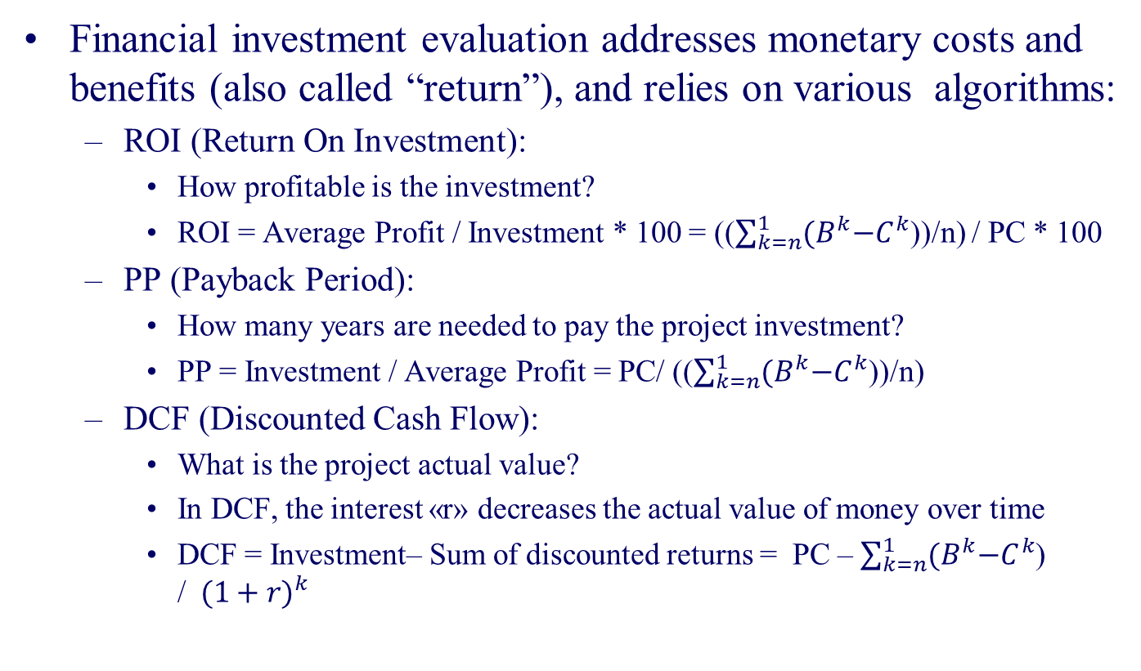
PROJECT VALUE: FINANCIAL APPROACH
Financial investment evaluation addresses monetary costs and benefits (also called “return”), and relies on various algorithms:
ROI (Return On Investment):
How profitable is the investment?
ROI = Average Profit / Investment * 100 = (($\sum_{k=n}^{1}{{(B}^{k}−C^{k}}$))/n) / PC * 100
PP (Payback Period):
How many years are needed to pay the project investment?
PP = Investment / Average Profit = PC/ (($\sum_{k=n}^{1}{{(B}^{k}−C^{k}}$))/n)
DCF (Discounted Cash Flow):
What is the project actual value?
In DCF, the interest «r» decreases the actual value of money over time
DCF = Investment– Sum of discounted returns = PC – $\sum_{k=n}^{1}{{(B}^{k}−C^{k}}$) /${ (1+r)}^{k}$

Slide 40
PROJECT VALUE: FINANCIAL APPROACH
However, a bare financial evaluation:
Is incomplete, since it neglects qualitative /intangible benefits that often are the very reason for a project, thus misleading project assessment;
Is redundant, if companies consider IT projects as operational expenses (OPEX) rather than investment expenses (CAPEX) and, therefore, projects with zero return could be acceptable.
Given the limits of financial evaluation, a holistic evaluation should address the whole impact and focus on the PROJECT VALUE.

Slide 41
PROJECT VALUE
PROJECT COSTS
SOFTWARE
PROJECT BENEFITS
MANAGEMENT VALUE
PROJECT VALUE
FINANCIAL APPROACH
INFRASTRUCTURE
BUSINESS
SOCIAL VALUE
NET VALUE APPROACH
OPERATIONS COST
OPERATIONS
SYSTEM MAINTENANCE
PROJECT MANAGEMENT

Slide 42
NET VALUE APPROACH
Gross project / product value (V)
Tangible
Intangible
Social value (SV)
Tangible
Intangible
Management value (MV)
The gross project value V is defined as the sum of the management value MV (the sum of tangible and intangible returns for the enterprise) and the social value SV (the sum of tangible and intangible for the users), namely
V = MV + SV
The net project value V* also considers project cost (CP) & operation costs (OP) i.e.
V* = (MV+SV) – (CP+OP)

Slide 43
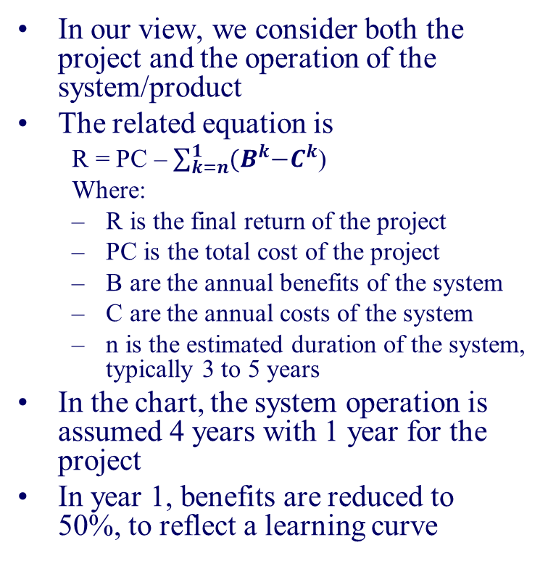
NET VALUE APPROACH
In our view, we consider both the project and the operation of the system/product
The related equation is
R = PC – $\sum_{k=n}^{1}{{(B}^{k}−C^{k}}$)
Where:
R is the final return of the project
PC is the total cost of the project
B are the annual benefits of the system
C are the annual costs of the system
n is the estimated duration of the system, typically 3 to 5 years
In the chart, the system operation is assumed 4 years with 1 year for the project
In year 1, benefits are reduced to 50%, to reflect a learning curve

Slide 44
COSTS AND BENEFITS OF DIGITAL PROJECTS R250816
COST-BENEFIT ANALYSIS
SUMMARY AND REVIEW QUESTIONS
PROJECT BUDGET MANAGEMENT
ASSIGNMENT

Slide 45
SUMMARY AND REVIEW QUESTIONS
SUMMARY
PROJECT COST
BENEFIT MAP
COST MAP
SENSITIVITY ANALYSIS
SENSITIVITY ANALYSIS
PROJECT BENEFIT
COST BENEFIT TREE
REVIEW QUESTIONS

Slide 46
SUMMARY: THE TREE OF COSTS AND BENEFITS
Total balance
Project cost
Benefits
Costs
Annual balance
Project management
Development
Software project
System Test
Analysis (modelling)
Business Project
Analysis
Miscellanous
Technology
Mobile
LAN/ Clients/EUC
Servers
Management value
Tangible
Intangible
Social value
Tangible
Intangible
Network services
Maintenance
Business
Education/ training/ change
SW application
Operations staff
Energy
Cost saving
Sales Increase
Operations
Hw / Sw platforms
Software platforms
Cloud services
User Test

Slide 47
Review questions: costs
Explain how to compute the software cost of a digital project.
How can you esteem infrastructure and business cost of a digital project?
How can you calculate operations and maintenance costs?
Why should the project budget also address operations and maintenance costs?

Slide 48
Review questions: benefits
Explain what is the management value and what the social value.
Explain how you can measure tangible benefits, e.g., in manpower and stock.
Explain how you can measure intangible management benefits, e.g. in governance and risk-
Explain in which projects tangible and intangible social benefits may be critical
A system supports materials management in an automotive company: benefits are mainly managerial and tangible. Please identify benefits by using the checklist of tangible benefits.
In an e-commerce system benefits are both managerial and social. Please identify such benefits by using the checklists of tangible benefits and of social benefits.

Slide 49
Review questions: benefits
A Business Intelligence project in a large company that profiles customers.
A BI project for customer profiling extracts data from sales, product catalogue and market research. A good example are the marketing systems of telecommunication companies, Amazon and alike.
That system that can require a millionaire investment is aimed at better tuning marketing, sales and assistance. Benefits are all for Management Value and stem from:
tailored offering to business customers (e.g. small offices) with a higher capture rate = higher profit
tailored offerings to consumers and campaign marketing = higher sales and profit
selective assistance related to customer profile (gold, silver, bronze) = higher customer loyalty= higher profit
Hence, benefits are pervading the whole tree of management value, both tangible and intangible. You can easily guess and specify their impact not only in terms of cost saving (less cost for the customer analysis) and sales increase (as told before) but also in terms of intangibles

Slide 50
Review questions: benefits
A web/mobile project for citizens, that stores pension data and enables the payment of pensions.
In this case all benefits are in the social value, since the user will have all data on its mobile and can inquire and display data of his/her pension account
A web/mobile project for tourism management stores data about resorts and supports customized visits.
In this case benefits are in the social value, because the individual tourists can better manage their holidays, and for municipalities, which can track access and visits.

Slide 51
SUMMARY AND REVIEW QUESTIONS
SUMMARY
BENEFIT MAP
SENSITIVITY ANALYSIS
PROJECT COST
COST BENEFIT TREE
REVIEW QUESTIONS
COST MAP
SENSITIVITY ANALYSIS
PROJECT BENEFIT

Slide 52
PROJECT COST MAP
Project cost
Project management
Development
Software Project
System Test
Analysis (modelling)
Business Project
Analysis
Technology
Mobile
LAN/ Clients/EUC
Servers
Education/ training/ change
User Test
Software platforms
Cloud services

Slide 53
Sensitivity assessment
Project cost
Project management
Development
Software Project
System Test
Analysis (modelling)
Business Project
Analysis
Miscellaneous
Technology
Mobile
LAN/ Clients/EUC
Servers
Education/ training/ change
User Test
Software platforms
Cloud services
Costs are estimated in a qualitative scale by filling the cost items
Null = Less than 3%
Relevant: Between 3 and 10%
Critical: over 10%

Slide 54
PROJECT COST – ERP project Accounting in a large utility - 500 accountants
Project cost
Project management
Development
Software Project
System Test
Analysis (modelling)
Business Project
Analysis
Technology Deployment
Mobile
LAN/ Clients/EUC
Servers
Education/ change
User Test
Software platforms
Cloud services

Slide 55
PROJECT COST – ERP PROJECT Sales + factory - 3 product divisions and 20 countries
Project cost
Project management
Development
Software Project
System Test
Analysis (modelling)
Business Project
Analysis
Miscellaneou
Technology
Mobile
LAN/ Clients/EUC
Servers
Education/ training/ change
User Test
Software platforms
Cloud services

Slide 56
PROJECT COST – Innovative customer profiling in a large telecom with dedicated hardware
Project cost
Project management
Development
Software Project
System Test
Analysis (modelling)
Business Project
Analysis
Technology Deployment
Mobile
LAN/ Clients/EUC
Servers
Education/ change
User Test
Software platforms
Cloud services

Slide 57
PROJECT COST MORTGAGE LOAN MANAGEMENT
Project cost
Project management
Development
Software Project
System Test
Analysis (modelling)
Business Project
Analysis
Technology Deployment
Mobile
LAN/ Clients/EUC
Servers
Education/ change
User Test
Software platforms
Cloud services

Slide 58
PROJECT COST – HC project (Doctor)
To be filled by the students
Project cost
Project management
Development
Software Project
System Test
Analysis (modelling)
Business Project
Analysis
Technology Deployment
Mobile
LAN/ Clients/EUC
Servers
Education/ training/ change
User Test
Software platforms
Cloud services

Slide 59
SUMMARY AND REVIEW QUESTIONS
SUMMARY
BENEFIT MAP
SENSITIVITY ANALYSIS
PROJECT COST
COST BENEFIT TREE
REVIEW QUESTIONS
COST MAP
SENSITIVITY ANALYSIS
PROJECT BENEFIT

Slide 60
SENSITIVITY ANALYSIS
Benefits are estimated in a qualitative scale by filling the benefit items
Management
Value
Social
Value
Tangible
Intangible
Cost saving
Sales Increase
Image
QoS
Risk reduction
Governance
Compliance
Social saving
Higher value
Tangible
Intangible
QOS
KPI
Benefits
Negligible
Relevant
Critical: coincides with project objectives

Slide 61
PROJECT BENEFITS – ERP project Accounting in a large utility - 500 accountants
Management
Value
Social
Value
Tangible
Intangible
Cost saving
Sales Increase
Image
QOS
Risk reduction
Governance
Compliance
Social saving
Higher value
Tangible
Intangible
QOS
KPI
Benefits

Slide 62
PROJECT BENEFITS MORTGAGE LOAN MANAGEMENT
Benefits
Management
Value
Social
Value
Tangible
Intangible
Cost saving
Sales Increase
Image
QOS
Risk reduction
Governance
Compliance
Social saving
Higher value
Tangible
Intangible
QOS
KPI

Slide 63
Potential Benefits in HC project (Doctor)
To be filled by the students
Benefits
Management
Value
Social
Value
Tangible
Intangible
Cost saving
Sales Increase
Image
QOS
Risk reduction
Governance
Compliance
Social saving
Higher value
Tangible
Intangible
QOS
KPI

Slide 64
COSTS AND BENEFITS OF DIGITAL PROJECTS R250816
COST-BENEFIT ANALYSIS
SUMMARY AND REVIEW QUESTIONS
PROJECT BUDGET MANAGEMENT
ASSIGNMENT

Slide 65
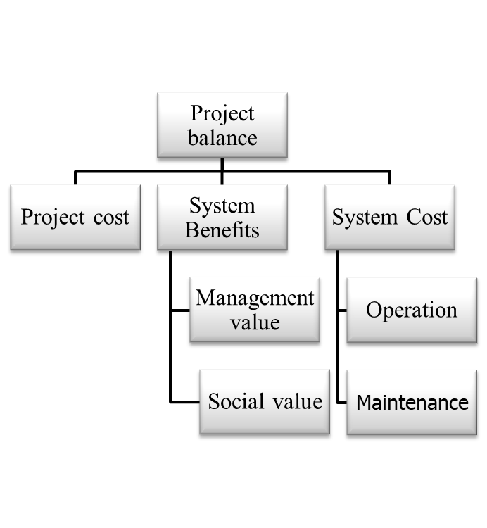
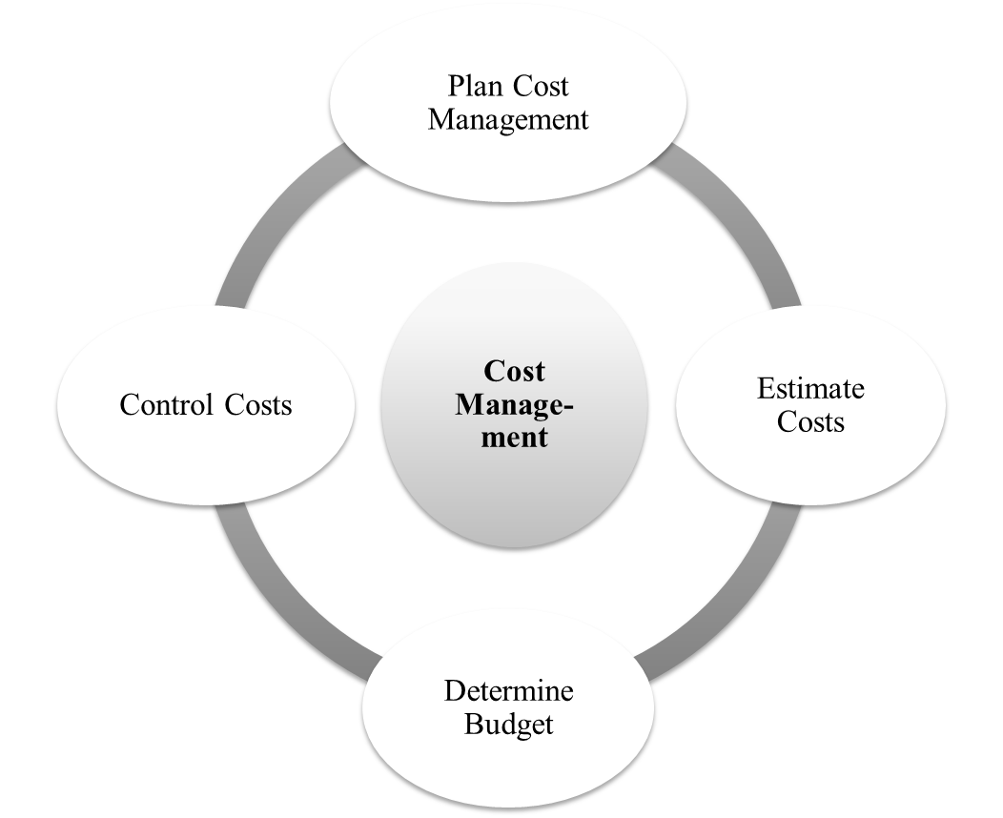
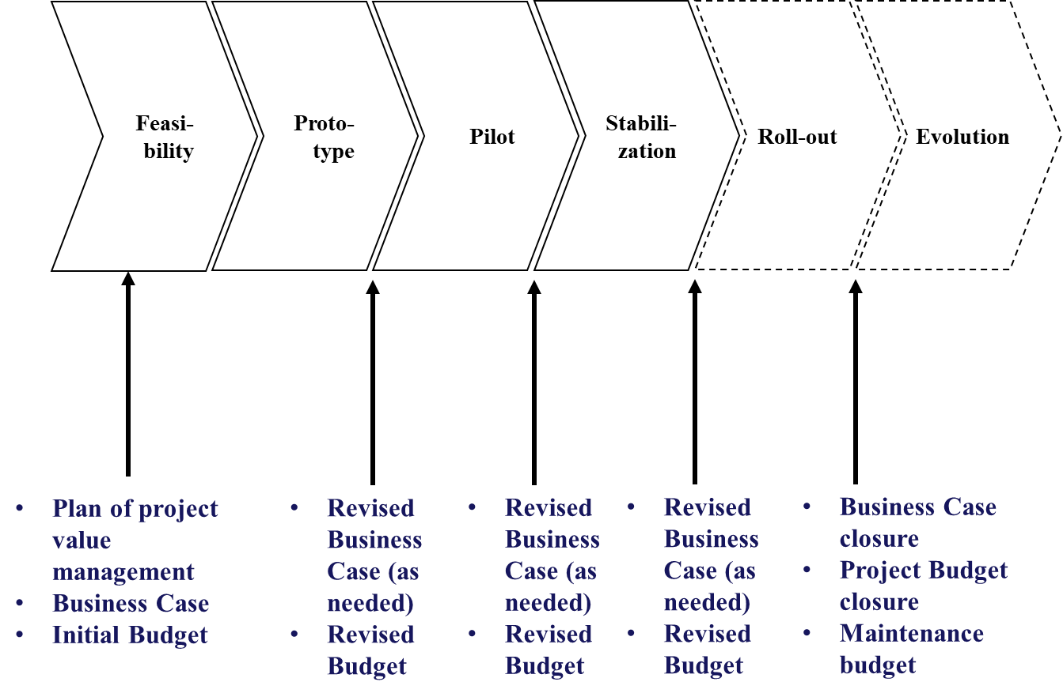
Summary
Cost and benefit analysis relies on 4 pillars
Business case
Cost - benefit tree
Cost management process
Cost-benefit milestones
Business case
(PMBOK)

Slide 66
Pillar 1: Business Case
“Business Case” is an artifact of the Cost/benefit analysis
A Business Case (according to PMBOK) is a short document with the information [needed] to determine whether the project is worth the required investment, i.e.
Business need to be served e.g.
Request by a corporate customer (e.g., a new power station to serve a new industrial park),
Technological advance (e.g. electronic tickets instead of paper tickets)
Legal requirement (e.g., automation for handling toxic materials),
Ecological impacts (e.g. energy control system)
Social need (e.g., health care support)
Cost-benefit analysis of the project
Other relevant information (e.g. competition survey, benchmarking, etc.)

Slide 67
Pillar 2: Cost and benefit items
Project balance
Project cost
System Benefits
System Cost
Management value
Social value
Maintenance
Operation
To support the business case and project cost management, we will address:
The whole system lifecycle
The whole system impact
The project balance results from the project cost (“the investment”) and the costs and benefits of the system

Slide 68
Pillar 2: Cost and benefit items (cont.)
Total balance
Project cost
Benefits
Annual
Costs
Project management
Software project
Business project
Technology
Management value
Tangible
Intangible
Social value
Tangible
Intangible
Maintenance
Operations

Slide 69
Pillar 3: Cost management
Cost Manage-ment
Plan Cost Management
Estimate Costs
Determine Budget
Control Costs
Business case evaluates project/product/system benefits at the very beginning of the project and is revised as needed
Costs are managed from the project start to end by the project office
In PMBOK, budget costs are regularly compared against actual costs

Slide 70
Pillar 4: Cost/benefit lifecycle
Not only costs but also benefits can change during the project, thus altering the project balance
Cost- benefit analysis is to be revised/updated
Ideally, the business case is performed at the very beginning and revised as needed in project milestones
Ideally, cost budget is regularly updated
We here map the cost/ benefit management on a prototype-oriented project life cycle

Slide 71
Pillar 4: Cost/benefit lifecycle (cont.)
Feasi-bility
Proto-type
Pilot
Stabili-zation
Roll-out
Evolution
Plan of project value management
Business Case
Initial Budget
Revised Business Case (as needed)
Revised Budget
Revised Business Case (as needed)
Revised Budget
Revised Business Case (as needed)
Revised Budget
Business Case closure
Project Budget closure
Maintenance budget

Slide 72
COSTS AND BENEFITS OF DIGITAL PROJECTS R250816
COST-BENEFIT ANALYSIS
SUMMARY AND REVIEW QUESTIONS
PROJECT BUDGET MANAGEMENT
ASSIGNMENT

Slide 73
Assignment structure
Introduction
Summary
Detail
Project Costs
Business Case
Benefits
Annual Costs
Tree
Table
Items considered
Assumptions
Values
Items considered
Assumptions
Values
Items considered
Assumptions
Values

Slide 74
Assignment structure: Business Case
Business Case
Summary
Detail
Please list and describe in one-three pages the main needs the project should serve, typically including:
Request by a corporate department
Technological advance
Legal requirement
Ecological impacts
Social need
Competition /alignment to the state-of-art
A short overview of the competition or the state of art is welcome

Slide 75
Business Case: example (GP visit)
Business Case
Summary
Detail
The project stems from three business needs: technological alignmen, performannce control, social need.
Technology alignment
AI support to GP for both anamnesis and diagnosis with dedicated systems;
Tracking of the patient treatment and reminders;
Implementation of a referral system;
Multi-plaftform and multilingual
Performance control on doctors
number of visit per day/month;
prescribed drugs;
prescribed therapies.

Slide 76
Business Case: example (GP visit)
Business Case
Summary
Detail
Social need:
GPs have the mission of prescribing drugs, making certificates, vaccines and treating wounds. Support to their practice is of utmost importance for the whole population.
The anamnesis and diagnosis systems make it easier for doctors to understand the symptoms of a patient and, therefore, recommend the right treatment.
A multilingual booking system makes sure that even foreigners will be able to use it seamlessly.

Slide 77
Summary
Business Case
Summary
Detail
The summary includes
A sensitivity analysis of the tree of costs and benefits with 1-2 page of comments
The P&L statement of the project, with global value of costs and benefits
Related comments can be in the detail section
See the following page

Slide 78
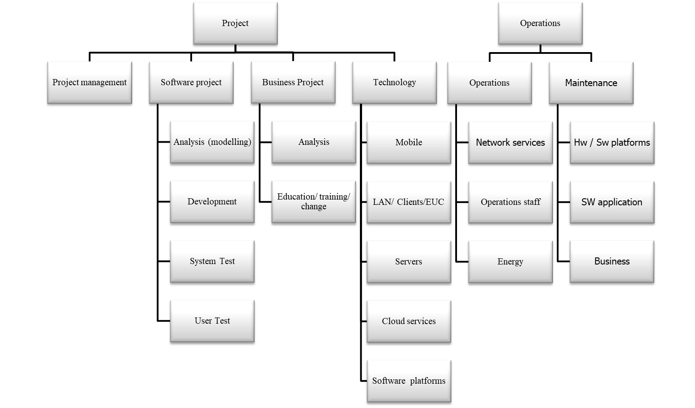
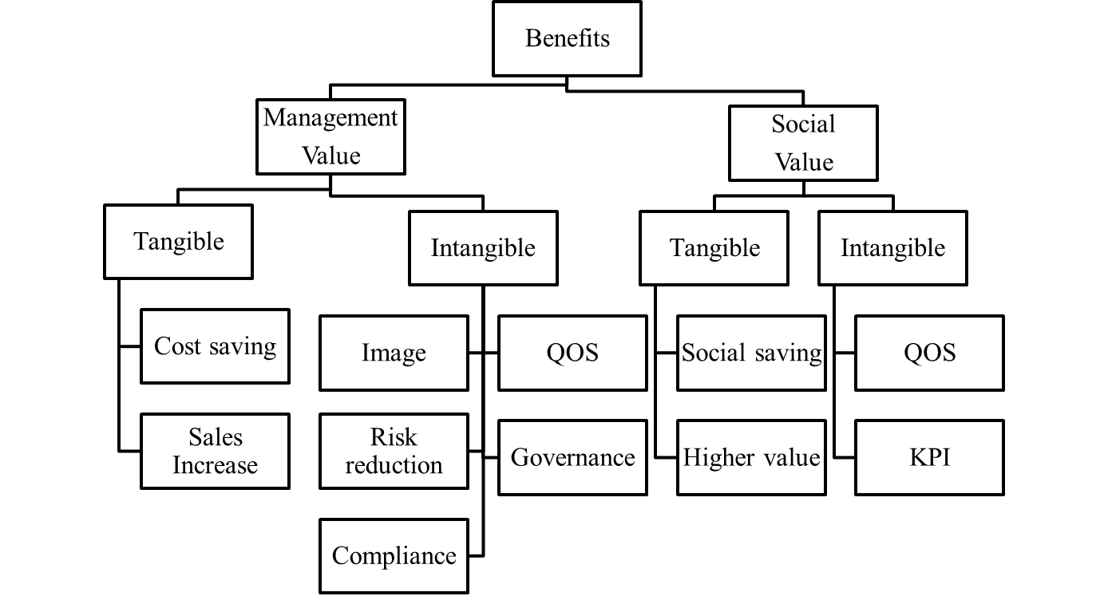
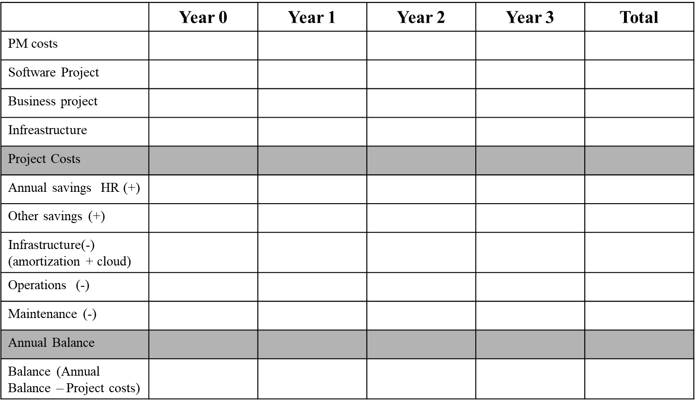
Summary: structure
Business Case
Summary
Detail
Use colors to indicate relevance (negligible, relevant, critical)
Add one page of comments to explain your assessment
Use colors to indicate relevance (negligible, relevant, critical)
Add one page of comments to explain your assessment
Use an Excel spreadsheet
Put total value (best guess)
You can add comments but detail comments are in Detail Section

Slide 79
Summary: Project P&L Statement (Use Excel Spreadsheet)
Business Case
Summary
Detail
 | Year 0 | Year 1 | Year 2 | Year 3 | Total
PM costs
Software Project
Business project
Infreastructure
Project Costs
Annual savings HR (+)
Other savings (+)
Infrastructure(-) (amortization + cloud)
Operations (-)
Maintenance (-)
Annual Balance
Balance (Annual Balance – Project costs)

Slide 80
DETAIL: content
Business Case
Summary
Detail
In the detail section please:
Focus the benefit and cost items which you have identified as relevant and critical in the sensitivity maps
Fill one spreadsheet for costs and one for benefits using the template here below
Item decription | Algorithm | Assumptiions | Value or Coommnt

