Slide 1
PROJECT RISK R 250817
INTRODUCTION: PROJECT FAILURES
PROJECT RISK MANAGEMENT
PROJECT GLOBAL RISK SCORING
REVIEW QUESTIONS
ASSIGNMENT

Slide 2
INTRODUCTION: PROJECT FAILURES
Failure grid and failure factors
Failure case studies
Success factors

Slide 3
Project risk areas
Risk Management
Risk Mitigation/ reduction
Negligible Risk
Risk Management
Risk Impact
In our vision, risk indicates the likelihood of not obtaining an expected result (= failure likelihood)
Projects are inherently risky because they are dealing with uncertainty
Project Risk affects various areas:
Time: the project lasts longer than planned
Budget: the project costs more than planned
Outcome: the project outcomes do not fulfill requirements
The risk gravity GR may be expressed as GR = I*P
I = Impact (on Time, Budget, Outcome)
P = Likelihood of the risk
Risks, depending on their gravity, can be mitigated, managed, or neglected
High
Risk ikelihood
Low
Low
High

Slide 4
Failure grid
Project failure can impact Time, Budget, Outcome
The grid shows project failure areas and common causes
Actually, most project miscarry:
Budget overrun 70-200%
Delayed schedule
Project rejection
Unmet expectations
In my experience, 1 out of 3 projects is successful by meeting outcome expectations despite overrunning budget and/or time
A project on time and budget that fully meets expectations is an exception
Poor Analysis
Complete Success
Failure
Poor Planning
Performance on Outcome
High
Performance on Time & Cost
Low
Low
High

Slide 5
Risk in projects
Failure and mishaps can stem from various factors
Project innovation: inability to get results
Size: loss of control and budget/time explosion
Business change refusal:
An intensive business change may affect user behavior, organization structure (centralization), jobs, procedures
People often do not like to change their habits or work practice (unless they foresee a substantial enhancement)
Poor project management:
Missing plans and control
Poor risk analysis
Missing methodology
We list here some cases of project failure

Slide 6
INTRODUCTION: PROJECT FAILURES
Failure grid and failure factors
Failure case studies
Success factors

Slide 7
Project failure case studies
Case | User | System integrator |  |  |  | Outcome
 |  | Project management | Requirements Analysis | Software Technology | Deployment & Technology
Fashion / Sport MNC (ERP system) | Low commitment Unfamiliar with ERP projects Poor project management | No User Test No regression test No risk analysis | Poor domain knowledge No analysis | No knowledge of the platform options | OK | BUSINESS DEADLOCK Project terminated
Industrial Machinery MNC (ERP system) | Low commitment Pennywise approach | OK | Poor domain knowledge and rushed analysis | Fair knowledge of platform options | Wrong analysis of processing load | SYTEM DEADLOCK Project resumed with new suppliers
Furniture Medium Company (ERP system) | Low commitment Unfamiliar with ERP projects | Poor to absent | No domain knowledge Poor analysis | OK | OK | SYSTEM ABORTED Project terminated
Telecom (Accounting System)) | Fair commitment Familiar with large projects Unfamiliar with ERP platforms | OK | Over- customization pushed by the user | OK | OK | System re-factored with standard features

Slide 8
The Fashion Project: the sales order lifecycle
Design models
Order to suppliers
Store in warehouse
Process customer orders
Ship to shops
Present to shops
(catwalk and web)
In clothing industry, the company designs and sells the product, manufactured by third-party factories
In customer orders (from shops) each item is identified by the triple Model-Size-Color
Therefore, the order template is a grid, with colors in columns sizes in rows (or vice versa)

Slide 9
The Fashion Project: the sale order grid
Transaction scope: customer and item
Customer # |  | Customer name & address
Order # |  | Delivery date
Item # |  | Item description
 | Transaction : REMIX
 | BLUE | RED | GREEN | WHITE | BLACK
32 | 5 | 10 | 5 | 15 | 20 |  | 55
34 | 6 | 12 | 6 | 18 | 24 |  | 66
36 | 10 | 20 | 10 | 30 | 40 |  | 110
38 | 12 | 24 | 12 | 36 | 48 |  | 132
40 | 8 | 16 | 8 | 24 | 32 |  | 88
42 | 7 | 14 | 7 | 21 | 28 |  | 77
44 | 5 | 10 | 5 | 15 | 20 |  | 55
46 | 4 | 8 | 4 | 12 | 16 |  | 44
48 | 2 | 4 | 2 | 6 | 8 |  | 22
 | 59 | 118 | 59 | 177 | 236 |  | 649
Transaction type: remix, new order, return, etc.
Cloth Color
Cloth Size

Slide 10
The Fashion Project: the single sale order
Open order & select colors
Sky Blue
Ferrari red
Rose
Ice white
Blue Navy
Orchid
Fuchsia
Sulphur Yellow
Pompei red
Black
Close order
The project proposed a single screen with a series of selections
For each individual order, the salesclerk should enter 1 size and M colors thus multiplying the time needed
An order of 10 colors was10 times longer.

Slide 11
The Fashion Project: a diagnosis
The single sales order template blocked the sales office
The disaster happened because of poor analysis and project mis-management.
That disaster could have been avoided either by an agile approach or project checkpoints - analysis validation, prototype, user test – that would have spotted the wrong design.
The subsequent tables, which summarize the project history and map the project on PMBOK knowledge areas.

Slide 12
The Fashion Project story
DATE | ACTION | COMMENT
Year 1- May | User as-is analysis | Limited, no modelling
Year 1- September | User selects project partner and app platform; contract 600K EUR | Too low price
Year-1 November | Project launch and hardware selection; Project is sub-contracted | Team without domain experience and platform knowledge
Year 1 Dec - Year2 May | Analysis + Customization | Business processes and rules not analyzed; grid-based order processing ignored; fashion orders plug-in replaced by a custom development
Year 2 –PILOT June (10 days) | A partial demo is presented and tested | No user test to save time!
Year 2- June/July RELEASE & TERMINATION | Sales blocked due to the order fulfillment (10X slower) Various severe bugs | No parallel system running User recalls personnel from vacations and resumes the old system

Slide 13
The Fashion Project mapped on PMBOK areas
PMBOK AREA | PERFORMANCE | SEVERITY
Integration | Not really managed
Scope | User requirements analysis and scoping not made
Time | No re-planning
Cost | Downsized
Quality | Not managed
HR | Inexperienced resources
Communications | Not managed
Risk | Not performed
Procurement | Squeezed
Stakeholder | Not engaged

Slide 14
INTRODUCTION: PROJECT FAILURES
Failure grid and failure factors
Failure case studies
Success factors

Slide 15
How can a project be successful? Critical Success Factors
System integrator:
PROJECT MANAGEMENT
EXPERIENCE on PLATFORM and SOFTWARE DEVELOPMENT
EXPERIENCE on DOMAIN
Software platform:
DEPENDABILITY / SUITABILITY for organization’s industry and size
User organization:
COMMITMENT to CHANGE

Slide 16
PROJECT RISKS
INTRODUCTION: PROJECT FAILURES
INDIVIDUAL PROJECT RISKS MANAGEMENT
PROJECT GLOBAL RISK ANALYSIS
REVIEW QUESTIONS
ASSIGNMENT

Slide 17
Risk Analysis perspectives
Project risks cannot be eliminated
Hence, the project manager should identify, assess and control risk
The risk of a project shall be considered from multiple complementary perspectives
INDIVIDUAL RISKS, stemming from events or opportunities encountered in the project life, e.g., supplier failure
GLOBAL RISK stemming from project innovation, requirements uncertainty, size
Such perspectives are supported, respectively, by
PMBOK that provides a comprehensive approach to manage individual risks throughout the project lifecycle
PROJECT GLOBAL RISK ANALYSIS that assesses the overall risk of the project before a project starts

Slide 18
Framework for Risk Management (PMBOK)
Project Risk Areas
1
Product
2
Demand
3
Planning & Control
4
Project Team
5
Techno-logy
6
User
Identification
Qualitative Analysis
Quantitative Analysis
Decision on risks:
Mitigate
Manage
Accept
On-going Management
Project Risk Lifecycle

Slide 19
Framework for Risk Management (PMBOK)
 | 1 Product | 2 Demand | 3 Planning & Control | 4 Project team | 5 Technology | 6 User
Identification
Quantitative analysis
Qualitative analysis
Decision
Ongoing management
PMBOK suggests 6 risk areas of the project (columns)
Project risk areas should be processed by a sequence of analyses and managed DURING the project (ongoing management)

Slide 20
PMBOK: Risk Management
Project Management
Integration
Scope
Time
Cost
Quality
HR
Communi-cations
Stakeholder
Risk
Procurement
We here illustrate risk management as described in PMBOK edition 5
Edition 6 has slightly enhanced edition 5 by adding an overview of global project risk and by introducing the risk response implementation process and risk monitoring (see)

Slide 21
PMBOK: Risk Management: edition 5 versus 6
Risk
Edition 6
Monitor Risks
Plan Risk Management
Identify Risks
Qualitative Risk Analysis
Quantitative Risk Analysis
Plan Risk Responses
Implement Risk Responses
Risk
Edition 5
Plan Risk Management
Identify Risks
Qualitative Risk Analysis
Quantitative Risk Analysis
Plan Risk Responses
Control Risks

Slide 22
Risk: 1. Plan Risk Management (edition 5)
Project Management
Risk
Plan Risk Management
Identify Risks
Perform Qualitative Risk Analysis
Perform Quantitative Risk Analysis
Plan Risk Responses
Control Risks
It defines how to conduct risk management activities for a project.
The risk management plan is vital to communicate with and obtain agreement and support from all stakeholders
Careful and explicit planning enhances the probability of success for risk management processes.
Plan Risk Management should begin when a project is conceived and should be completed early during project planning.

Slide 23
Risk: 1. Plan Risk Management (edition 5)
Project Management
Risk
Plan Risk Management
Identify Risks
Qualitative Risk Analysis
Quantitative Risk Analysis
Plan Risk Responses
Control Risks
Input
Project management plan
Project charter
Stakeholder register
Enterprise environmental factors
Organizational process assets
Tools & Techniques
Analytical Techniques
Expert Judgement
Meetings
Output
Risk Management Plan

Slide 24
Risk: 2. Identify Risks (edition 5)
Project Management
Risk
Plan Risk Management
Identify Risks
Qualitative Risk Analysis
Quantitative Risk Analysis
Plan Risk Responses
Control Risks
It determines which risks may affect the project and documents their characteristics.
Identifying risks is an iterative process, because risks may evolve or become known as the project progresses.
The risk statement should support the ability to compare the relative effect of one risk against others on the project.

Slide 25
Risk: 2. Identify Risks (edition 5)
Input
Risk management plan
Cost management plan
Schedule management plan
Quality management plan
Human resource management plan
Scope baseline
Activity cost estimates
Activity duration estimates
Stakeholder register
Project documents
Procurement documents
Enterprise environmental factors
Organizational process assets
Tools & Techniques
Documentation reviews
Information gathering techniques
Checklist analysis
Assumptions analysis
Diagramming techniques
SWOT analysis
Expert judgment
Output
Risk Register
Project Management
Risk
Plan Risk Management
Identify Risks
Perform Qualitative Risk Analysis
Perform Quantitative Risk Analysis
Plan Risk Responses
Control Risks

Slide 26
Risk: 2. Identify Risks
Risk Area | Risks | Responsibility
1. Product | Estimating project/product size dependability | Project Manager
2. Demand | Requirements unclear Requirements change Patient flow underestimated | Region’s HC delegate
3. Planning & Control | Project Resources underestimated Time underestimated | Project Manager
4. Team | Team turnover Long hiring times | HR Department
5. Technology | Unfriendly development environment Exceeding response time Data protection Undersized network | IT Department
6. User | User rejection Technical support | Hospitals and GP guild

Slide 27
Risk: 3. Qualitative Risk Analysis (edition 5)
Project Management
Risk
Plan Risk Management
Identify Risks
Qualitative Risk Analysis
Quantitative Risk Analysis
Plan Risk Responses
Control Risks
It prioritizes risks for by assessing their probability of occurrence and impact.
It assesses the weight of risks by
their relative likelihood of occurrence
their impact on project objectives
the time frame for response
the organization’s risk tolerance
etc.
An evaluation of the quality of the available information on project risks clarifies the quality of risk assessment
The analysis is performed regularly throughout the project life cycle, as defined in the project’s risk management plan.

Slide 28
Risk: 3. Perform Qualitative Risk Analysis (edition 5)
Project Management
Risk
Plan Risk Management
Identify Risks
Perform Qualitative Risk Analysis
Perform Quantitative Risk Analysis
Plan Risk Responses
Control Risks
Input
Risk management plan
Tools & Techniques
Risk probability and impact assessment
Output
Project documents updates
Scope baseline
Risk register
Enterprise environmental factors
Organizational process assets
Probability and impact matrix
Risk data quality assessment
Risk categorization
Risk urgency assessment
Expert judgment

Slide 29
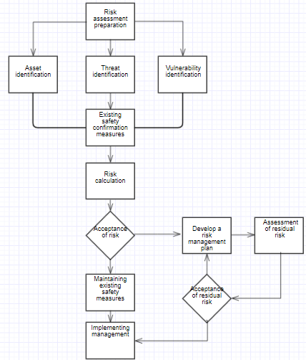
Risk: 3. Qualitative Risk Analysis
The flow contains a twofold assessment
whether the risk is acceptable
whether the residual risk is acceptable.
A good practice is preparing counter-measures when defining the project. If you do not, you will be compelled to design and implement then during the project

Slide 30
Risk: 4. Quantitative Risk Analysis (edition 5)
Project Management
Risk
Plan Risk Management
Identify Risks
Qualitative Risk Analysis
Quantitative Risk Analysis
Plan Risk Responses
Control Risks
It numerically analyzes the effect of identified risks on overall project objectives.
It generally follows the Perform Qualitative Risk Analysis process.
In some cases, data are not sufficient to develop appropriate models.
The project manager should exercise expert judgment to determine the need for and the viability of quantitative risk analysis.
The process should be repeated, as needed.

Slide 31
Risk: 4. Perform Quantitative Risk Analysis (edition 5)
Project Management
Risk
Plan Risk Management
Identify Risks
Qualitative Risk Analysis
Quantitative Risk Analysis
Plan Risk Responses
Control Risks
Input
Risk management plan
Tools & Techniques
Data gathering and representation techniques
Output
Project documents updates
Cost management plan
Schedule management plan
Risk register
Enterprise environmental factors
Organizational process assets
Quantitative risk analysis and modeling techniques
Expert judgment

Slide 32
Risk: 4. Perform Quantitative Risk Analysis Quantified Risks
Risk 5 Technology | Impact | Prob | Value
5.1 Unfriendly development environment | 0.05 | 0.3 | 0.015
5.2 Exceeding response time | 0.1 | 0.5 | 0.05
5.3 Data protection | 0.4 | 0.5 | 0.20
5.4 Undersized network | 0.2 | 0.5 | 0.10
We give here an example on the Risk Area 5 Technology
Gravity (0 to 1) and probability (0 to 1) of each risk element are assessed
Risk Value is then Value = Impact x Probability

Slide 33
Risk: 5. Plan Risk Responses (edition 5)
Project Management
Risk
Plan Risk Management
Identify Risks
Qualitative Risk Analysis
Quantitative Risk Analysis
Plan Risk Responses
Control Risks
It develops options and actions to enhance opportunities and to reduce threats to project objectives.
Each risk response requires an understanding of the mechanism by which it will address the risk.
It includes the identification and assignment of one person (an owner for risk response) to take responsibility for each agreed-to and funded risk response.

Slide 34
Risk: 5. Plan Risk Responses (edition 5)
Project Management
Risk
Plan Risk Management
Identify Risks
Perform Qualitative Risk Analysis
Perform Quantitative Risk Analysis
Plan Risk Responses
Control Risks
Input
Risk management plan
Tools & Techniques
Strategies for negative risks or threats
Output
Project management plan updates
Risk register
Strategies for positive risks or opportunities
Contingent response strategies
Expert judgment
Project documents updates

Slide 35
Risk: 5. Plan Risk Responses (edition 5): Risk Response Plan (example)
Risk 5 Technology | Response
5.1. Unfriendly development environment | Provide ad hoc rooms with plenty of facilities
5.2. Exceeding response time | Scaling test on cloud
5.3. Data protection | Develop ad hoc identification + card + encryption
5.4. Undersized network | Scaling test on cloud
We give here an example on the Risk Area 5 Technology
Risks are to be managed by the IT department, as defined in Risk Planning

Slide 36
Risk: 5. Plan Risk Responses (edition 5): Risk Response Plan (example)
Risk 2: Demand | Risk reduction actions
2.1 Requirements unclear | Consult industry experts Strengthen communication with stakeholders Demo and questionnaire to collect requirements Collaborative approach Benchmarking Version identification to track requirement changes
We give here an example on the Risk Area 2 Demand
Risks are to be managed by the Region’s HC delegate, as defined in Risk Planning

Slide 37
Risk: 6. Control risks (edition 5)
Project Management
Risk
Plan Risk Management
Identify Risks
Qualitative Risk Analysis
Quantitative Risk Analysis
Plan Risk Responses
Control Risks
It implements risk response plans, tracks identified risks, monitors residual risks, identifies new risks, and evaluates risk process effectiveness throughout the project.
Planned risk responses are executed during the project.
The process can involve choosing alternative strategies, executing a contingency or fallback plan, taking corrective action, and modifying the project management plan.
The risk response owner reports periodically to the project manager on the effectiveness of the plan, any unanticipated effects, and any correction needed to handle the risk appropriately.

Slide 38
Risk: 6. Control risks (edition 5)
Project Management
Risk
Plan Risk Management
Identify Risks
Perform Qualitative Risk Analysis
Perform Quantitative Risk Analysis
Plan Risk Responses
Control Risks
Input
Project management plan
Tools & Techniques
Risk reassessment
Output
Work performance information
Risk register
Work performance data
Work performance reports
Risk audits
Variance and trend analysis
Technical performance measurement
Reserve analysis
Meetings
Change requests
Project management plan updates
Project document updates
Organizational process assets updates

Slide 39
Risk: 6. Control risks Risk report (example)
ID Risk
Risk description
Risk Closure
ID risk
ID project
ID Project Manager
Risk class
Identifier
Identification date
Risk description
Risk status
Risk owner
Resolution deadline
Resolution actions
Impact (gravity)
Probability
Resolution description
Closure date
Authorized by …

Slide 40
Risk: 6. Control risks Project risk: case studies
Risk
Risk description
Risk Status
1 : identified
2 : assigned
3: on
4: solved
Risk reduction actions
Accountability
E = executes
A = assists
D = decides
Server installation
Late CFP*
Late test
Late release
2- Assigned
Provisional HW as a demo
E - Purchase Dpt
D - Steering Committee
Launch of new services to customers
New database structure
4-Solved
New system architecture which fulfills new requirements
D - Technical Committee
E - Data Workgroup
A - User Focus Group
* Call For Proposal

Slide 41
PROJECT RISK
INTRODUCTION: PROJECT FAILURES
INDIVIDUAL PROJECT RISKS MANAGEMENT
PROJECT GLOBAL RISK ANALYSIS
ORGANIZATIONAL IMPACT ANALYSIS
REVIEW QUESTIONS
ASSIGNMENT

Slide 42
An approach to assess the GLOBAL project risk
Risk dimensions
Size: up to 30
Innovation: up to 35
Uncertainty: up to 35
Risk score
Absolute Score = Innovation + Uncertainty + Size
Weighted Score = 100* (Expected risk / Accepted Risk) e.g. (70/50) / *100= 120%
Accepted risk reference values
Core project : 70
Support project: 50
Innovation
Uncertainty
Size

Slide 43
Project Risk Scoring: Innovation: up to 35
Technology (OS, Platforms, etc.): up to 15
Low: 1
Average: 5
High: 15
Information / Execution architecture: up to 10
Low (Tested and mature) : 1
Average (New but tested in several projects): 5
High (New solution and not really tested by other projects): 10
Domain / technology experience of IT professionals: up to 10
High (several projects): 1
Average (engagement in one project) : 3
Limited: 10
Risk
Innovation
Size
Uncertainty
Technology
Information
architecture
Domain Knowledge
Effort
Users
Organizational span
Structure of procedures
User awareness / change readiness
BP innovation

Slide 44
Project Risk Scoring: Size: up to 30
Project effort (Full Time Equivalent)
Low: less than 2 FTEs: 1
Average: 2 to 10 FTEs: 2
Large: 10 to 30 FTEs: 4
Very Large: over 30 FTEs : 10
Number of end users
Low: less than 10 : 1
Average: 10 to 50 : 3
Large : 50 to 200: 5
Very Large : over 200 : 10
Organizational span
Low: 1 business process / 1 function : 1
Average: business process across several functions: 3
Very large: a business process across different organizations or with the involvement of customers: 10
Risk
Innovation
Size
Uncertainty
Technology
Information
architecture
Domain Knowledge
Effort
Users
Organizational span
Structure of procedures
User awareness / change readiness
BP innovation

Slide 45
Project Risk Scoring: Uncertainty: up to 35
Degree of structure of procedures and business rules: up to 15
High (input, output, event and business rules are set by law or public regulation): 1
Average (best practice) : 5
Low (design freedom, competitive advantage) : 15
Business process innovation (% of change in elementary activities): up to 10
Low: less than 10%: 1
Average : 11% to 50% : 3
High : over il 50%: 10
IT awareness / change readiness of users: up to 10
High : 1
Average : 3
Low to zero: 10
Risk
Innovation
Size
Uncertainty
Technology
Information
architecture
Domain Knowledge
Effort
Users
Organizational span
Structure of procedures
User awareness / change readiness
BP innovation

Slide 46
Risk profile: radar
The risk of projects can be represented on a chart
In this chart:
A is small innovative project e.g., a real time monitoring system in a factory based on a wide range of sensors
B is a project with high uncertainty, large size but low innovation e.g., a new customer marketing system in a consumer company

Slide 47
Project Risk scoring: Fashion Project case
Low
Middle
High
Very high
Risk
Innovation
12
Size
8
Uncertainty
12
Technology
Information
architecture
Domain Knowledge
Effort
Users
Organizational span
Structure of procedures
User awareness / change readiness
BP innovation
The chart clearly shows where risks are
Innovation itself is moderate, but the low domain knowledge and low user readiness could kill the project
Not always a low risk means a successful project!

Slide 48
Risk mitigation
Experience shows that no best way exists to manage a project
Project management should reflect the risk profile of the project.
A heavy project office is useless with a small and low risk project
Conversely, a big bang rollout (where all the users start at once) might probably be a disaster in a large and innovative project
Even few critical elements may imply a global failure
Risk mitigation tailor project management to risk by a twofold actions:
On the system, i.e., the digital product to be released
On the project, i.e., the process through which the digital product will be conceived and implemented

Slide 49
Risk mitigation: actions on system and project
Innovation
Uncertainty
Size
System
Downgrade innovation
Project
Excellent experts
Piloting
System
Gradual releases
Focus on core
Project
System
Copy
Focus groups
Project
Strong Project Office
Strong planning and control
Milestones
Spec freezing
Change management
Agile approach
Excellent experts

Slide 50
PROJECT RISK
INTRODUCTION: PROJECT FAILURES
INDIVIDUAL PROJECT RISKS MANAGEMENT
PROJECT GLOBAL RISK ANALYSIS
REVIEW QUESTIONS
ASSIGNMENT

Slide 51
Review questions
Risk may impact project budget, schedule, outcome. Risk is measured as R = (Gravity ) * (Likelihood). Consider a project you are aware of and describe in one page the main individual risks you can identify at a first glance
Individual Risk Management and Global Project Risk analysis are complementary, since they focus on 2 distinct project aspects. Explain why both are necessary in managing a project.

Slide 52
PROJECT RISK
INTRODUCTION: PROJECT FAILURES
INDIVIDUAL PROJECT RISKS MANAGEMENT
PROJECT GLOBAL RISK ANALYSIS
REVIEW QUESTIONS
ASSIGNMENT

Slide 53
ASSIGNMENT 1 : Structure
Project Risks
Individual risks
Global Risk
Risk Plan
Table
Explanation
Risk Control
Table
Explanation
Risk Variables
Innovation
Size
Uncertainty
Risk Profile
Project Risk mitigation
Pilot
Split
Manage Risk
Downgrade Objectives
Information Assurance

Slide 54
Individual Risks
Project Risks
Individual risks
Risk Plan
Table
Explanation
Risk Control
Table
Explanation

Slide 55
Risk Plan Table
Risk Area | Risks (list of risks for each risk area) | Responsibility (who oversees and takes actions)
1. Product
2. Demand
3. Planning & Control
4. Team
5. Technology
6. User

Slide 56
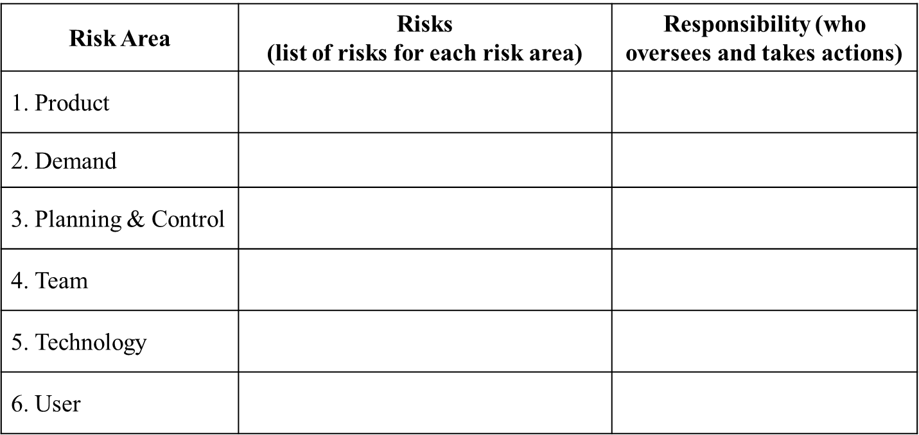
Risk Plan Explanations
Explanations should
comment the risks listed
map the risk responsibilities on the project organization

Slide 57
Risk Control Table
Risk | Impact x Prob = Value | Actions

Slide 58
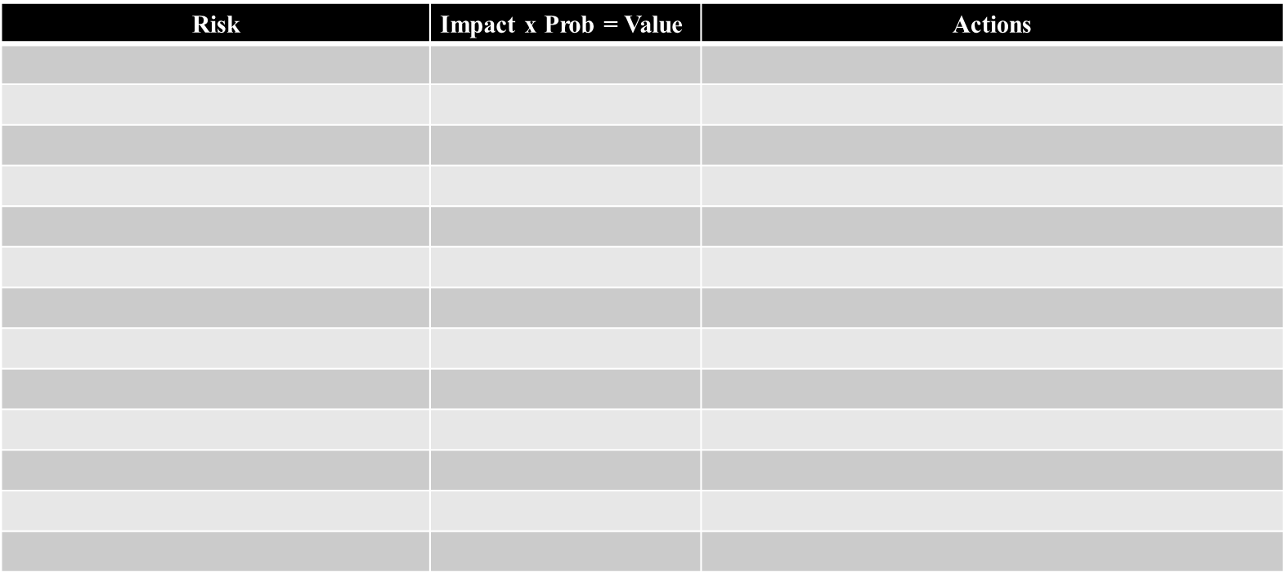
Risk Control Explanations
Explanations
Should comment the probability and the impact of the risk listed
Actions should match with the responsibilities listed in the risk plan
The risks should be the same listed in the risk plan
A graph of the risk values would be welcome

Slide 59
ASSIGNMENT 1 : Structure
Risk Variables
Innovation
Size
Uncertainty
Risk Profile
Project Risk
Global risks

Slide 60
Risk Variables
Risk | Variable | Score
Innovation | Technology | Low:3
 | Information/Execution Architecture | Average:8
 | Domain Knowledge | Limited:10
Size | Effort | Large:4
 | Users | Very Large:10
 | Organizational span | High:10
Uncertainty | Structure of procedures | Average:5
 | BP innovation | High:10
 | User awareness/change readiness | Low to null:10

Slide 61
Risk Scoring: Innovation
Innovation Technology
Score:3 (Low)
Explanation: Servers, Payment Devices etc. are already on the market, then they do not lead a high innovation. However, new technologies and the existing ones should be integrated .
Total Innovation
Total Sore=21
Explanation: Even without any new technologies the risk is high because we change the way information flows in the system
Information/ execution architecture
Score:8(Average)
Explanation: Centralized database, Multichannel communication, will create a complex system (extranet) It implies an average innovation.
Domain / technology experience of IT professionals
Score :10 (Limited)
Explanation: IT relies on interviewing healthcare professionals, but they do not have specific experience on health care.

Slide 62
Risk Scoring: Size
Project effort (Full Time Equivalent)
Score: Large: around 30 FTEs
Explanation: We assume project lasts 3 years (150 weeks) and each work week includes 40 hours. We assume an average team of 10 people and a fulltime project management of 2 people.
Number of end users
Score: Very Large: over 200: 10
Explanation: We assume that 60% of the patients and all medical staff use the system. Hence 60% of 10 M = 6M
Organizational span
Score:High:10
Explanation: Health care services cross different departments as gp, lab, hospitals.
Total Size
Total Score=24
Information/ execution architecture

Slide 63
Risk Scoring: uncertainty
Structure of procedures
Score: Average :5
Explanation: The structure of the procedure in health care is clear. The patients go to GP then to lab.
Business process innovation (% of change in activities):
Score: over 50% : high 10
Explanation: The process is shorter and information flow changes.
IT awareness / change readiness of users
Score : Low : 10
Explanation: citizens and doctors aare not computer proficient
Total Size
Total Score=25
Information/ execution architecture

Slide 64
Risk Profile
Total risk= Innovation (21) + Size (24) + Uncertainty (25)= 70
A risk score around 70 is a typical value for a core project

Slide 65
RISK MITIGATION
Project Risk
Pilot
Split
Manage Risk
Downgrade Objectives
Information Assurance
Project Risk mitigation
Global Risk

Slide 66
Risk mitigation actions: Pilot
Pilot project addresses information sharing interface with a focus group of stakeholders. The solution is totally configured. By testing information sharing on the focus group, we identify risks on information flow, implementation of technologies, responses from end users. Pilot project involves on 1 GP, 20 Patients with different diseases,1 call center and 2 labs
.
GP
Call Center
Activities:. The call center shall test the reservation procedure for GP and LAB
Patients
Activities: A sample of 20 patients book exams. Once results are online they shall check if their UPR is updated.
Activities: GPs store information about 20 patients with different diseases in the EPR which is accessed.
Outcome: Understand issues by GP computer proficiency. Define training and information sharing security problems
Outcome: Feedback on information flow and of call center efficiency.
LAB
Outcome: Test the ability to use the online system. Define risk mitigation as simpler interface to with virtual assistance.
Activities: 2 labs perform exams booked by citizens. After the exam patient they must update.
Outcome: The risk is in information updating

Slide 67
Risk mitigation actions: split
.
Since we have 5 stakeholders, we split the project accordingly. Eventually, we integrate the project. By this action we can isolate project risks as
Information flow within and between organization structures
Balanced Workload
Schedule management
We can mitigate risks by
Training: Call center operators need higher level of IT training than GPs. GPs shall understand the basic level of the system. Other stakeholders do not need IT training e.g. region management shall only analyze data.
Information management: By splitting we isolate information. GPs handle information about the patient and not about payment. Call centers manage the information about the patient but not on the patient treatment .

Slide 68
Risk mitigation actions: Manage Risk
.
Technology Integration: Innovation of technology is low. So, we do not need to mitigate such risk.
Information: With centralized information management and multi channel communication, an appropriate flow of information is critical. Because information flow was integrated by a former technology, the risk comes from the new technology integration. Experts in information integration can mitigate the risk.
Domain knowledge: The experts do not have a deep knowledge of the domain. For mitigating the risk, an expert shall help IT professionals
Project effort: The project is large. A strong project office can mitigate the risk by a project methodology (PMBOK)
IT awareness of users: To overcome that low computer proficiency, the project can hire a specialist of HMI and a psychologist and develop mock-ups on communication channels as TV, web, app.

Slide 69
Risk mitigation actions: Downgrade Objectives
If the complexity of implementing solution is too high, we can downgrade objectives e,g. a simplified technology on Lab for information input to the system.
.
Risk mitigation actions: INFORMATION Quality
A main concern is the integrity and reliability of information. A risk is the wrong information in the entered from the sources. E.g. call center operators could enter wrong data about patients and create unreliable information. Incomplete or wrong information make services unreliable. For reducing the risk, we should adopt system with automatic instead of manual input. Patients should use cards.
Risk mitigation actions: Privacy
One of the concerns is the privilege in accessing information. By setting privilege on the system, we assure information security and privacy for stakeholders. Without security the system will fail. A security specialist should be hired.

